Slide 1
CWIC Partner Report : ISRO WGISS-44,China
Nitant Dube
Space Applications Centre, ISRO
Ahmedabad, INDIA

Slide 2
Overview of ISRO connector Interface with CWIC
User
CWIC (Production)
Registered DIFS
MOSDAC
NRSC
Data Ordering System
CSW
Data Ordering System
OpenSearch
Connector
Connector
MOSDAC Metadata
NRSC
Metadata

Slide 3
Integration with CWIC (Status)
Following two ISRO data centers interfaced with CWIC
MOSDAC: Operational using CSW interface
Data is free, only Registration is Required
NRSC: Operational using OpenSearch Interface
Bhuvan EO data is free and can be downloaded directly using URL in the metadata
All other products are on chargeable basis and requires registration

Slide 4
NRSC- DIFs
Currently for the following satellites, metadata for browsing and product download is provided to CWIC.
Data Products Ordering - Priced Products
Cartosat-1 (PANA, PANF)
Resourcesat-2 (LIS3,AWIF,L4FMX)
last 6 months:
Resourcesat 2A (LIS3,AWIF,L4FMX) - enabled in July, 2017
Resourcesat-1 (LIS3,AWIF,L4MN) - enabled in April,2017
Oceansat2 LAC (OCM) - enabled in Sept, 2017
Ordering Interface with CWIC
A link is provided for ordering. The selected scene from CWIC page is to be sent to NRSC product ordering web page. As soon as the user logs in at this page, the list of selected scenes at CWIC appear in the cart. These products in the cart can be then confirmed for ordering.

Slide 5
NRSC- DIFs
Data Products Ordering - Free Products
IMS1-HYSI
Indian Mini Satellite-1 HYSI level 1B products are available for direct download at CWIC
OS2-OCM-GAC
Only Radiance OceanSat2 products are available for direct download at CWIC.
In order to download other product types of OceanSat2 a link is provided to login and download.

Slide 6
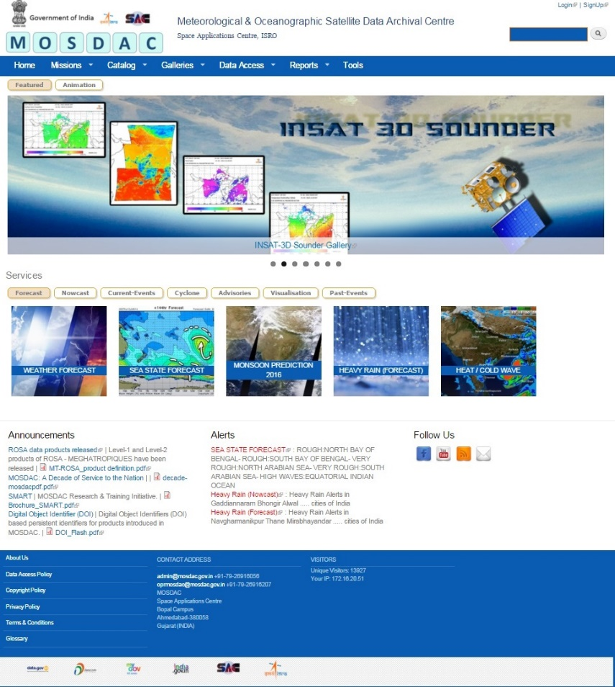
MOSDAC Metadata/data
MOSDAC : Meteorological and Oceanographic Satellite data archival Centre
Available Missions
INSAT-3D
INSAT-3DR
Kalpana-1
INSAT-3A
MeghaTropiques
SARAL
SCATSAT-1
Planned Missions INSAT-3DS
GISAT-1
Oceansat-3 SCAT
http://mosdac.gov.in

Slide 7
MOSDAC-CWIC Interface
Planned Changes
Switching from CSW to OpenSearch Interface
This will allow us to easly integrate all our products with CWIC
OpenSearch Interface will be merged to main MOSDAC website, providing high reliability to MOSDAC-CWIC link

Slide 8
Future Plans
Testing of OpenSearch Interface for MOSDAC
Integration of New DIFS

Slide 9
Thank You

