Slide 1
WGISS Client/Carbon Portal Ken McDonald/NOAA-RTI Liping Di, GMU Martin Yapur/NOAA Data Access Session, WGISS–44 September 26, 2017

Slide 2
Topics
Introduction/Background
WGISS Client Demonstration
WGISS Carbon Portal

Slide 3
Motivation
Generic CWIC Clients
Provide common discovery/access to all CWIC partner holdings
Provide fixed set of search/access services across all collections
Specialized Community Clients/Portals
Make the CWIC infrastructure available to communities
Limit search domain to specific discipline or area of interest
Enable integration of CWIC satellite data with other data types
Combined these portals maximize the utilization of the CWIC infrastructure

Slide 4
CWIC Community Portal Initiative
As part of its support to CWIC Dev/Ops task with GMU, NOAA added a subtask and resources to initiate the design/implement CWIC community portals
Task statement includes several subtasks
Review existing client/portal implementations
Identify one or more communities that wish to collaborate on the initiative
Engage community representatives to establish initial set of requirements
Design portal architecture in collaboration with community
Implement a prototype

Slide 5
Project Evolution
While initiated within CWIC Project portal implementation should investigate access to CWIC, FedEO and possibly other data providers
Enabled by efforts of the WGISS Data Access Team
Can provide common access to all CEOS holdings
GMU team proposes to extend services beyond discovery and access
Visualization and animation services
Simple analytic functions
On-demand preprocessing and customization (e.g. re-projection, re-formatting, etc.)
CEOS Carbon Team identified as initial partner in development of community portal

Slide 6
Current Status
GMU team has implemented generic WGISS Portal
Discovery of CEOS agency collections brokered by CWIC and FedEO
Search and access within collections using CWIC and FedEO
Keyword, space and time constraints
System has be demonstrated to Carbon Team representatives (Mark Dowell and Stephen Plummer)
Initial feedback provides guidance on steps to customize portal to meet specific needs of Carbon Community
Demonstration
http://gis.csiss.gmu.edu:8080/CWIC_Client/pages/main.html

Slide 7
Carbon Team Feedback
Search terms like “Carbon” too broad to be useful
ECV Inventory under review and Carbon Team has action to identify parameters and collections of interest
Topics/terms keywords could be drawn from Carbon Strategy Report
Gridded, higher level products of most use to target community
Users generally interested in particular regions (global/continental/national/local) as defined by TransCom or RECCAP
Users likely interested in most recent data
Desire to access non-satellite data (in situ, model output)
GEOSS/GCI as possible mechanism

Slide 8
Next Steps/Actions
Use cases
Carbon Team agreed to identify a few parameters and one or more regions of interest to seed the prototype (Mark suggested FPAR, LAI and Land Cover)
They also suggested using the Carbon Strategy document to construct example use cases
Project Plan
WGISS to develop a plan to tailor the client to address the use cases
Review of the Carbon Strategy document will continue
Multiple iterations with the Carbon Team representatives are anticipated

Slide 9
Back-up Slides

Slide 10
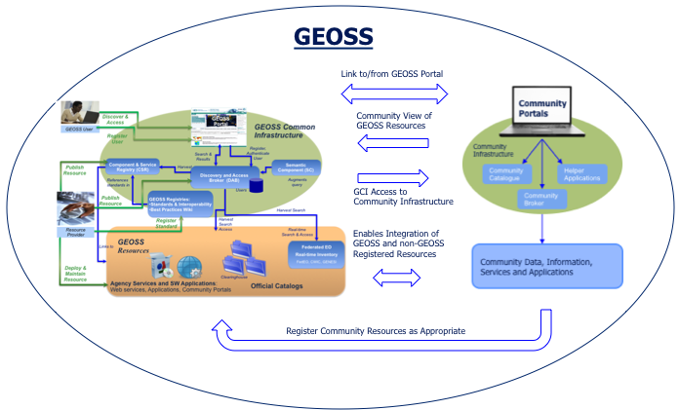
GEOSS Community Portals
CWIC client initiative similar to the GEOSS Community Portals Subtask under the GCI Development (GD-07) Task
GEOSS CP Team comprised of GEOSS Common Infrastructure (GCI) Providers and Community Representatives
Idea is to maximize utilization of GCI by promoting and enabling development of community portals/clients and leveraging community infrastructure capabilities

Slide 11
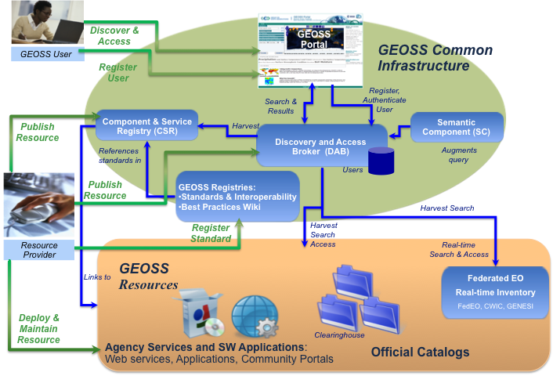
CEOS as a GEOSS Community
GEOSS
CEOS
Link to/from GEOSS Portal
IDN-
CWIC-FedEO
Clients
Community View of
GEOSS Resources
WGISS
Common
Infrastructure
IDN
CWIC
GCI Access to
Community Infrastructure
FedEO
Enables Integration of
GEOSS and non-GEOSS
Registered Resources
CEOS Agency Systems
Register Community Resources as Appropriate

