Slide 1
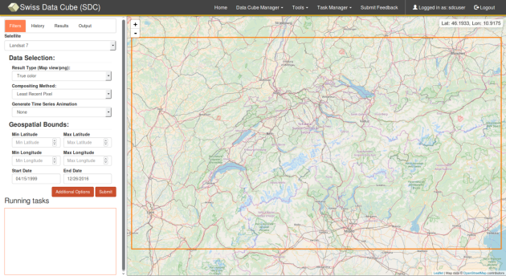
The Swiss Data Cube (SDC)
EO for monitoring the environment of Switzerland in space and time
Bruno Chatenoux
Dr. Gregory Giuliani & Prof. Pascal Peduzzi, Dr. Andrea De Bono, Karin Allenbach, Jean-Philippe Richard with the help of CEOS and GeoScience Australia

Slide 2
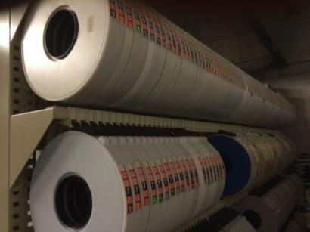
What is GRID–Geneva ?
Global Resource Information Database – Geneva
Established in 1985 by UNEP as one of the first environmental data hubs of the GRID network. Known as GRID-Geneva, the centre was given the mandate to collect and process high-quality environmental data worldwide to support environmental early warnings and multi-scale assessments for informed decision-making and policy-setting.

Slide 3
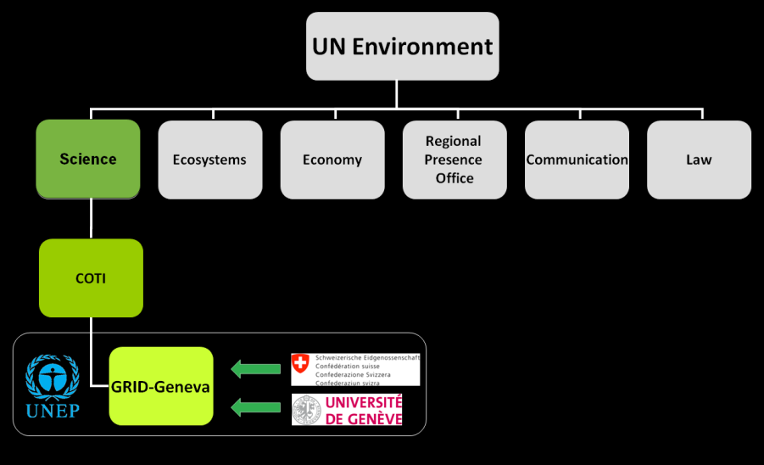

What is GRID–Geneva ?
Notes:
Country Outreach Technology Innovation
Federal Office for the Environment

Slide 4
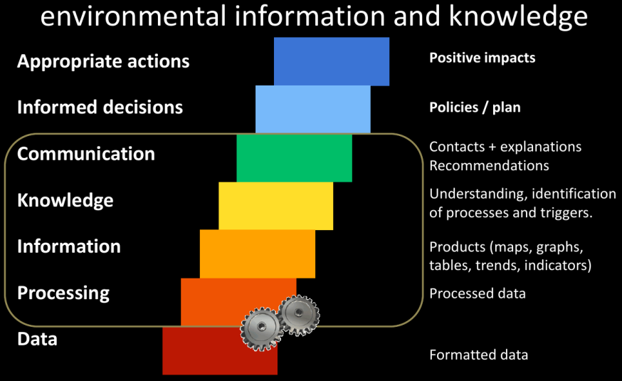
What does GRID–Geneva ?

Slide 5
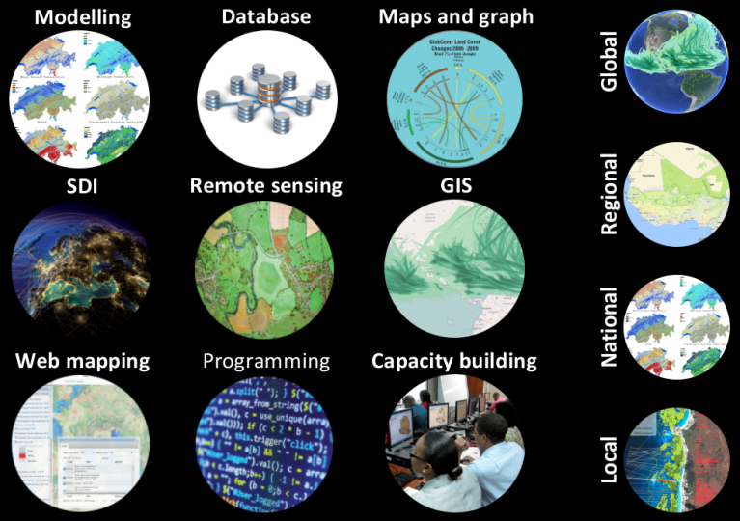
What does GRID–Geneva ?

Slide 6
Swiss Data Cube mandate
Data Cube Feasibility study: testing the new data cube concept over Switzerland using all Landsat images covering Switzerland for 5 years (26 passes per year). This would provide a real case study for a Complete Swiss Data Cube.
Prepare the Data Cube platform on a virtual server.
Populate the platform with 5 years of data and testing.
Support from: GEO/GEOSS, CEOS, GeoScience Australia
Special thanks to Brian Killough & Alfredo Delos Santos (CEOS)

Slide 7
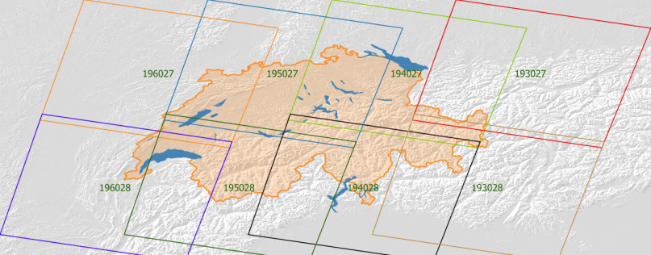
Data ingestion – 802 scenes for the whole Switzerland (1984, 1990, 2000, 2010, 2016)
Nb. scenes: 96
Nb. scenes: 106
Nb. scenes: 118
Nb. scenes: 109
Nb. scenes: 82
Nb. scenes: 95
Nb. scenes: 105
Nb. scenes: 91
8 tiles
~ 800 scenes

Slide 8
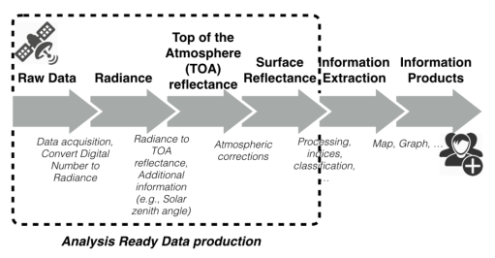
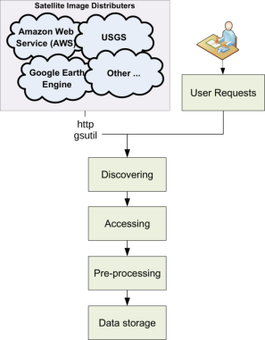
From LiMES to ARD for DataCube
Giuliani, G., Dao, H.,De Bono, A., Chatenoux, B., Allenbach, K., De Laborie, P., Rodila, D.,Alexandris, N. and Peduzzi, P. (2017) Live Monitoring of Earth Surface (LiMES): A Framework for Monitoring Environmental Changes from Earth Observations. Remote Sensing of Environment (2017).

Slide 9
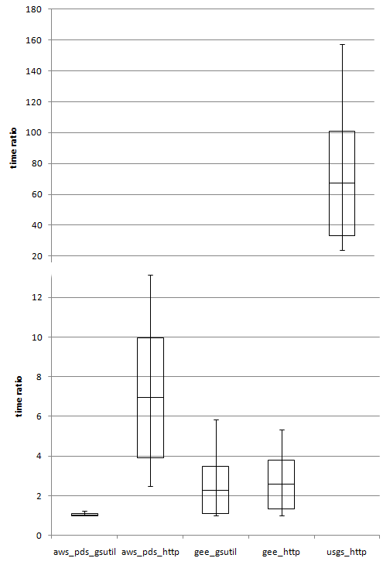
ARD processing
Assumptions and constrains
ARD from ESPA cannot be fully automated (manual order) and requires undefined delay for their preparation
USGS Pre-collection not kept updated
USGS Collection not fully back processed
GEE and AWS archive almost complete Landsat imagery and have a large bandwidth

Slide 10
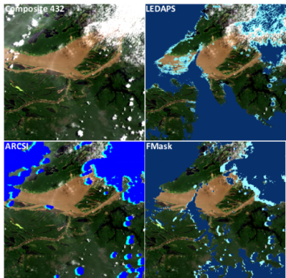
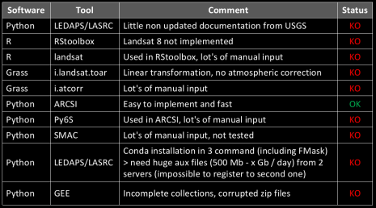
ARD processing
Selected tools
Download when possible with gsutil (https://cloud.google.com/storage/docs/gsutil)
Cloud and cloud shadow mask with FMask (https://code.google.com/archive/p/fmask)
conversion to SR with ARCSI (http://rsgislib.org/arcsi)
Notes:
Atmospheric and Radiometric Correction of Satellite Imagery

Slide 11
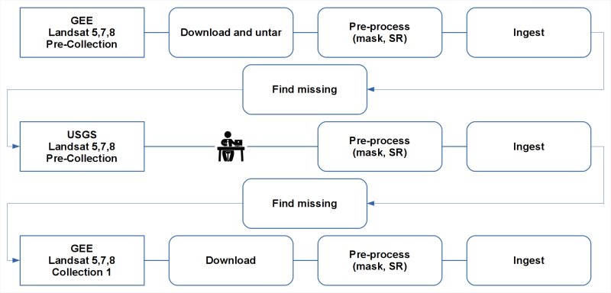
ARD processing
Primary workflow

Slide 12
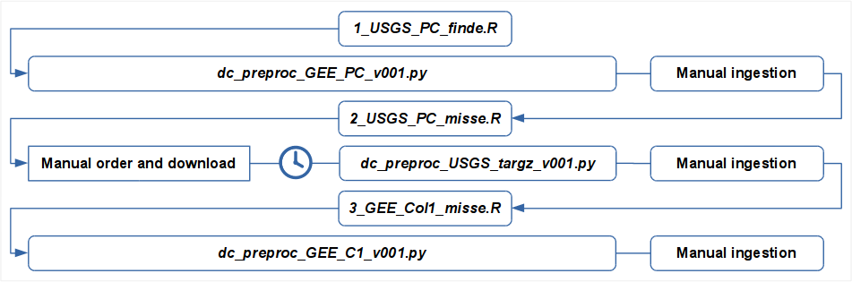
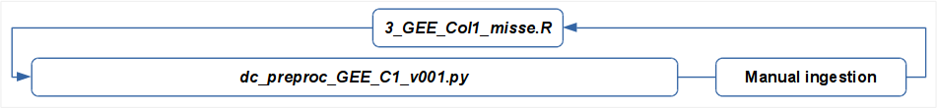
ARD processing
Primary scriptkflow
Update scriptkflow

Slide 13
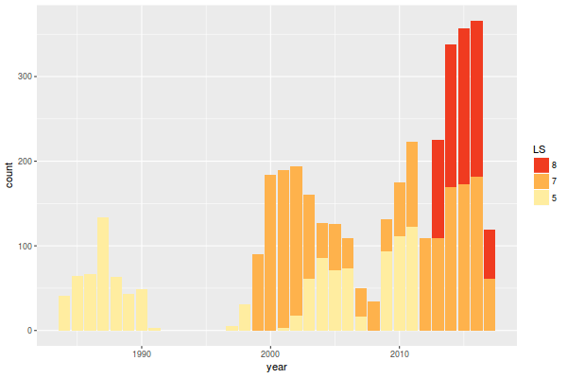
Swiss Datacube completed
Ingestion of 3808 L5/L7/L8 scenes (PC), for the whole Switzerland (1984-2017)
90’s gap

Slide 14
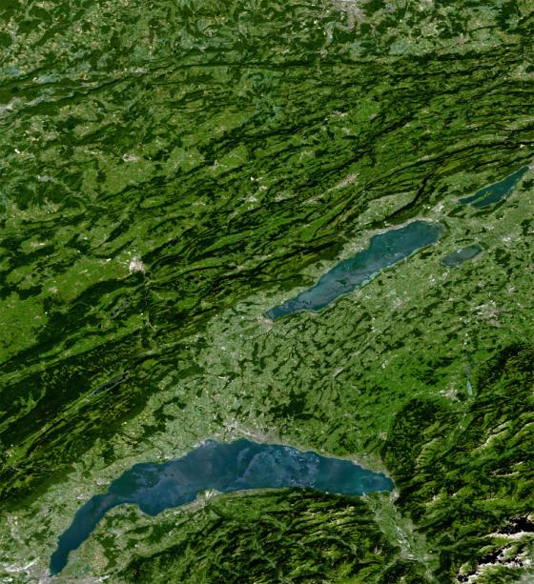
Summer (May-Sept 2016) mosaic Landsat 8, maximum NDVI.

Slide 15
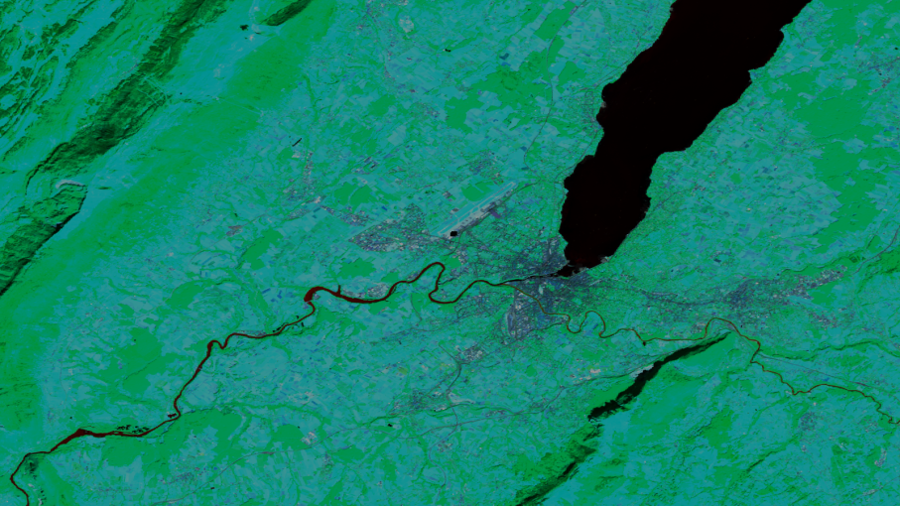
Custom Mosaic Tool
The Custom Mosaic Tool uses a collection of acquisitions to create a single image composed of the 'best' pixels based on the chosen criteria.
August 2016 LS8

Slide 16
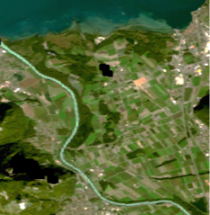
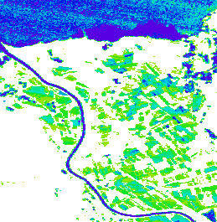

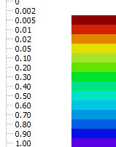
Water Detection Tool
The Water Detection Tool uses a collection of acquisitions to find the normalized water observations in a given area over the specified time frame. The WOFS algorithm can be found at: http://www.sciencedirect.com/science/article/pii/S0034425715301929
Water percentages
Time start: 2016-04-05
Time end: 2016-09-30
Platform LANDSAT 7
Scene Count: 21
Pixel Count: 68’635

Slide 17
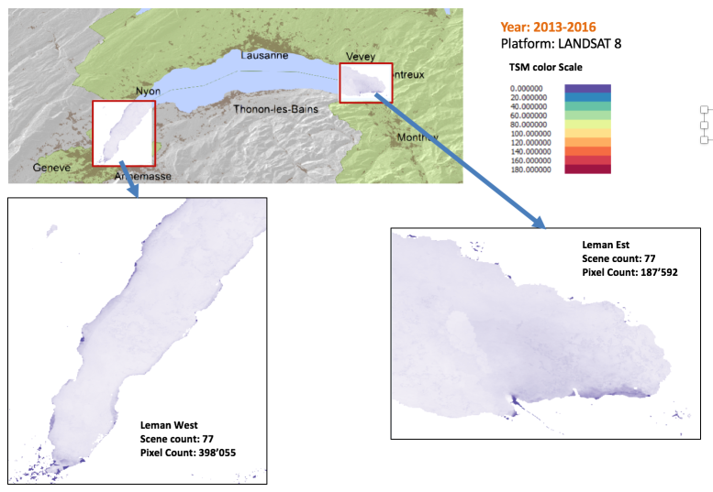
Total Suspended Matter (TSM) Tool
The TSM Tool uses a collection of acquisitions to find the average total suspended matter in a given area over the specified time frame. The TSM algorithm can be found at: http://www.sciencedirect.com/science/article/pii/S0034425716301560
.

Slide 18
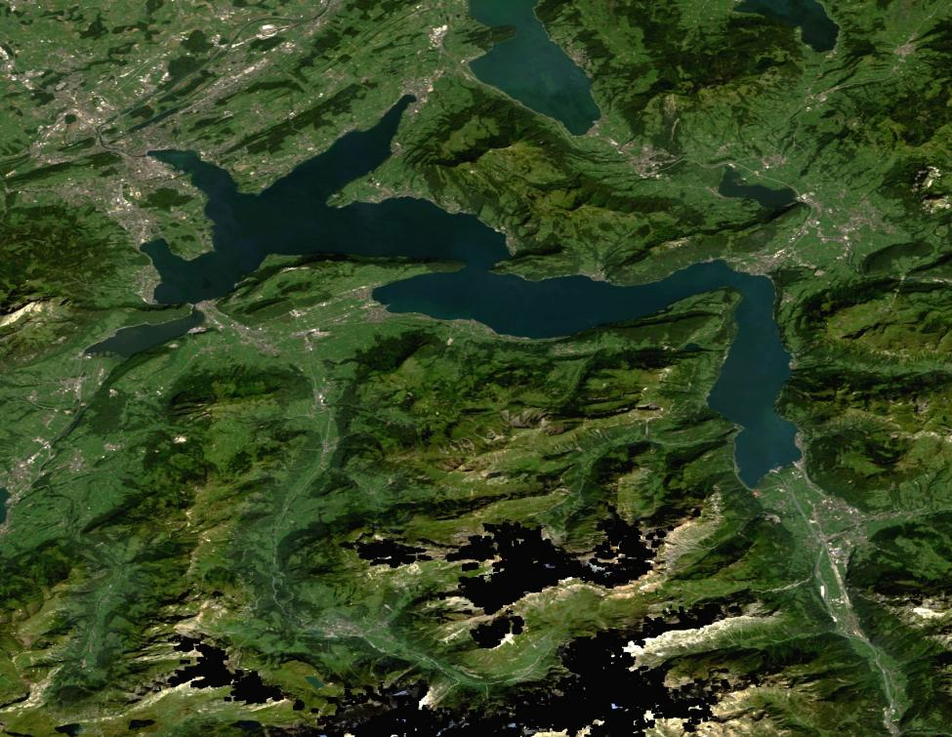

Slide 19
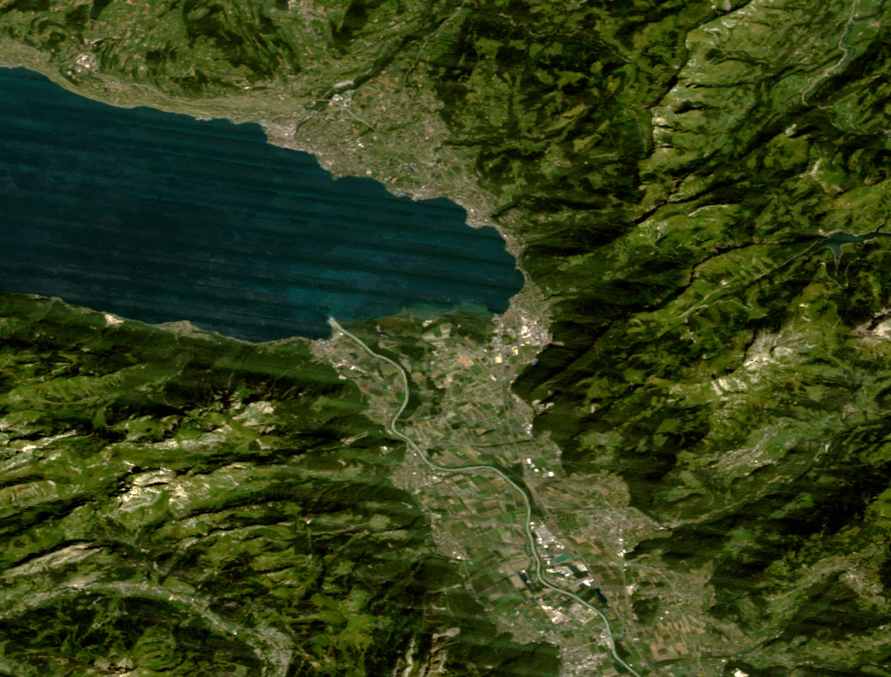
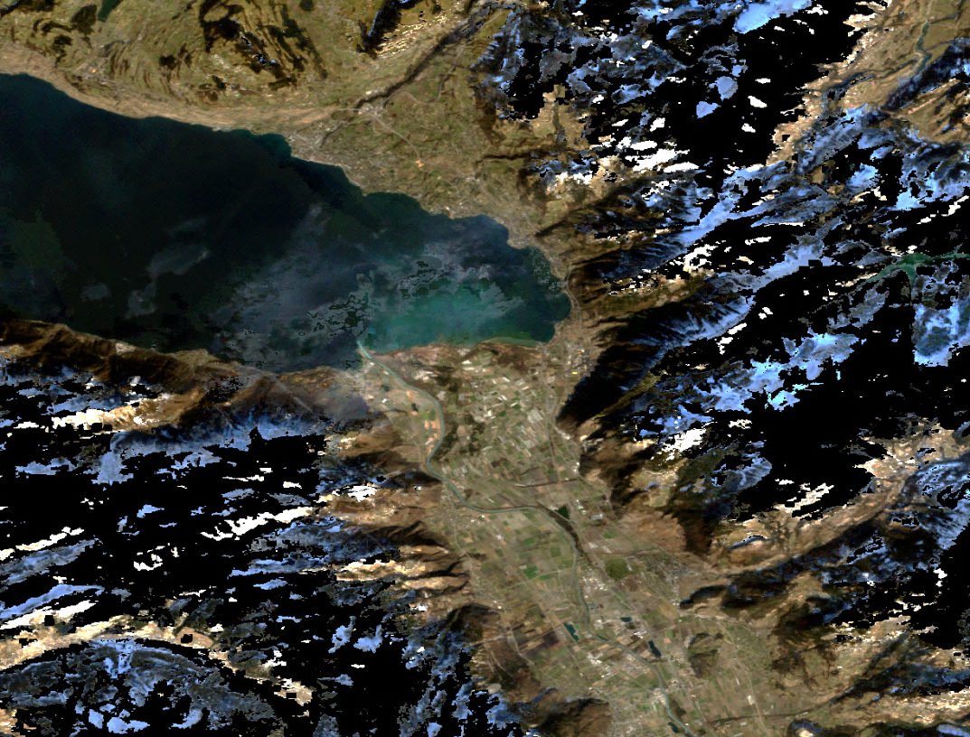
Data ingestion: outputs caveats
Custom Mosaic Tool
The Custom Mosaic Tool uses a collection of acquisitions to create a single image composed of the 'best' pixels based on the chosen criteria.
Time start: 2016-04-05
Time end: 2016-09-30
Compositing Method: Median pixel
Platform LANDSAT 7
Scene Count: 42
Pixel Count: 1’139’544
Snow and shadows on median pixel
Stripes Landsat 7
Time start: 2000-01-01
Time end: 2000-03-15
Compositing Method: Median pixel
Platform LANDSAT 7
Scene Count: 20
Pixel Count: 1’139’544

Slide 20
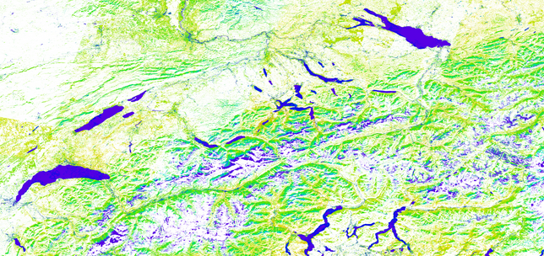
Dificulties dues to Swiss context
Topography

Slide 21
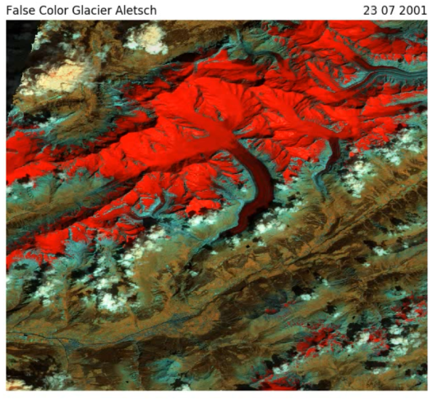
Dificulties dues to Swiss context
Snow > Masking algorithm modified

Slide 22
Publication in preparation
Giuliani, G., Chatenoux, B., De Bono, A., Rodila, D., Richard, J-P., Allenbach, K., Dao, H. and Peduzzi, P. (in prep) Building an Earth Observations Data Cube: lessons learned from the Swiss Data Cube (SDC) on generating Analysis Ready Data (ARD). Big Earth Data.

Slide 23
Curent status
Future plans 2018:
Project proposal accepted by FOEN. Consortium: UNIGE/GRID-UNIZH-WSL
Incorporate Sentinel 1 and 2
Needs of the Swiss government offices for monitoring the Swiss Environment using the Data Cube
2 Masters & 3 Certificate of geomatics @ UNIGE
Develop algorithms for time series (urban, forest, snow, water quality, protected areas, land cover, change detection,…) along with partners.
Operational services open to all Swiss institutions for research, monitoring and planning.
FNS Sinergia proposal to be submitted in December 2017

Slide 24
Georgian and Moldovian Data Cubes
Mainstreaming biodiversity and ecosystem services in Eastern Europe and Caucasus
The project will provide new tools and techniques to national experts in order to help in the identification of threatened ecosystems and for their sustainable management through transfer of technology and capacity building

Slide 25
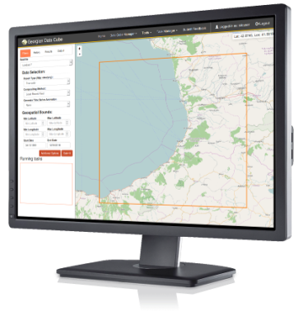
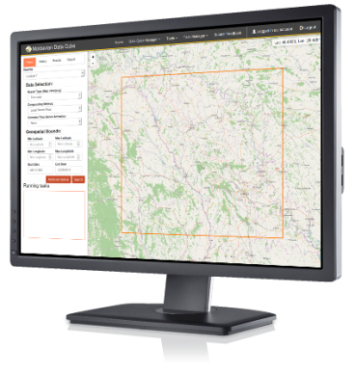
Georgian and Moldovian Data Cubes
Mini 1 tile DC per country to be used
DC on GRID-Geneva server to be transferred to national IT infrastructures

Slide 26
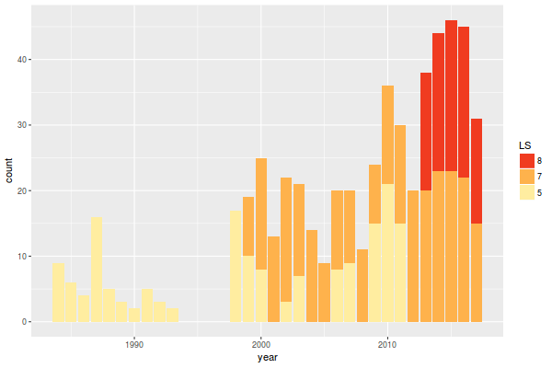
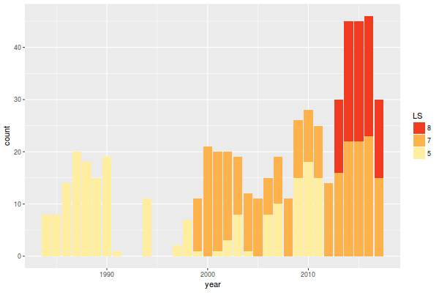
Georgian and Moldovian Data Cubes
Mini 1 tile DC per country to be used
DC on GRID-Geneva server to be transferred to national IT infrastructures
90’s gap

Slide 27
Bruno.chatenoux@unepgrid.ch
http://www.grid.unep.ch

