Slide 1
Data Stewardship Interest Group
WGISS-44 Meeting
WGISS Data Stewardship Maturity Matrix
RADI, Beijing, China 25–28 September, 2017

Slide 2

Outline
WGISS EO Data Stewardship Maturity Matrix
Comments from WGISS
Discussion & Next steps

Slide 3
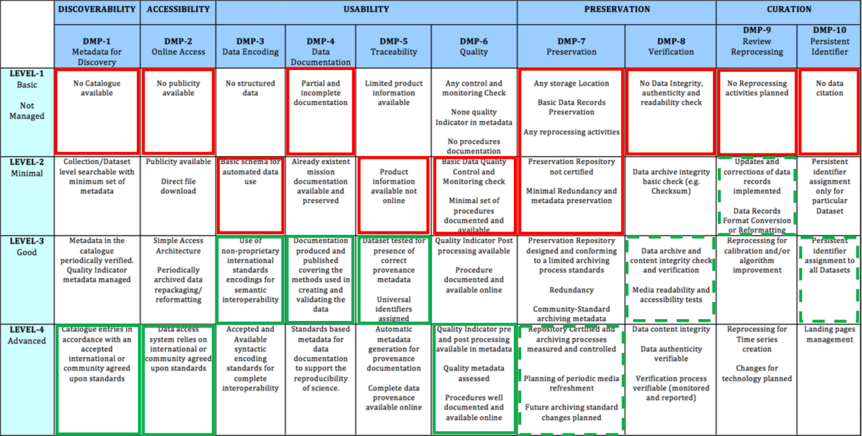
AVHRR Curation Project: Pilot

Slide 4
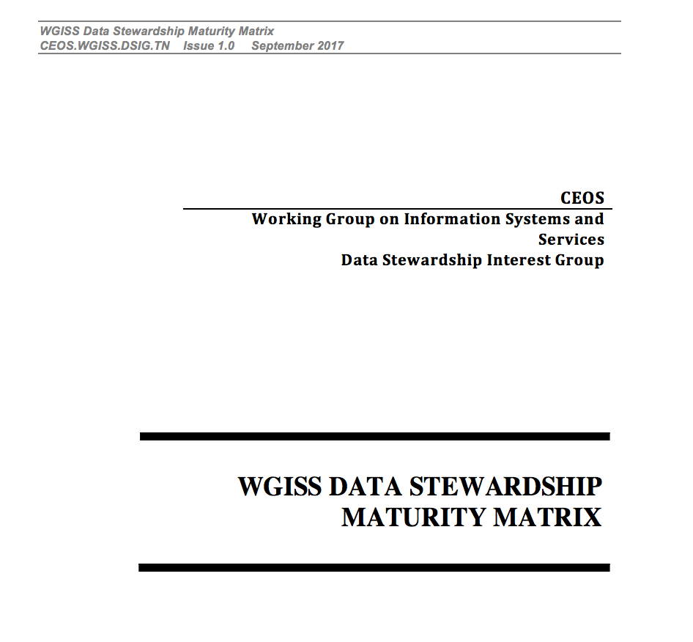
WGISS EO Data Stewardship Maturity Matrix-
White Paper

Slide 5
  WGISS EO Data Stewardship Maturity Matrix

Slide 6
WGISS EO Data Stewardship Maturity Matrix
RIDs

Slide 7
RIDs Management
23 major comments + 10 minor comments from Hampapuram Ramapriyan and LTDP WG Members
…………….

Slide 8
  Discussion & Next steps

Slide 9
DISCUSSION WAY FORWARD
Next Steps:
  Improvement of the Data Management Principles using the WGISS EO Data Stewardship Maturity Matrix.
  WGISS EO DATA Preservation Guidelines verification with new version of WGISS EO Data Stewardship Maturity Matrix

Slide 10
  Back-up

Slide 11
References
http://tinyurl.com/DSMMtemplate
http://www.slideshare.net/gepeng86/scientific-data-stewardship-maturity-matrix
https://www.jstage.jst.go.jp/article/dsj/13/0/13_14-049/_article

Slide 12









Interested Organizations
CMMI
Standards for Establishing Trusted Repositories for USGS Digital Assets
A Provenance MM
CDR
Data Stewardship in the Earth Sciences
Data Management Maturity
ISO 16363
Other Organizations
Notes:
The DMM model Editorial Board will recommend strategies for adapting and deploying a DMM model to the Earth and space sciences create guidance documents to assist in its implementation, and provide input on a pilot appraisal process.
The ASF SAR DAAC participates in ESIP to further its goals of supporting national and international Earth science research, field operations, and remote-sensing applications that benefit society. These goals complement ESIP’s focus on “the collection, stewardship and use of Earth science data, information, and knowledge that is responsive to societal needs.”
5.4 Future Work
In the meantime, the ESIP Data Stewardship Committee continues to work towards advancing the state of the art in data stewardship through the establishment of a series of liaisons with other groups working in this area. For example, several of the Research Data Alliance (RDA) Working Groups and Interest Groups have members who act as liaisons between those RDA communities and ESIP. In addition, ESIP has members on the FORCE11 DCIG group, on CODATA groups, and on other groups that are conducting related activities.
ESIP teams also are contributing to the development of standards and best practices within the Earth science community. For example, we have started developing example data citation guidelines for reviewers, editors, and authors to help journals and scientific organizations that are considering updating their guidelines to include data related topics.
To characterize the state of preservation of Earth Science data, we are beginning to test the Data Stewardship Maturity Matrix, originally developed by Ge Peng, of NOAA [46], on data that are external to the NOAA environment. The hope is that the Matrix can be generalized enough to work for Earth Science data more broadly, so that the Matrix can be applied in a uniform fashion by data centers and other data-holding organizations to express the state of any particular data set within their care. In assessing such tools, resources that offer similar utility also will need to be considered.
ESIP community discussions are open to individuals and organizational representatives. Individuals may join discussions by perusing the ESIP wiki and attending any of the listed teleconferences or by adding their names to the posted mailing lists. Organizations are encouraged to join the ESIP Federation by completing a membership application. Organizational membership is free, subject to review of application and approval by the Federation Assembly.

