Slide 1
Committee on Earth Observation Satellites
WGISS-44
Hosted by Institute of Remote Sensing & Digital Earth (RADI), Chinese Academy of Sciences
Beijing ,China
September 25-29, 2017

Slide 2
WGISS-44
September 25-29, 2017
Grand Skylight CATIC Hotel, Beijing
Beijing, China

Slide 3
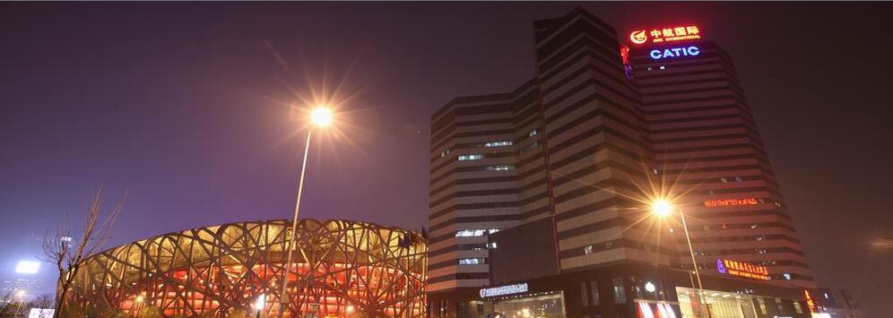
Grand Skylight CATIC Hotel, Beijing
Soaked in the green Olympic Park, Grand Skylight CATIC Hotel, Beijing is close to the 2008 Olympics main venue -- the “Bird’s Nest”. When you are enjoying the hotel’s professional and warm service, you can also feel the Olympic passion and spirit with the geographical advantage in the Olympic Village Area. After the 2008 Olympics, the hotel was awarded "The Best Olympic Hospitality Hotel" by the Beijing Organizing Committee for the Olympic Games.

Slide 4
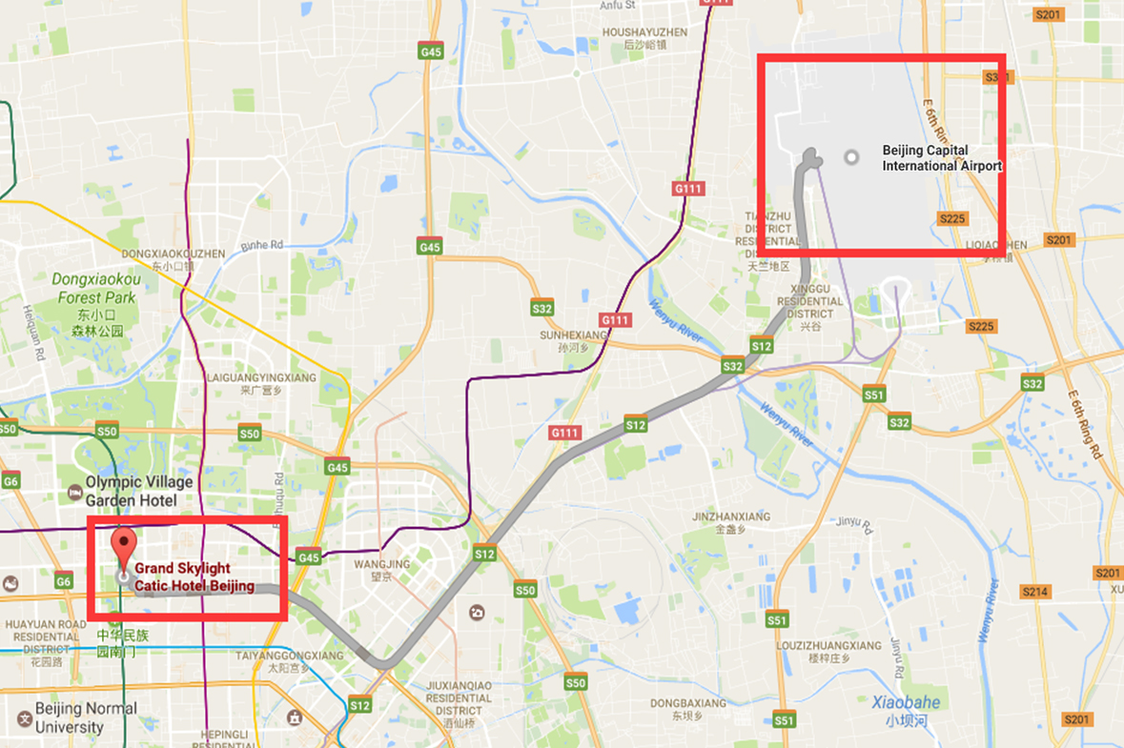
Getting to and from Grand Skylight CATIC Hotel, Beijing
No.18 Beichen East Road, Asian Games Village, Chaoyang District, Beijing
Arriving by car from Beijing Capital International Airport: Approx. time: 29 mins & Distance: 28 km
Arriving by train from Beijing Capital International Airport: Approx. time: 80-90 mins. & Airport Line –> Subway Line 10 –> Subway Line 8 –> 750 meters Waiking

Slide 5
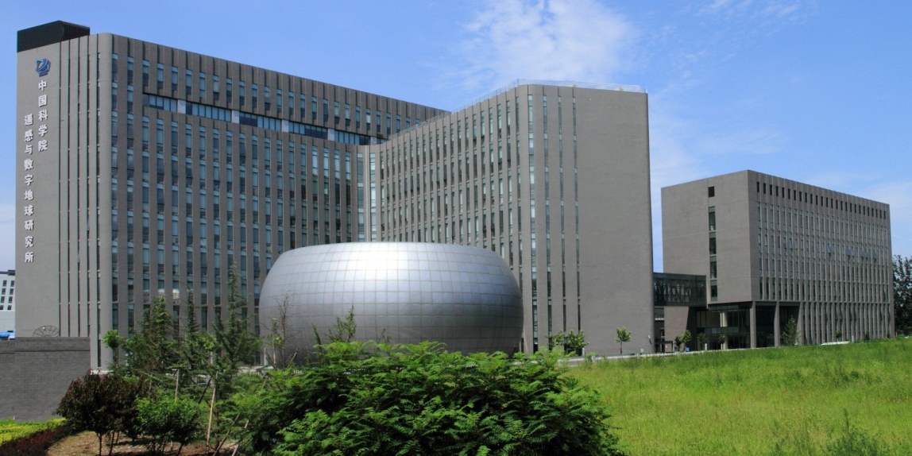
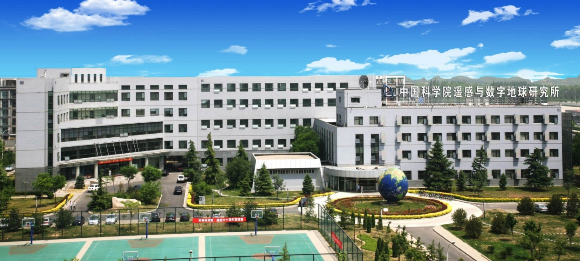
Host: RADI
The Institute of Remote Sensing and Digital Earth (RADI) was established in 2012, through consolidating two CAS institutes: the Institute of Remote Sensing Applications (IRSA) and the Center for Earth Observation and Digital Earth (CEODE).
RADI includes two parks: New Technology Park (CEODE) & Olympic Park (IRSA).
New Technology Park
CAS Key Laboratory of Digital Earth Science
China Remote Sensing Satellite Ground Station
Airborne Remote Sensing Center
Olympic Park
State Key Laboratory of Remote Sensing Science
Center for Applied Technology of Earth Observation
National Engineering Center for Geoinformatics

Slide 6
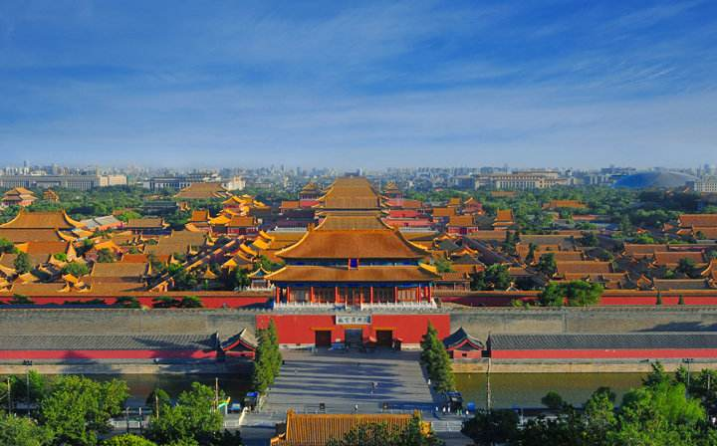
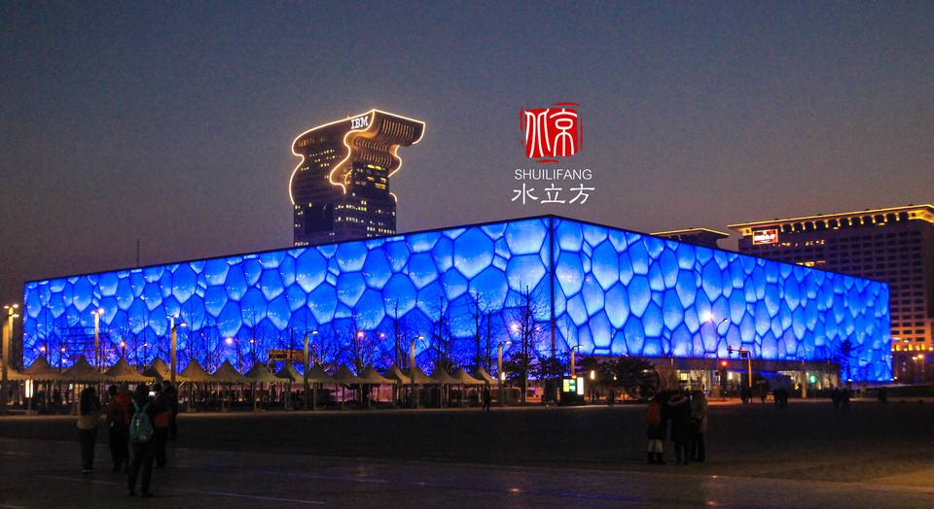
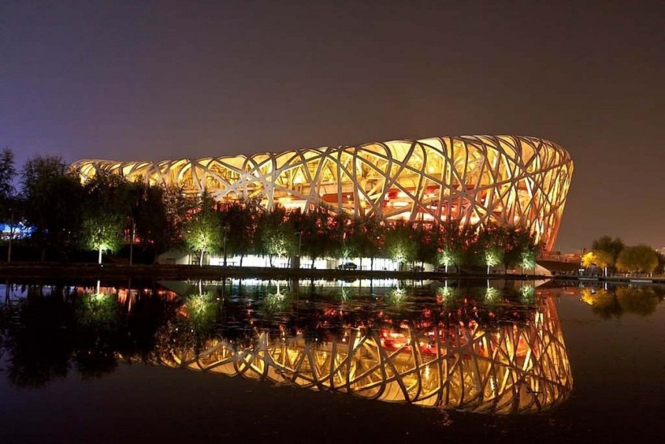
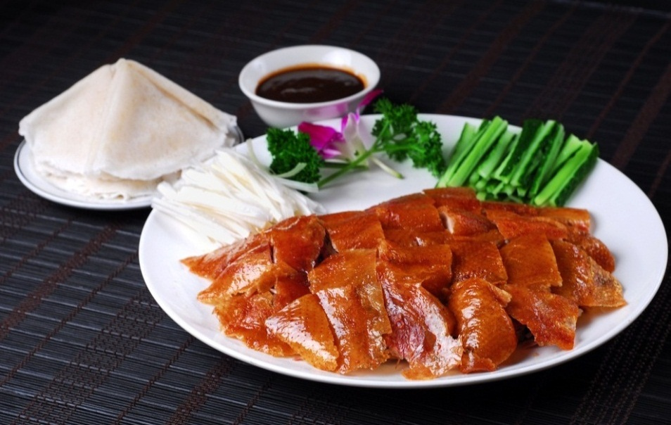
Free time in Beijing
No Host Dinner (max 200-300 ￥)

Slide 7
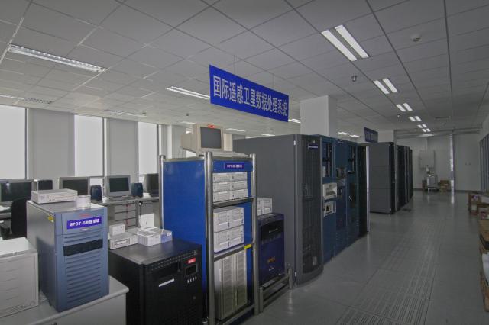
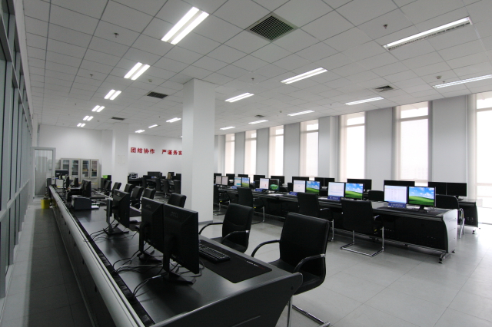
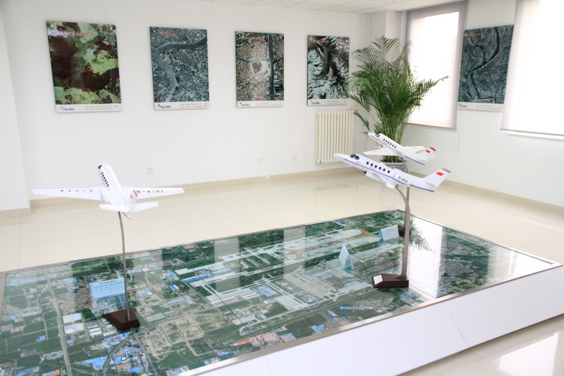
RADI Facility Tour
Remote Sensing Data Processing Center
RSGS Management System
Airborne Remote Sensing Center
Remote Sensing & Digital Earth Hall

Slide 8
Tentative WGISS 44 Agenda
 | Monday | Tuesday | Wednesday | Thursday | Friday
09:00 – 12:00 | WGISS Discussions | Data USE Data ACCESS | CEOS Future Data Architectures Workshop | Data PRESERVATION | Agency reports
12:00 – 13:30 | Lunch | Lunch | Lunch | Lunch | Lunch
13:30-17:30 | Technology Exploration: focus on Federated User Management. | RADI Facility Tour | CEOS Future Data Architectures Workshop | Miyun Satellite Ground Station Tour | WGISS meeting summary and conclusions, future plans and actions.
19:00 |  | Dinner

Slide 9
See you all at WGISS-44 in Beijing!

