Slide 1
WGISS 2018-2020 Work Plan
Committee on Earth Observation Satellites
Mirko Albani - ESA
WGISS#45
INPE, São José dos Campos (SP), Brazil
09 April 2018

Slide 2
Background and Needs
Input for CEOS 2018-2020 Work Plan reviewed with WGISS EXEC and provided to CEO; updates and revisions.
CEOS 2018-2020 Work Plan being endorsed
WGISS 2018-2020 Work Plan being drafted to cover routine activities and address CEOS Work Plan actions on WGISS
Draft circulated to EXEC for comments/inputs
Discussion during WGISS#45
Finalization by end April 2018

Slide 3
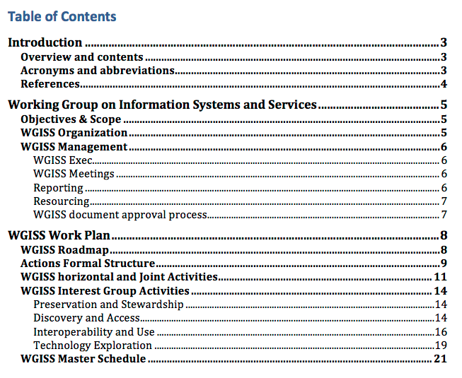
WGISS 2018-2020 Work Plan Overview

Slide 4
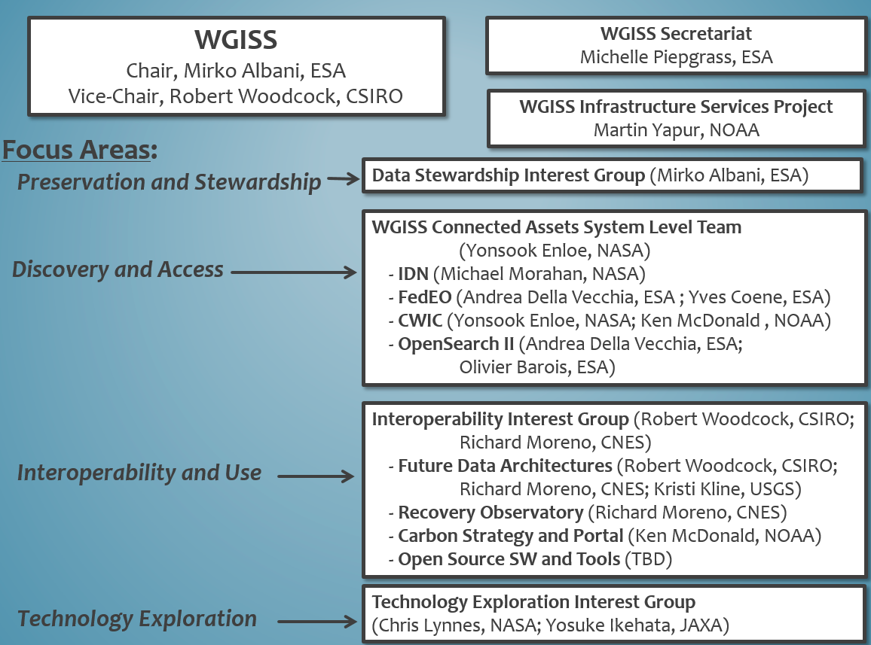
WGISS Interest Groups

Slide 5
WGISS 2018-2020 Work Plan Actions
Action Objective: unique identifier of the activity
Deliverables: list of deliverables to be produced
Projected Completion Date: due date of the action
Background Information: description of the activity and background information
Working Group: responsible CEOS entity(ies)
Responsible: action owner
Contributors: WGISS individuals contributing to the action
Notes: additional comments

Slide 6
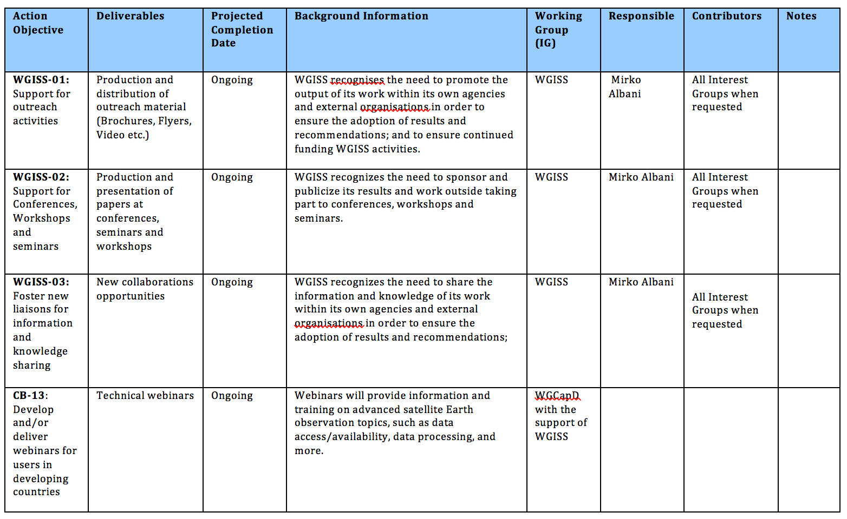
WGISS Horizontal and Joint Activities

Slide 7
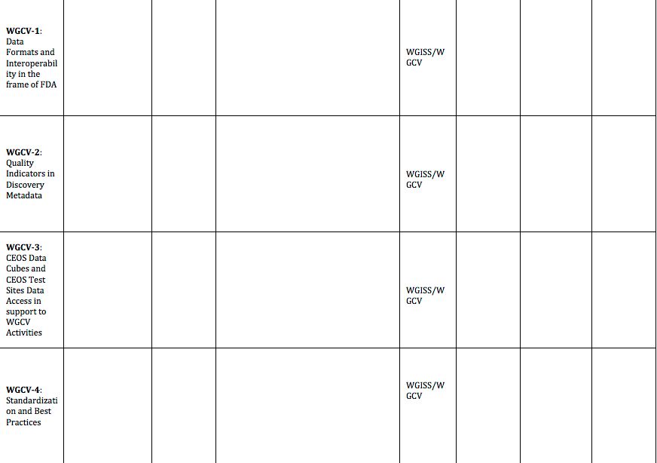
WGISS Horizontal and Joint Activities … Continued
Notes:
Carbon Portal prototype

Slide 8
WGISS Interest Group Activities

Slide 9
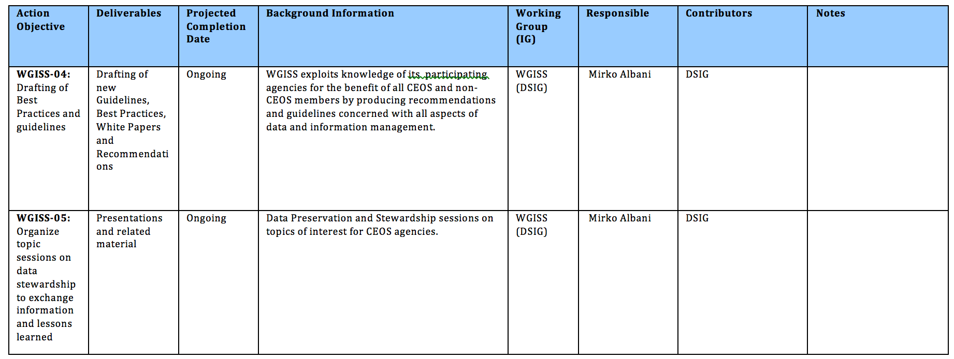
Preservation and Stewardship

Slide 10
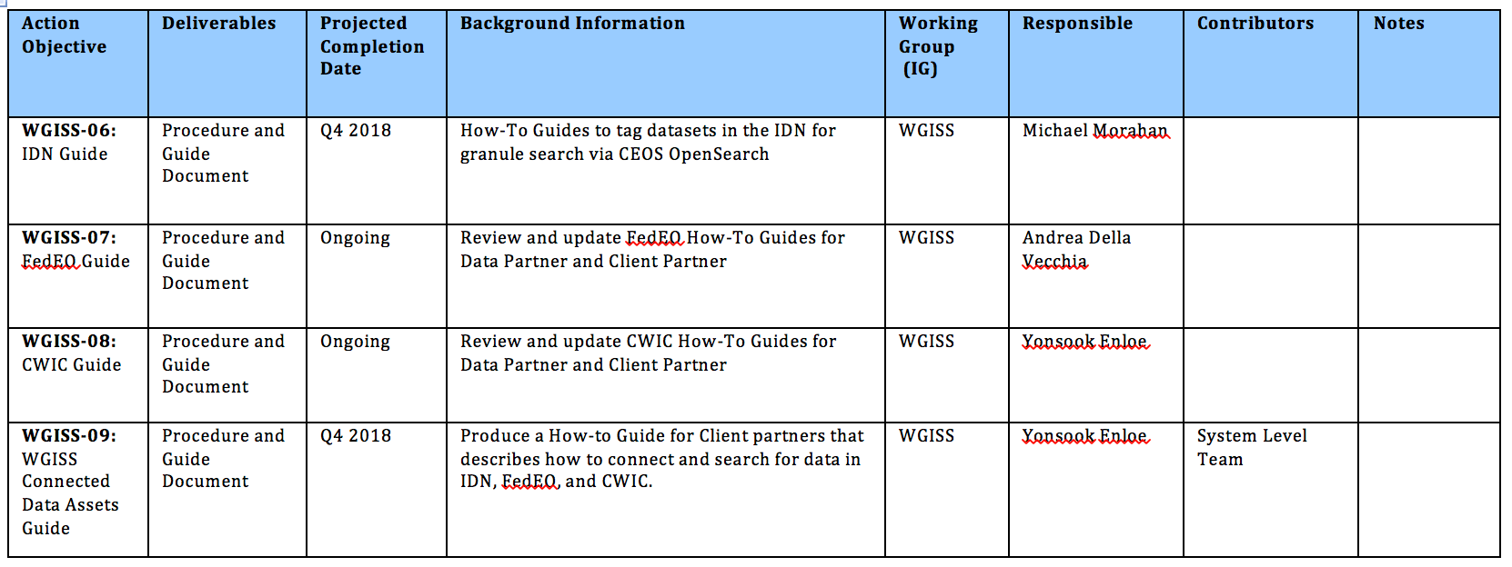
Discovery and Access

Slide 11
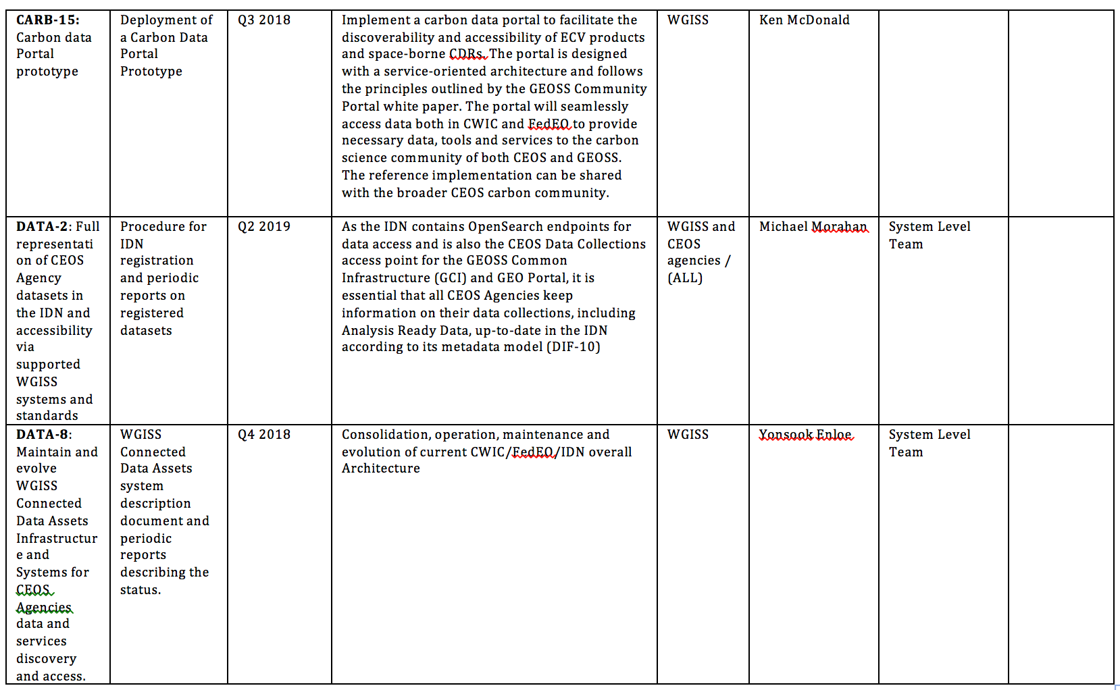
Discovery and Access … Continued

Slide 12
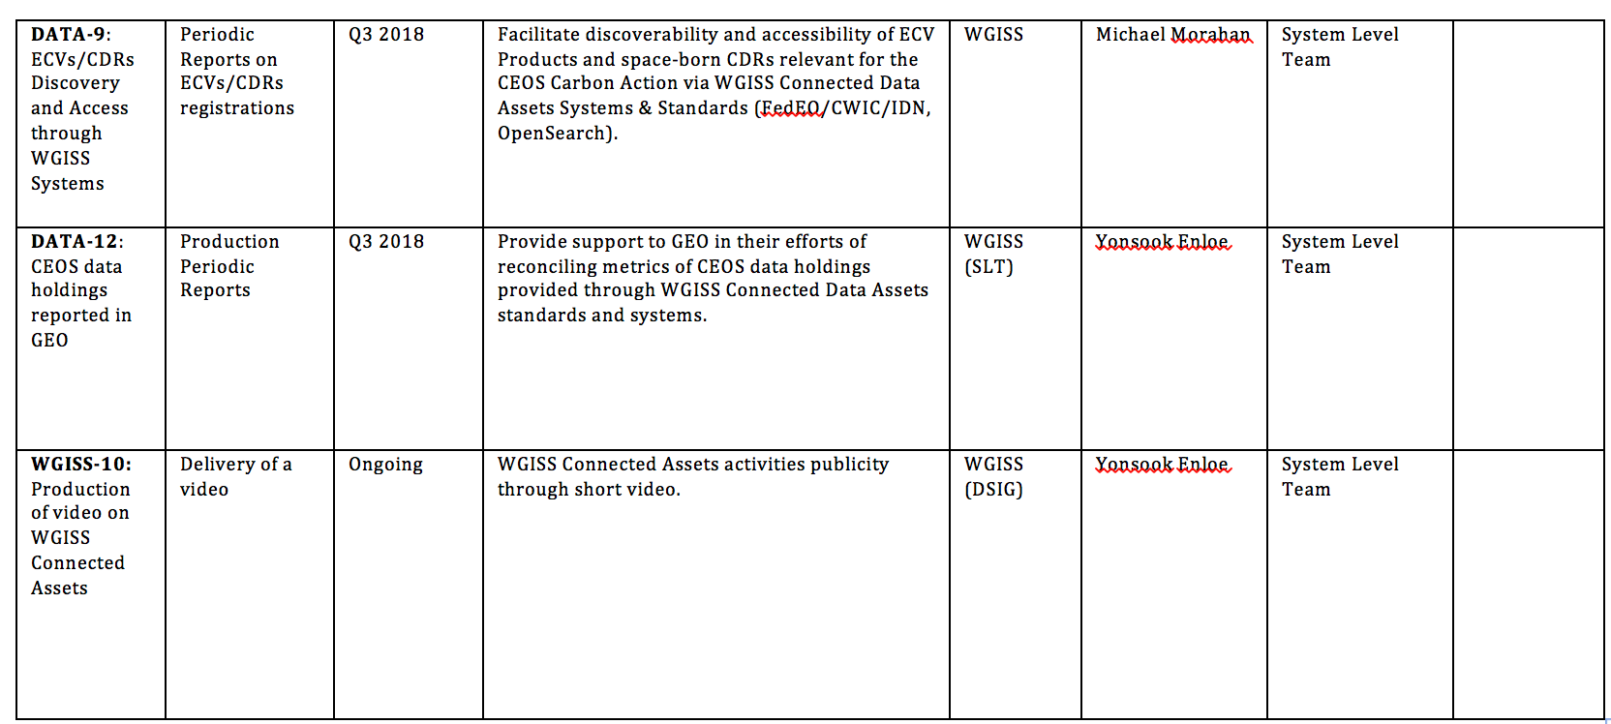
Discovery and Access … Continued

Slide 13
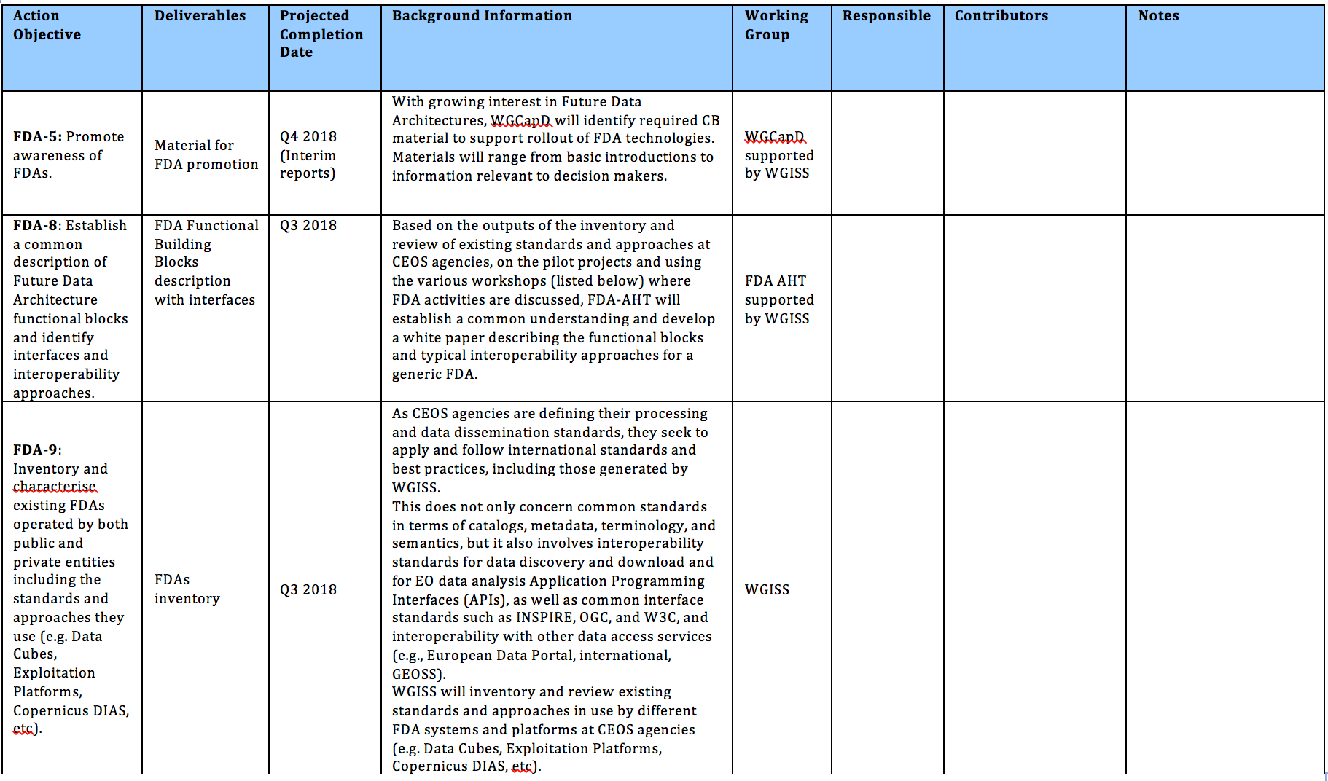
Interoperability and Use - Future Data Architectures

Slide 14
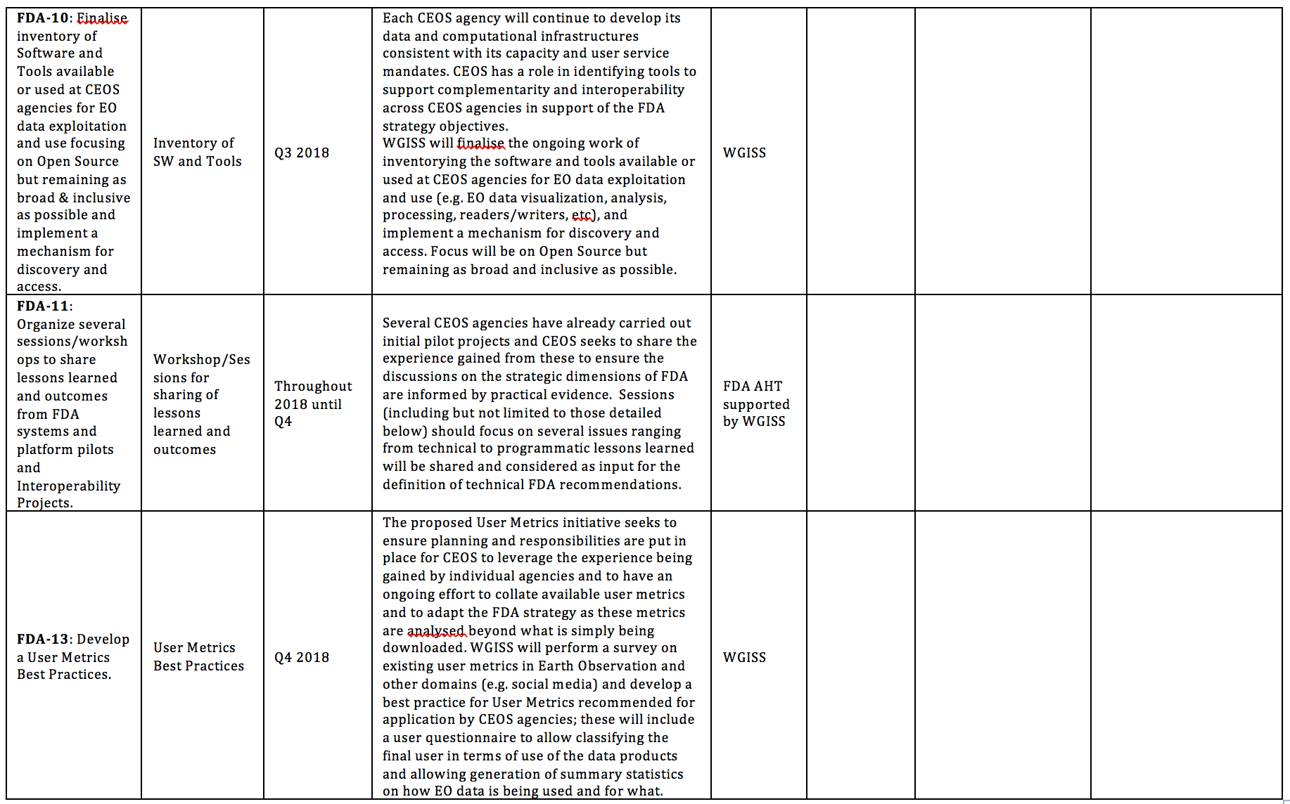
Interoperability and Use - Future Data Architectures … Continued

Slide 15
Interoperability and Use - Future Data Architectures … Continued

Slide 16
Technology Exploration

Slide 17
WAY FORWARD
ESA to update Draft plan including results of WGISS#45 session discussion
Assignment of Sections to individuals for completion
Final Draft for review by end of April: EXEC review and formal issue by May

