Slide 1

Future Data Architecture
Cloud Hosting at USGS
WGISS-45
Kristi Kline
USGS EROS Center
U.S. Department of the Interior
U.S. Geological Survey

Slide 2
Modernizing the Landsat Systems
Modernize Processing, Access, and Distribution of Landsat Data
  Change from primary business model of downloads to enabling access to full archive
  Enable users to interact with data in an integrated environment
  Ensure provenance and data stewardship

Slide 3
Modernizing the Landsat Systems
Steps to modernize Landsat:
  Establish an enterprise cloud environment for Landsat
  Enable access to data in the cloud
    Replicate data and establish operational data management procedures
  Establish modern access and visualization tools to access Landsat data in cloud systems
  Establish an environment for global scale production of Landsat data in the cloud using a cloud framework
  Demonstrate key science use cases exploiting Landsat in cloud environments
  Replicate the Image Assessment System database to the cloud to enable Cal/Val querying efficiencies

Slide 4




Landsat in Cloud
Data ready for immediate use (not compressed/packaged)
Cloud Optimized Geotiff – fast, indexed access
Old paradigm – Search and Download; Use data in your local systems
New paradigm – Search and use in the cloud
  Scalable capabilities
  Immediate data access
5: Update DB/Index
6: Perform an audit
Tiles/Scenes DB
Tiles/Scenes DB
4: Generate COG
EROS
Cloud
1: Monitor, control,
troubleshoot, report
Data Manager
COG
Generator
Tiles/Scenes COG
Object Storage
2: Copy Tiles/Scenes data
3: Read Tiles/Scenes data
Tiles/Scenes Block Storage
Tiles/Scenes
Object Storage (Rolling Cache)
Mass Storage System
Notes:
Assumption: Tiles in the cloud will be converted to the COG format

Slide 5
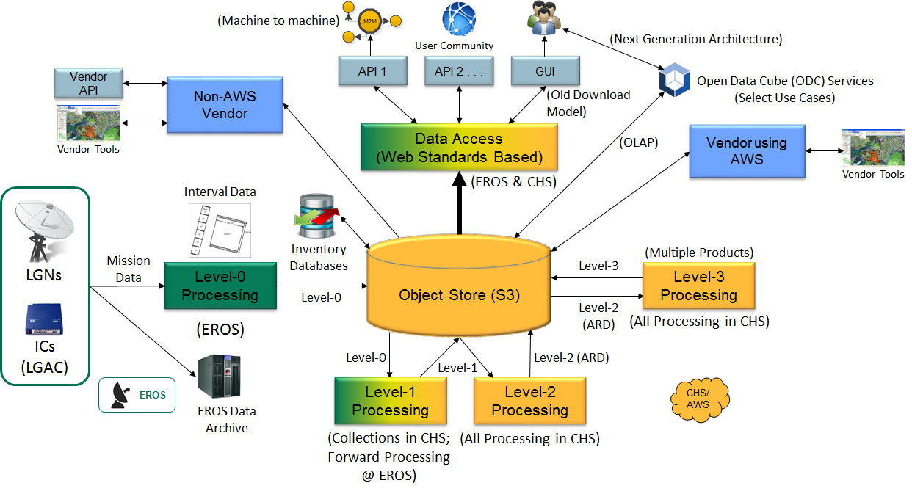
Proposed Architecture

Slide 6
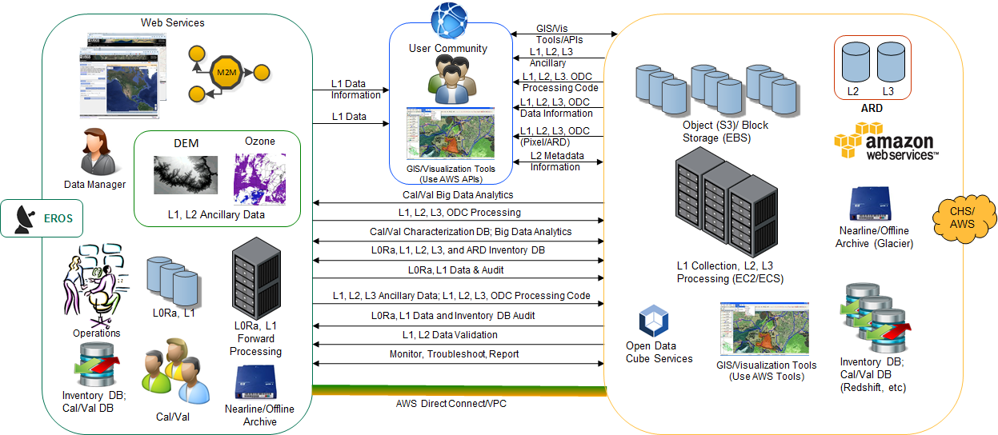
Proposed Architecture Systems Interface Overview
Notes:
talk about this as our enterprise approach

Slide 7
Re-Imaging Everything!
Current operational concept
  Users search the archive
  Download data to your own systems
  Unpackage the data and prepare it for use
Data in the Cloud
  Not compressed
  Cloud Optimized GeoTiffs ready for immediate use in the cloud
  Not necessary to download (use the cloud systems)

Slide 8
Re-Imaging Everything!
Software
  Migrating all processing software to Dokker containers
  In AWS…
    AWS Container Service, AWS Container Registry, Batch, Lambda are a few of the things we will use
    Researching what servers to request in AWS and cost analysis
FEDRAMP is limiting
  Lots of time spent working on getting added tools and IT Security aspects

Slide 9
One Major Win (almost…)
Landsat Image Assessment System (IAS)
  Collects characterization data from each scene processed into an Oracle database (local)
  Calibration/Validation engineers use the information to create calibration files necessary for processing
  Size: > 20TB (Over 8 BILLION rows!)
    Data Growth rate: ~ 500GB / month (15+ GB / day)
Moving data into AWS Redshift

Slide 10
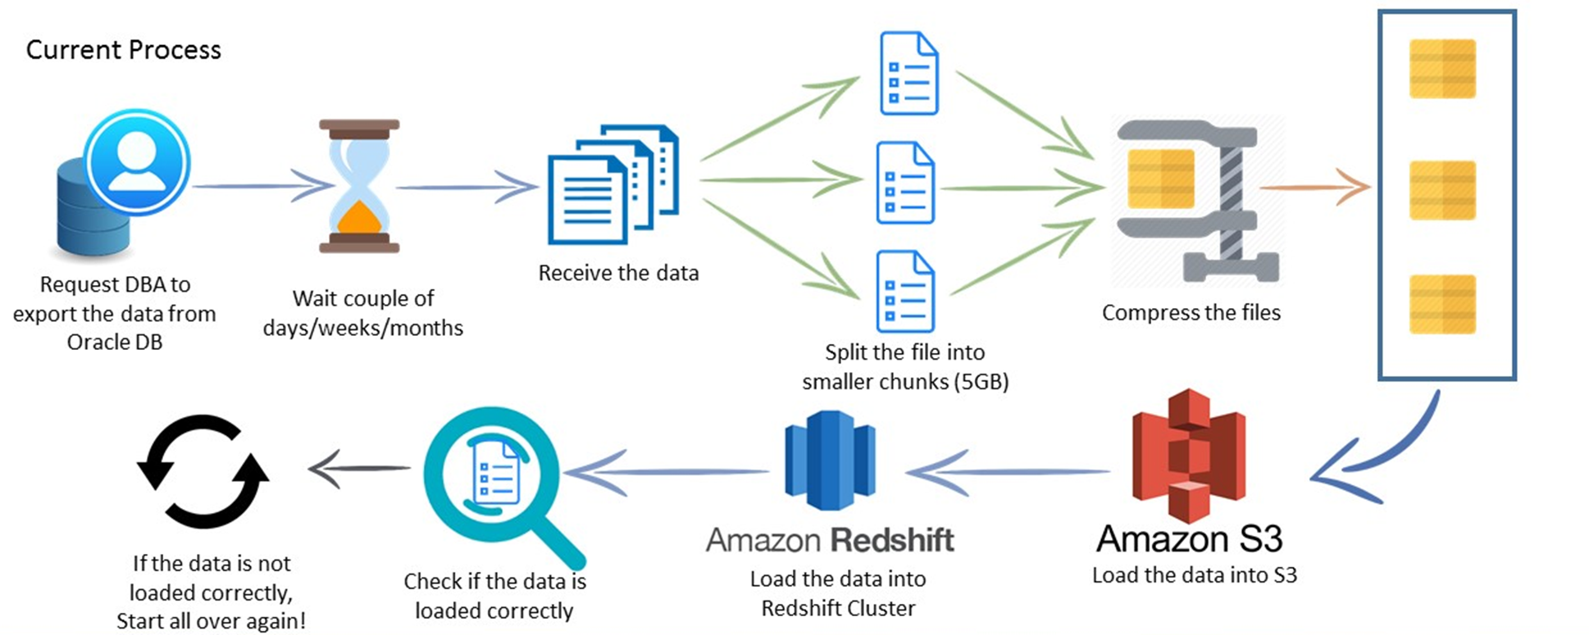
One Major Win (almost…)
Current Process to move data…

Slide 11
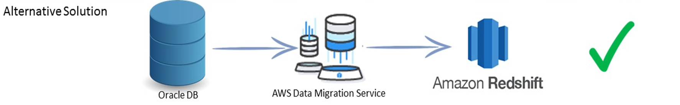
One Major Win (almost…)
Working on getting access to AWS Database Migration Service…
Initial tests show that queries that take over 8 hours locally take 18 minutes or less in Redshift!

Slide 12
Questions/Discussion

