Slide 1
CNES FDA status
Workshop on Future Data Architectures (FDA)
CEOS / WGISS – 11/04/2018
Richard MORENO
CNES

Slide 2
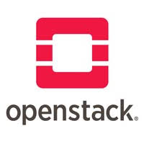
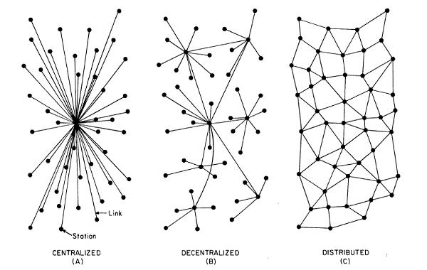
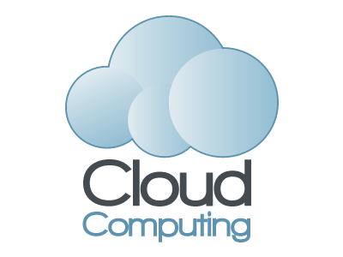


Vision for Future Data Architecture
FDA can be handled at 2 levels
  Interconnection of distributed systems/platforms
  At the level of the platform
Interconnection of distributed system
  Standard interfaces for
    Data access and discovery (ex Opensearch, CSW/ISO)
    Services (ex WPS, Opendap, …)
    Processing (ex Docker, Openstack)
  Authentication
  Security
  Potential cloud usage
Platform
  Architecture
  Technology (ex datacube, spark, machine learning, …)
CNES - Direction du Numérique, de l'exploitation et des Opérations

Slide 3
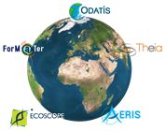
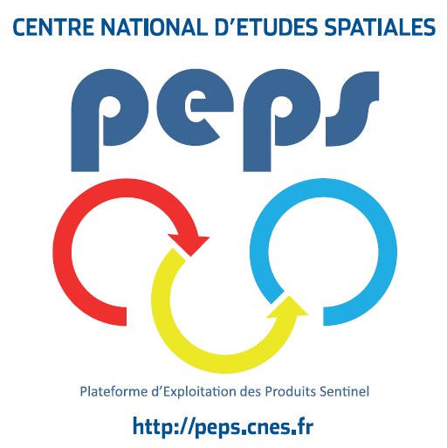

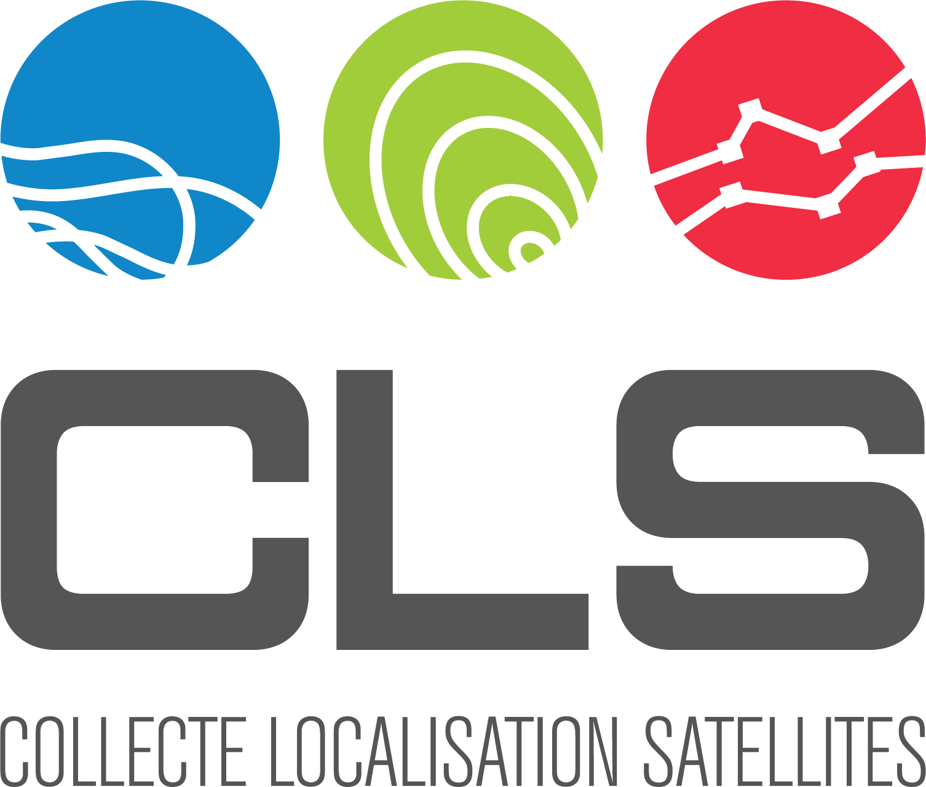
4 FDA examples
Research Infrastructure “Earth system”
  Built above French “Data and services centers”
  Objective : foster research and application across Earth System thematic areas
PEPS : French Copernicus Collaborative Ground-Segment
  Mirror of Sentinel 1, 2 and 3 data
  Data distribution / Hosting of processing and services
2 examples of ground systems based on big data technologies
  GAIA ground-segment
  CLS ground-segment
CNES - Direction du Numérique, de l'exploitation et des Opérations

Slide 4





« System Earth » Research Infrastructure
Ocean surface data & service centre
http://www.odatis-ocean.fr/
Atmosphere data & service centre
https://www.aeris-data.fr
Land surface data & service centre
https://www.theia-land.fr/
Solid Earth data & service centre
https://www.poleterresolide.fr/
CNES scientific missions are hosted in data & service centres
These centers also host :
- other space data (NASA, NOAA, JAXA, …)
- in-situ data
- airborne / ship data
Mix several sources of data => increase reliability and quality
- approach similar to newspace companies : Orbital insight, Space Know ; Quant Cube
Result of huge invesment => cannot envisage to stop and transfer everything to the cloud
CNES - Direction du Numérique, de l'exploitation et des Opérations

Slide 5

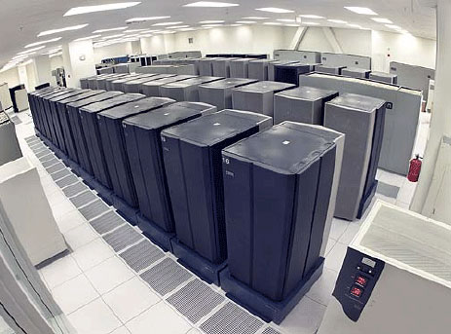
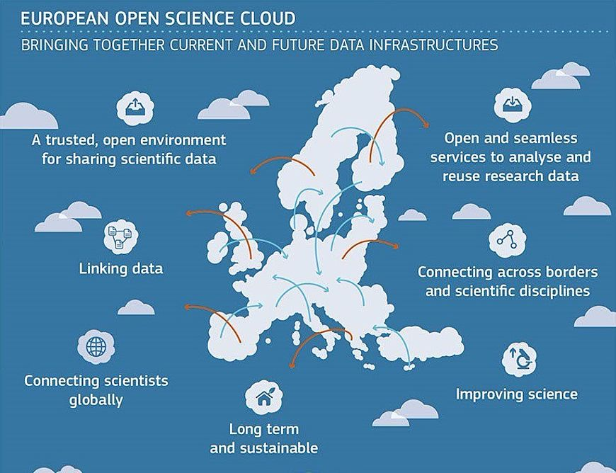
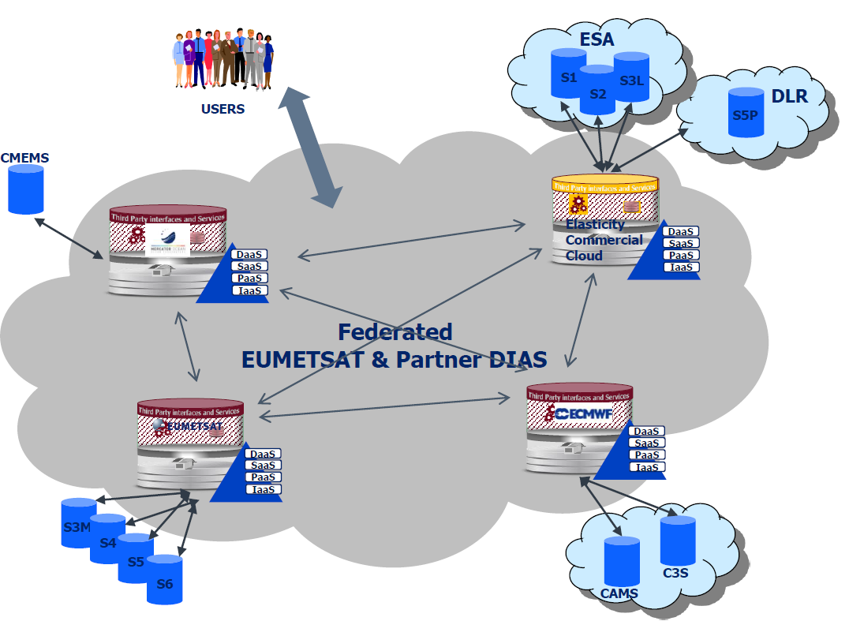
« System Earth » Research Infrastructure
Project will start soon
Will also be the base of the Space Climate Observatory
Standard interfaces for data, services and processing.
Systems and architecture compatible or derivated with/from several existing initiatives: EOSC (CE), GO FAIR, EO Innovation Europe (ESA), CEOS, GEOSS
Organisation similar to the
EUMETSAT DIAS or
to EOSC
EOSC
DIAS
…
CNES - Direction du Numérique, de l'exploitation et des Opérations

Slide 6
PEPS
PEPS hosted by CNES in Toulouse – France
Service officially open since 11 September 2015
PEPS hosts all S1, S2 and S3land products
Volume
  Volume of data : 4 PB (end of 2017)
  Foreseen volume 8 PB (end of 2018)
  PEPS (current) capacity : 14 PB
CNES - Direction du Numérique, de l'exploitation et des Opérations

Slide 7
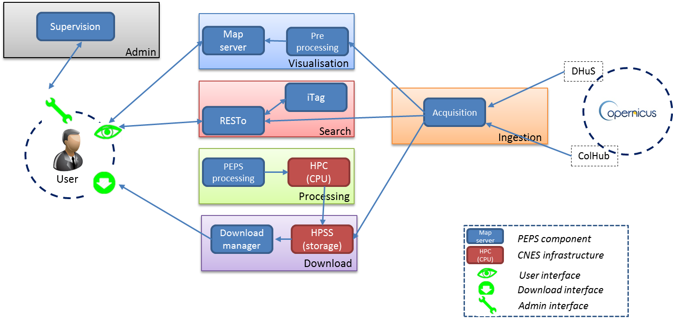
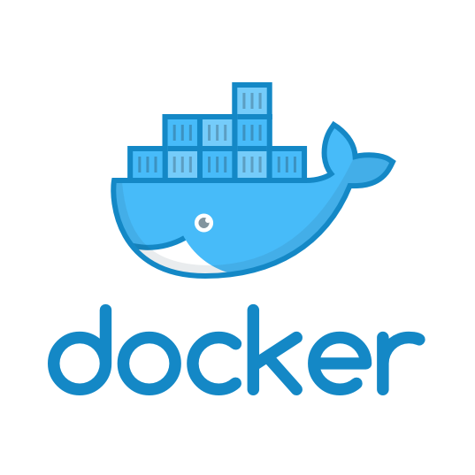
PEPS
Ingestion and storage of all Sentinel 1, 2, 3 over the globe
Discovery and retrieval
Processing capabilities close to the data
WPS
CNES - Direction du Numérique, de l'exploitation et des Opérations

Slide 8
PEPS phase 2
  Phase 0 in progress
    DIAS & EOSC taken into account
  Objective : decision taken in 1st quarter 2019
  PEPS will be operational at least until end of 2020
CNES - Direction du Numérique, de l'exploitation et des Opérations

Slide 9
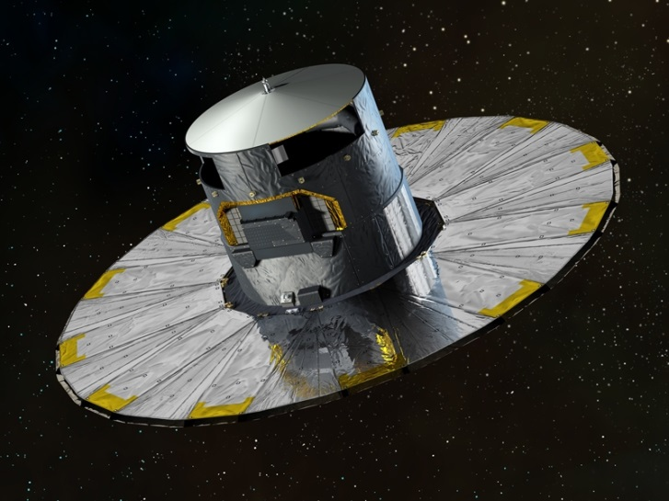
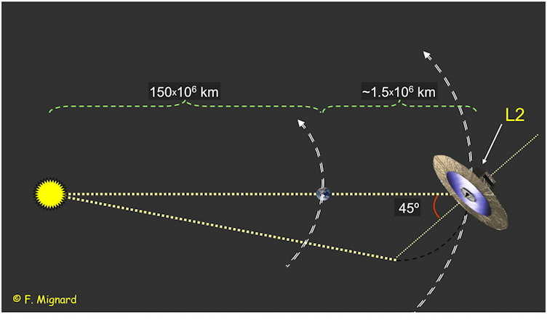
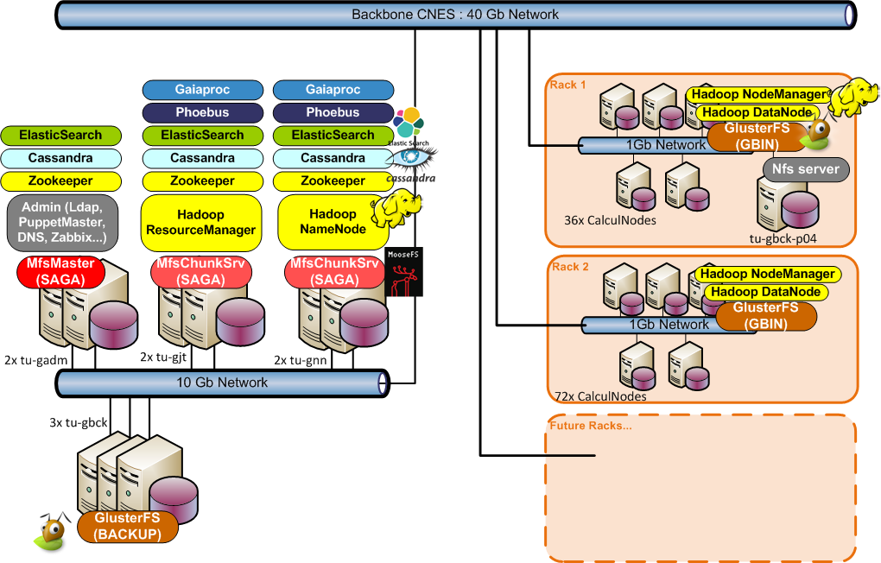
The GAIA mission
    Satellite launched in 2013
      At Lagrange Point 2 (L2)
      2 on-board telescopes with several sensors
    Main goal: three-dimensional map of our Galaxy
      to reveal the composition, formation and evolution of the Milky Way
      1 billion stars, each seen 80 times
    Gaia measures:
      Positions (and distances): astrometry
      Velocities wrt Earth: spectrometry
      Light (flux, spectra…): photometry
    Results published in catalog releases
      DR1 14th September 2016
      DR2 April 2018
      DR3 2020, DR4 2022…

Slide 10
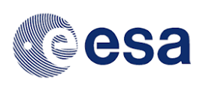
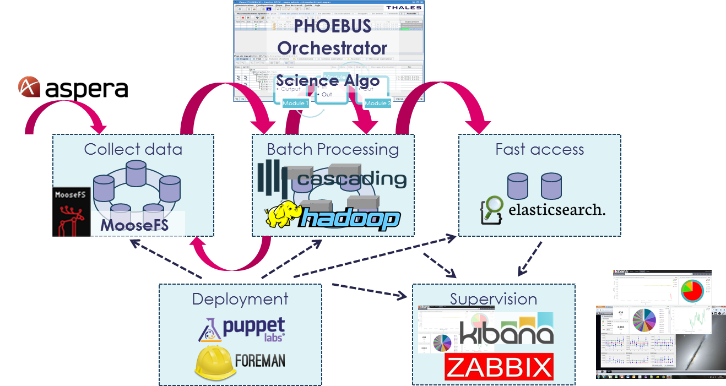

Gaia CNES Center Architecture
Mission and data characteristics
  1 billion stars to observe,
  100s billions of measures,
  ~3 PB of data to handle,
  Up to 50 distincts Hadoop jobs, for just 1 workflow.
  Complex data manipulation (join, sort).
Hadoop clusters
  172 + 44 computing nodes
  HDFS raw: 3,5 PB
  YaRN: 4’448 Cores, 25 TB RAM
Notes:
GEY Speech:
So lets start with the GAIA mission, the ESA space observation project dedicated to build a milky way three-dimentional map and more precisely the CNES Data Processing Centre.
You can see the main goal of the mission which is to observe more than one billion star and a lot of other astronomical objects.
Mission characteristic, 280 billions records, 3 PB of data.
Based on Hadoop, with Cascading for simplifying data flow and Phoebus to perform orchestration.
We also used DevOps tool such as Foreman and Puppet for platform deployment.
And Elastic search, Javascript or Kibana for data visualization tools. Moreover we integrate Hadoop tuning oriented tool like DrElephant (LinkedIn)
An interesting fact, we have quite a lot of what is called Cascading flows, so complex data manipulation queries performed with Hadoop.
Each year, the platform grow to follow data volume increase. Today the operational and qualification platform uses 216 computing nodes mounting 3,5 PB raw HDFS volume. About 4’500 Cores accessing 25 TB of RAM.

Slide 11
Gaia computations at DPCC
    4 years experience with an Hadoop cluster
      High number of objects: dozens of tables containing up to 80 billions rows
      Calendar constraints: short delays for daily processing, vs final deadline for cycle
      High volumes of data (3PB of results foreseen at the end of the mission)
      Resource sharing between several processing chains
    Some lessons learned, as real-life examples in:
      Data management
      Data processing
      Hardware architecture

Slide 12



Conclusion
    Hadoop does the job
      Despite the Gaia constraints (number of objects, volumes, calendar, resource sharing…)
  Pros:
    Management of huge data volumes
    Efficient parallel processing
    Efficient resource sharing
    Good reliability
    Scalability
    Robustness to hardware issues
  Cons:
    Poor performances monitoring
    A very complex configuration
      Requiring a dedicated team of experts

Slide 13

Our vision
CLS, a worldwide company, united by a passion : imagine and deploy space-based solutions to understand and protect our Planet for a sustainable management of its resources
For Earth, from Space

Slide 14
Processing

Slide 15
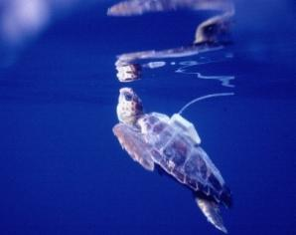
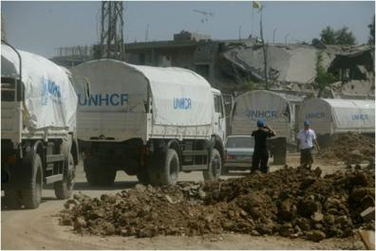
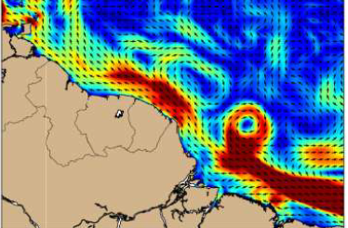
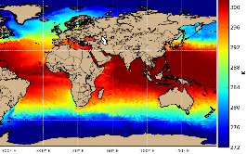
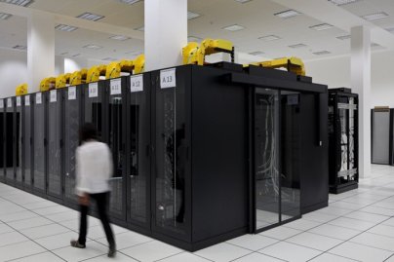
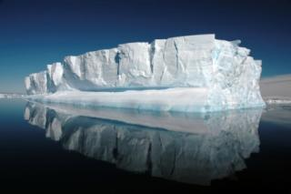
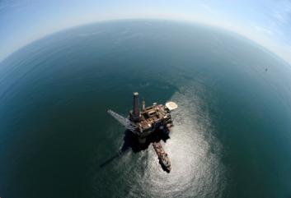
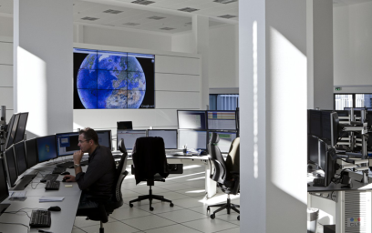
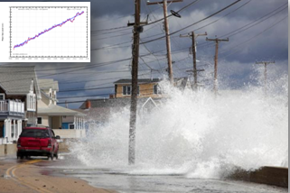
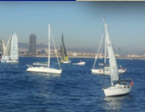
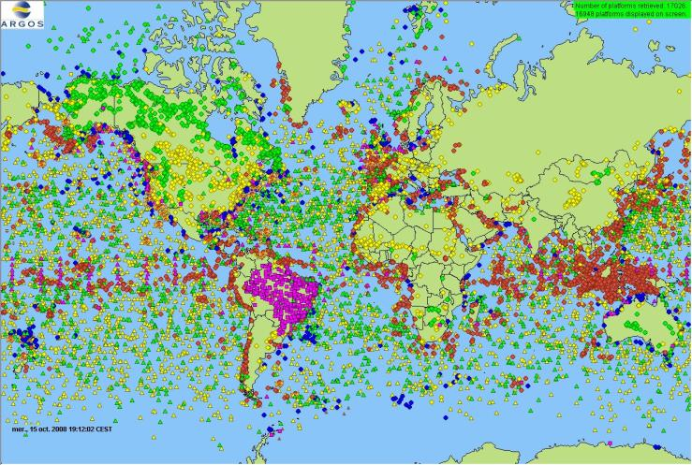
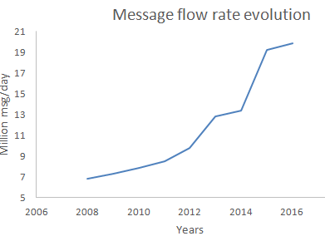
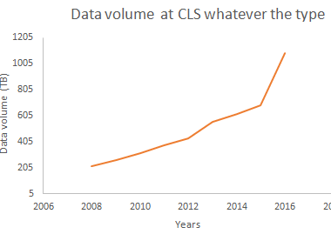
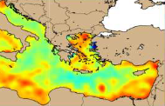

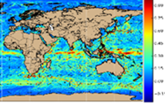
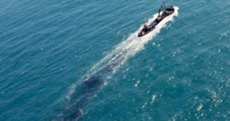
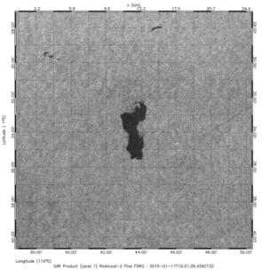
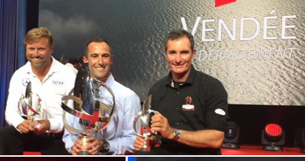
The CLS context
Thematic expertise: Operational exploitation of localisation, earth observation and ocean surveillance data
Data variety at its best
Significant volumes of heterogenous data
Realtime streams and large archives
Large numbers of small and large data objects
Current volume: 1 PB
  Projection 2020 : 6PB
Qualification de la donnée
Croiser les données
Indicateur qualité sur la donnée

Slide 16
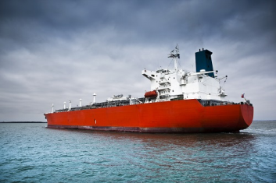
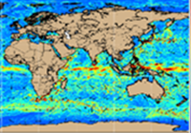
Data and use case
Data :
  AIS (positions, vessel info) : 5 years of data (from 2013, 25 Billions positions, 12 To), realtime stream (ingestion rate of up to 20.000 msg/s)
  METOC (MeteoOceanic data): Netcdf grid data
  SAR image extractions : iceberg, vessels
  VMS : Illegal fishing monitoring
Use case :
  Data Ingestion and extraction (temporal, geographical)
  Use cases
    Data qualification : invalid vessel ID, non coherent speed
    Detection of enter/exit from areas in realtime
    Detection of RDV between vessels
    Extraction of METOC variable values along the vessel routes (also used in animal tracking scenarios)
    Trajectometry : study in progress
    Detection of anomalies in AIS reception

Slide 17
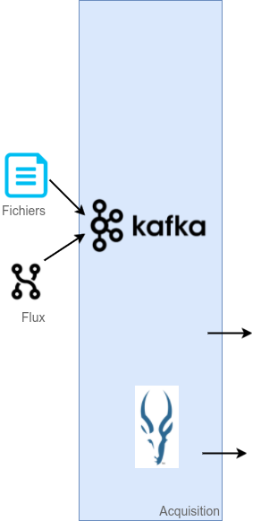
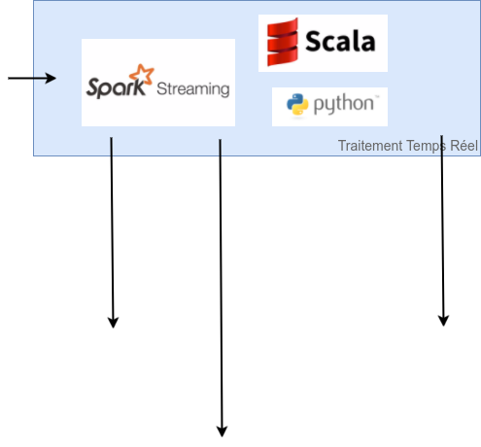
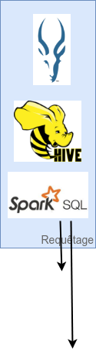
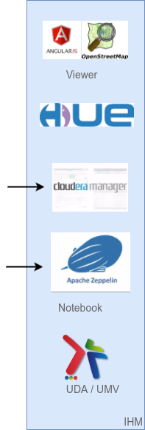
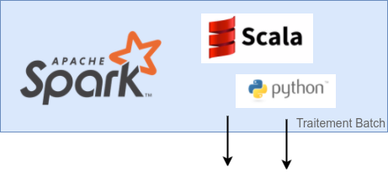
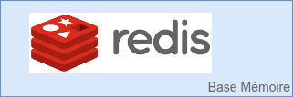
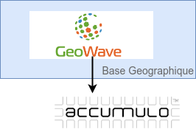
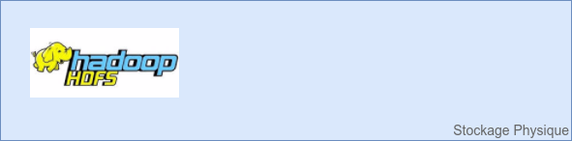
Architecture
- UI
- Geography DB
- Storage
- Ingestion / Acquisition
- Batch processing
- Memory DB
- Query
- Realtime processing
Transformation into AVRO files
Persistance
  From AVRO to Parquet
  Use of GeoWave API
Positions extraction
Extraction E/E zones
Trip extraction
Detection of RDV
Extraction of informatoin along track
Addition of columns
Qualification: data integrity, coherence check (algorithms Kafka consumers)
Ports cartography
Trip calculator
Reprocessing
Positions: 2 storage dimensions
  TimeSeries (positions/vessel or fleet): Parquet
    compression, partition
    Column format for fast use of timeseries
    Support to Impala, Hive, Spark
  Zonal (positions per geography): GeoWave / Accumulo
Vessel Information: vessel database
  Latest information: Redis
    Fast access
  Archives: Parquet files
AIS – High volumes: 12 million positions/day, future x24 (1 position/minute for ~ 200.000 vessels)
realtime: up to 20.000 msg/s: Kafka message broker
Decoding of NMEA payload
Association position / vessel: Redis
Detection Entry/Exit zones: spark streaming

Slide 18
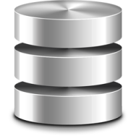





Software Architecture
File system Parquet
(Historical AIS Data
for timeseries request)
AIS Request
AIS data Ingestion
Raw data Ingestion
consolidation
Historical
UDA
TimeSerie
request
Akka
Fresh
Ingestion
KUDU
(Fresh AIS Data
for timeseries request)
Web Interface : UMV
User
Zonal
request
geowave
geowave
Accumulo
(AIS Data for Zonal request)

Slide 19
Some numbers
AIS : Ingestion of 2 years of Data
  In 2 days
  4,4 billion positions
  3 million vessels
Real flow connection :
  25000 messages / second

Slide 20
Storage

Slide 21
Objectives
Competitive solution
Reliable, scalable and extensible innovative system controlled by the provider (CLS)
High level of performance and availability
Major asset for reprocessing activities, easy and performant access to the data

Slide 22
Scality ring
Chosen LTA infrastructure is based on a Scality RING solution especially selected for its robustness and scalability.
Millions of users, deployed and used since 6 years.
Scale-out solution
Based on Object storage technology
Management of high volumes

Slide 23
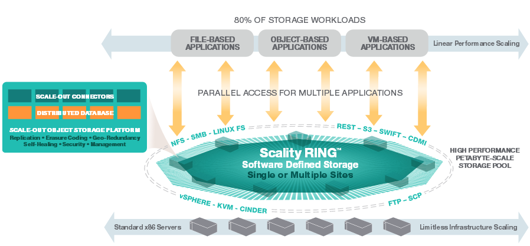
Scality ring

Slide 24
Scality ring
Objects replication (default configuration is 5 copies )
No file size limit
Unlimited number of objects
Multi-site object management
Parallel access
Monitoring and management interface
Easily expendable without service disruption

