Slide 1
CSIRO Agency Update
Dr. Robert Woodcock

Slide 2
CSIRO Centre for Earth Observation
Co-ordinate EO science across CSIRO and showcase it externally
Act as primary point of contact, to represent CSIRO (and Australia) at relevant domestic and international earth observation committees.
Manage the CSIRO NovaSAR national facility and associated applications science
Coordinate and fund some of CSIRO’s EO satellite calibration and validation needs
Facilitate access and use of novel EO technologies (eg Lidar, SAR, hyperspectral, gravity, etc.)
Developing further EO partnerships with industry primes, SME’s and Defence
Establish an operational DataCube capability to underpin CSIRO earth observation science and commercialisation opportunities
Support CSIRO’s contributions to new Australian Space Agency

Slide 3
CSIRO Investments, Partners & Capability
SKA Pathfinder – Radio astronomy antenna clusters, data networks, high performance computer (Pawsey) – Western Australia
NASA – CSIRO Deep Space Communication Complex – Tidbinbilla, ACT
Defence Materiel Technology Centre – DMTC HAAS Program
NovaSAR earth observation satellite – tasking and downlink rights worldwide
Earth Observation Data Analytics – DataCube Platforms (NCI and AWS Cloud)
“Space 2.0” SME and Start-ups engagement
Satellite calibration platforms and robotics
Future Science Platform Projects

Slide 4
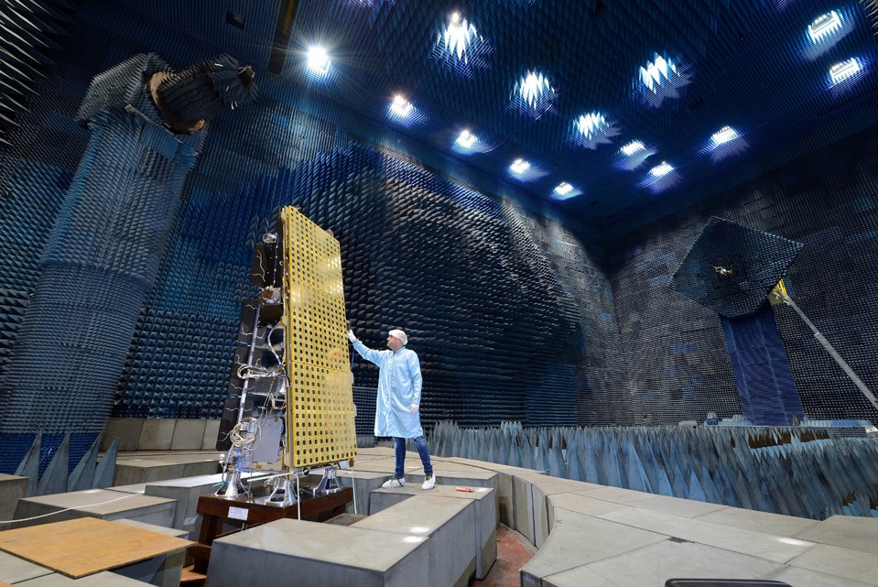
NovaSAR
Special wide swath Maritime Mode (400 x 800km)
Estimated Launch – June 2018; 7 years lifetime
Automatic Identification of Ships (AIS) on-board
6m, 20 x 1000+km StripMap Mode
S-band, 3GHz
Operated from UK, but payloads available to partners

Slide 5
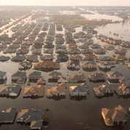
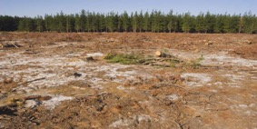
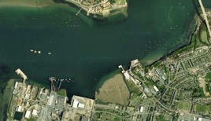
Applications focused approach
Sample target applications based on discussions with potential customers:
Ship detection
Illegal shipping/fishing, oil bunkering
Oil spill monitoring
Search and rescue
Forestry
Logging, forest fire damage
Flood management
Flood extent mapping
Land use mapping
Land registry
Agriculture: crop ID and extent
Disaster management
Earthquakes / landslides (mapping, infrastructure and building damage assessment)
Floods
© Google Earth

Slide 6
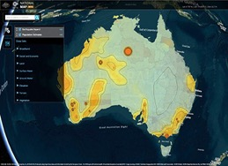
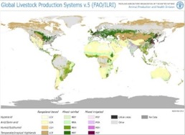
CSIRO Earth Analytics Industry Innovation Hub
Helping SMEs build their business
CSIROs EO analytics innovation
Ready to Run applications and services
Quality data
Scalable to size of each business
Industry Services
Licensing
Consulting
International Services and Partnerships
Supports public good and IP-controlled science and products
CSIRO EO Science-as-a-Service Platform
Notes:
Working with industry to accelerate technology readiness and have CSIRO science building innovative new businesses.
Change in business model and work practice to leverage the new paradigms
Directly addresses a range of issues discussed with SMEs as barriers to testing and using CSIRO innovations

Slide 7
From Data to Impact…
Open Data Cube | Scalable platform for EO analytics
CEOS | Ensured EO data supply => Analysis Ready
CSIRO | Accelerate IP through to Industry use
Primary websites www.opendatacube.org www.github.com/opendatacube www.github.com/ceos-seo
Global impact from EO science through a network of data cubes and CEOS engagement
Connecting Science to Impact in Earth Observation
This Photo by Unknown Author is licensed under CC BY-SA

Slide 8
CSIRO Astronomy & Space Science
Space Industry Development
CASS Space Program
EO Centre Office
CSIRO Centre for Earth Observation
Inter-agency and Domestic Relations
International Coordination
EO Data and Applications
Space Technology and Ground Operations
DMTC HASS
Sub-Team
Cross-BU Advisory Committee
EO Data & Analytics
Sub-Team
Future sensors, Cubesats, etc. Sub-Team
Satellite Cal/Val Sub-Team
Satellite Operations
Sub-Team
Notes:
Program Org Structure – by BU/Program/Teams/Sub-Teams

