Slide 1
Working Group on Information Systems and Services (WGISS)
Committee on Earth Observation Satellites
Iolanda Maggio, ESA
WGISS#46 Meeting
Data Stewardship Reference Model – White Paper
DLR – Oberpfaffenhofen, Germany
22nd October 2018

Slide 2
Data Stewardship Reference Model - Background & Scope
Main Objective: clarify how to apply and use WGISS assets for data stewardship
CEOS 2017-2019 Work Plan highlighted the first need of a Reference Model for data stewardship planning and implementation.
The short white paper provides few guidelines and recommendations for the preservation and improvement of data including a roadmap for scientific data stewardship improvement through WGISS assets support.

Slide 3
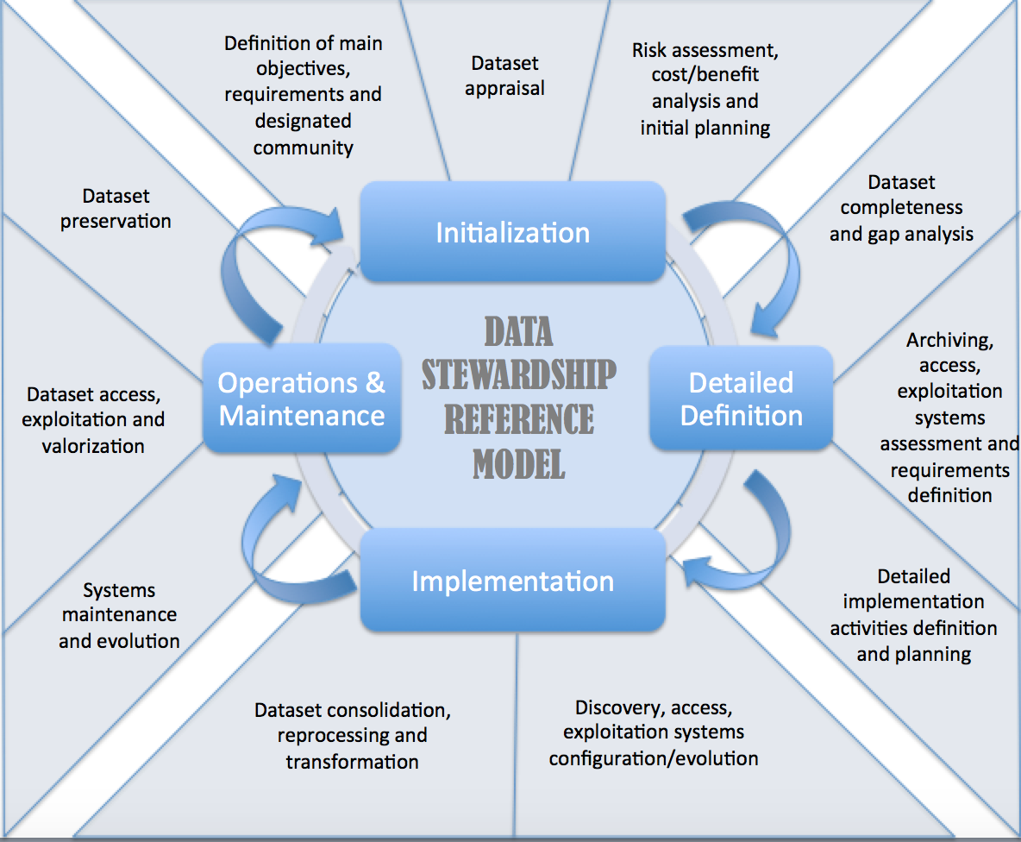
WGISS Data Stewardship Reference Model - Activities

Slide 4
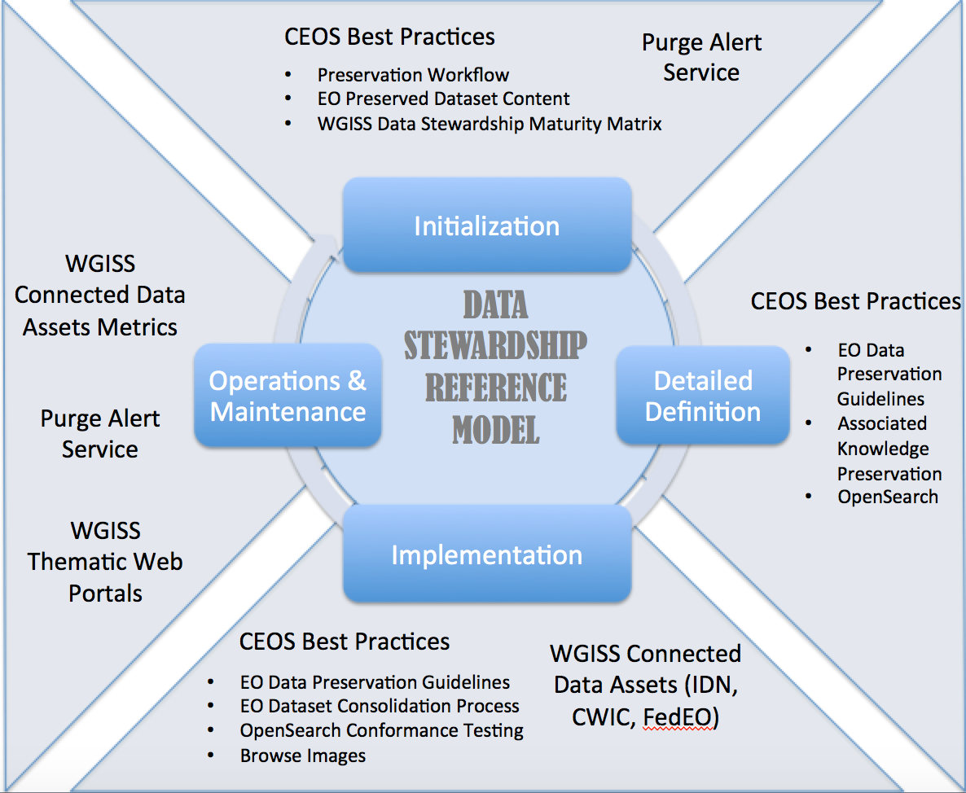
WGISS Assets Supporting Data Stewardship

Slide 5
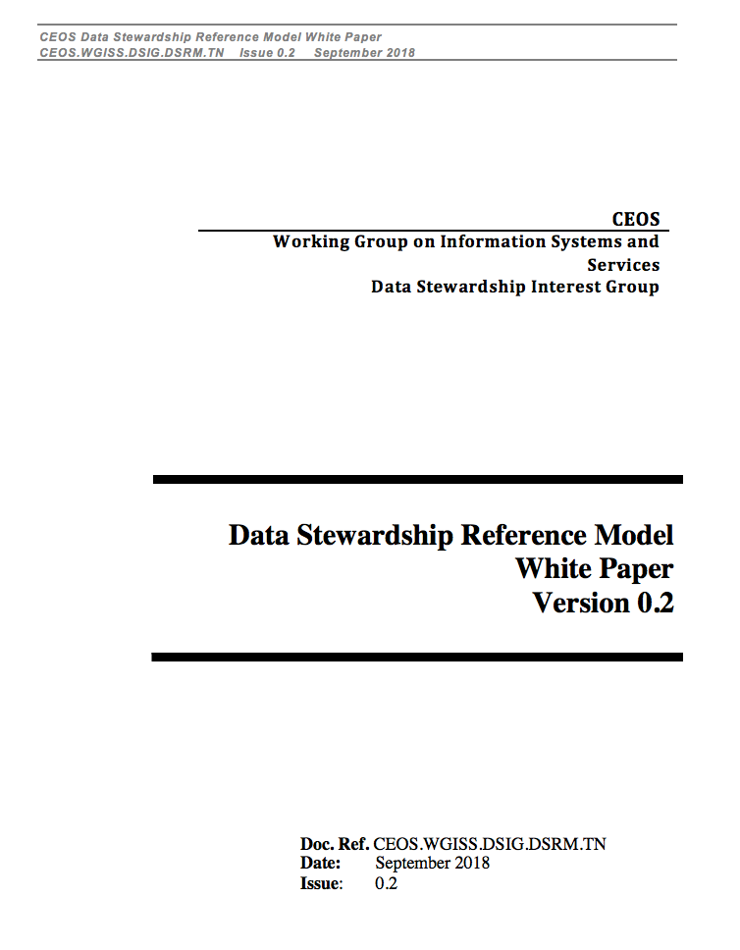
Data Stewardship Reference Model – White Paper

Slide 6
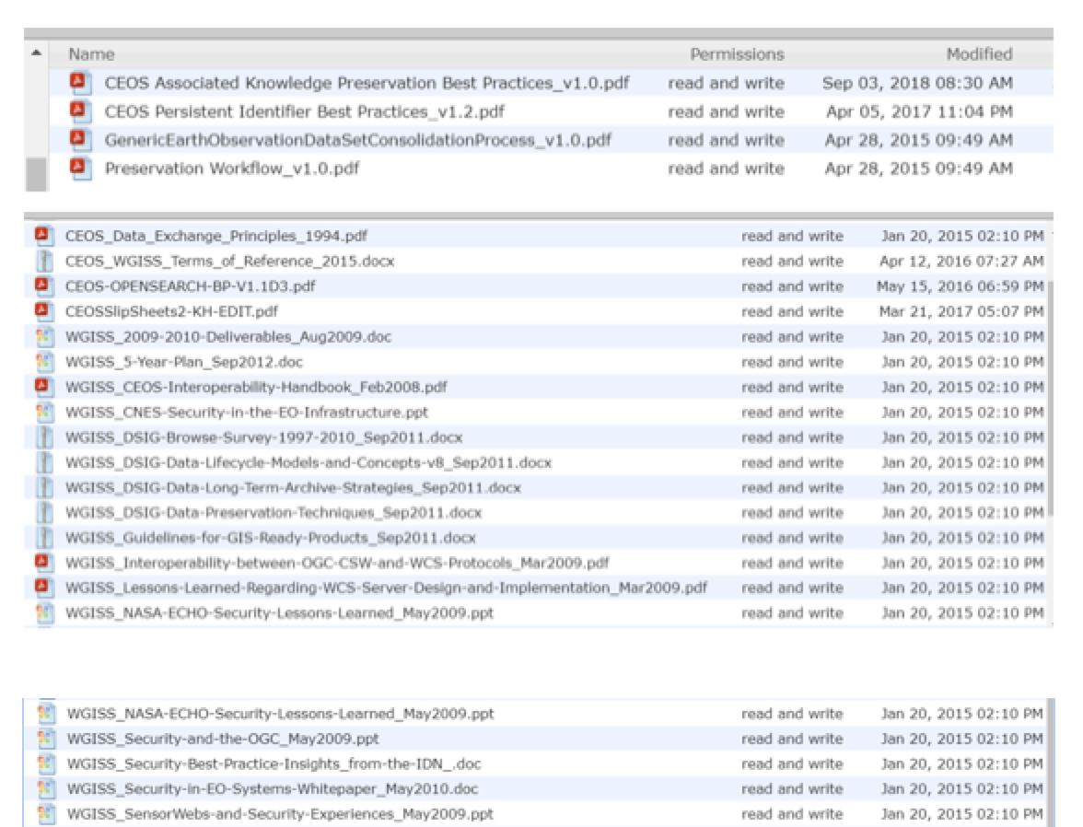
WGISS Assets Supporting Data Stewardship – Content
The WGISS Assets distinguished in two categories:
Best Practices and White Papers:
EO Data Glossary of Acronyms and Terms
EO Data Preservation Guidelines
CEOS Preserved Data Set Content Best Practices
Generic EO Data Set Consolidation Process
CEOS Persistent Identifiers Best Practices
CEOS Associated knowledge Preservation Best Practices
EO Data Purge Alert Procedure
…
Systems and services:
WGISS Connected Data Assets:
- IDN
- FedEO
- CWIC
- Open Search
Purge Alert Service
WGISS Thematic Web Portals
…

Slide 7
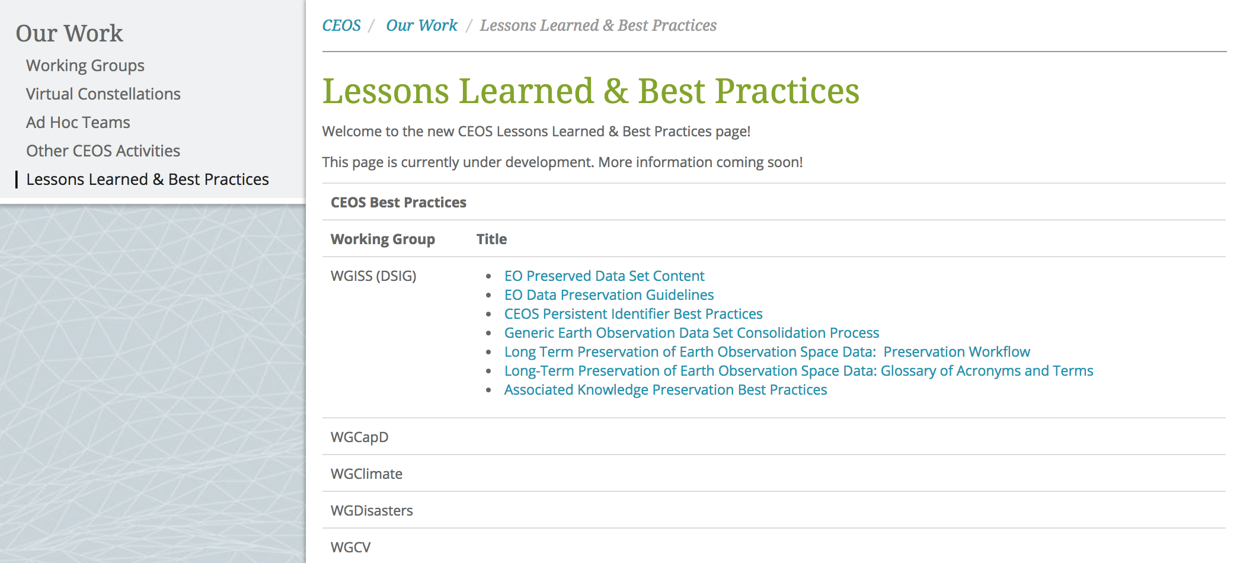
WGISS Agencies Contribution

Slide 8
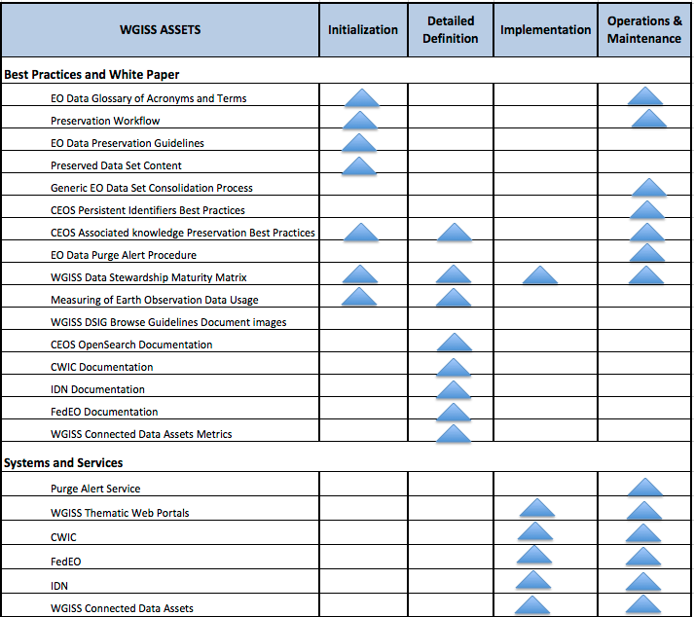
WGISS Assets Supporting Data Stewardship – Roadmap

Slide 9
WAY FORWARD
White paper structure
White paper completeness
Graphical representation
Closure of the action relating to the Assets confirmation
The Final Data Stewardship Reference Model white paper will be circulated for review

