Slide 1


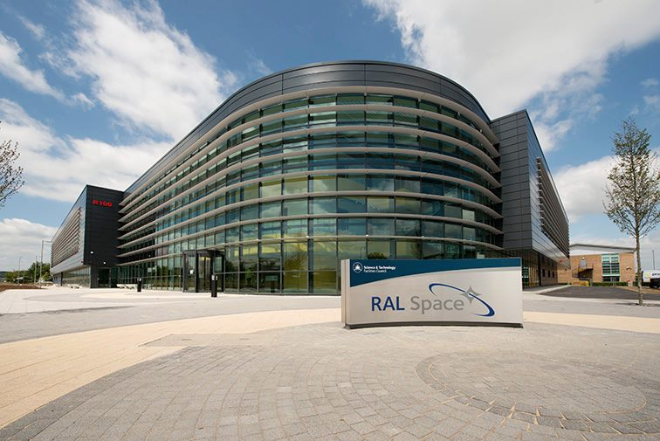
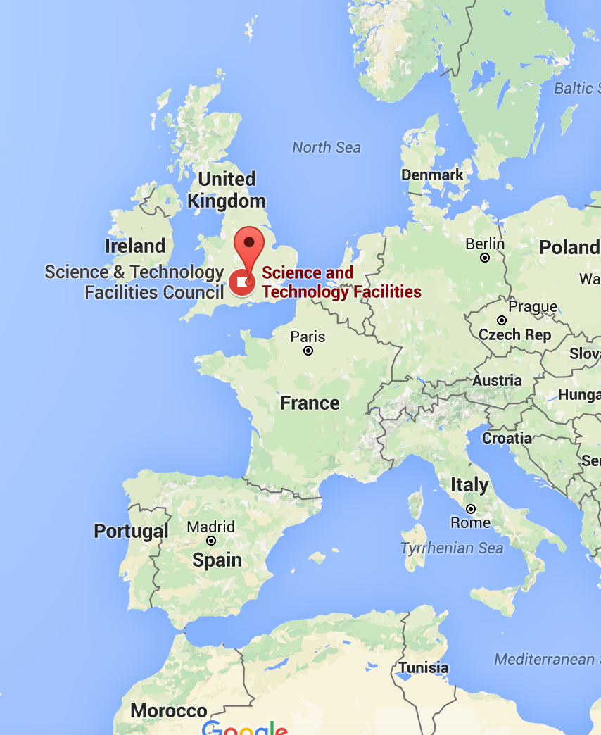


2018
WGISS - 46 Munich u
Esther Conway (STFC/NCEO), Uzma Ali (UKSA) and Iolanda Maggio (ESA)

Slide 2

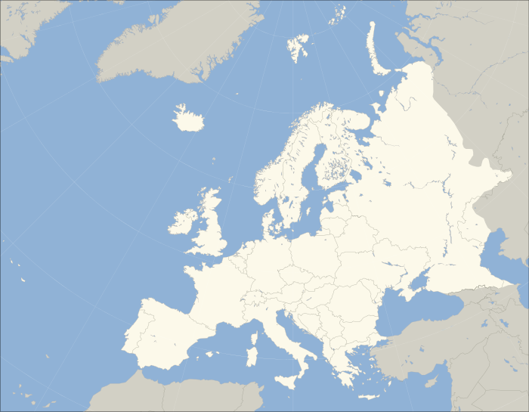
History of PV Conference SERIES
CNES in Toulouse (PV 2002)
ESA-ESRIN in Frascati (PV 2004)
DCC in Edinburgh (PV 2005)
DLR in Oberpfaffenhofen (PV 2007)
ESA-ESAC in Madrid (PV 2009)
CNES in Toulouse (PV 2011)
ESA-ESRIN in Frascati (PV 2013)
EUMETSAT in Darmstadt (PV 2015)
UKSA in Harwell UK (PV 2018)

Slide 3

PV2018
Growing Conference
12 Invited Speakers
48 Oral presentations
22 Posters
69% Overseas
310 distinct authors
Over 200 participants
Science Disciplines
Earth Observation
High energy Physics
Astronomy
Environmental
Infrastructure
Space Weather
Planetary
Climate
Agriculture

Slide 4









Session 1: Data stewardship approaches to ensure long-term data and knowledge preservation and data standards.
Conference Objectives
Facilitate Science Archives and Data Service Providers sharing knowledge, experiences, and lessons learnt and best practices. In addition to fostering cooperation in the areas of Data Exploitation, Preservation and archived Data Stewardship.
Address key emerging issues for science archives including but not limited to Open Data, Big Data, Managing Heterogeneity, Data Management Planning, Data Usability, Exploitation and Impact
Provide a forum for organisations dealing with preservation of own data and value adding to present the status of their activities, plans and expectations. In PV2018 we particularly welcome input from a broad range of science archives and data providers. In addition to space data archives we would like to extend a special invitation to:
  Large science facilities from different domains to facilitate discussion of our common challenges
  Specialist science archives and data service providers who are integrating data with space based observation to produce innovative data services.
Adding Value and Preserving Data
Session 2: Adding value to data and facilitation of data use
Session 3 :Virtual Research Environments for science data exploitation and value adding
ddd
Session 4: Data preservation in practice: past (present) and future
For further Information Please contact:
Esther Conway esther.conway@stfc.ac.uk
Or visit the website: http://www.ceda.ac.uk/contact/pv2018/

Slide 5
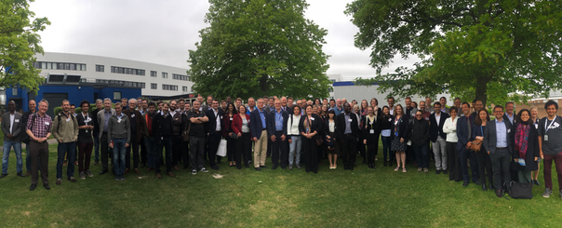
Rutherford Appleton Laboratory, Harwell UK, 15th -17th May 2018
Growing Conference Dedicated to Adding Value and Preserving Data
12 Invited Speakers
48 Oral presentations
22 Posters
69% Overseas speakers
310 distinct authors
Approx. 200 participants attending workshops, tours and main conference
PV2018 Conference Proceedings Published !
Visit: http://www.ceda.ac.uk/contact/pv2018/

Slide 6

Key Outcomes
Conference Proceedings: http://purl.org/net/epubs/work/37981055
Presentations Online: https://drive.google.com/drive/folders/16jckVPEikUKfS-lhZR5Xb2qWv-WEw6k_
Special PV2018 edition coming soon !

Slide 7
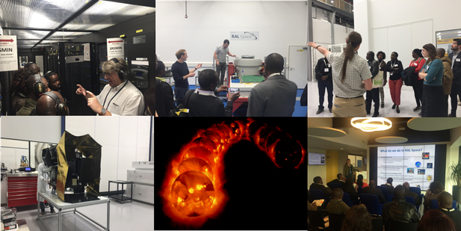
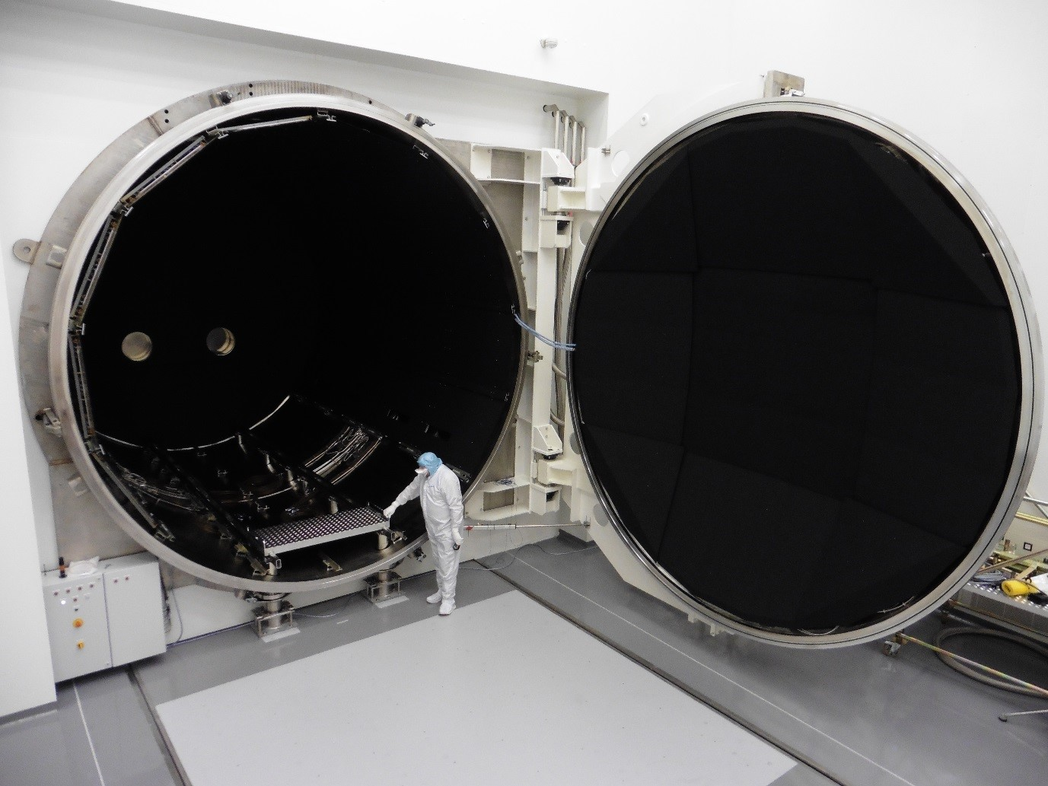

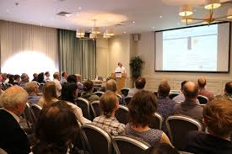
Events And Tours
Data Rescue Workshop
Data infrastructure for ODA countries Workshop
R100 Facilities Tour
Data Innovation and Exploitation Event

Slide 8
Session 1: Data stewardship approaches to ensure long-term data and knowledge preservation and data standards.
Session 1A : Chair Harald Rothfuss - EUMETSAT | Session 1B : Chair Brian Matthews - STFC
JASMIN, Providing a platform to support Data Analysis and the Creation of Virtual Research Environments | OAIS proposed new concepts
A Distributed Analytics Framework for Large-scale Heterogeneous Geoscience Data | ESA Data Preservation System
Data Stewardship Reference Lifecycle | British Geological Survey (BGS) Practices in Data Curation
Session 1C : Chair Thomas Stein - NASA PDS | Session 1D: Chair David Giaretta - CCSDS
Data Policy of Institute of Space and Astronautical Science (ISAS) at JAXA | Evolution of CNES tools and processes for long term preservation of space science data
Developing improved workflows and tools for preserving and exploiting environmental research data – a case study from the NERC National Geoscience Data Centre (NGDC) | Semantic framework for responsible digital preservation policy
A Standard Reference Model for Planetary Science Data Archives | Database Archiving and Big Data Techniques from the E-ARK project

Slide 9
Session 2: Adding value to data and facilitation of data use
Session 2A: Chair Christophe Arviset - ESA ESAC | Session 2B: Chair Alison Waterfall - CEDA
Giving access and value added services to CDPP historic data sets | Developing an Open Data Portal for the ESA Climate Change Initiative
Using machine learning to extract data from unstructured research data | Enhancing access to environmental research data for a wider user community
MASER: A Toolbox for low frequency radio astronomy | Policy, infrastructure, skills and incentives driving African data sharing: the African Open Science Platform Project
Session 2C: Chair Mark Jarman - Satellite Applications Catapult | Session 2D: Chair Nancy Ritchey - NOAA
Pioneering Steps towards Use of Data-cubes in the Global Earth Observation System of Systems | Data Rescue Workshop at PV2018
Data Cube as a National Geo-spatial Information System | Sharing Earth Observation Data on the Web
The AgroMet Data Cube: Developing Smart Data Access for Pest Risk Research and forecasting | Sustainable management of agricultural research data: A case for Big Data platform development for climate Smart Agriculture in Kenya

Slide 10
Session 3 2017: Virtual Research Environments for science data exploitation and value adding
Session 3A: Chair Phil Kershaw - STFC | Session 3B: Peter Allan - STFC
The NERC Data Labs Initiative | Virtual European Solar & Planetary Access (VESPA): a Virtual Observatory in Planetary Science
The Data Distribution Centre of the Intergovernmental Panel on Climate Change | Virtual Planetary Space Weather Services offered by the Europlanet H2020 Research Infrastructure
PROBA-V MEP and TERRASCOPE: bringing the users closer to the data | EVER-EST: The Platform allowing scientust to cross-fertilize and cross-validate data
Session 3C : Chair Iolanda Maggio - RHEA/ESA ESRIN | Session 3D: Chair Mirko Albani - ESA ESRIN
Building an Infrastructure for Climate Model Archives | Enabling the use of NOAA Open Data through Partnerships with Commercial Cloud Platforms
ESA’s Research and Service Support as a Virtual Research Environment for Heritage Mission data valorisation | Designing DAFNI : a national facility for modelling infrastructure
VRE for meteorological and climatic processes analysis | NASA’s Earth Observing Data and Information System – Near-Term Challenges

Slide 11
Session 4: Data preservation in practice: past (present) and future
Session 4A : Chair Eberhard Mikusch - DLR | Session 4B: Chair Sam Pepler - CEDA
Collaborative Long-Term Data Preservation: From Hundreds of PB to Tens of EB | Sentinel Data Archiving at ESRIN
20-years of ESA space science data archives management | 40 years of Dundee Satellite Receiving Station's EO data archive
The Norwegian National Ground Segment; Preservation, Distribution and Exploitation of Sentinel data. | Stewardship Maturity Model for NOAA’s OneStop Project
Session 4C - Chair Christophe Arviset - ESA ESAC | Session 4D: Chair Jamie Shiers - CERN
Adding value and facilitating data reuse: the case of the 4TU.Centre for Research Data | Building the Data Management Plan of Observatoire de Paris
Audit and Certification of Trustworthy Digital Repositories - lessons learned | ESA Space Data and Associated Information Long Term Preservation, Discovery and Access.
Digitizing analog spectrograms recorded on 35 mm film rolls on the Nançay Decameter Array from 1970 to 1990 | Embedding Research Data Management Support in the Scholarly Publishing Workflow

Slide 12
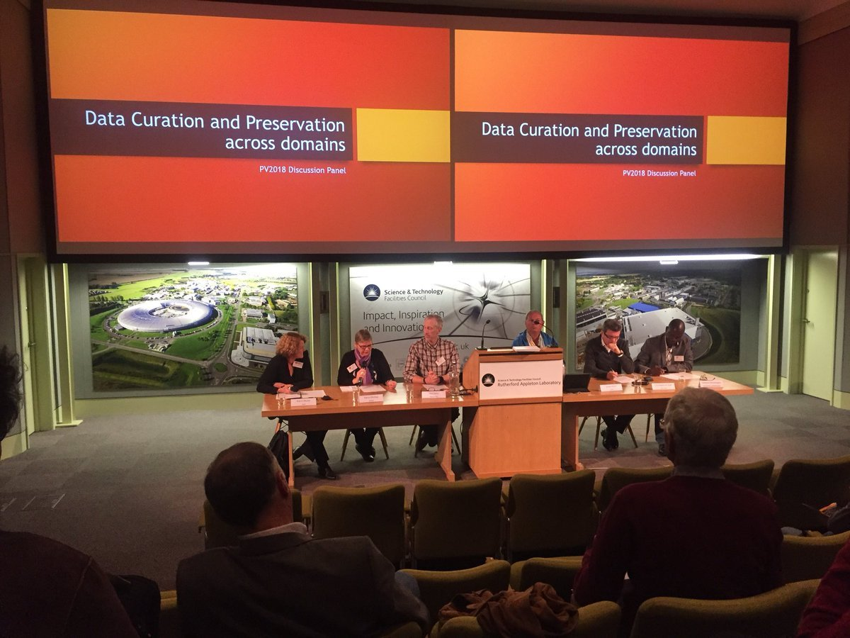
Data Curation and Preservation Across DOMAINs – DISCUSSION PANEL
Chair: Katrin Molch - DLR
Nancy Ritchie - NOAA
Tom Stein – NASA PDS
Jamie Shiers – CERN
Christophe Arviset – ESA ESAC
Tshiamo Motswega – University of Botswana

Slide 13
CEOS WGISS Keynote

Slide 14

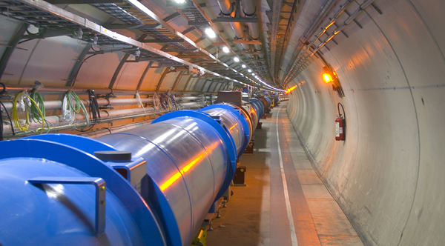
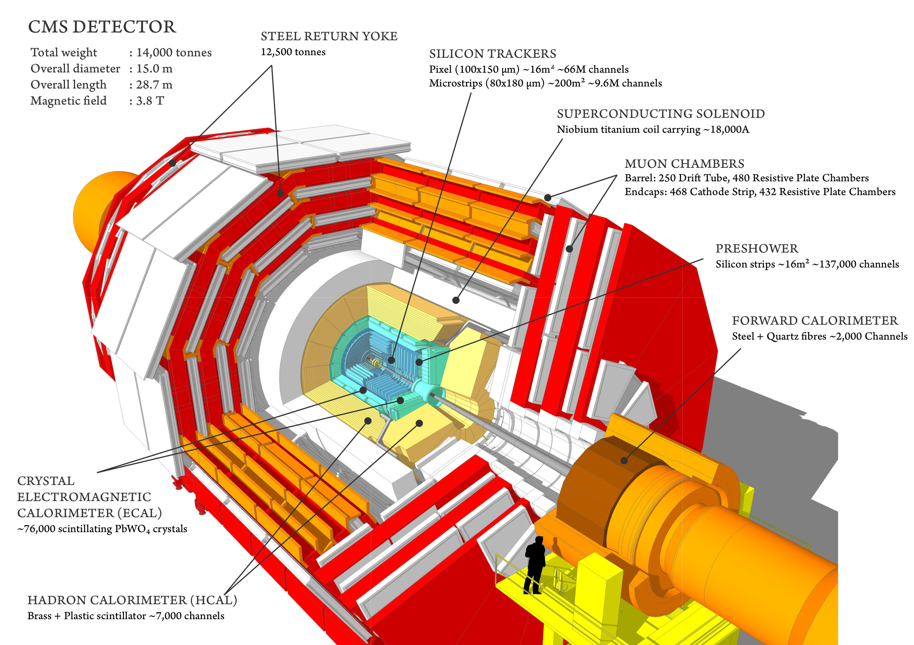
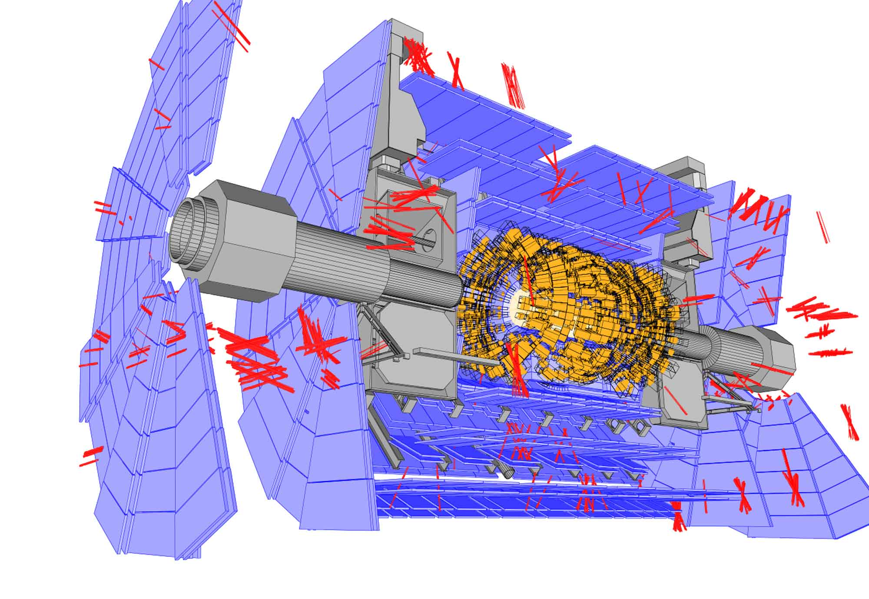
PV2020 @ CERN

Slide 15
PV2018 Conference Proceedings Published !
For further Information Please contact Esther Conway esther.conway@stfc.ac.uk
Or visit the website: www.ceda.ac.uk/contact/pv2018/

