Slide 1
Knowledge Sharing Opportunities: Conferences LIVING PLANET 2019
WGISS#46 Meeting,
DLR Oberpfaffenhofen, Germany
22nd October 2018,

Slide 2
LIVING PLANET 2019 CONFERENCE

Slide 3
LIVING PLANET 2019 CONFERENCE - Objectives

Slide 4
LIVING PLANET 2019 CONFERENCE - Themes
SESSIONS OVERVIEW: https://az659834.vo.msecnd.net/eventsairwesteuprod/production-nikal-public/30a5b66e0d3a40dfa6aa5d6038f3bb47

Slide 5
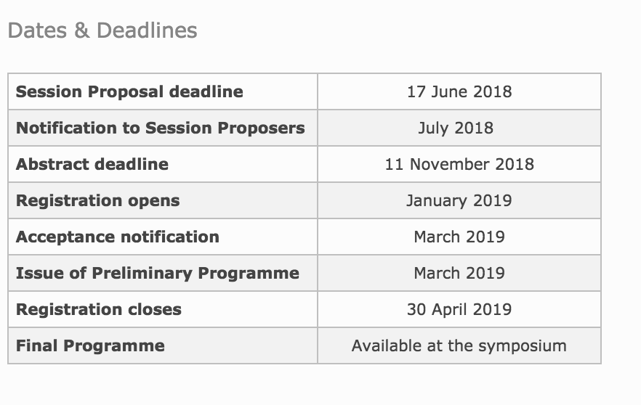
LIVING PLANET 2019 CONFERENCE – Dates & Deadlines
SESSIONS OVERVIEW: https://az659834.vo.msecnd.net/eventsairwesteuprod/production-nikal-public/30a5b66e0d3a40dfa6aa5d6038f3bb47

Slide 6
Thank You !!

