Slide 1
Working Group on Information Systems and Services (WGISS)
Committee on Earth Observation Satellites
Mirko Albani, ESA, WGISS Chair
WGISS#46 Meeting
GEOSS-WGISS Interoperability and Future Data Architectures – Introduction
DLR – Oberpfaffenhofen, Germany
24th October 2018

Slide 2
WGISS-GEOSS Interoperability & FDA WORKSHOP - Scope
This workshop addresses interoperability aspects between CEOS WGISS and the Global Earth Observation System of Systems (GEOSS) taking stock of the recent development in the frame of CEOS Future Data Architectures (FDA).

Slide 3
CEOS WGISS Contribution to GEOSS
GEOSS Platform accessing WGISS CDA infrastructure for CEOS agencies data discovery and access
Participation & support to GEOSS Data Providers Workshops (e.g. “User Metrics” session, May 2018)
WGISS represented in NextGEOSS Advisory Board and Working with NextGEOSS on federated authentication technology solutions
Joint Workshop on GEOSS-WGISS interoperability and FDA at WGISIS#43 and WGISS#46
WGISS representative will be proposed as member of the GEOSS Expert Advisory Group
WGISS contributing to GEOSS-EVOLVE initiative
WP 1: GEOSS Architecture and Evolution
WP2: Functional Testing
WP 3: Data Management Principles
WP 5: Demonstrations Projects
WP 6: Community Portals

Slide 4
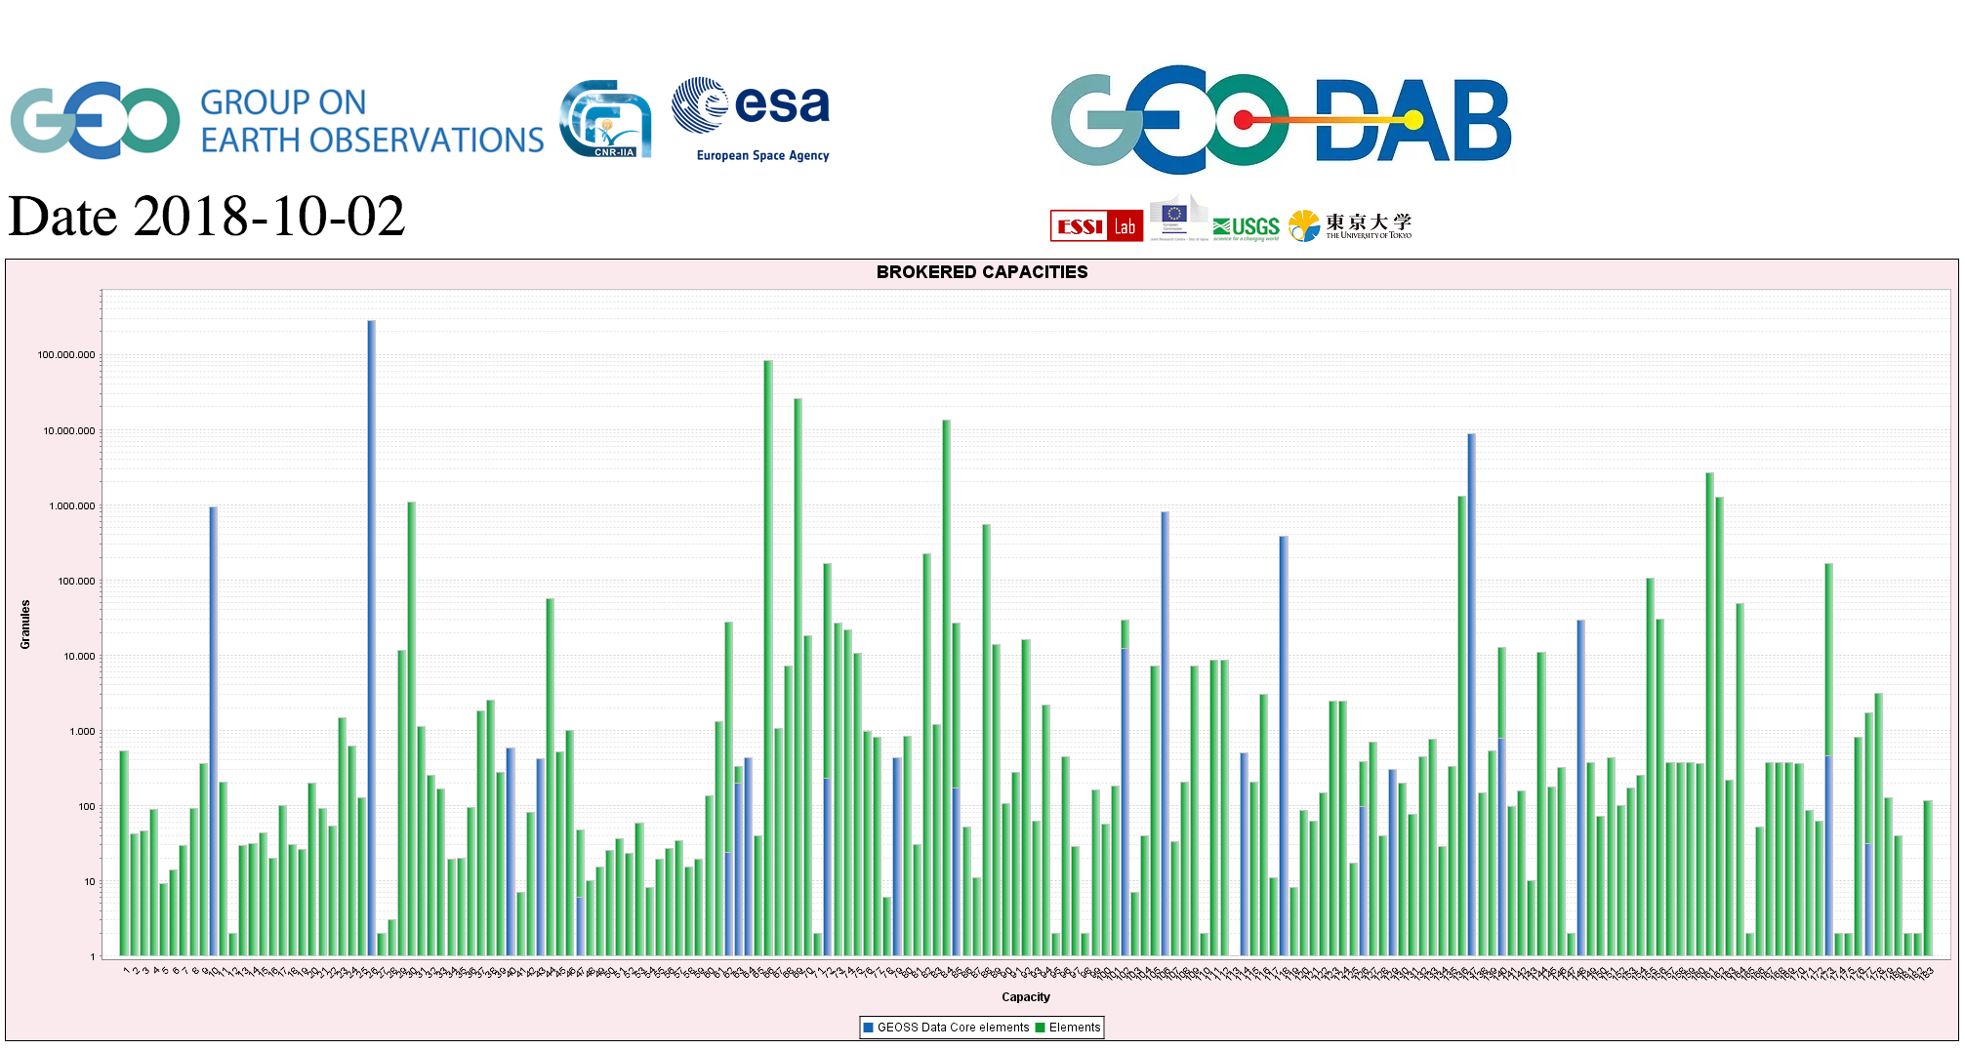
CEOS data in GEOSS
GEOSS PLATFORM DISCOVERABLE DATA PRODUCTS
CWIC
FedEO

Slide 5
Background - WGISS#43, NASA, Annapolis
Possible synergies between CEOS WGISS and
AmeriGEOSS in the areas of outreach and education, data and products, applications and tools, and use cases.

Slide 6
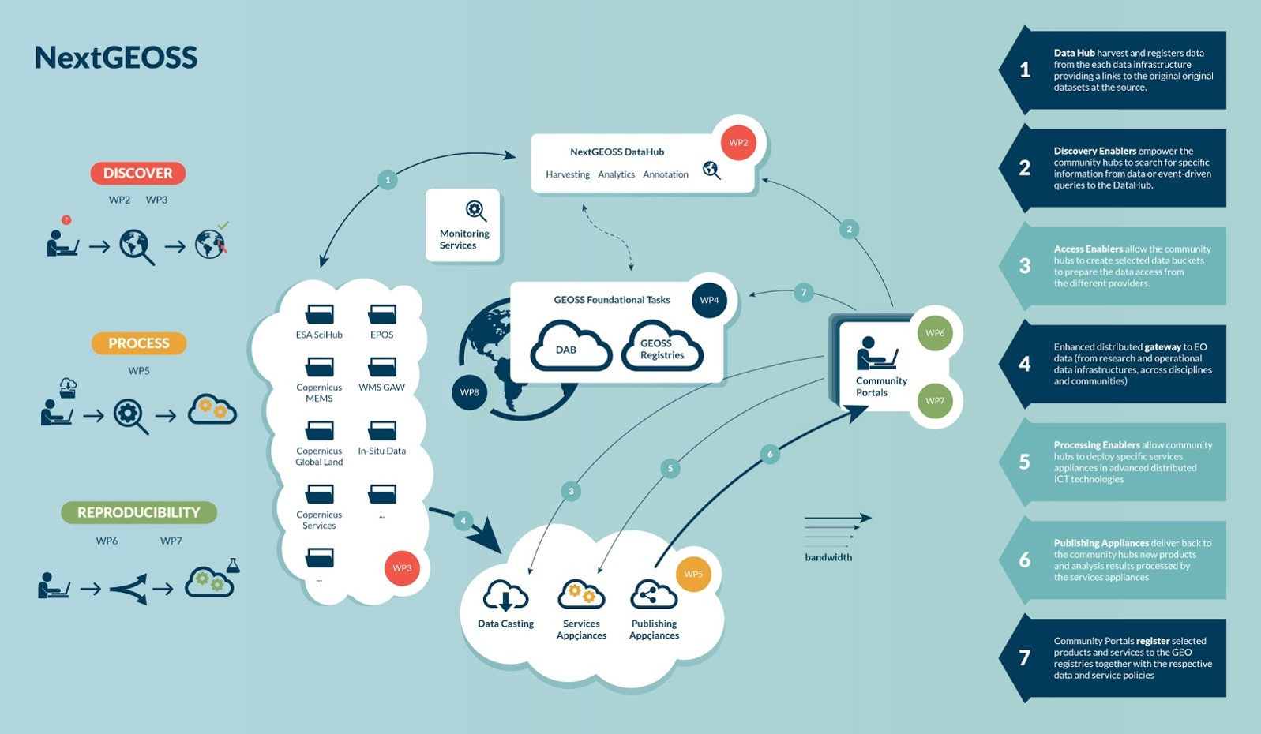
Background - WGISS#43, NASA, Annapolis
WGISS is now represented on the NextGEOSS Advisory Board
Working with NextGEOSS on federated authentication technology solutions
NextGEOSS Architecture and interoperability: data hub,
discovery and access enablers, and enhanced distributed
gateway to EO data, processing enablers, publishing appliances, and community portals.

Slide 7
Workshop Objectives
Strengthen interaction and coordination between WGISS and GEOSS at technical level.
Identify additional topics where we could work together and maximise outputs and impact.
Discuss and define CEOS WGISS contribution in shaping the evolution and future vision of GEOSS as a whole and in particular for what concerns ground segment systems and platforms (i.e. Future data Architectures).
Define a WGISS-GEOSS (Action) Plan and schedule periodic teleconferences to monitor progress in the activities.

Slide 8
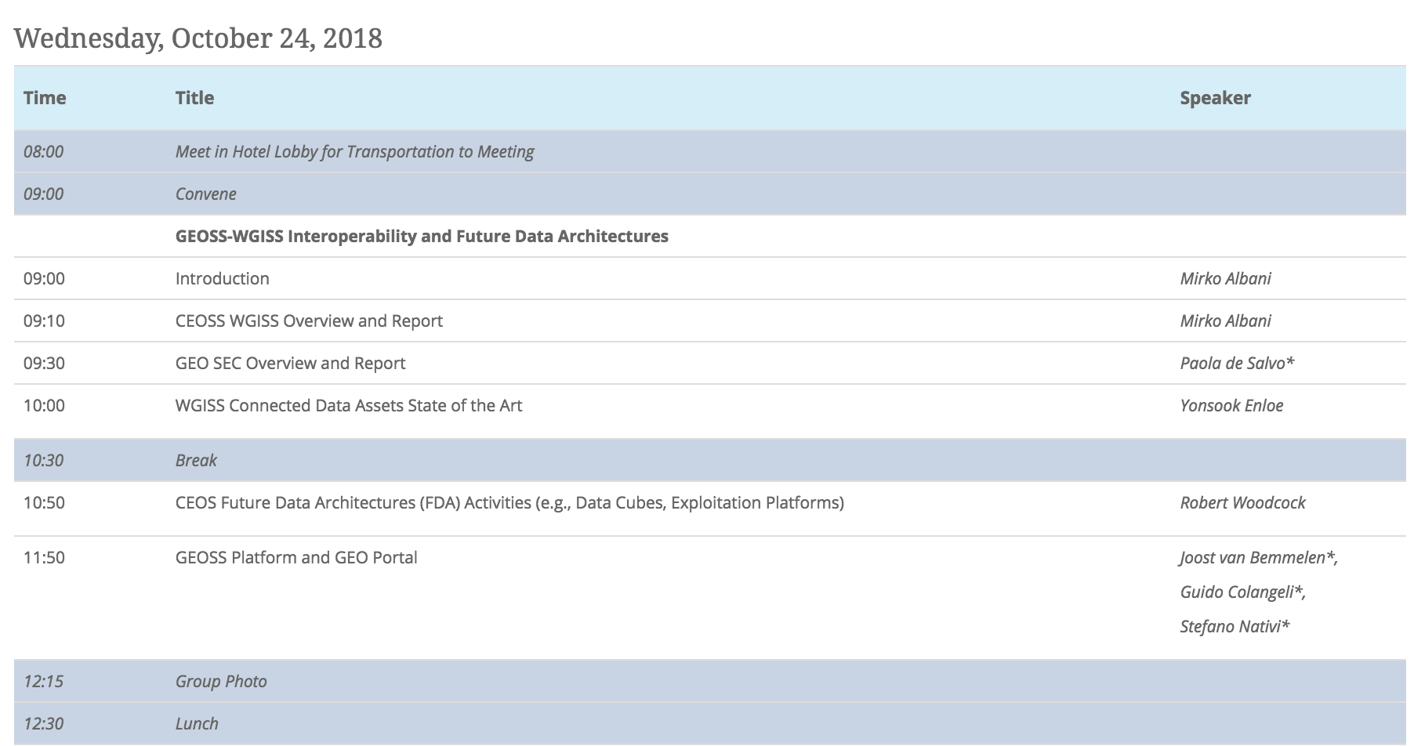
WGISS – GEOSS Interoperability & FDA - Agenda

Slide 9
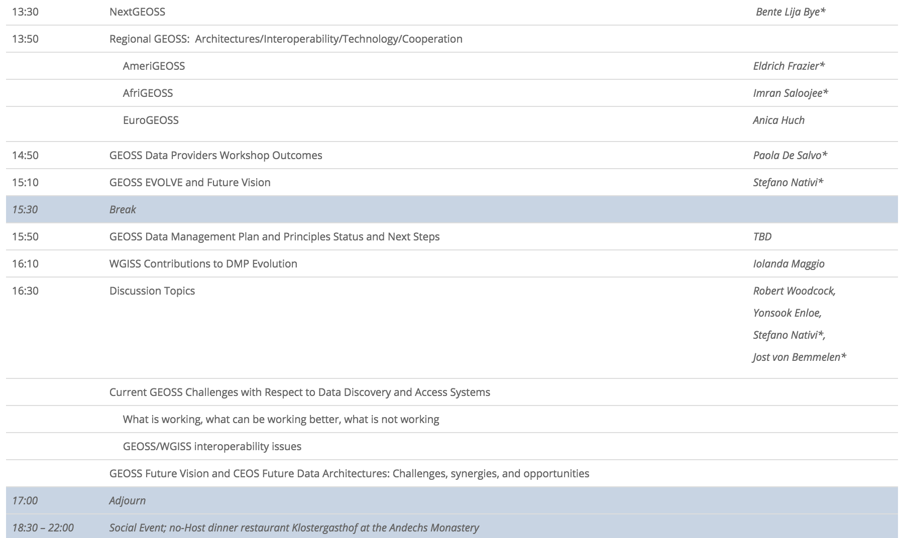
WGISS – GEOSS Interoperability & FDA - Agenda

