Slide 1

WGISS - Working Group for Information Systems and Services
Committee on Earth Observation Satellites
Mirko Albani-ESA
WGISS#46 Meeting
GEOSS- WGISS Interoperability and FDA
DLR, Oberpfaffenhofen, Germany
24th October 2018

Slide 2
WGISS Scope
WGISS (The Working Group on Information Systems and Services) is a subsidiary body supporting CEOS.
  Promotes collaboration in the development of systems and services that manage and supply Earth Observation data;
  Creates and demonstrates prototypes supporting CEOS and Group on Earth Observation (GEO) requirements;
  Addresses the internal management of EO data, the creation of information systems and the delivery of interoperable services.
The activities and expertise of WGISS span the full range of the information life cycle from the requirements and metadata definition for the initial ingestion of satellite data into archives through to the incorporation of derived information into end-user applications.
Notes:
Recent advances in technology open the floor for new and innovative approaches for data exploitation and use and require an adaptation and evolution of the approaches, infrastructures and services provided by CEOS agencies. WGISS contribution and role in providing a forum for technical exchange and sharing, and for the definition and prototyping of common and interoperable approaches and architectures for data management and exploitation will become more and more central for CEOS agencies and for CEOS as a whole in support to the achievement of its objectives

Slide 3
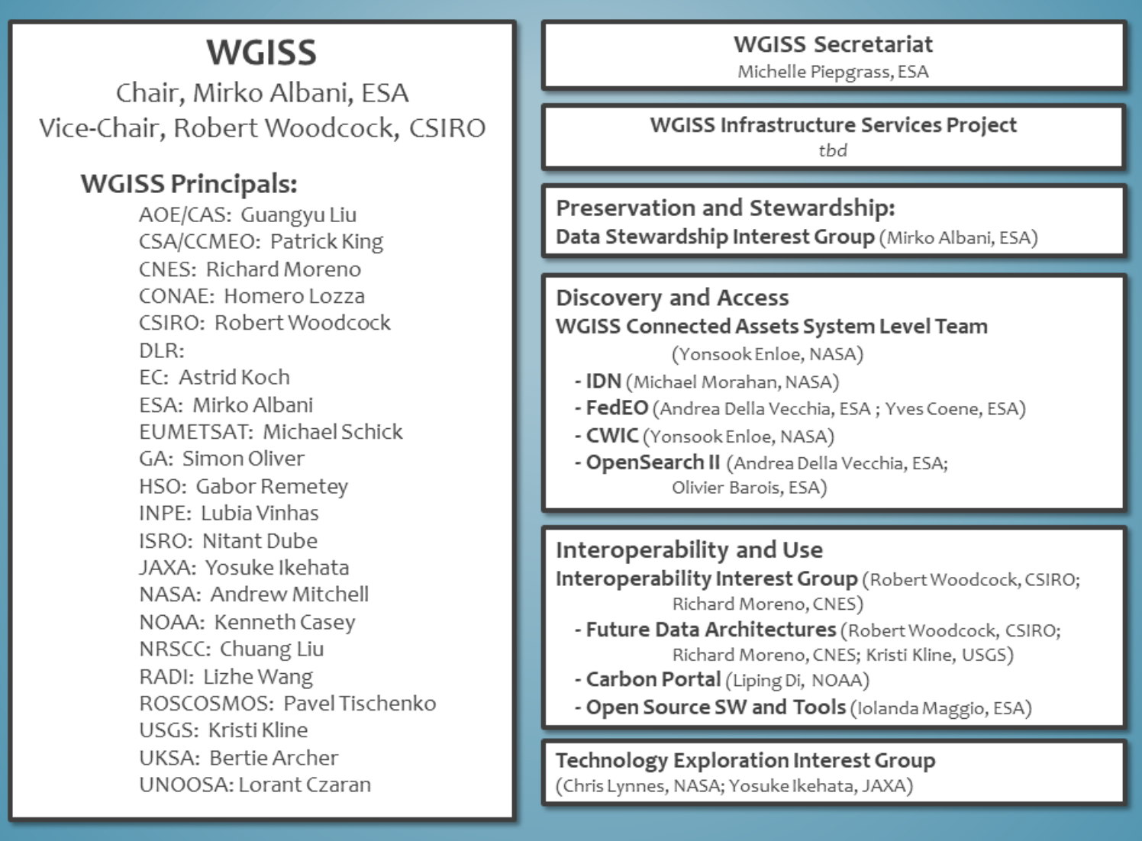
WGISS Structure

Slide 4
Outline
Data Preservation and Stewardship
Data Discovery and Access
Interoperability and Use (including FDA)
Technology Exploration

Slide 5



Data Stewardship Interest Group
WGISS accomplishes its Data Preservation and Curation efforts through the Data Stewardship Interest Group (DSIG)

Slide 6






Data Stewardship Best Practices
Document Tree
Policy Documents
Individual organizations'
policies (stewardship, access, ...)
EO Data Stewardship
Cooperative Framework
Applied to
CEOS EO Space Data Sets
Data Purge Alert Procedure & White Paper
High level framework documents
Applied to
Technical Documents
Preservation Workflow
Glossary of Acronyms and Terms
General guidelines and best practices
Support
Persistent Identifiers Best Practice
EO Data Preservation Guidelines
Preserved Data
Set Content
Associated Knowledge Preservation
CEOS Maturity Matrix
Reference Model for Data Stewardship
Guidelines and best practices on specific topics & Technical implementation procedures
EO Data Set
Consolidation Process
Measuring EO
Data Usage
Image Source: http://eastenders.wikia.com/wiki/File:Under-construction.png

Slide 7
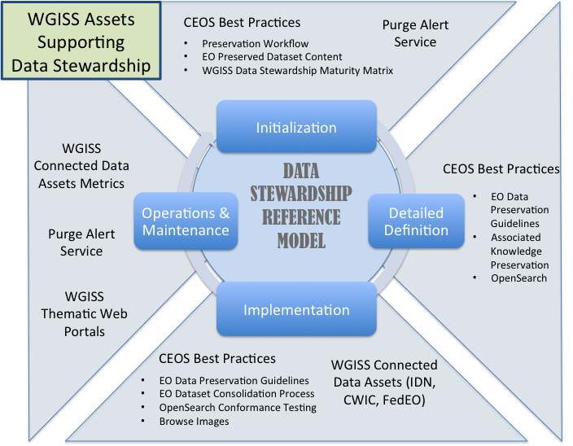
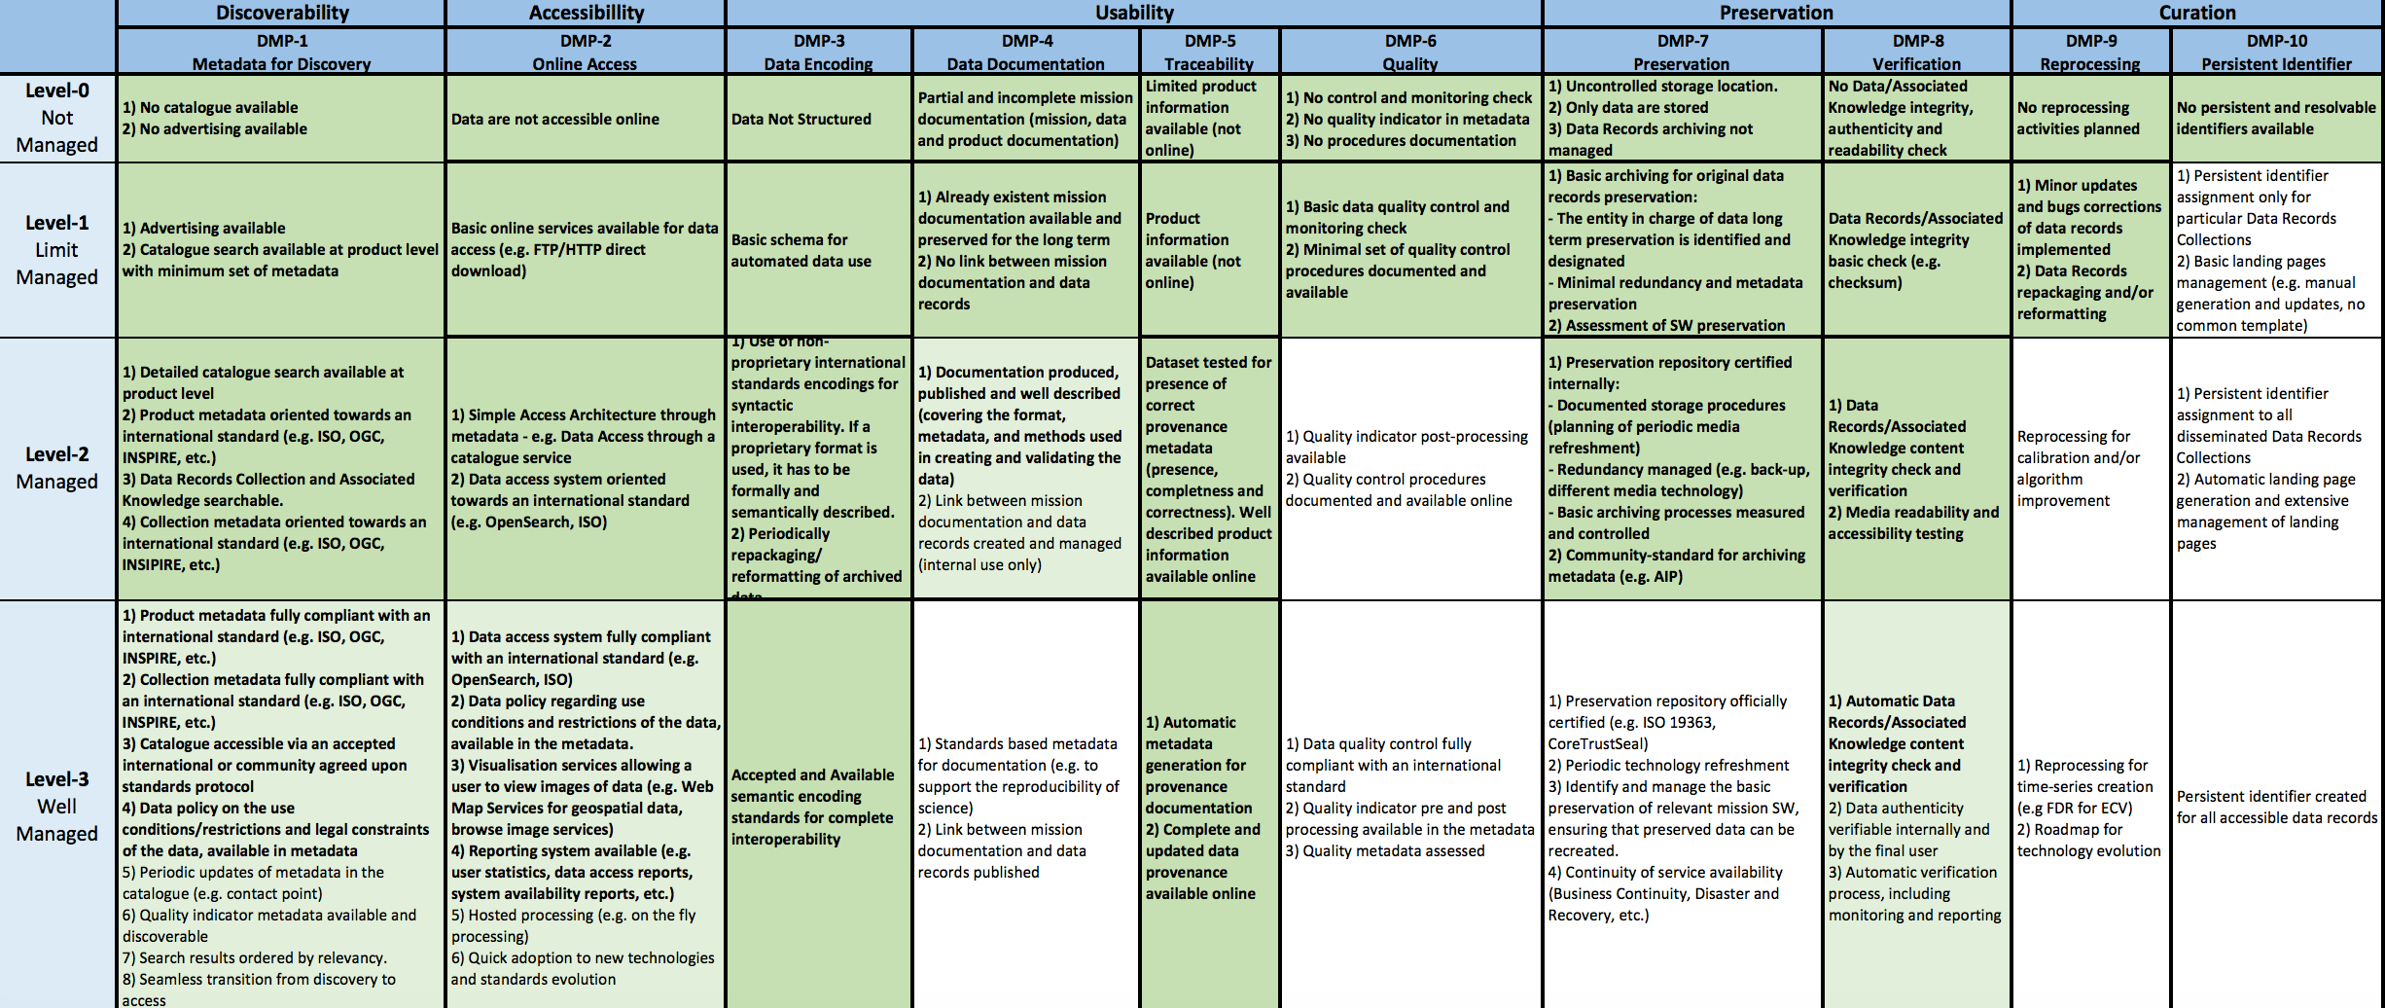
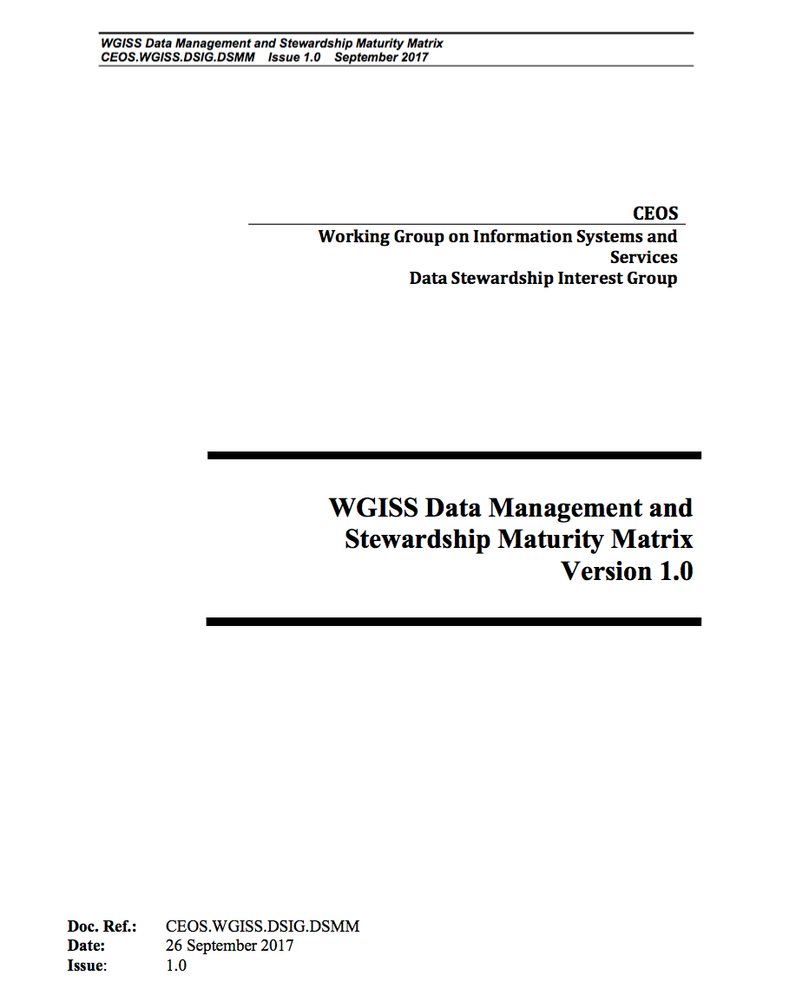
Data Stewardship Interest Group
Latest Outcomes
Reference Model for Data Stewardship
WGISS EO Data Stewardship Maturity Matrix

Slide 8


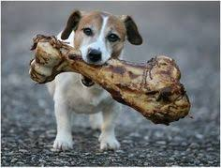
Discovery & Access
WGISS accomplishes its Data Discovery and Access efforts through the WGISS Connected Data Assets System Level Team (SLT)

Slide 9
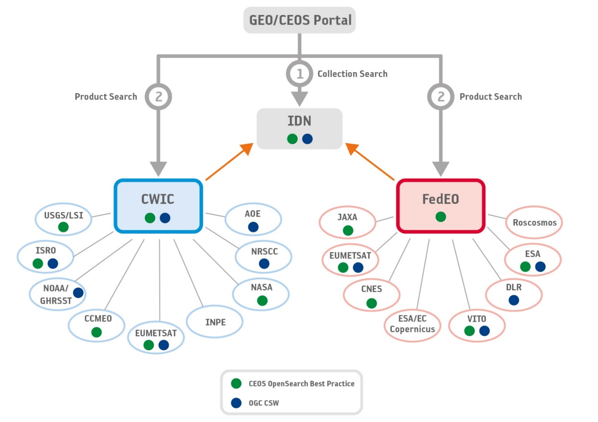
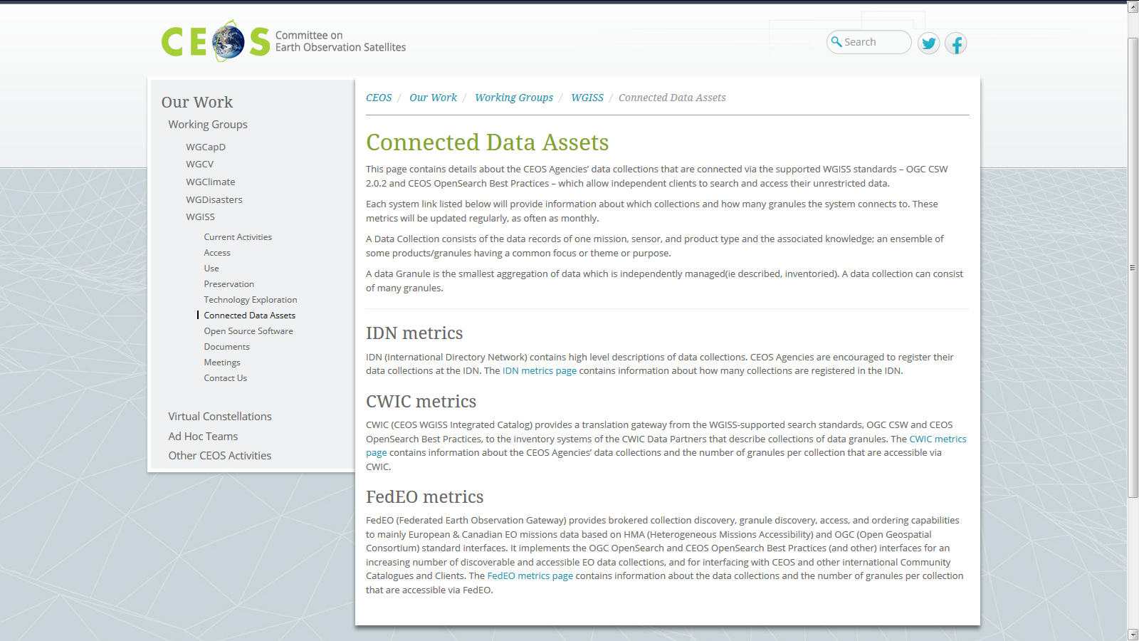
WGISS Connected Data Assets
Architecture
Relying on IDN/CWIC/FedEO components, provides a single entry point for external clients to discover and access CEOS agencies data. It is supported by the WGISS Connected Assets System Level Team (SLT)
Search over 32,000 collections in the IDN
Access over 5000 collections with associated over 300+ million granules (granule search)

Slide 10
WGISS Connected Data Assets (CDA)
System Level Team (SLT) coordinates maintenance and operations.
Client Portals:
  GEOSS Platform (GEO Portal)
  AMERIGEOSS Portal
  ESA EOPortal
  CEOS COVE Tool
  CEOS Carbon Portal
Being enlarged with new partners and continuously populated with additional data collections, for example:
  ECVs/CDRs in coordination with WGClimate, COVERAGE Team, CEOS Carbon Team
  ESA Heritage and Earth Explorer Missions (11 million granules)
  NOAA One Stop (over 100 million granules)
  National Remote Sensing Center of China (NRSCC) now active participant in WGISS CDA (35 millions granules)
Example IDN: DIF-9 to DIF-10 Transition Schedule
(2017-2018)
Sent Provider DIF-9 to DIF-10 QA/Triage Reports.
May 1, 2018
Start migrating existing non-NASA EOSDIS DIF-9 records to DIF-10.
2019 (First quarter)
Plan to have all metadata records transition.
Notes:
WGISS Connected Data Assets Operational Systems (IDN, CWIC, FedEO):
Is maintained and operated in coordination among different agencies (System Level Team) and implements the OpenSearch Interoperability Best Practice defined in WGISS.
Provides a single entry point for GEO (GEOPortal) to discover and access CEOS agencies data.
Is being enlarged with new partners and continuously populated with additional Collections (e.g. ECVs/CDRs inventories from WGClimate).

Slide 11
ECVs/CDRs Discovery and Access through WGISS Systems
913 ECV/CDRs from ECV Inventory V2.0
CURRENT
FUTURE
417
496
204 not in IDN
Progress and next steps
Providers and PoCs responsible of the 204 datasets not registered in IDN preliminarily contacted
First batch of datasets being addressed: will be registered by Q4 2018
Second batch will be addressed in coordination with WGClimate in the frame of ECV Inventory update to V3. Completion by Q4 2019
Notes:
Objective: facilitate discoverability and accessibility of ECV Products and space-born CDRs relevant for the CEOS Carbon Action via WGISS Interoperability Systems & Standards (FedEO/CWIC/IDN, OpenSearch).
Approach: start from results of WGClimate Questionnaire for ECV Inventory population; tailoring for Carbon Action and gaps identification wrt data records already discoverable/accessible through WGISS systems.
Additional Resources: support from WGClimate and experts for priorities setting; activities at data providers’ side to be carried out by relevant entities.
496 out of 913 considered (417 out of 913 not considered because future collections).
288 out of 496 registered in IDN with granule/product accessible via CWIC infrastructure
4 out of 496 registered in IDN with IDN granule/product accessible via CNES infrastructure
204 out of 496 not registered in IDN

Slide 12
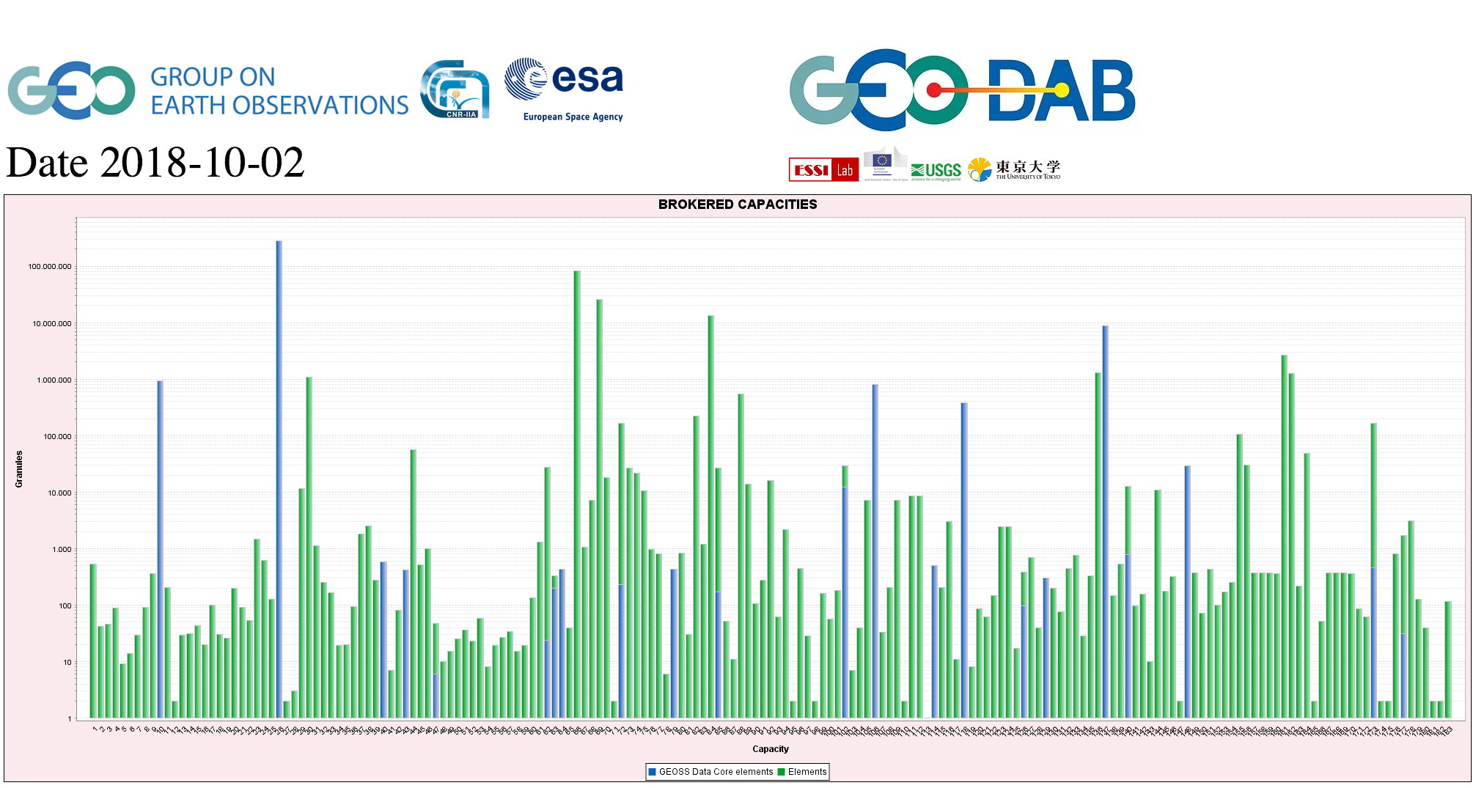
CEOS data in GEOSS
GEOSS PLATFORM DISCOVERABLE DATA PRODUCTS
CWIC
FedEO

Slide 13


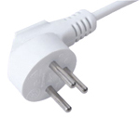


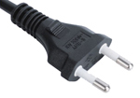










Interoperability and Use
Interest Group
WGISS accomplishes its interoperability and data use efforts through the Interoperability Interest Group.

Slide 14

FDA Themes supported via WGISS
CEOS Analysis Ready Data (ARD)
  Develop and provision CARD4L-compliant optical and/or SAR products
  Examine ARD for ocean and atmosphere domains
Interoperable Free and Open Tools
  Continue supporting the CEOS Data Cube (CDC) initiative
  Demonstrate new technologies through ongoing support of ‘pilot projects’ and consideration of alternate candidate architectures
Data, Processing, and Architecture Interface Standards
  Develop standards for pixel-level data discovery, access, and common analytical processing requests (e.g., cloud free mosaics of ARD) exploiting EO satellite data among various CEOS exploitation platforms
Analytical Processing Capabilities
  Prototype portable web-based analytical processing APIs/Web Services that work across CEOS exploitation platforms in full computing environments for time series and other analysis
User Metrics
  Develop a data use metrics framework through which agencies can contribute to how EO data is being used, rather than just downloaded data quantities

Slide 15
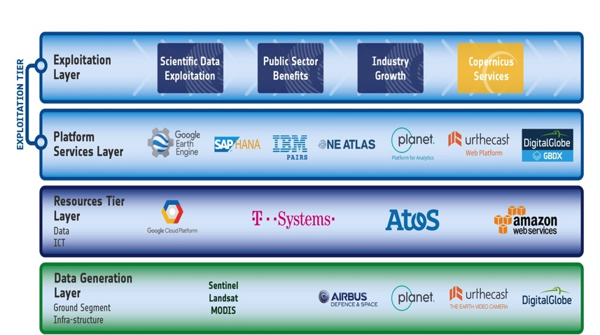
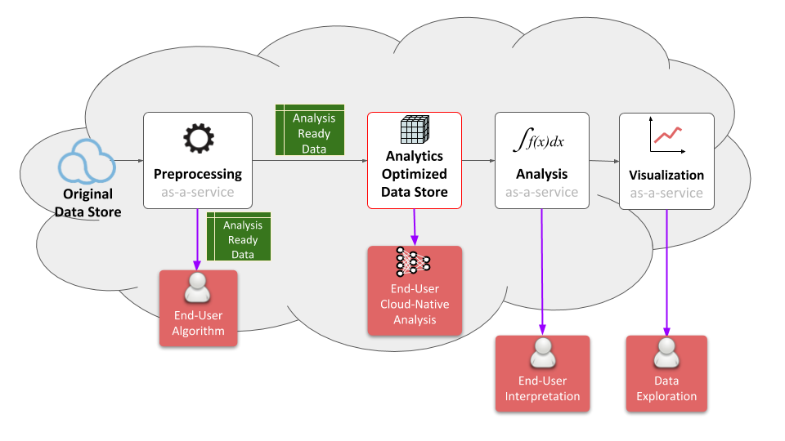
FDA Common Description
White Paper
Multiple viewpoints into the evolving FDA landscape:
  Enterprise, Information, Computation, Engineering, Technology
Building on WGISS Discovery and Access Infrastructure with a system wide view
Emphasis on what is changing: Analysis, Cloud, consumer EO
Notes:
WGISS is supporting the FDA ad-hoc team in the drafting of a white paper on to establish a common description of Future Data Architecture functional blocks and interfaces
There is large consensus that a common architectural model and terminology will:
facilitate interagency dialog
enable identification of interfaces
enable work on standardisation once interfaces identified
So we are working on a unified pretty diagram based on 5 viewpoints to convey all the necessary knowledge.
Building on WGISS Discovery and Access Infrastructure with a system wide view
Emphasis on what is changing: Analysis, Cloud, consumer EO
Technology and Engineering viewpoints link directly to the open source software and FDA inventory activities.

Slide 16
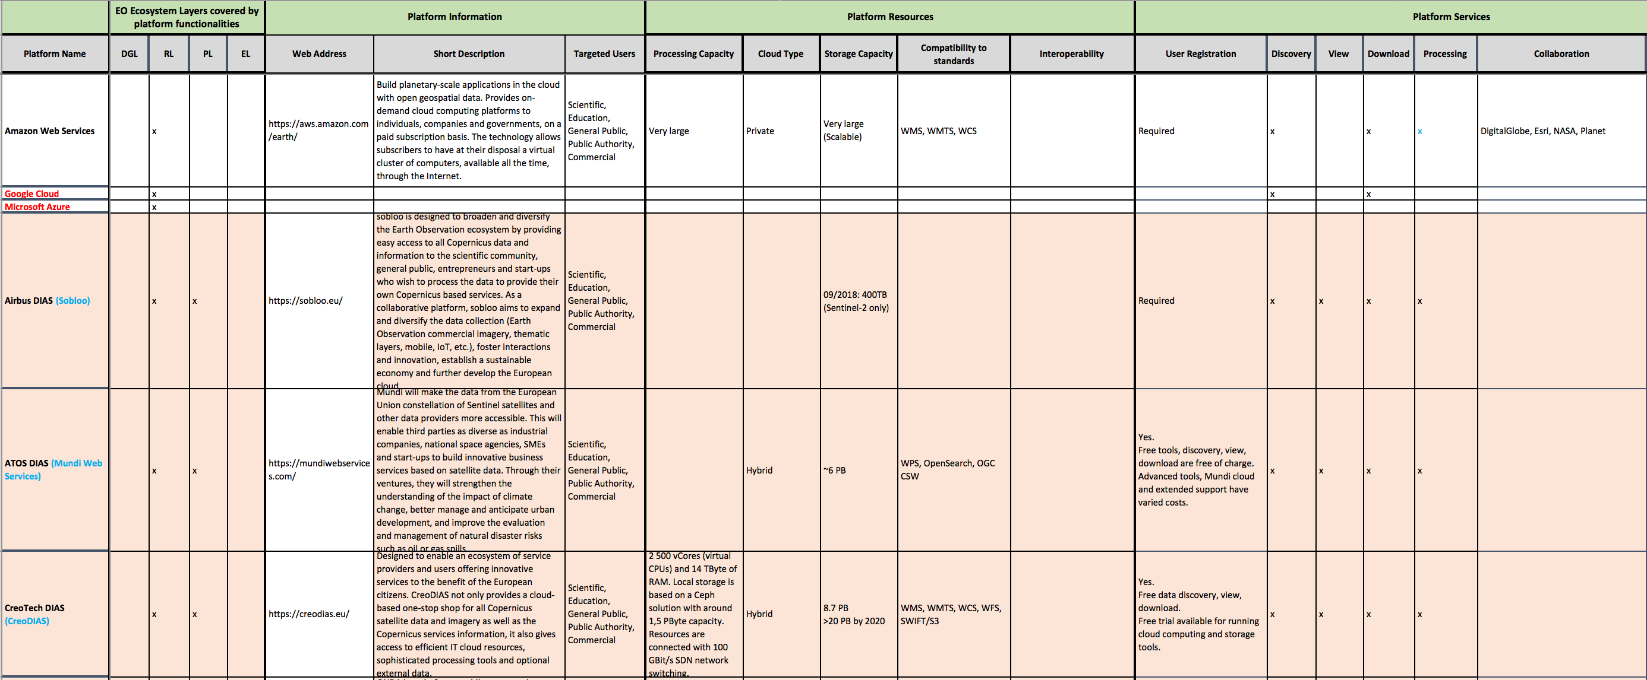
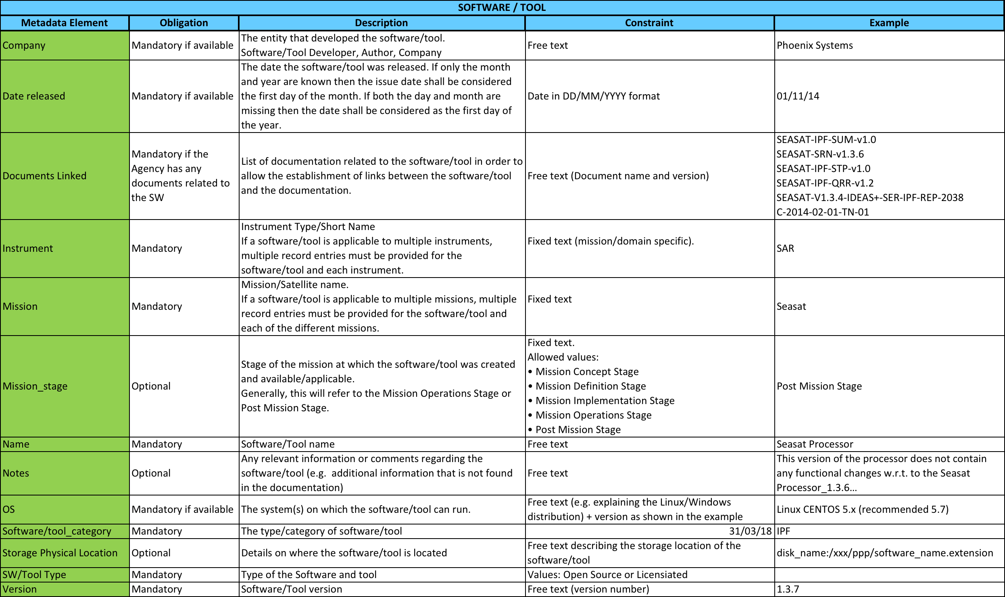
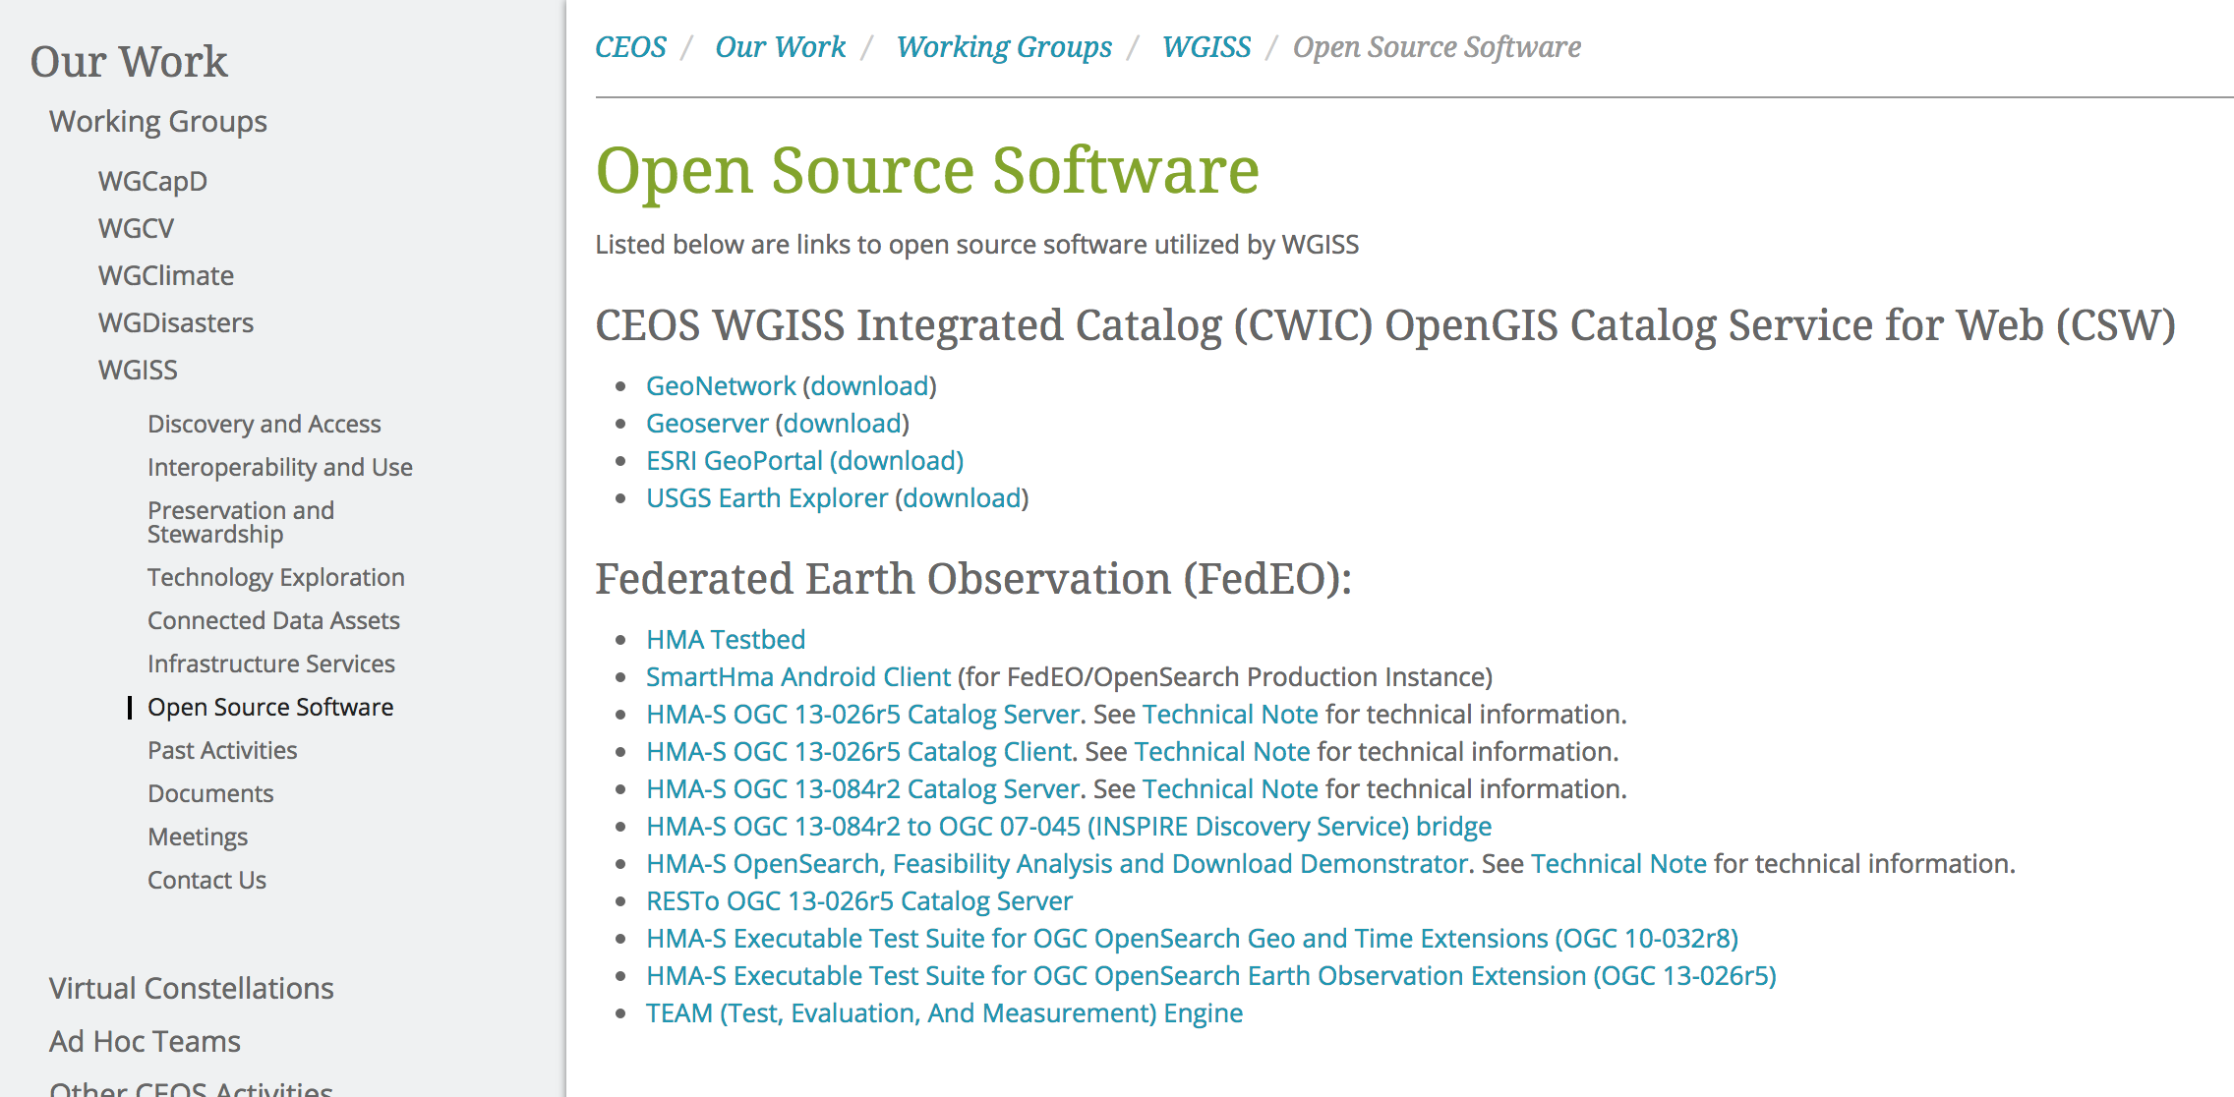
Inventories: 1) FDA Elements; 2) Open Source SW and Tools
Inventory of “EO use environments” to provide insight into the EO ecosystem: being filled-up with info collected from WGISS members
Inventory and tracking tool to access identified CEOS agencies SW and tools for data use being finalised
Notes:
Consensus that an inventory of “EO use environments” is a useful exercise that will provide insight into the EO ecosystem
Template defined in coordination with FDA-AHT
Inventory being filled-up with information collected from different sources

Slide 17
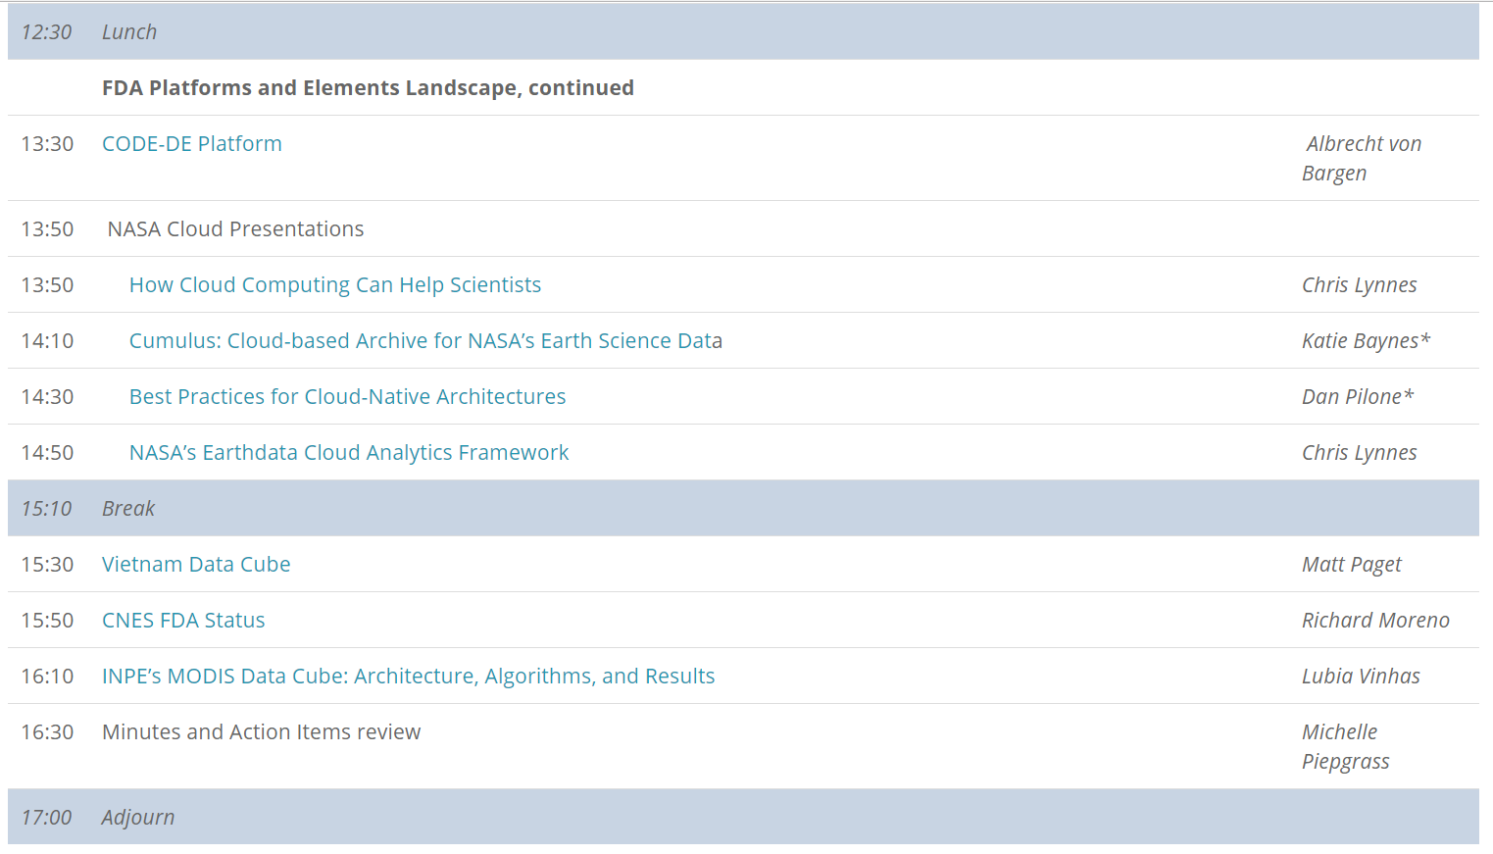
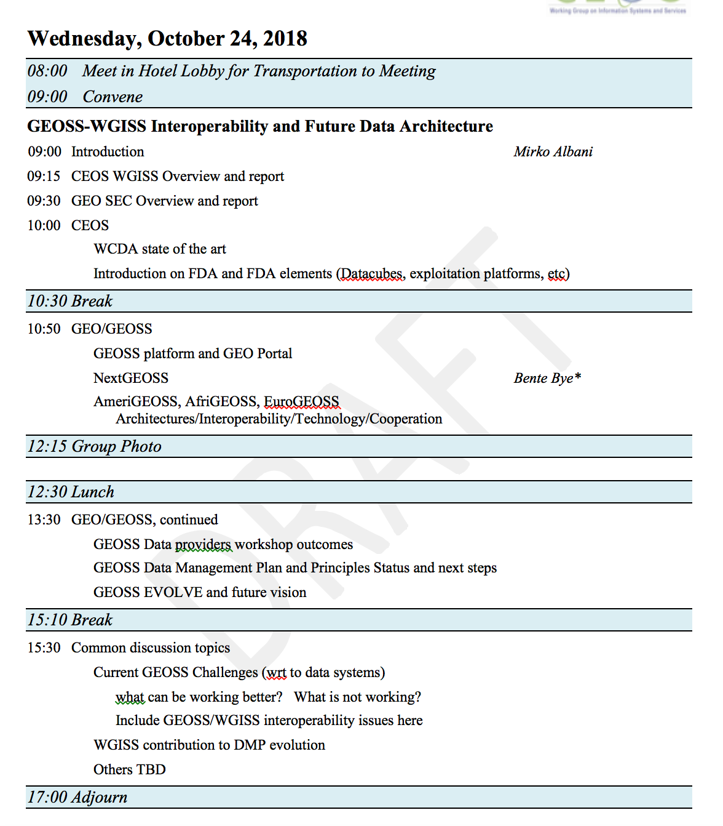
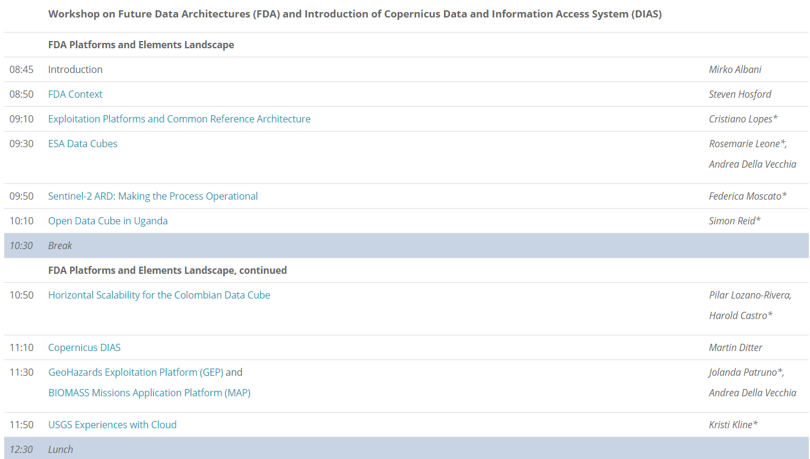

FDA Workshops
http://ceos.org/meetings/wgiss-45/

Slide 18
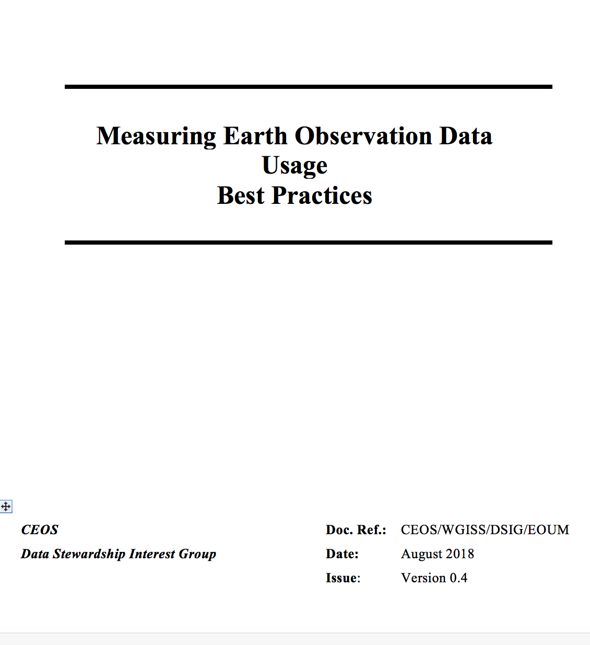

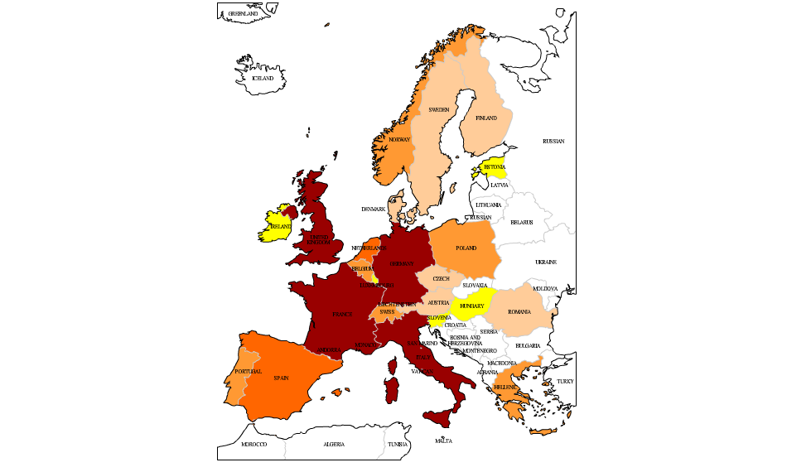
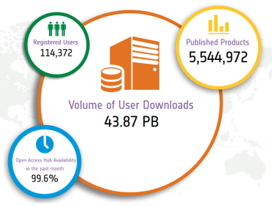
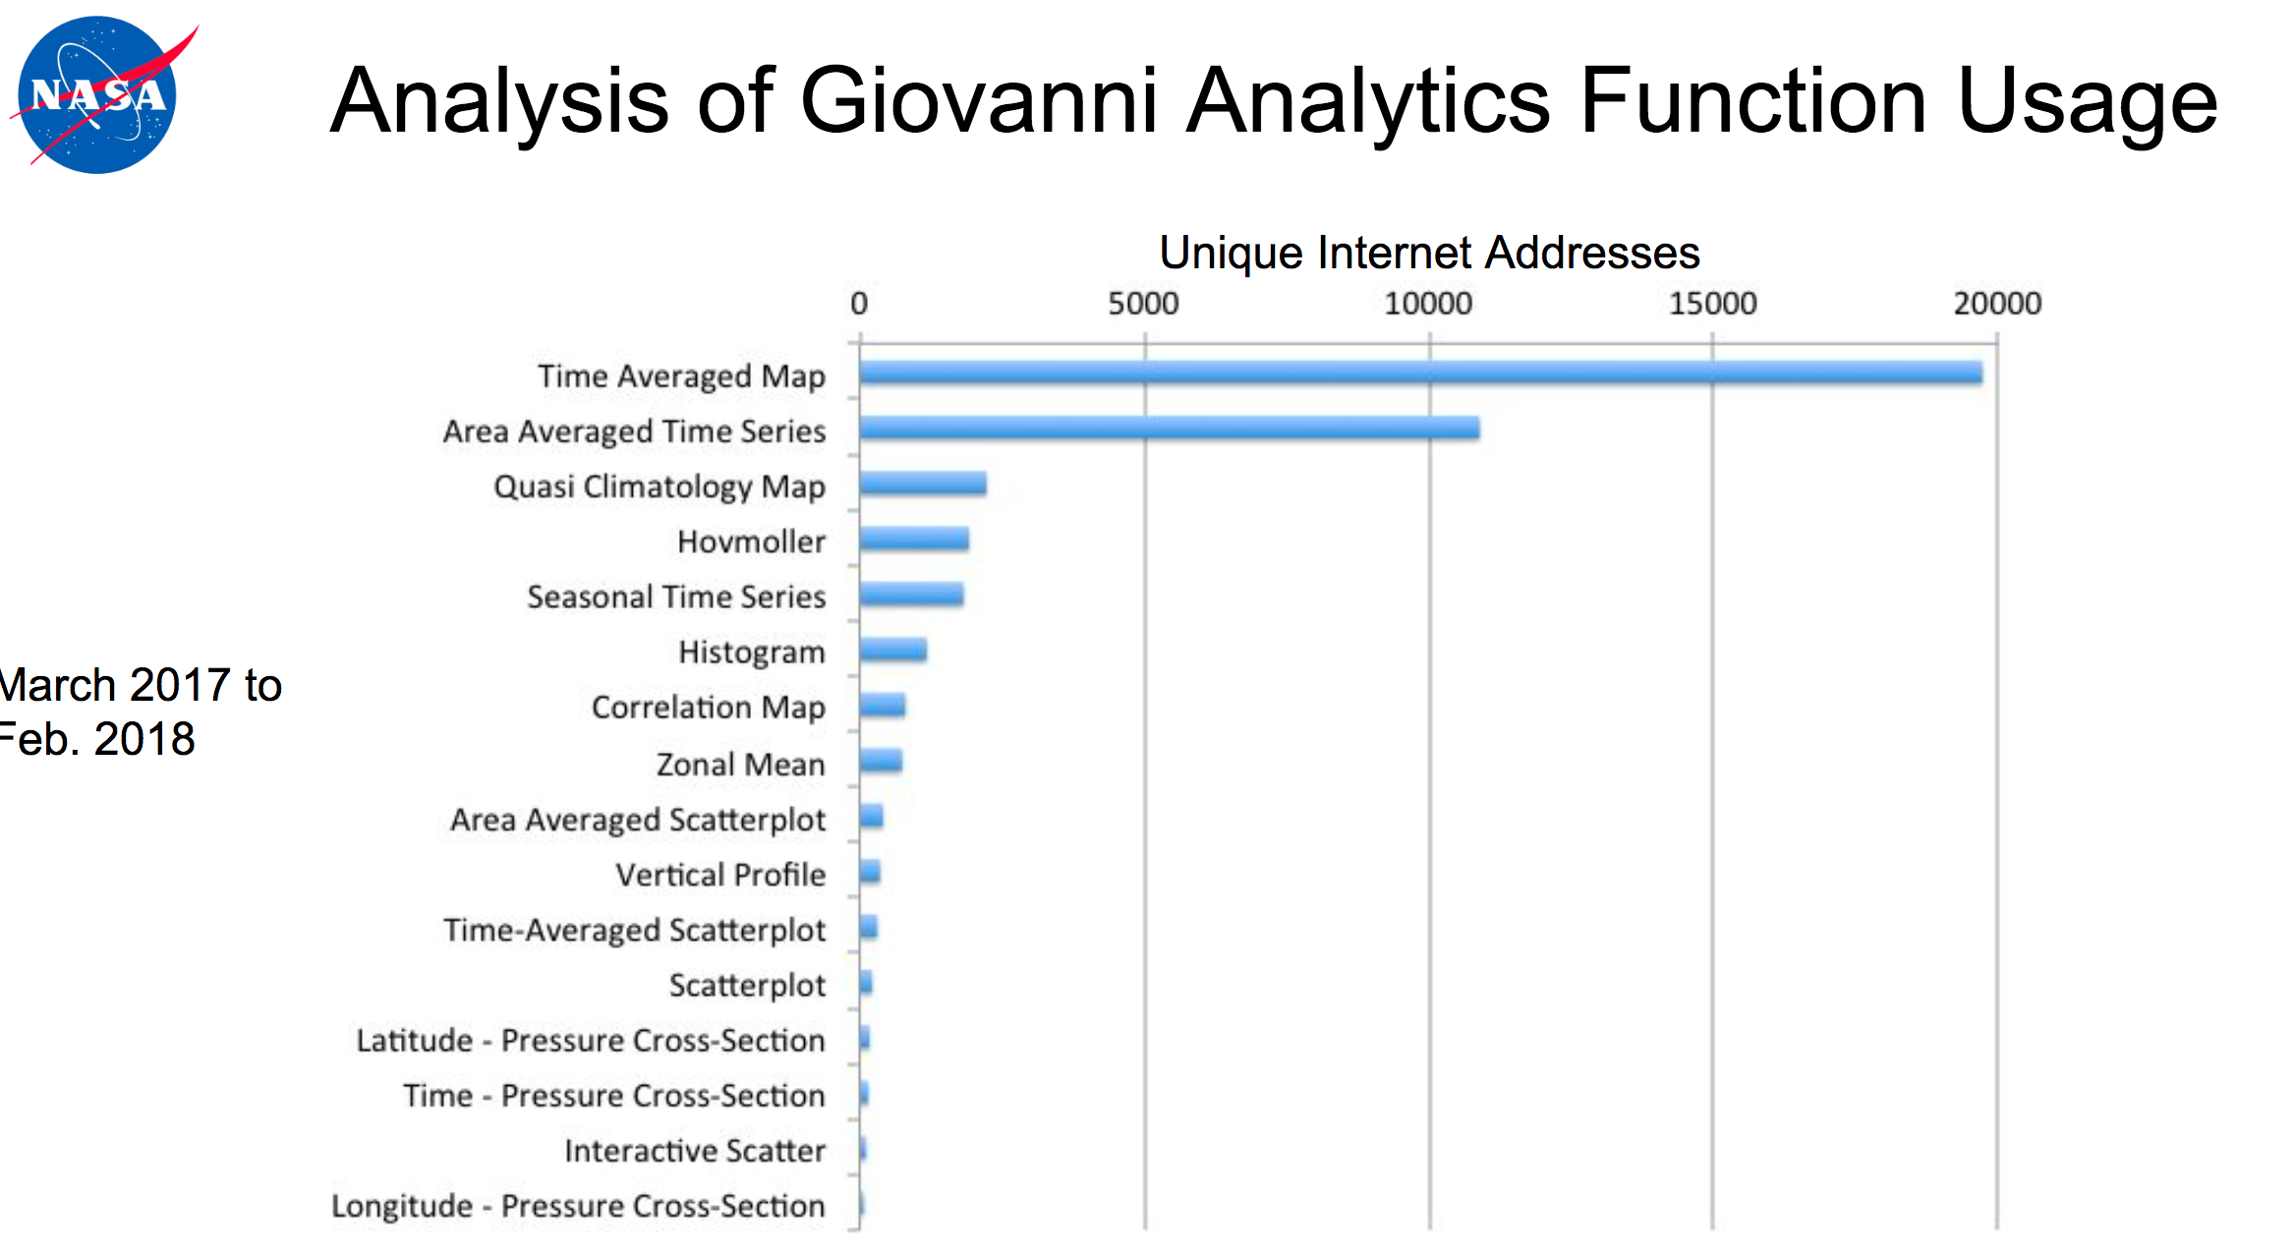
EO Data Usage Best Practice
EO Data Offer Metrics
Web/Platform Metrics
User Engagement and Satisfaction Metrics
1-100
100-199
200-399
400-799
>800
Number of user projects
Notes:
USER METRICS CONCEPT OVERVIEW
Objectives and needs – Why
Data Usage Metrics Categories – Which
Data Usage Metrics Collection – When and How
USER METRICS DEFINITION
Assumptions
User Metrics Description
User Metrics Formatting
Earth Observation Data Offering Metrics
Web and Platform Metrics
User Engagement and Satisfaction Metrics
USER METRICS FROM THIRD PARTIES
ANNEX A – Examples of statistics and INDICATORS
ANNEX B - List of Software for Statistics and User Metrics generation

Slide 19
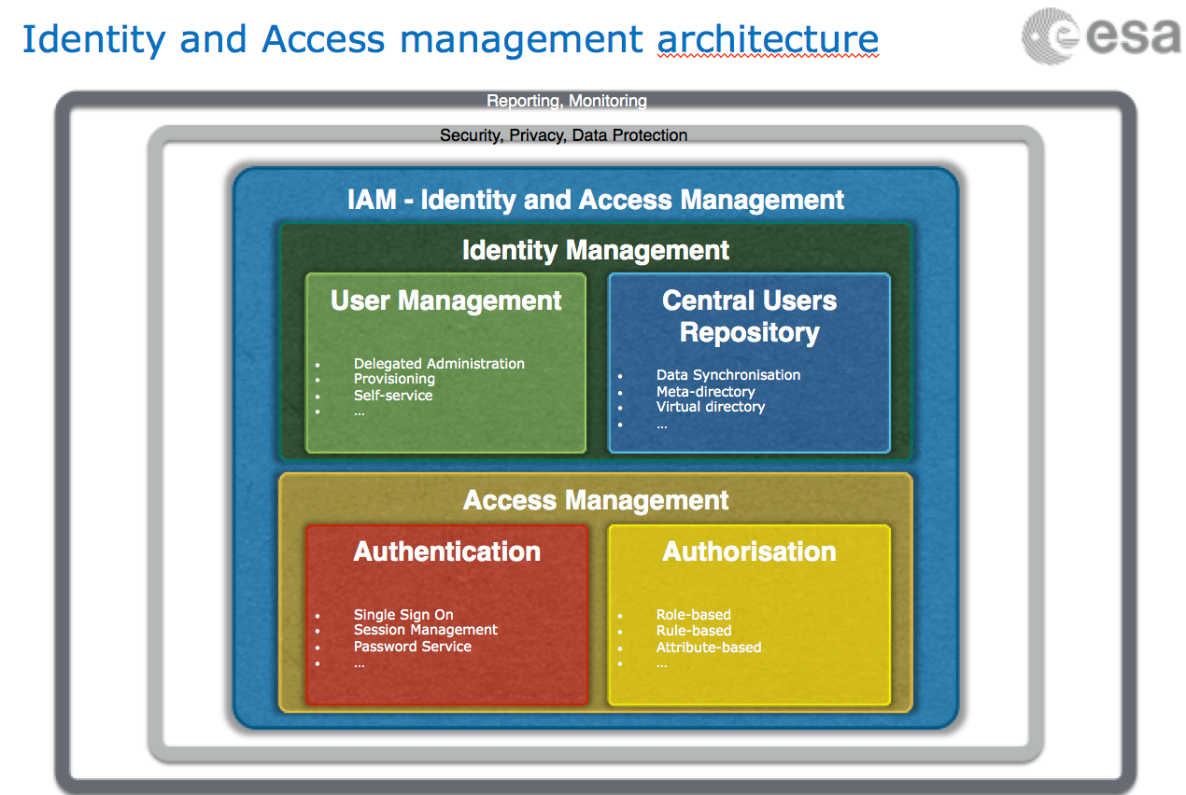
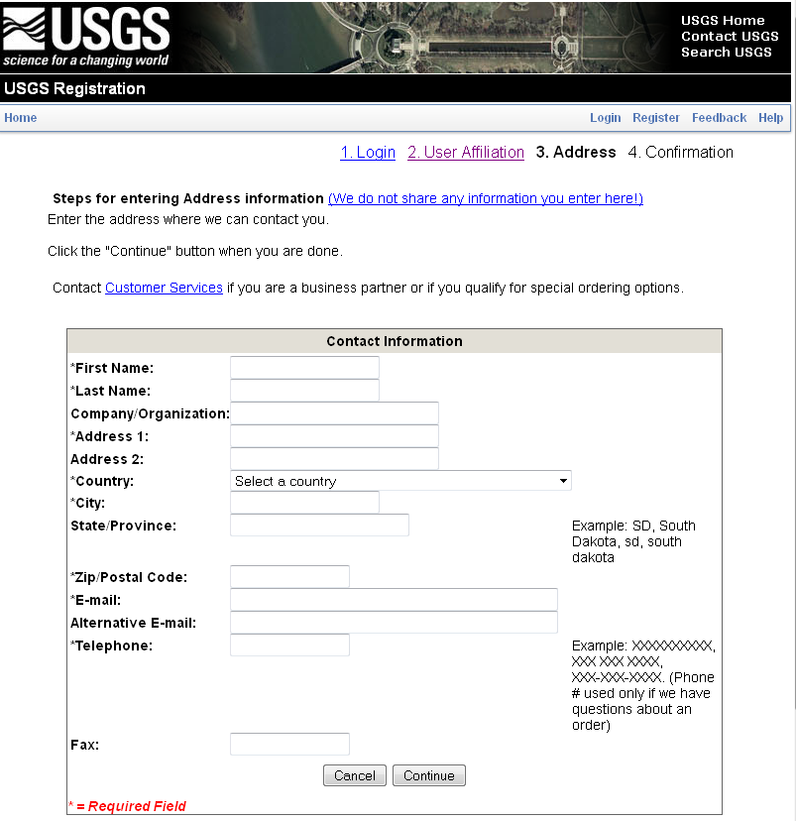
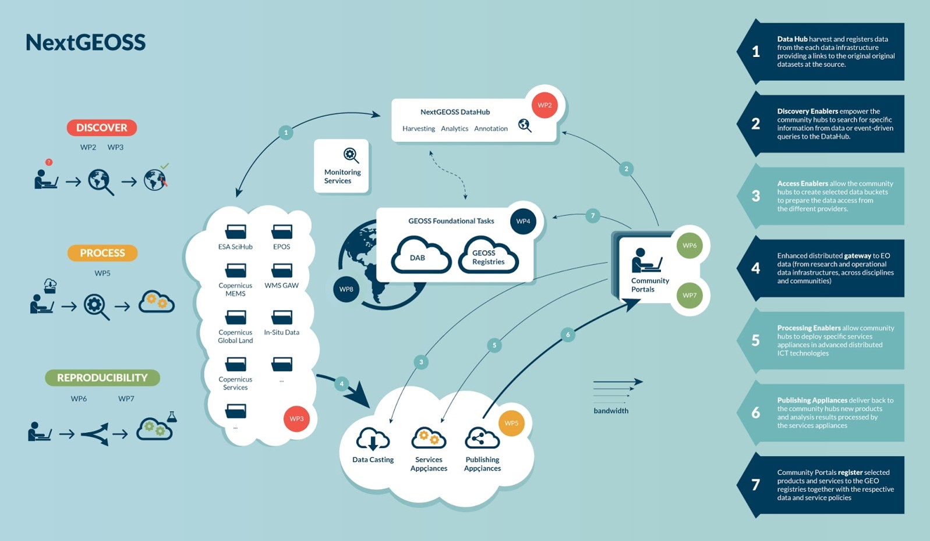
Federated Identity Management (SSO) White paper

Slide 20
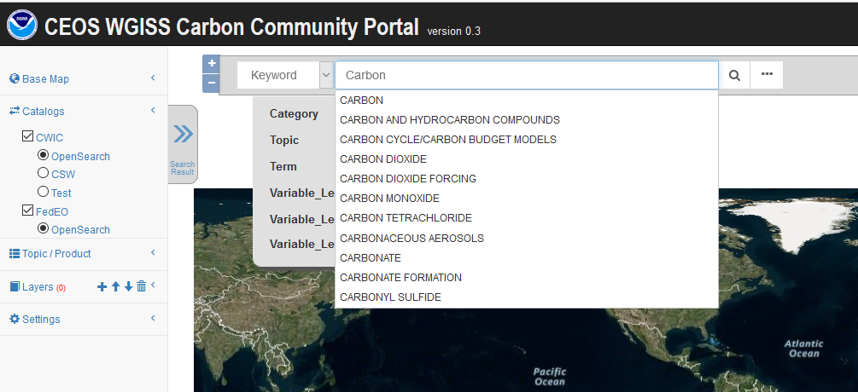
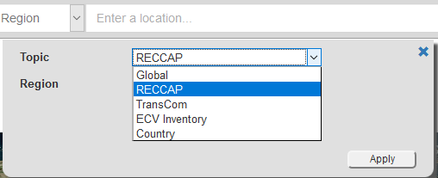
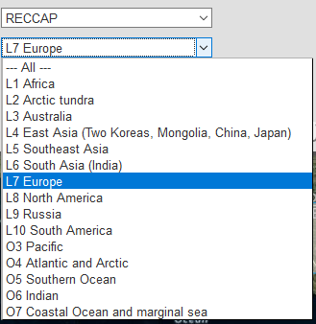
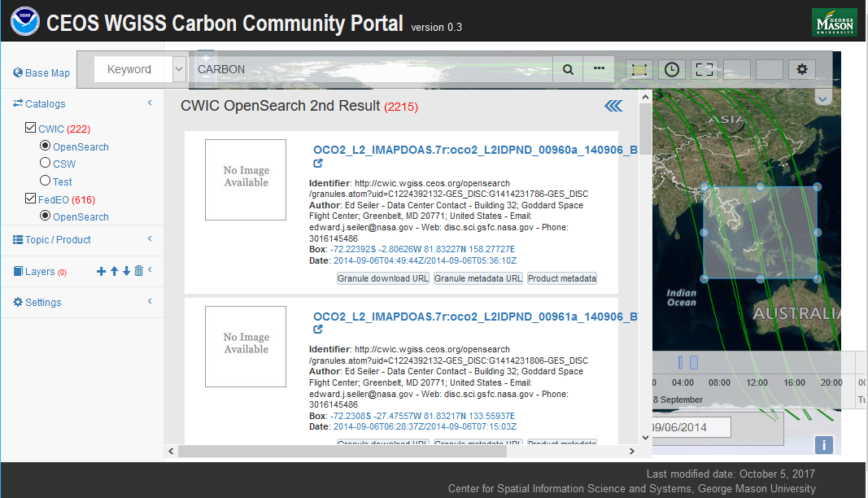
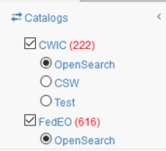
WGISS Carbon Community Portal
Special regions: Global, RECCAP, TransCom, Country Names, ECV Inventory)
Temporal Searches: support for time range and specific date
Pre-defined Carbon topics/datasets: (Atmospheric, Ecosystem, Ocean, Mixed-Theme)
Keywords (auto-completion with IDN Science Keywords)
Return records from both CWIC and FedEO
Notes:
Objective: Implement a prototype carbon data portal to facilitate the discoverability and accessibility of ECV products and space-borne CDRs. The portal will seamlessly access data both in CWIC and FedEO to provide necessary data and services to the carbon science community of both CEOS and GEOSS.
Approach: prototype developed by WGISS in coordination with CEOS Carbon Team and WGClimate Carbon (requirements and use cases provision/validation).
Status: Several iterations held between WGISS and Carbon teams. Carbon Portal latest version (August 2018) with Carbon Team for review/feedback.
Next steps: 1) Improve discoverability of ECV/CDR key datasets for Carbon Community and functionalities based on received feedback; 2) Open-up portal to wider user community to gather additional feedback (target end October 2018).

Slide 21



Technology Exploration
Interest Group
The Technology Exploration interest group serves as a forum for exchange of technical information and lessons-learned experience about current and trending technologies, services and other WWW/ Internet related software technologies.

Slide 22

Technology Activities
Past Technology Webinars
Relevancy Ranking of Data Search Results
Data Cubes for Large Scale Data Analytics
Burgeoning Role of Python for Earth Observation Data Analysis
The OGC Coverage Standards Suite: Introduction and Overview
Agile Development and the Scaled Agile Framework
Future Webinars being organised in cooperation with WGCapD: more end user oriented
Joint webinars and advertising with:
  WGCapD
  NextGEOSS
  GEOSS Evolve
  Federation of Earth Science Information Partners (ESIP)
http://ceos.org/ourwork/workinggroups/wgiss/technology-exploration/
Technology Session at WGISS#46 will address Artificial Intelligence, Machine Learning and other “disrupting” technologies
Notes:
Relevancy Ranking of Data Search Results
14th of March 2017
Stefano Nativi (GEOSS EVOLVE)
Chris Lynnes and James Norton (NASA)
Data Cubes for Large Scale Data Analytics
19th of June 2017
Rob Woodcock (CSIRO)
Brian Killough (CEOS SEO)
Burgeoning Role of Python for Earth Observation Data Analysis
22nd of August 2017
Syed Rizvi (Open Data Cube)
Rich Signell (USGS)
Alber Sanchez (INPE)
The OGC Coverage Standards Suite: Introduction and Overview
19th of January 2018
Dr Peter Baumann (Rasdaman)
Scrum and scale agile methods
31st of July 2018
Ms. Dana Shum (Raytheon NASA)

Slide 23
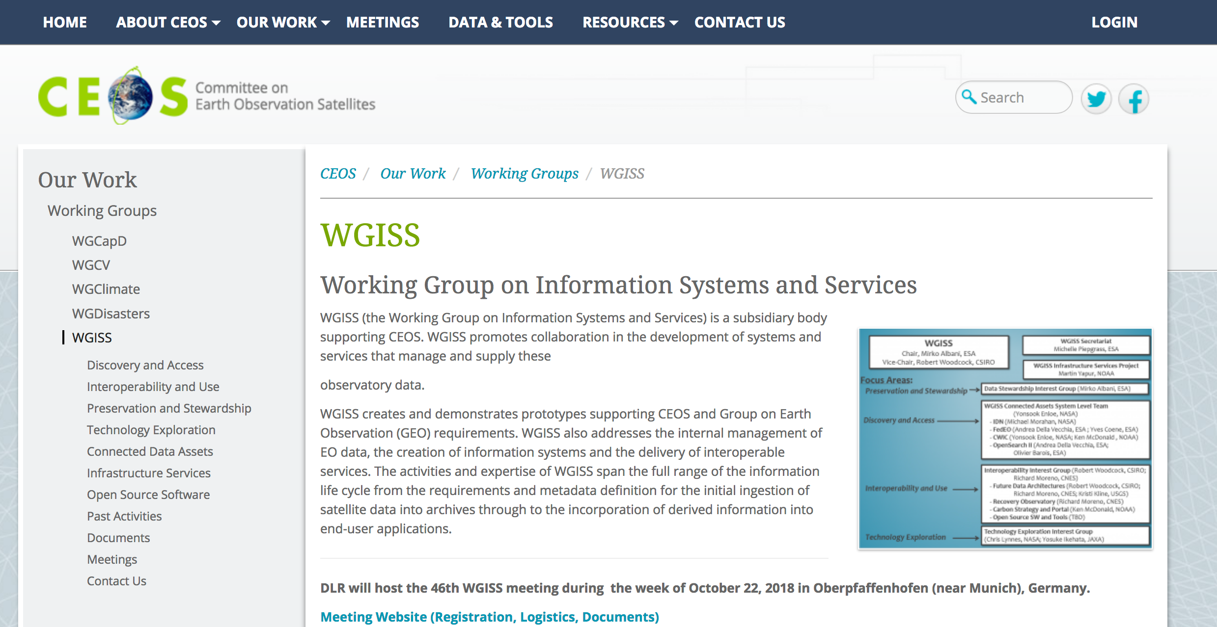
WGISS Information
http://ceos.org/ourwork/workinggroups/wgiss/

Slide 24


