Slide 1
ESA Agency Report
Mirko Albani, ESA
WGISS#46 Meeting,
22-25 October 2018,
DLR Oberpfaffenhofen, Germany

Slide 2

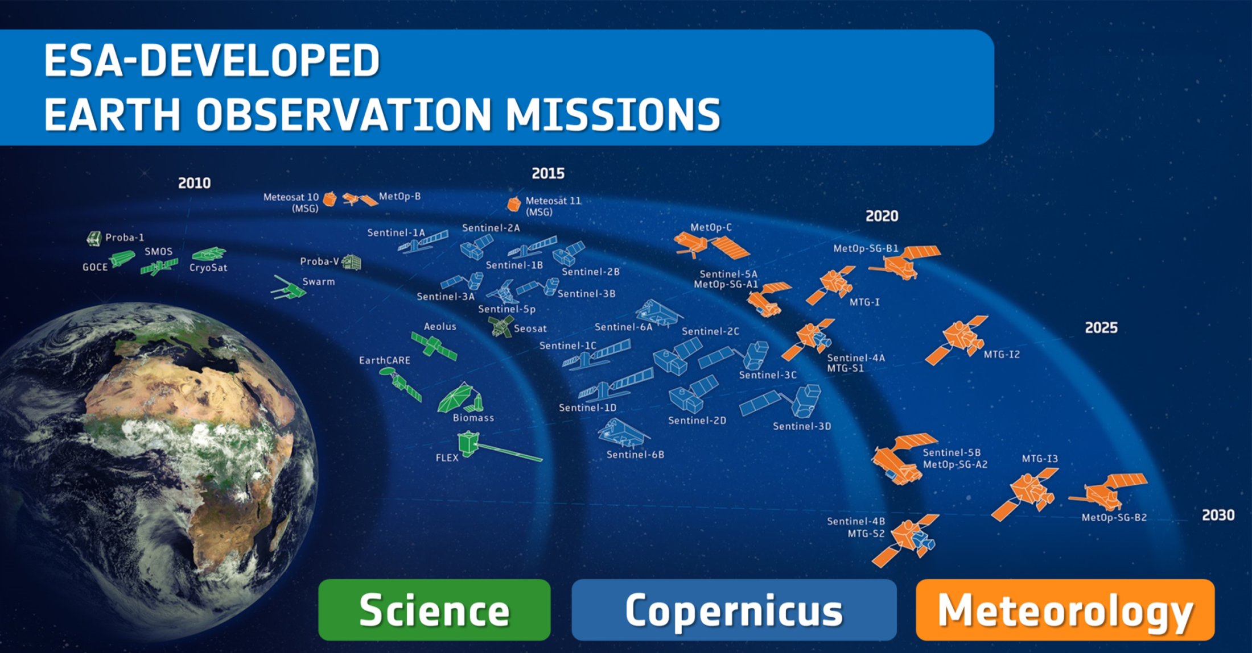
Satellites
26 under development
14 in operation

Slide 3
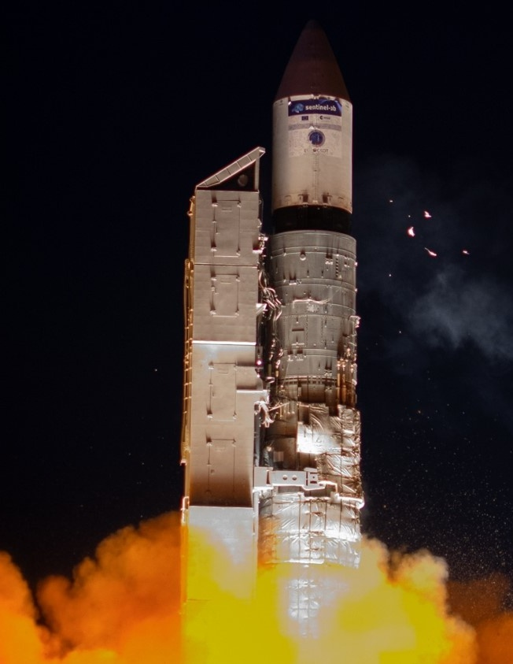
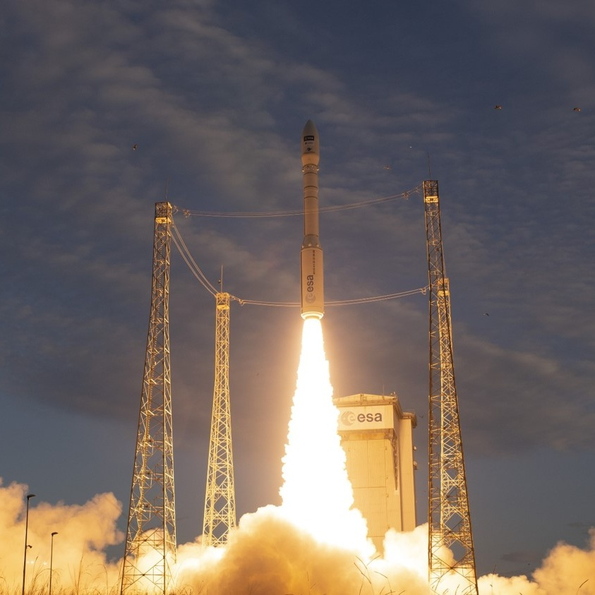
Sentinel-3B Launch
Aeolus Launch
Plesetzk
25 April 2018
Kourou
22 August 2018
MetOp-C Launch (planned)
Kourou
6 November 2018
Notes:
Sentinel-3B
The seventh Sentinel, Sentinel-3B, has been launched from Plesetzk on 25 April to form the third Sentinel pair in orbit together with its twin satellite Sentinel-3A. Following a perfect launch, an excellent separation from Breeze and a prompt signal acquisition from Kiruna, Sentinel-3B keeps performing very well in orbit.
Aeolus
First wind LIDAR– NWP impact
Laser switched on successfully!
Ingestion into NWP from early 2019

Slide 4
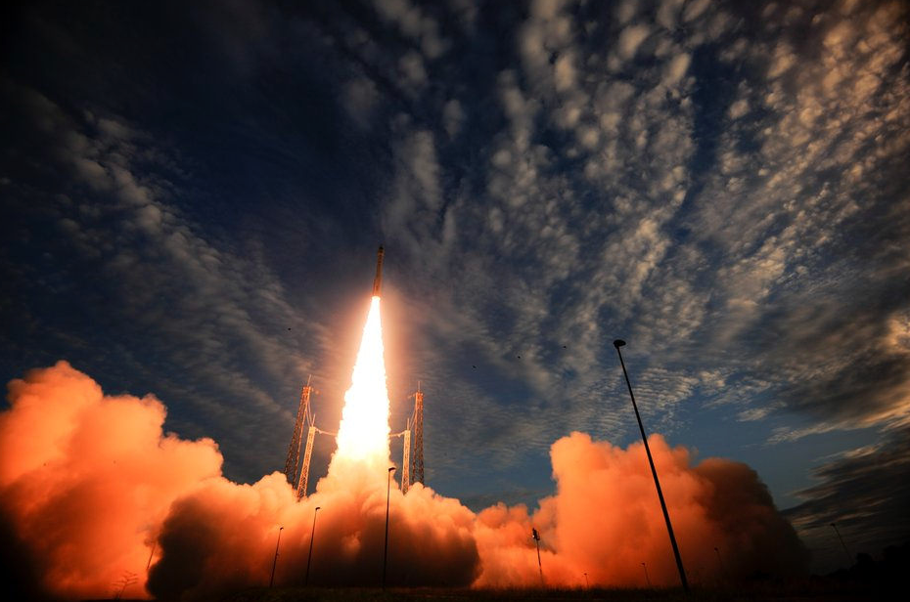
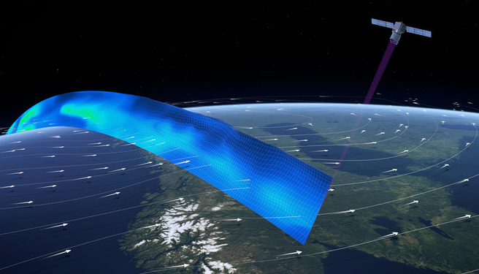
AEOLUS LAUNCH
22nd of August 2018
“Aeolus epitomises the essence of an Earth Explorer. It will fill a gap in our knowledge of how the planet functions and demonstrate how cutting-edge technology can be used in space,”
https://www.esa.int/Our_Activities/Observing_the_Earth/Aeolus/ESA_s_Aeolus_wind_satellite_launched

Slide 5
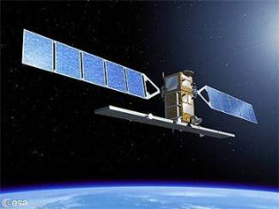
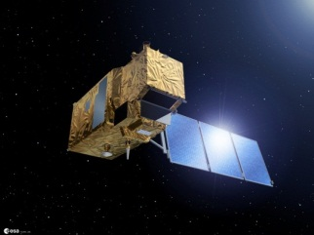
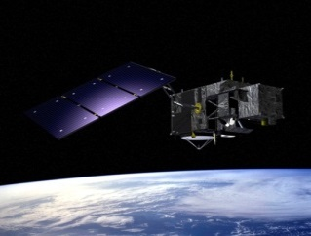

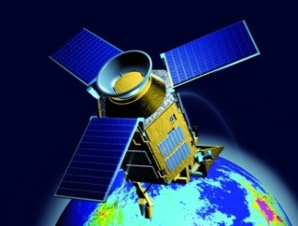
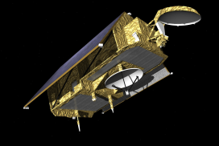







Copernicus Space Component: State of Play
FULL, FREE AND OPEN
THE SENTINELS
Sentinel Mission and Status
Key Features
SENTINEL-1:
4-40m resolution, 3 day revisit at equator
2 Sats in orbit
Polar-orbiting, all-weather, day-and-night radar imaging
SENTINEL-2:
10-60m resolution, 5 days revisit time
2 Sats in Orbit
Polar-orbiting, multispectral optical, high-res imaging
SENTINEL-3:
300-1200m resolution, <2 days revisit
2 Sats in Orbit
Optical and altimeter mission monitoring sea and land parameters
SENTINEL-4:
8km resolution, 60 min revisit time
1st Launch in 2020
Payload for atmosphere chemistry monitoring on MTG-S
SENTINEL-5p:
7-68km resolution, 1 day revisit
1 Sat in Orbit
Mission to reduce data gaps between Envisat, and S-5
SENTINEL-5:
7.5-50km resolution, 1 day revisit
1st Launch in 2021
Payload for atmosphere chemistry monitoring on MetOp 2ndGen
SENTINEL-6:
10 day revisit time
1st Launch in 2020
Radar altimeter to measure sea-surface height globally

Slide 6
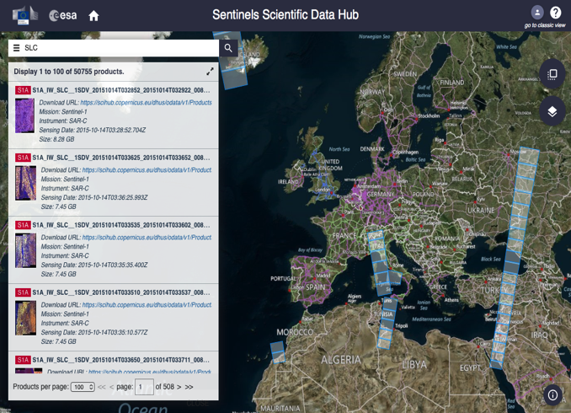
Sentinel Data Access @ ESA
ESA offers free access for all users to Sentinel products: most recent as well as complete long term archive
  Any user can self-register at sentinels.copernicus.eu
ESA delivers on 24/7 basis Near Real Time products (3 hours from sensing) as well as Non Time Critical products (24 hours from sensing)
ESA Data Hub provides an OPEN SOURCE Web interface
Users can set own scripts to automatically search filter and download products
Sentinel Toolbox available as open source software https://github.com/senbox-org
Data Hub Server software available at
https://github.com/SentinelDataHub/DataHubSystem.

Slide 7
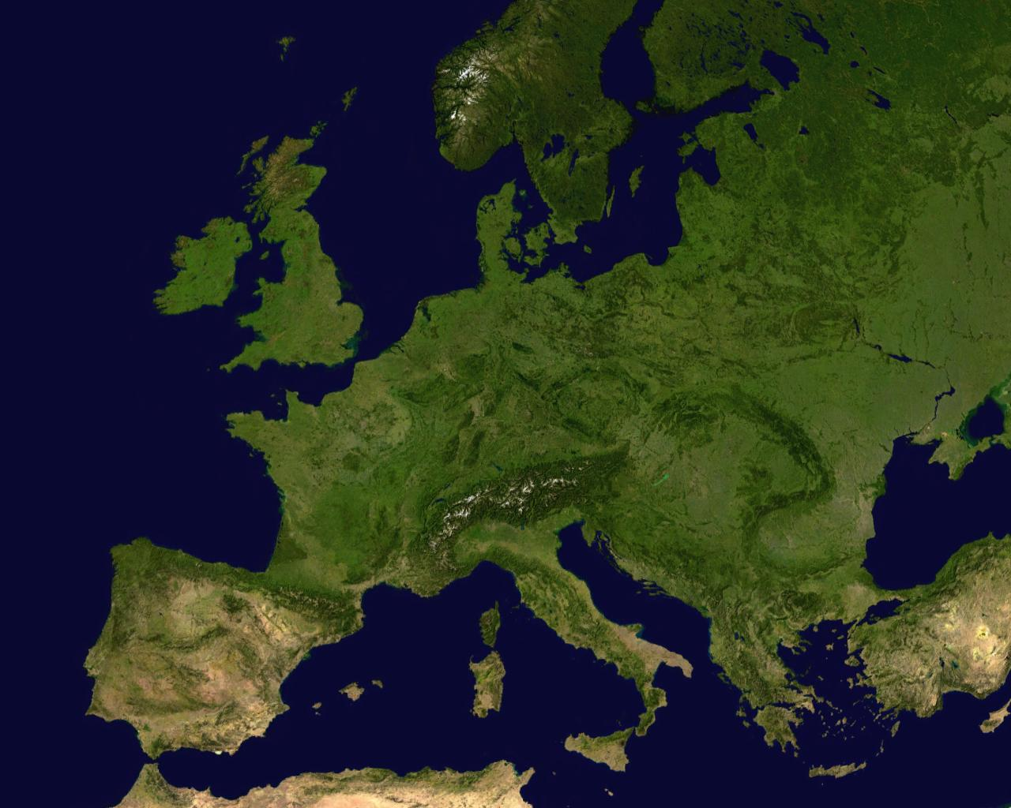
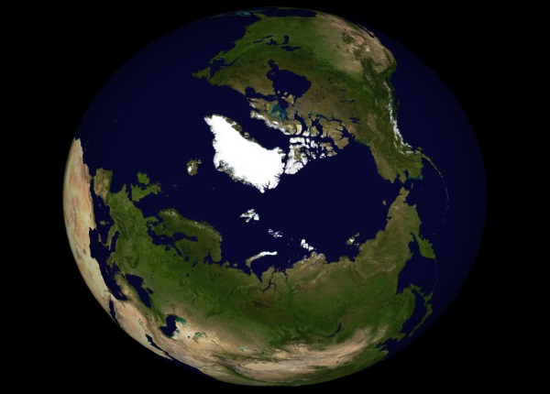
















Sentinel Data Hubs
ESA Open Access
Data Hub
Collaborative
Data Hub
Copernicus Services Data Hub
International Access Data Hub

Slide 8





Sentinels Data Access Statistics – Global View
11%
45%
22%
North
America
Europe
Asia
4%
15%
Africa
2%
South
America
Oceania
100% increase of users from Asia and South America in last quarter
Statistics: Q4-2017 (31 December2017)

Slide 9
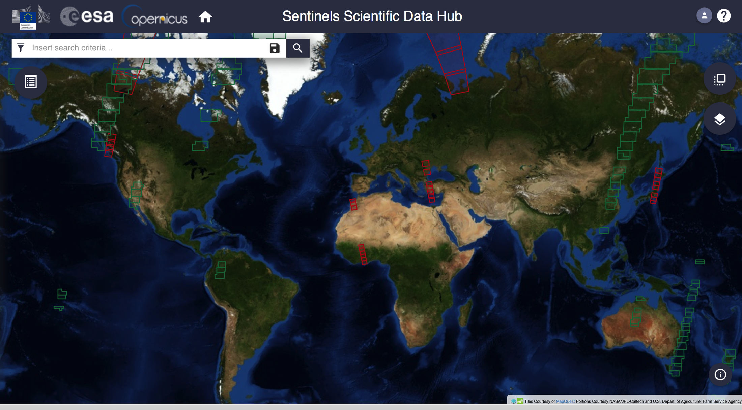
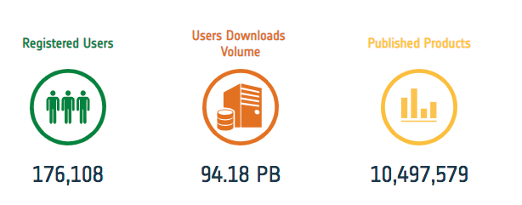
Sentinels Data Distribution - Overall Statistics
Statistics: September 2018

Slide 10
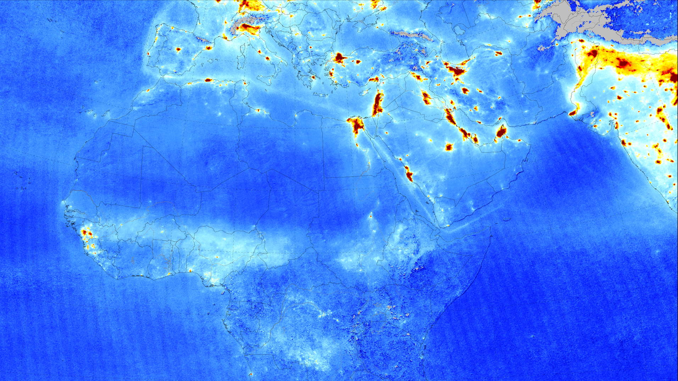
Nitrogen Dioxide from Sentinel-5P
April 2018 average
© KNMI / NSO
Notes:
Sentinel-5P tropospheric nitrogen dioxide measurements over Europe, Africa, Middle East, and India from April 2018 (averaged) are shown here.
Air pollution emitted by big cities and shipping lanes is clearly visible.
Launched in October 2017, Sentinel-5P is part of a fleet of satellites central to Copernicus, Europe’s environmental monitoring programme.
With a resolution of up to 7 x 3.5 km, Sentinel-5P’s Tropomi instrument can detect air pollution over individual cities.
Tropomi also has the capacity to locate where pollutants are being emitted, effectively identifying pollution hotspots.

Slide 11
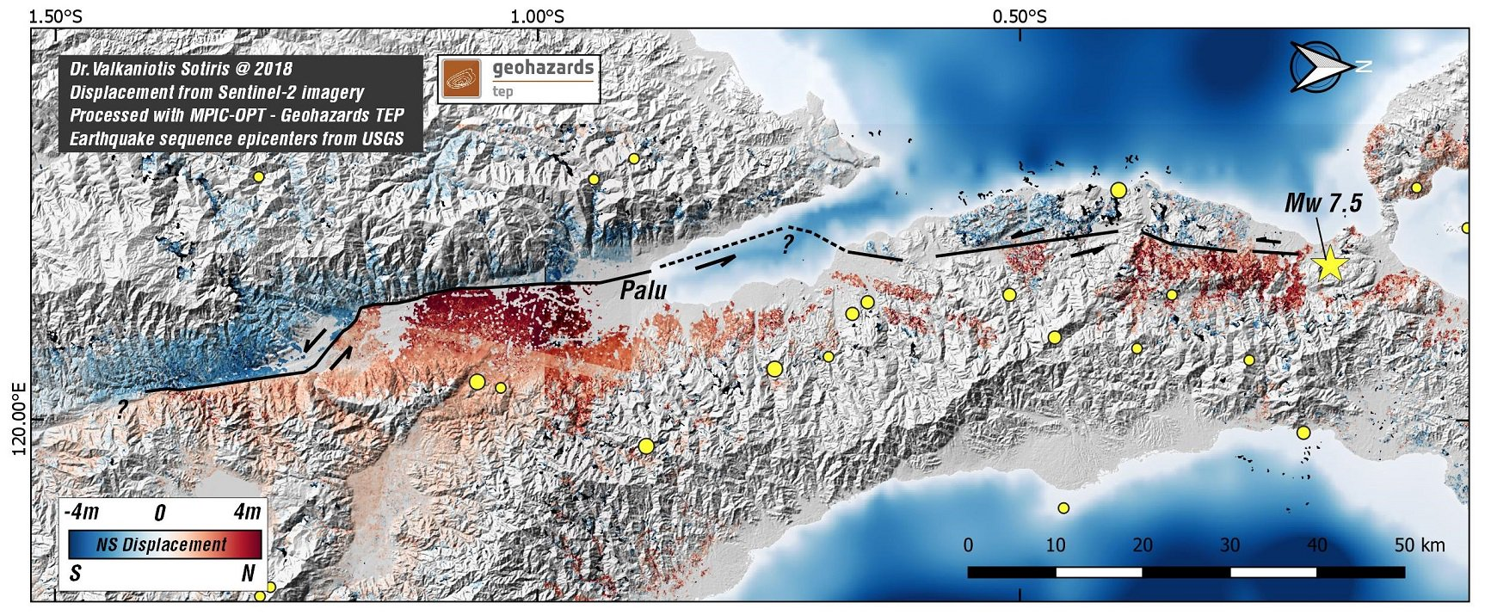
Palu Earthquake
Based upon Sentinel-2 data - October 2018
Notes:
This image / map based upon Sentinel-2 data show the horizontal displacement around the town of Palu, on the Indonesian Island of Sulawesi
The displacement is a result from the Earthquake that hit the island on 2 October 2018
The red areas on the map, below the black fault line, have shifted northwards (right is north on this map)
The blue areas, above the black line, have shifted southwards, at some parts up to 4 meters
The resulting energy of this shifting land caused a tsunami that killed thousands of people and destructed many parts of the coastline towns and villages of the island
The map is a product of the TEP geohazards

Slide 12
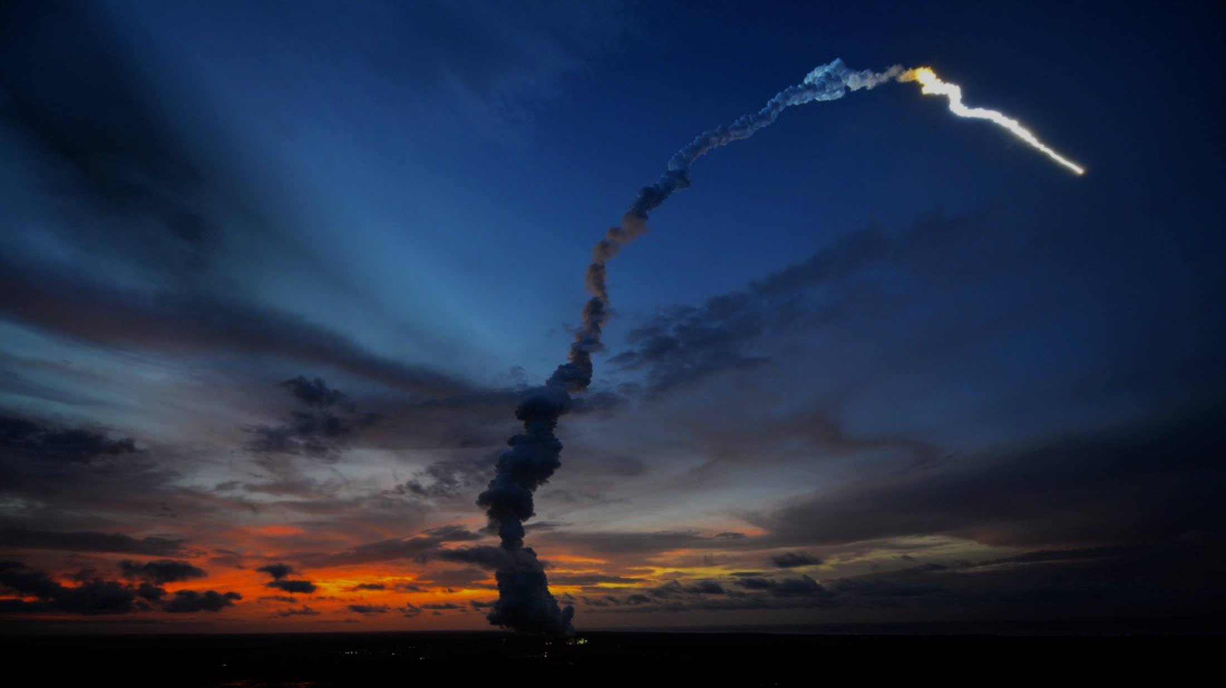
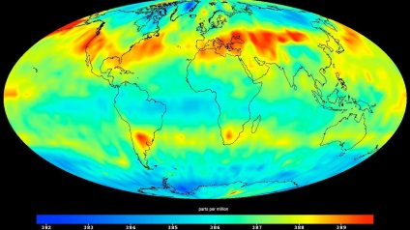
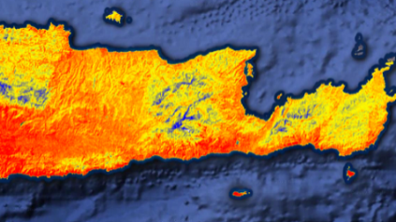
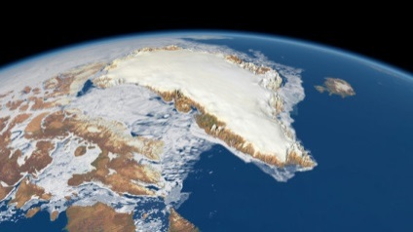
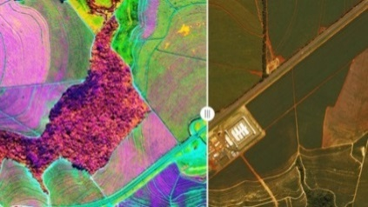
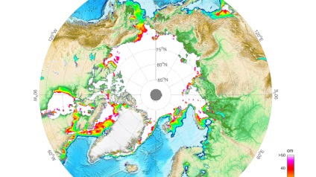
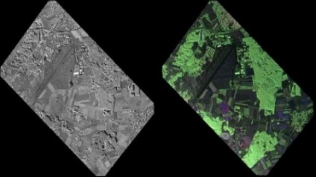
Operational EO: Copernicus 2.0
6 High Priority Candidate Missions
 | Anthropogenic CO₂ Imaging Spectrometer |  | High Resolution Surface Temp.
 | Polar Ice & Snow Topography |  | Hyperspectral Imaging
 | Passive Microwave Imaging |  | L-band SAR
 | Monitor causes of Climate Change (CO₂ emissions) |  | Agriculture & Water Productivity
 | Monitor effects of Climate Change (Arctic/Polar ice volume) |  | Food Security, Soil & Minerals, Forestry, Biodiversity
 | Sea Ice Conc. & SST (Arctic sit. awareness) |  | Soil Moisture, Vegetation & Ground Motion
Notes:
Kick-Off & Progress
Potential Sentinel expansion system study activities initiated
End-to-end performance simulation campaigns
Scientific studies in support of mission requirements definition
Pre-developments of most critical technologies.
Copernicus Long Term Scenario
20 new spacecraft
6 new mission domains: CO₂ imaging spectrometry, thermal / hyperspectral / microwave imaging, etc.
Integration of NewSpace and national mission data
Sophisticated, operational data access

Slide 13
ESA Principal Investigators (PI) projects - Statistics

Slide 14
ESA Principal Investigators (PI) projects - Statistics

Slide 15
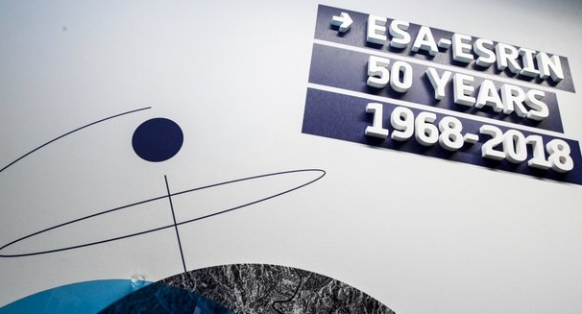
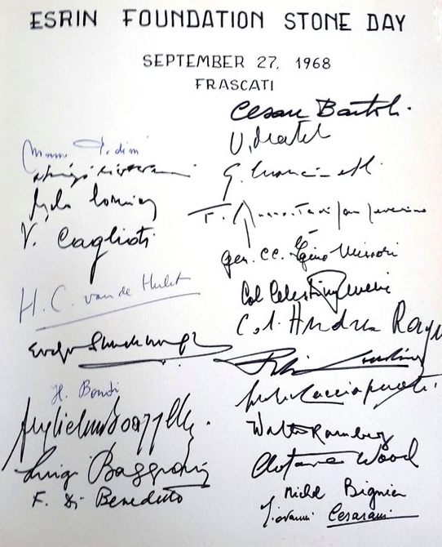
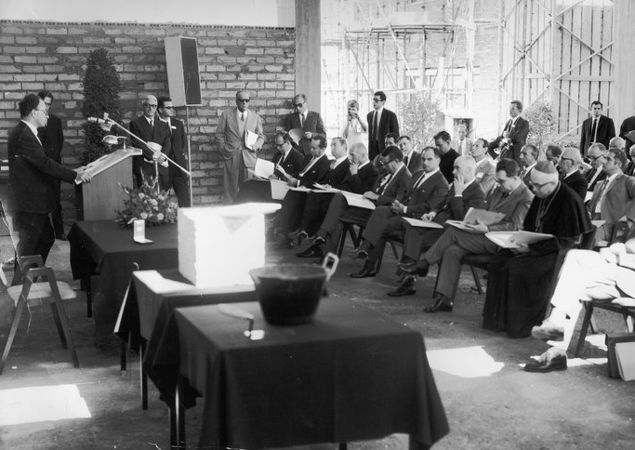
ESA Celebrated 50 years of ESRIN
ESRIN inauguration
ESRIN foundation guestbook

Slide 16
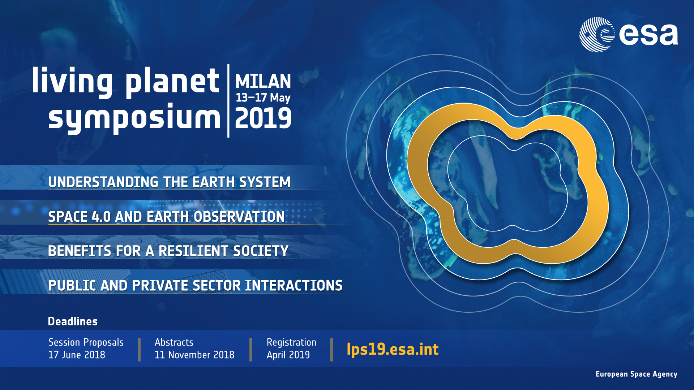

Slide 17
Thank you for your attention!

