Slide 1
NATIONAL CENTERS FOR ENVIRONMENTAL INFORMATION
Kenneth S. Casey, PhD
Deputy Director, NCEI Data Stewardship Division
NOAA Satellite and Information Service | National Centers for Environmental Information (NCEI)

Slide 2
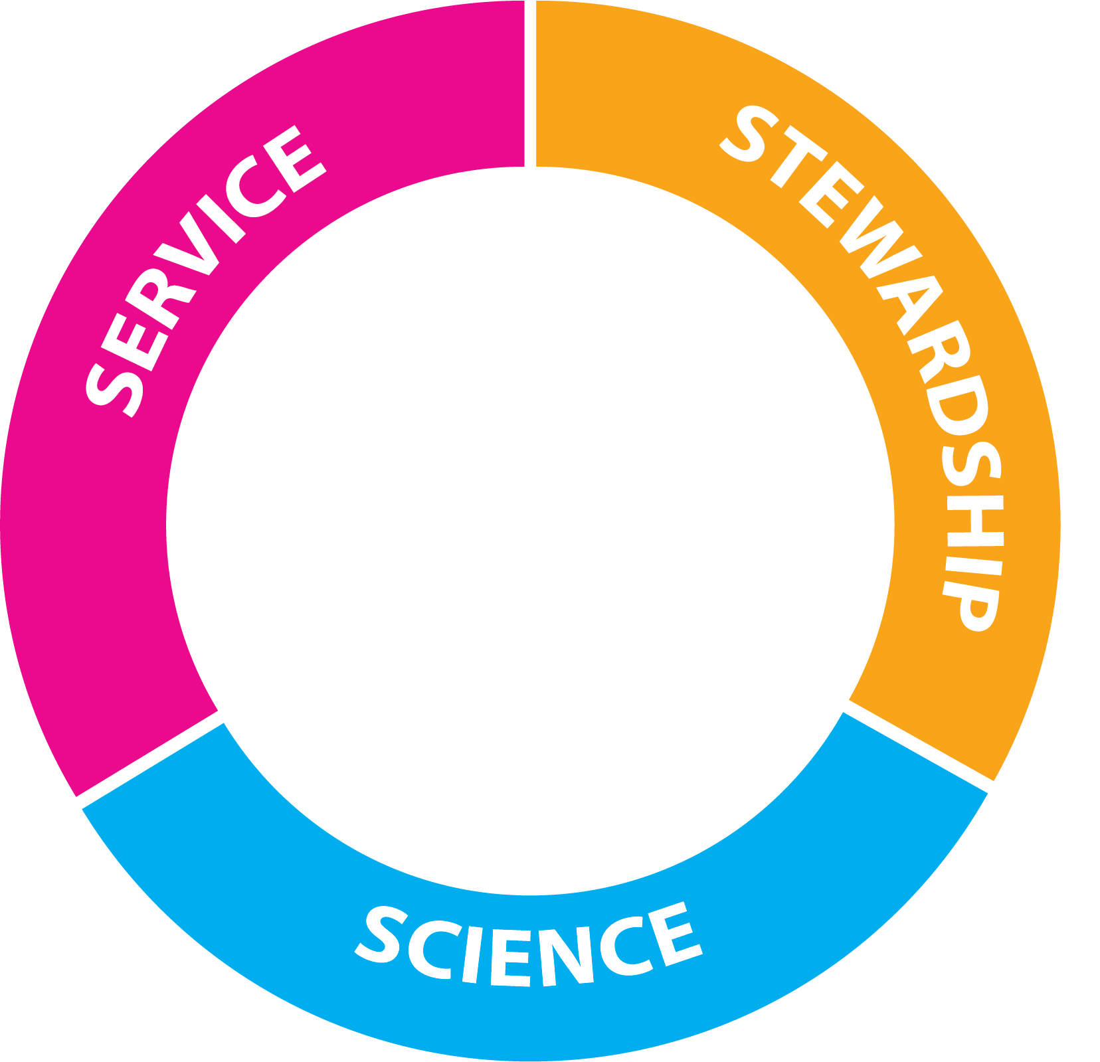
National Centers for Environmental Information
Host and provide access to one of the most significant archives on Earth, with comprehensive oceanic, atmospheric, and geophysical data
Provide science, service, and stewardship to a wide range of stakeholders
Strive always to be the nation’s leading authority for environmental information
STAKEHOLDERS
International
US Federal
DoC/NOAA
State/Local
Academic
NGOs
Private Sector
DoC = US Department of Commerce

Slide 3
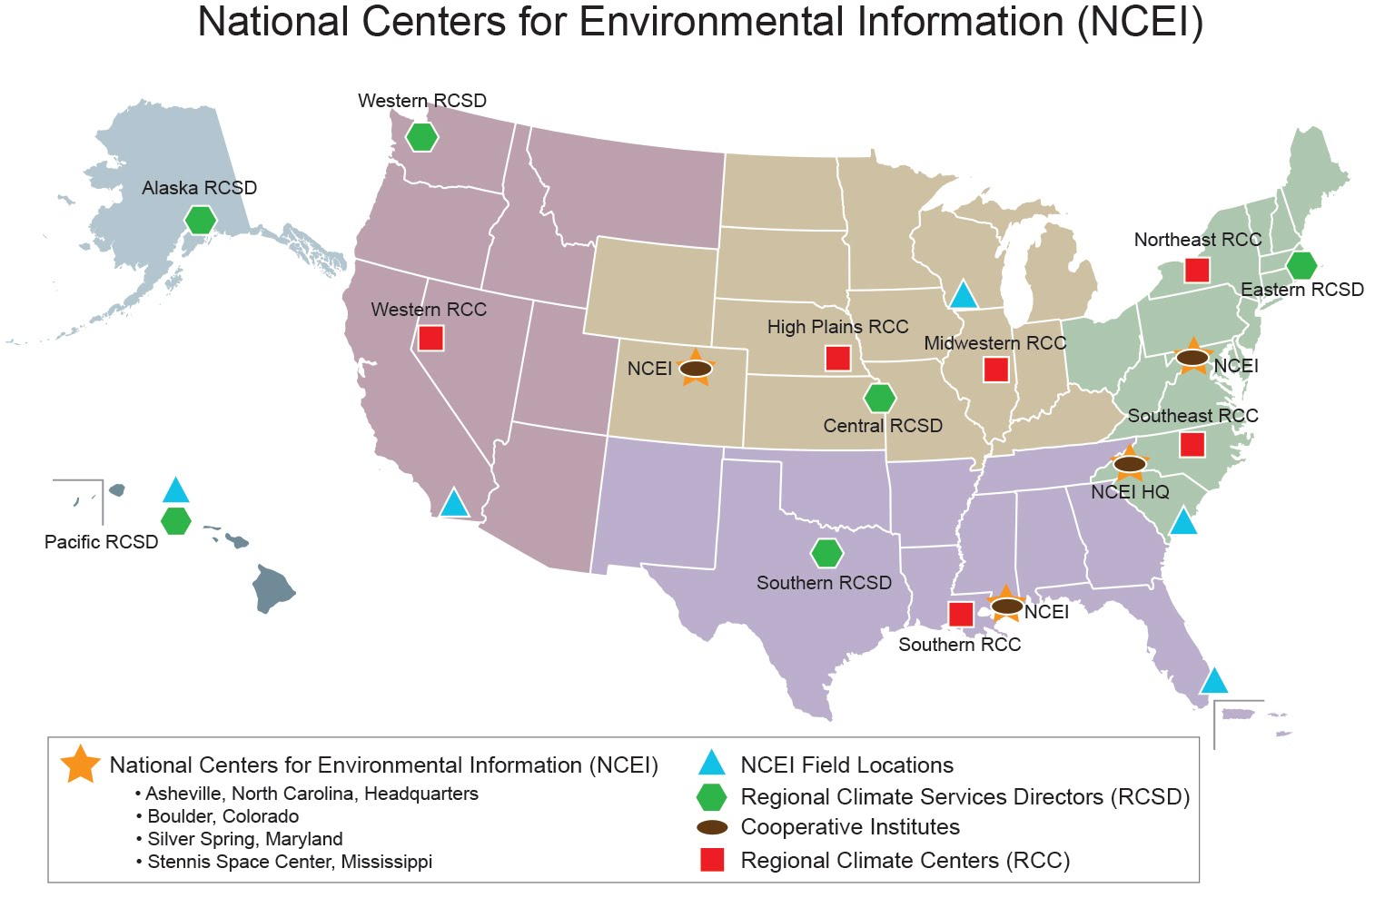
NCEI: A Nationwide Presence

Slide 4
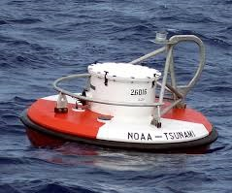
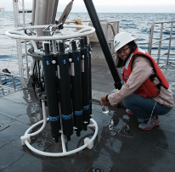
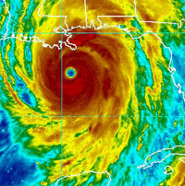
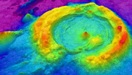
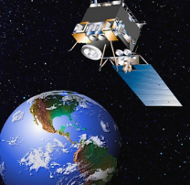
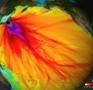
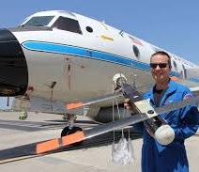
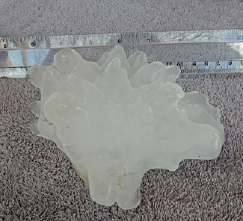
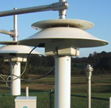
National Centers for Environmental Information
From the depths of the ocean to the surface of the sun and from million-year-old sediment records to near real-time satellite images

Slide 5
Tiers of Data Stewardship
National Services and International Leadership
6
5
Authoritative Records
4
Derived Products
3
Scientific Improvements
Enhanced Access and Basic Quality Assurance
2
Long Term preservation and Basic Access
1
Long-Term preservation and Basic Access

Slide 6
National Centers for Environmental Information Functional Organization
NCEI Director’s Office
Climate Science
Center for Weather and Climate
Center for Coasts, Oceans, and Geophysics
Large Marine Ecosystems
Oceanography
Dataset
Products
Oceanographic Sciences
Customer
Engagement
Climate & Weather Information Services
Scientific Information
Services
Data Stewardship
Weather Science
Geophysical
Sciences
Observations &
Data Records
Monitoring
Coastal & Marines Geophysics
Solar Geophysics
Data Operations
Software Engineering
Archive
Data Access
Support Services
Information Technology
Finance & Acquisitions
Plans & Programs
Communications & Outreach
Standards & Evaluation
Information Technology
Logistics Support

Slide 7
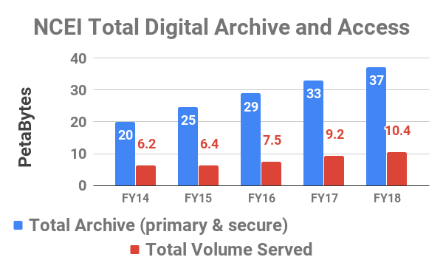
NCEI Archive and Access Volumes

Slide 8
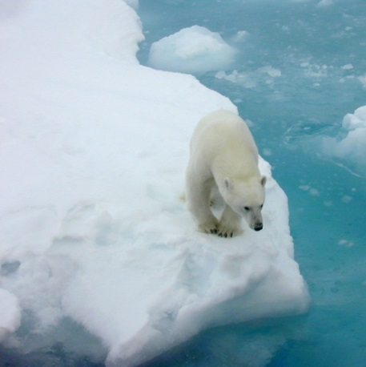
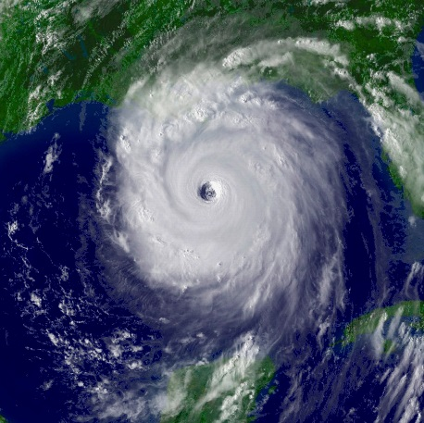
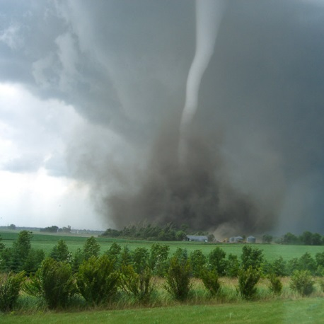
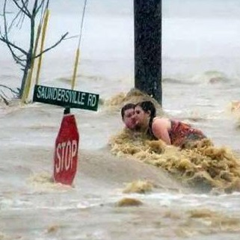
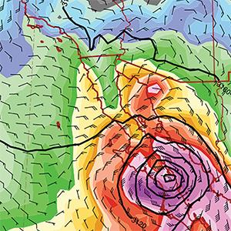
Weather and Climate Products
Providing climate information to inform our future
Monthly U.S. & Global Climate Reports
U.S. Billion-Dollar Weather & Climate Disasters report
U.S. Drought Monitor
Regional Snow Fall Index
Tornado Climatology
Hourly Precipitation Data
Climate Extremes Index
Blended Sea Winds

Slide 9
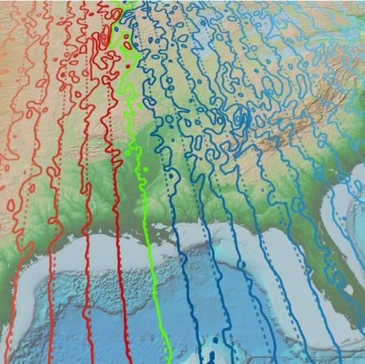
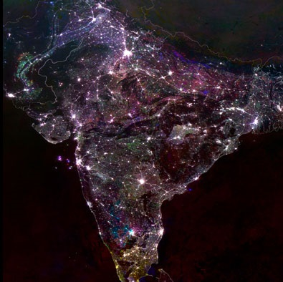
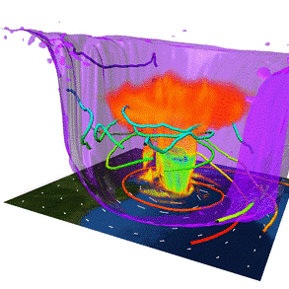
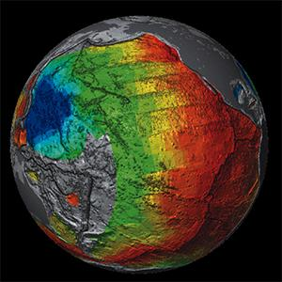
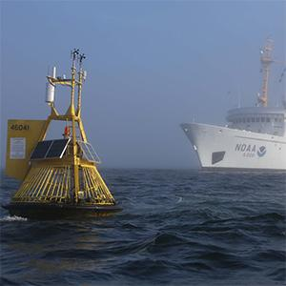
Coasts, Oceans and Geophysics
Providing data and information from the sun’s surface to Earth’s seafloor
Ocean Exploration Digital Atlas
Enhanced Magnetic Model
Nighttime Lights Analysis
Gulf of Mexico Data Atlas
Model Reanalysis
Deep Sea Corals Data Portal
Bathymetry and
Global Relief
World Ocean Database

Slide 10
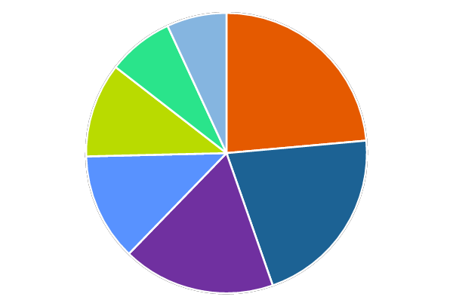
NCEI Data Fulfill Sector Needs
Science, Technology, and Engineering
6.9%
Ecosystems (Agriculture/Aquaculture)
7.6%
Transportation and Infrastructure
23.6%
10.9%
Energy
Insurance, Finance, and Legal
12.4%
21.1%
Health and Emergency Management
17.6%
Higher Education

Slide 11
NCEI Engagement with WGISS
 | Ken Casey NCEI Data Stewardship Division, Deputy | NOAA WGISS representative
 | Nancy Ritchey NCEI Archive Branch Chief | WGISS Data Preservation and Stewardship Interest Group
 | Rich Baldwin NCEI Data Access Branch Chief | WGISS Discovery and Access Interest Group

Slide 12
The Nation’s Trusted Authority for Environmental Information
Asheville, NC
Boulder, CO
Silver Spring, MD
Stennis Space Center, MS
NATIONAL CENTERS FOR ENVIRONMENTAL INFORMATION (NCEI)

