Slide 1
Recovery Observatory

Slide 2
Recovery Observatory: the idea
Space agencies already organize the emergency response after disasters (International Charter) …
… But have little or no coordination for the post-crisis part of the disaster management cycle
A CEOS initiative (Working Group Disaster)
Triggered through lessons learned by CNES from Kal-Haiti project (precursor of a Recovery Observatory) after 2010’s earthquake in Haiti
Developed in the framework of CEOS/WGISS

Slide 3
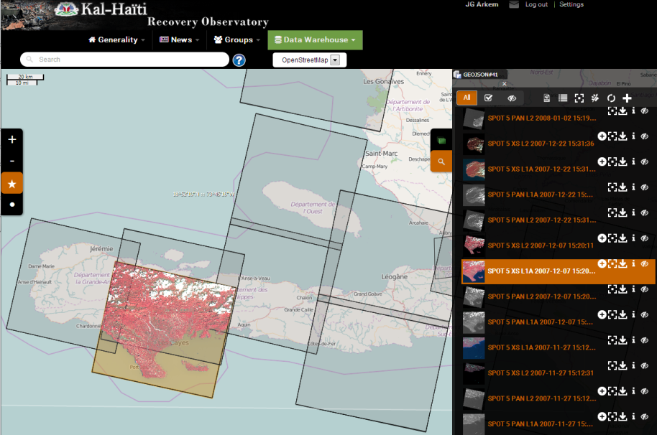
Recovery Observatory – Objectives
Demonstrate the value of using satellite Earth Observations to support Recovery from a major disaster:
Assessment of damages, reconstruction planning, reconstruction monitoring
Establish institutional relationships between CEOS and stakeholders from the international recovery community.
Promote innovation around high-technology applications to support recovery.
In December, 2016, The CEOS (after a recommendation from Disaster WG) officially triggered the Recovery Observatory for impact of Hurricane Matthew in Haiti.
This system aims at tracking recovery of buildings, transportation networks, agricultural activities and environmental rehabilitation for a period of three-to-four years.

Slide 4
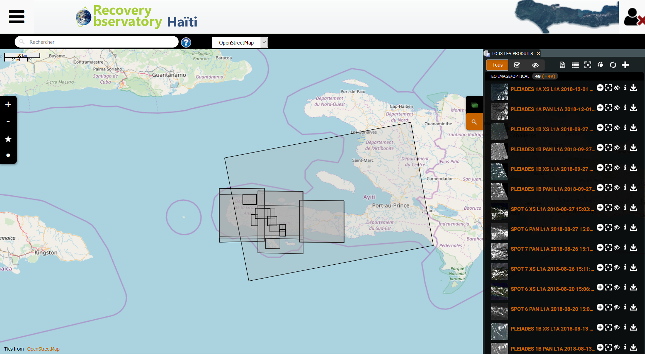
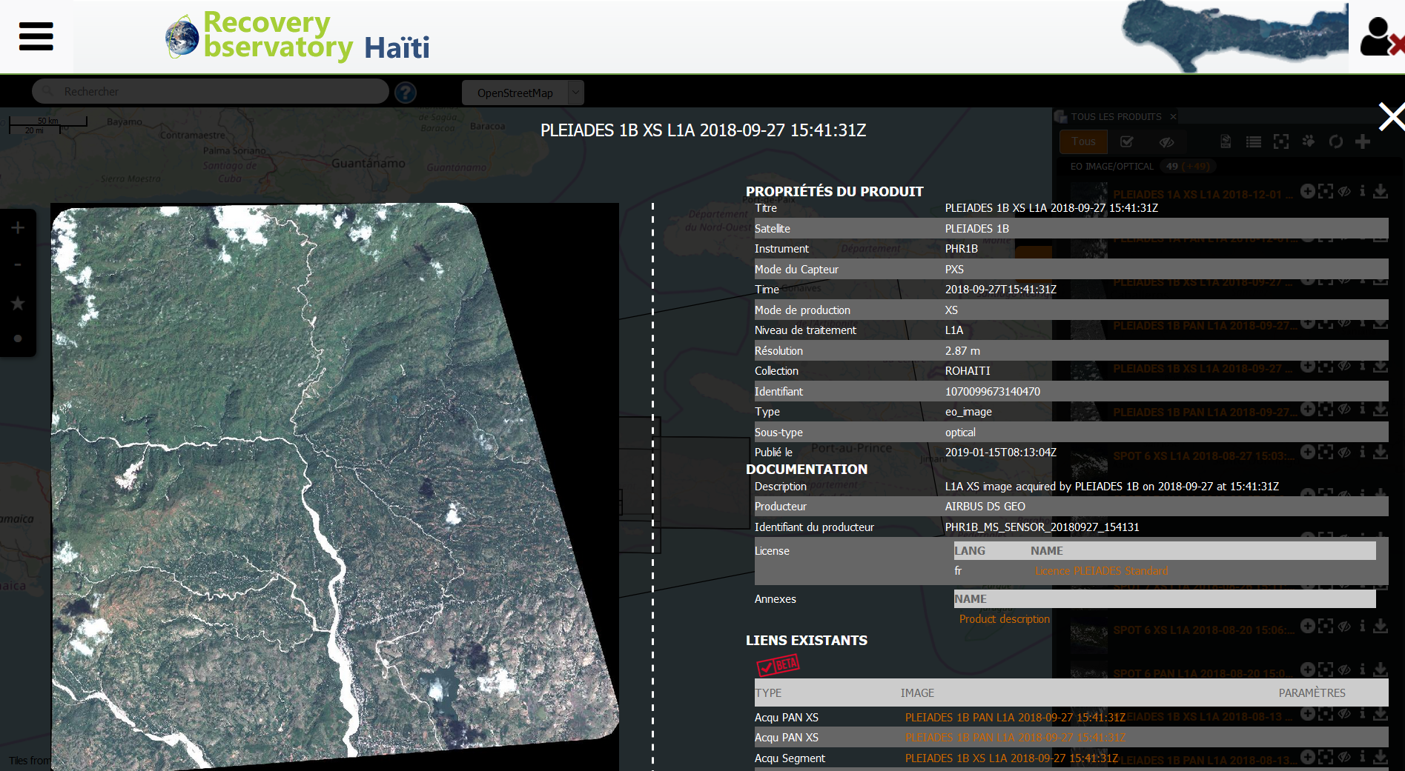
https://www.recovery-observatory.org

Slide 5
DotCloud Platform

Slide 6
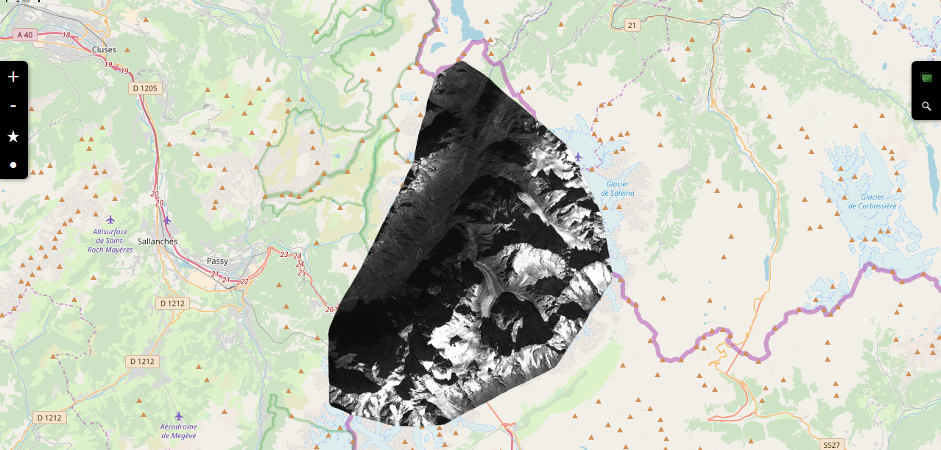
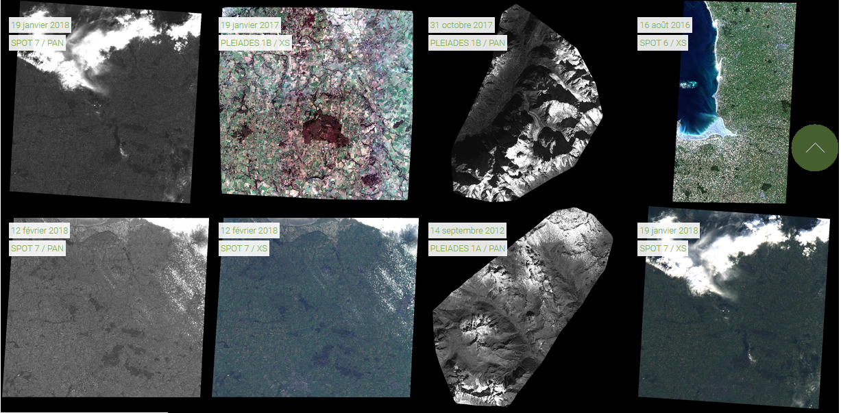
Dotcloud
Display full resolution data for authorized users, moderate resolution for others (RESTo, Mapshup, MapServer, Drupal)
Catalog of data acquired in the framework of Projects and its value added products
Quick access to QL, catalog metadata, advanced search function
Showcase of work within Projects

Slide 7
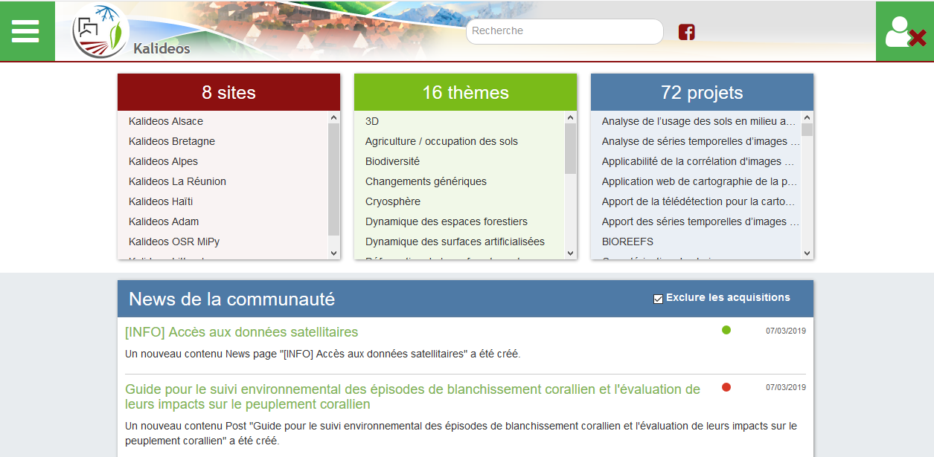
Dotcloud : a community of Users

Slide 8
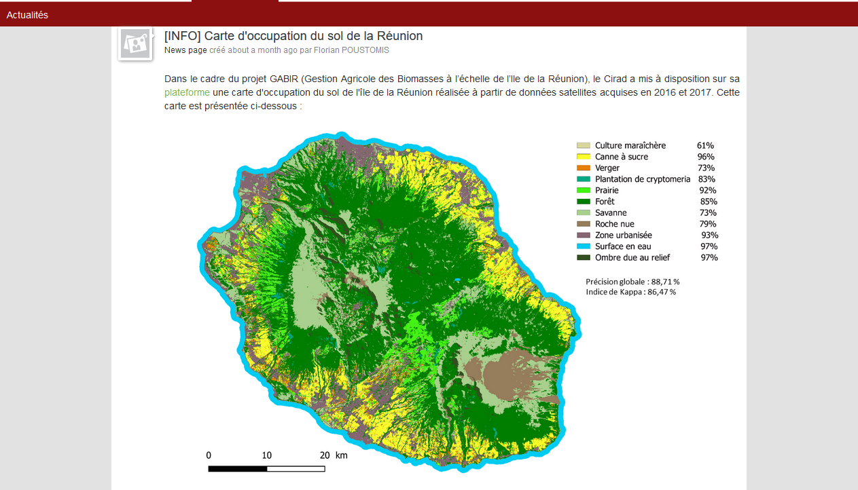
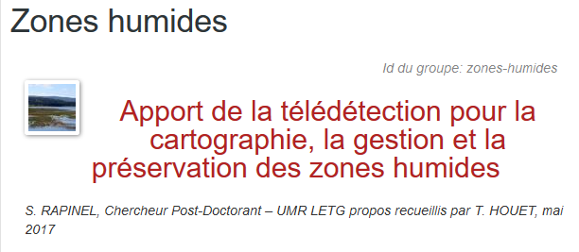
Dotcloud
Community animation
Exchanges between actors
User feedback

Slide 9
Extract from presentation to WGD #10
Recovery Observatory (RO) Haiti Hurricane Matthew RO Status and Next Steps

Slide 10
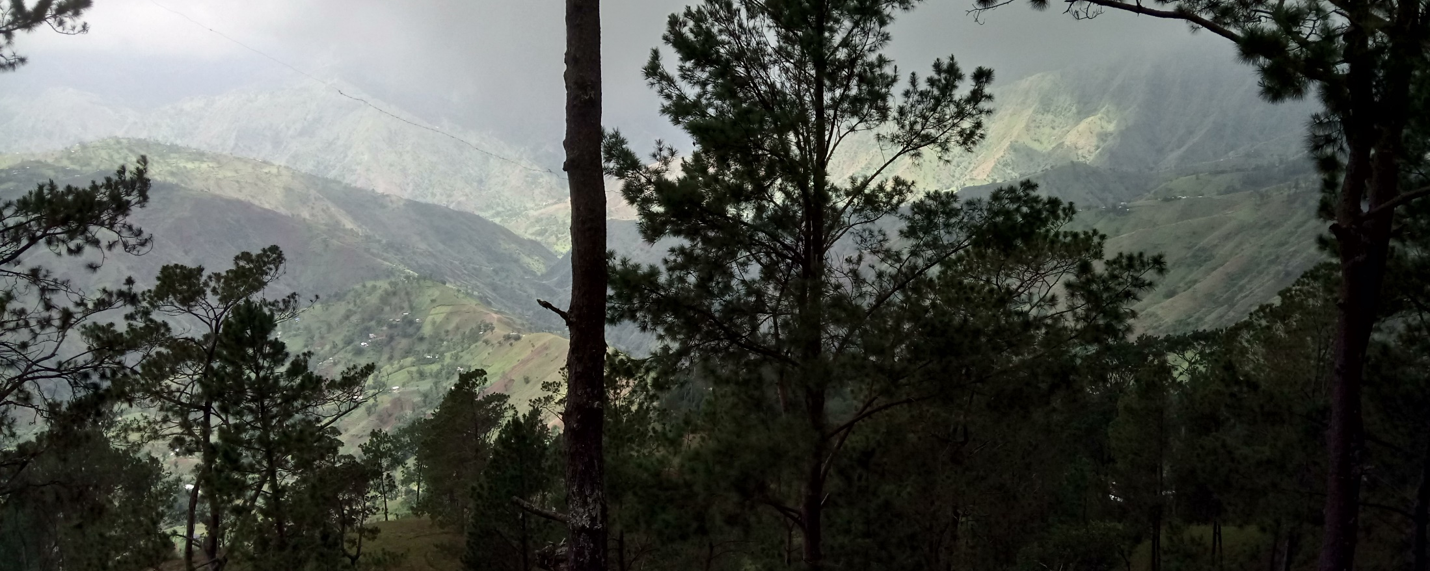
RO Haïti Status Overview
Hurricane Matthew
in Haïti
Oct 4th 2016
A Reminder of Haiti’s diversity
Triggering of the RO by CEOS Chair - December 22, 2016
Mission #1 to Haiti - end January 2017 Definition of activities in Haiti
Mission #2 to Haiti 29 May – 2 June 2017 1st RO users workshop
Mission #3 to Haiti 5 Dec - 8 Dec 2017 technical review , link universities
Mission #4 to Haiti 8 – 11 Mai 2018 - 2nd User Workshop (PàP + Les Cayes)

Slide 11
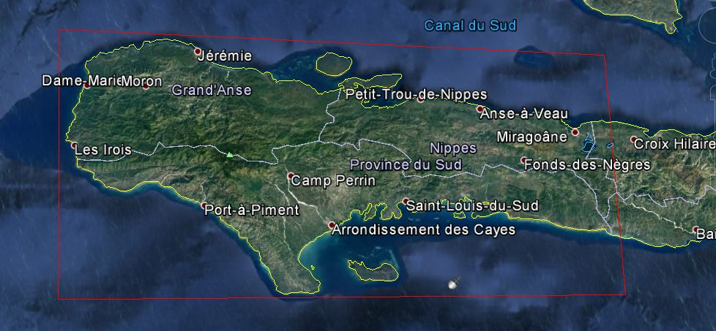
Haiti RO covers three departments: Grand’Anse, Sud, and Nippes

Slide 12
RO Thematic Products
Produit | Utilisateur-clef | Elaboration | Données satellites
Buildings | CIAT/ Planning Ministry | SERTIT, Copernicus EMS | Pléiades, WV
Land Use | ALL | CNIGS/CNES | Orthophotos, Sentinel-2
Forest | ONEV /Environnement Ministry | Copernicus EMS | S2, Spot6/7, Optique THR
Agriculture | Agriculture Ministry | Copernicus EMS | Sentinel-2, SPOT
Macaya Park Monitoring | ANAP / ONEV / Env. Min. | Copernicus EMS SERTIT | Optical THR, radar THR
Watershed / Flood | ONEV/ Agriculture Ministry | CIMA Foundation | MNT 1m/20cm and radar THR
Terrain Motion / Mining quarries | BME / Public Work Ministry | EOST, ASI | CSK, Pléiades, Spot6/7
Vector Borne Disease risk | Heath Minister/ OMS | NOAA | L8, Images NOAA + statistic needs
Air pollution | ONEV / Ministère Santé | NASA | S5P Tropomi Interest pronounced
+ some new precise needs
(more after on different thematics)

Slide 13
RO Timeline
Infrastructure
Product definition, image requirements
Lessons
learned
RO Haiti Triggering
12/22/16
Early RO evaluation
2015 2016 2017 2018 2019 2020
jfmamjjasond jfmamjjasond jfmamjjasond jfmamjjasond jfmamjjasond jfmamjjasond
PDNA
ROOP
Today
Hurricane Matthew
in Haïti
10/04/16
Malawi, Nepal
Demonstrators
Missions to Haiti (2 to 3 per year)
Technical Review
5-8 Dec
1st
31 Jan – 3 Feb
1st User Workshop
29 May – 2 June
2nd User Workshop
8 – 11 May
External Mission
Generic RO
WB + UNDP DC

Slide 14
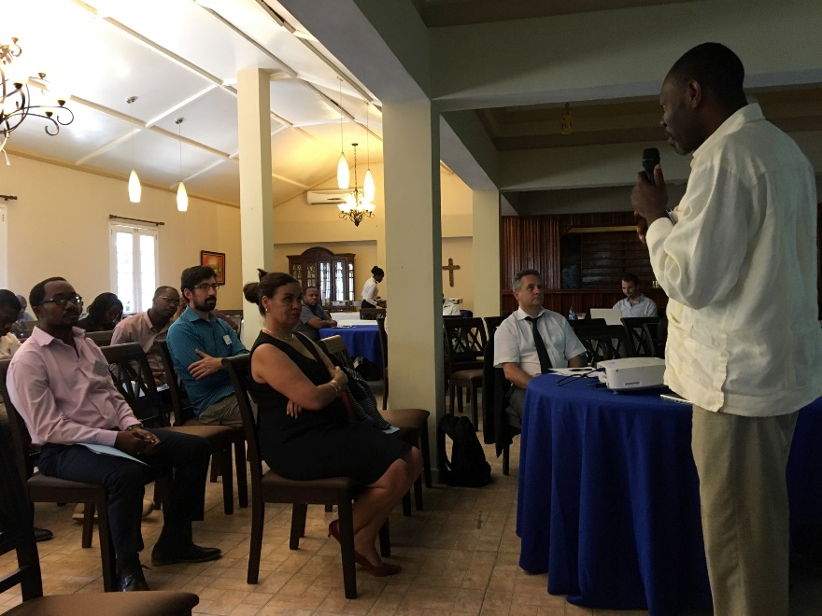
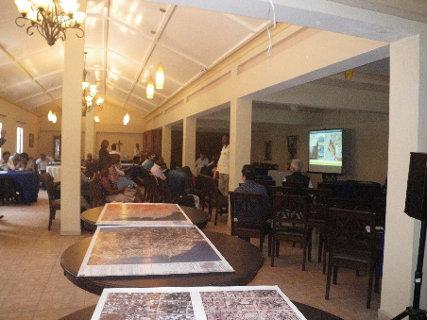
Mission : User Workshop #2
First Workshop « local users » Les Cayes – 8 mai 2018
About Thirty participants, including :
The Major of Jérémie
Les Cayes councils
American University of les Cayes
MARNDR (Agriculture ministry)
MDE/ONEV (Environment ministry)
PADF (Pan American Devlpt Found.)
ONU-Habitat
ONG Global
First analysis of products
Awareness of project objectives
Clear involvement of local actors in support of the project
Identification of training needs and capacity development
The Mayor of Jérémie during the workshop

Slide 15
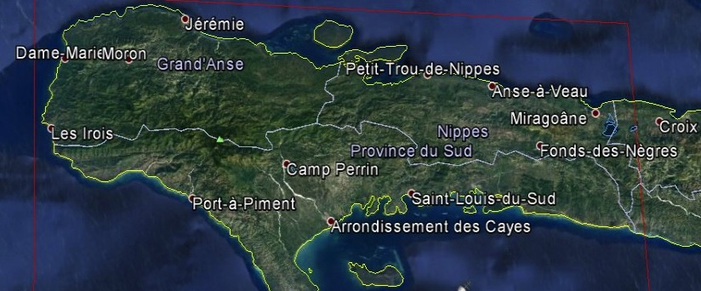
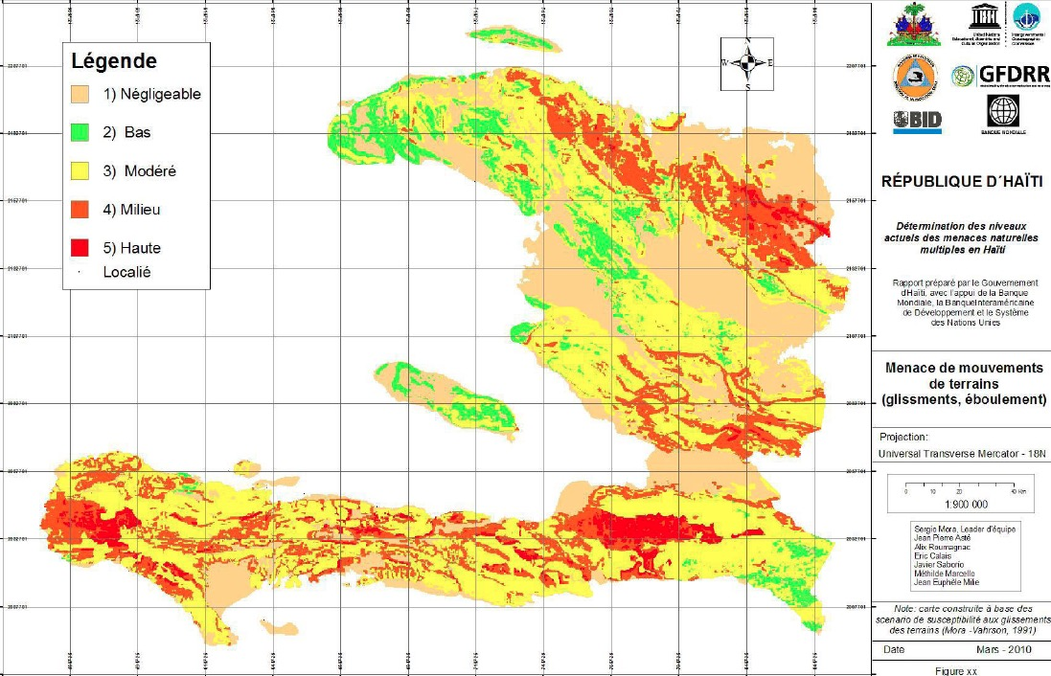
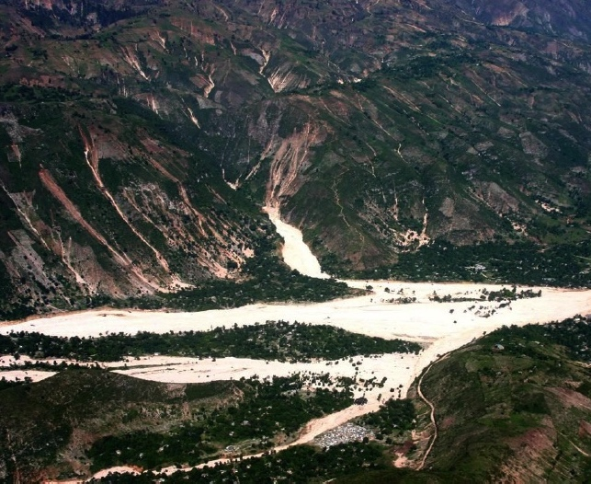
Post-hurricane landslide detection and mapping: Haiti
First landslide susceptibility map for the country
Topogragy = first driver of landsliding
Map created without landslide information
Landscape after Matthews
Major rain events
Cuba

Slide 16
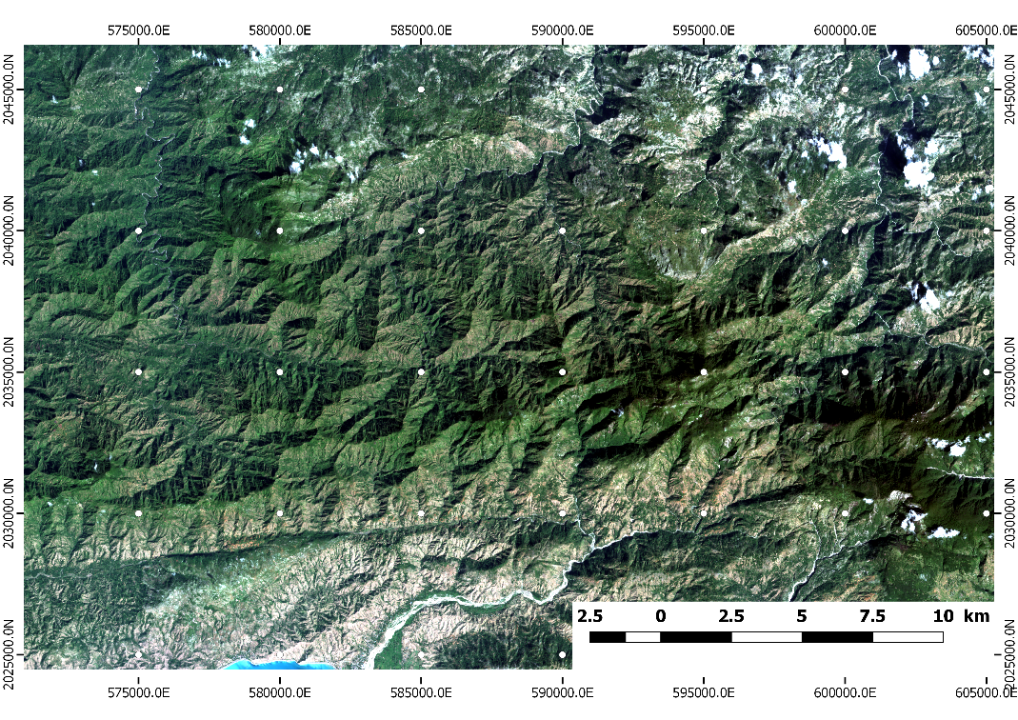
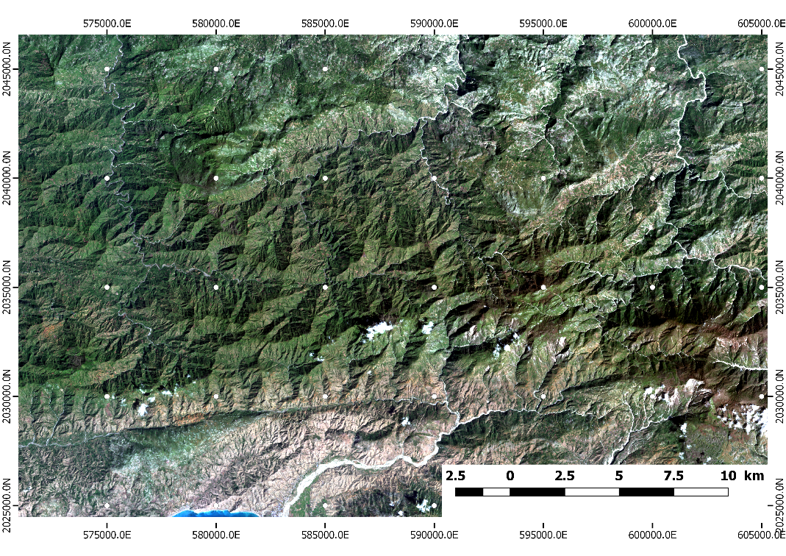
Post-hurricane landslide detection
and mapping: Haiti
Spot 6 pre-event 2016/04/14 (1.5m)
Spot 7 post-event 2017/04/04 (1.5m)

Slide 17
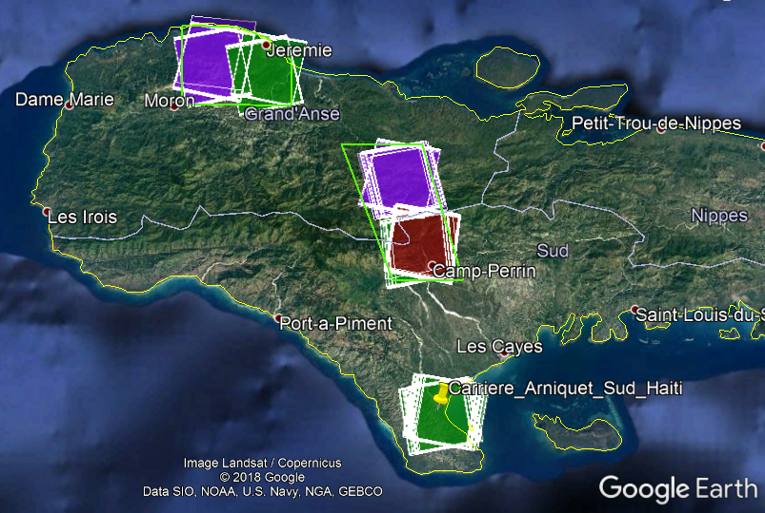
ASI – Terrain motion products
Satellite data → newly acquired ASI’s COSMO-SkyMed X-band data
3-year long tailored monitoring campaign [started on 1st Dec 2017]
SpotLight images at very high spatial resolution (1 m)
Ascending and descending mode acquisition geometries, 16 days revisit time
SpotLight data status as of 31/08/2018
More than 160 COSMO-SkyMed SpotLight scenes already acquired for the target areas
~16 scenes per site, per geometry
(as of 31/08/2018)

Slide 18
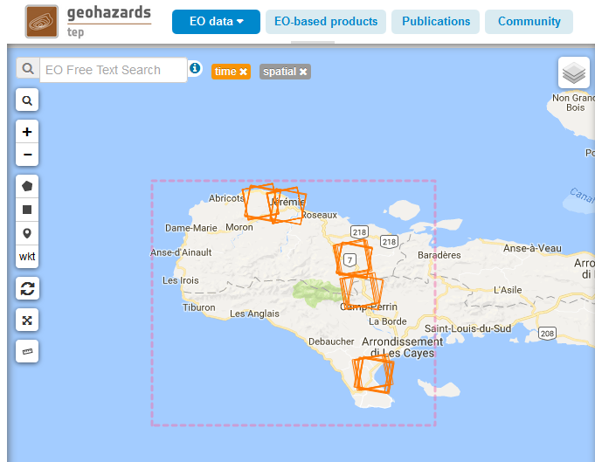
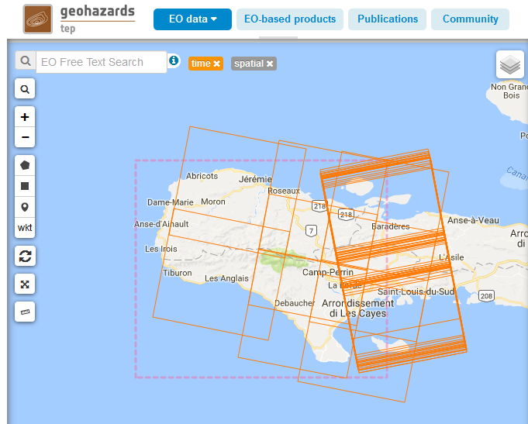
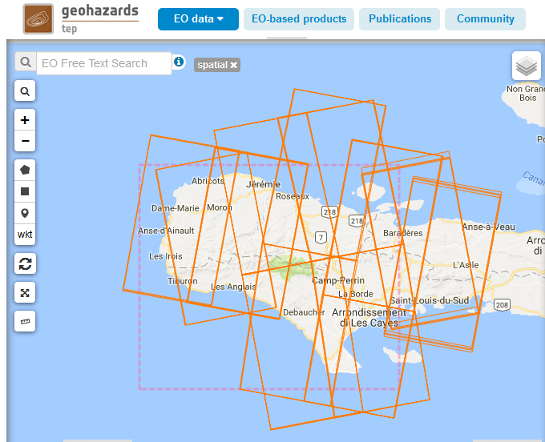
ASI – Terrain motion products
Exploitation of ESA’s Geohazards Exploitation Platform (GEP)
Feb 2018: RO-Haiti GEP project approved
Mar/Apr 2018: work with ESA and Terradue to setup GEP account & tools
Task 1: Ingestion of new SAR data into GEP [Feb 2018 - present]
COSMO-SkyMed: regularly uploaded by ASI and ESA onto ESA’s ftp since Feb. 2018
TerraSAR-X: link with DLR server established by DLR and ESA in Feb. - Mar. 2018
COSMO-SkyMed SpotLight
COSMO-SkyMed StripMap
TerraSAR-X StripMap

Slide 19
Copernicus EMSN50 (buildings)

Slide 20
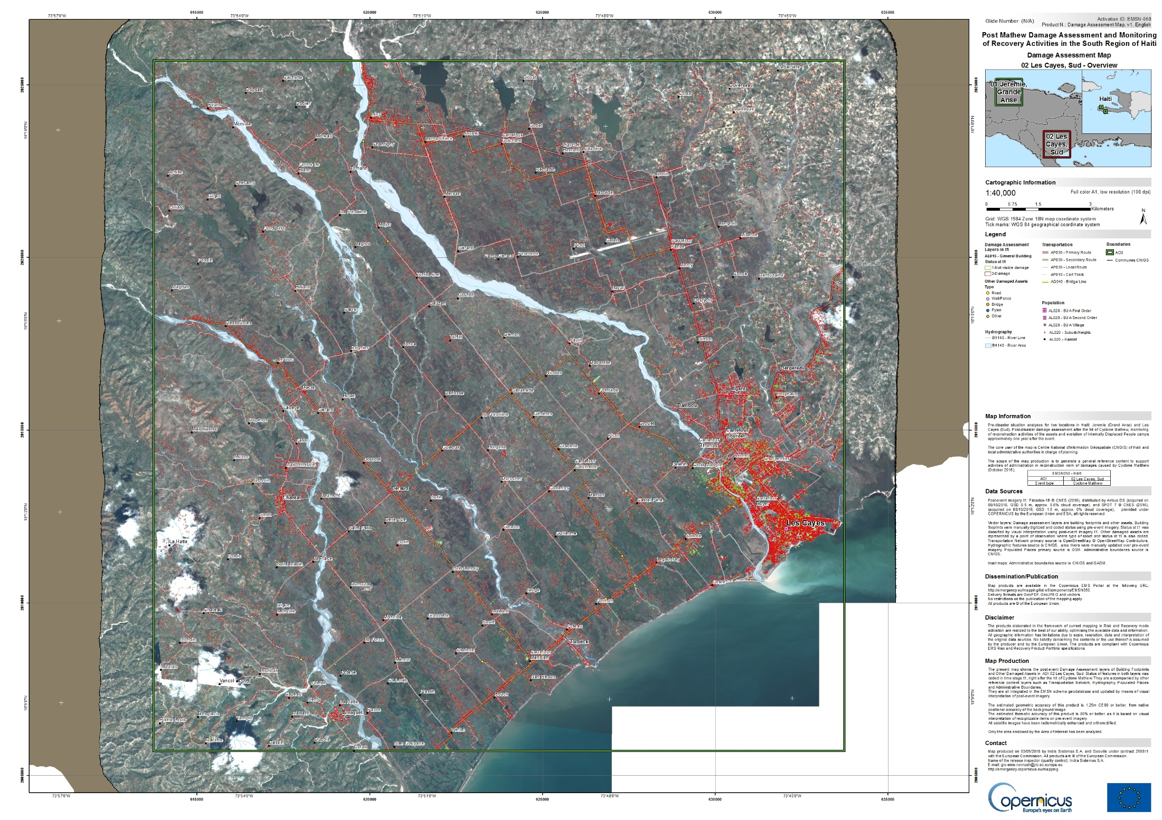
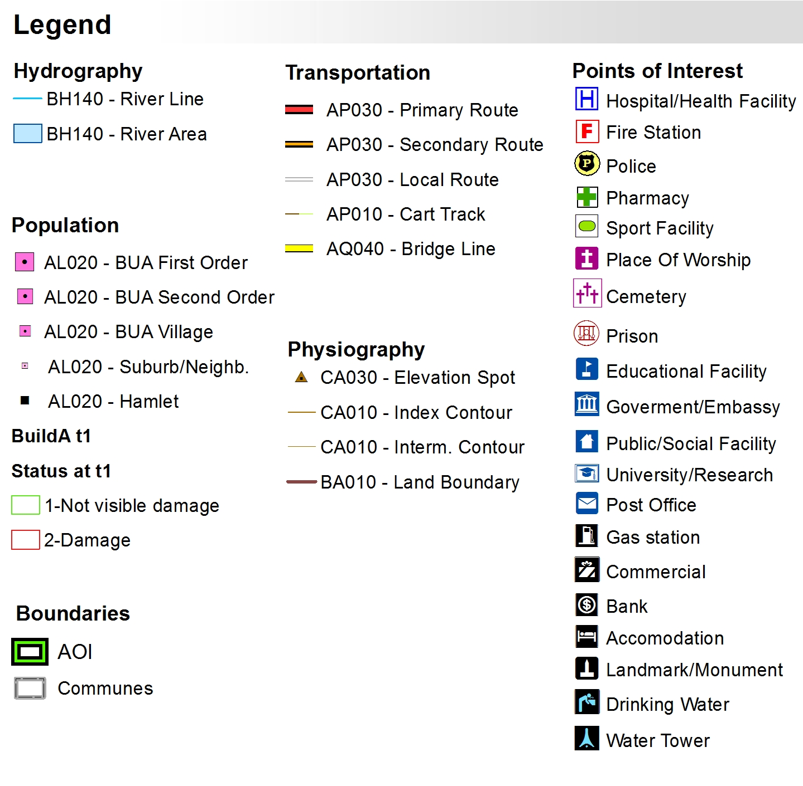
Copernicus EMSN50&51

Slide 21
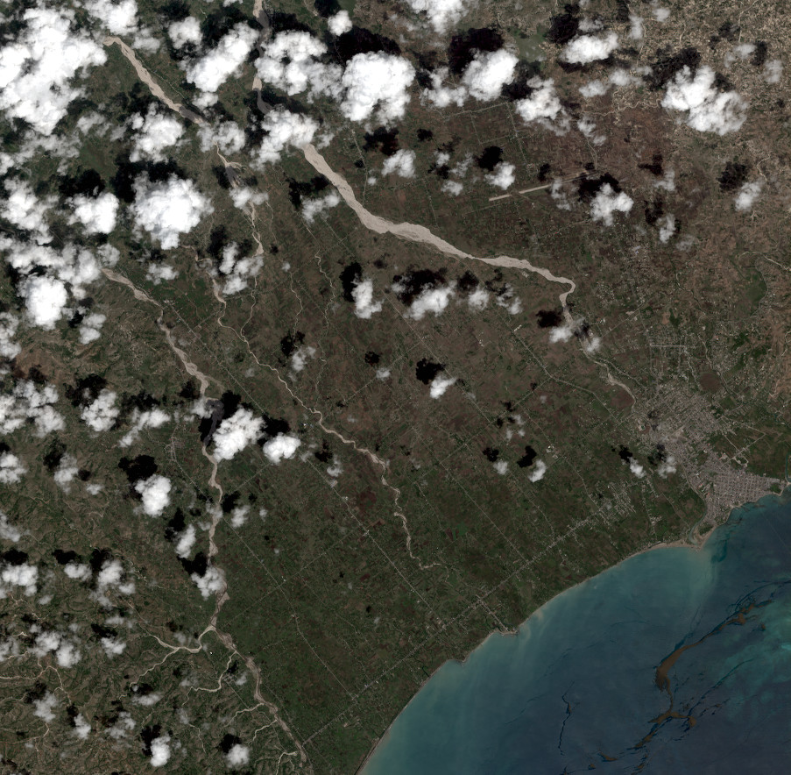
Links with NASA, NOAA, WB Haiti
WB Haiti - Les Cayes Agriculture
Links with a new WB « post Irma » agriculture study in Les Cayes
How does Climate Change change impact agriculture?
Understand local impact of Climate Change
Pioneering work on how one could make a sustainable plain irrigation system
Exchanges of Data (satellite images / ground observations) and sharing results
Another “post Irma” WB study should benefit from RO data in the coming months
NOAA
Discussions about vector borne diseases evaluation, further expression of interest by Health ministry. Will use L8 and NOAA images but need public health statistical data (accessibility TBC during next mission)

