Slide 1
EOSDIS Approach to
Data Services in the Cloud

Slide 2
Data Transformation Services in the Cloud
Subsetting: Variable, Spatial, Temporal
Reformatting: shapefile, etc.
Regridding / Reprojection / Orthorectification
Stitching / Mosaicking
Dataset-Specific Preprocessing
Despeckling for Synthetic Aperture Radar
Geophysical Retrievals
Etc.

Slide 3
What Makes Cloud Different?
What’s New? | So What?
Data egress costs money | Subsetting saves money
Data processing costs money | We have to watch costs of transformations
Processing faster does not cost more | Transformations that used to be orders may be streamable (synchronous)
Transformation code is easily shared via containers or machine images | Users can transform at their own speed
Data are stored in Web Object Storage, not filesystems | Current tools (may) need to be adapted to read the input data

Slide 4
User Interaction Patterns
synchronous streaming
request
subsetting 1 file
100100110001010111...
synchronous staging
request
preprocessing 1 file to Analysis-Ready Data
data “handle”
request
aggregating many files
asynchronous staging
data “handle”

Slide 5
How Reuse Can Work
Source Code
Package Installation (conda, homebrew, …)
Python module
Container
Amazon Machine Image (AMI)
Service

Slide 6
Reuse Targets
Legacy Source
gdal: the core of virtually every Geographic Information System
nco (netCDF Command Operators): fast netCDF preprocessing and analysis
Sentinel Application Platform (SNAP): easy to use Synthetic Aperture Radar and other processing
Open Geospatial Consortium Services
Recent Packages
Python: pandas, xarray, scikit-learn…
R: ?
Future: Analysis-Ready Data processing components and chains
*netCDF = network Common Data Form

Slide 7
Managing Cost
Egress vs. Processing vs. Storage
“Easy” Calls:
Promote subsetting and other data reduction
Promote analysis “in place”
Harder tradeoffs
How much to do for the user?
How much to cache?
New Tasks
Developing the most cost-effective data transformation capabilities
Monitoring ongoing expenditures vs. budget

Slide 8
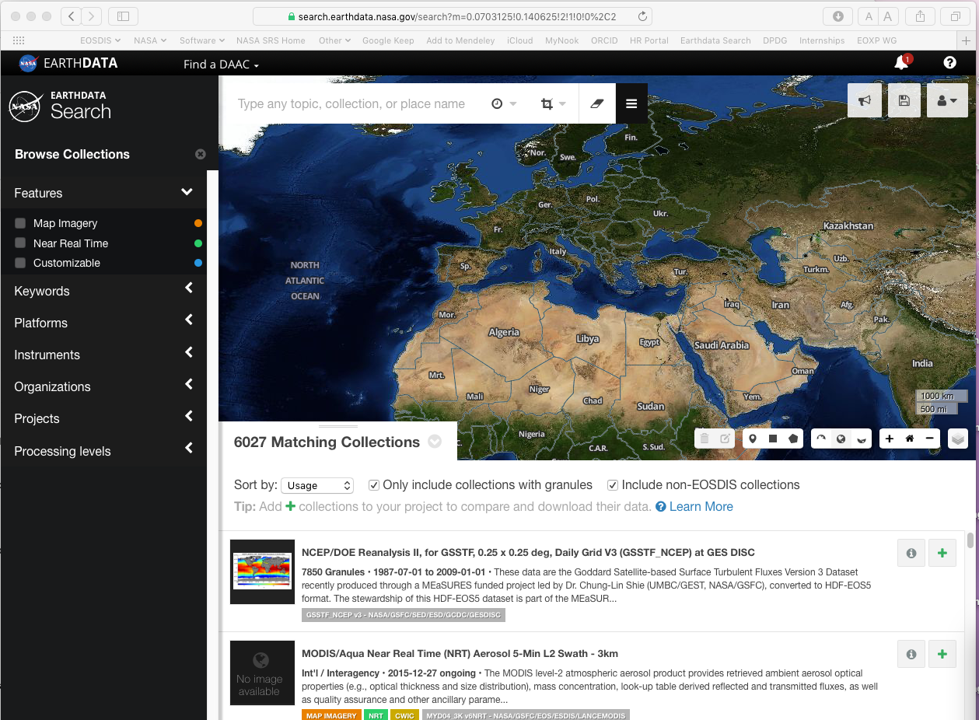
Interfaces: User vs. Application
Python
pandas
xarray
netcdf
zarr

Slide 9
Interface Convergence in Jupyter
Jupyter
Python
pandas
xarray
netcdf
zarr

Slide 10
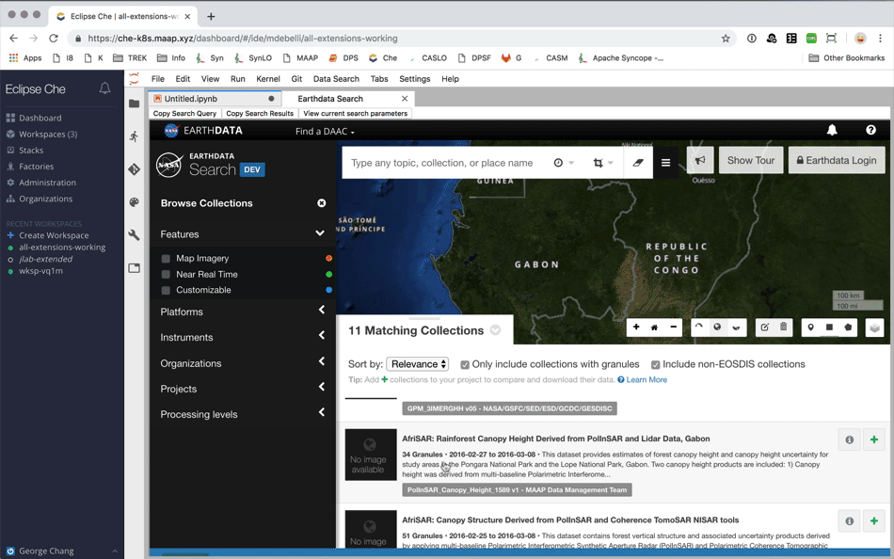
User-Application Interface Convergence in Jupyter

Slide 11
Search - Analysis Convergence
Search
Search
Search
Analyze
Download
Analyze
Analyze

