Slide 1
Workshop on Leveraging AI in the Exploitation of Satellite Earth Observations and Numerical Weather Prediction
Summary of the
Presented by Sid Boukabara*
NOAA/NESDIS Center for Satellite Applications and Research (STAR)
With Contributions from Workshop Science Committee members
P. Tissot (Texas A&M),D. Hall (NVIDIA), V. Krasnopolsky (NOAA), A. Huang (U.w), J. Stewart (NOAA/CSU), J. Ten Hoeve (NOAA), J. Williams (IBM), K. Ide (UMD), N. Oza, Nikunj (NASA), P. Dolan (Google), S. Haupt (UCAR), E. Kearns (NOAA), K. Casey (NOAA), J. Hickey (Google)
CEOS/WGISS-47 Meeting, Thursday May 2nd, 2019, Silver Spring, MD, USA

Slide 2
Content
1
Workshop: Motivation Main Takeaways
2
Highlights of AI Applications in EO and NWP
3
Looking Forward

Slide 3
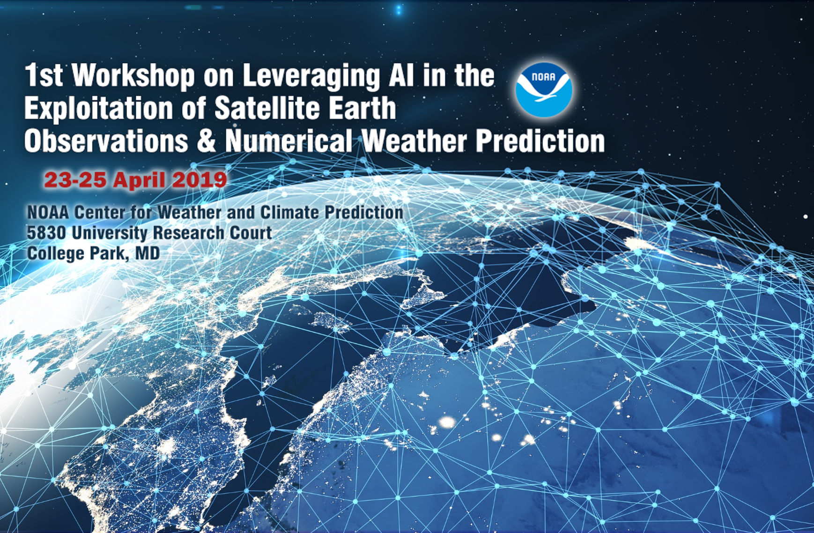
Objectives of the Workshop (What was intended):
Reviewing AI-enabling technology and tools
Furthering scientific objectives of better utilization of Earth observation
Sharing ideas to improve NWP skills
Improving efficiency of environmental data processing and exploitation for cost effectiveness
Identifying innovative ways to use satellite data and other environmental data to create new products and services and generate new markets
Expanding commercial markets of high-level environment-related products and services to benefit society and the economy
In other words, goal is infuse new numerical approaches such as AI and ML in NOAA systems, and in particular in areas where we face Big Data challenges
How:
By gathering scientists, program managers, and leaders from public, academic and private sectors.
By enabling experts involved in the development and adaptation of AI tools and applications to meet and exchange experiences with NOAA.

Slide 4
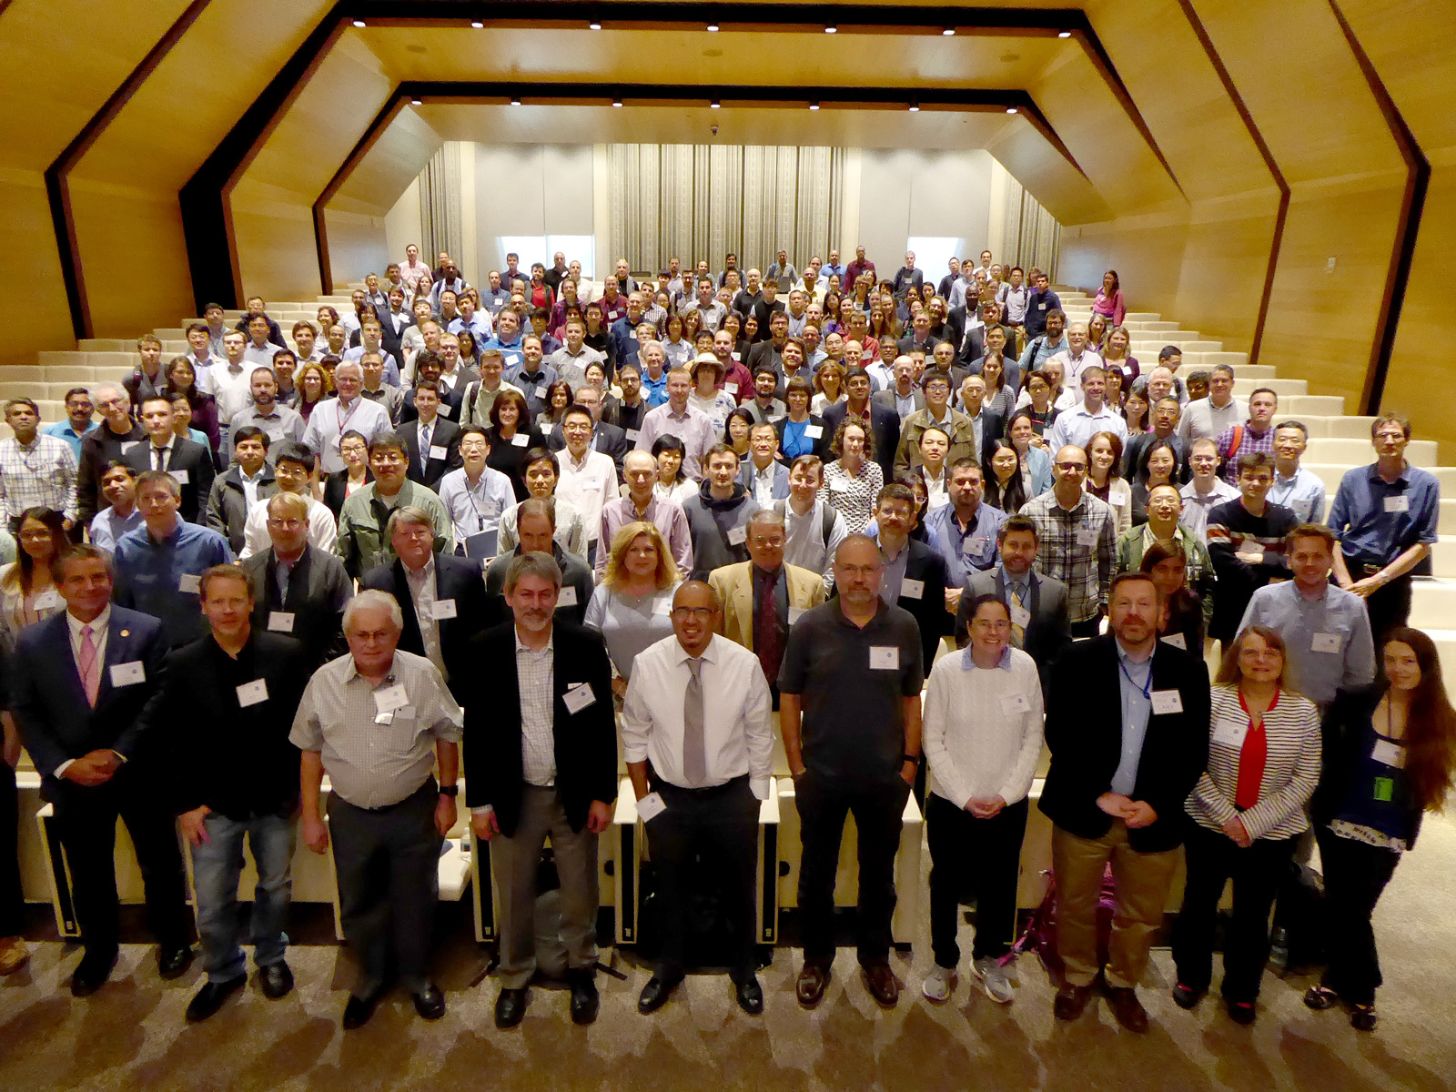
Participants
In person stats: Total registered: 444
Tutorials: 90
Oral presentations: 42
Poster presentations: 51
Panels: 3
Panelists: 17
Foreign Nationals: 75 Universities: 25 universities Private sector: 15 institutions Federal Agencies: 10: Countries: 10 WebEx stats:
Peak of 215 attendees
Universities: ~20 universities
Private sector: ~24 institutions
Federal agencies: ~8
Countries: 11

Slide 5
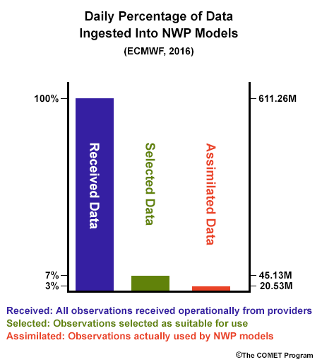
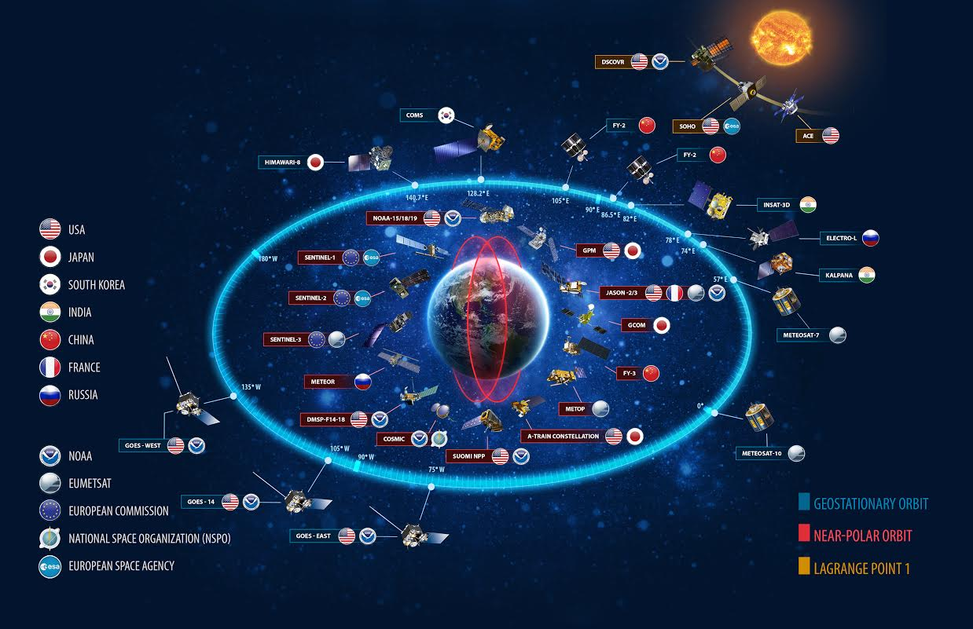
Main Motivations of the Workshop
GOS Trends:
New Sensors (higher resolutions, etc)
New technologies (small sats, etc)
Emergence of New GOS (IoT, etc)
New Players in GOS (international, commercial, etc)
Significant Increase in volume and diversity of data
Parallel Trends
Budget, HPC Constraints
Higher societal impact
Higher users expectations of enhanced model resolutions, accuracy

Slide 6
Main Highlights of the Workshop
Evidence was presented that AI has a significant potential for being a positively disruptive technology to support NOAA mission (more skills, more efficiency)
Good mixture of academic (Harvard, PSU, JHU, UCAR,..), private sector (Google, Microsoft, NVIDIA, IBM, ..) and federal sector (NOAA, NASA, Oak Ridge Lab, ..)
Strong appetite for Tutorials (for AI) for NOAA scientists
Strong desire for sustained AI-Science collaboration
Strong desire for sustained partnerships (Federal-Academic-private)
A lot of magic happened during the workshop: especially during breaks and lunch and posters sessions.
Establishment of the NOAA AI Working group –Open to partners
NOAA strong leadership backing
Workshop’s outcomes will contribute toward the NOAA AI strategy/roadmap

Slide 7
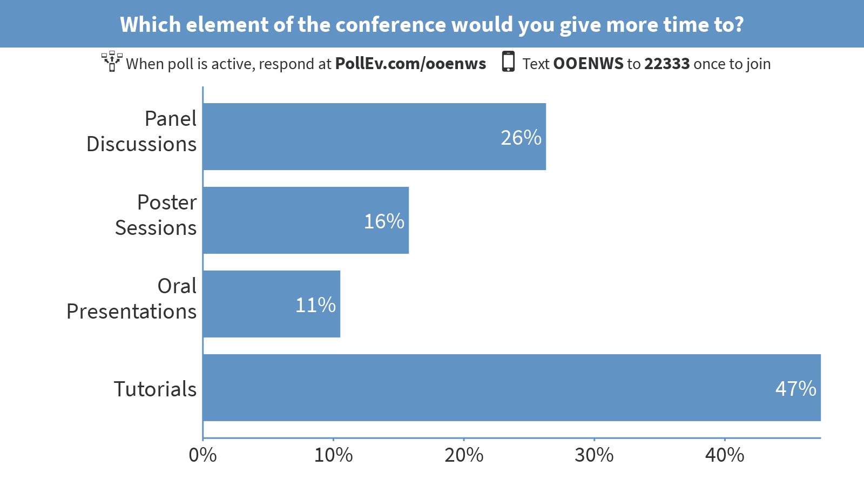
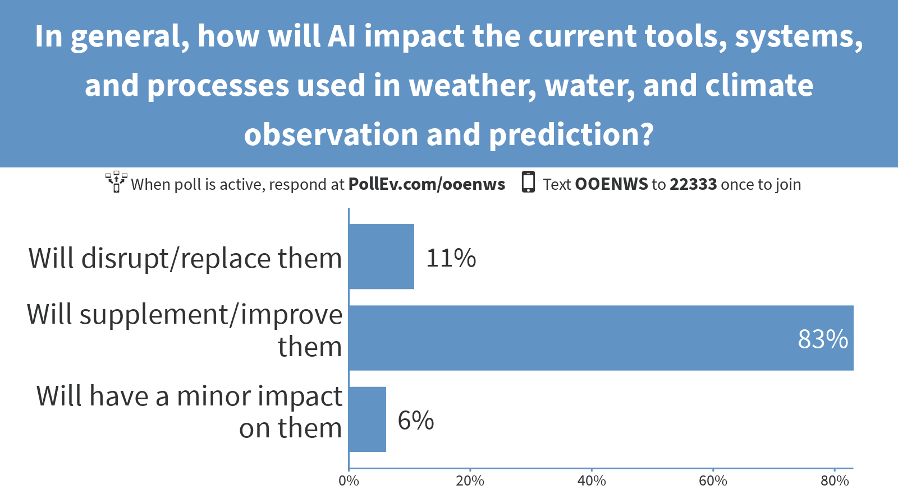
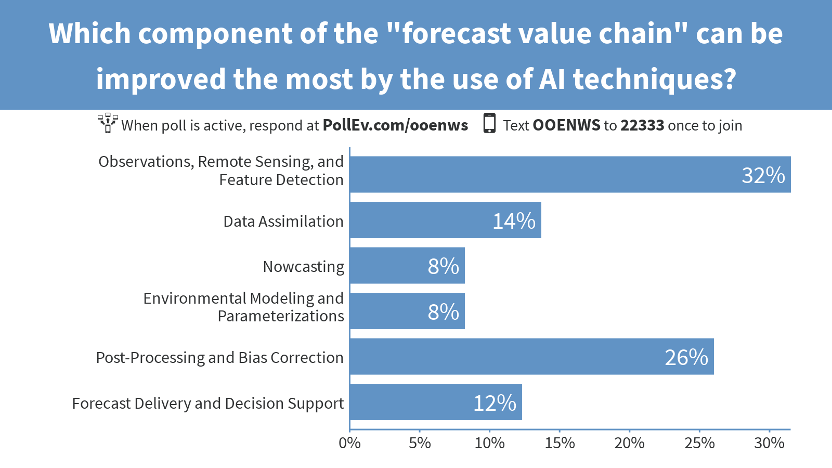
Audience’s Main Takeaways from the Workshop

Slide 8
Content
1
Workshop: Motivation Main Takeaways
2
Highlights of AI Applications in EO and NWP
3
Looking Forward

Slide 9
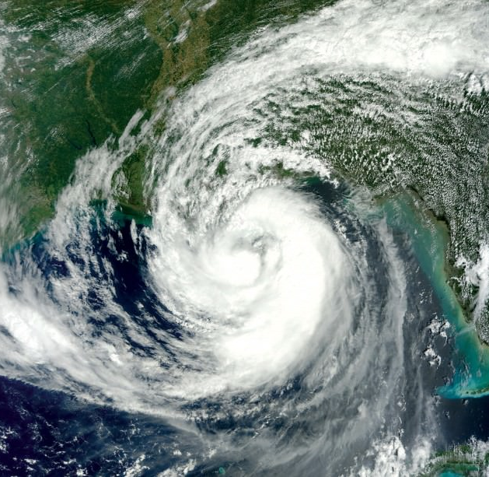
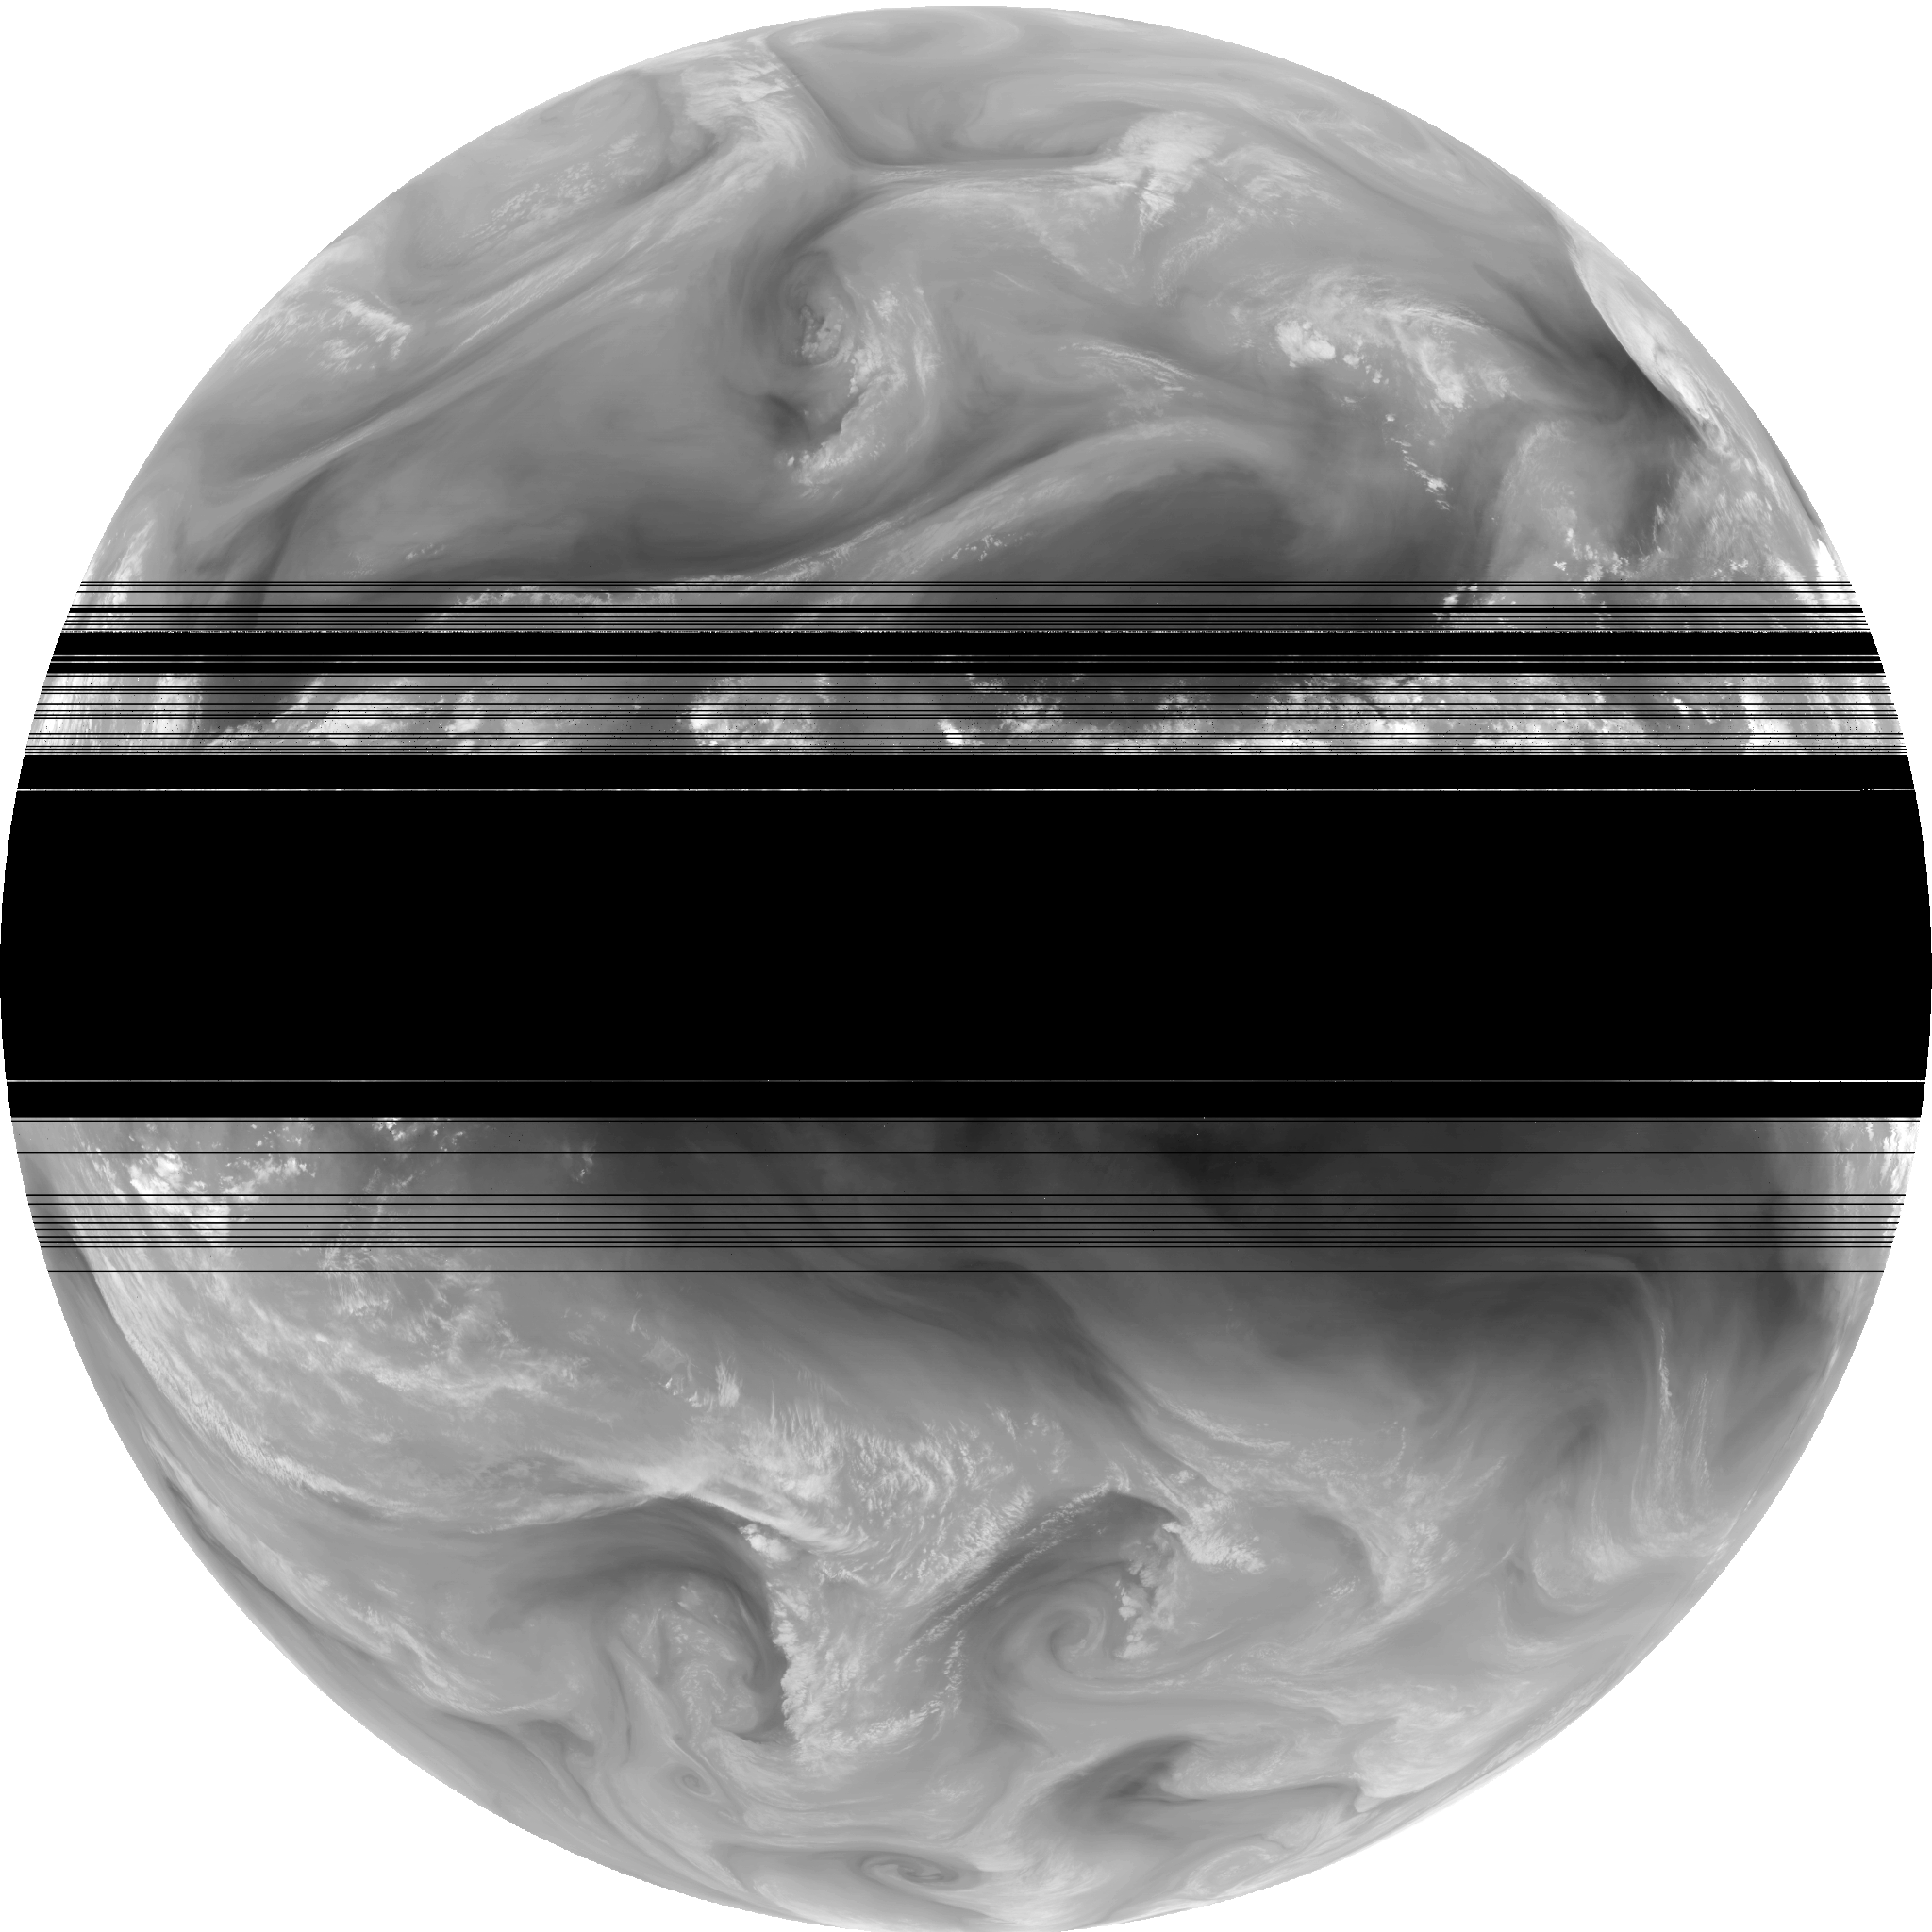
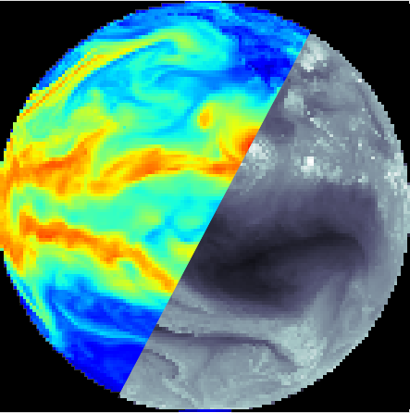
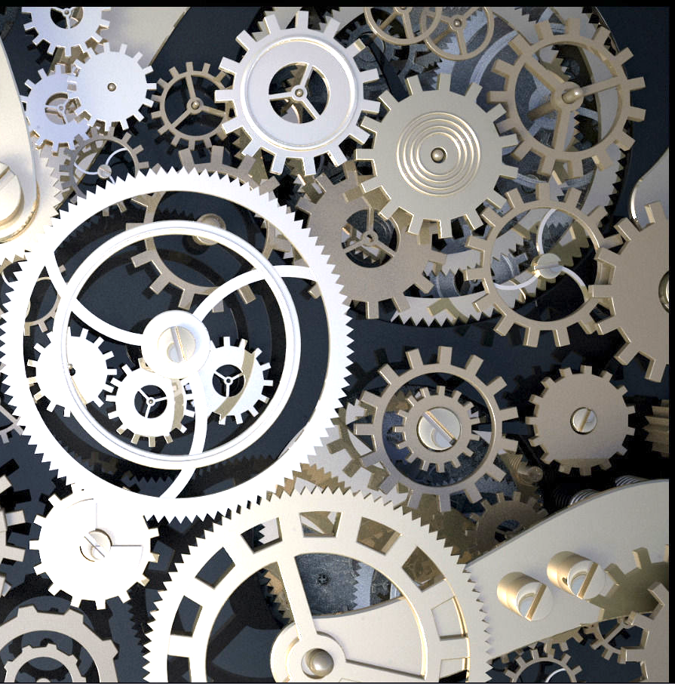
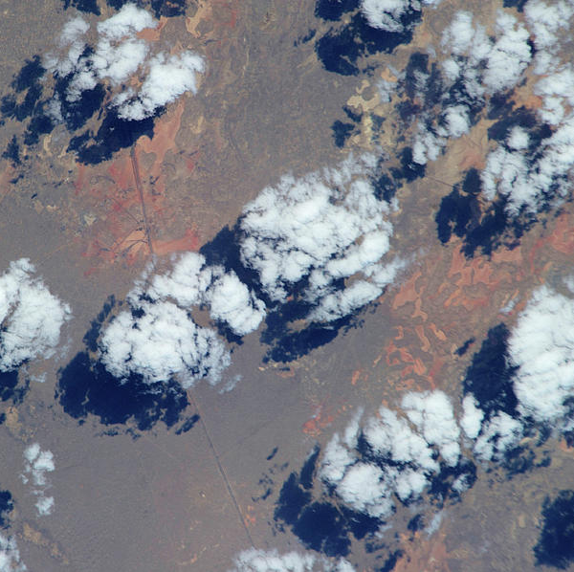
Applications of AI in NOAA-related Issues
detection
ENHANCEMENT
Credit: David Hall. NVIDIA
Tropical storms, extreme weather
Forest fires
Impact craters
Exoplanet light curves
Coronal holes, sunspots, CMEs
Storm damage
Frame repair
Sequence repair
Slow motion
Super-resolution
Cloud removal
Data augmentation
translation
EMULATION
Data Assimilation
Forecast verification
Model intercomparison
Common data formatting
Colorization
Digital Elevation from Imagery
Physics Acceleration
Turbulence
Radiation
Convection
Microphysics
Dynamics Acceleration
prediction
PARAMETRIZATION
Uncertainty prediction
Storm track
Storm intensity
Fluid motion
Now casting
Satellite frame prediction
New parametrizations
From higher resolution model
From observational data
Notes:
What sorts of things can we do with deep neural networks? Many many things.
When brainstorming about ways to apply deep learning to NWP, I came up with a large list of ideas, which is growing all the time.
Potential applications include: detection of extreme weather events, enhancement and repair of satellite data, satellite to model variable conversion for data assimilation, automated acceleration of expensive routines using neural-net emulation, time series prediction for now-casting or storm tracking, and the development of improved physical parameterizations from data.

Slide 10
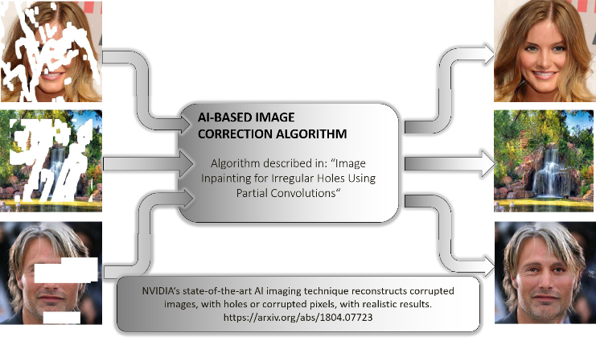
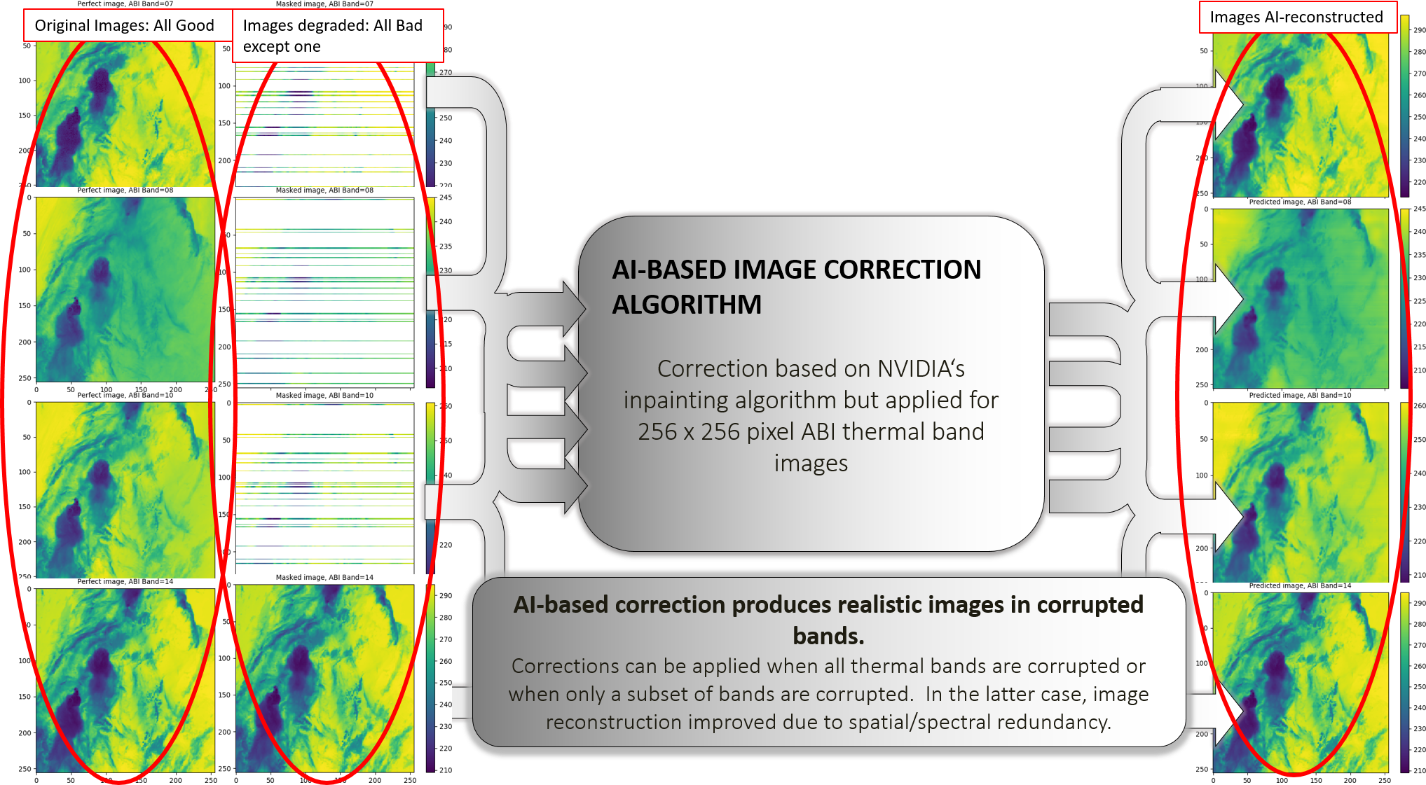
GOES-17 ABI Thermal Band Calibration Correction Using NVIDIA’s Image Inpainting Algorithm (U-Net Algorithm) –Gap Filling/Reconstruction

Slide 11
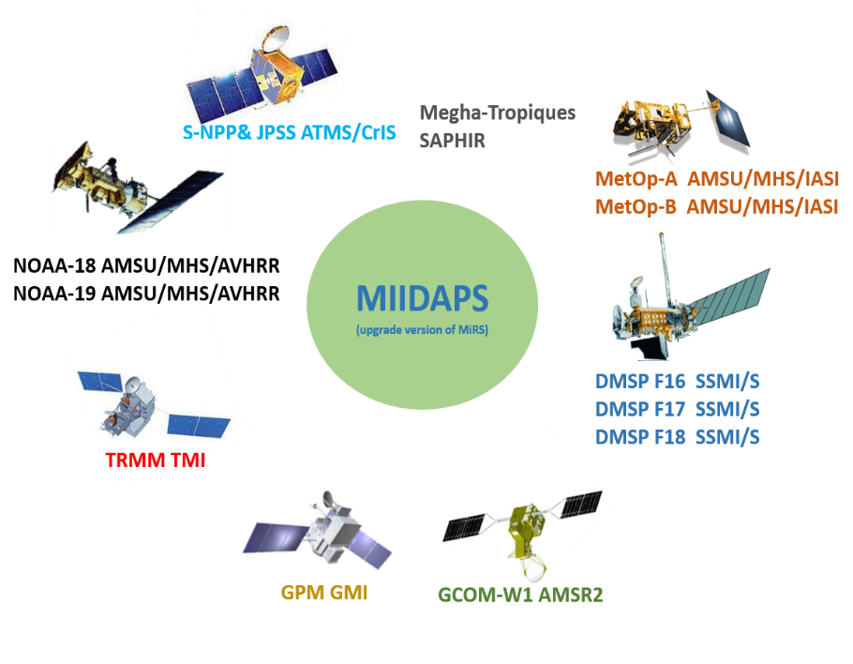
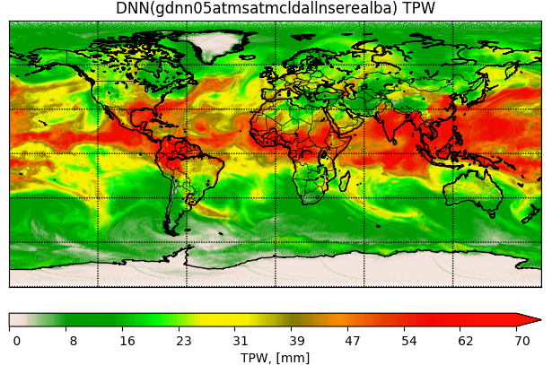
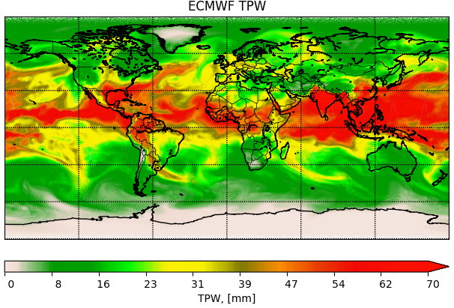
Pilot Project: MIIDAPS-AI: Multi-Instrument Inversion and Data Assimilation Preprocessing System
Use of Deep Neural Network (DNN) for Geophysical Retrieval and Quality Control Purposes
Google TensorFlow/KERAS Tools used for MIIDAPS-AI
MIIDAPS-AI outputs (TPW) Using SNPP/ATMS Real Data
Reference source of TPW: ECMWF Analysis
How to assess that AI-based output (Satellite Analysis) is valid?
Assessing quality by comparing against independent analyses
Assessing Radiometric Fitting of Analysis
Assessing analysis spatial coherence
Assessing inter-parameters correlations
MIIDAPS-AI
ECMWF
 | MIIDAPS-AI | MiRS
Processing Time for a full day data. A single sensor (ATMS). Excluding I/O | ~5 seconds | ~ 2 hours
11

Slide 12
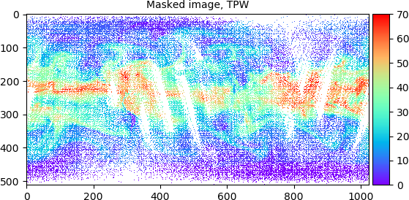
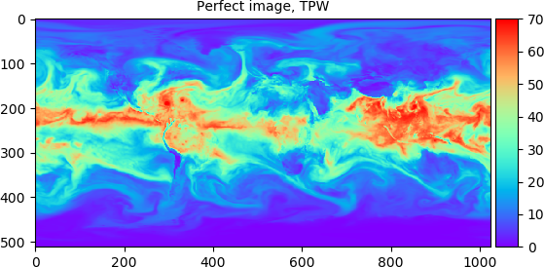
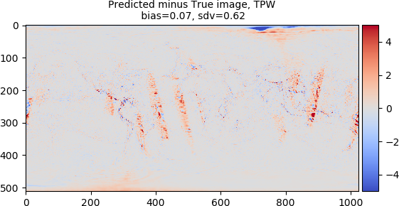
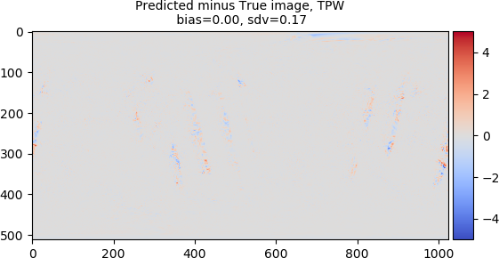
Estimation of TPW at 0.35ºx0.35º without background Info (Data Fusion mode)
Assessing AI-based Data Assimilation and Fusion: (U-Net Algorithm) –Gap Filling/Reconstruction
Estimation of TPW at 0.35ºx0.35º with background Info (Data Assimilation mode)
Timing to estimate T(500hPa) and TPW at 0.35ºx0.35º on a single Tesla P100 (Pascal): 1.8 sec for 18 cycles or 0.1 sec/cycle

Slide 13
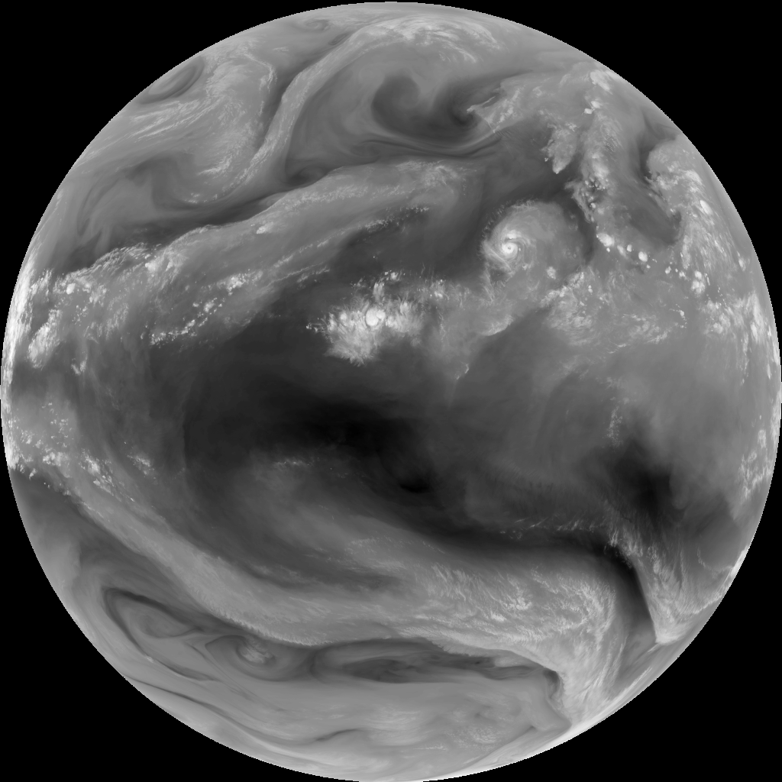
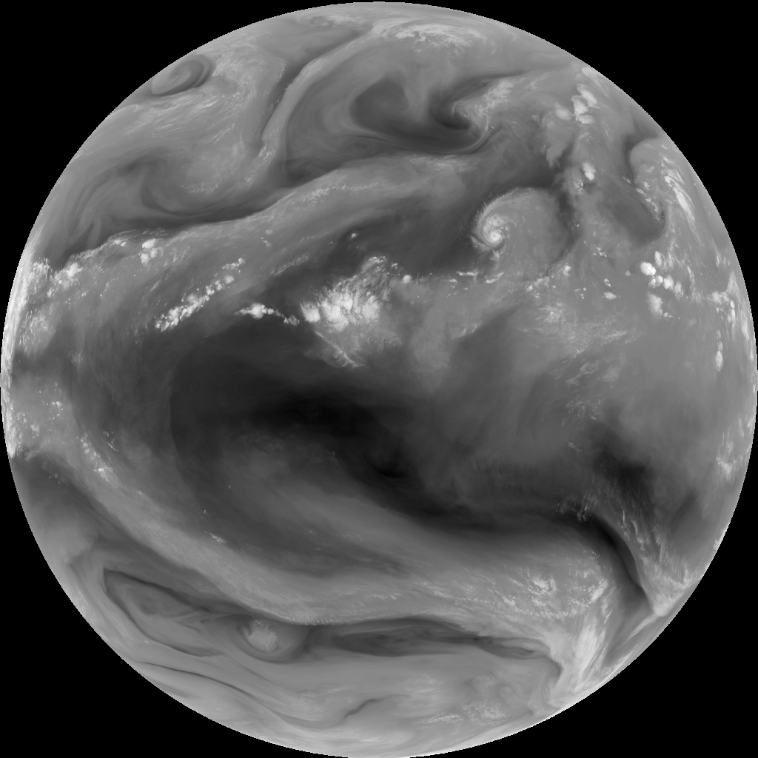
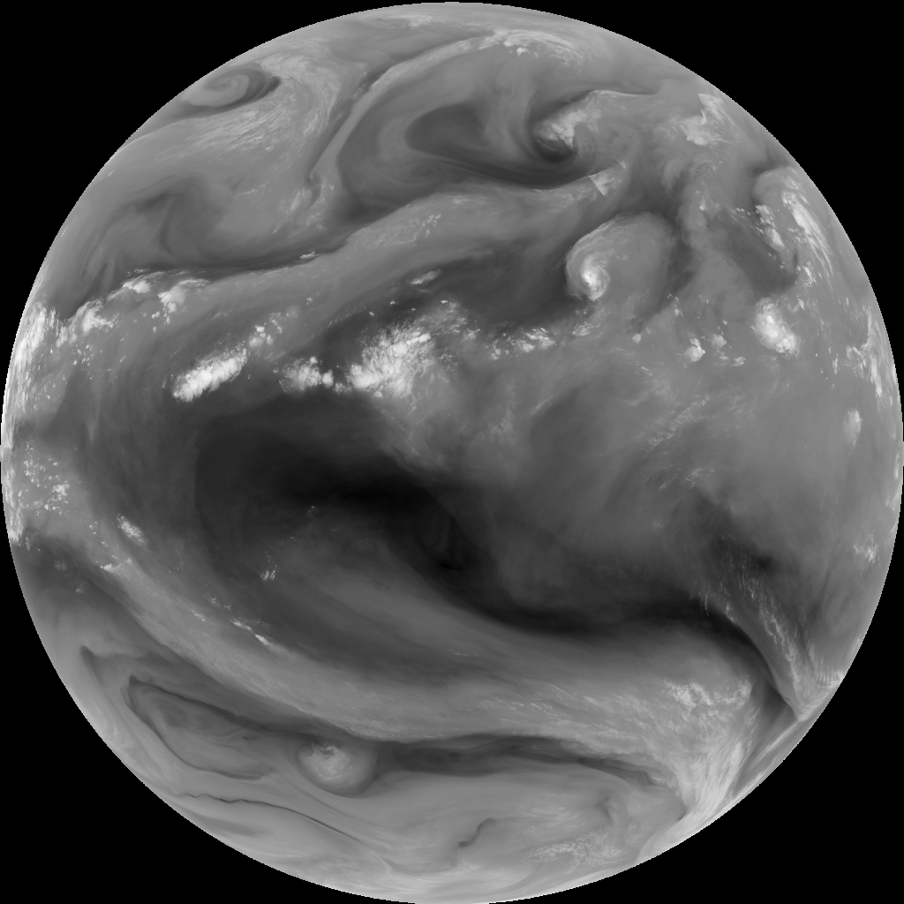
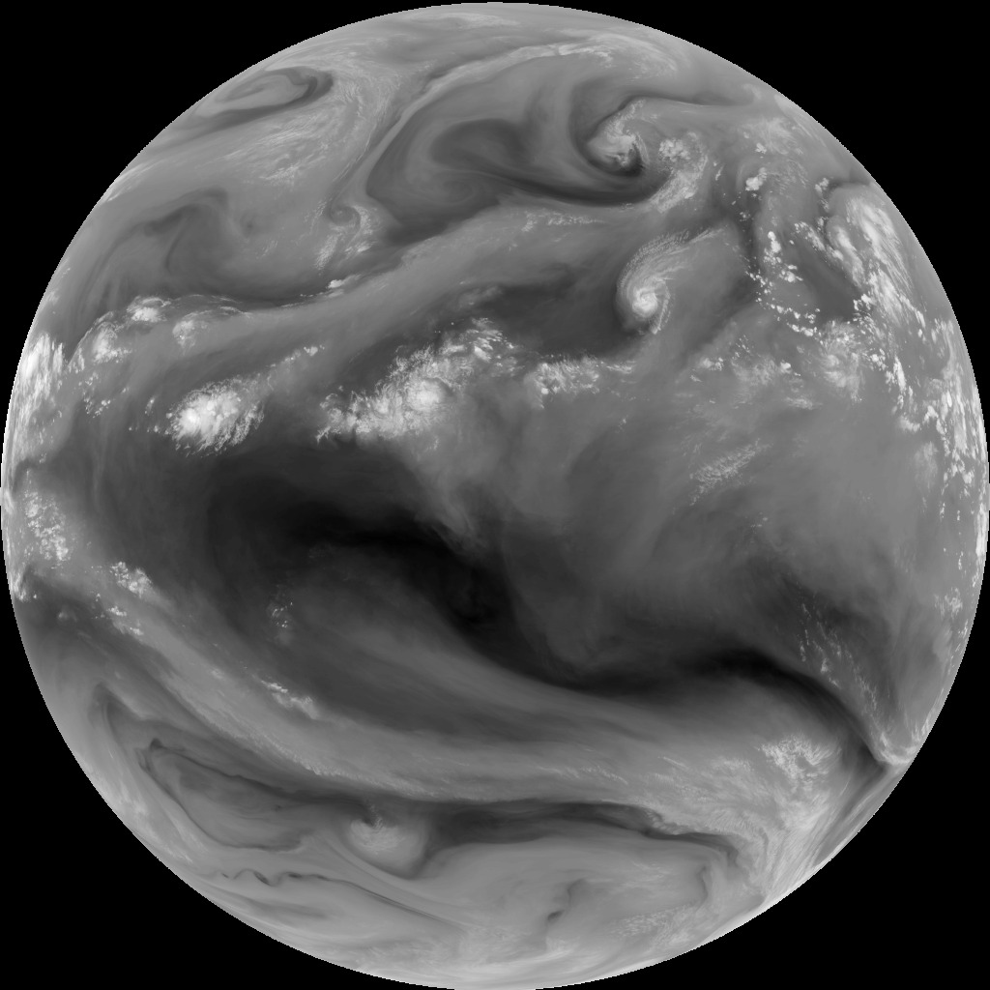
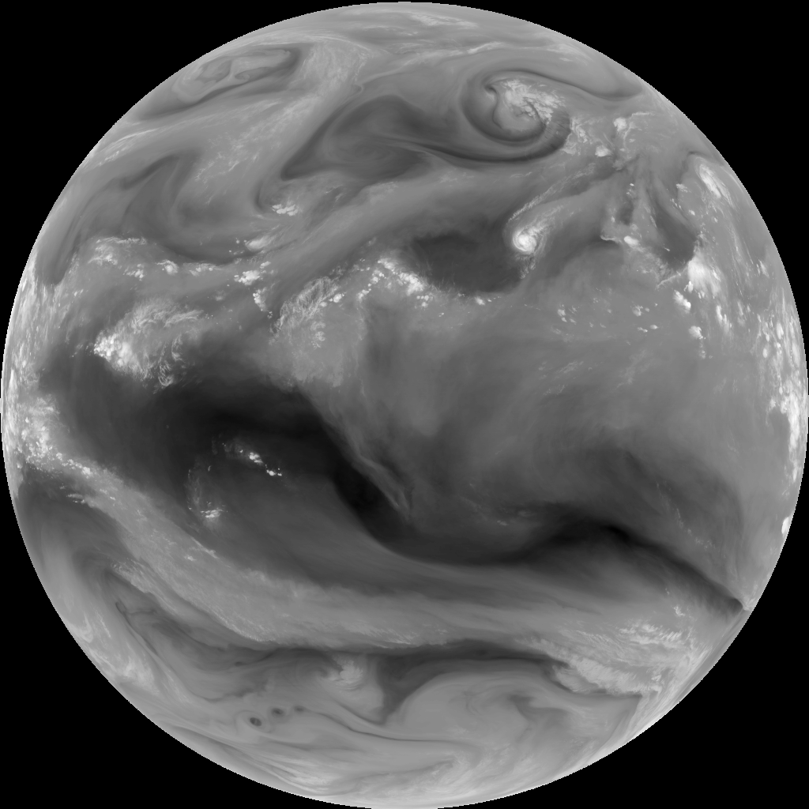
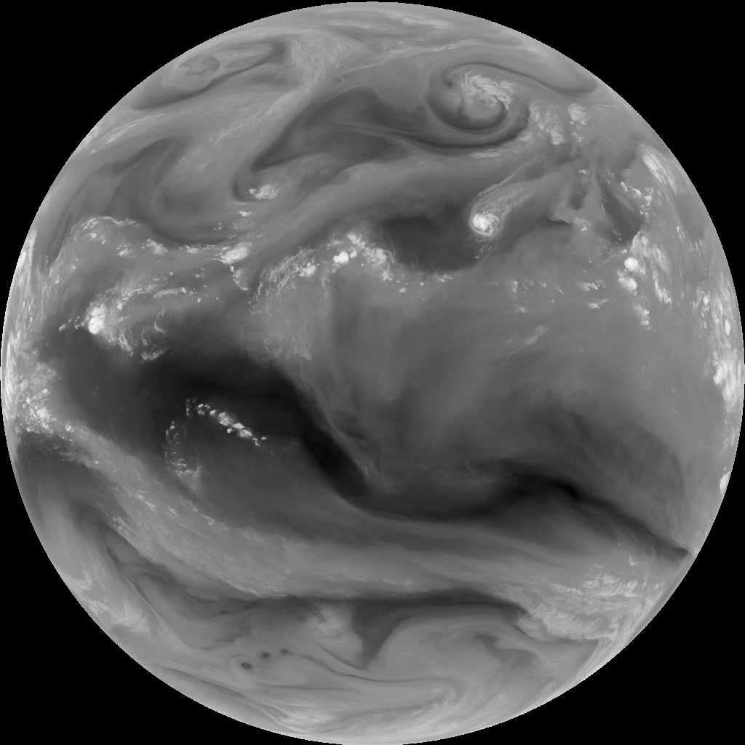
GOES-15 SLOW-MOTION SATELLITE Loop
110 output frames
Ground Truth
Keith Searight, NOAA ESRL SOS
David Hall NVIDIA
INPUT | GOES-15 band 3, GFS winds
OUTPUT | Interpolated GOES-15
INPUT FREQ | 1 every 3 hours
OUTPUT FREQ | 1 every 18 minutes
Prediction
Applications:
Visualization
Data Augmentation
Replace dropped frames
Reduce storage requirements
11 input images
Notes:
Here we show the results of inputting 11 images and outputting 110 interpolated frames.
This type of slow motion movie can be used for visualization, for data augmentation, replacing dropped frames, or for reducing data storage requirements.
For a first attempt, it works pretty well. However, the wind fields are only an initial guess, and simple advection fails to capture cloud formation, evaporating, and the three dimensional nature of the flow.

Slide 14
Content
1
Workshop: Motivation Main Takeaways
2
Highlights of AI Applications in EO and NWP
3
Looking Forward

Slide 15
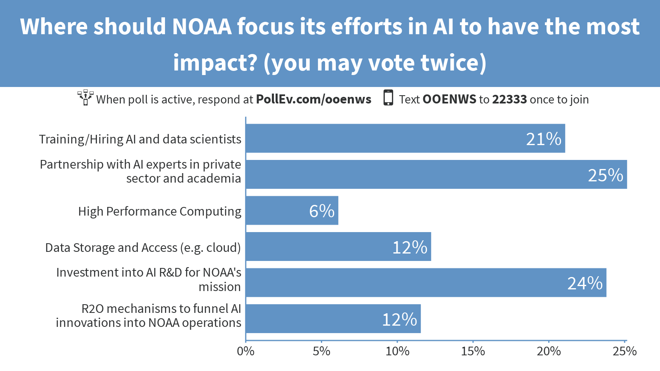
Workshop’s Audience Top Recommendations to NOAA

Slide 16
Main Science & Strategic Takeaways (Part 1)
AI is used across the entire value chain: From ingest of Observations to Decision-Making
AI has advanced tremendously in other fields (autonomous vehicles, medicine, finance, gaming industry, etc). Learning Transfer could accelerate its use in our EO/NWP Field
AI was demonstrated to benefit NOAA, sometimes as complement (for some applications like Hurricanes) and sometimes as alternative to heritage systems (image correction, ..). Particularly efficient for non-linear systems.
Application areas for AI and weather are vast and wide ranging: including agriculture, wind turbines, solar energy, aircraft turbulence forecasting, etc.
AI has the opportunity to ingest tremendous amounts of science data (including IoT) to improve forecasts
Both NOAA and Academic/Private Partners highlight need to leverage public-private and industry-academia partnerships.
Idea of Joint University-Private sector and Government Alpha Institute on AI was proposed (by Amy McGovern from OU)

Slide 17
Main Science & Strategic Takeaways (Part 2)
Challenges of leveraging AI were brought up:
Interpretability/Explainability issue,
Uncertainty estimation/quantification,
Accounting for physical constraints/incorporating domain knowledge,
Limited variability of training-set
Issue of extrapolation
Numerical Stability
HPC requirements for training multivariate problems
AI-based systems can be viewed as additional tools for forecasters, similar to the Watson project in the medical field
Data Assimilation and Machine Learning should leverage/merge. Many similarities exist (between DA and AI training)
R2O is critical. Obstacles to R2O include Trust in AI techniques.

Slide 18
Conclusion
Rapid Growth in the use of AI/DL/ML in NWP and Satellites
Overall it was a great workshop! We Plan to have a second one next year
Likely will expand the scope to cover the ‘Earth System’, beyond just EO and NWP
We will use Workshop outputs/lessons learned to help formulate the NOAA AI strategy
AI potential is enormous: But we have to do it right, in order to avoid having a hype-type situation that will lead to a bubble burst
Community is eager for this type of engagement.
NOAA seems well posed to leverage AI in its mission and to address the challenge of Big Data
Partnerships will be key. Many mechanisms are in place to facilitate this (e.g. CRADAs)
Two major drivers will continue to make AI attractive in our field: (1) Significantly increased efficiency (therefore driving down cost) and enhancement of skills (accounting for unknown or difficult to model phenomena, etc present in the data)

