Slide 1
NASA Agency Report
WGISS – 47
Silver Spring, MD
Andrew Mitchell
Earth Science Data and Information System (ESDIS) Project
Goddard Space Flight Center
Greenbelt, MD
May 2, 2019

Slide 2
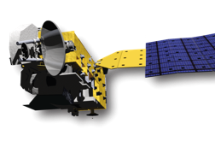
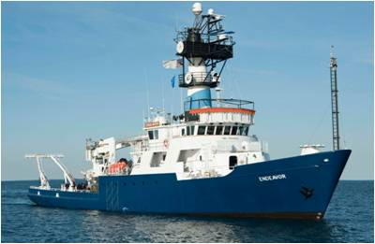
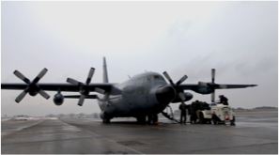
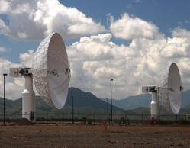
Earth Observing System Data and Information System
Users
EOSDIS
Research
distribute
Applications
Education
data downlink
subset
archive
capture and clean
process
Notes:
Image of the plane used in ICEBridge mission. Image of the Endeavor used for SPURS field campaign.

Slide 3
Role of EOSDIS
  Data Management
  Long Term Archive of Earth Science Datasets
  Interoperable Distributed Data Archives
  Science Data Processing
  Both Comprehensive and Science Discipline specific data support
  Online services for data discovery and data access
  Near-Real Time Data Access
  Earth Science Discipline-Oriented User Services
  Earth Science Standards Office
  Configuration Management and Metrics Systems
  Network Data Transport to distributed system elements

Slide 4
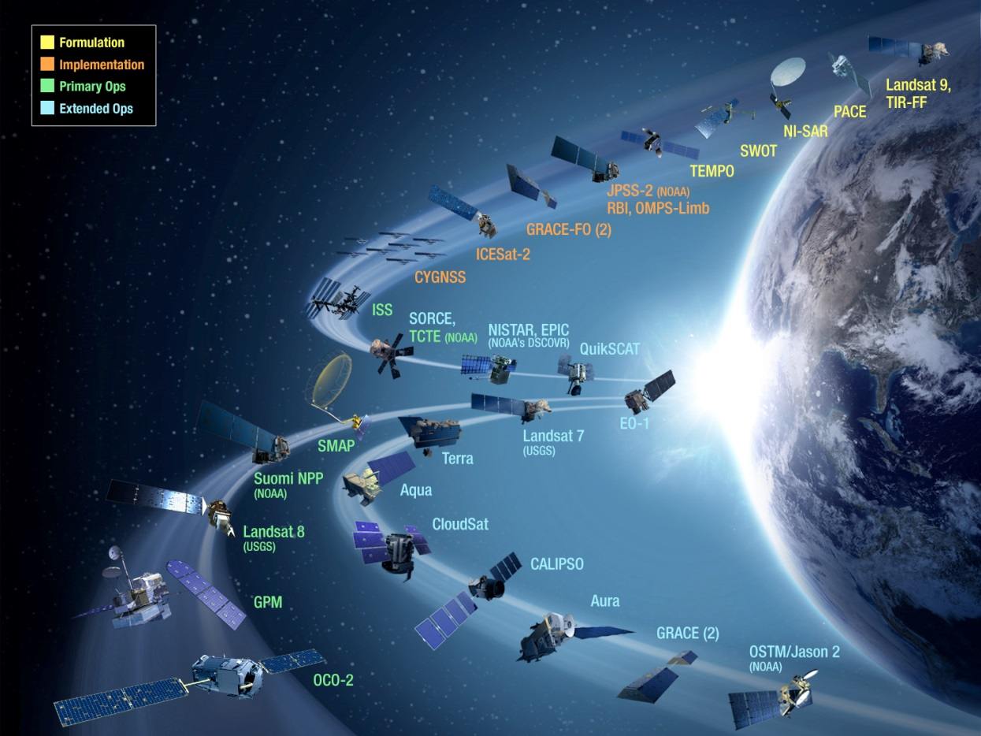
Extensive Data Collection
Started in the 1990s, EOSDIS today has 11,000+ data types (collections)
Land
    Cover & Usage
    Surface temperature
    Soil moisture
    Surface topography
Atmosphere
    Winds & Precipitation
    Aerosols & Clouds
    Temperature & Humidity
    Solar radiation
Ocean
    Surface temperature
    Surface wind fields & Heat flux
    Surface topography
    Ocean color
    Cryosphere
        Sea/Land Ice & Snow Cover
    Human Dimensions
        Population & Land Use
        Human & Environmental Health

Slide 5
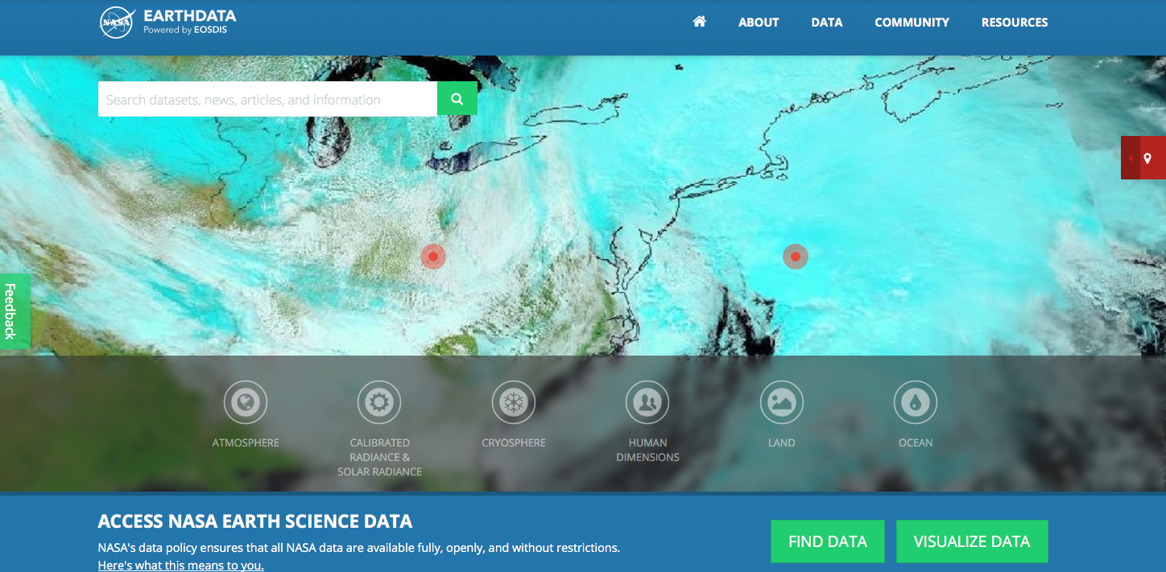
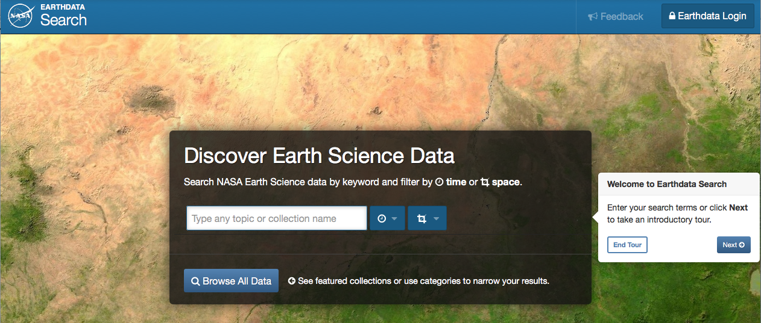
Looking for Earth Science data?
earthdata.nasa.gov
search.earthdata.nasa.gov
www.facebook.com/NASAEarthData
twitter.com/NASAEarthdata

Slide 6
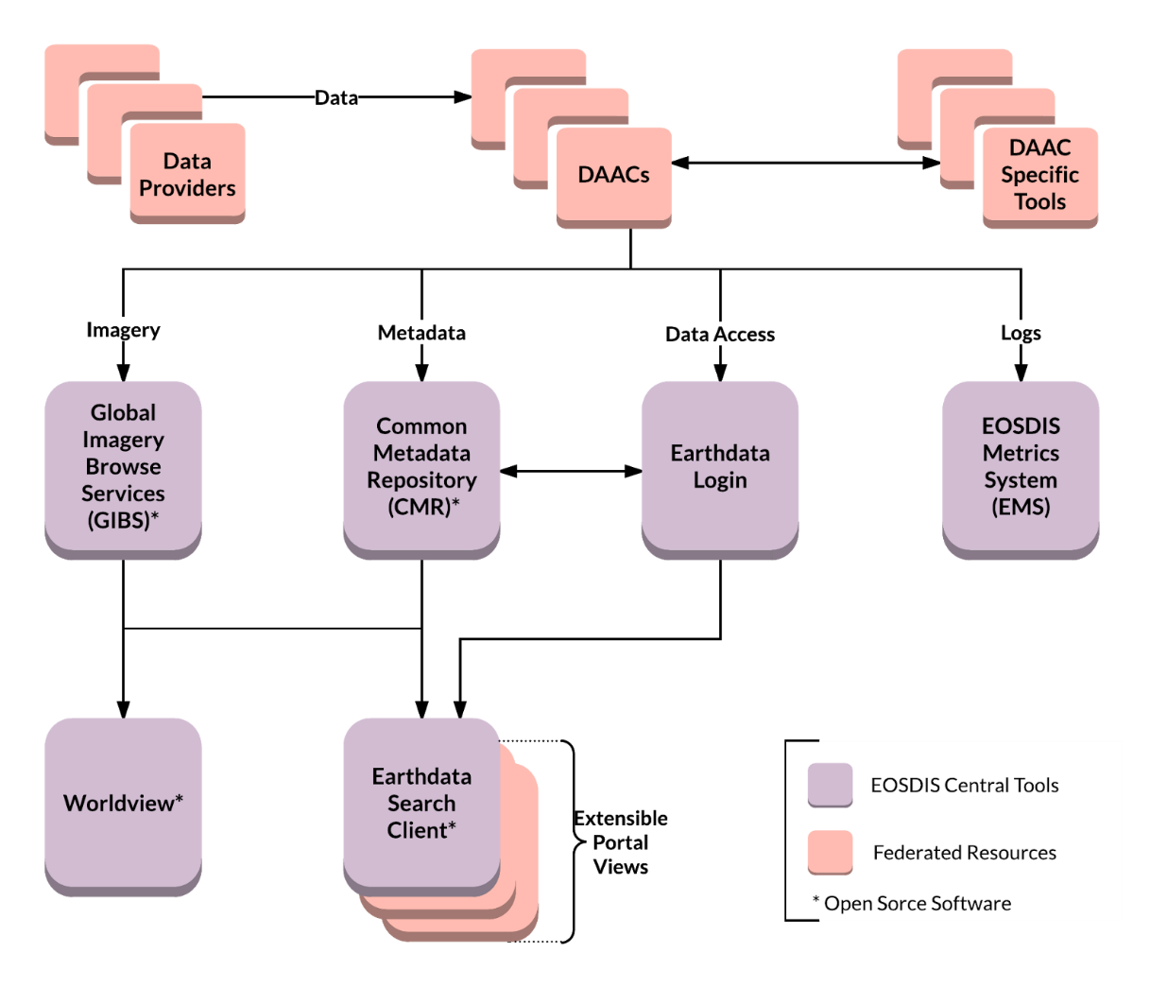
EOSDIS Core Services
Open Data APIs and Free Data Download
Open Service APIs
Open Source Clients
Notes:
Common discovery and visualization tools and services spanning all DAACs and SIPS to improve the discoverability, access and usability.
Open API architecture allows application developers maximum flexibility to “mix-and-match” services. Supports multiple
Interfaces with international organizations and U.S. government agencies to “federate” NASA metadata into their systems.

Slide 7
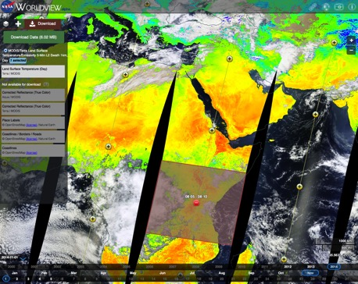
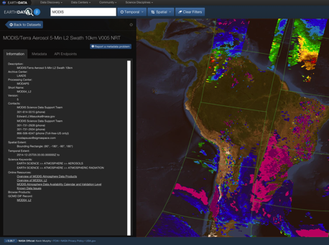
EOSDIS Data Access
Role Centralized Reusable Capabilities
Earthdata: The EOSDIS website https://earthdata.nasa.gov will increase visibility to the interdisciplinary use of data and demonstrate how data are used.
High Performance Data Search and Discovery
  Common Metadata Repository (CMR): Provide sub-second search and discovery services across the Sentinel and other EOSDIS holdings.
  Earthdata Search Client: Data search and order tool https://search.earthdata.nasa.gov
Imagery and Data Visualization Tools
  Global Imagery Browse Services (GIBS): full resolution imagery in a community standards-based set of imagery services
  Worldview: highly responsive interface to explore GIBS imagery and download the underlying data granules https://earthdata.nasa.gov/labs/worldview/
  Giovanni: Quick-start exploratory data visualization and analysis tool
Near Real-Time Capabilities: Provided by “LANCE” (Land Atmosphere Near real-time Capability for EOS) which produces products within < 3 hours of observation. Near real-time capabilities are co-located with the standard science production facilities.
EOSDIS Metrics System (EMS): collects and reports on data ingest, archive, and distribution metrics across EOSDIS
Earthdata Infrastructure (EDI DevOps): platform for requirement management, code development, testing and deployment to operations
User Support Tool (UST): user relationship management and issue resolution (Kayako)
Earthdata Log-in (User Registration System): provides a centralized and simplified mechanism for user registration and account management for all EOSDIS system components.

Slide 8
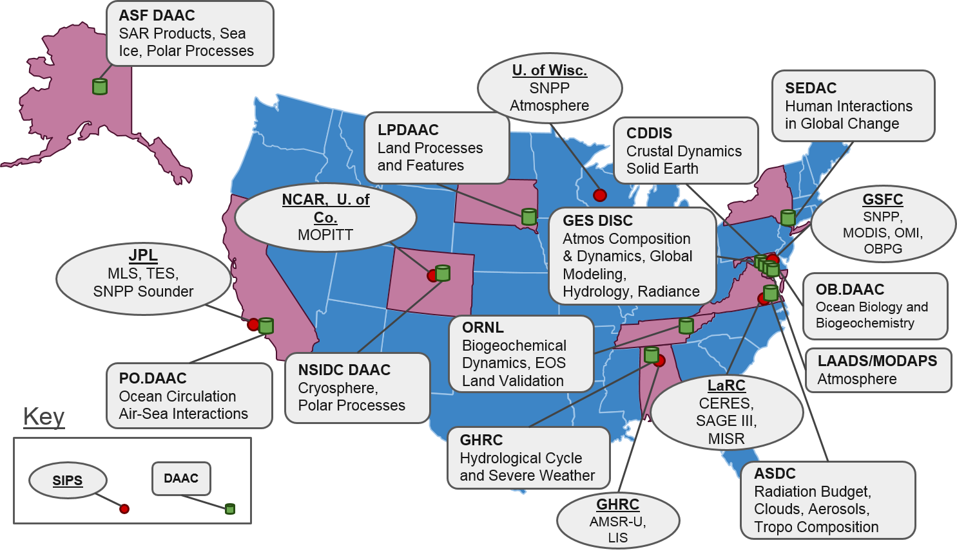
EOSDIS Components
Distributed Active Archive Centers (DAACs) , collocated with centers of science discipline expertise, archive and distribute standard data products produced by Science Investigator-led Processing Systems (SIPS)
1
6
12

Slide 9
Cloud Transition

Slide 10
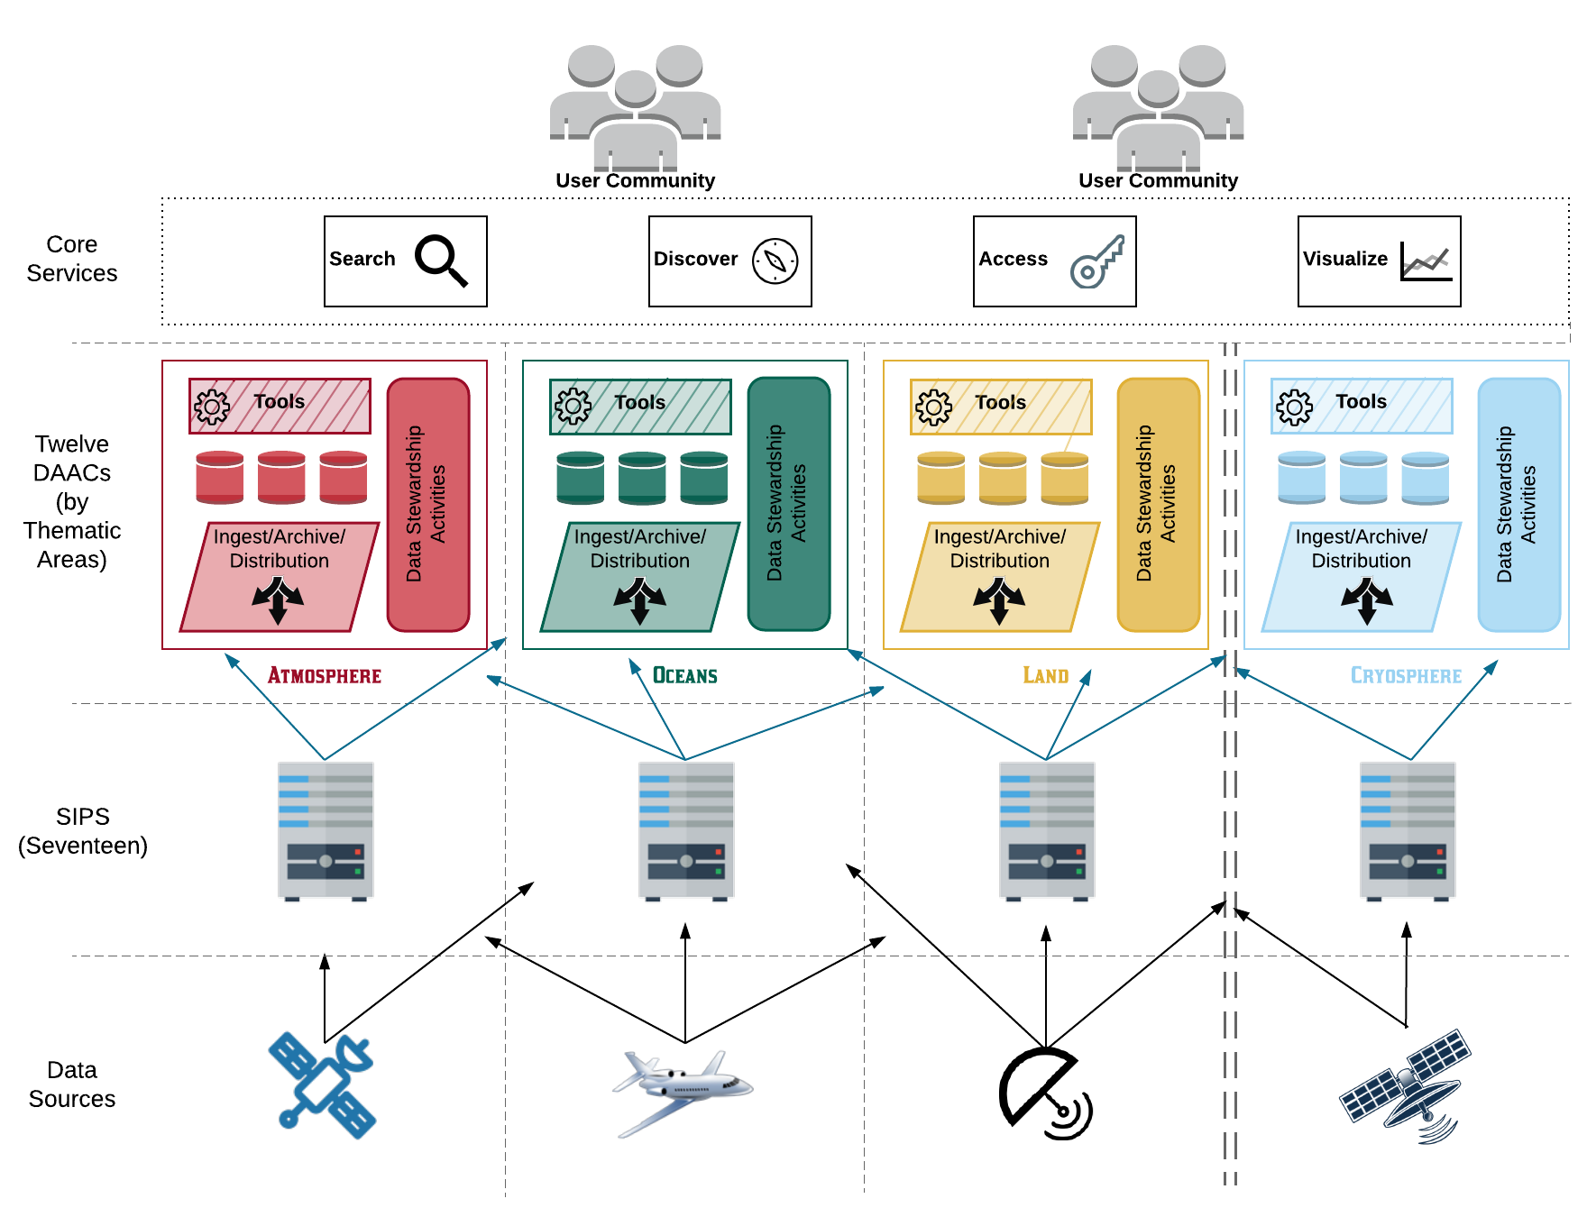
Current Architecture
Characteristics (+)
Characteristics (-)
Optimized for archive, search and distribution
Uneven levels of service and performance
Expert user support
Significant time to coordinate interfaces
Easily add new data products and producers
Limited on-demand product generation and end-user processing capabilities
Predictable
Duplication of storage
Duplication of services and software

Slide 11
EOSDIS New Missions Volumes - next 5 years
Missions | Launch Date | Daily Data Volume GB/day | DAAC(s)
GRACE FO | May 22, 2018 (LAUNCHED) | 2 | PO.DAAC
ECOSTRESS on ISS (EVI-2) | June 29, 2018 (LAUNCHED) | 643 | LPDAAC
ICESat-2 | September 15, 2018 (LAUNCHED) | 893 | NSIDC
GEDI on ISS (EVI-2) | December 5, 2018 (LAUNCHED) | 35 | LPDAAC, ORNL DAAC
OCO-3 on ISS | May 3, 2019 | 38 | GES DISC
TROPICS (EVI-3) | January 2020 | 50 | GES DISC
MAIA (EVI-3) | September 2020 | 77 | ASDC DAAC
Sentinel-6A | November 2020 | 600 | PO.DAAC, GES DISC
CLARREO-PF on ISS | March 2021 | 385 | ASDC DAAC
SWOT | September 2021 | 19,900 | PO.DAAC
JPSS-2 | July 2021 | 1,700 | GES DISC, OB.DAAC, LPDAAC, NSIDC, LAADS, ASDC DAAC
TEMPO (EVI-1) | Dec 2021 | 1,700 | ASDC DAAC
NISAR | Dec 2021 | 86,000 | ASF DAAC
GeoCarb (EVM-2) | June 2022 | 907 | TBD
PACE | Fall 2022 | 3,500 | OB.DAAC
TOTAL |  | 116,430 GB or 116 TB/day
1
7

Slide 12
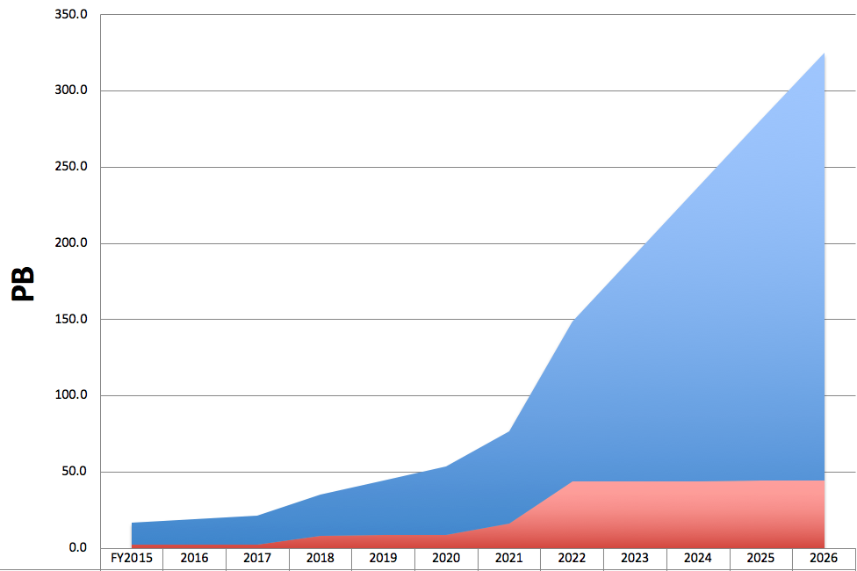

EOSDIS Data System Evolution
The current architecture will not be effective as the annual ingest rate increases from 4 to 45PB/year as new missions begin operations.
ESDIS is developing open source cloud native software for reuse across the agency, throughout the government and for any other user.
Cloud offers benefits like the ability to analyze data at scale, analyze multiple data sets together easily and avoid lengthy expensive moves of large data sets allowing scientists to work on data “in place”

Slide 13
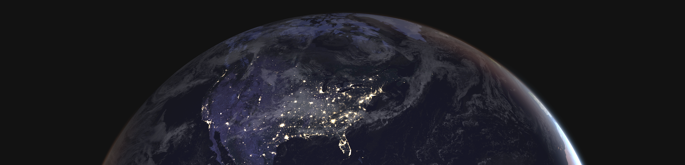
Improve the efficiency of NASA’s data systems operations – continues free and open access to data
Prepare for planned high-data-rate missions
Increase opportunity for researchers and commercial users to access/process PBs of data quickly without the need for data management
Transparent/extendable open source processing framework
Earthdata Cloud

Slide 14
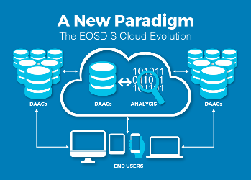
Earthdata Cloud Accomplishments
Designed and deployed a custom built cloud optimized platform (NGAP – NASA Compliant General Application Platform) which provides highly flexible cloud native infrastructure, NASA compliant IT Security controls, networking services, and business cost control in Amazon Web Services (AWS).
Developed prototype cloud optimized software, “Cumulus”, for performing Earth science data ingest, archive, and distribution capabilities to support all EOSDIS missions
Developed and deployed a customized “egress breaker” and “egress throttle”
Two key EOSDIS elements now running in Amazon Web Services (AWS) are the Common Metadata Repository (CMR) and Earthdata Search. The CMR is the central repository for NASA Earth science metadata and enables sub-second searches through the entire EOSDIS archive. Earthdata Search is the primary application developed by EOSDIS for data search and discovery. Global Imagery Browse Services (GIBS), which provides access to over 400 satellite imagery products that can be viewed using client applications such as EOSDIS Worldview, is expected to be the next EOSDIS application to evolve to the cloud.

Slide 15
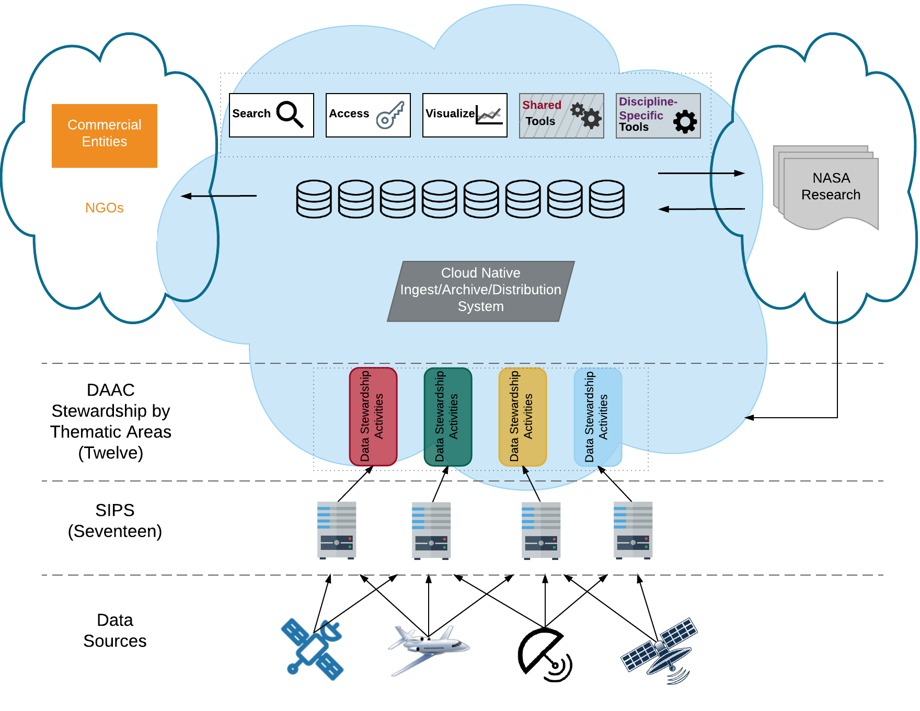
Simplified Commercial Cloud Architecture
Characteristics (+)
Characteristics (-)
Processing next to data – buy by the yard for anyone
Development coordination
Cost management
No duplication of data - Data available to all DAACs and users
Security, ITAR, SBU, EAR99
Expert user support
Business processes and skillsets
Easily add new data producers
Vendor lock-in
Apply new technology more easily (e.g. machine learning)
Developing an architecture that will allow us to efficiently provide for the larger missions

Slide 16

Prioritizing EOSDIS Data Products For Cloud Migration
Tier 1 Factors | Prioritization Factor in Migration
End User Value | Dataset Popularity
 | Length of Observation History
 | Interoperability with other products
 | Product Level
 | Identified Level of Service
End User Value / HQ Prioritization | Existing Migration Plans
HQ Prioritization | International Collaboration Opportunity
 | Legacy Technology Pressure (retiring older systems)
 | Probability of SIPS/SDS migration to cloud
Cost Factors | Cloud Storage Cost
 | Cloud Egress Cost
 | On-Premise Cost
 | Predictability of Future Costs
 | On-going Operations Costs
Effort to Implement | Complex processing pipeline
 | Rapid Turnaround
"Fitness" for Cloud Use | Available Services
 | Availability of Algorithms
 | Multi-DAAC Usage
 | Interdisciplinary Usage
 | Opportunity for new Algorithm Development
 | Past Usage Patterns
Risk to Migrate | Data Security Requirements
 | Long-term Commitments
 | Ease to Exit from Cloud
 | Data Mobility
In addition to SWOT and NISAR, we are defining a mechanism for selecting high priority datasets to use commercial cloud technology for data management (ingest, archive, process and distribution).

Slide 17

EOSDIS Key Metrics for FY2018
EOSDIS provides
  A production capability for standard science data products from EOS instruments
  An “active archive” of Earth science data from EOS and other past and present missions
  A distributed information framework (data centers, SIPS, networks, interoperability, other system elements) with partners supporting EOS investigators and other users in science, government, industry, education, and policy
EOSDIS Science Elements | No.
EOSDIS Data Centers | 12
Science Investigator-Led Processing Systems (SIPSs) | 14
EOSDIS Metrics (Oct. 1, 2017 to Sept. 30, 2018)
Unique Data Products | 9,855
Distinct Users of EOSDIS Data and Services | 4.1 M
Web Site Visits of 1 Minute or more | 3.1 M
Average Daily Archive Growth | 22.7 TB/day
Total Archive Volume | 27.4 PB
End User Distribution Products | 1611.4 M
End User Average Daily Distribution Volume | 66.8 TB/day
Notes:
Sources of data for the tables in the chart can be found in these files:
EOSDIS_Key_Metrics_03302009.xls (this file contains the explanation for each value on the EOSDIS Key Metrics PowerPoint chart tables; the tabs show the derivation of the values); and FY09AnnualReport_CDDIS_Normalized.xlsx (this file provides the full source data tables for the EOSDIS Metrics table).

Slide 18

EOSDIS Products Delivered: FY00 thru Jan 2019
157.9 M added in Jan 2019
Year
Notes:
As of Feb 2009, all historical data comes from EMS (no EDGRS annual report data for pre-2000) and OBPG data is added from the Ocean Color website statistics for FY04 through FY12.
Prior years (FY00-FY2008) products distribution data sources cover the following data centers:
ASF DAAC, LP DAAC, GES DISC, GHRC DAAC, PO.DAAC, ASDC, NSIDC DAAC, ORNL DAAC, SEDAC, including OBPG* since FY2004, LAADS DAAC since FY2006, CDDIS since FY2009 and LANCE since FY10. All data are on FY boundaries.
FY2011 data is cumulated per month for the following 11 data centers:
ASF DAAC, LP DAAC, GES DISC, GHRC DAAC, PO.DAAC, ASDC, NSIDC DAAC, ORNL DAAC, LAADS DAAC, SEDAC, CDDIS, and LANCE with OBPG* added at end of the fiscal year.
FY2012 data is cumulated per month for the following data centers:
ASF DAAC, LP DAAC, GES DISC, GHRC DAAC, PO.DAAC, ASDC, NSIDC DAAC, ORNL DAAC, LAADS DAAC, SEDAC, CDDIS and LANCE; OBPG* data included as of June 2012, the earlier months added at end of the fiscal year.
As of FY12 CALIPSO distribution is included in ASDC totals.
FY2013/14/15/16/17/18/19 data is cumulated per month for the following data centers:
ASF DAAC, LP DAAC, GES DISC, GHRC DAAC, PO.DAAC, ASDC, NSIDC DAAC, ORNL DAAC, LAADS DAAC, SEDAC, CDDIS, OB.DAAC*, LANCE
(* Beginning in October 1 2015, OBPG has been renamed to OB.DAAC)

Slide 19
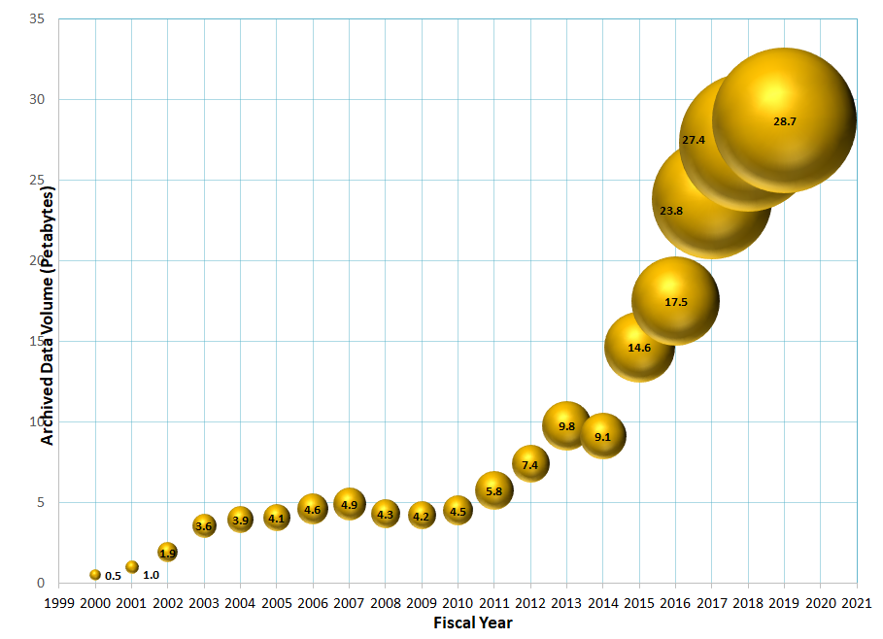
Total EOSDIS Accumulated Data Archive Volume (Petabytes)
Trend: 2000-2019 (at the end of Jan 2019)
Deletion of MODIS Collection 5
MODIS reprocessing
Addition of
AQUARIOUS and ICEBRIDGE
products
Addition of
GPM and ALOS PALSAR products
Addition of
Data from
LAADS DAAC
Addition of
ICESAT
product
Deletion over 2 PB in ASF DAAC due to consolidation and transition
Deletion of
MODIS Collection 4
Products

Slide 20
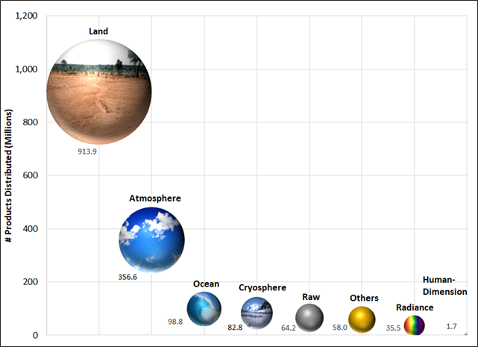
EOSDIS Yearly Total Data Volume (PB) and Number of Products (Billions) Distributed to End Users
FY2018 Number of Products Distributed by Discipline
Products whose discipline was not available or not applicable including some of the ancillary data

Slide 21
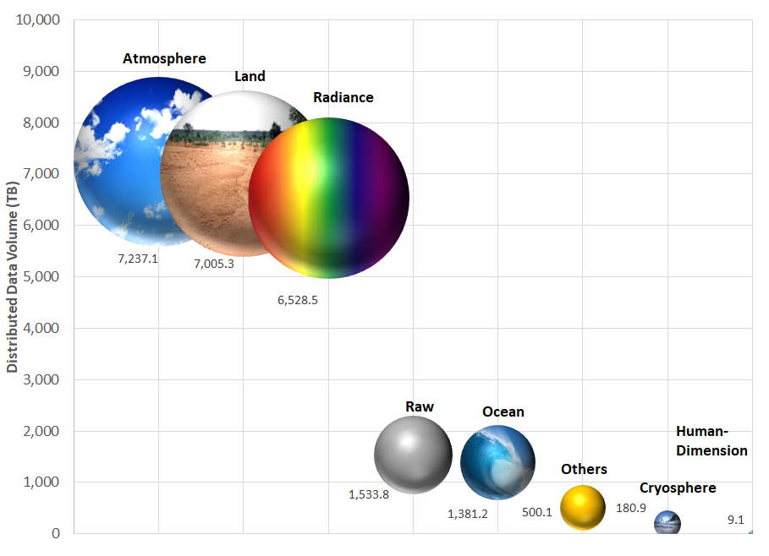
FY2018 EOSDIS Distributed Data Volume by Discipline
Radiance includes Sentinel 1A-, 1B Level 1 data

Slide 22
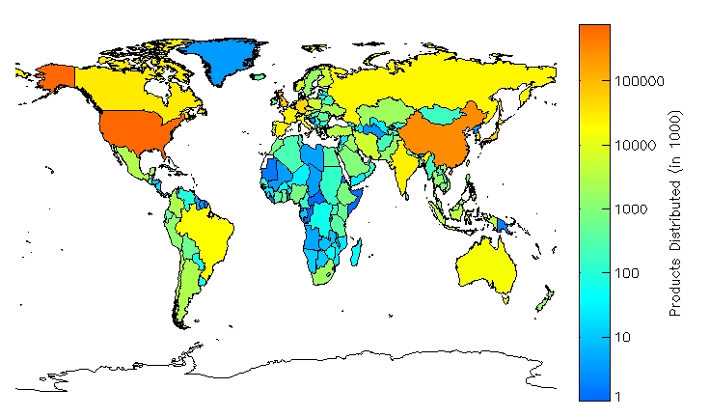
FY2018 EOSDIS Global Distribution of Number of Data Products
Top 10 Countries
United States
China
United Kingdom
Germany
Japan
Czech Republic
Canada
India
Korea, South
Spain
NASA's Earth Science data is distributed globally, the effect of an open data policy now in effect for over 17 years

Slide 23
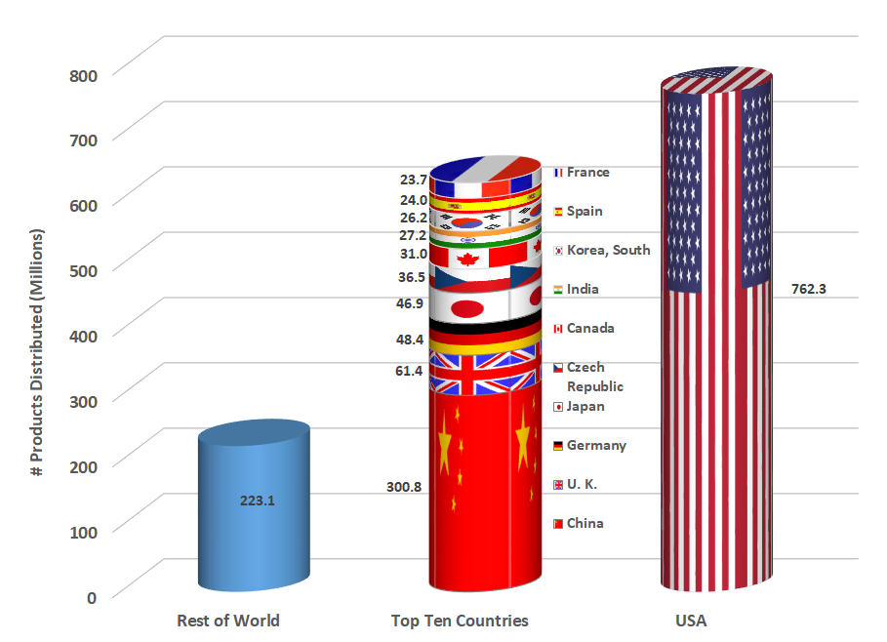
FY2018 EOSDIS Number of Data Products Distributed by Country

