Slide 1
WGISS Connected Data Assets Status Report October 8, 2019 Andrea Della Veccia Yonsook Enloe

Slide 2
WGISS Connected Data Assets Session Today
WGISS Connected Data Assets Status Report – Andy Mitchell
CWIC Report – Archie Warnock
IDN Report – Michael Morahan
FedEO Report – Mirko Albani
NASA Services & Tools Metadata Refactoring Efforts – Valerie Dixon
NOAA One-Stop and the Cloud – Ken Casey
OGC Happenings – Yves Coene
Testbed15 “Service Discovery”
OGC 17-184 “Collection Description”
GEOSS Platform – New Version: “Data and Knowledge” - Guido Colangeli
Data Discovery and Access Discussion - ALL

Slide 3
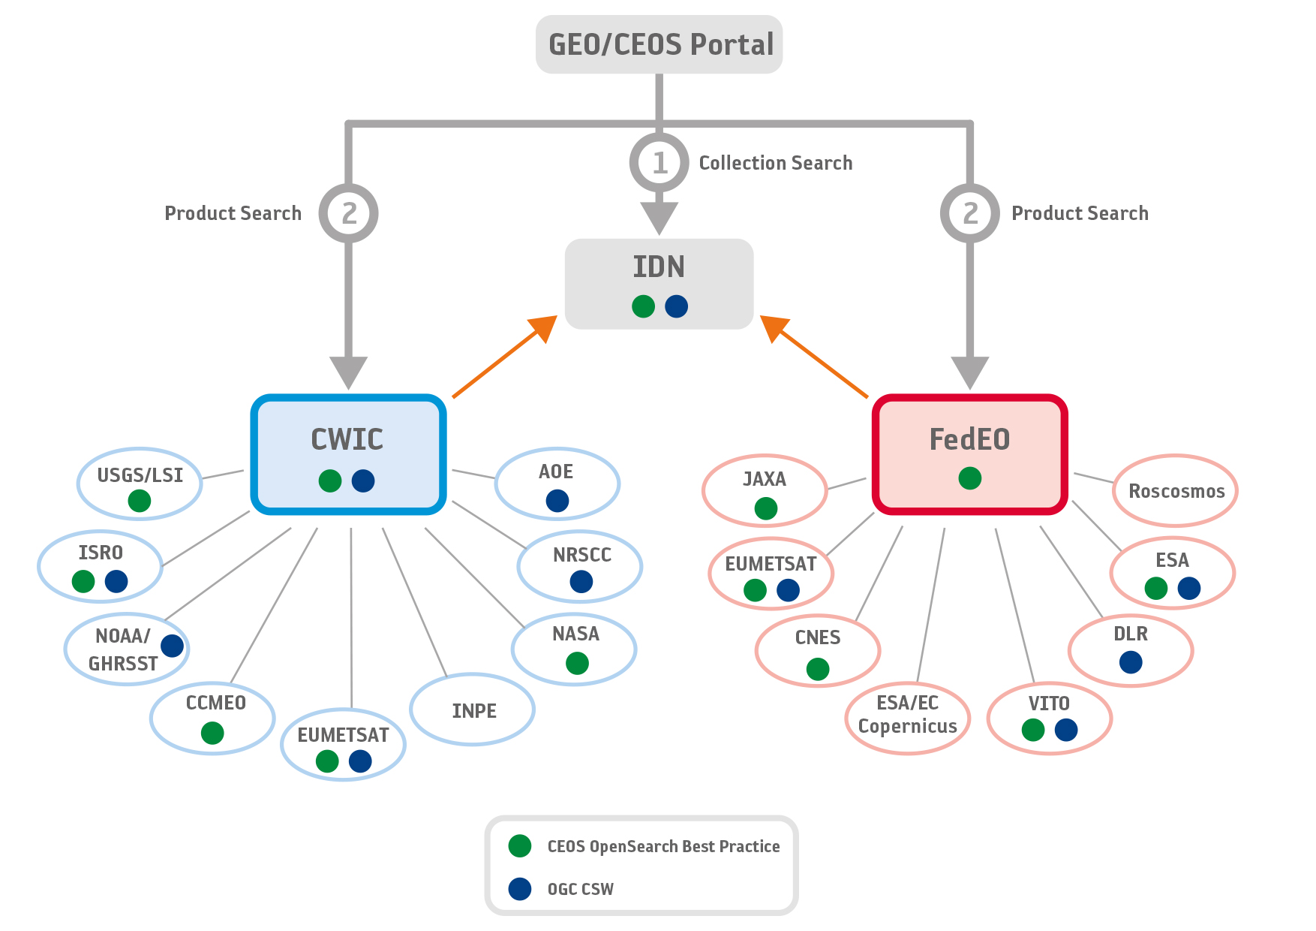
Architecture WGISS Data Assets

Slide 4
WGISS Action: CEOS Portal
WGISS-47-17a&b – Identify the best approach to implement a single map-based front-end/portal to discover and access CEOS agencies data through WGISS CDA back-end. Implement CEOS branding for portal.
NASA’s Earth Data Search Client is offered for this. EDSC can search collections at IDN and activate the granule search for CWIC & FedEO collections at the data partner sites. Michael Morahan will demonstrate this during the IDN Report.

Slide 5
WGISS Actions : Metrics
WGISS-47-17c – Assess advantages and feasibility to implement (part of ) CEOS Data Usage Metrics
Progress Report:
WGISS Connected Data Assets (WCDA) System Level Team (SLT) analyzed the current metrics being reported or planned to be reported by IDN, CWIC & FedEO to identify what metrics can be collected by the WCDA. Can collect metrics associated with metadata search and not the data access.
Primary importance are the metrics associated with usage of the system (metadata search) and failures (number of searches that failed; average time of search completion).
Failure metrics will be used to identify system failure at data partner sites.

Slide 6
WGISS Action: ECV Dataset Registration
WGISS-47-29 – CDA SLT to analyze what kind of effort and solution can be accomplished by WGISS to automate future ECV inventory updates
WGISS-47-30 – CDA SLT to send WGClimate the list of elements in the inventory that should be made mandatory so they can be registered automatically
Sustained effort to analyze the spreadsheets for ECV dataset information and align that with the IDN fields needed for dataset registration and to communicate that information back to the WGClimate.
Registration of ECV datasets much improved

Slide 7
Towards a WGISS Federation
Data collection registration at the IDN using the IDN keywords; Info about how granule search is supported will be included in the data collection registration; Tag for granule access;
Data partners need to support 1 of the 2 supported WGISS standards
CEOS OpenSearch Best Practices (v 2)
OGC CSW 2.0.2 (time to only support CEOS OpenSearch going forward?)
All searchable data must have a data access path
Data download
Data order (free or with cost)
Email order (free or with cost)
Servers must have high availability (99%?)
A technical point of contact needed for each data partner

Slide 8
WGISS CDA Key Documents
IDN Metadata Registration set of docs and tools:
http://ceos.org/ourwork/workinggroups/wgiss/access/international-directory-network/
WCDA (WGISS Connected Data Assets) Client Guide
CWIC Data Partner Guide (OpenSearch)
FedEO Data Partner Guide
CWIC Synchronization Document (test scripts to test dataset access)
WCDA Error Handling
CEOS OpenSearch Best Practices v1.2
CEOS OpenSearch Best Practices Conformance Test Plan
CEOS OpenSearch Developer’s Guide

Slide 9
Current WCDA Metrics
WGISS Connected Data Assets Status Page
http://ceos.org/wgiss-connected-data-assets-status/
Automated updated (daily) metrics for WCDA searchable collections/granules in IDN, CWIC, & FedEO
Single document, WDCA Client Guide, gives details on how to search for all the data collections/granules in the WCDA
Error handling approach agreement

Slide 10
Challenges Ahead
Adding Services/Tools to WCDA;
NASA is defining how Services and Tools can be described and invoked in the Unified Metadata Model (UMM)-Services and UMM-Tools documents. WGISS CDA was invited to participate in the document review which ended Aug 30, 2019. Andrea Della Veccia and Yves Coene participated).
Can the elements described in UMM-S & UMM-T be used to add services/tools to WCDA?
Developing FDA capabilities to give users a specialized “chunk” of data, preprocessed to be ready to analyze.

Slide 11
Working with GEOSS
IDN, FedEO and CWIC accessible from Geo Web Portal and integrated via GEO DAB
WGISS Connected Data Assets webpage on the WGISS webpage display metrics → the link to the completely revamped automated page has been given to CEOS CEO and GEO Sec.
WDCA Client Guide document available to the GEO data providers

Slide 12
Outreach to Tool Developers
WDCA Client Partner Guide – document written by the System Level Team; Details how to search for collection and granule data at IDN, CWIC, and FedEO.
How to search for CEOS data collections in IDN
How to search for CWIC/FedEO data granules
How to search for GEOSS tagged collections
Outreach to potential tool developers
One page flyer targeting tool developers (need to update urls – see below)
Soft copy of the flyer will be kept on the WGISS website
Local printing
Issue: old urls do not work anymore with move to the new email listserv; Need to update outreach materials or make the old urls work again.
old→ http://wgiss.ceos.org
new→http://ceos.org/outwork/workinggroups/wgiss/
old→wgiss.ceos.org/access
new→ceos.org/ourwork/workinggroups/wgiss/access/

