Slide 1

    Our Vision
    “To be a world-leading technology and innovation company, helping businesses of all sizes to realise the potential from space”
Rob Fletcher
Head of Geospatial Platforms & Solutions

Slide 2
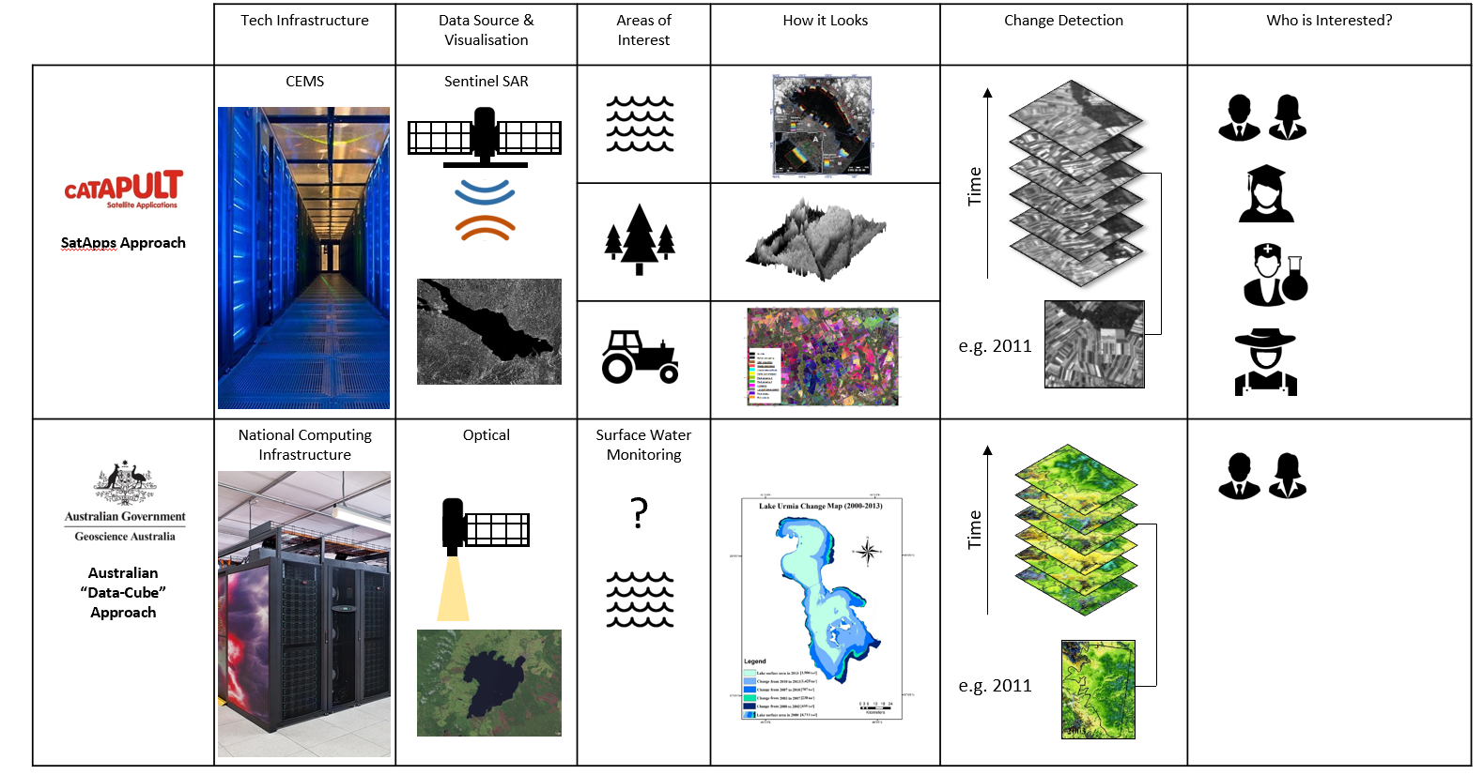
UK Initiatives on Open Data Cubes 2015

Slide 3







Future Components

Slide 4
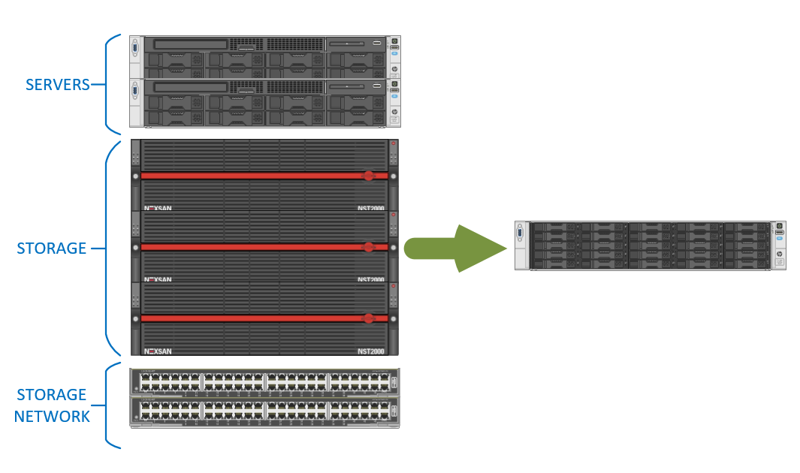
Hyper-Converged – Cube in a Box

Slide 5
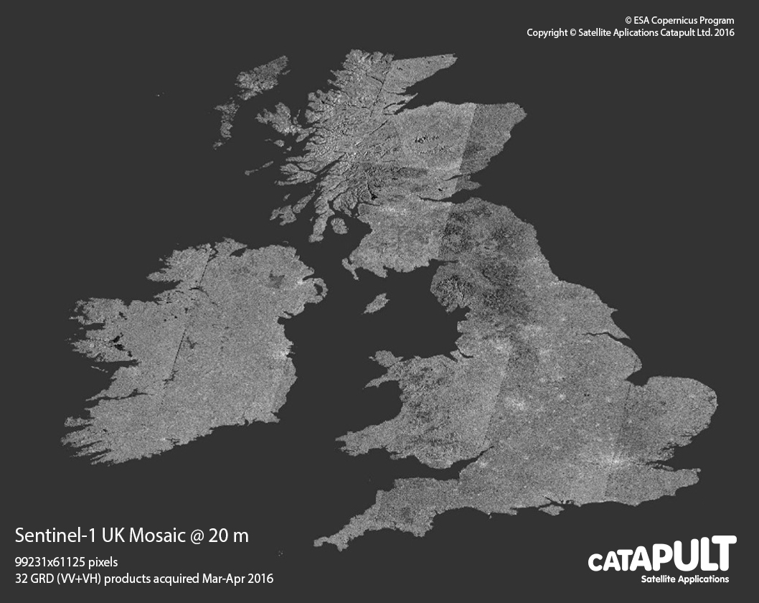
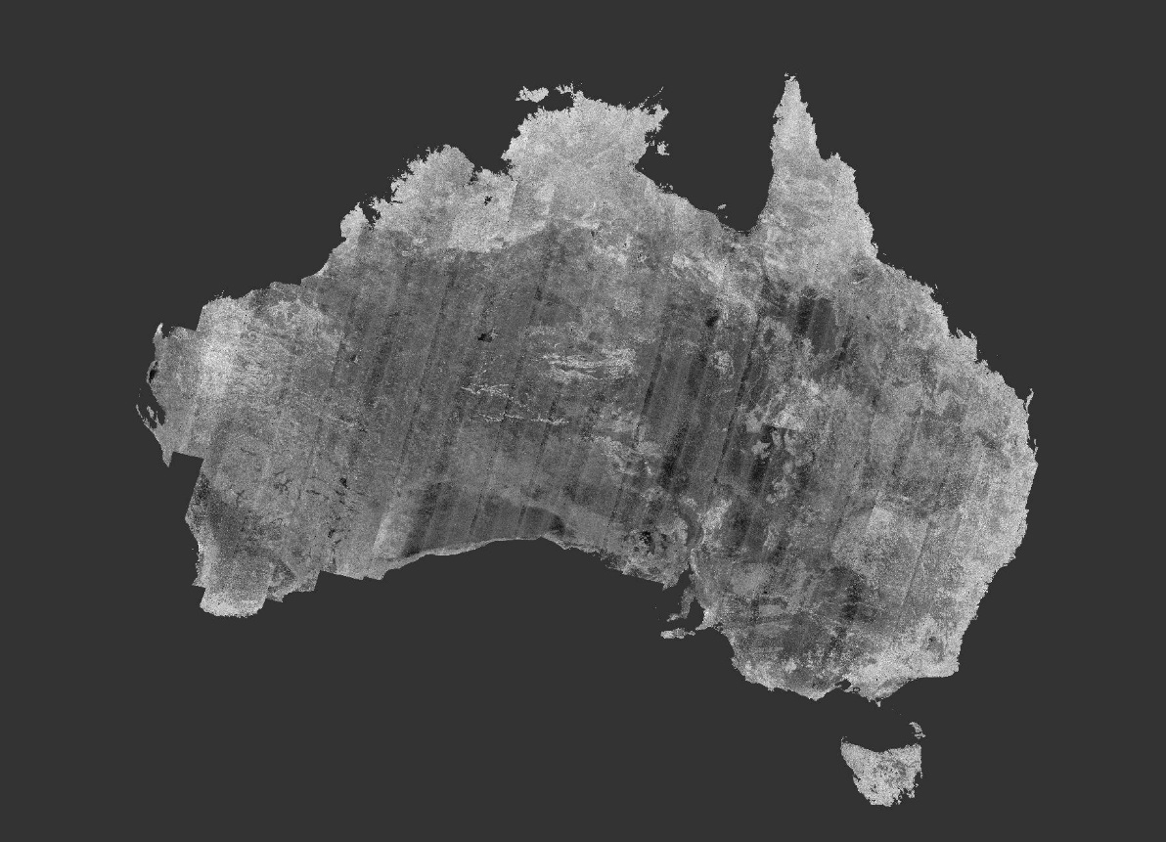

SENTINEL-1 ANALYSIS READY DATA
SENTINEL-1 ANALYSIS READY DATA
Sentinel-1:
Calibrated and orthorectified absolute backscatter products
Sentinel-1 Australia Mosaic @ 40 m
103566 x 82716 pixels
451 GRD (VV+VH) products acquired Jan-May 2015

Slide 6
SENTINEL-1 ANALYSIS READY DATA
SENTINEL-1 ANALYSIS READY DATA
Sentinel-1:
Calibrated and orthorectified absolute backscatter products

Slide 7
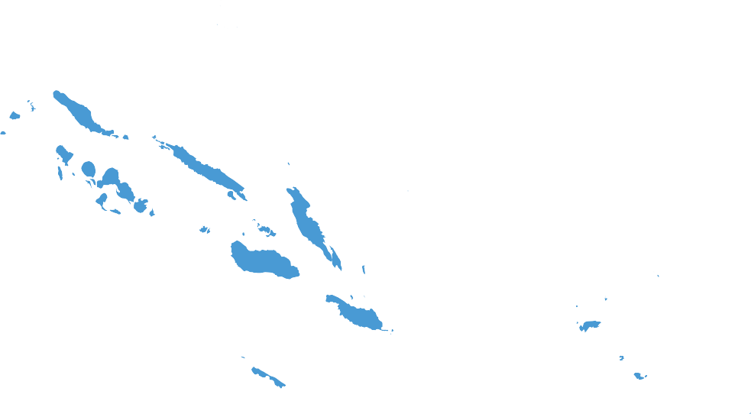






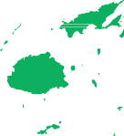








Building climate resilience with small island nations

Slide 8
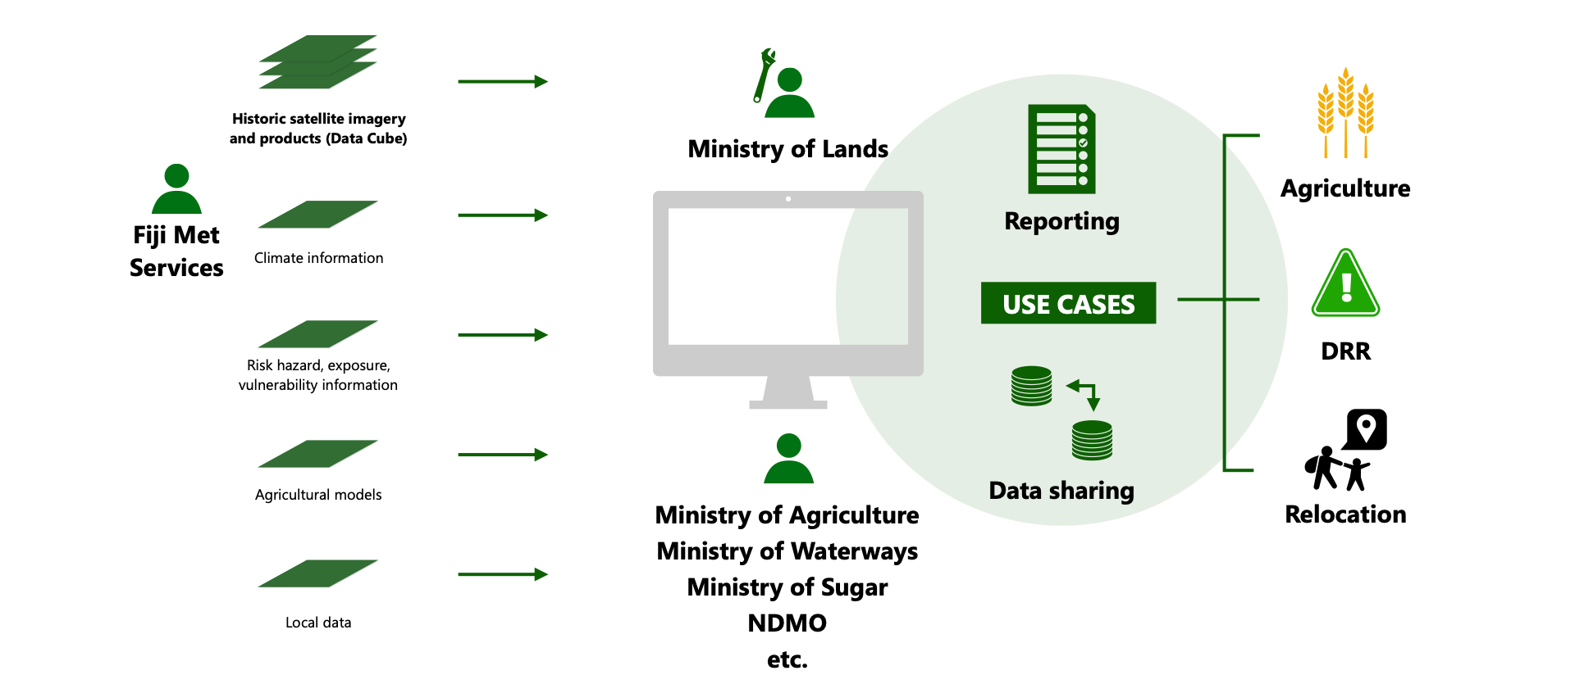
CommonSensing Geospatial Platform
© Satellite Applications Catapult

Slide 9
Open Data Cube – Developments
Developing a Cloud agnostic platform for EO analysts to work with "Analysis Ready Data" (ARD), based on the Open Data Cube initiative
Utilised the DCAL (Data Cube Application Library) set of applications as a starting point for further development of added-value products that are of interest for the purpose of addressing sustainable development goals
Two working streams:
  Deployment material for ARD processing workflows, specifically trying to leverage AWS Spot instances
  AWS EKS – Managed Kubernetes Service to avoid lock in of services such as AWS ECS – Elastic Compute Service
  Working with AWS Spot instances to determine if is a cost-effective method to host the ODC
© Satellite Applications Catapult

Slide 10
Open Data Cube Hackathon at Harwell – May 2019
Aims:
To develop core functionality of the Open Data Cube, and to also generate Earth Observation (EO) products using Analysis Ready Data (ARD) for Sentinel-1, Senintel-2 and Landsat data, to support the IPP Common Sensing project
Generate a Level 3 Land Classification based on the UN Food and Agriculture Organisation’s classification schema
Development of a coastal change layer using S1 including tide data to improve accuracy
Attendees:
Satellite Applications Catapult, GeoScience Australia, CSIRO, the University of Aberystwyth, UNEP GRID and Frontier SI
© Satellite Applications Catapult

Slide 11
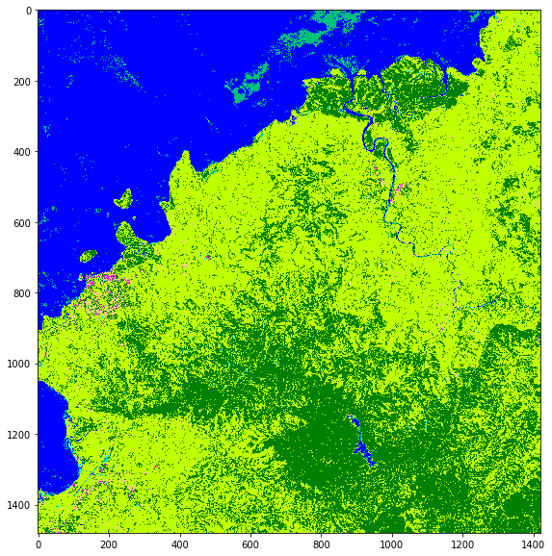
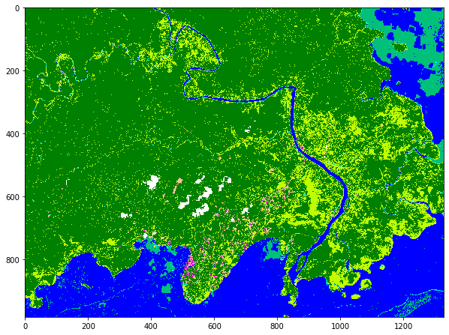
Open Data Cube Hackathon at Harwell – May 2019
FAO L3 land cover classification for Fiji created using layers created on the ODC including water (from Sentinel-1), fractional cover (vegetation) and an urban layer from Sentinel-1. These outputs were displayed in a web-portal developed by the hack team.
© Satellite Applications Catapult

Slide 12
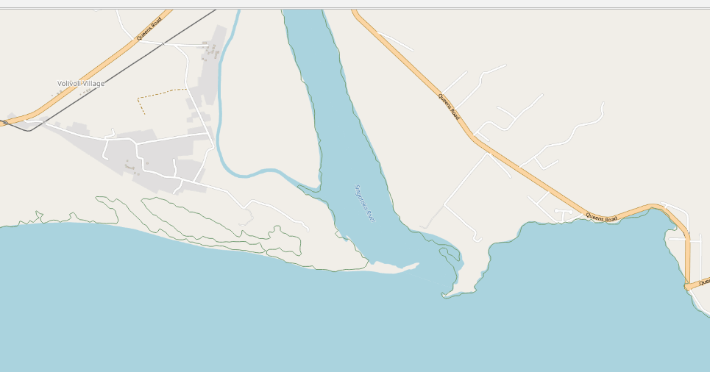
Open Data Cube Hackathon at Harwell – May 2019
Sentinel-1 Coastline Extraction May 2018 – April 2019

Slide 13
Focus Area: Viti Levu - Fiji
Inland Water Bodies
Population centres
Landsat mosaic showing the topographical and vegetation differences, rivers and urban centre AOIs

Slide 14






ODC Application Library
Cloud Statistics Custom Mosaics Spectral Products Water WOFS Land Change NDVI Phenology
Landsat 8 Landsat 8 Landsat 8 Landsat 8 Landsat 8 Landsat 8
Sentinel 1 Sentinel 1 Sentinel 1 Sentinel 1 Sentinel 1 Sentinel 1
Sentinel 2 Sentinel 2 Sentinel 2 Sentinel 2 Sentinel 2 Sentinel 2

Slide 15
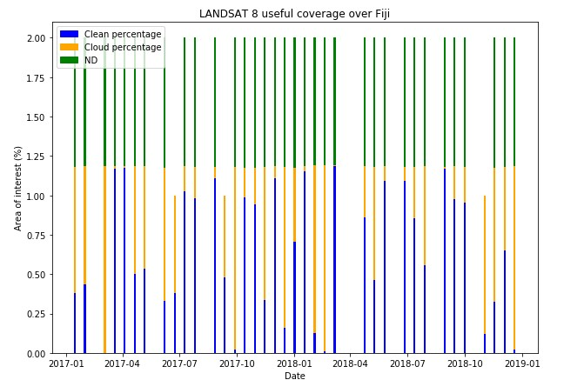
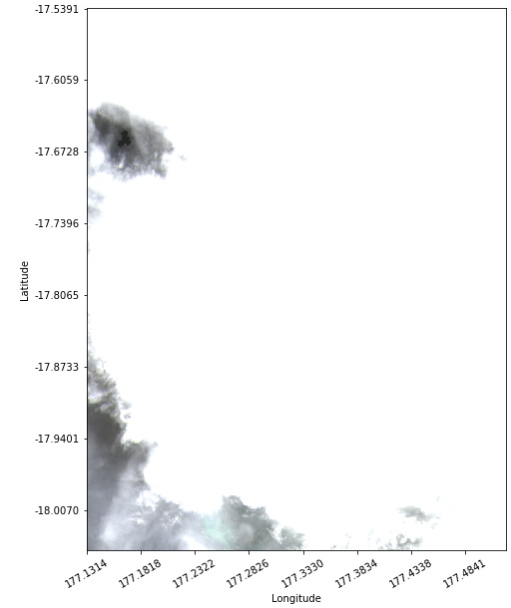
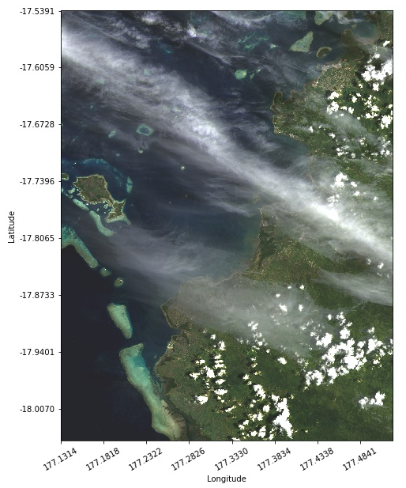
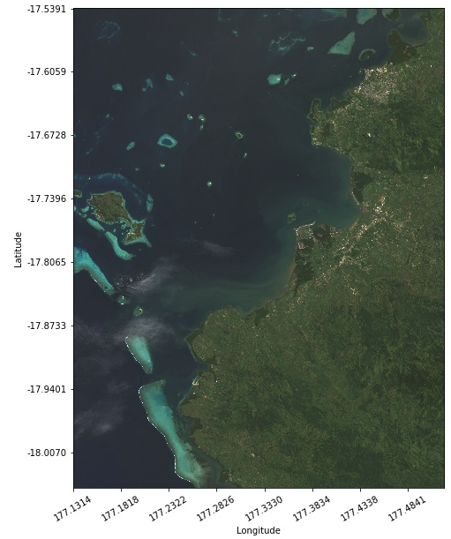
Cloud Statistics DCAL
FULL CLOUD
PART CLOUD
NO CLOUD
3 images 2017/18 showing varying levels of cloud coverage.

Slide 16
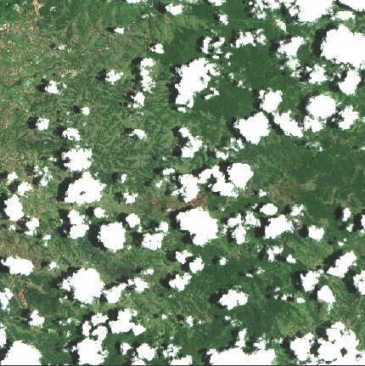
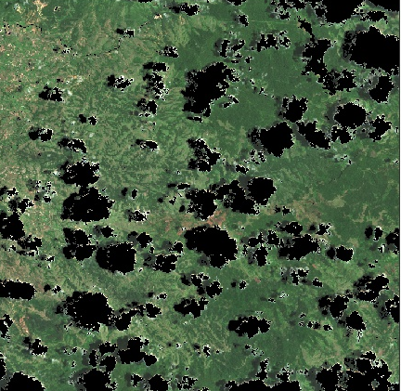
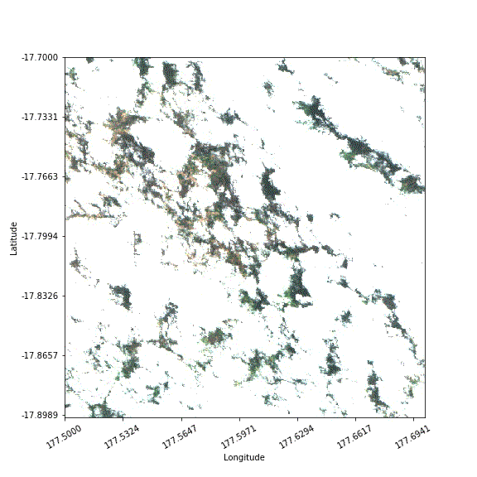
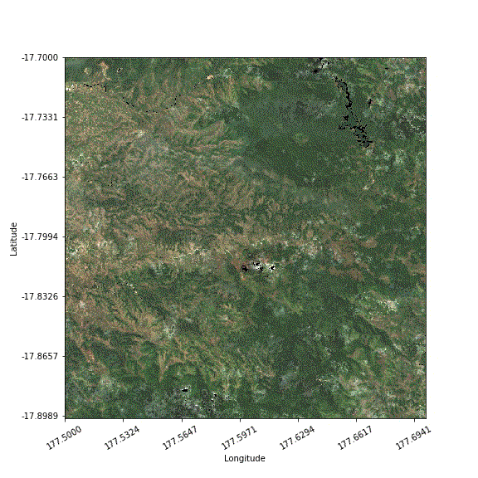
Cloud Statistics DCAL
Original Sentinel-2 Data
Identify and mask cloud
5-scene geomedian mosaic

Slide 17
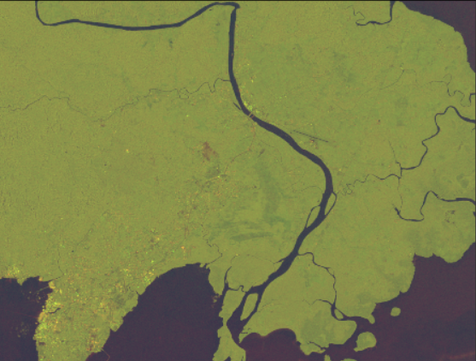
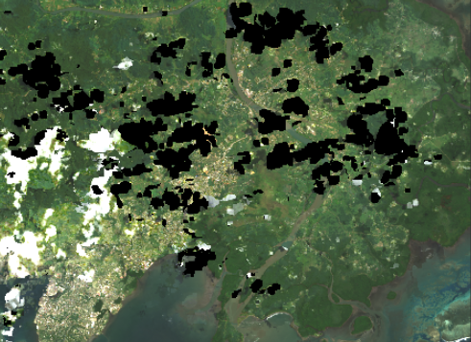
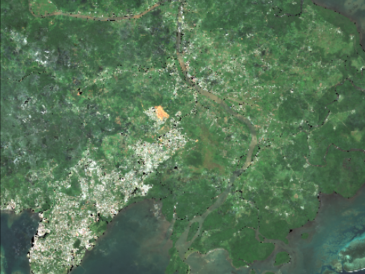
Custom Mosaics DCAL
Sentinel-1 False Colour Composite
Sentinel-2 Geo-median
Landsat-8 Geo-median
Notes:
Figure X – Following on from DCAL_Cloud_Statistics, DCAL_Custom_Mosaics works to remove cloud through layers of images over a given time frame by averaging them out. The images you’re seeing are taken from all 3 of the satellites from February to May of this year. The top right image shows the SAR based Sentinel-1 False Colour Composite, unaffected by cloud an the bottom two show Landsat-8 and Sentinel-2 images after Geoscience Australia# Geo-median algorithm has been applied.
Black areas show pixels which have been masked by the filter and the white pixels show clouds that have failed to be picked up by the filter.

Slide 18
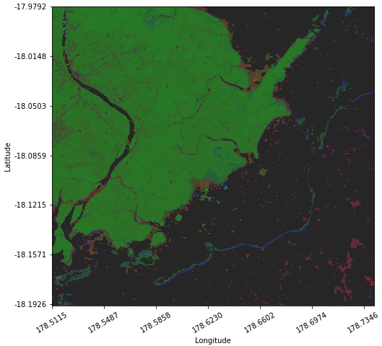
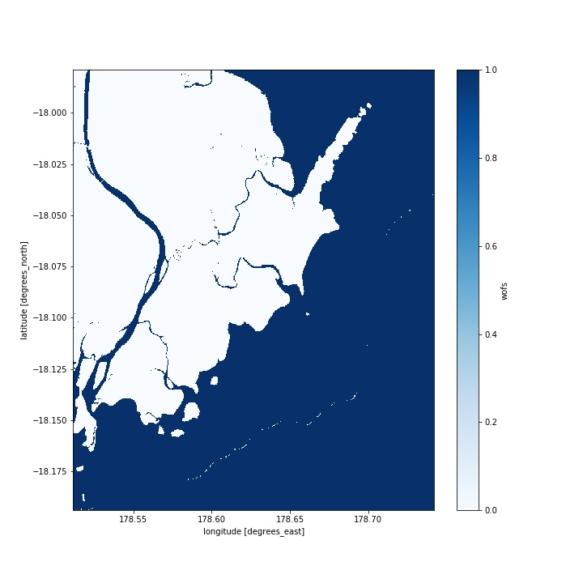
Bare soil or urban area
Non-green vegetation
Green vegetation
Water
Spectral Products DCAL
Water
Non-Water
Geo-median image over the AOI, essentially a true colour image.
Land Fractional Cover ‘mid processing product: RGB false colour map. Red = bare soil or urban areas, blue = non-green vegetation, green = green vegetation, black = water
Water Observations from Space, water identification ‘final processed’ product denoting water and non-water areas.

Slide 19
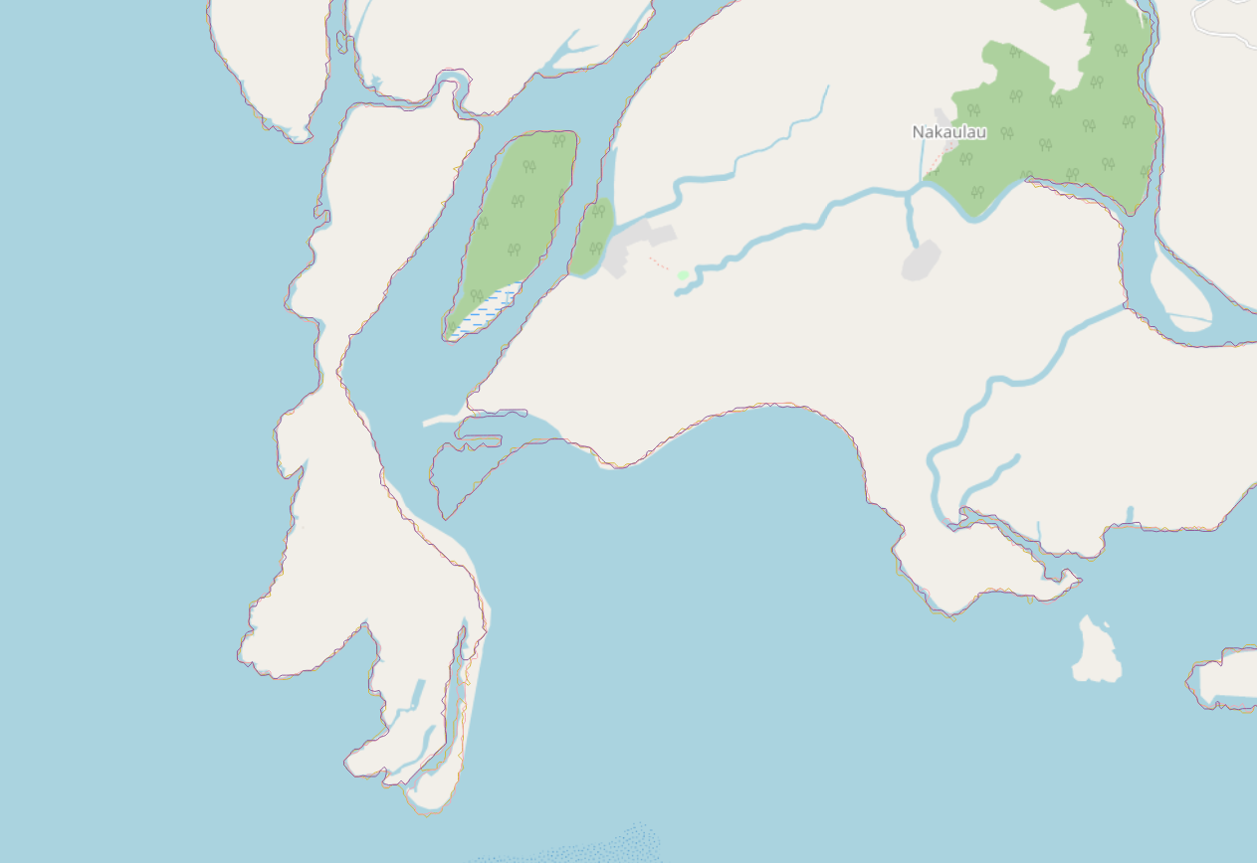
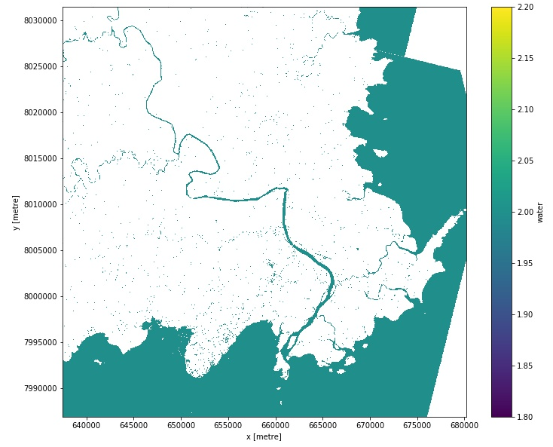
Coastline Change Detection & WOFS DCAL
JPG map image showing layers of water detection
outlining the coastline and some inland rivers
Geojson output files from the same run, shown in QGIS and layered over map to show the change of water-land boundaries with time period.
Notes:
Geojson files require manually inputting into specialised software such as QGIS in order to create a figure such as this, superimposed over an ordinary map to display coastal change over time.

Slide 20
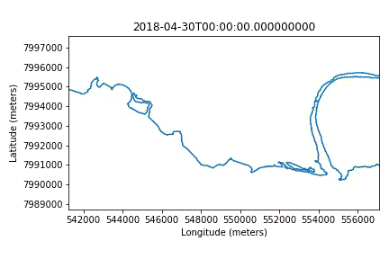
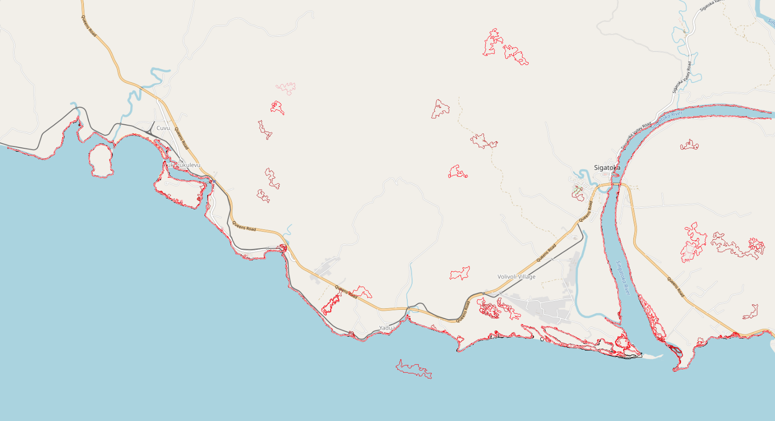
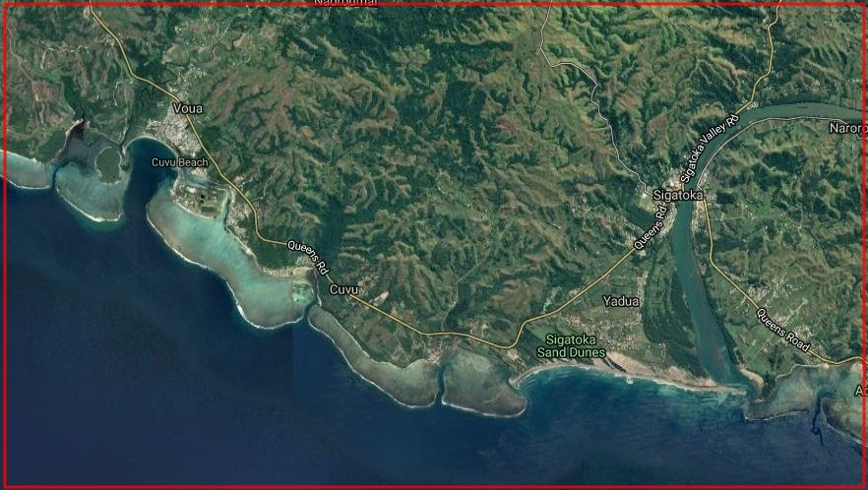
Coastline Change Detection & WOFS DCAL
The app maintains the coastal monitoring functionality, now with an inbuilt time-lapse animation and tweaked for extra precision.
Layers manually overlaid on a pre-existing map

Slide 21
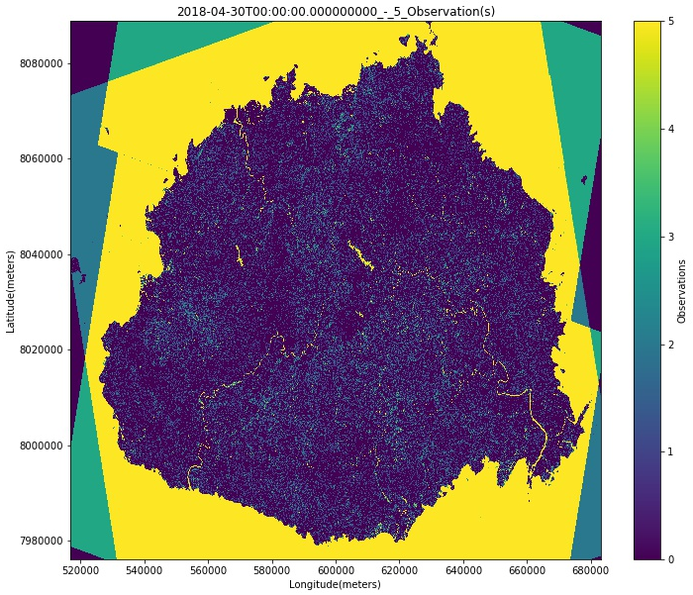
Inland Water Monitoring
Repurposing and rebranding
An open threshold water detection run over the whole island of Viti Levu. The main island’s standing water bodies and rivers are clearly visible, as is the coastline.

Slide 22
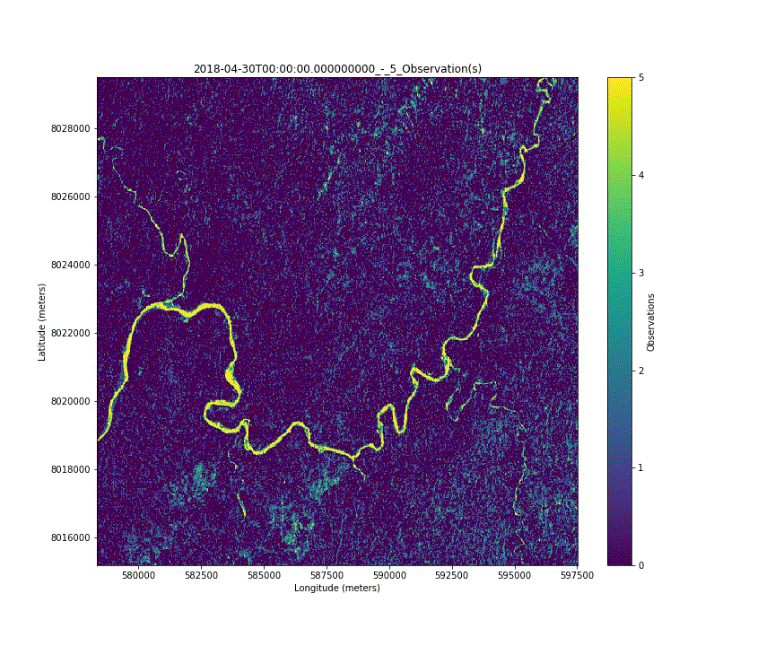
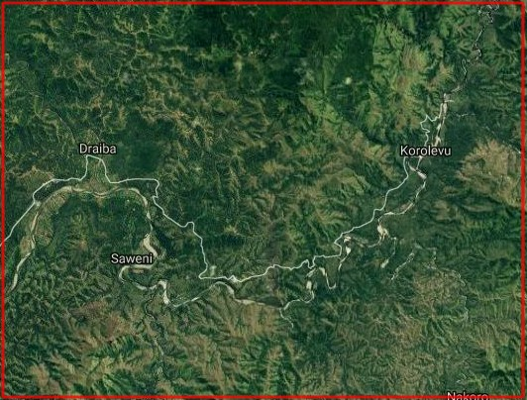
Rivers/Surface Water Detection
The Sigatoka River monthly time lapse over the full range of the Sentinel 1 data available, 04-2018 to 03-2019. The open threshold inadvertently shows surface water, which can be used to indirectly measure precipitation, indicate climate and estimate surface moisture.

Slide 23
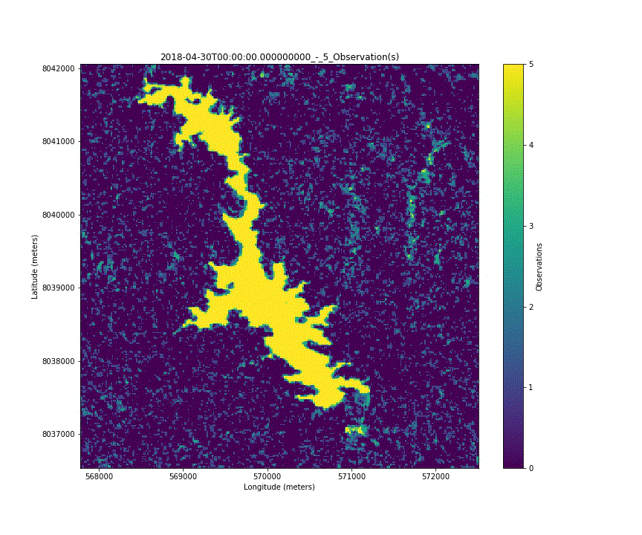
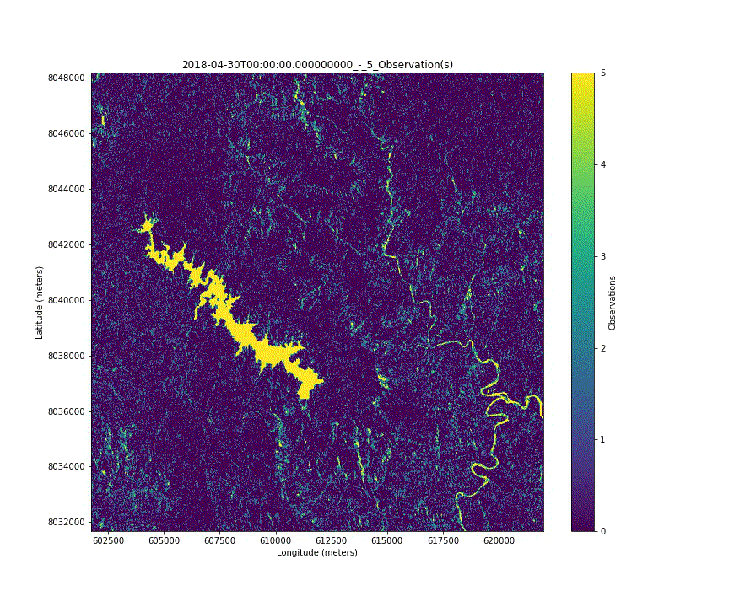
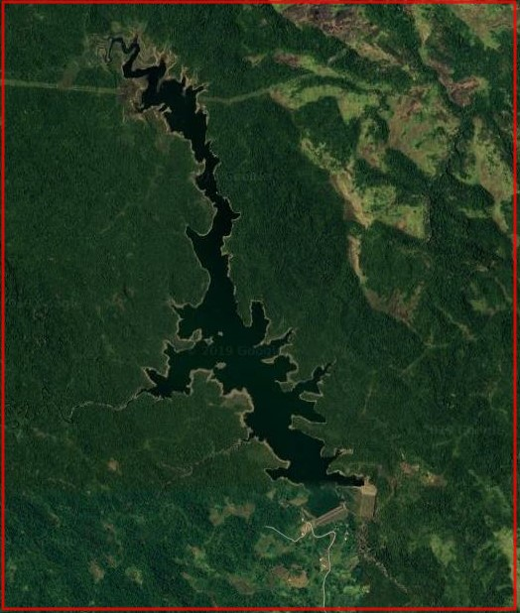
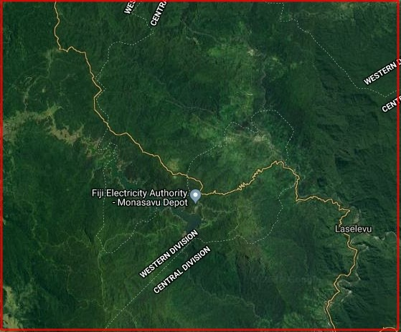
Image Left - Over the same time period as the rivers figure, this animation shows the health of a major freshwater reservoir in the western region of Viti Levu by showing the change in volume over time.
Inland Water Bodies
Image Right – This figure shows the largest inland lake on the island and a nearby river, notice how the feeder streams are highlighted during the rainy season in late Autumn.

Slide 24
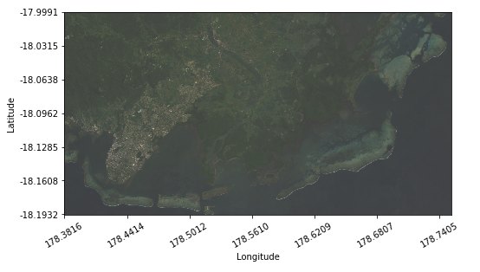
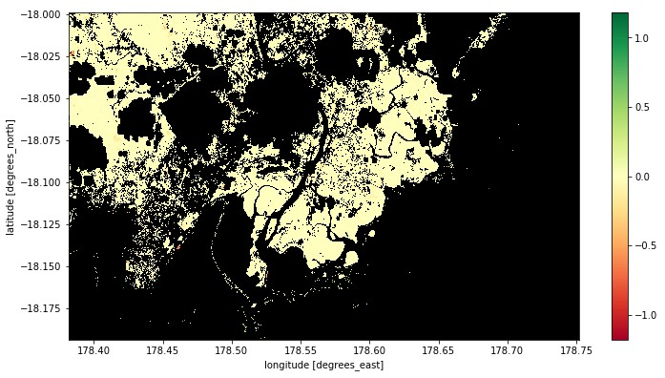
Land Change DCAL
Top– RGB image over the SE of Viti Levu over Suva, a close approximation to a true colour image.
Bottom – Spectral Parameter Anomaly, one of the output figures for Land Change DCAL, showing the change in vegetation. The changes are small here as the runtime was only set to over 2016.
The large dark sections are due to the cloud mask not catching all the clouds.

Slide 25

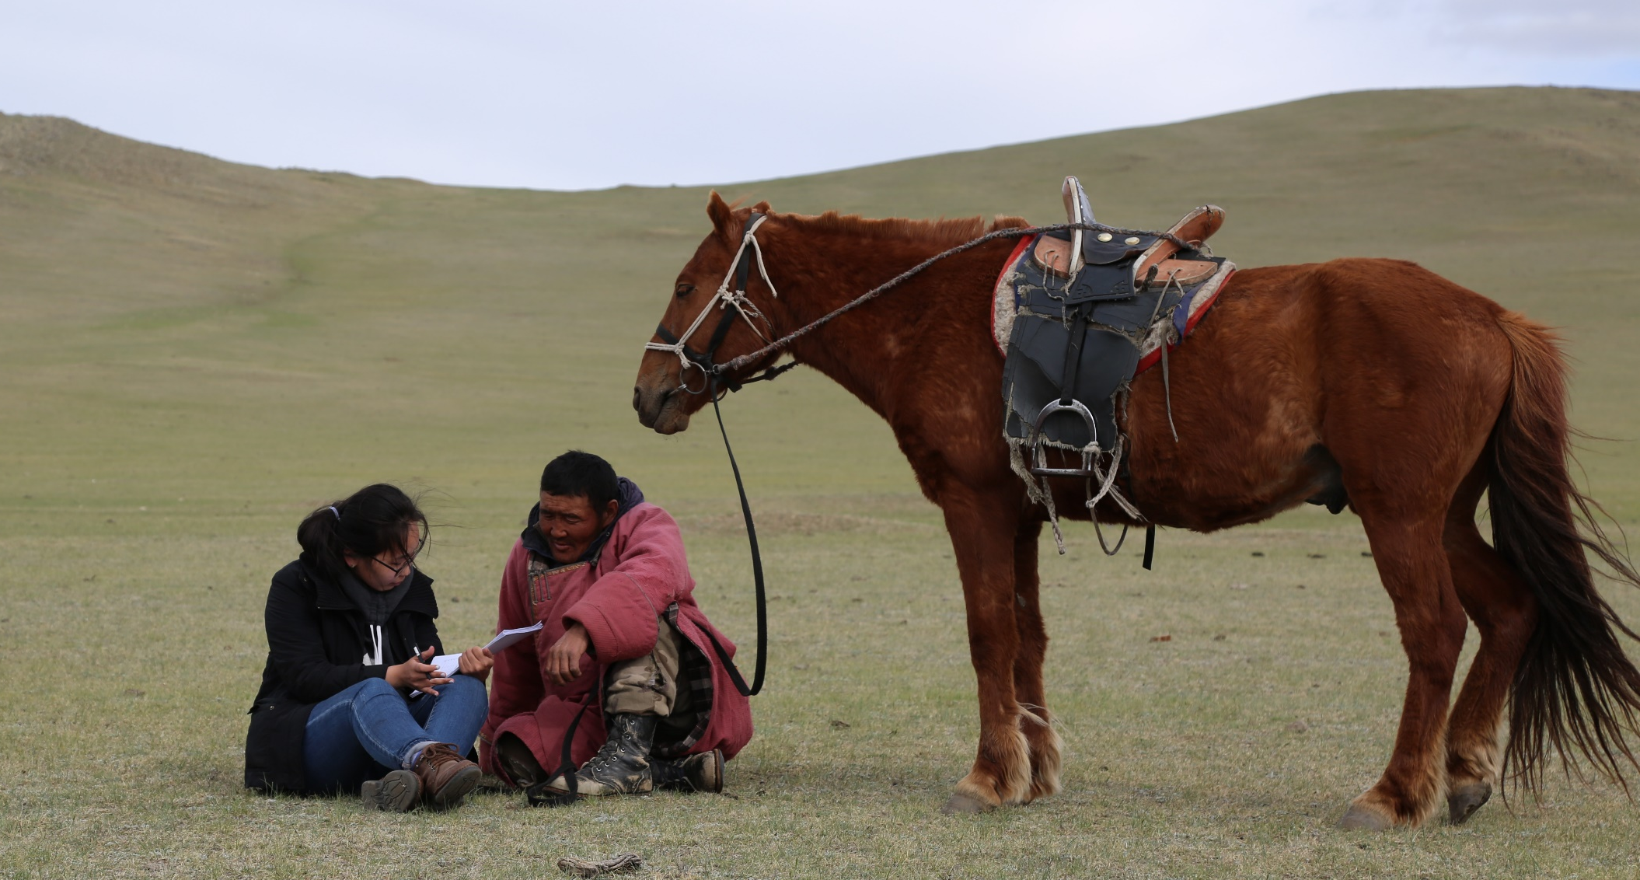
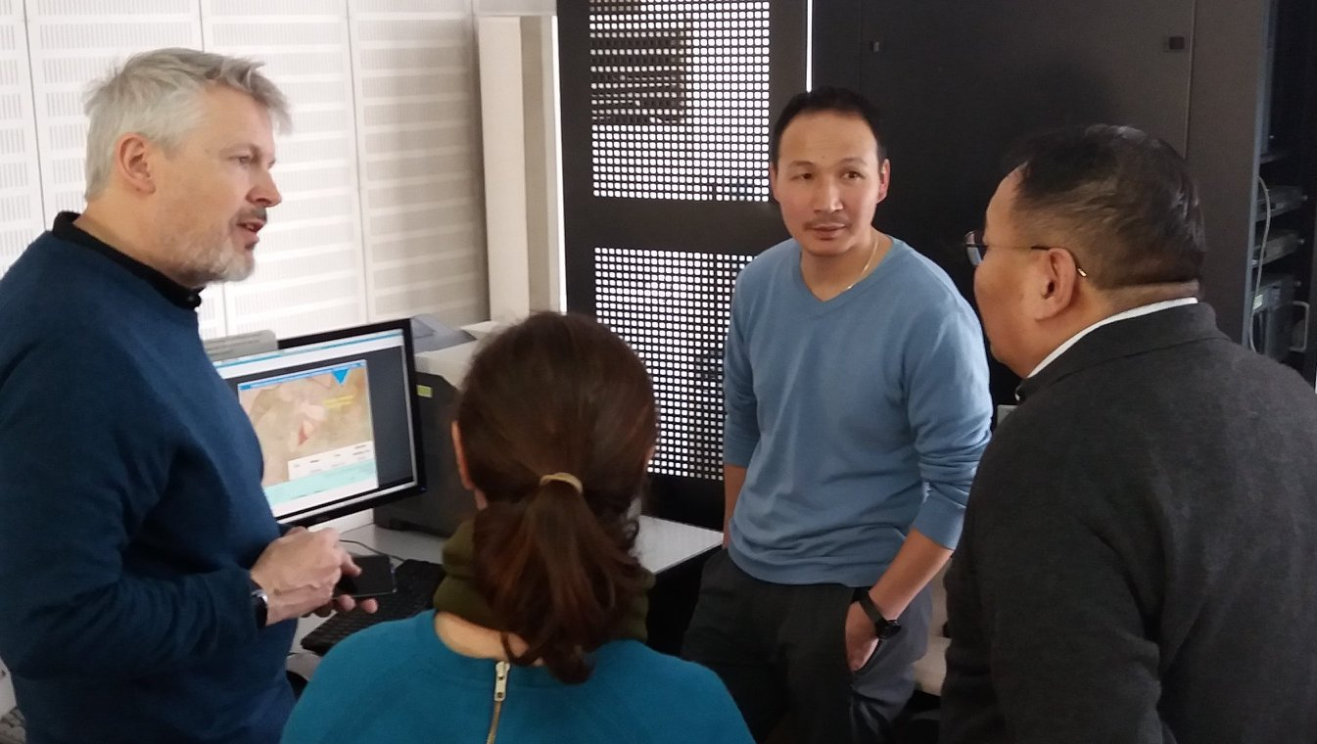
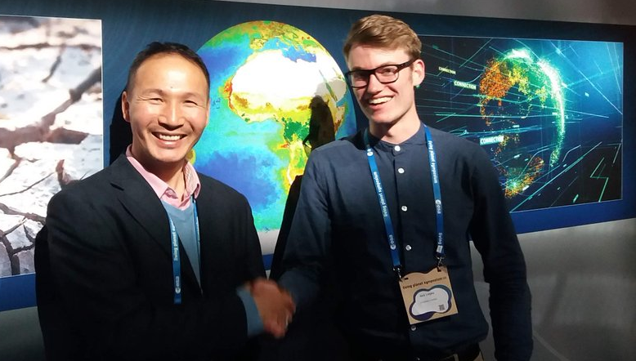




Mongolian Data Cube
Improved severe-weather resilience for Mongolian herding communities using satellite Earth Observation
What’s the problem?
30% of Mongolian population is dependent on livestock herding
Dzuds are occurring increasingly frequently, which can kill large numbers of livestock
What’s a dzud?
Typically drought leading to poor pasture followed by a harsh winter
Damaging for the economy & heath and welfare
The 2009-2010 dzud killed ~20% of the national livestock
What’s the cause?
Dzuds are increasingly exacerbated by climate change
Plus overgrazing and poor management
How can satellite Earth observation help?
Better information is required for
  Pasture
  Drought
  Snow

Slide 26
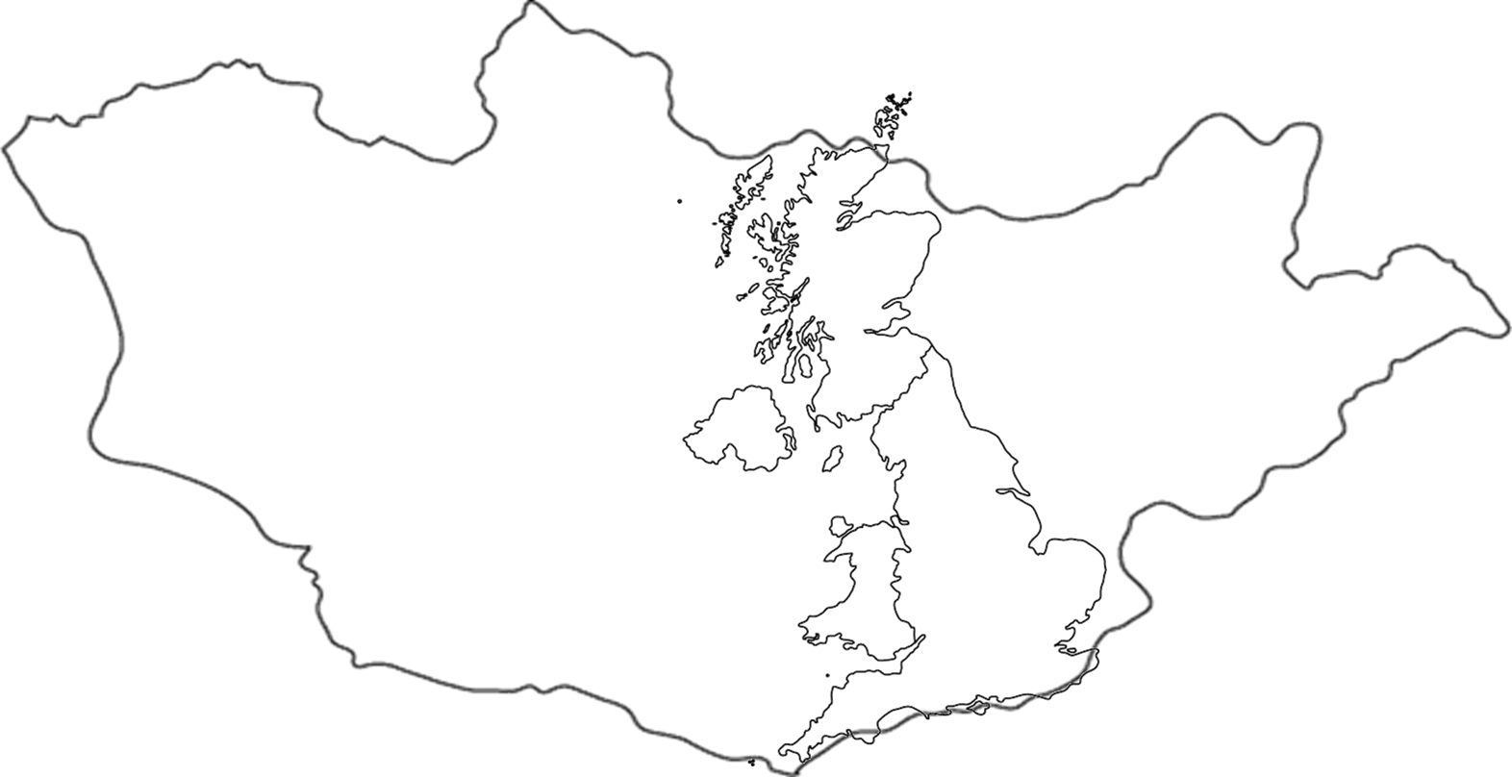
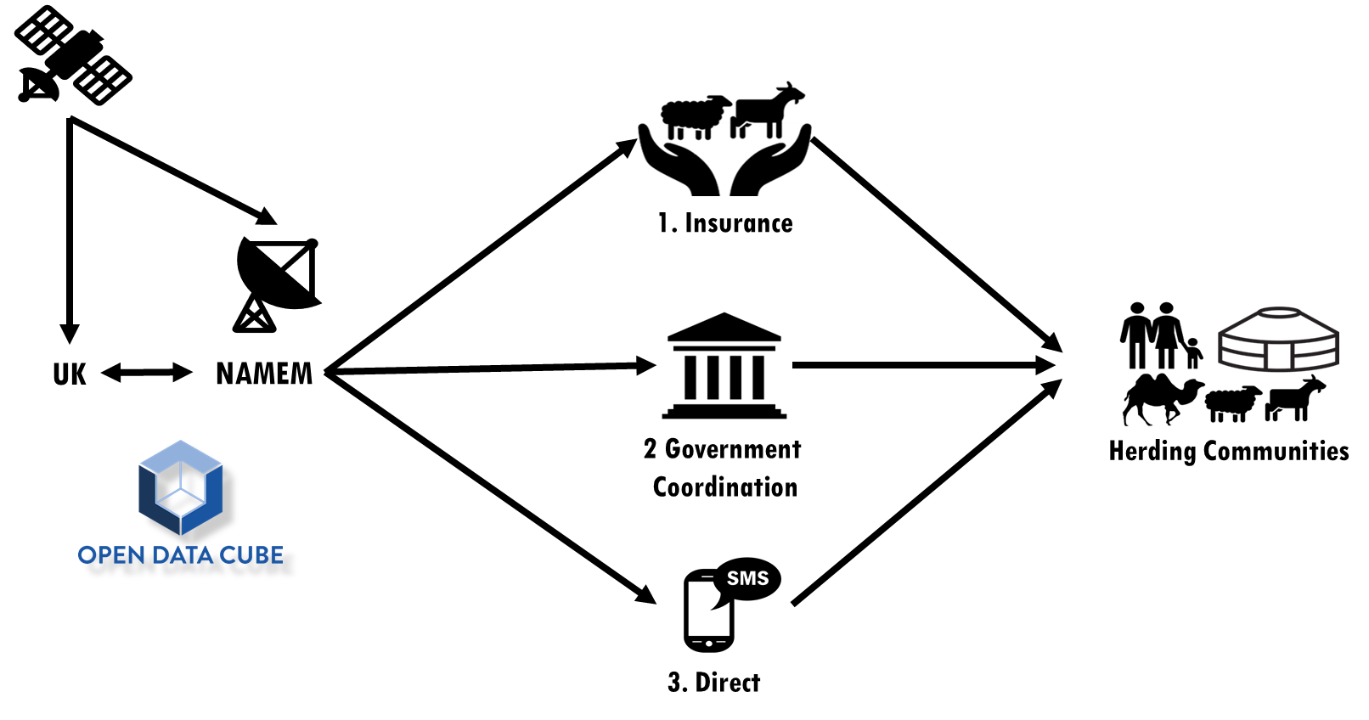
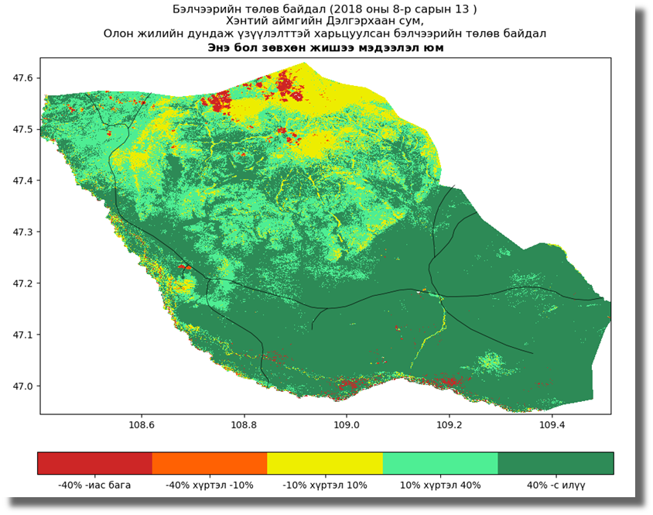
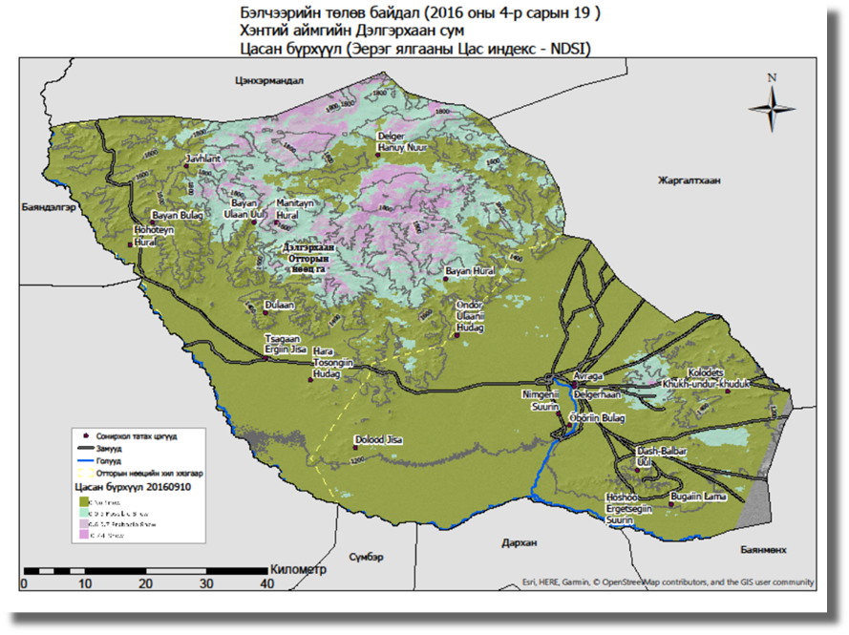
The Mongolian Data Cube
Mongolia is over 6 times the area of the UK
But with a population the size of Wales
Why use a Data Cube?
Mongolia is a large country
We have a lot of data
  Currently 5.7 Terabytes (& growing)
  Using Sentinel-2, Landsat 8, Modis & VIIRS
  Need 10 years of historical data for anomaly products
Data Cubes for sustainability
The wider Data Cube community have helped the SIBELIUs development team
The community maintains the base Data Cube software
Especially useful in a developing country
The Mongolian Data Cube is at the heart of SIBELIUs
Pasture Anomaly Product
Snow Product

