Slide 1
SEO Report to WGISS-50
Brian Killough
NASA Langley Research Center
CEOS Systems Engineering Office (SEO)
WGISS-50 Meeting (virtual) September 22, 2020

Slide 2
SEO Task Status
Support to SDGs ... continuing development and testing of ODC algorithms focused on SDG 6.6.1 (water), SDG 11.3.1 (urbanization) and SDG 15.3.1 (land degradation).
ODC Amazon Sandbox ... developing a data cube “sandbox” on the Amazon Cloud that will connect to the new Landsat and Sentinel-2 global archives on AWS-West. October 2020 release ??? (depends on AWS data release)
Africa Regional Data Cube ... continuing to support the transition to Digital Earth Africa and participate in the DE-Africa Technical Advisory Committee (TAC)
Earth Analytics Interoperability Lab ... working with CSIRO to support data and algorithm testing for CEOS initiatives (COAST, Disasters, Rice Monitoring, GHG, DEM evaluation). This will have further discussion in WGISS.
COVE Tool ... continuing work on a new coverage/revisit performance feature and a new coincident observation tool
CEOS Outreach ... participation (session chair, 8 papers) at the IGARSS 2020 (virtual) Conference(next week). CEOS social media presence growing... 2528 Twitter followers, 1603 Facebook likes, 20,000+ website visits.

Slide 3
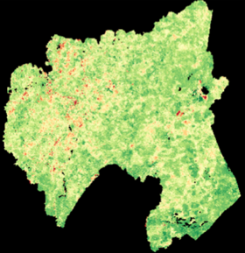
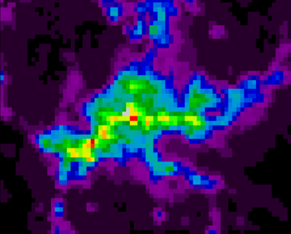
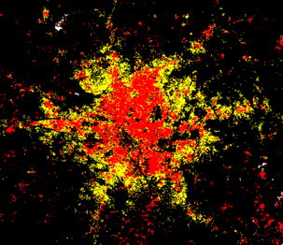
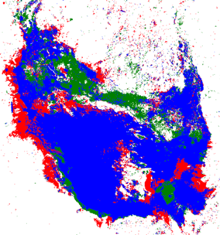
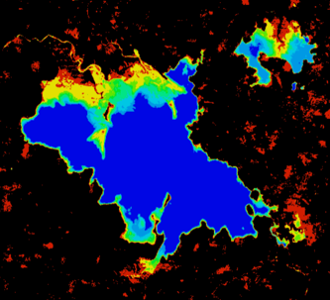
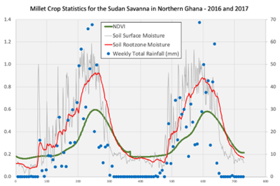
Open Data Cube (ODC)
Open Source Geospatial Foundation (OSGeo) ... working with the ODC team to add the ODC to OSGeo.
Google Cloud Prototype ... testing ODC installed on Google Cloud and connected to Earth Engine datasets ... working very well!
Advancing ODC Algorithms ... improving Jupyter notebooks for easier use and training (with DE-Africa) and enhancing products
Digital Earth Americas ... first meeting (limited attendance) was held on August 19. Exploring user needs and next-steps.
Digital Earth Pacific ... contacted by SPC (Pacific Islands) to discuss ideas for a DE-Pacific data cube. Vanuatu may be the first prototype.
User Forum ... investigating the forum used by “Sentinel Hub” to support the growing number of global ODC users
ODC Website: www.opendatacube.org
ODC GitHub: https://github.com/opendatacube

Slide 4
Update on Data Flows
GOAL: Global Landsat, Sentinel-1, Sentinel-2, and ALOS analysis-ready data (ARD) in Cloud-Optimized GeoTIFF (COG) format on the cloud and STAC metadata. This will support a number of global data cube projects and provide an efficient cloud-based solution.
Landsat ... Level-2 surface reflectance data (Collection 2) on AWS-USA-West by October 2020.
Sentinel-2 ... There is now global Level-2A on AWS-Frankfurt since Dec 2018. Joe Flasher (AWS) confirmed that they are working with Sinergise to process older S2 data to bring the L2A global archive (on AWS-Frankfurt) up to date. Element-84 (U.S. company) is converting this data to COG format and pushing it to AWS-US-West, along with Landsat. The AWS-Frankfurt data will remain in place and the global COG format data would be a separate holding.
Sentinel-1 ... The SEO is working with DE-Africa to co-fund (via Sinergise) the development of a Sentinel-1 Data Cube processing pipeline that complies with ARD specifications and uses COG format and STAC metadata. This is only for backscatter intensity data cubes. This tool would allow the generation of global S1 data cubes anywhere in the world. For now, this tool will be used for prototype cubes, but based on demand and resources may be able to support a number of projects.

