Slide 1
Agency Report
JAXA Earth Observation Programs
WGISS-50
Sep. 22 – 24, 2020
Makoto NATSUISAKA, Yosuke IKEHATA, Kyoko MIMURA, Wataru MATSUMOTO, and Masatoshi TAGA
Japan Aerospace Exploration Agency (JAXA)
Satellite Applications and Operations Center (SAOC)
Space Technology Directorate I

Slide 2

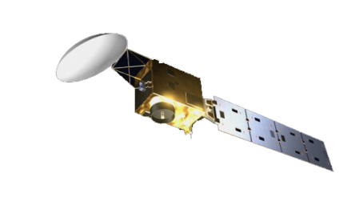
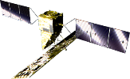
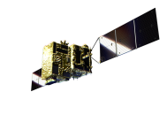
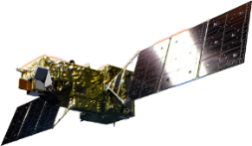


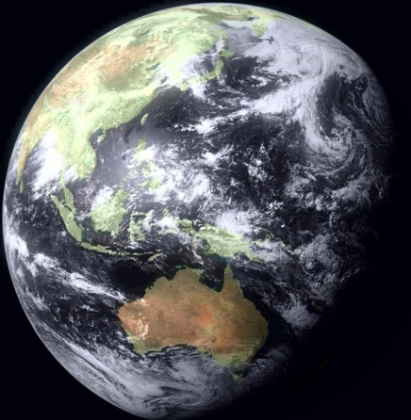
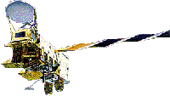
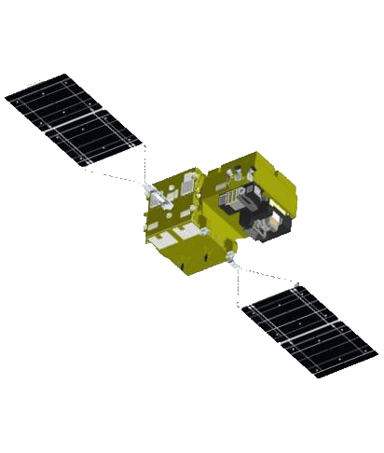
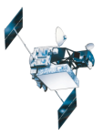

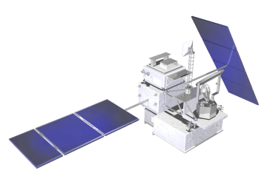
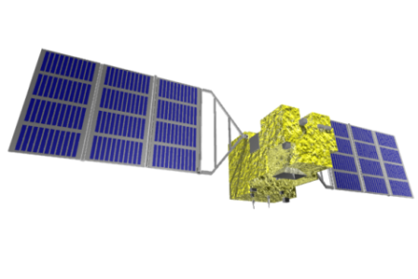
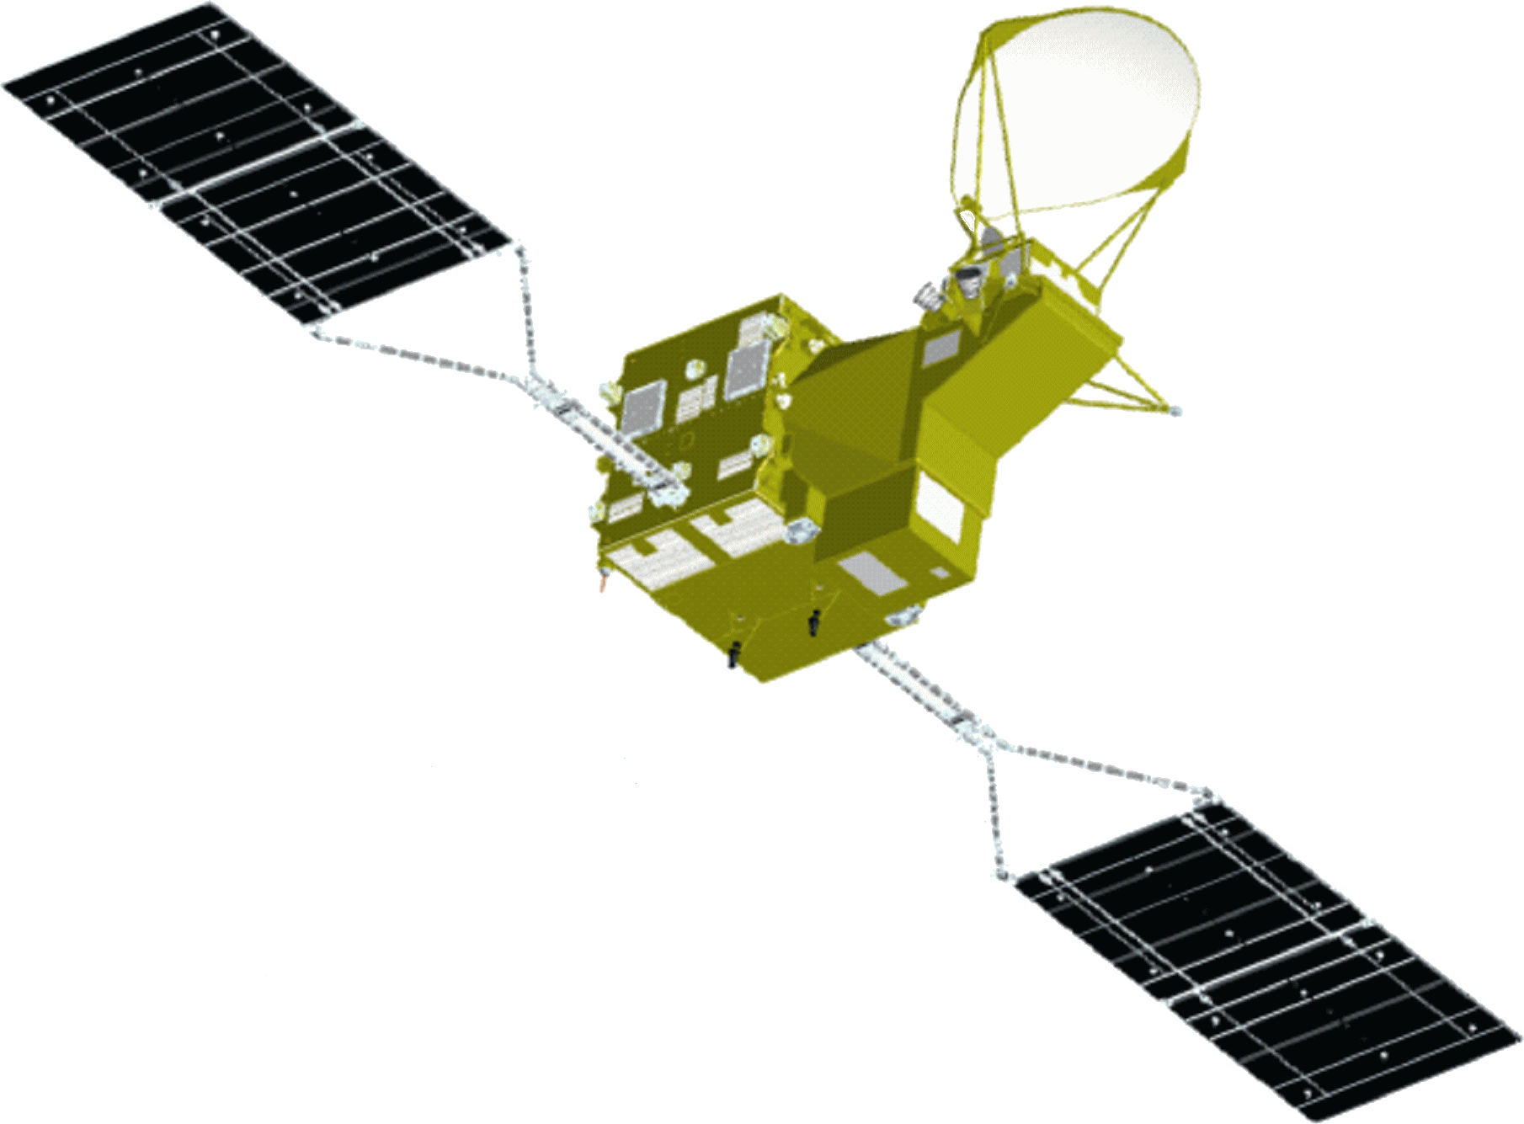
JAXA’s Past, Current and Future EO Satellites/Sensors
GOSAT-GW
(JFY 2023)
Earth CARE/CPR
Advanced Radar Satellite
(JFY 2022)
Advanced Optical Satellite
(JFY 2021)
GOSAT-2
(JFY 2020)
(JFY 2018)
GCOM-C (Shikisai)
ALOS (DAICHI)
(CY 2017)
(CY 2006)
SLATS
Aqua/AMSR-E
(JFY 2018)
(CY 2002)
ADEOS/ADEOS-Ⅱ
ALOS-2 (Daichi-2)
(CY 1996/CY 2002)
(CY 2014)
TRMM/PR
GCOM-W
(SHIZUKI)
(CY 1997)
(CY 2012)
GOSAT (IBUKI)
JERS-1
MOS-1/MOS-1b
(CY 2009)
(CY 1992)
(CY 1987/ CY 1990)
GPM/DPR
(CY 2014)
Notes:
JAXA has operated 6 EO satellites and developed 4 satellites.
The development of a new satellite, GOSAT-GW, has just been initiated toward the launch in JFY 2023.

Slide 3
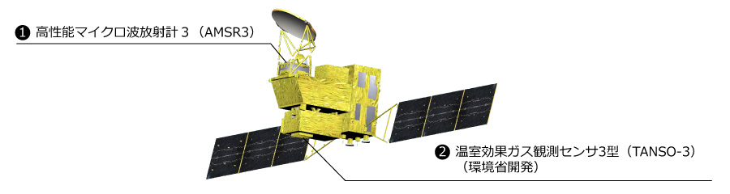
New Project
GOSAT-GW
The development of GOSAT-GW (Global Observing SATellite for Greenhouse gases and Water cycle) has been started as a joint mission with MOEJ (Ministry of the Environment, Japan) and NIES (National Institute for Environmental Studies).
GOSAT-GW will have AMSR3 （Advanced Microwave Scanning Radiometer 3） to be developed by JAXA and TANSO-3 （Total Anthropogenic and Natural emissions mapping SpectrOmeter-3）to be developed by MOEJ.
AMSR3
（Advanced Microwave Scanning Radiometer 3）
TANSO-3
（Total Anthropogenic and Natural emissions mapping SpectrOmeter-3）
Notes:
GOSAT-GW is a joint mission with MOEJ (Ministry of the Environment, Japan) and NIES (National Institute for Environmental Studies).
JAXA develops AMSR3 (Advanced Microwave Scanning Radiometer 3）and MOEJ develops TANSO-3 （Total Anthropogenic and Natural emissions mapping SpectrOmeter-3.

Slide 4
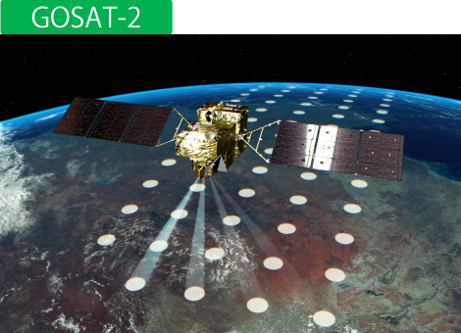
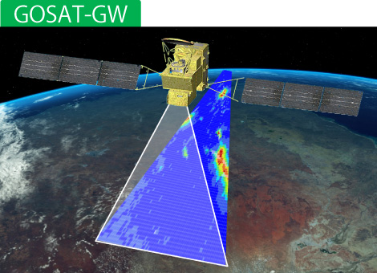
TANSO-3
The sensor type will be changed from FFT to diffraction grating.
The change will enable 2D observations.
  Wide View Mode: Swath 911km, Resolution 10km
  Narrow View Mode: Swath 90km, Resolution of 3km
Notes:
A major feature of TANSO-3 is that the sensor type will be changed from FFT to diffraction grating, which will enable 2D observations.

Slide 5
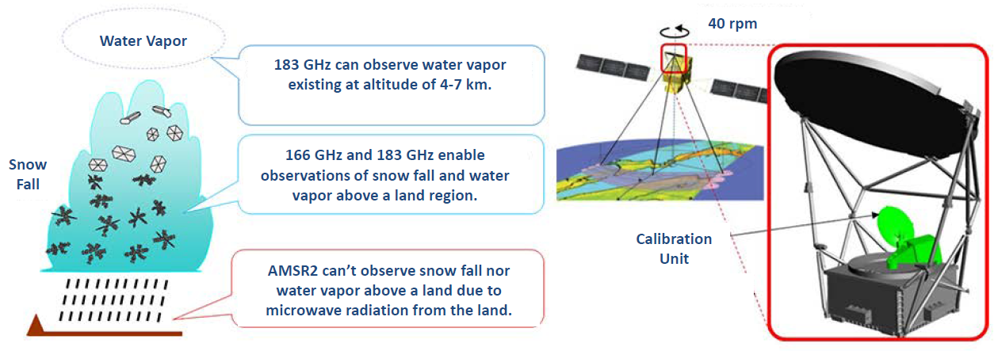
AMSR3
Higher-frequency channels of 166 GHz and 183 GHz will be added.
Those frequencies are not influenced microwave radiations from a land surface and enable AMSR3 to observe snow falls and water vapors above a land region.
Notes:
A major feature of AMSR3 is that Higher-frequency channels of 166 GHz and 183 GHz will be added.
Those frequencies are not influenced microwave radiations from a land surface and enable AMSR3 to observe snow falls and water vapors above a land region. Those higher frequencies can observe water vapor, snow fall, water vapor at high altitude, which can’t be observed by AMSR2.

Slide 6
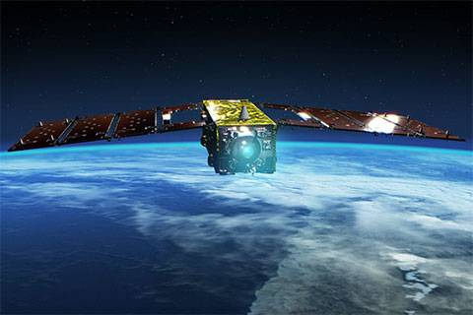
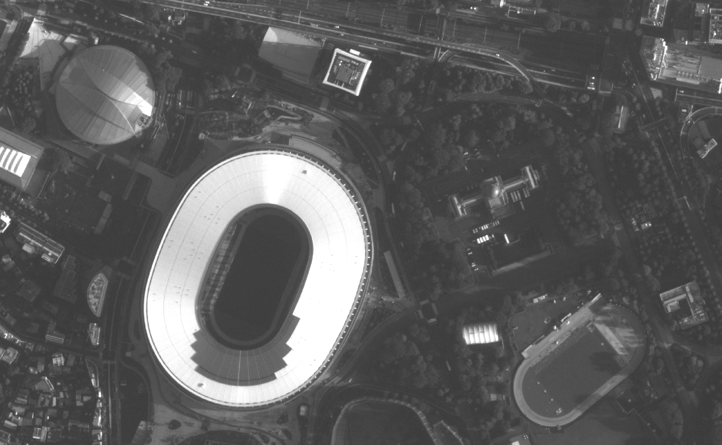
New Product
SLATS
SLATS (The Super Low Altitude Test Satellite "TSUBAME“) is the first Earth observation satellite to use a super low orbit raging from 300 – 167.4 km in altitude.
Operated from Dec., 2017 – Oct., 2019.
High resolution optical images taken with SHIROP (Small and High Resolution Optical Sensor) were released from G-Portal.
↑ Registered as a Guinness World Record
High resolution optical image taken at an altitude of 191km
Notes:
SLATS (The Super Low Altitude Test Satellite "TSUBAME“) is the first Earth observation satellite to use a super low orbit raging from 300 – 167.4 km in altitude and was operated from Dec., 2017 – Oct., 2019. The high-resolution optical images was released from G-Portal.

Slide 7
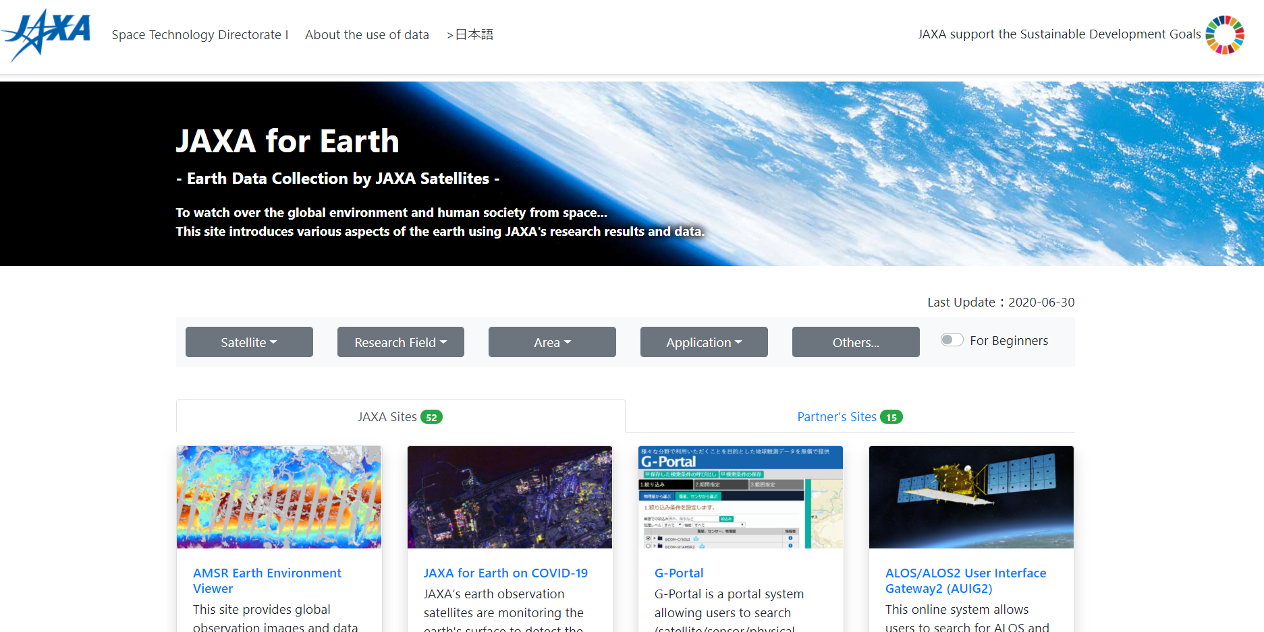
New Portal
JAXA for Earth
JAXA for Earth was released as a primary gateway to JAXA EO portals and partners’ portals. http://earth.jaxa.jp/en.html
The portal covers not only JAXA portals like G-Portal, AUIG-2 (ALOS-2/ALOS), GSMaP (Precipitation), JASMES (Microwave Sensors), Daichi Bosai web (Disaster Monitor), etc., but also partner portals like CEOS IDN, GEOSS Portal, GIDAS (GOSAT), etc..
Notes:
JAXA for Earth was released as a primary gateway to JAXA EO portals and partners’ portals.
http://earth.jaxa.jp/en.html
The portal covers not only JAXA portals like G-Portal, AUIG-2 (ALOS-2/ALOS), GSMaP (Precipitation), JASMES (Microwave Sensors), Daichi Bosai web (Disaster Monitor), etc., but also partner portals like CEOS IDN, GEOSS Portal, GIDAS (GOSAT), etc..

Slide 8
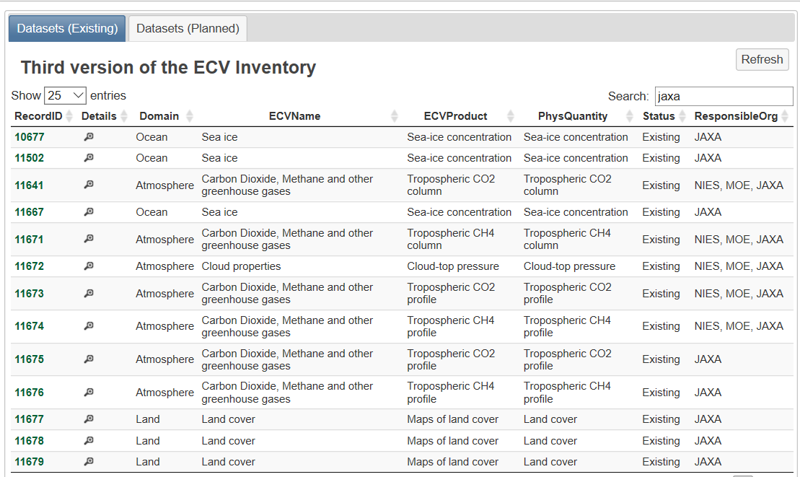
ECV 3.0
13 JAXA products were registered to the ECV 3.0 inventory.
Notes:
13 JAXA products were registered to the ECV 3.0 inventory.

