Slide 1
NOAA Persistent Identifiers
Nancy Ritchey
Chief, Archive Branch, Data Stewardship Division
NOAA/NESDIS National Centers for Environmental Information (NCEI)
Thursday, 23 April 2020
WGISS-49
Virtual

Slide 2
Persistent Identifier Guidance and Governance
NOAA Data and Publication Citation Procedural Directive (PD) defines basis for Persistent Identifiers (Digital Object Identifiers) for a data collections - currently being updated
PD assigns responsibilities for Working Group oversight and role of data stewards (data) and librarians (publications) for creating and managing DOIs
Working Group adjudicates questions and recommends improvements to implementation processes
Notes:
NOAA Data and Publication Citation Procedural Directive, https://nosc.noaa.gov/EDMC/PD.DC.php

Slide 3
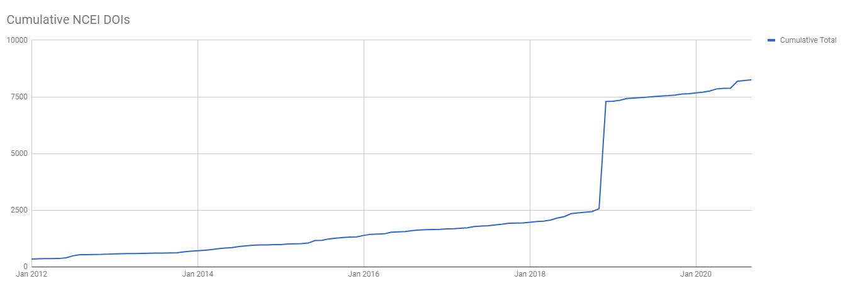
Data PIDs By the Numbers
Track and report metrics
~8222 Data DOIs since NOAA started minting Data DOIs in 2012
Received 1074 transferred DOIs when CDIAC closed
Average* of ~310 DOIs/year
*Excludes ~5000 DOIs in 2018 for special project to support WDS Paleoclimate

Slide 4
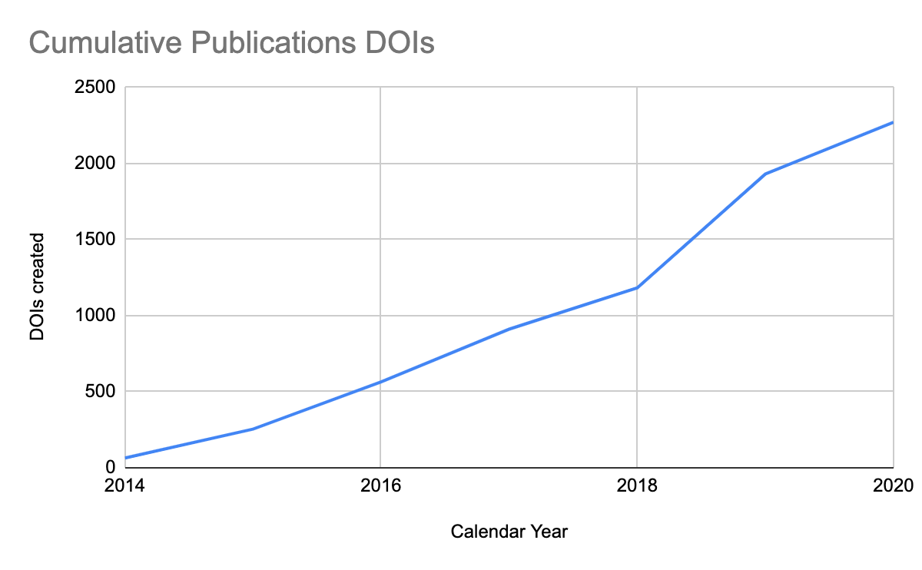
Publication PIDs By the Numbers
Track and report metrics
>2270 Publication DOIs since NOAA started minting Publication DOIs in 2014
Average of ~324 Publication DOIs/year

Slide 5
PIDs for Documentation and Software
NOAA Central Library responsible for publications, including NOAA Tech Memos, Cruise Reports, other NOAA publications
NCEI responsible for data and documentation that may augment or accompany data in archival data collections
NOAA does not have a centrally-managed software repository and does not currently create a DOI for NOAA-created software

Slide 6
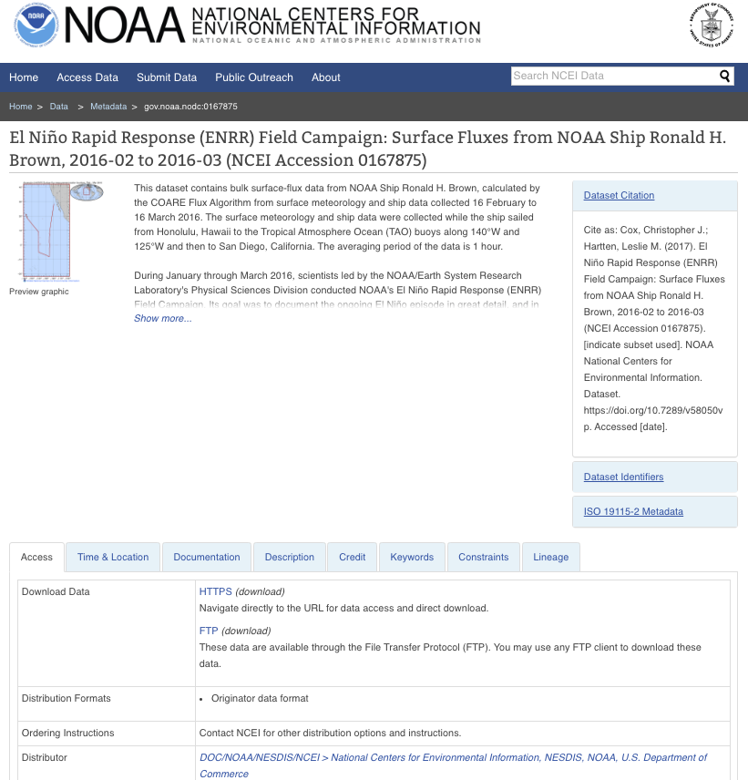
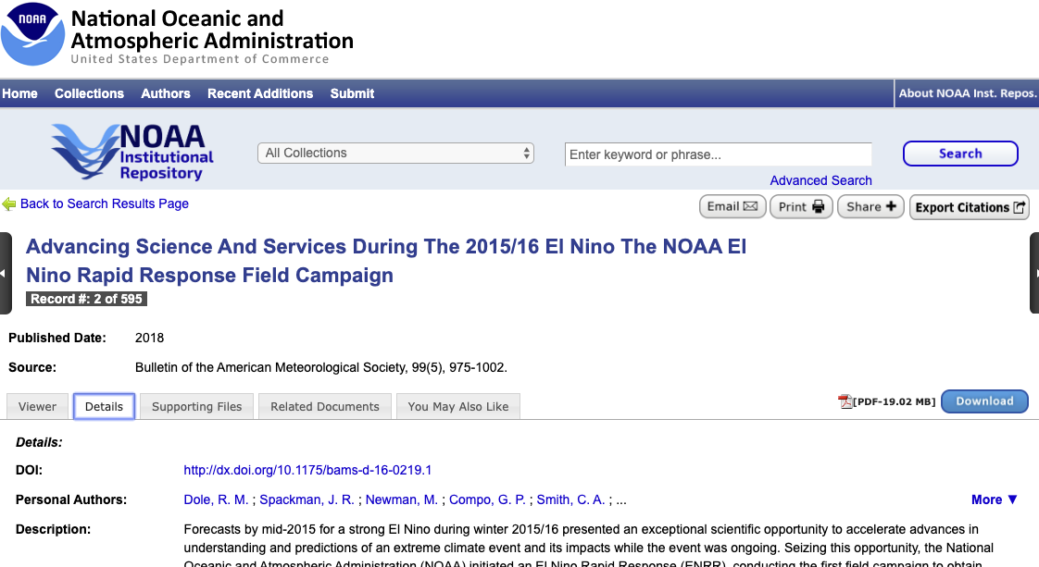
Landing Page Approach
Data DOIs link directly to a uniformly-presented landing page presenting the content of ISO 19115 metadata for the data collection
Publication DOIs link directly to the NOAA Institutional Repository landing page for the publication
Metadata provides two-way cross-references between DATA and PUBLICATIONS when those linkages are known and documented
DATA
PUBLICATION

Slide 7
Recent Developments
New Version 2.0 of the NOAA Data and Information Citation PD (draft is in review/approval process)
Clearer delineation between requirements and processes for NOAA data and publications
Documents processes for reserving a DOI for data and publications
NCEI Data DOI Minting SOP for consistent implementation
Published basic DOI information on the NCEI archive page
Planned work: Integrate DOI management into enterprise metadata tools

Slide 8
Lessons Learned
Important to have a publicly-accessible policy statement (e.g., PD) to underpin the process and basic requirements
Review and maintain the policy statement to keep up with and manage expectations
Be prepared (via a team or Working Group) to field and resolve nuanced questions about the process and policy interpretation
Communicate updates and changes widely and quickly

Slide 9
Other Notable Points
NOAA changed DOI vendors which affected the DOI prefixes used for NOAA data and publications and the process for managing and reporting DOI metrics
Management and monitoring of DOI minting across NOAA due to license limits (10K/year)
Challenges for managing metadata for data that have a pre-existing DOI from a non-NOAA source

Slide 10
Challenges
Event-based DOIs for cruises have been requested, but not adjudicated. Do other repositories mint DOIs for events?
How should data citation information be embedded in distributed data files? Like a watermark for data.
Users access subsets of various data. How can dynamic, custom citation information be provided to users for their ad hoc data access?
Support of DOIs required by publishers in order to publish articles. How are you handling that? Publisher requirements and timelines do not match current capabilities

Slide 11
Thank You!

