Slide 1
Persistent Identifier Implementation at ISRO
Committee on Earth Observation Satellites
T. Sai Kalpana
NRSC, ISRO, India
WGISS-50
22-24 Sept 2020

Slide 2
Persistent Identifier Implementation
ISRO uses DOI for assigning Persistent Identifiers to its data products.
ISRO data products are registered through CrossRef as the Registration Agency.
DOIs are assigned to data sets that are publicly disseminated and are associated to specific product processing level/product type and not to individual products/scenes.
Each assigned DOI has associated landing page
Notes:
This slide introduces about the ISRO (NRSC, MOSDAC) assigning Persistent Identifiers for the data products and individual landing pages are provided for each DOI for the description of the product by creating individual landing pages. The URL of the landing pages are provided in the next slide. For each type of a product of a satellite and sensor a DOI is registered. ISRO Registered all the current DOI’s through CrossRef registration Agency.

Slide 3
Persistent Identifier Implementation
Total DOI assigned to products till date:
16 Products of various satellite/sensors are available in NRSC UOPS (satellites like Resourcesat series, Oceansat series, Cartosat-1, IRS-1C, IRS-1D)
202 Products are available on MOSDAC
DOI assignment and registration is an ongoing process for all the available collections that are publicly being disseminated.
All DOI’s are listed at the below URL:
https://mosdac.gov.in/satellite-catalog
https://www.nrsc.gov.in/irsdata_DOI
Notes:
Currently NRSC has registered 16 DOI’s and MOSDAC has registered DOI’s for 202 products. Standard product type for various satellite and sensors DOI has been registered by NRSC , as there are many other product types, we are in process of registering for others.
The listed URL’s in the slide will display all the registered DOI’s for a quick look with the required details.

Slide 4
Persistent Identifier Implementation
DOI naming convention
https://dx.doi.org/10.46693/NRSC/10/RS2_LIS3_STUC00GTD
Base identifier
Data Center (Data Processing Area)
Identifying ISRO centre
Unique Product ID
Notes:
The naming convention followed by MOSDAC/NRSC of ISRO is with base identifier followed by ISRO center and its corresponding data center with the product type of the particular satellite and sensor.
Resourcesat series, Oceansat series, Cartosat-1, IRS-1C, IRS-ID satellites standard product types DOI’s are registered by NRSC.

Slide 5
NRSC/ISRO Status
https://dx.doi.org/10.46693/NRSC/10/RS2_LIS3_STUC00GTD
Landing page
Notes:
This slide displays the landing page of one of the DOI belonging to Resourcesat-2 satellite Lis3 sensor standard product.

Slide 6
Landing Page NRSC/ISRO
The DOI resolves to a Landing Page, which in turn forwards to the actual page represented by the DOI.
The Landing Page describes about the product type of the mentioned satellite sensor, its usage, access and contact details to get the data. The coverage of the satellite is also specified.
Description
Data Access
Coverage
Keywords
Constraints
Citation
Notes:
The landing page provides in detail description of product usage, availability , the link to be used for citation , contact details to get the product etc by NRSC/ISRO.

Slide 7
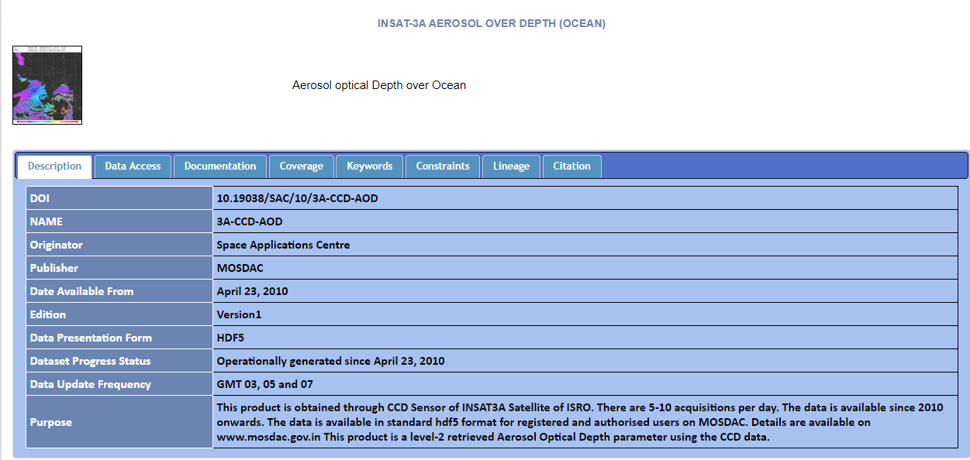
MOSDAC/ISRO Status
https://doi.org/10.19038/SAC/10/3A-CCD-AOD
Landing page
Notes:
This slide displays the landing page of one of the DOI belonging to INSAT products . It provides in detail description of product usage, availability , the link to be used for citation , contact details to get the product etc by MOSDAC/ISRO.

Slide 8
THANK YOU
saikalpana_t@nrsc.gov.in
Contributions: T.Sai Kalpana, Ankitha Reddy, D.Smitha, P.Ravinder
Anupama sharma
Support: M.Manju Sarma, Nitant Dube, Utkarsh

