Slide 1
Technical Content and Information Preservation
WGISS#50 Virtual Meeting – 22-24 September 2020

Slide 2
CONTEXT … Not Just data
Notes:
Information technology is changing rapidly and this change also affects digital data from Earth Observation missions. Risks include the corruption of the bit-stream, obsolescence of the file format, extant hardware and operating environments that make data unreadable on the physical and logical level. On the other hand, insufficient documentation and information regarding the data (e.g. their quality, format specifications, validation approach, etc), the inability to discover the data, or service compatibility can also prevent their re-use.
Evolution from Long Term DATA Preservation to Long Term «X» Preservation to be sure to preserve also all associated information.

Slide 3
TERMS and CONCEPTS
Notes:
Terms and concepts taken from the Open Archival Information System (OAIS) ISO Standard

Slide 4
EO Space Data Technical Content and Information
Technical Content and Information
Notes:
Technical content and Information to be preserved together with EO data (non-exhaustive list) is presented below:
Information:
Documentation
Images
Metadata files (information on creation, access rights, restrictions, preservation history, and rights management)
Multimedia (Video/Audio)
Workflows
Bi directional links
Schemas
Emails
Software/Tools:
Software Applications:
Data Product generation
Quality control
Product visualization
Value adding
SW related “IT Infrastructure”:
Compiler
Programming language
Storage system
Operative System
Libraries
Databases

Slide 5
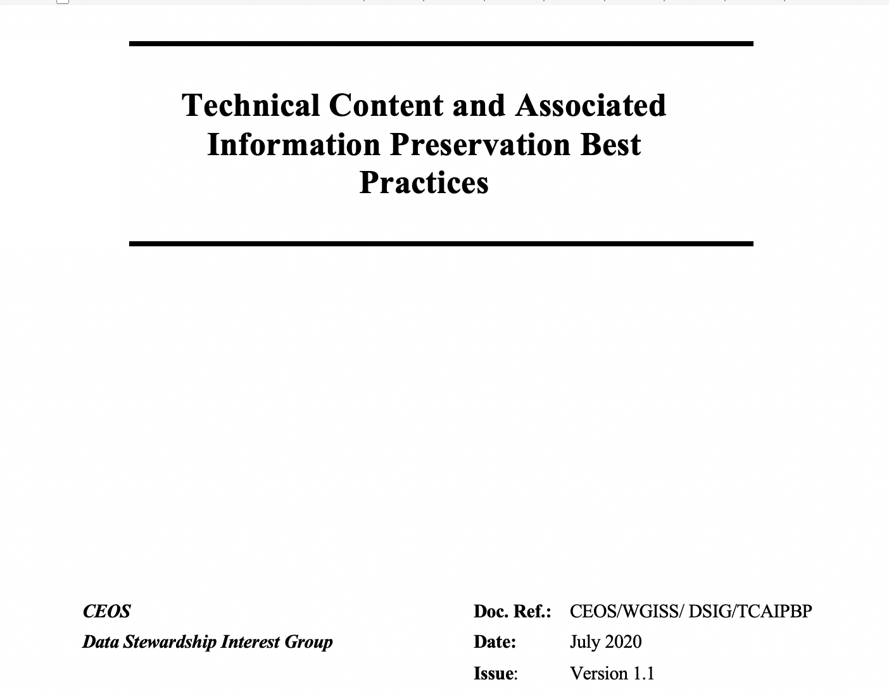
CEOS BEST PRACTICE
Recently
Updated
Provide recommendations and best practices for the preservation of EO Data Associated Technical Content and Information.
Notes:
http://ceos.org/ourwork/lessons-learned-best-practices/

Slide 6
Technical Content and Information preservation – Topics for discussion
Long Term Preservation Platforms (Open source and/or licensed)
Preservation processes
Preservation Metadata and Formats
Provenance and linked network
Software and Tools Long term preservation
Artificial Intelligence applications (e.g. natural language processing and machine learning to find reference to data in papers and link them to the ESA archives and to automate the keyword creation)

Slide 7
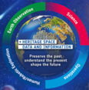

EO Data Technical Content and Information Long Term Preservation at ESA (1/3)
Notes:
The above systems and services are meant to ensure long term preservation of EO data and associated technical content and information. They have been put in place and are running beside the nominal systems and services dealing with documents and information management and access (e.g. documents management systems, web sites, etc).
The Preserved Dataset Content system deals with the management and curation of space data and technical content and is populated with metadata coming from the Space Data Preservation Archive, the Technical Information Archive, the SW and Tools Preservation platform, and different systems and services from the EO Operational Payload Data Ground Segment (items in black).

Slide 8
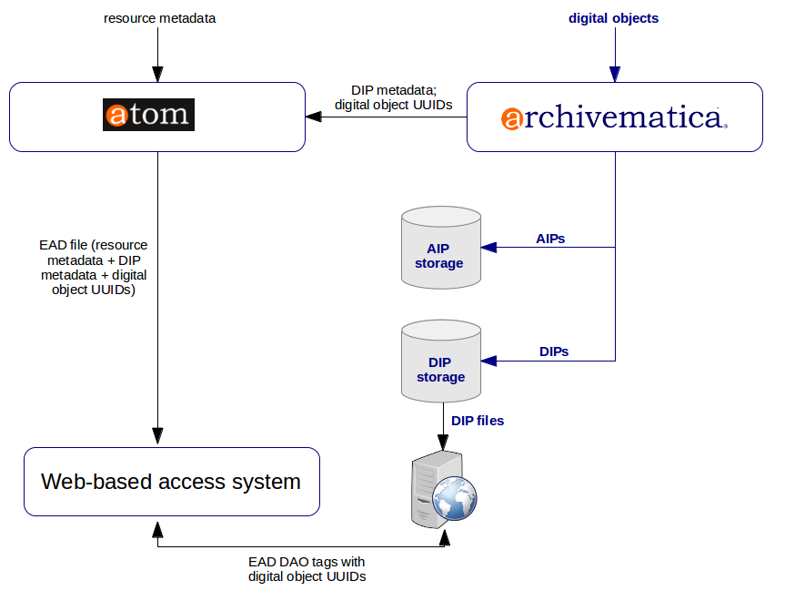
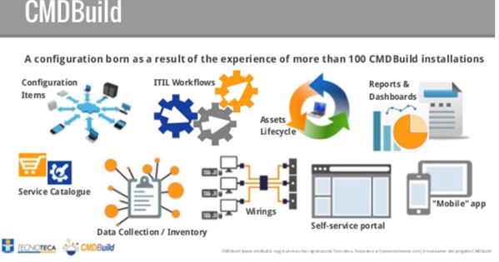
EO Data Technical Content and Information Preservation at ESA (2/3)
→ Space Data Technical Information Preservation Archive

Slide 9

EO Data Technical Content and Information Preservation at ESA (3/3)
Data Curator
PDSC Tailoring
MERCURY Circulator
Workflows + Additional Metadata
EOP & Internal Repository
Papers and Technical Documents Backlog
ATOM
Data Librarian
Ingest Docs + Metadata SIP
AIP
Physical DIP
Repository
New Technical Documents
New Scientific Publications
Pre-Ingest
Archivematica
Other Repositories
EAD 2002 XML
No Physical DIP
Repository

Slide 10
Long Term Preservation Processes

Slide 11
Metadata and format definition and use (1/2)

Slide 12
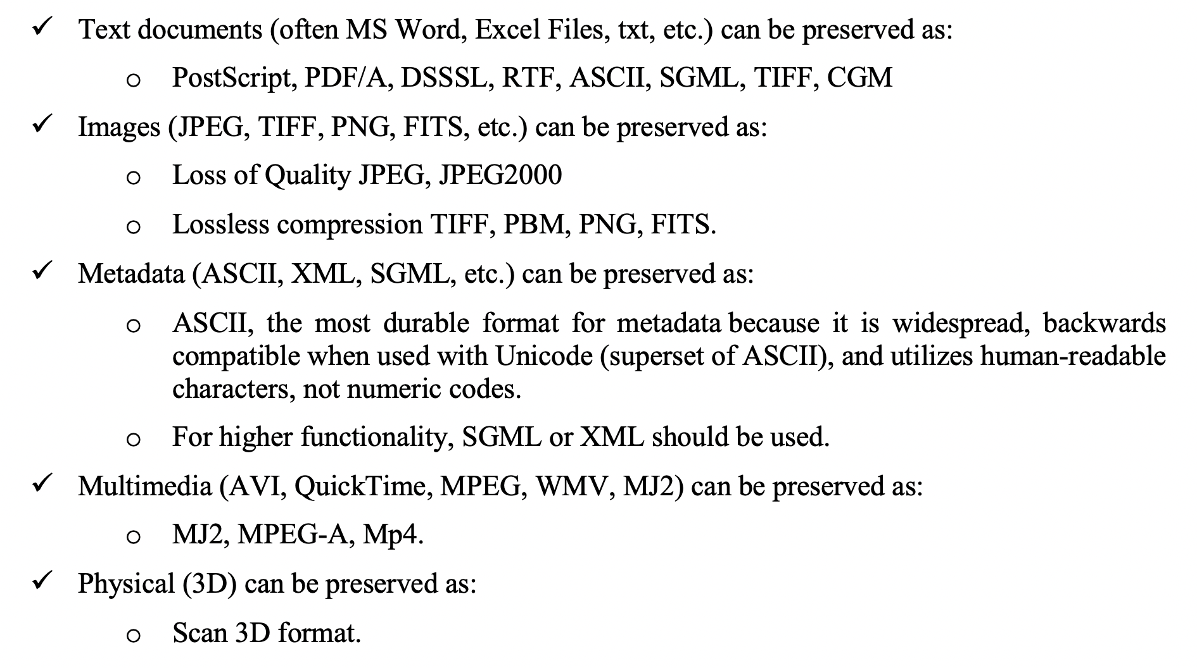
Metadata and format definition and use (2/2)

Slide 13
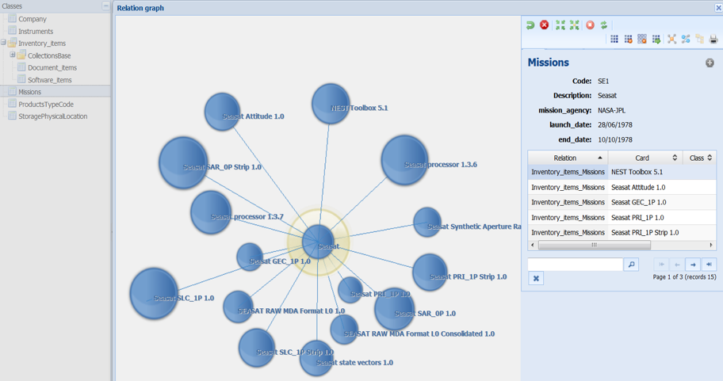
Provenance and linked network
Once the associated technical content and tools are linked to the corresponding data records (including their physical location), the data set is considered consolidated from the information point of view.

Slide 14
Software and Tools Long term preservation - Ongoing
Long-Term Software Preservation (actually storing the software, but also salvaging it and virtualizing it when necessary);
Preserved Software Execution On-Demand (discovering, running and using the software);
Preserved Software Execution with Elastic Capacity (configuring and exploiting dynamic computing resources for execution)

Slide 15
Artificial Intelligence applications – To Be Started
Application of Natural language processing and machine learning for:
Automatic discovery of Missions Dataset in publications/papers and link them to the ESA archives and automatic the keywords creation;
Automatic Documentation Classification (e.g. Weekly Report, Operation Concept, etc.);
Natural Language Processing to identify relationships between actions (verbs), time expressions (dates), and targets/instruments. Machine learning used to match pre-defined patterns and identify new ones;
Natural Language Processing to identify (key)words in text and classify papers by topic. Both humans and machines do the same on sample of papers.

Slide 16


