Slide 1
Discovery of Services
Yves Coene (Spacebel), Andrea Della Vecchia (Randstad),
Damiano Guerrucci (ESA), Mirko Albani (ESA)
CEOS WGISS#52
19 October 2021

Slide 2
Executive Summary
Current “WGISS Connected Data Assets” made possible thanks to cooperation within WGISS/SLT:
  Preparation of “CEOS OpenSearch Best Practices”
  Implementation of Best Practices by Partners and integration with IDN
ESA seeking for cooperation within WGISS/SLT on
  “CEOS Best Practices for Service Metadata and Discovery” to be elaborated within System Level Team (SLT)
  ESA volunteering to prepare working draft
  Aiming for inclusive work plan, including work already done.
Current presentation:
  Sketch of proposed approach / Best Practices organization
  Survey of related metadata models
  Examples of current & ongoing implementations

Slide 3
Outline
Context
Proposed work plan
Service metadata models
Current implementations
Conclusion

Slide 4
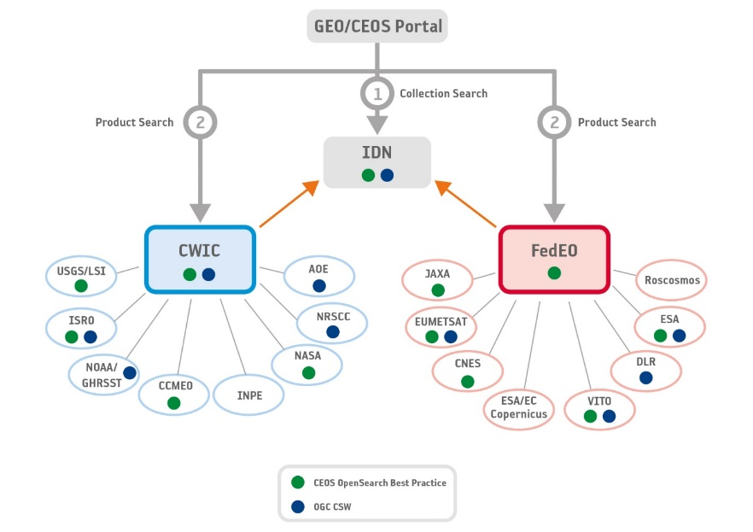
Context
Successful approach to provide access to WGISS Connected Data Assets:
  Agreement on CEOS Best Practices (OpenSearch) [Collections + Granules]
  Integration through IDN (supports UMM-C elements)
  Multiple encodings/views for UMM-C elements at IDN and Partners
  Interchange format with IDN: DIF-10 (*)
(*)

Slide 5
Context
Planned support for metadata and discovery of “services” @ESA
  E.g. EOCAT, FedEO
  Aim for interoperable, standards-based implementation
Extend the approach and aim for sharing “services” (incl. tools, applications) at WGISS level as well ? E.g.
Seeking for collaboration and inclusion of work already done.
First step: ESA volunteers to draft an initial “CEOS Best Practices for Service Metadata and Discovery” for elaboration within System Level Team (SLT) …

Slide 6
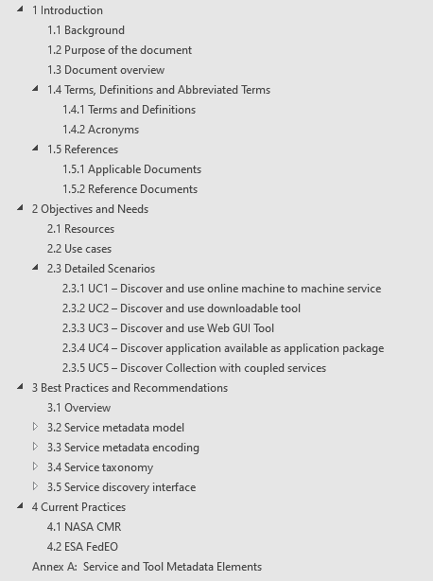
Proposed work plan
Document “objectives and needs”
  Use cases for service discovery
  Detailed scenarios
Describe current practices
  NASA CMR
  ESA FedEO
  Others…
Agree upon Best Practices and recommendations
  Service metadata model (minimal)
  Metadata encoding
  Service discovery interfaces
  Controlled vocabularies used in metadata

Slide 7
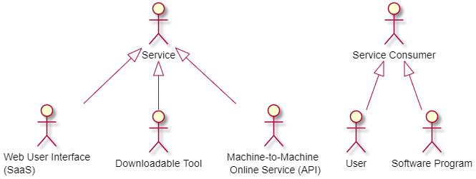
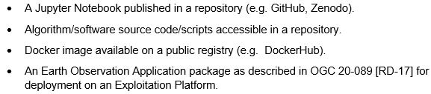
Objectives and needs
“service” resources to be described/discovered:
  Online M2M services and API (e.g. OGC)
  Downloadable tools
  Online Web user interfaces
Specific examples

Slide 8
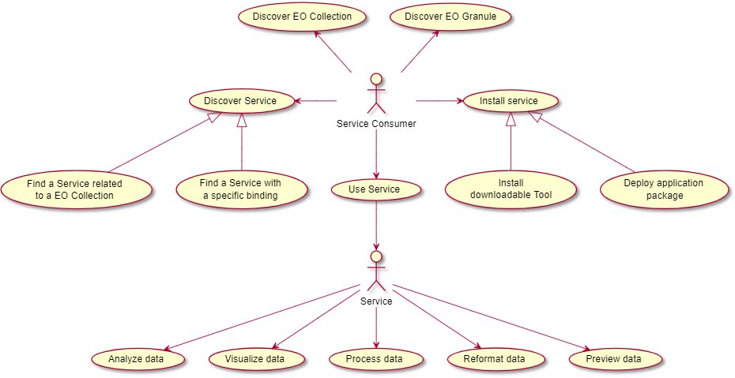
Use Cases
“Discover Service” & “Use Service”: complement use cases from “CEOS OpenSearch Best Practices”:
  “Discover EO Collection”
  “Discover EO Granules”

Slide 9
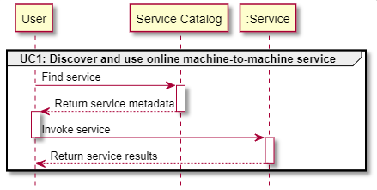
Discovery Scenarios
Use Case 1: Online machine to machine interfaces (API)
Description:
  Client discovers service bindings and executes the (view, download, processing, transformation…) service
  Examples: OGC WM(T)S, WPS, WCS, OPeNDAP, CSW, OGC API, INSPIRE Invocable Spatial Data Services …

Slide 10
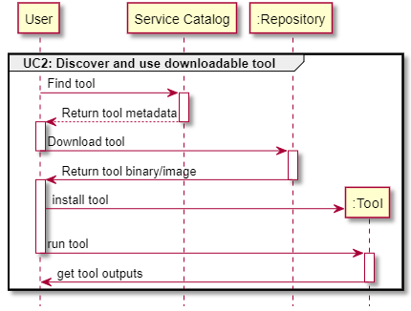
Discovery Scenarios
Use Case 2: Downloadable tools
  Source code, binaries, Jupyter Notebooks, Docker images, …
  Download from repository (GitHub, ..) or registry (e.g. DockerHub, …)

Slide 11
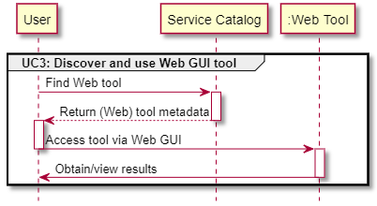
Discovery Scenarios
Use Case 3: Web GUI tools
  Software as a Service (SaaS)
  E.g. Jupyter Notebook on Google Colaboratory

Slide 12
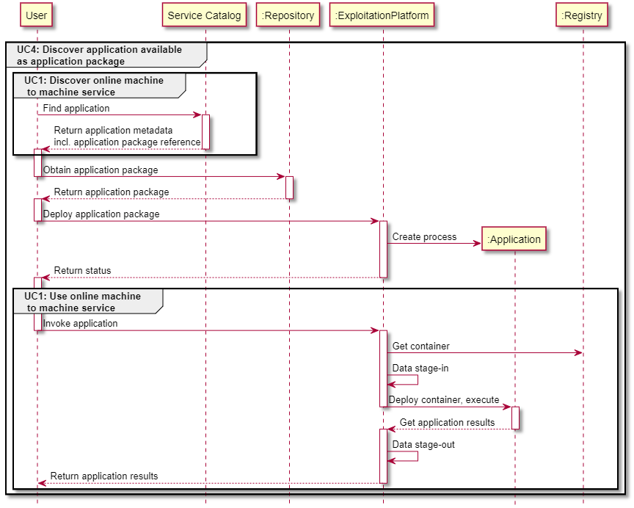
Discovery Scenarios
Use Case 4:
Application Package
  E.g. OGC 20-089
  Includes “service” deployment steps via API
  Is combination of other use cases

Slide 13
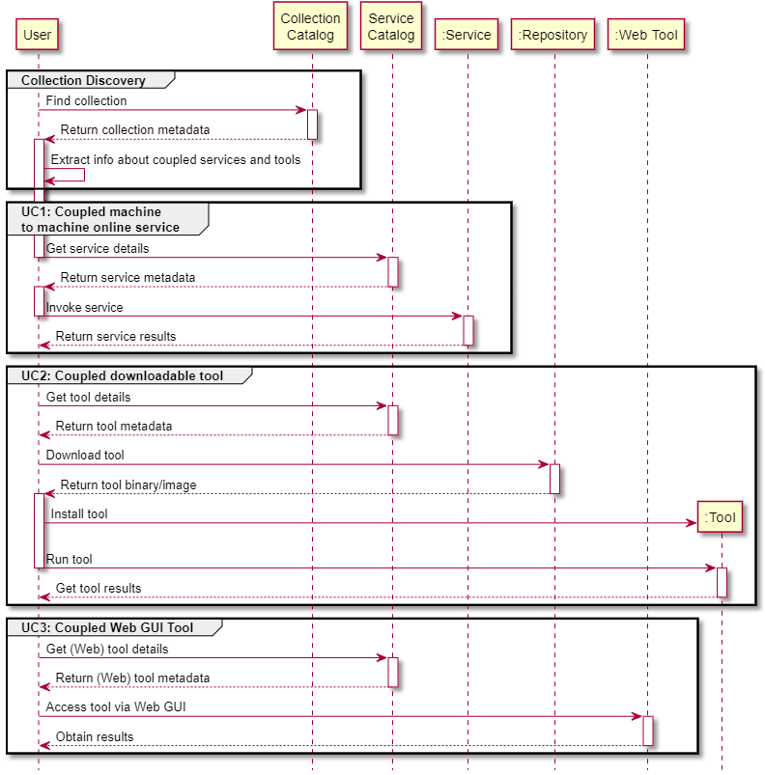
Discovery Scenarios
Use Case 5: Coupled resources
  Discover services (UC1, UC2, UC3) “coupled” with collections or granules.
  Continuation of prior collection/granule discovery steps.
  Example: via collection metadata, access a “coupled” DataCube (WCS) / Pixel-based Access service.

Slide 14
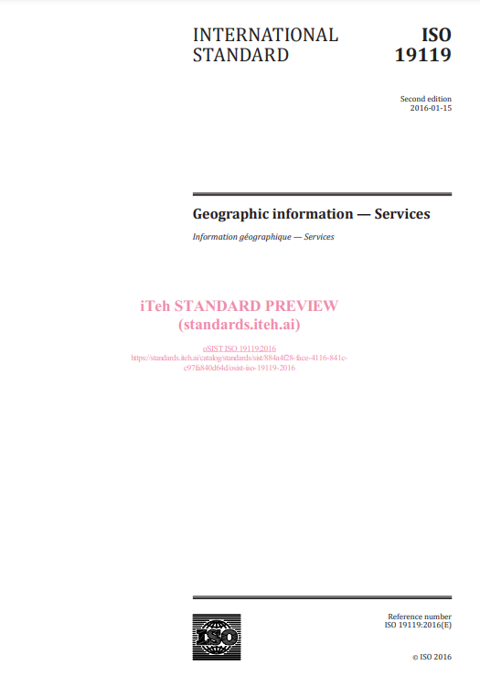
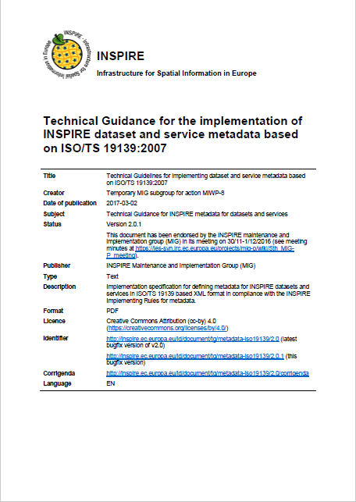
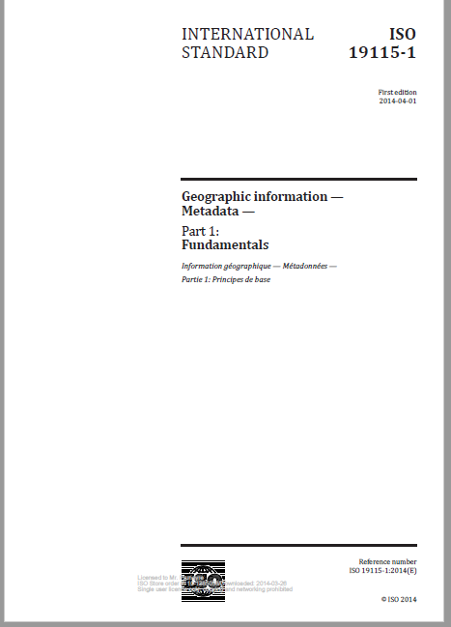
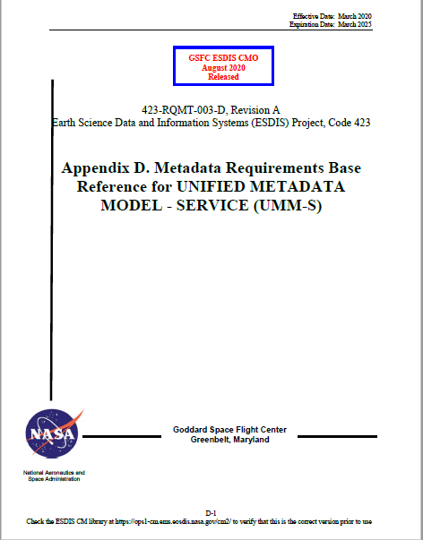
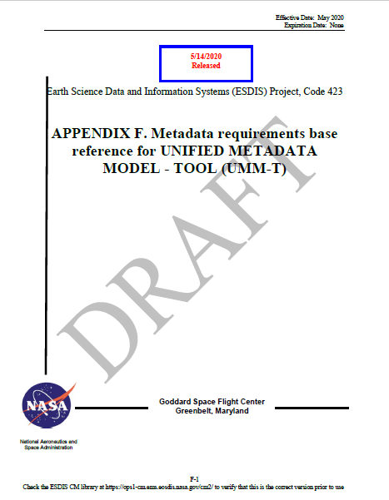
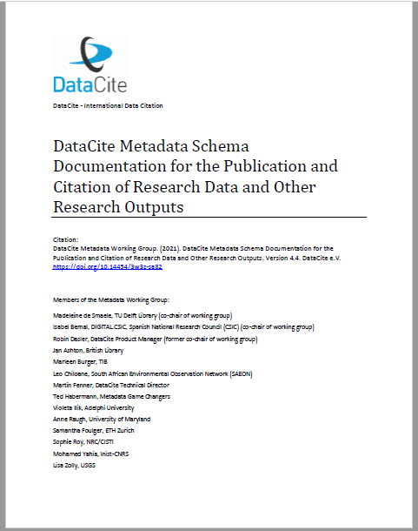
Service Metadata Models
Cross-Comparison of applicable metadata models/elements
  ISO19115-1:2014 Annex F.3 “Metadata for discovery of services”
  UMM-S, UMM-T
  INSPIRE Technical Guidance (Metadata), …

Slide 15
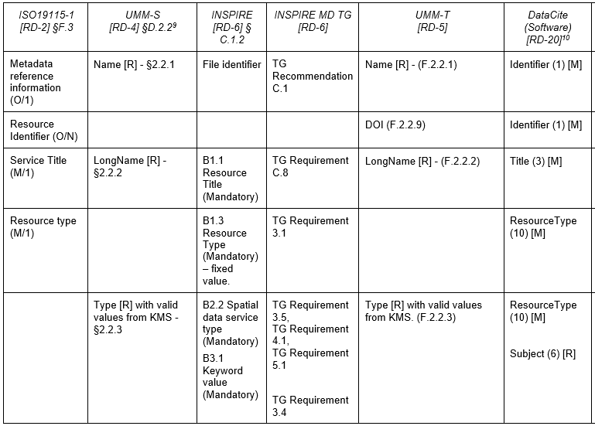
Service Metadata Models
Cross-Comparison of applicable metadata models/elements
  Mandatory and optional elements

Slide 16
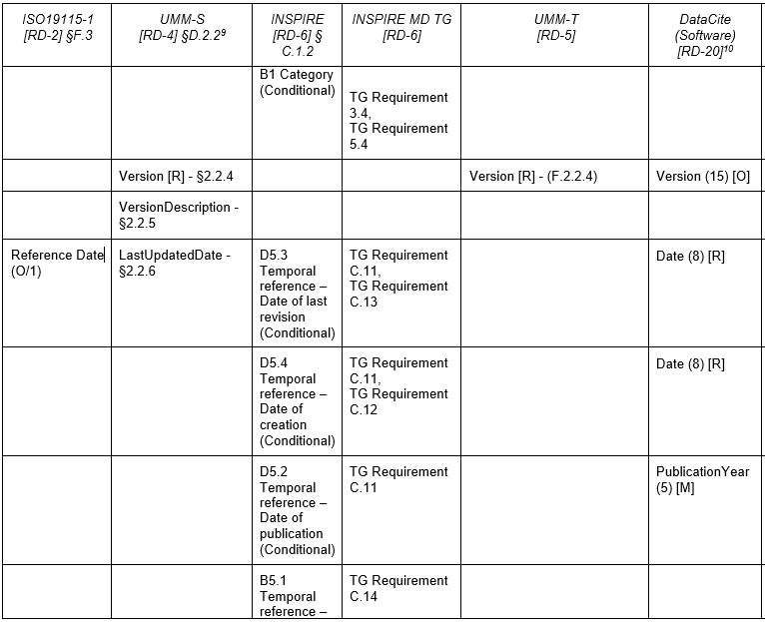
Service Metadata Models

Slide 17
Service Metadata Models
Cross-Comparison of applicable metadata models/elements:
  WGISS SLT team to agree on minimum metadata model ?
    Mandatory: if “mandatory” in majority of models
    Recommended / optional: other.
  WGISS SLT team to agree on interchange format with IDN ?

Slide 18
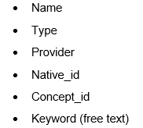
Current implementations - CMR
Discovery interface:
  https://cmr.earthdata.nasa.gov/search/site/docs/search/api.html#searching-for-services
  https://cmr.earthdata.nasa.gov/search/site/docs/search/api.html#searching-for-tools
  Search parameters:
Metadata Models:
  UMM-T,
  UMM-S
Metadata encoding
  UMM JSON

Slide 19







Current implementations – FedEO Evolution
Discovery interface:
  RESTful OGC API Features / OpenSearch interface covering:
    “service” resources / rel=“service”
    “collection” resources / rel=“collection”
    “granule” resources / rel=“results”
  Search parameters advertised in OpenAPI definition and OSDD:
    Originating from (OGC) OpenSearch and its extensions
  Search responses in Atom / GeoJSON / JSON-LD etc.

Slide 20
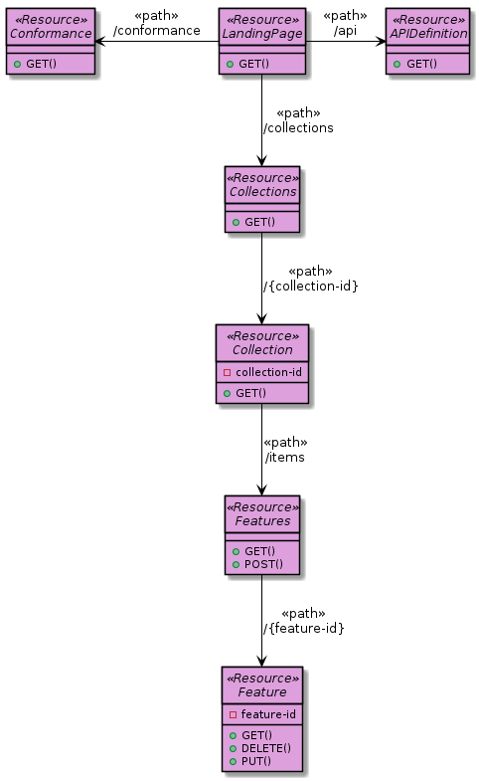
FedEO API Evolution | RESTful
RESTful API offering multiple interfaces:
  OGC API – Features (core)
  STAC
  OpenSearch
Content negotiation
  e.g. (GeoJSON) representations
  / profiles
Read/write interface
  Consumed by OpenSearch clients,
  OGC API - Features clients,
  STAC clients, Google crawler,
  Metadata Editor, …
OSDD is one among
possible representations
OpenSearch URL templates:
/collections/series/items?...
/collections/datasets/items?…
/collections/services/items?...

Slide 21


Current implementations – FedEO Evolution
Service metadata models
  ISO19119
  ISO19115-1
  INSPIRE Metadata IR
Service metadata encodings (planned):
  ISO19139:2007 (XML),
  “Technical Guidance for … service metadata based on ISO 19139:2007”
  OGC 19-020r1 (GeoJSON), …
  ISO19115-3 (XML)
  GeoDCAT-AP v2 (JSON-LD)
  Etc. e.g. agreed IDN interchange format…

Slide 22

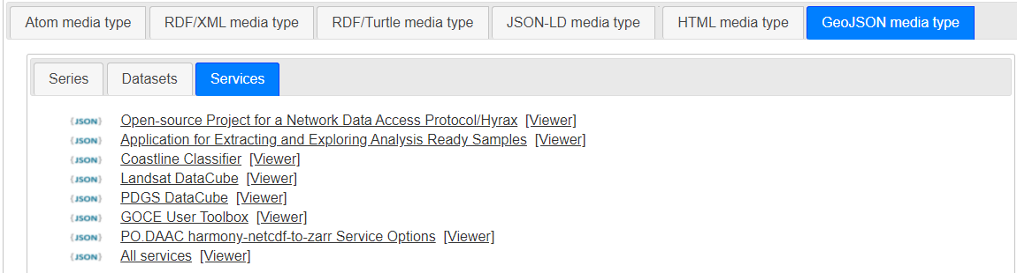
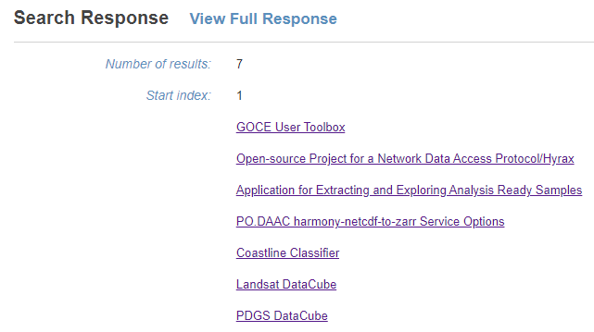
Current implementations – FedEO Evolution
Examples (work in progress):
  https://eovoc.spacebel.be/collections/services/items?httpAccept=text/html
  https://eovoc.spacebel.be/readme.html

Slide 23
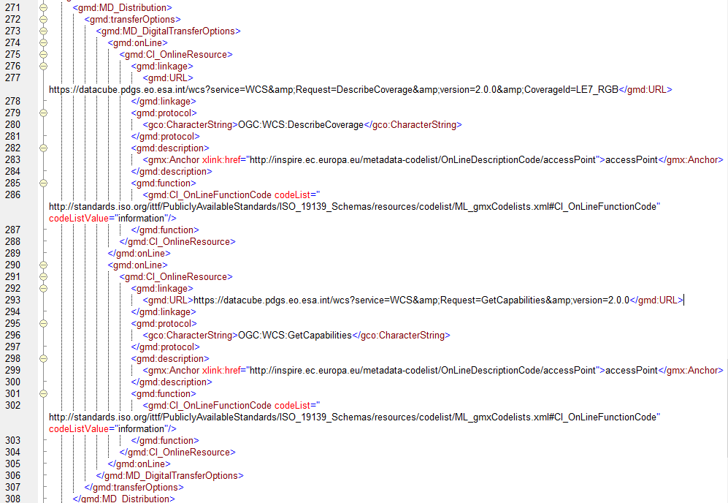
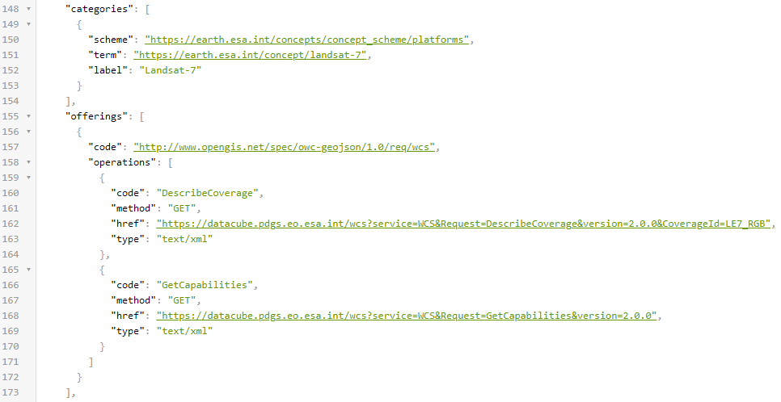
Current implementations – FedEO Evolution
Examples (work in progress):
  https://eovoc.spacebel.be/collections/services/items/eo-pdgs-landsat-datacube
  OGC 14-055r2 offering / ISO MD_Distribution provide binding information for clients

Slide 24
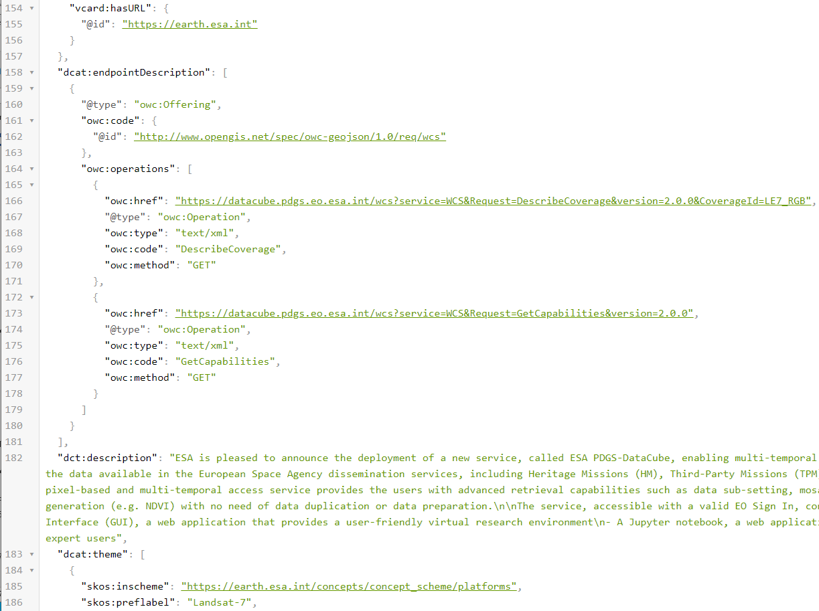
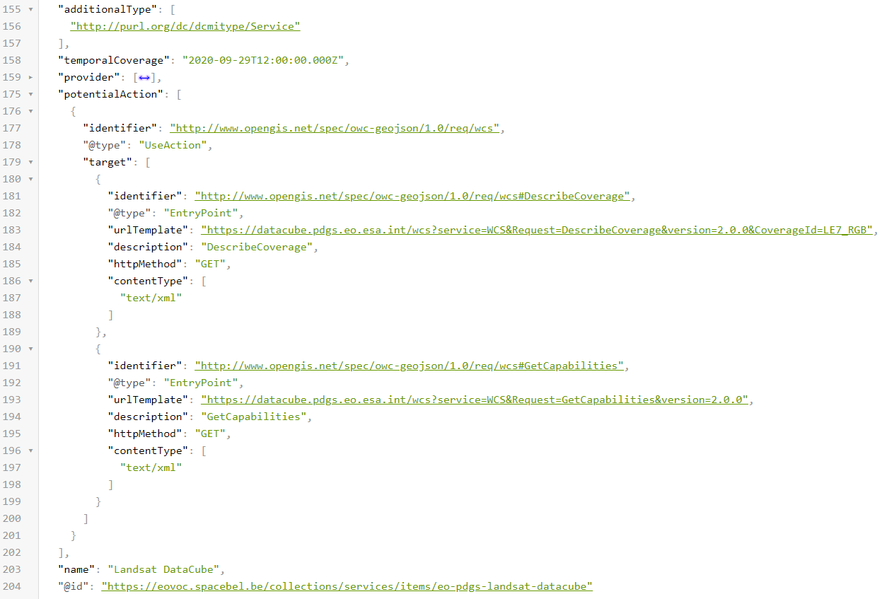

Current implementations – FedEO Evolution
Examples JSON-LD (work in progress):
  GeoDCAT-AP v2.0

Slide 25
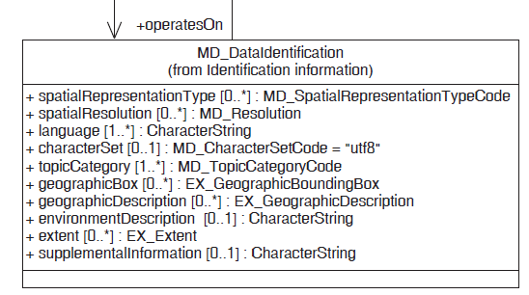
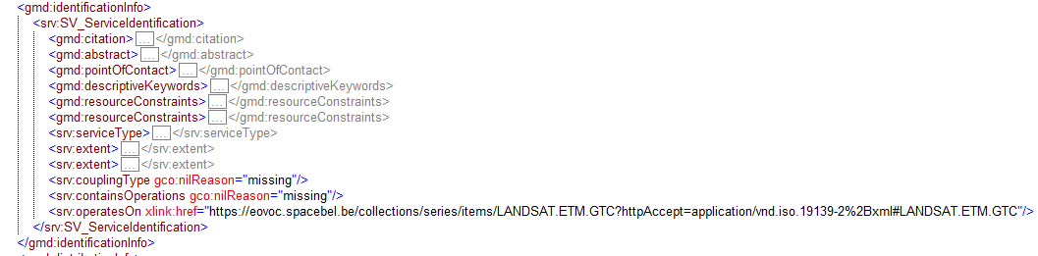
Current implementations – FedEO Evolution
Examples (work in progress):
  Service to Collection coupling: Collection MD_DataIdentification shall have a unique “id” attribute [equal to the fileIdentifier] to allow for INSPIRE-compliant coupled-resources (operatesOn)

Slide 26
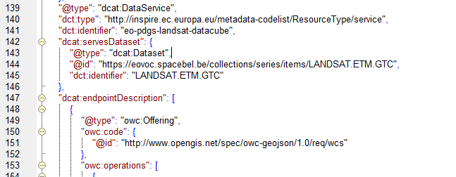
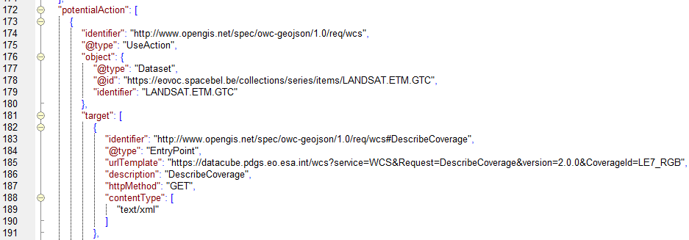
Current implementations – FedEO Evolution
Examples JSON-LD (work in progress):
  Service to Collection coupling

Slide 27
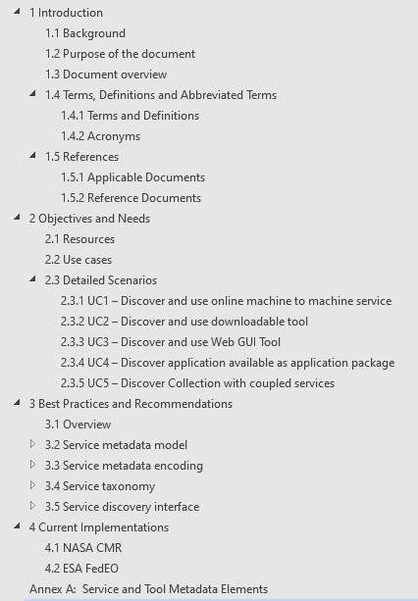
Conclusion
Proposal to collaborate on “CEOS Best Practices for Service Metadata and Discovery”
DRAFT Table of Content
Inputs (e.g. about more “current practices”) and contributions are welcome
Objective to share (possibly through IDN) services/tools/applications described via agreed minimal metadata (model)

