Slide 1

Working Group on Information Systems and Services (WGISS)
Committee on Earth Observation Satellites
Serge RIAZANOFF, VisioTerra for ESA
WGISS#52 Virtual Meeting
Processing-On-the-Fly Macro-Language (POF-ML)
19th October 2021

Slide 2
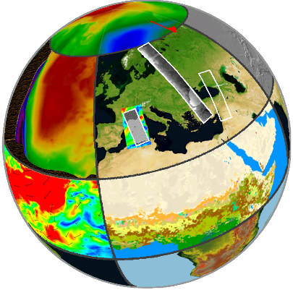
Executive summary
Systematic / on-demand / on-the-fly processing
VtWeb – From high-level requirements up to design
VtWeb – Design principles
VtWeb – Data Processing Relay
VtWeb – Generic platform for customized platforms
VtWeb for geoservices
Hello World of NDVI POF-ML
Indicator for monitoring deforestation in Cameroon
Radar Cross Section Equalization (RCSE) applied to Sentinel-1
Pan-sharpening of Sentinel-2 SWIR bands by its 10m bands
Use of VtWeb POF-ML in CEOS / WGCV / TMSG / DEMIX
VtWeb

Slide 3
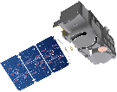

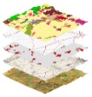


Systematic / on-demand / on-the-fly processing
ground segment
telemetry
NRT processor
L0 / L1
Systematic production
On-demand production
On-the-fly processing
L1C
L2A
•••
share
capitalise
compare processors
publish
…
heavy equipment- stand-alone station with large disk space and RAM to support SNAP, OTB, ENVI, GIS…
SIG
Web browser
WMS layers
Ecological !
Process only that is required
heavy production (peta-bytes) | light (one whole product) | very light (area at scale of interest)
new version of the processor ⇒ reprocess the whole archive | no impact | no impact
download with high bandwidth | download high large bandwidth | very low bandwidth

Slide 4
VtWeb – From high-level requirements up to design
High-level requirements | Design concepts | VtWeb features
Better exploit EO data | Hide the complexity of data access, representation, processing levels, projection… Enable user to only check | Dataset modules Near real-time access Time series
Bring users to data | Enable users to focus on his/her core business / skill Provide a wide range of data types and time-series | Worldwide free data 2D / 3D display in their classical Web navigators without any installation
Extract information from big data | Enable users to interactively browse / transform / merge data Compare / aggregate products Compute indicators | Processing on-the-fly (POF) Get associated data Change tracker Layer stack of mixed data
Share this information | Very low bandwidth (streaming) Enable users to share the custom processed “product”: for a view for their GIS | Smart dissemination: “hyperlook” - KML script - GeoTIFF - WMTS

Slide 5








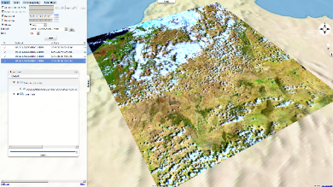

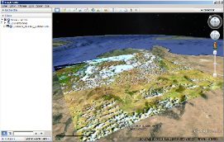

VtWeb – Design principles
VisioTerra
collections
Landsat, ASTER…
www.visioterra.fr/?VtWeb
global / free data
data retrieval / data mining
satellites / meteo / ECV / Geol. /
hydro./ alti./ LULC / populations…
Near Real-Time access
automated processing
  for citizen
  - default style
  - predefined styles
  for scientists
  - parameter tuning
  - POF-ML editor
collaborative infrastructure(s)
2D webmapping / 3D virtual globe
on user’s area of interest
archives to analyse changes
value-added geoservices, recurring monitoring, alarms…
meteo., climate
NASA
MODIS
Copernicus services
NOAA
oceano.
Sentinels,
Envisat, ERS…
maps
• • •
GeoTIFF, WMTS
→ G.I.S.
KML
KMZ

Slide 6
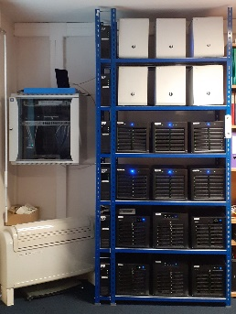
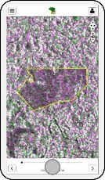
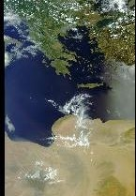
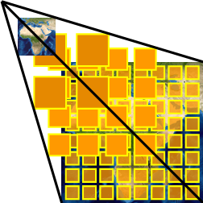
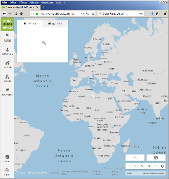
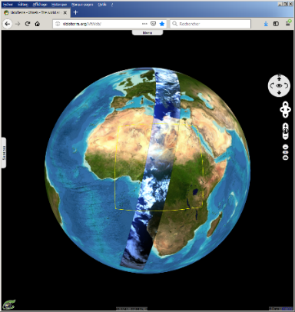
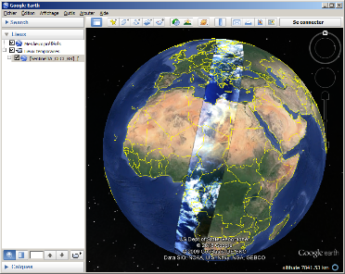
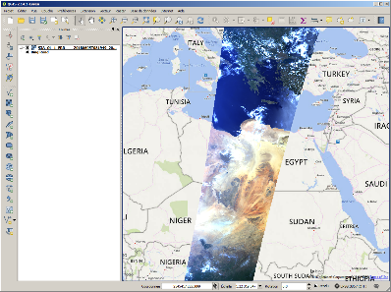

VtWeb – Data Processing Relay
VisioTerra
collections
Landsat, ASTER…
meteo., climate
NASA
MODIS
Copernicus services
NOAA
oceano.
Our HW+SW VtWeb infrastructure
(1PB disk cache, 1 Gb/s symmetric optical fibre)
Managing heavy products upstream
Delivering light services downstream
→ fighting against numerical divide in Africa
“Bringing users to multi-source data”
Synchronisation of VtWeb catalogues with many data provider catalogues
Interactive or automatic (geoservices) selection of products in user’s site
If the product is not already in cache, → download and prepare it
(statistics and quadtree in native geometry / aggregation depending on the type and usage)
Sentinels,
Envisat, ERS…
maps
• • •
Infrastructure VtWeb
Other
devices
Other
infrastructures
VtWeb client
Google Earth
G.I.S.
KML
KMZ

Slide 7
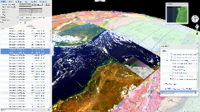
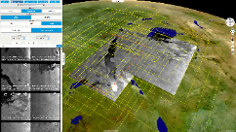
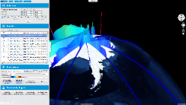
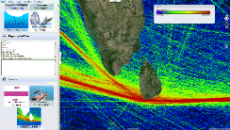
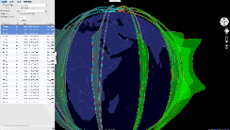
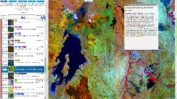
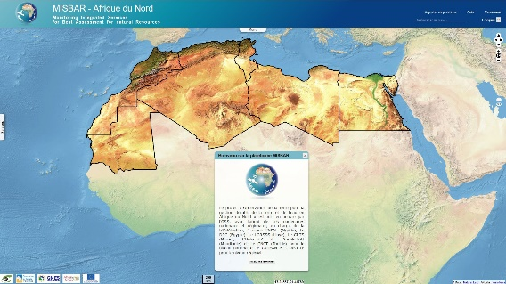
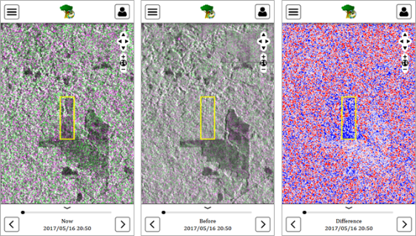

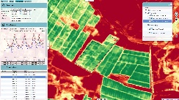
VtWeb – Generic platform for customized platforms
visioterra.org/VtWeb
Since 2013
An advanced
one-stop-shop model
A showcase capitalising
VisioTerra know-how
hedavi.esa.int
visioterra.net/VtCryoSat
visioterra.net/VtPace
visioterra.net/VtGsep
www.sentinelvision.eu
visioterra.org/misbar
visioterra.org/FlegtWatch

Slide 8



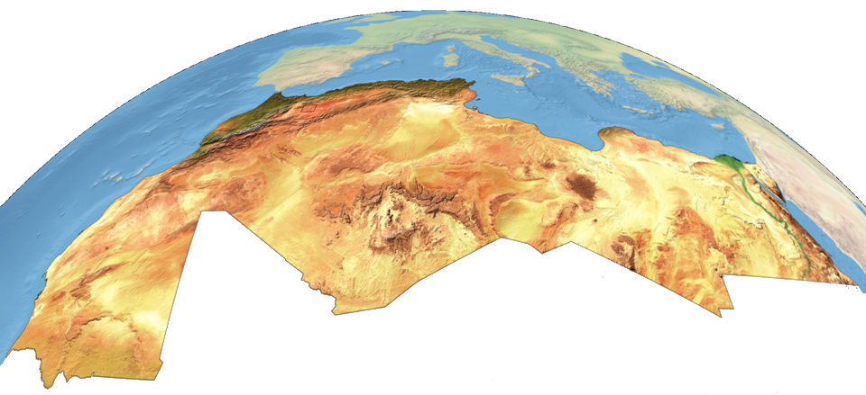


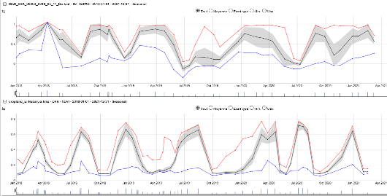
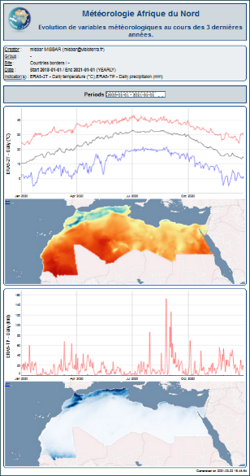
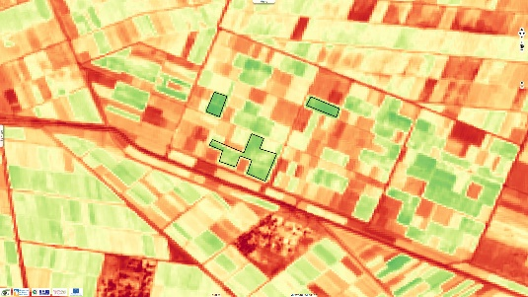
VtWeb for geoservices
VtWeb / POF-ML applied to GMES&Africa projects
  MISBAR – Agriculture & irrigation (see attached)
  CAFWS – Deforestation & fires
HW+SW installed at OSS (Tunisia)
and AGEOS (Gabon)
Interactive functions for citizen,
students, researchers…
Geoservices for monitoring / evaluation
  Management of users and sites
  Indicators (vegetation, moisture, rainfall…)
  Dashboards to detect anomalies
  Automatic edition of periodic bulletins
  …
dashboard
periodic bulletin

Slide 9
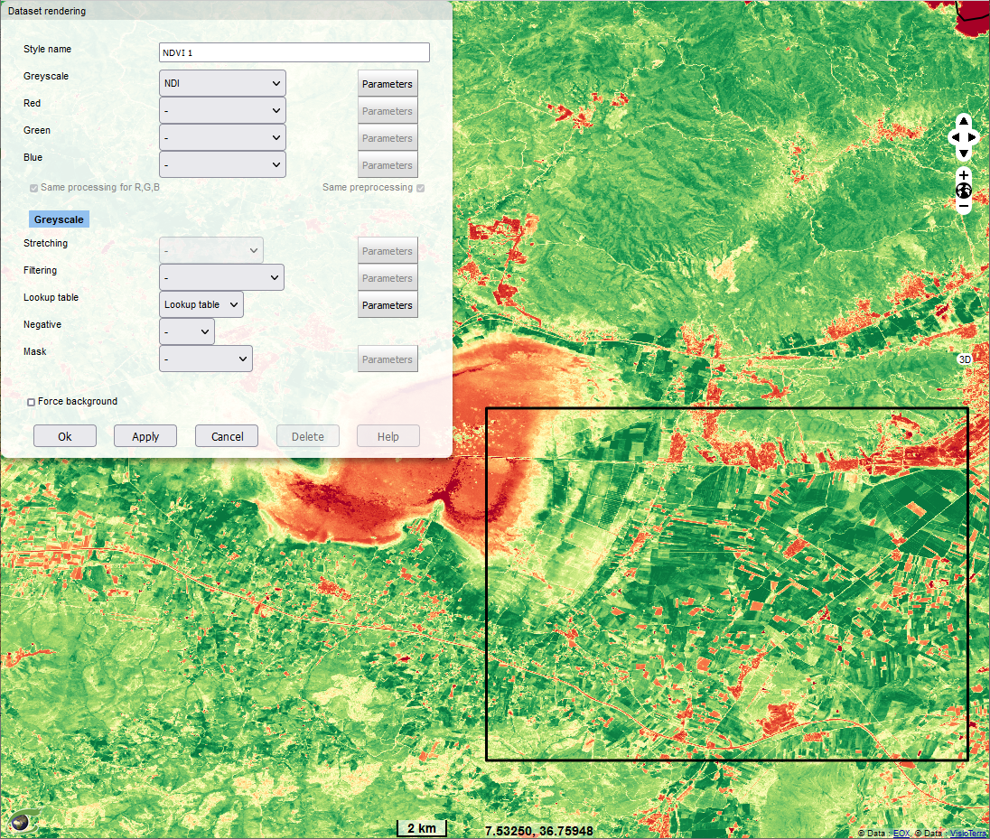
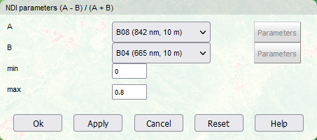
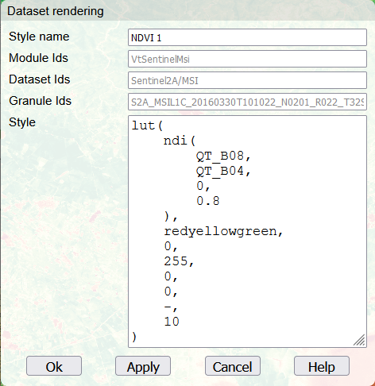
Hello World of NDVI POF-ML
Hyperlook: rich URL describing a layer stack and the POF-ML script of each layer ≈ data cube https://visioterra.org/VtWeb/hyperlook/13ed0cd072bb41d38ce69829fbd4d287
POF-ML: Processing-On-the-Fly Macro-Language
PU: Processing Unit
Interactive mode
POF-ML edition mode
WCS
ODC
computation PU
Rendering
PU
WMTS

Slide 10
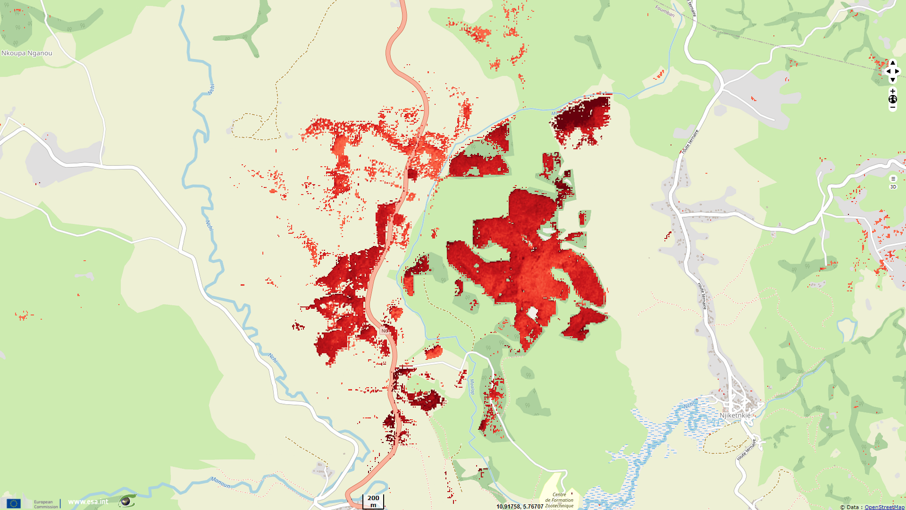
Deforestation in Cameroon
Hyperlook: https://www.sentinelvision.eu/hyperlook/64bf1c8fbefa4d6fa9b08cdb500a15df

Slide 11
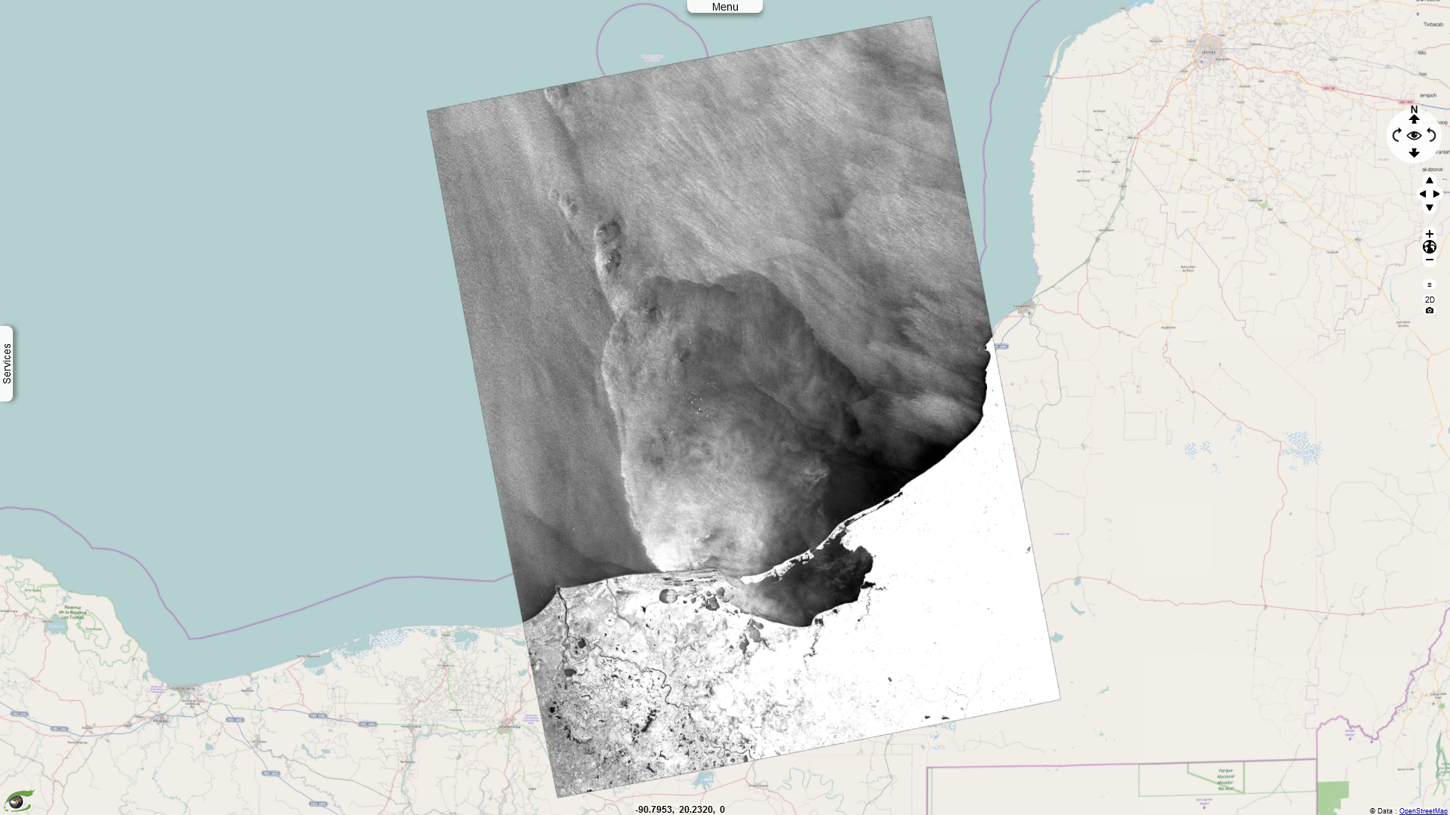
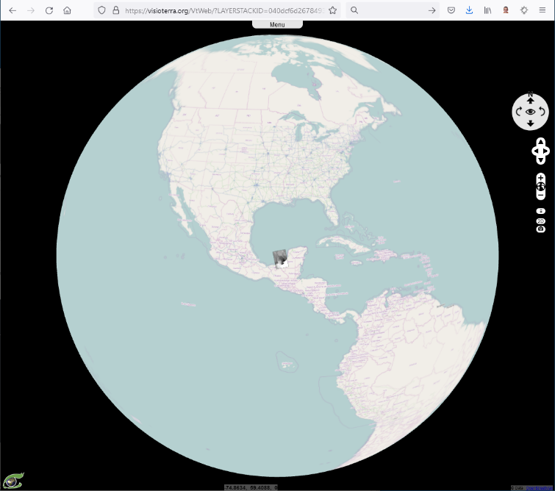
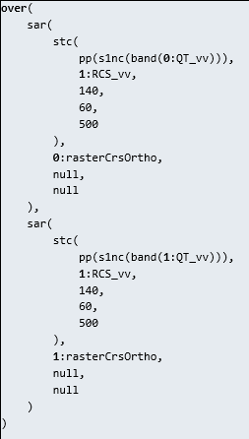
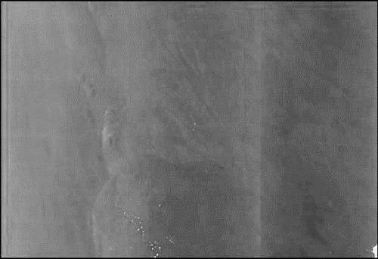
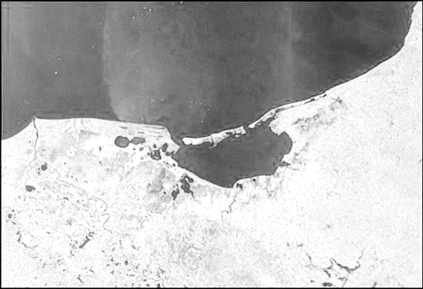
Radar Cross Section Equalization (RCSE) applied to Sentinel-1
Hyperlook: https://visioterra.org/VtWeb/hyperlook/040dcf6d26784930be91f3e898ffb144

Slide 12
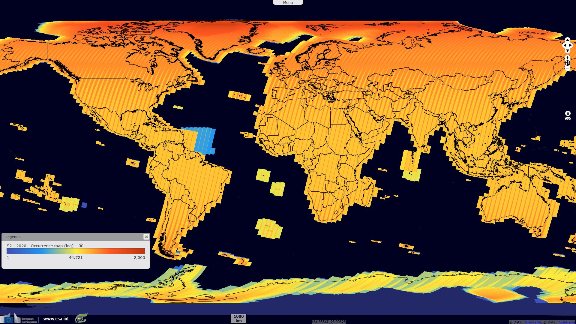
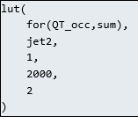
Observation occurrences of
Sentinel-2 in 2020
Hyperlook: https://www.sentinelvision.eu/hyperlook/5d50cdfb95af4a0ea84eaf7bbaf1af1b

Slide 13
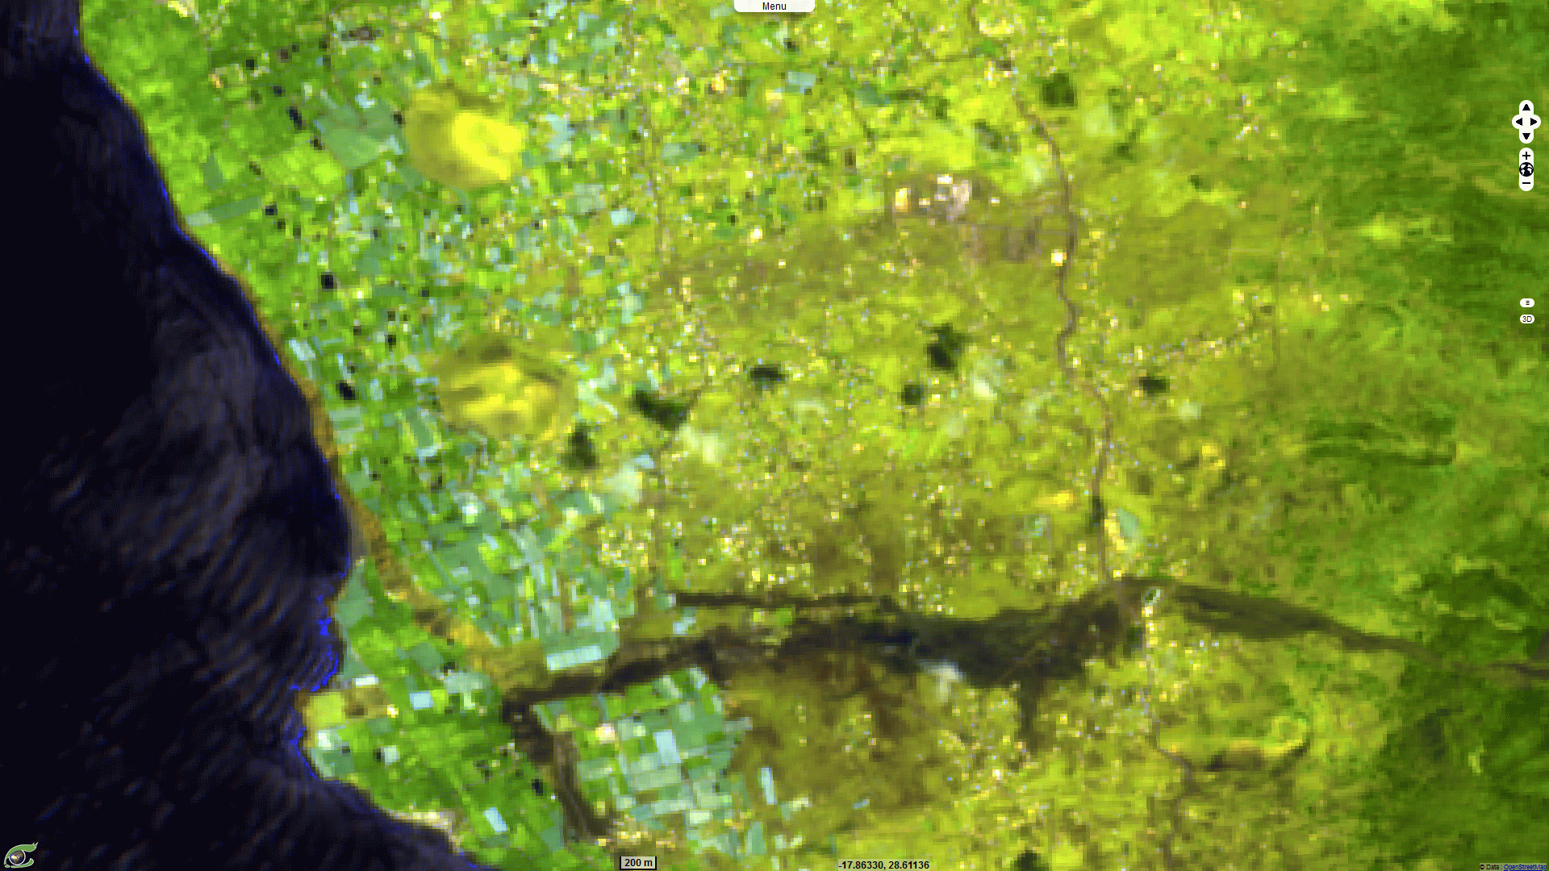
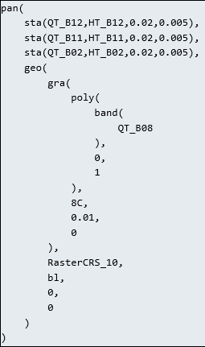
Pan-sharpening of Sentinel-2
SWIR bands by NIR band 8
Animation: https://visioterra.org/VtWeb/hyperlook/553c0c495c7f4cacb1720c8eeffcad66

Slide 14
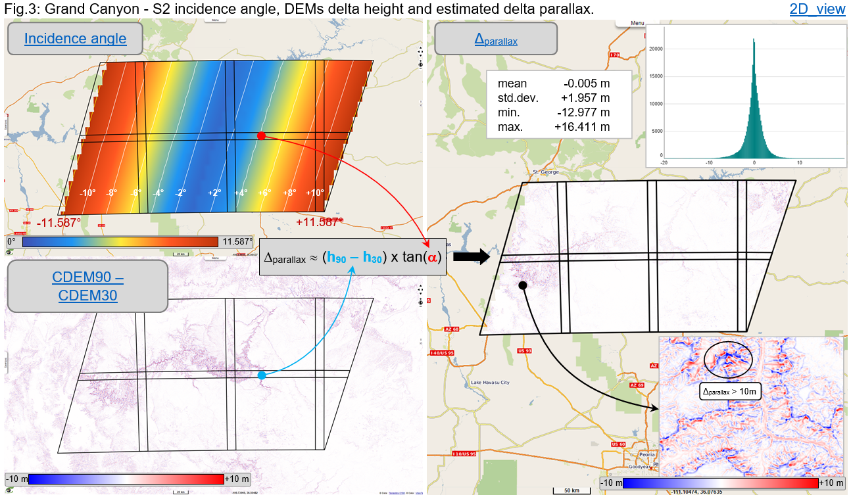
Use of VtWeb POF-ML in
CEOS / WGCV / TMSG / DEMIX
See HYP-099-VtWeb-E_COP-DEM_GLO-90_vs_GLO-30_for_Sentinel-2_orthorectification.pdf

Slide 15
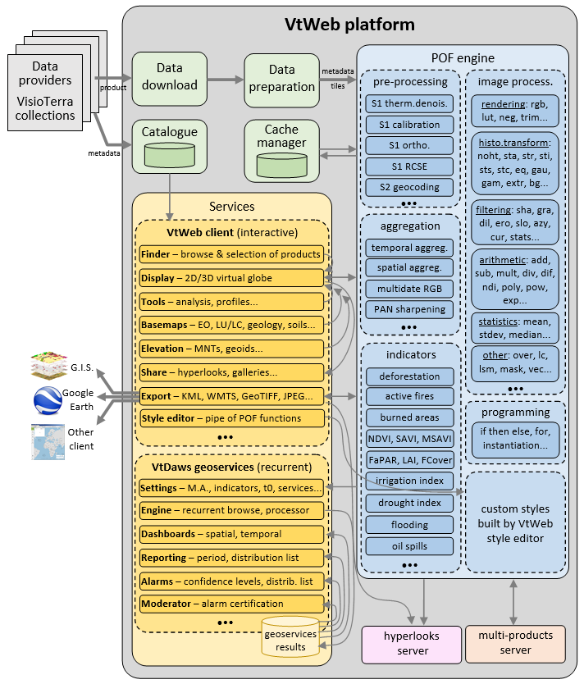
Processing units of POF-ML v1.0
Pre-processing
  Orthorectifications
  Calibrations…
Aggregations
  Temporal
  Spatial…
Image processing
  Global radiometry transforms
  Filtering
  Arithmetic
  Rendering…
Indicators
  Pixel based
  Combined…

Slide 16


Questions?
Serge RIAZANOFF Director serge.riazanoff@visioterra.fr
VisioTerra

