Slide 1
CEOS WG Disasters
Laura Frulla
CEOS WGD Vice-Chair
WGISS-53
24 March 2022

Slide 2
WGDisasters Mission Statement
The CEOS WGDisasters ensures the sustained coordination of disaster-related activities undertaken by the CEOS Agencies and acts as an interface between CEOS and the community of stakeholders and users involved in risk management and disaster reduction.
Who belongs?
Membership is open to all CEOS Agencies (Members and Associates).
Also experts from non-CEOS Agencies who have relevant expertise to contribute to the objectives of the WGDisasters.
Slide 2

Slide 3
WGDisasters Objectives
Support the efforts of Disaster Risk Management (DRM) authorities in protecting lives and safeguarding property by means of satellite-based EO and science-based analyses
Foster increased use of EO in support of DRM
Support the implementation of the UNDRR Sendai Framework for Disaster Risk Reduction (DRR), and in particular contribute to its Priority One, “Understanding Risk”
Raise the awareness of politicians, decision-makers, and major stakeholders of the benefits of using satellite EO in all phases of DRM
In pursuit of these objectives, the WGD should:
Contribute to the monitoring of the implementation of this Framework;
Support the work of international initiatives such as for instance GEO
Strive to increase the awareness of decision-makers of the critical role of satellite EO;
Reinforce the need for enhanced satellite EO programs to address DRM needs.
Slide 3

Slide 4
WGDis Chair Priorities 2022-2023
Focus on Operational Uptake of past WG successes to increase resilience
Demonstrators:
Continue to demonstrate potential but begin building path to sustainable operations post demonstrator – stronger ties to international stakeholders but also local actors
Increase focus on capacity building in all demonstrator activities
Strengthen ties to GEO WGs through increased visibility of WG Dis activities within GEO (international, regional)
Explore linkages to climate related activities, especially through the impact of climate change relating to extreme weather events and local impacts of climate (assessment, mitigation, resilience)
Exploit new technology opportunities, either through new missions, new activities or new data exploitation techniques
Slide 4

Slide 5
WGDisasters Subgroups
Landslide Demonstrator
Volcano Demonstrator
Seismic Hazards Demonstrator
GeoHazards Lab
GEO-DARMA
Flood Pilot
GSNL
Recovery Observatory Demonstrator
Wildfire Pilot
Slide 5

Slide 6
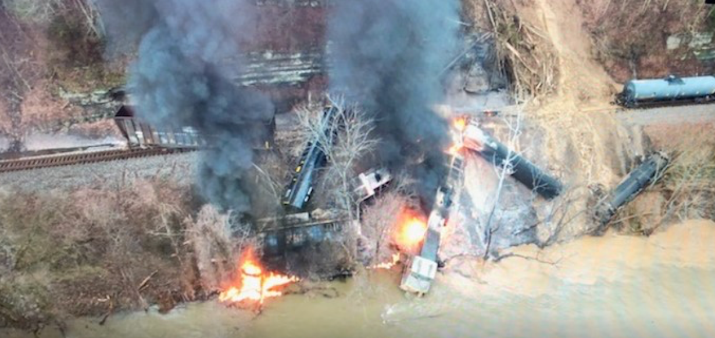
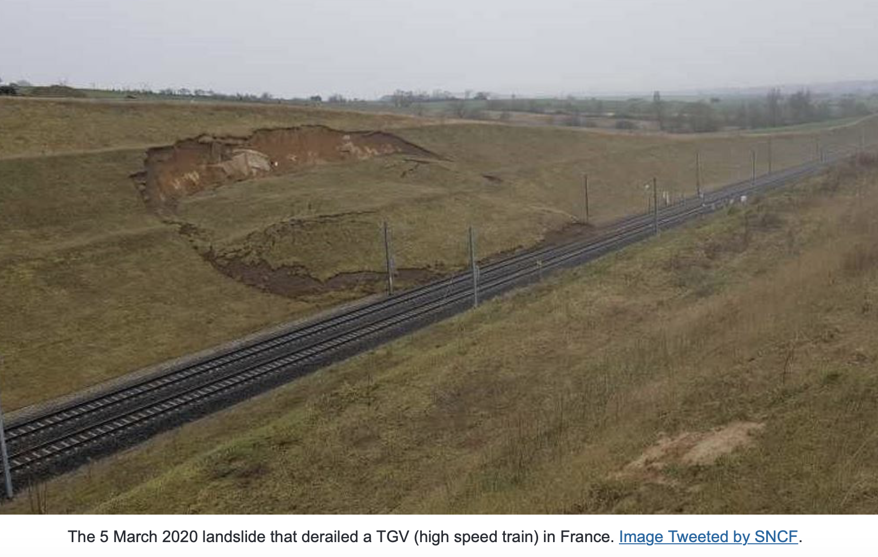
Landslide Demonstrator
Aims to demonstrate the effective exploitation of satellite EO across the full cycle of landslide disaster risk management (i. e. preparedness, response, and recovery at global, regional, and local scales), including the possibility of multi-hazard focus on cascading impacts and risk.
Elkhorn city (Kentucky, US) – February 2020 – shallow landslide / mudflow
East France – March 2020 – landslide on high speed train TGV
Slide 6

Slide 7
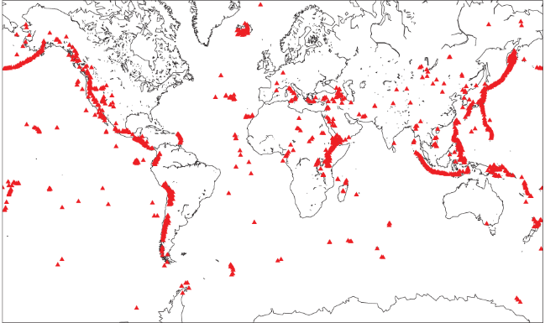
Volcano Demonstrator
Aims to evaluate the utility of remote sensing data for anticipating, detecting, and tracking volcanic eruptions.
Supports EO applications that promote volcanic disaster risk reduction worldwide.
Demonstrator Leads: Mike Poland, USGS. Susi Ebmeier, University of Leeds.
Slide 7

Slide 8
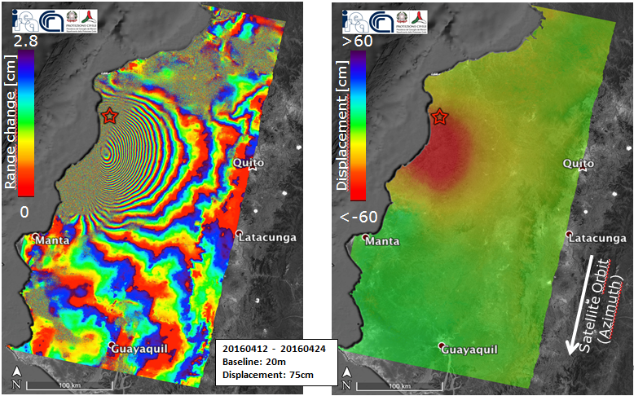
Seismic Hazards Demonstrator
Develops and demonstrates advanced science products for rapid earthquake response
Supports the uptake of these products and methodologies through co-design and development with WG stakeholders and users.
Slide 8

Slide 9
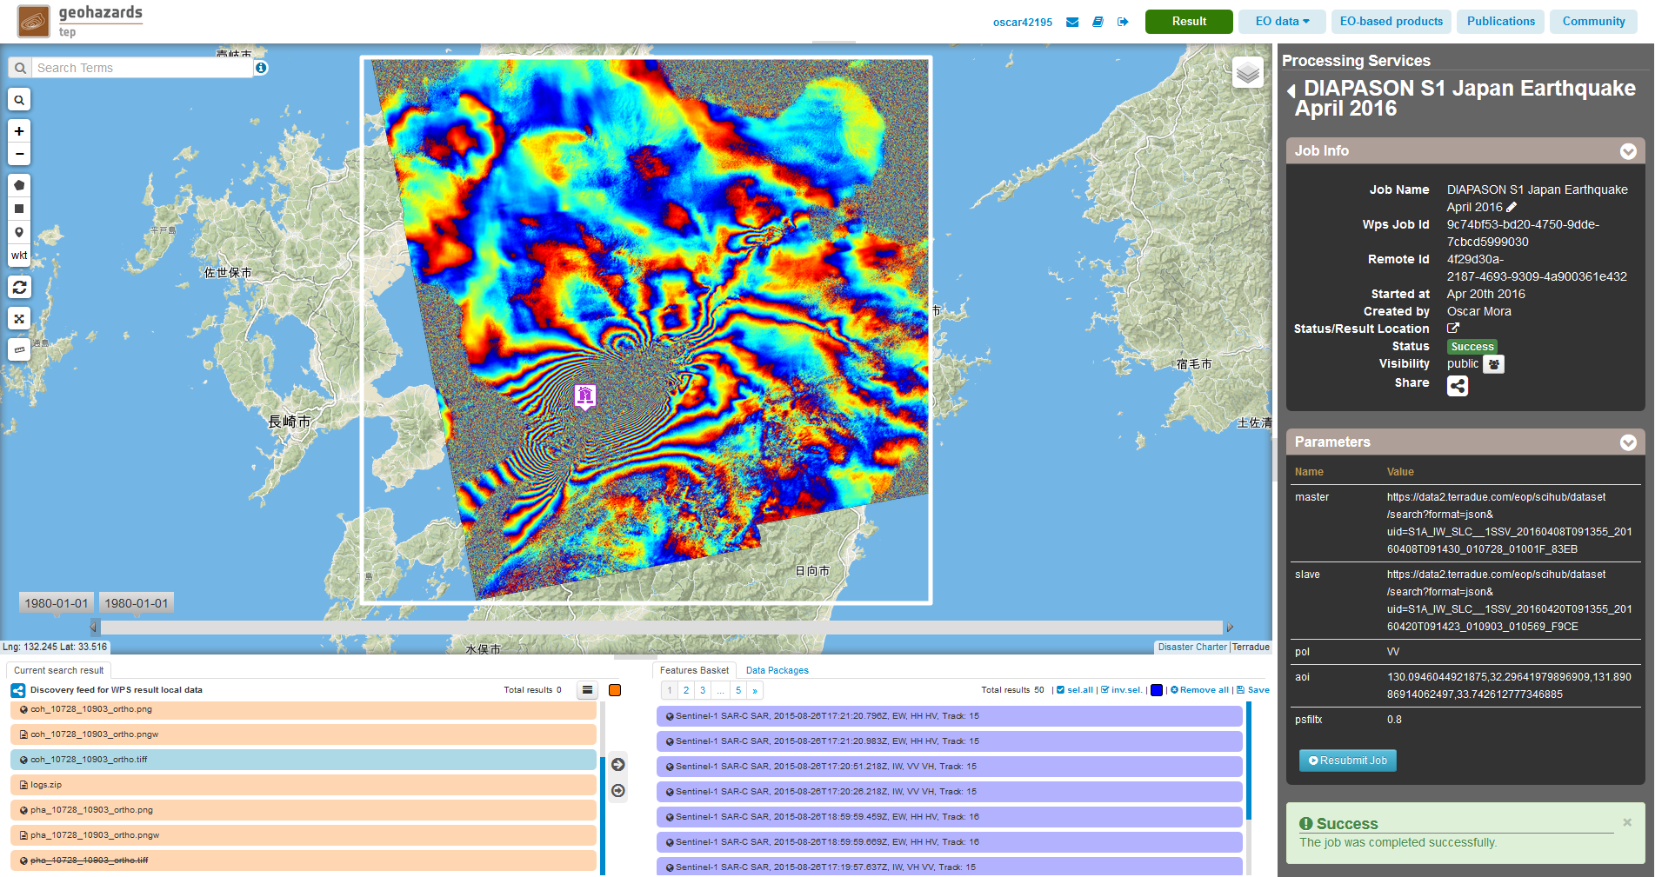
GeoHazards Lab
Enable greater use of EO data and derived products to assess geohazards and their impact.
Optimizes use of existing and new technologies with a focus on hosted tools and services to exploit satellite data in Cloud environments.
Slide 9

Slide 10
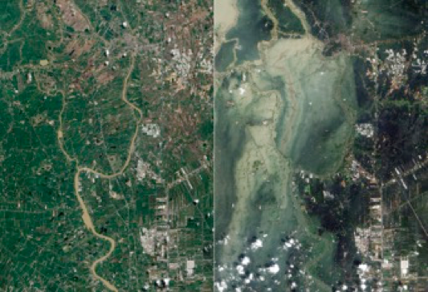
GEO-DARMA
(GEO Data Access for Risk Management-DARMA)
Supports practical implementation of critical elements of the UN Sendai Framework.
Is an open initiative undertaken with partners from both satellite and non-satellite organizations.
Slide 10
Aims

Slide 11
Flood Pilot
Explores and demonstrates best practices for combining diverse optical and radar data sources to improve current abilities to map flood extent and depth, and improve understanding of how hazard science can be better integrated with vulnerability and exposure information.
Slide 11
Landslide Demonstrator

Slide 12
GSNL
(Geohazards Supersites & Natural Laboratories-GSNL)
Aims to improve geophysical scientific and geohazard assessment, promoting rapid and effective uptake of new science results for enhanced societal benefits in DRR
Is a voluntary international partnership.
Slide 12

Slide 13
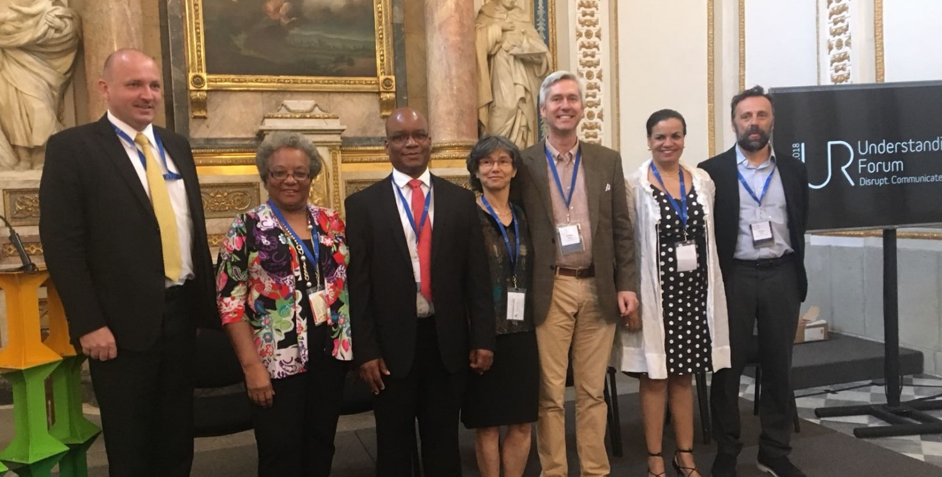
Recovery Observatory Demonstrator
Increases the contribution of satellite data and products to recovery efforts following major disaster events. Pilot efforts focused specifically on Haiti for several years and are now evolving into a generic methodology that can be applied to different geographical areas.
RO Delegation presenting concept in Haiti. (WB, DPC Haiti, CNIGS Haiti, CNES, Athena Global, UNDP, CIMA/ASI)
Slide 13

Slide 14
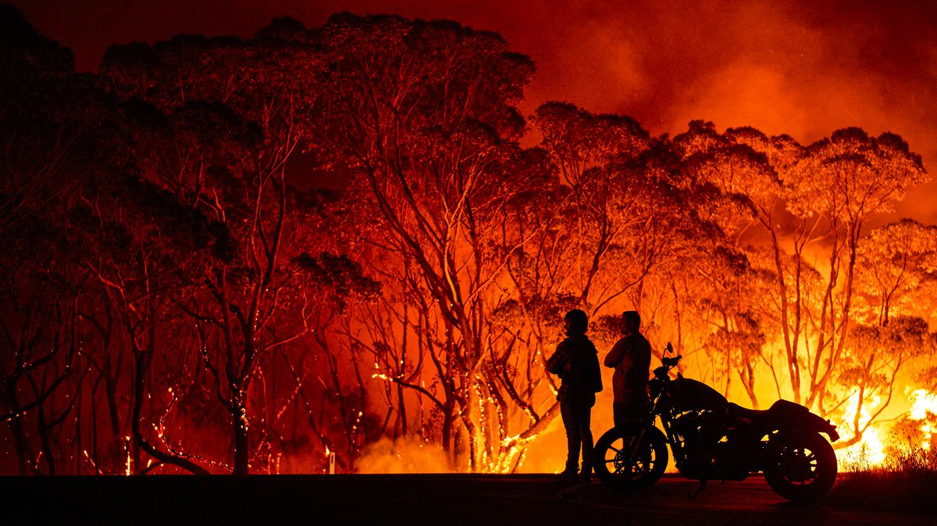
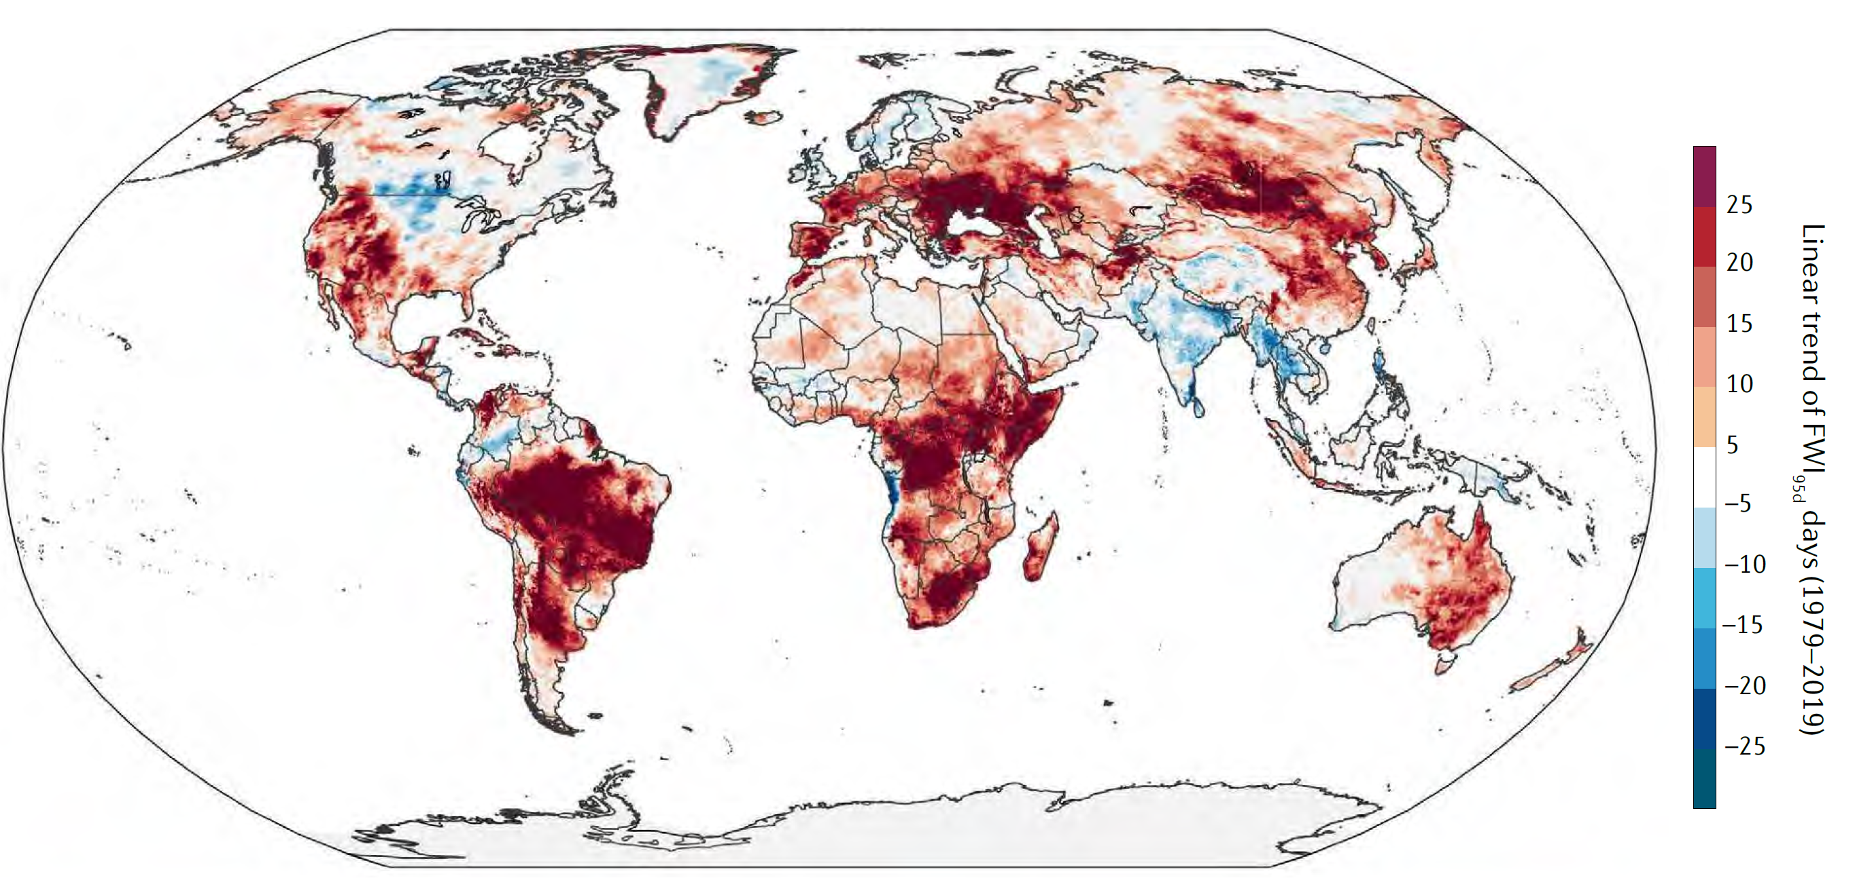
Wildfire Pilot
Aims to provide a fundamental basis for defining global priorities for active-fire monitoring and characterization
Explores the existing gaps in wildfire EO capabilities (existing and proposed)
Articulates global stakeholders and users requirements for active-fire remote sensing
Slide 14

Slide 15
Thank you!
Laura Frulla
CEOS WGD Vice-Chair
WGISS-53
24 March 2022

