Slide 1
Service Metadata and Discovery Best Practices Activity
Yves Coene (Spacebel for ESA), Mattia Stipa (ESA), Damiano Guerrucci (ESA), Mirko Albani (ESA)
CEOS WGISS #55
WGISS-WGDisasters Joint Symposium, 19/04/2023

Slide 2
Outline
Introduction
Document Overview
Objectives and needs
Best Practices and recommendations
Next steps

Slide 3
Introduction
“CEOS Best Practices for Service Metadata and Discovery”
Result of cooperation within WGISS System Level Team (SLT) since WGISS-52
Version 1.0 approved and published at https://ceos.org/ourwork/workinggroups/wgiss/documents/ in November ’22 (after WGISS-54).
Extends Best Practices for collection and granule discovery (CEOS OpenSearch Best Practices) to “services” (incl. tools, applications, service endpoints) with intention to “share”.

Slide 4
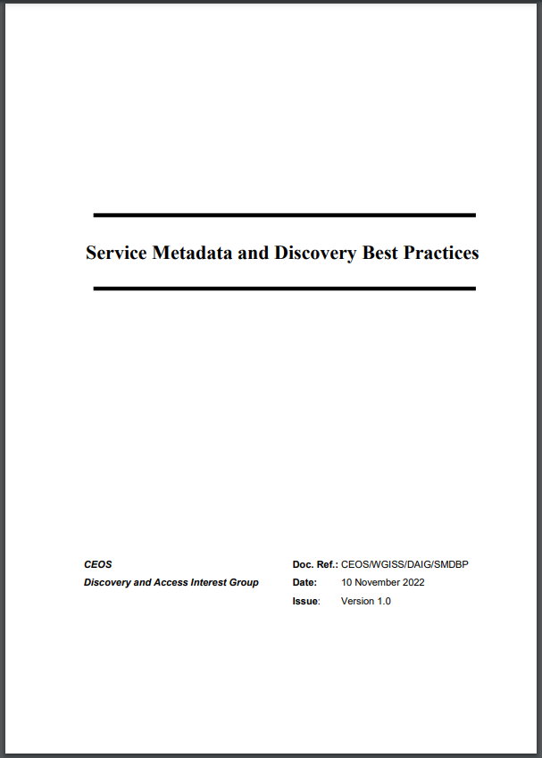
Document Content
§2 - Objectives and needs
Use cases for service discovery
Detailed scenarios
§3 - Best Practices and recommendations
Service metadata model (minimal)
Metadata encoding
Controlled vocabularies
Service discovery interface
§4 - Description of current implementations

Slide 5
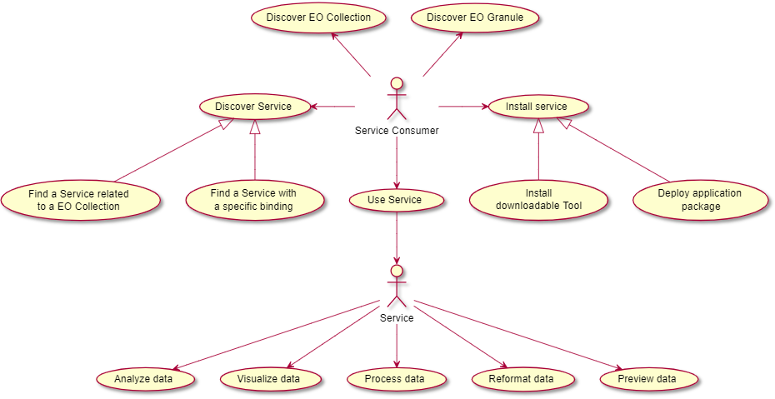
Objectives and needs – Use Cases
Use Cases:
CEOS OpenSearch Best Practices:
“Discover EO Collection”
“Discover EO Granules”
CEOS Service Discovery Best Practice:
“Discover (EO) Service”
“Use Service”

Slide 6
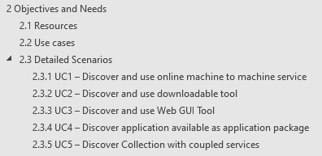
Objectives and needs – Discovery Scenarios
Scenario 1: Online machine to machine interfaces (API)
Scenario 2: Downloadable tools
Source code, binaries, Jupyter Notebooks, Docker images, …
Download from repository (GitHub, Zenodo, ..) or registry (e.g. DockerHub, …)
Scenario 3: Web GUI tools
Software as a Service (SaaS)
E.g. Jupyter Notebook on Google Colaboratory, Binder
Scenario 4: Application Package
Scenario 5: Coupled Services
Description:
Client discovers service bindings and executes the (view, download, processing, transformation…) service
Examples: OGC WM(T)S, WPS, WCS, OPeNDAP, CSW, OGC API, INSPIRE Invocable Spatial Data Services …

Slide 7
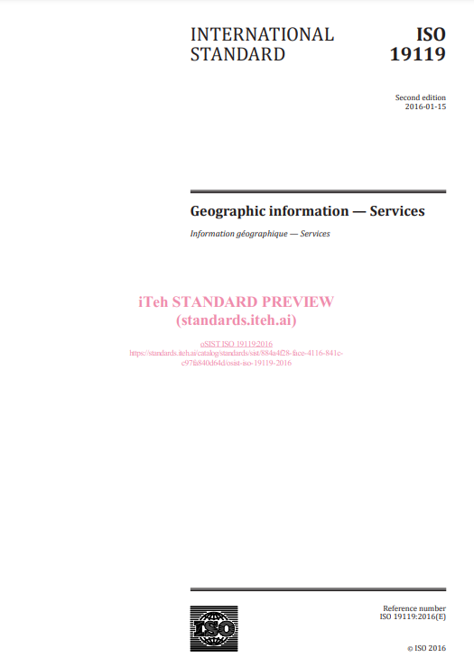
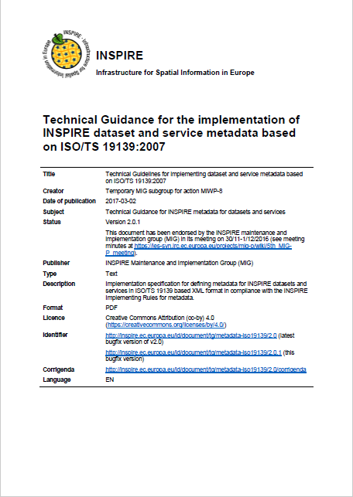
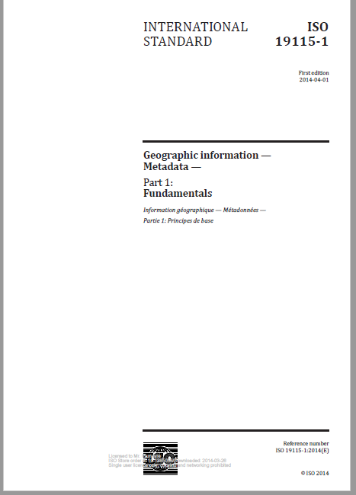
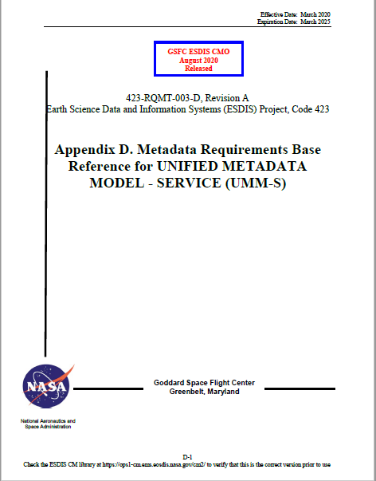
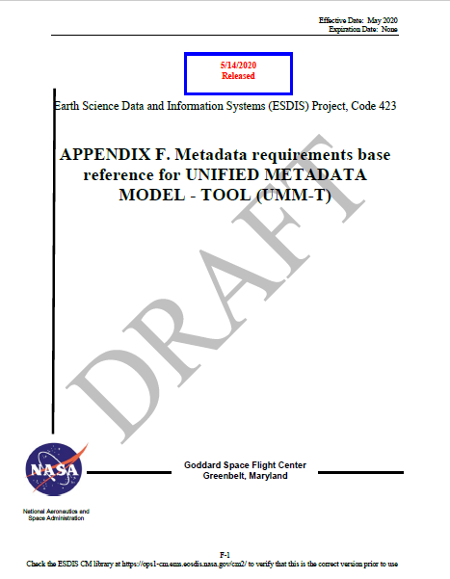
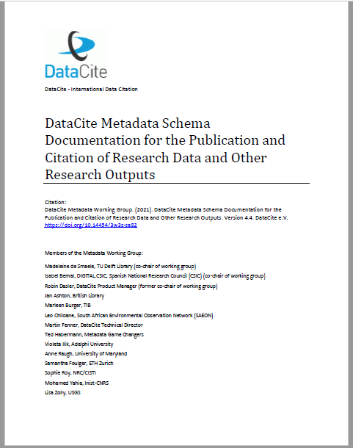
Best Practices and Recommendations
Based on survey of applicable metadata models/elements
ISO19115-1:2014 Annex F.3 “Metadata for discovery of services”
UMM-S, UMM-T
INSPIRE Technical Guidance (Metadata),
DataCite Metadata Schema Documentation, …

Slide 8
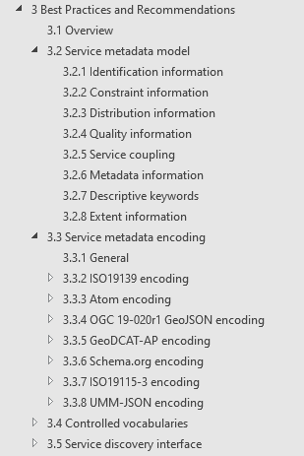
Best Practices and Recommendations
§3.2 Service metadata model (encoding agnostic)
8 categories
2 levels: [Requirement] or [Recommendation]
based on survey of applicable models
§3.3 Service metadata encoding
Applies Best Practices to 7 encodings
Including encoding examples

Slide 9
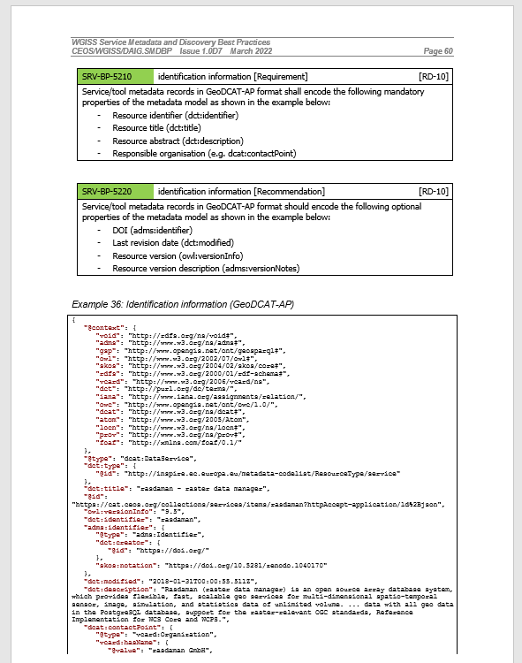
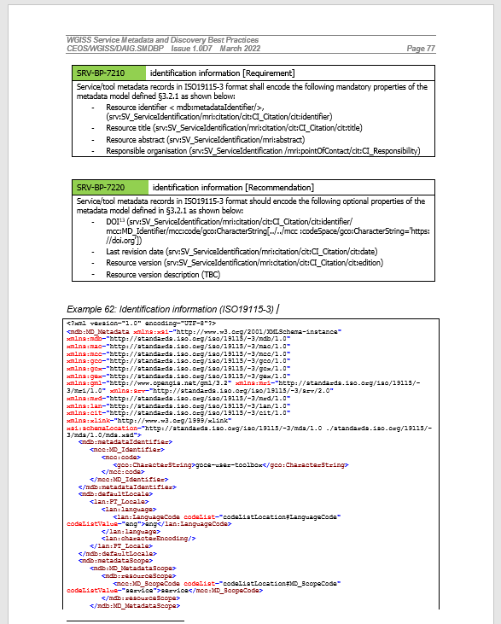
Example

Slide 10
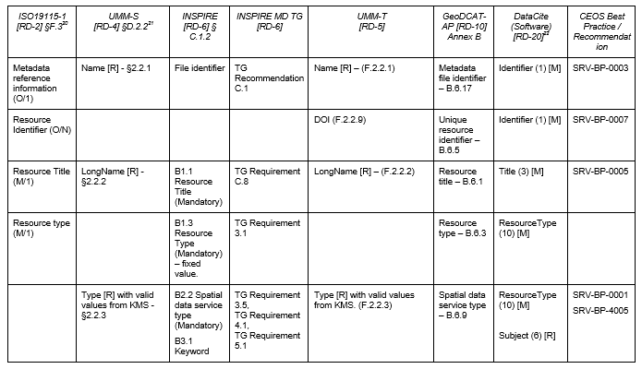
Best Practices and Recommendations
Cross-Comparison of relevant metadata models/elements/guidance
Traceability with proposed CEOS Best Practices

Slide 11
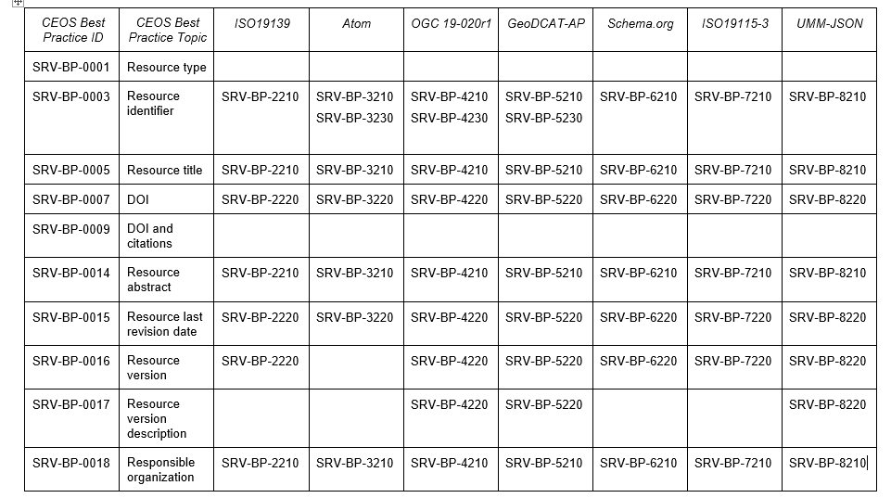
Best Practices and Recommendations
Proposed Best Practices can be applied to different encodings:

Slide 12
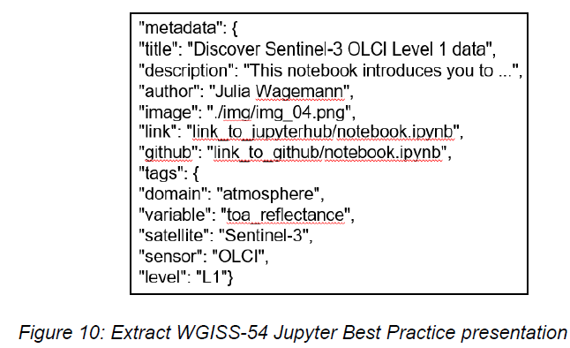
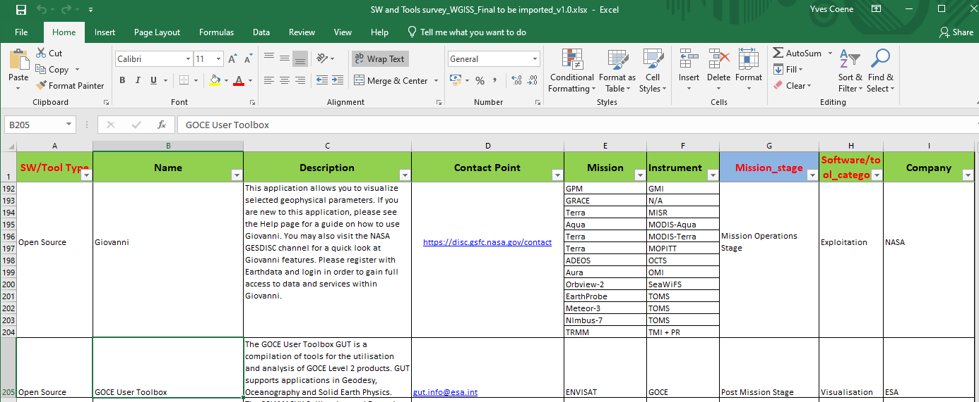
Next steps
Synergy with “Jupyter Notebooks Best Practice”
Cross-reference
Internal Notebook metadata versus metadata records in catalogue. Align encoding, extract metadata ?
CEOS Open Source SW and Tools Survey
“Couple” with corresponding collection metadata
Share “service/tool” metadata records through IDN.
As currently done for “collection” metadata records (DIF10)
Apply to specific use cases and take into account lessons learned in future document updates.
E.g. Checking the possibility of including the Coastal Observation Application Services and Tools.
Put in practice for cataloguing available “notebooks” (See example on next slides)

Slide 13
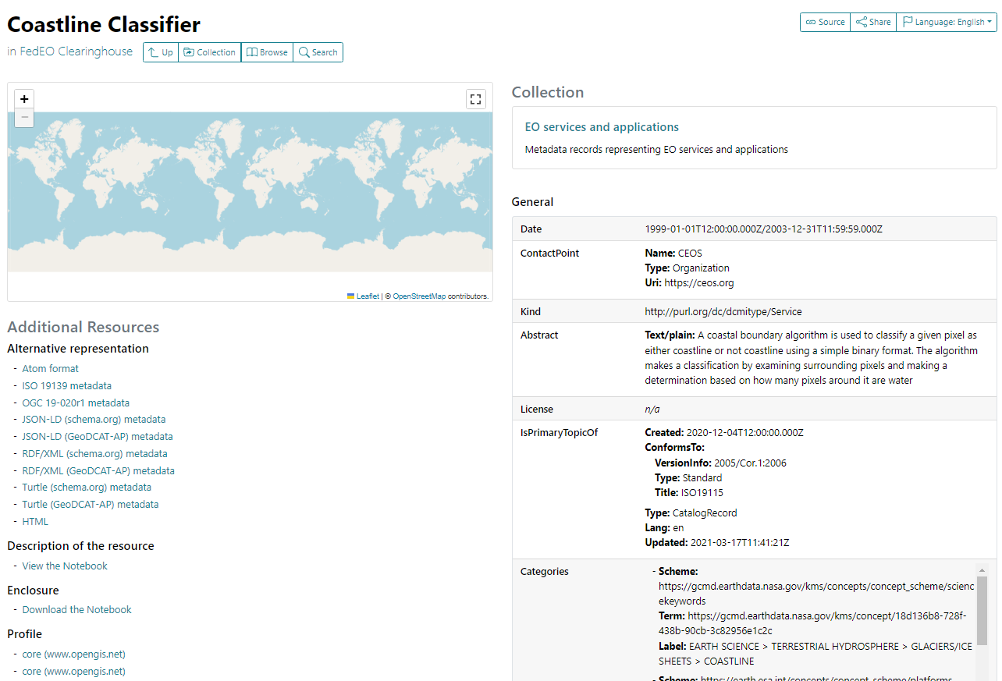
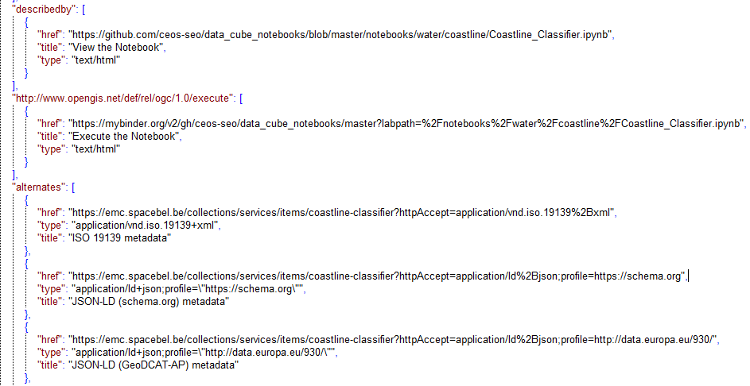
Next Steps: apply to Notebook discovery
No STAC “item” representation exists. OGC 19-020r1 GeoJSON used instead.
GeoJSON representation of service/tool items
Notes:
https://emc.spacebel.be/collections/services/items/coastline-classifier?mode=owc

Slide 14
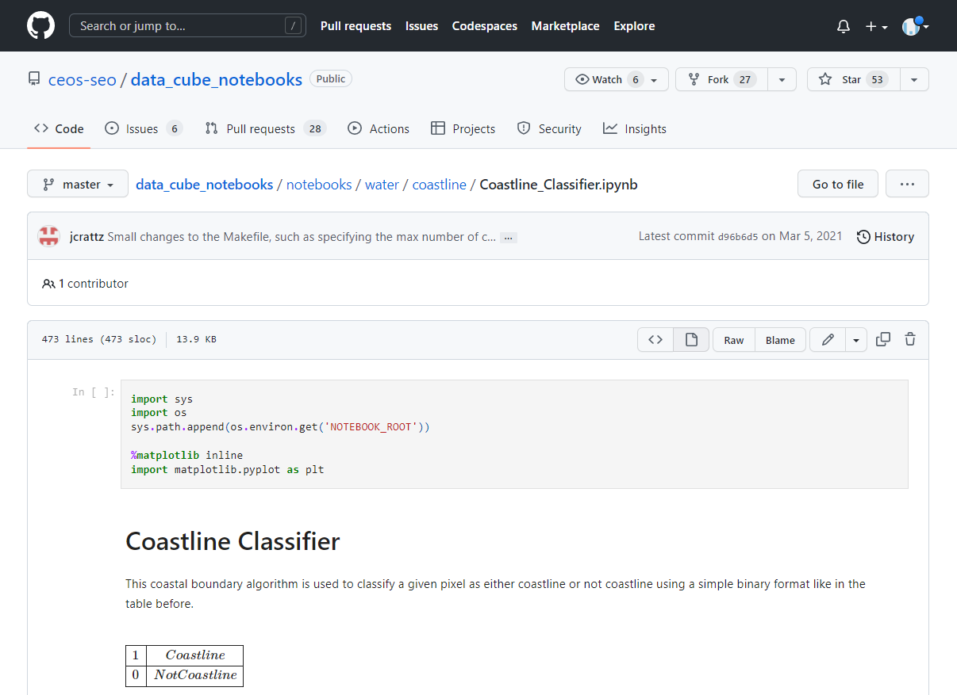
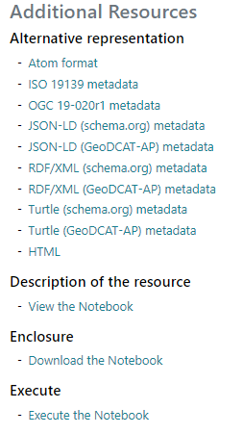
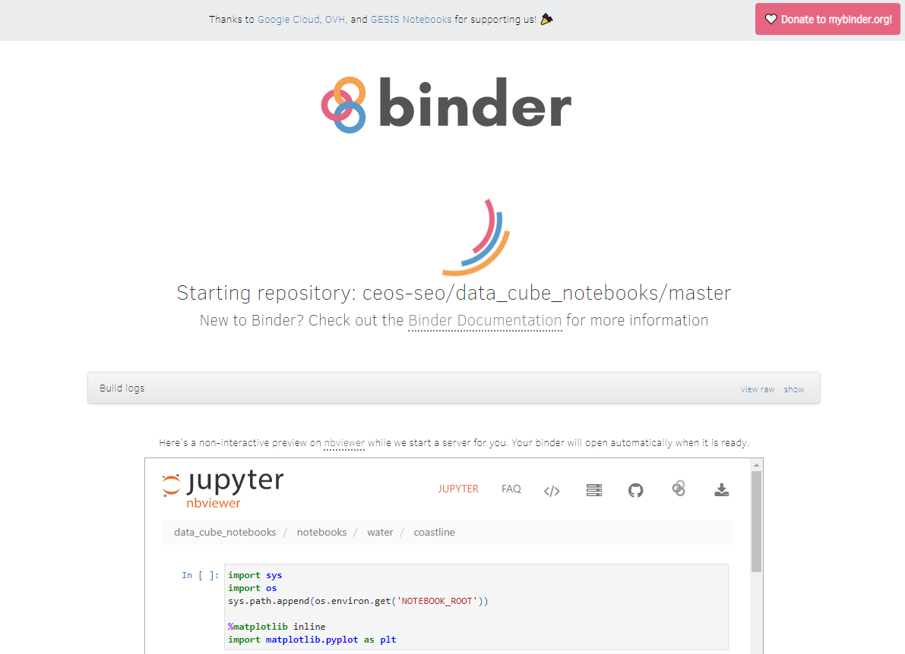
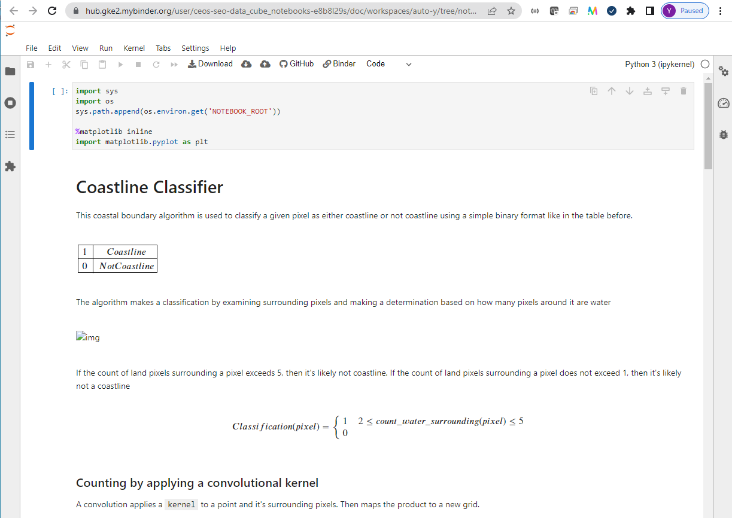
Next Steps: apply to Notebook discovery
Notes:
https://radiantearth.github.io/stac-browser/#/external/emc.spacebel.be/collections/services/items/coastline-classifier

Slide 16
Spare slides

