Slide 1
WGISS-55 - WGISS DSIG Best Practices Refreshment
I.Maggio, Rhea GROUP for ESA
Agenda ID: 2023.04.20_09.40
WGISS-55
Cordoba, Argentina (CONAE)
18-20 April 2023

Slide 2
Executive Summary
Refresh the Best Practice in terms of:
    New terms introduced by the rapid technology evolution
    Updates of the Document References considering the BP created in different periods
    Harmonising statements considering the full vision of the BPs in WGISS-DSIG landscape
    Adding/updating, when needed, use cases, recommendation and guidelines
Close the following actions:

Slide 3
DSIG BP Landscape

Slide 4
Preview Image Principle
CONTENT VERIFIED
Is it a real BP?
Could it be removed? It seems to be a general statement concept already present in other BPs?
It was suggested to readdress the whole concept of browse.
In Preservation Guideline Best Practice the THEME 7: DATA EXPLOITATION AND RE-PROCESSING seems to be
the right place for readdressing the concept, in particular in
GUIDELINE 7.10 – Facilitation of data exploitation - (Level C)

Slide 5
Data Management Statement
It is not a real Best Practice
It includes concepts already present in other BPs.
CONTENT VERIFIED and DOCUMENT REMOVED

Slide 6
Preservation Workflow
It contains all detailed tasks of the Reference Model White Paper
The document needed a refreshment in terms of terminology and a verification of the links inside
The references to the “Reference Model White Paper” and DMSMM have been added
CONTENT VERIFIED and DOCUMENT UPDATED

Slide 7
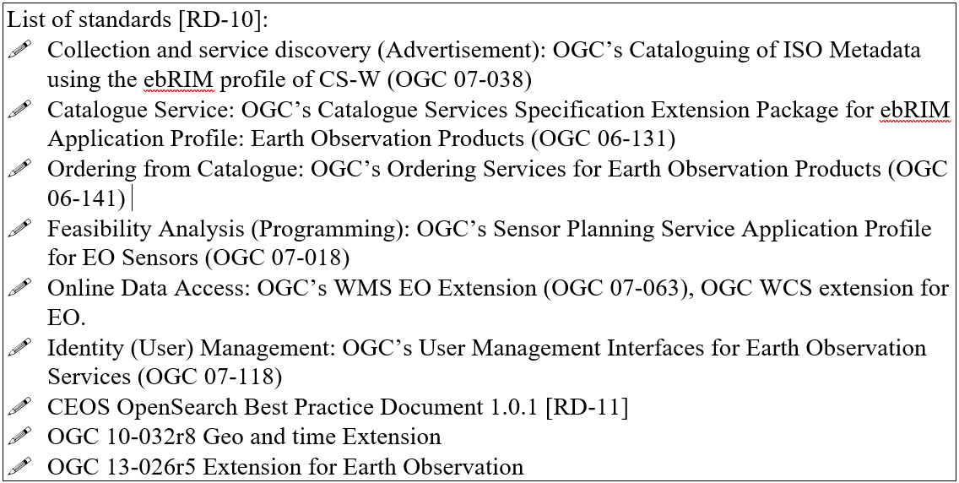
Preservation Guidelines
Only minor changes in the THEME 7: DATA EXPLOITATION AND RE-PROCESSING - GUIDELINE 7.12 – Facilitate data citation - (Level B): Landing page concept added
More effort to verify all references inside e.g.
CONTENT VERIFIED and DOCUMENT UPDATED

Slide 8
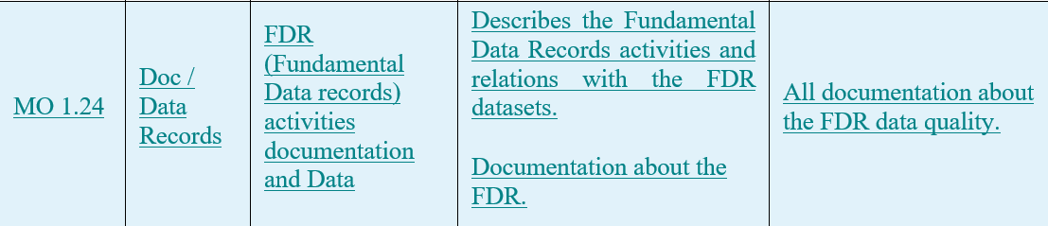
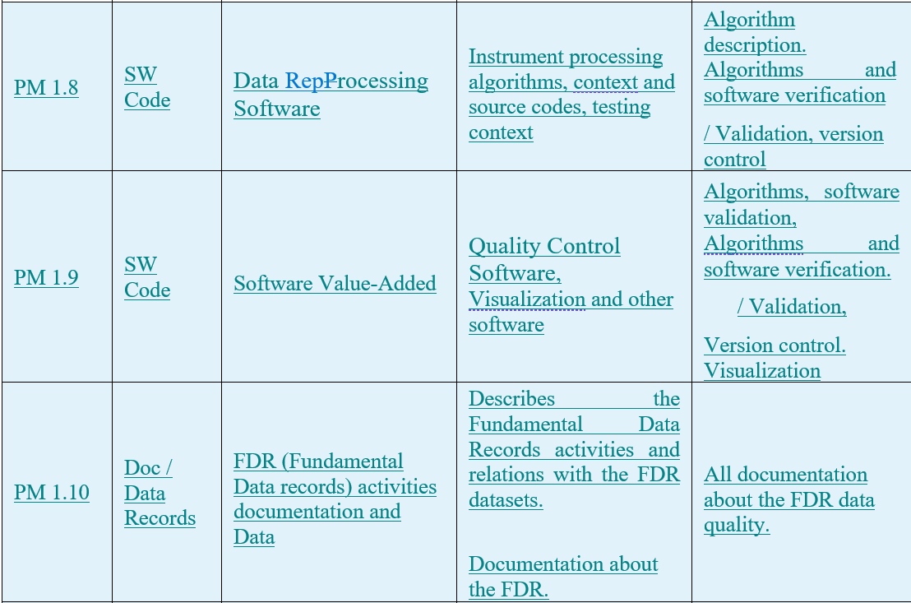
Preservation DataSet Content
MO 1.24 | Doc / Data Records | FDR (Fundamental Data records) activities documentation and Data | Describes the Fundamental Data Records activities and relations with the FDR datasets. Documentation about the FDR. | All documentation about the FDR data quality.
Starting point for ISO/DIS 19165-2 Geographic information — Preservation of digital data and metadata —- Part 2: Content specifications for earth observation data and derived digital products
Lessons Learned: using it in the ESA Preservation Workflow task the Data Curator identified few additional notes and elements to be added to the BP.
CONTENT VERIFIED and DOCUMENT UPDATED

Slide 9
Persistent Identifier Best Practice
Lessons Learned: using this BP in the ESA context few comments were collected.
In general:
Web links broken. A best practise should not include web links that are not preserved along time excepting the url https://doi.org/
Any agency related technical aspect should be removed because each DOI registration agency implements a specific interface.
Specific improvements:
On Landing Page session the following statements from Datacite (https://support.datacite.org/docs/landing-pages) were added.
New use cases added in B.2 Data Archive session
CONTENT VERIFIED and DOCUMENT UPDATED

Slide 10
Technical Content and Associated Information Preservation Best Practice
Few formats for long term preservation of associated information (e.g. email, presentation, images, video, etc.) updated considering new trends and standards
The SW preservation white paper is focused and updated with new technical solutions (e.g. Virtual Machine vs Containers)
Draft of Potential Long Term Software Preservation White Paper
Table of Contents:
  Scope and Introduction
  Why to Preserve Software
  Ongoing Software Preservation Efforts
  Principles of Software Preservation
    Collect, Preserve, Share
  Software Preservation Strategies
  Challenges and Complications
It can be a formal White Paper for WGISS?
CONTENT VERIFIED and DOCUMENT UPDATED

Slide 11
Measuring Earth Observation Data Usage Best Practice
HIGH EFFORT:
New metrics suggested
A couple of metrics not fully clear were better defined
A couple of metrics redundant were reviewed
New Cloud Metrics area considered (dedicated slide)
CONTENT VERIFIED and DOCUMENT UPDATED

Slide 12
In-situ Data Analysis
ACTION CLOSED
A study has been conducted and a report produced with the following content:
      Definition of the in-situ data
      Categories of in-situ data
      Sources of in-situ data (Ground-based, Marine-based, Air-based
      Benefit of in-situ data
      Current in situ data usage in Earth observation
      Challenges facing effective use of in situ data (Quality and consistency and Reliability and accessibility)
Could be it a new White Paper for WGISS?
Outcomes of the analysis:
For the nature of the in-situ data all Best Practice documents are extended to include also this concept

Slide 13
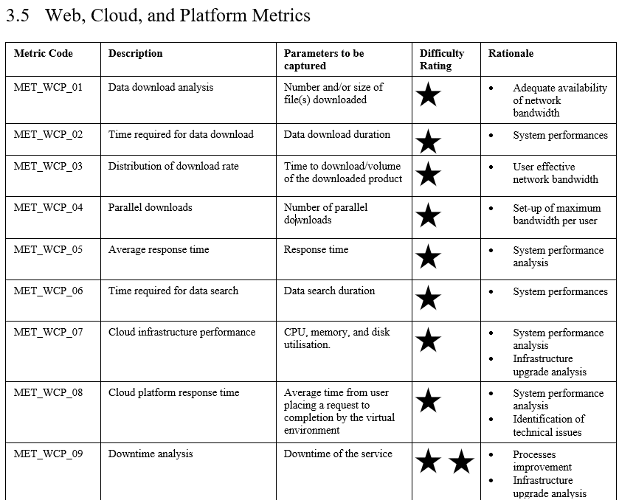
Cloud Metrics Data Analysis
ACTION CLOSED
Approach and production process:
Added the Cloud context in the Web and Platform Metrics paragraph (Web, Cloud, and Platform Metrics)
Provided the final version to the SLT Team
Received comments for the whole Best Practice
Implemented the received technical comments

Slide 14
White Papers and Reports Refreshment
White Papers and Reports
Long-Term Archive Strategies → (2011) It could be reviewed and included in the Archiving Technology Evolution Report
Data Preservation Techniques → (2011) Old White paper already covered by our Best Practices
Data Lifecycle Models and Concepts → (2012) Theoretical description of Data Model. Superseded by Reference Model?
Browse Survey 1997-2010 → It contains the “results of a March, 1997 survey of some CEOS agencies regarding the details of their production of AVHRR browse.” and the Browse Guidelines “This document is intended to assist data providers, including designers, developers and operators of Earth observation data systems to understand how a browse service might be made available to a wider audience.
Guidelines for GIS-Ready Products →(2011) It is a Draft For Comment
Browse Guidelines Document (version 2) → Link broken
Offline Media Trade Study → (2012) ARCHIVE AND RECORDS MANAGEMENT
Data Purge Alert White Paper → No review needed
WGISS Data Management and Stewardship Maturity Matrix White Paper → Already Reviewed and ready
WGISS Data Management and Stewardship Maturity Matrix → Already Reviewed and ready
WGISS Data Stewardship Reference Model White Paper → No review needed

