Slide 1
40 years of European AVHRR-LAC data – compiled, consolidated and now accessible via ESA dissemination service
Stefan Wunderle, Christoph Neuhaus, Sergio Folco, Mirko Albani
Oeschger Centre for Climate Change Research
Institute of Geography
University of Bern
ESA – ESRIN Frascati

Slide 2
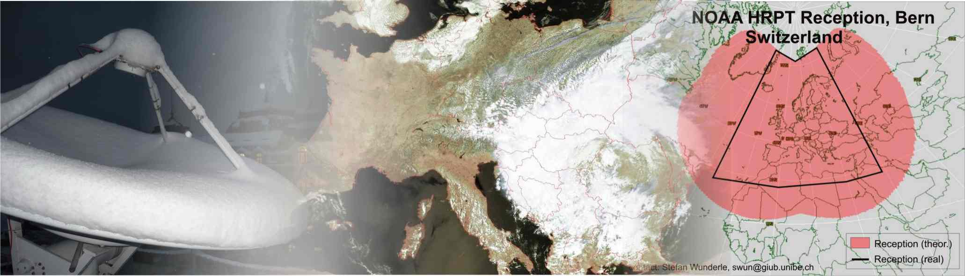
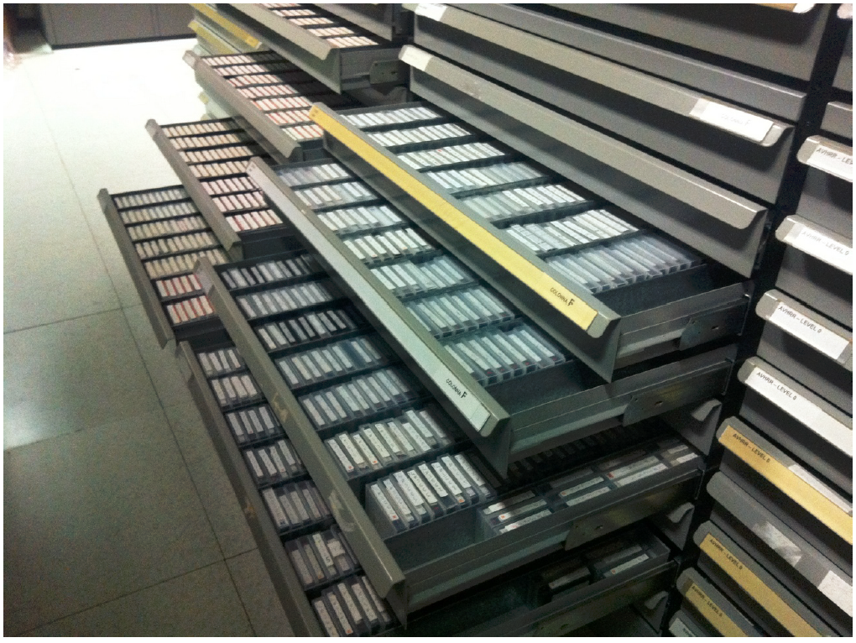
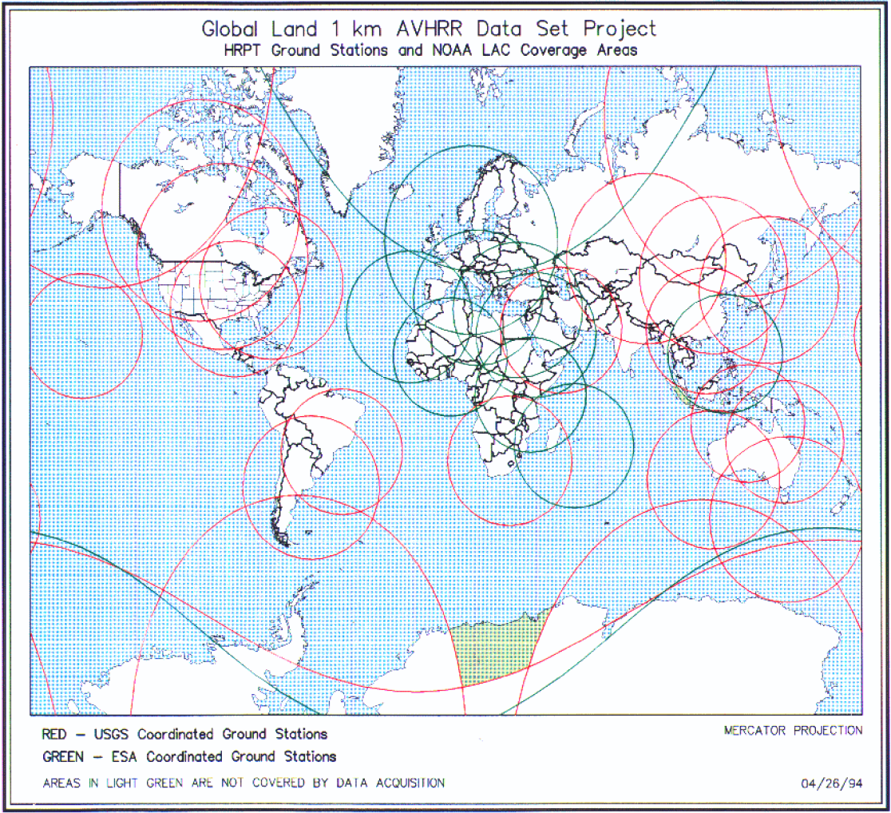
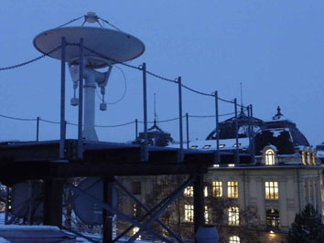
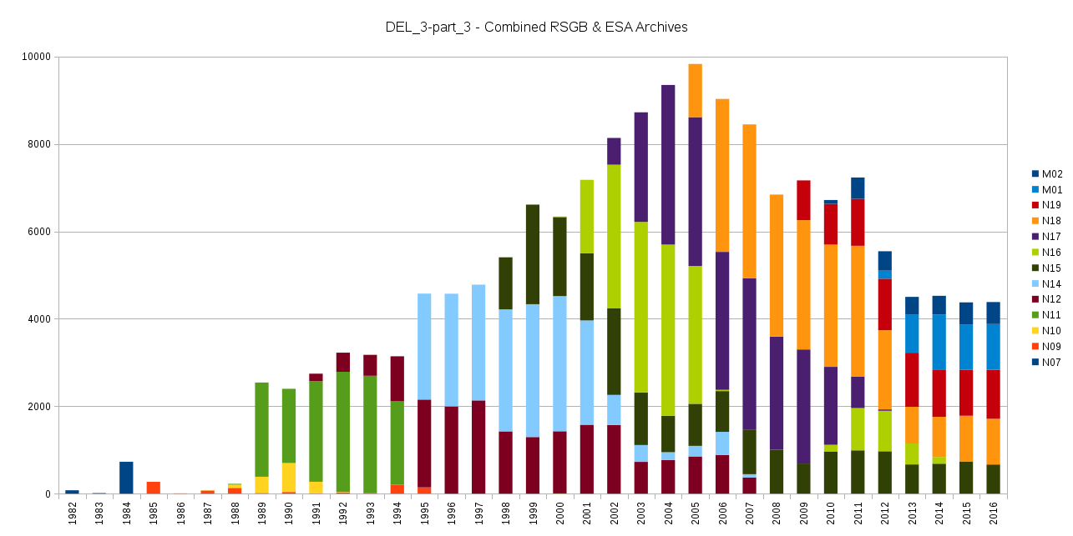
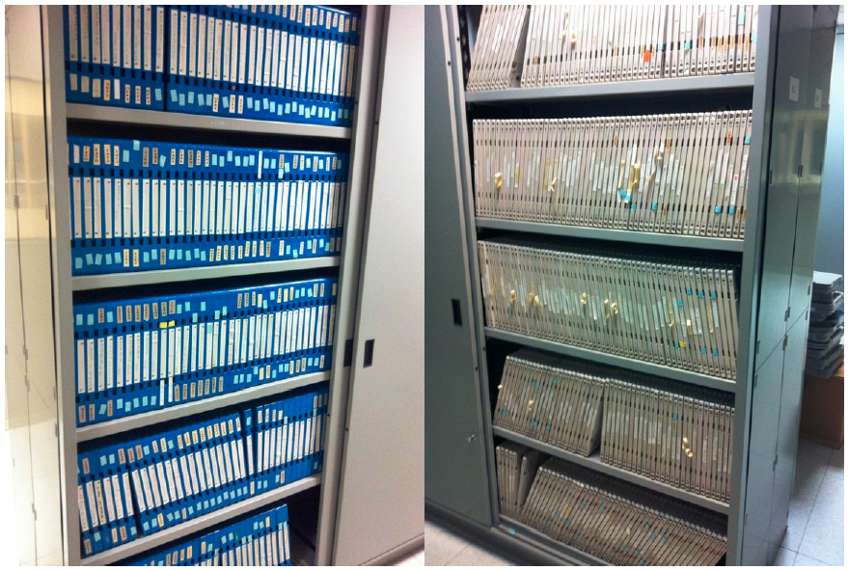
Motivation for the activity:
ESA Heritage Space Team and University of Bern
Heritage data are crucial to support climate change (and other) activities and projects
AVHRR data acquired at ESA for many years and available in different formats and media (most of them in robotic archive)
Heritage Space Programme taking now care of AVHRR data
UniBern – long tradition of AVHRR reception and processing
We see the need to make historical data accessible to the public and keep the data alive for an unlimited time.

Slide 3
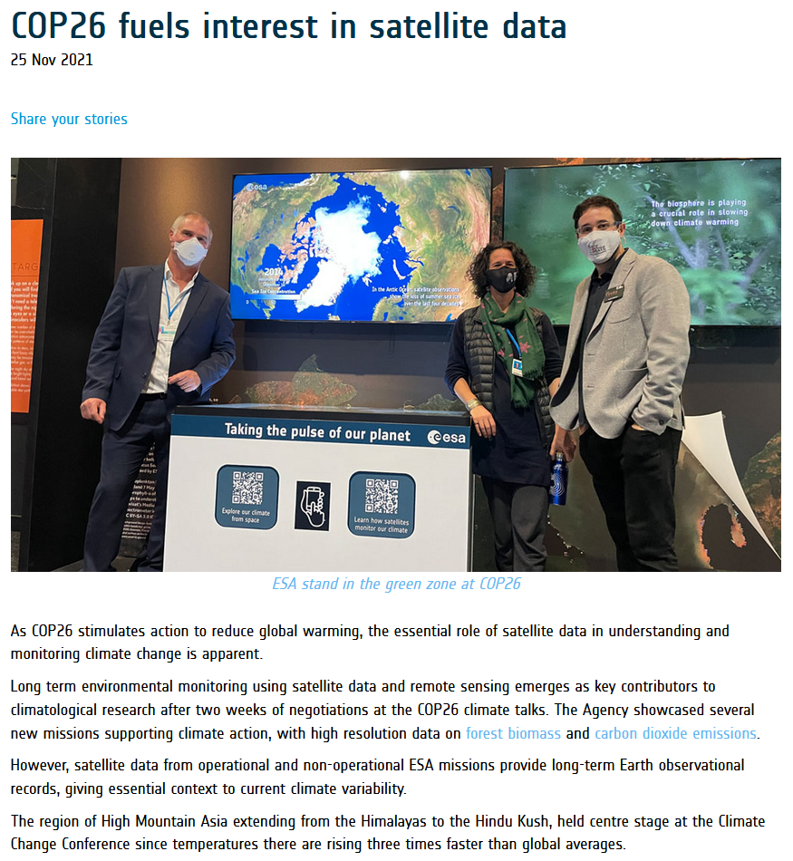
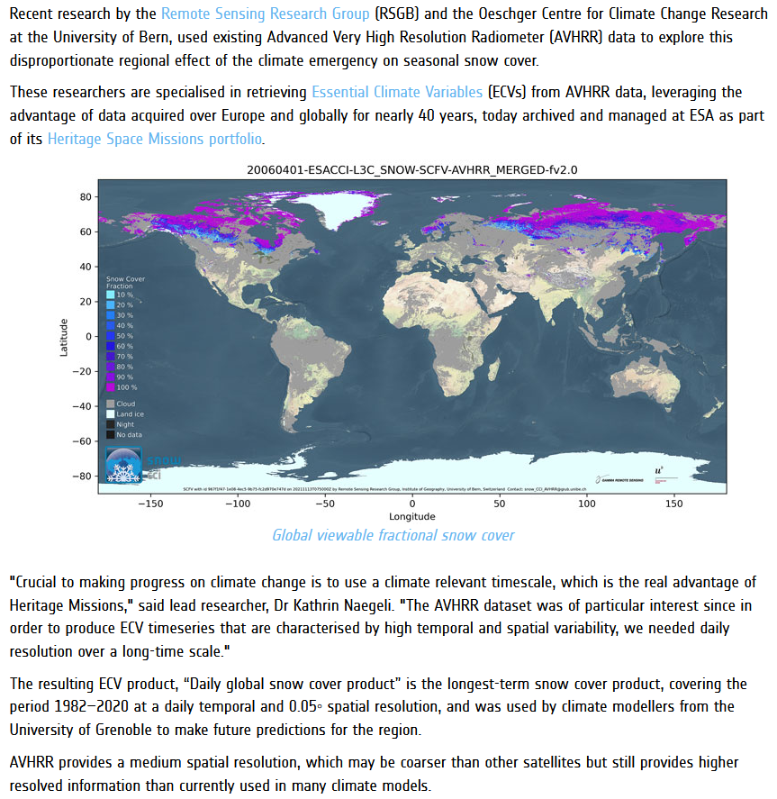
COP26 fuels interest in satellite data
https://earth.esa.int/eogateway/news/cop26-fuels-interest-in-satellite-data

Slide 4
AVHRR Curation Project: Steps implemented to compile an open accessible AVHRR data set via ESA dissemination service
WP_1: Inventory and gaps identification of AVHRR UniBe data incl. ESA data holdings and Dundee Station data.
WP_2: Consolidation procedure and reprocessing definition; development of software to re-format the different flavors of archived AVHRR data and fill the metadata files.
WP_3: AVHRR Master data set consolidation and reprocessing at UniBe Linux Cluster; transfer of software and scripts to ESA for own re-processing capability.
WP_4: AVHRR European Master data set validation (test of readability, check of consistency of all files in EO-SIP).
WP_5: Consolidation of AVHRR preserved data set composition and delivery.
WP_6: Transfer of all re-processed AVHRR data in level 1b (1981 – 2021) to ESA to be included in ESA archives and dissemination systems.

Slide 5
EO-SIP package (Earth Observation – Submission Information Package)
EO-SIP package structure, content and metadata attributes for the AVHRR products in scope, in line with the ESA infrastructure, to be used for archiving and dissemination.
AVHRR EO-SIP
EO Product
Metadata Report
1 1
1
0..1
Quality Report (1)
SIP Information File (1)
Browse Image

Slide 6
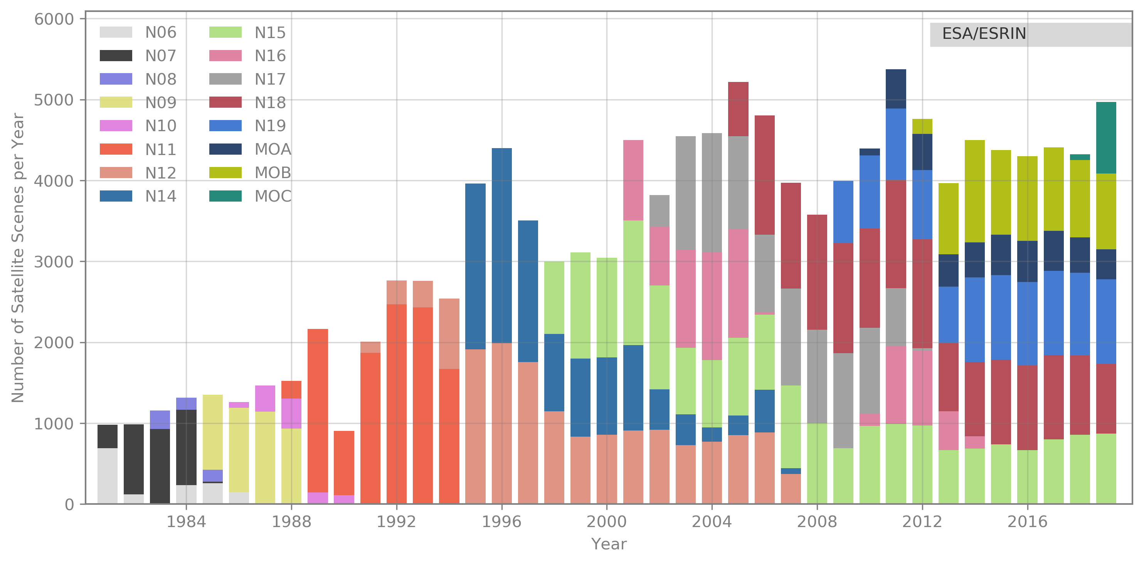
European 1-km AVHRR archive hosted at ESA includes data from University of Bern, Dundee Satellite Receiving Station and ESA holdings. Period: 1981 - 2021
Two-ten overpasses per day.
Dataset consists of more than 260.000 data products harmonized and consolidated through a dedicated ESA project (Heritage Space Programme).
All accessible free of charge via ESA dissemination services.
Archived for unlimited time by ESA.
Processing to Level-1c ongoing.
https://earth.esa.int/eogateway/catalog/avhrr-level-1b-local-area-coverage-imagery

Slide 7
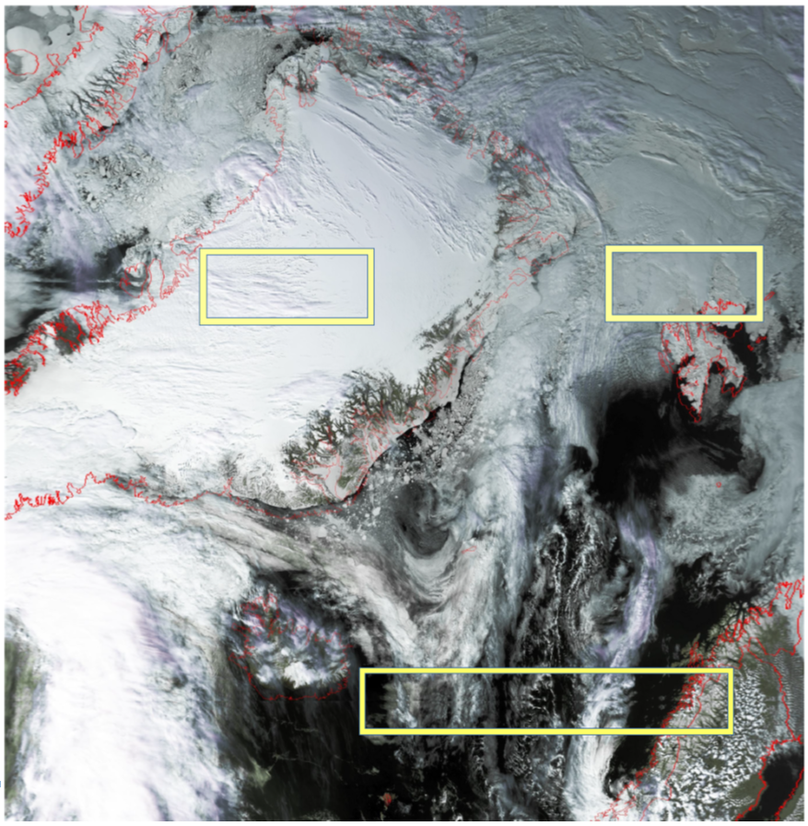
Recovery of CEOS Sharp-1 segments available at ESA
54.344 data segments merged and re-processed
Data were recorded on tapes not able to store one full path which was then split into more SHARP segments (one for each tape).
The segments overlapping areas were removed using a newly developed tool before merging to generate L1b products.
  Now, coastlines of the final product fit perfectly.
Finally, 99.8% (54.245 data segments) of the CEOS data could be re-processed and rescued!

Slide 8
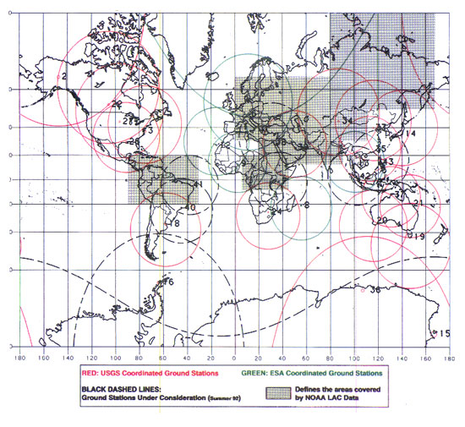
1 Km Project Data: 1 April 1992 to end 1999
USGS, NOAA, ESA and other non-US AVHRR receiving stations collected a global land 1-km multi-temporal AVHRR data set using NOAA's TIROS "afternoon" polar-orbiting satellite.
  23 stations worldwide divided in two groups plus the NOAA local area coverage (LAC) on-board recorders.
  The global land 1-km AVHRR dataset is composed of 5 channels, raw AVHRR dataset at 1.1 km resolution from the NOAA-11 and NOAA-14 satellites covering land surfaces, inland water and coastal areas.
The 1km project dataset acquired by stations under ESA responsibility has been aligned with the Level-1b Master Dataset over Europe and is now accessible through the ESA dissemination system.
Stitched data from stations under USGS responsibility are available at ESA but not suitable for reprocessing and alignment to European Master Dataset. Coordination ongoing with NOAA and USGS to retrieve the 31597 original (non-stitched) data.
Global Land 1 km AVHRR Data Set Project HRPT Ground Station Network (as of 1 April 1992) and Acquisition Areas for LAC Recorded Data

Slide 9
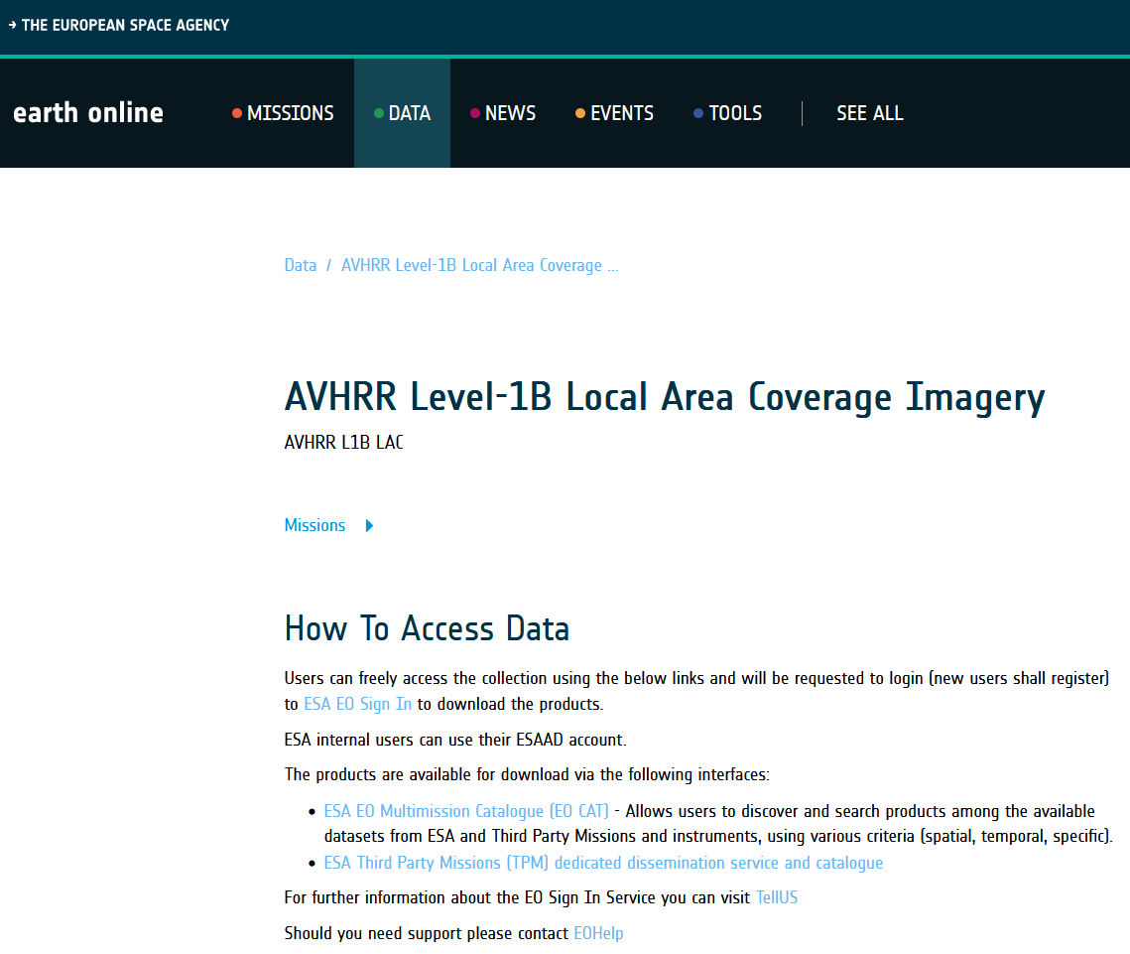
ESA Online Dissemination – AVHRR L1B data
https://earth.esa.int/eogateway/catalog/avhrr-level-1b-local-area-coverage-imagery
This collection is composed of AVHRR L1B products (1.1 km) reprocessed from the NOAA POES and Metop AVHRR sensors data acquired at the University of Dundee and University of Bern ground stations and from the ESA and University of Bern data historical archive.
The data collection covers Europe and the neighboring regions in the period of 1 January 1981 to 31 December 2020.
The product format is the NOAA AVHRR Level 1B that combines the AVHRR data from the HRPT stream with ancillary information like Earth location and calibration data which can be applied by the user. Other appended parameters are time codes, quality indicators, solar and satellite angles and telemetry.

Slide 10
Summary
  A homogenous and consolidated AVHRR LAC time series (1981 – 2021) is now available via ESA dissemination service.
  More than 250.000 AVHRR data (level 1b) covering Europe are ready to be used
  Approx. 55.000 CEOS Sharp-1 segments were rescued, re-processed in a consistent way (EO-SIP) and are accessible via ESA dissemination service, too.
  Software and processing procedure developed at University of Bern is installed and tested at ESA facilities.
  Next ongoing step is the generation of Level 1c data (calibrated and geocoded) for a better service to support communities without the needed expertise in AVHRR processing.

Slide 11
Future Outlook
Filling of AVHRR level1b archive with LAC data until the end of AVHRR sensor (NOAA, MetOp) approx. 2025.
Integrate global AVHRR LAC data of the pre-MODIS era (e.g. 1992 – 1999; more than 30.000 data sets); pursue rescue activities for local archives around the world.
On the way to a FCDR: more precise uncertainty characterization (FIDUCEO) and inclusion/alignment with Sentinel-3 and other medium resolution satellite data under consideration.
Data Usage: process AVHRR data as much as possible in alignment with CEOS ARD specifications and provide Analysis-Ready-Data (ARD) for climate modelling user community (CMUG)

