Slide 1
WGISS-54-09: Authenticating data replicas in the cloud
WGISS-55
April 18th - 20th, 2023
Doug Newman
NASA ESDIS Project, Goddard Space Flight Center
douglas.j.newman@nasa.gov
Michael Morahan
NASA EED-3
michael.p.morahan@nasa.gov

Slide 2
Summary
‘The definition of a use case that clarifies the challenges of authenticating data replicas in the cloud, This will include related goals, options, and technologies.’

Slide 3
Introduction
Authenticating data replicas in the cloud

Slide 4
Why replicate data?
Replicating data in multiple locations improves data availability and accessibility:
Fast and efficient access of data in various cloud regions or vendors
Constant data accessibility if one cloud region server is not available.
Convenience, different media formats to support multiple vender applications
Backup for disaster recovery
Regional compliance

Slide 5
Goals
Authenticating data replicas in the cloud

Slide 6
Data integrity challenge
‘I should be able to verify whether a specific file is genuinely from NASA’s data systems.’
‘I should be able to check whether a file accessed from a third-party resource has been deleted at the authoritative source.’
‘I should be able to check whether a file from a third-party resource has been modified or tampered with.’*
*Investigating Different Data-Traceability Approaches to Prevent Data Swamps

Slide 7
Ensuring users have legitimate data sources
Authenticating data replicas in the cloud

Slide 8
Checksum in metadata
Idea
Authoritative source of science file checksums. Example NASA’s Common Metadata Repository (CMR). User can perform checksum on file from replicated archive and compare it to the metadata record in CMR
Pros
Simple and inexpensive
No data transfer required
Cons
Requires a concrete linkage between the file in the replicated archive and the metadata record.
Requires the population of checksum in source metadata.
Does not scale well for the user.

Slide 9
Data Upload and verify*
Idea
The original archive provides a service that will verify the data is authenticated. Users would provide their replica data to the service for authentication.
Pros
Very simple for the user to verify authenticity of data
Cons
Requires implementation of verification service by archiver
Requires transfer of all data to be verified
Why not get the data from the original archive (upload versus download)
*Investigating Different Data-Traceability Approaches to Prevent Data Swamps

Slide 10
Blockchain provenance
Idea
The data is part of a blockchain (an immutable ledger). Every single change made to the original data is tracked and versioned. The immutable and decentralized nature of blockchain technology lends itself to data provenance solutions.
Pros
The most secure and tamper-proof of the surveyed solutions
The provenance of a data file is provided by the archiver in the blockchain
Cons
Complex to implement
Requires specialized knowledge on the part of the user to verify data

Slide 11
Technologies for replication
Authenticating data replicas in the cloud

Slide 12
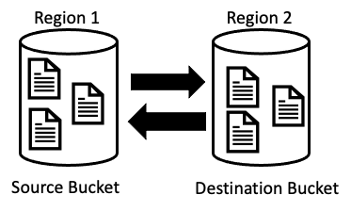
AWS Cross-Region Replication (CRR)
Data is automatically replicated across different AWS regions. Reason for CRR:
The need to store data in several regions to meet project compliance requirements.
If our collaborators are in two geographic locations, we can minimize latency in accessing data by maintaining object copies in cloud regions that are geographically closer to those collaborators.
To increase operational efficiency, if compute clusters in different regions analyze the same objects.
Notes:
AWS S3 Cross-Region Replication (CRR)
https://docs.aws.amazon.com/AmazonS3/latest/userguide/replication.html#crr-scenario

Slide 13
Snowflake
Idea:
Snowflake is a Platform-as-a-service (PaaS) that provides interoperability features between cloud providers such as Amazon Web Services and Microsoft Azure.
One of those features is replication of data between cloud vendor storage.
Pros:
Snowflake works with major cloud vendors
Cons:
An additional layer of infrastructure that both the original archive and the replicated archive need to agree on
Notes:
https://www.snowflake.com/
Snowflake: Replicating data across regions and cloud platforms
Replicate Snowflake database across cloud accounts in different regions

Slide 14
RClone
Idea
RClone is an open-source command-line program to manage files on cloud storage. Commands like UNIX’s rsync, cp, mv, mount, ls, ncdu, tree, rm, and cat. Features:
Transfers
MD5, SHA1 hashes are always checked for file integrity
Can be to and from network, e.g., two different cloud providers
Copy new or changed files to cloud storage
Sync (one way) to make a directory identical
Move files to cloud storage deleting the local after verification
Check hashes and for missing/extra files
Pros:
Analogous to on-premises versions such as rsync
Cons:
Not native to cloud vendor
Notes:
https://rclone.org/
Migrate data from Microsoft Azure Blob to Amazon S3 by using Rclone

Slide 15
Use Case 1: as-is archive replication
Authenticating data replicas in the cloud

Slide 16
As-is archive replication
As a data provider, I want to replicate a data archive so that I might…
Abide by data sovereignty laws
Abide by data localization laws
Meet compliance requirements
Minimize data access latency
Maximize collaboration within the earth science community

Slide 17
Use Case 2: value-added archive replication
Authenticating data replicas in the cloud

Slide 18
Value-added archive replication
As a data provider, I want to replicate a data archive in a different format so that I may,
Allow my users to leverage cloud-optimized access techniques
Re-process as Zarr, Cloud-optimized GeoTIFF (COG)
Sentinel-2 COGs: https://registry.opendata.aws/sentinel-2-l2a-cogs/
NASA POWER Zarr store
https://registry.opendata.aws/nasa-power/
Provide an ‘archive of convenience’
Replicate/combine portions of data for a specific scientific use case and provide additional assets

Slide 19
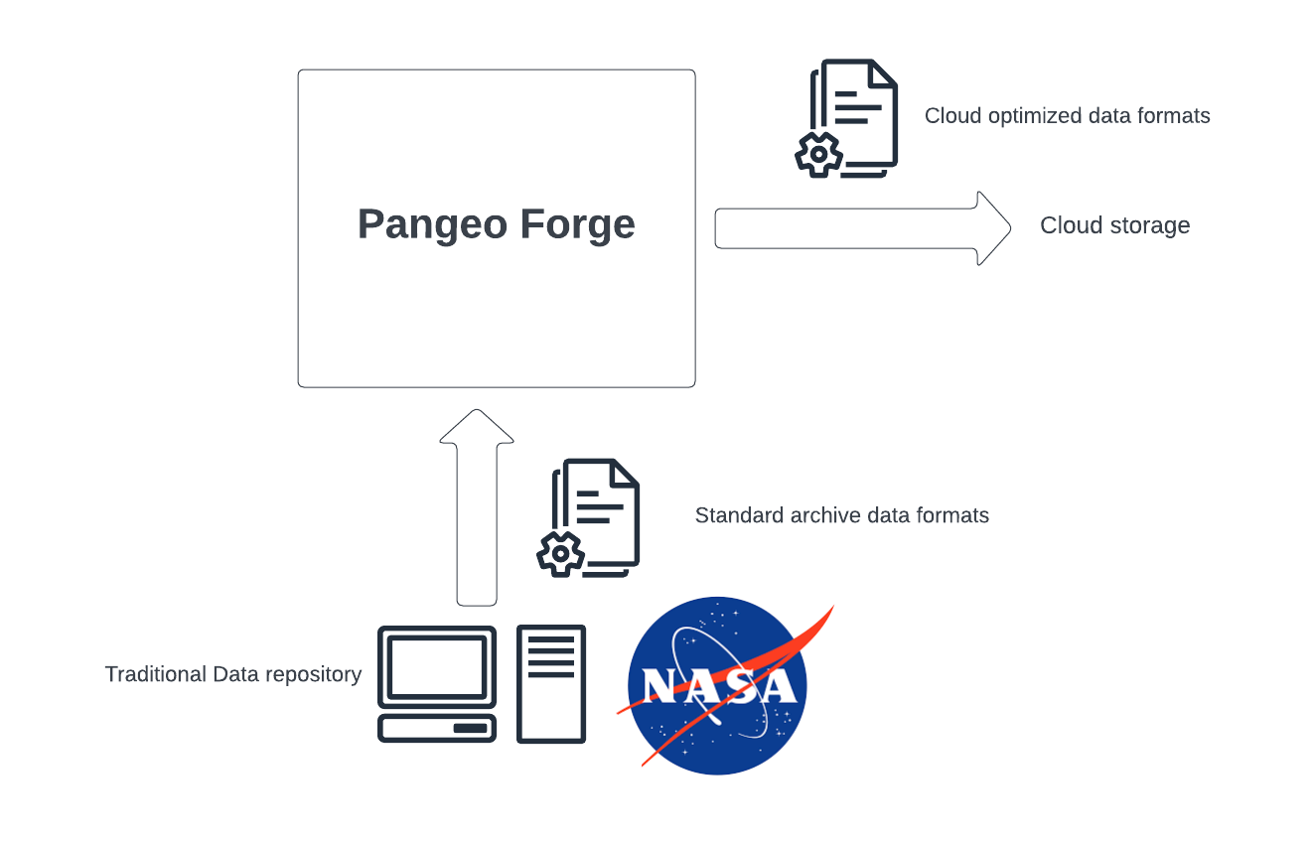
Example: Pangeo Forge production
‘Grass-roots’ analysis ready, cloud-optimized (ARCO) data sets have been popping up in various cloud environments recently.
Usage of them has revealed problems:
Out of date
Incomplete
Pangeo Forge is an attempt to produce and curate ARCO versions of archived earth science datasets from various agencies.
Curated, ongoing process!
Notes:
https://pangeo-forge.org/catalog
https://pangeo-forge.org/dashboard/feedstock/42

Slide 20
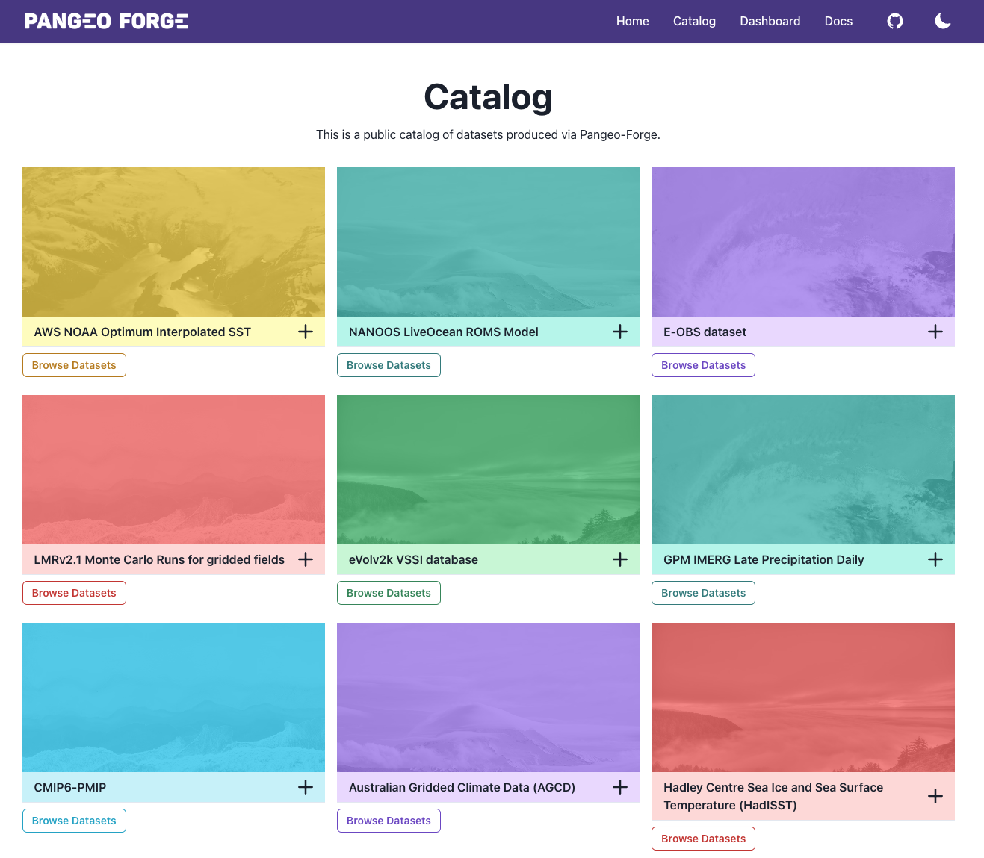
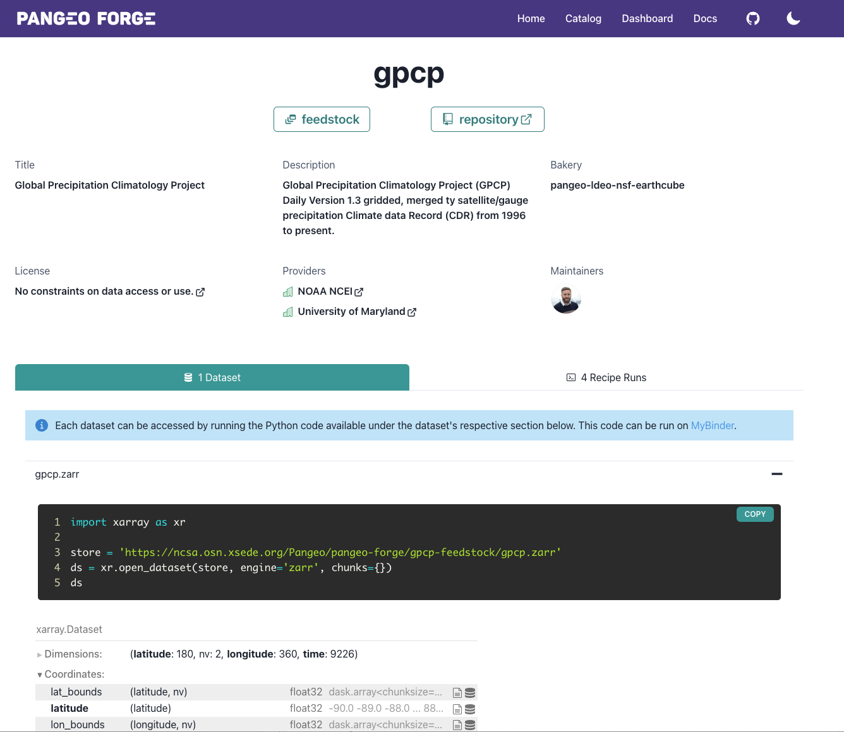
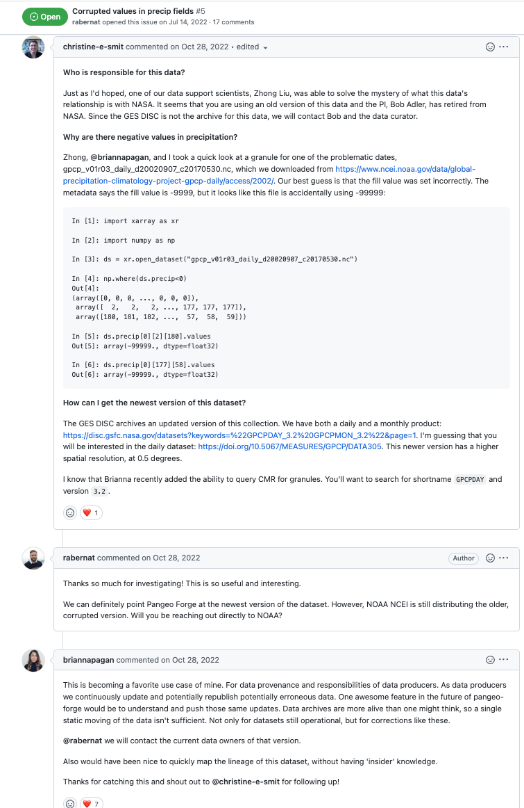
Example: Pangeo discovery
https://github.com/pangeo-forge/gpcp-feedstock/issues/5
Notes:
https://pangeo-forge.org/catalog
https://pangeo-forge.org/dashboard/feedstock/42
https://github.com/pangeo-forge/gpcp-feedstock/issues/5

Slide 21
Discussion

