Slide 1
WGISS-55 Upcoming Meetings

Slide 2
Upcoming Meetings
Recent Meetings
WGISS-54: Tokyo, Japan | October, 2022 (joint w/ WGCV)
WGISS-55: Córdoba, Argentina | April 18-20, 2023 (joint w/ WGDisasters)
Upcoming Meetings:
WGISS-56: Paris, France | Fall 2023
Hosted by: Centre National d’Etudes Spatiales (CNES), POC: Richard Moreno
Dates: October 24-26, 2023
WGISS-57: TBD | Spring 2024
WGISS-58: Sioux Falls, USA | Fall 2024 (joint w/WGCV)
Hosted by: USGS Earth Resources Observation and Science (EROS) Center

Slide 3
WGISS-56
Hosted by CNES – Paris FRANCE
October 24-26 2023
Richard Moreno CNES

Slide 4
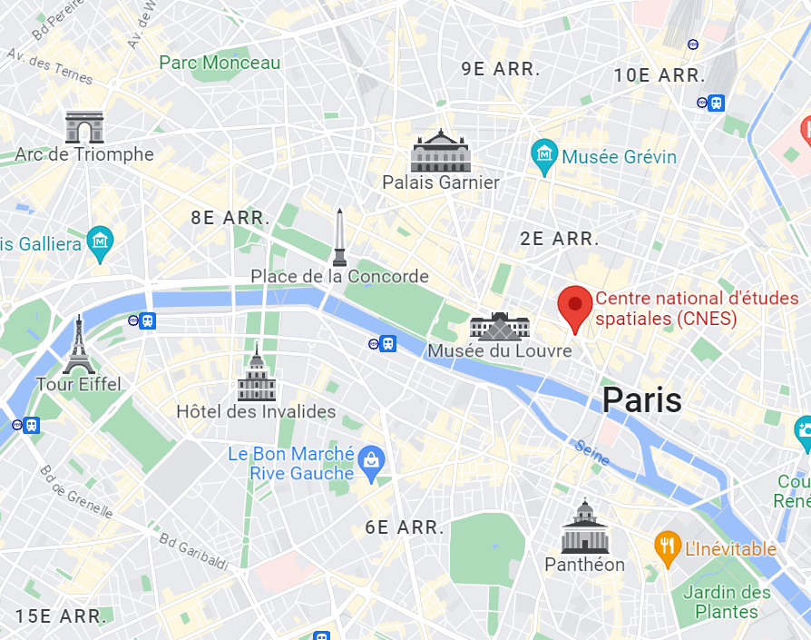
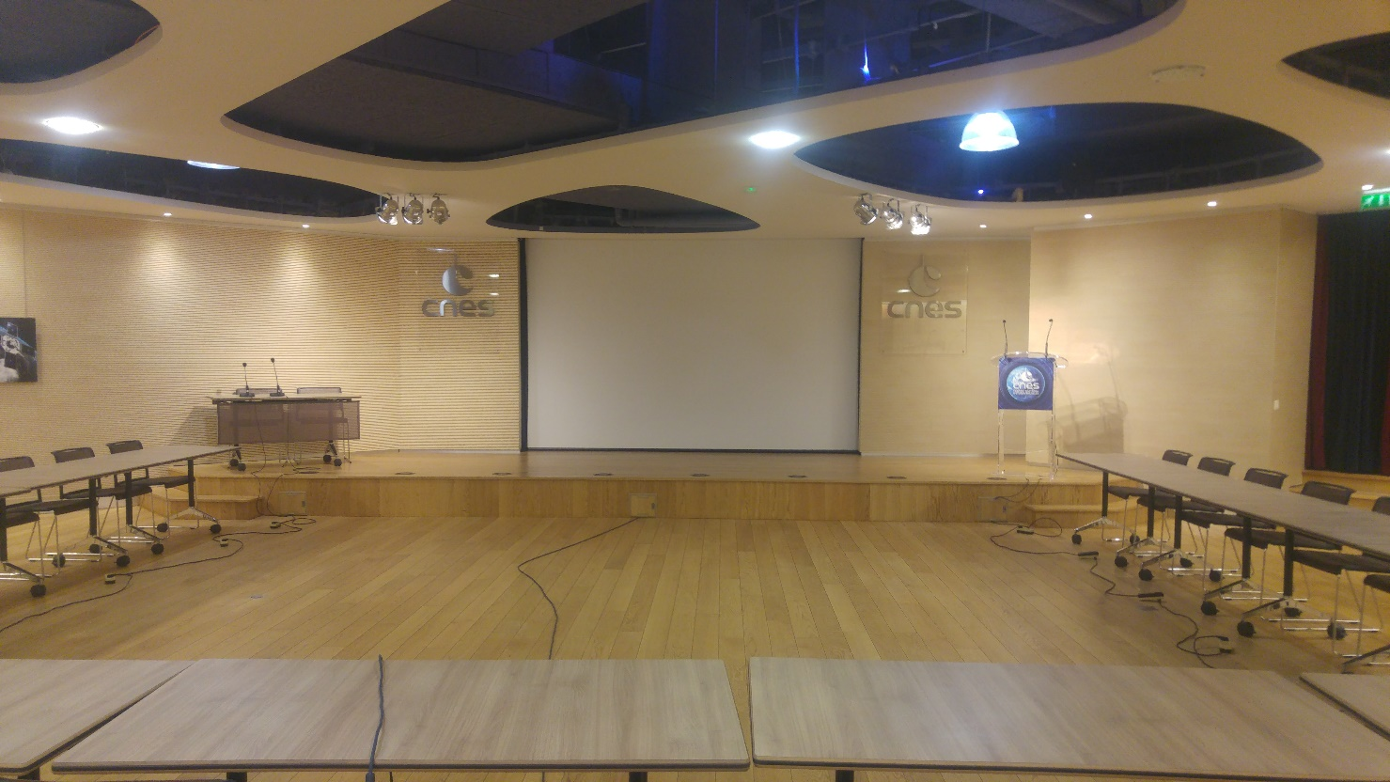
WGISS-56 hosted in CNES headquarter in Paris
WGISS-56 at the heart of Paris
CNES Headquarter
‘Salle de l’Espace’

