Slide 1
CSIRO Agency Report
CEOS WGISS-56, 24 October 2023

Slide 2
Executive Summary
Translatability and transferability of applications between platforms
Common-enough cloud data and analytics
Engagement, training and capacity building
SE Asia partners, Datacube Chile and CAL
CSIRO’s cloud-analytics platforms
Small team, big impact
Data preparation pipelines
SAR ARD, STAC, Cloud-enabled data
Open data cube 2.0
Forthcoming contributions

Slide 3
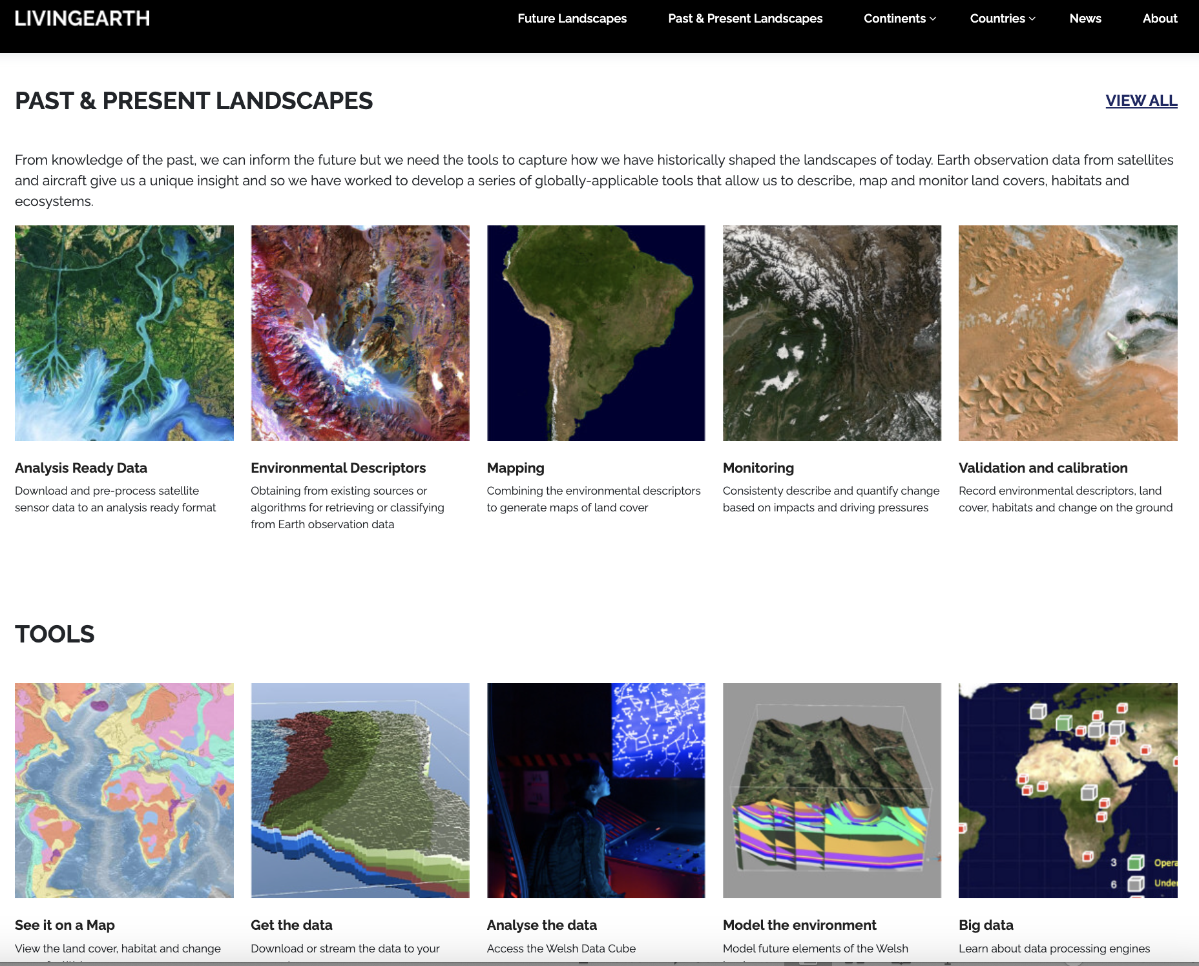
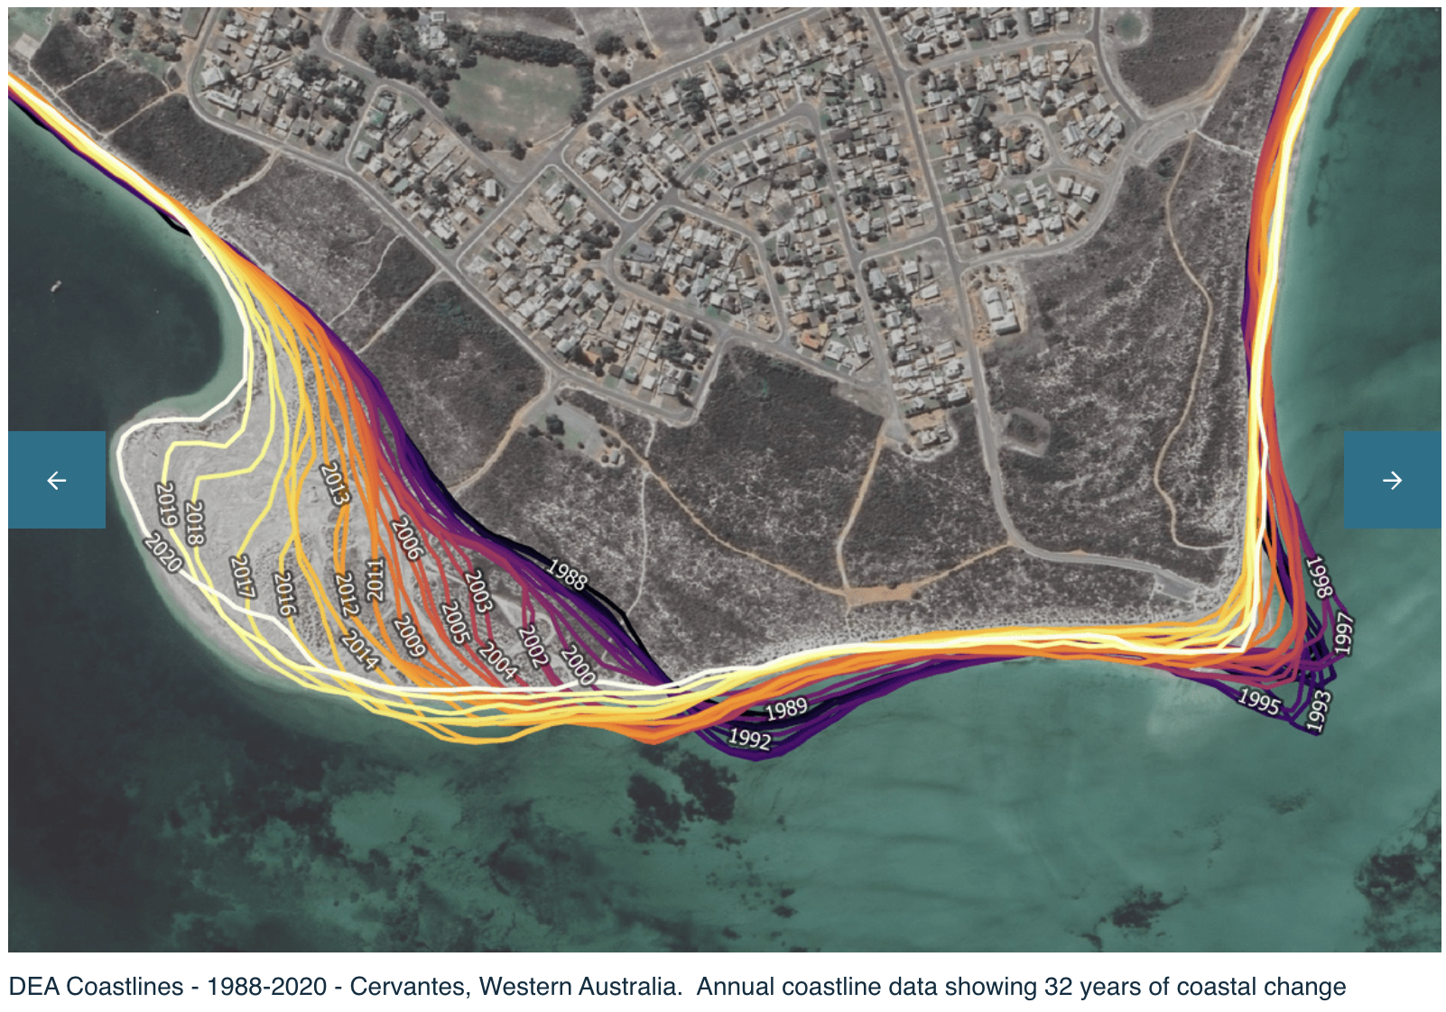
Translatability and transferability
Land cover classification scheme (LCCS)
Developed for Wales and Australia
Transfer from DE Aust/Africa to CSIRO EASI
Translate to Papua New Guinea
Vietnam Land cover and use
Developed by Can Tho University
Transfer from GEE to ODC/EASI
Upgrade application scalability, adaptability
Coastline change mapping
Developed by Geoscience Australia
Transfer from DE Aust/Africa to CSIRO EASI
Translate to Vietnam and SE Asia environments
Current learnings
“Baseline application”: global coverage data
Customize: local environment and data
Local partners: validation, verification
Sustainable use-cases: demo, public-good, capability dev/transfer
Contribution to “Living Earth” objectives
Notes:
Translatability and transferability for us is about
How to transfer the technical aspects of an application across platforms
And how to translate an application into a new domain
The common technology and choice between Digital Earth Aust and Africa with EASI
Means that we can readily transfer both notebooks and application workflows between platforms
The main points that enable this are
Common software
Common data product names and types
With global coverage and access data (e.g. Landsat and Sentinel-2)
Its possible to create a “baseline application” (unvalidated)
Then its also important to enable local partnerships
To develop validation and verification processes
And develop appropriate local use-cases

Slide 4
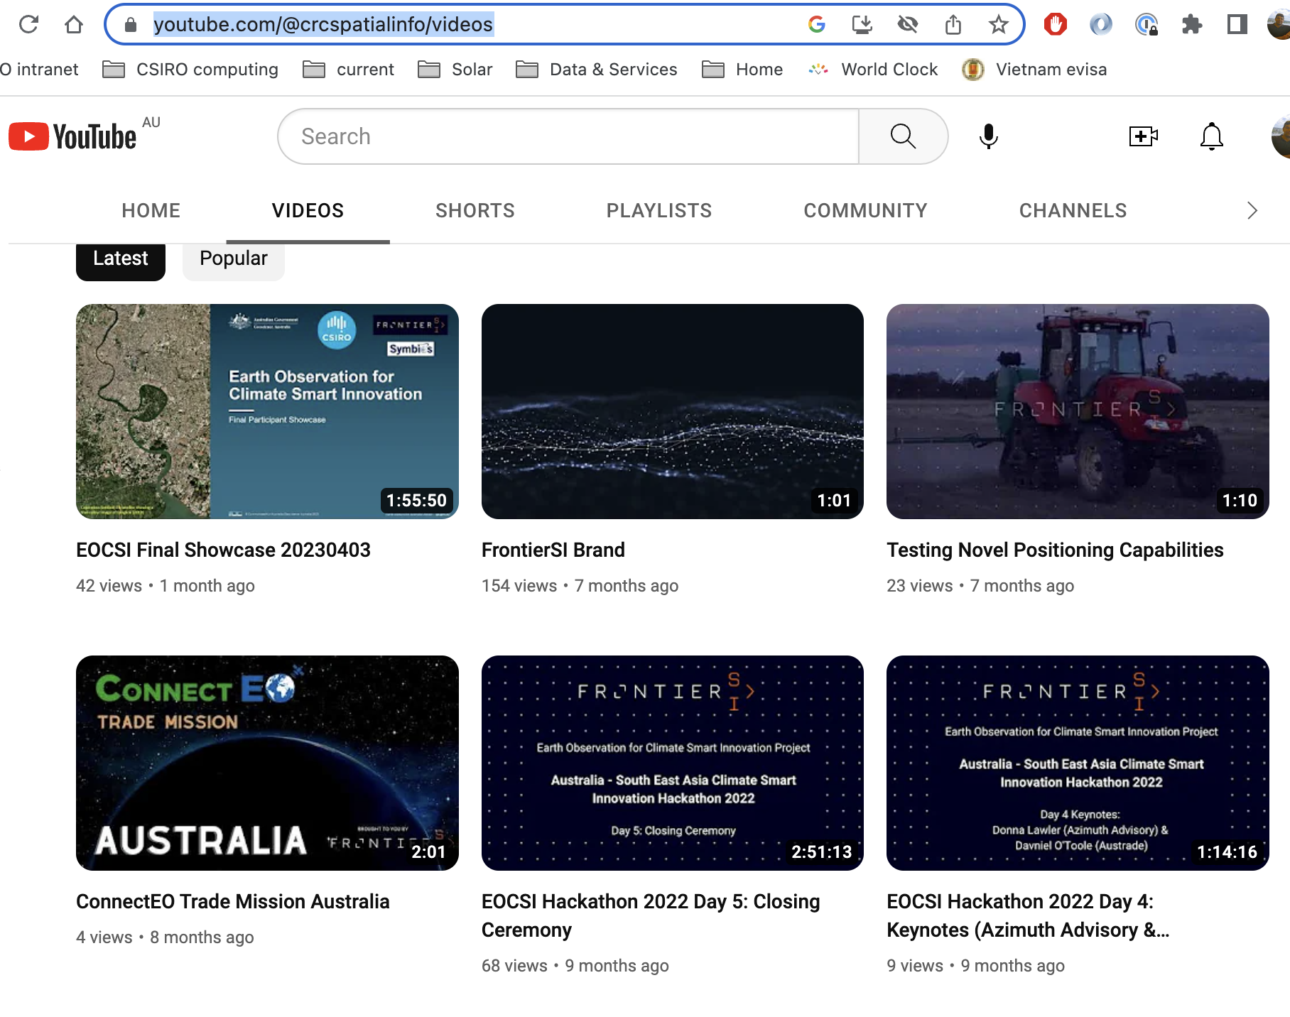
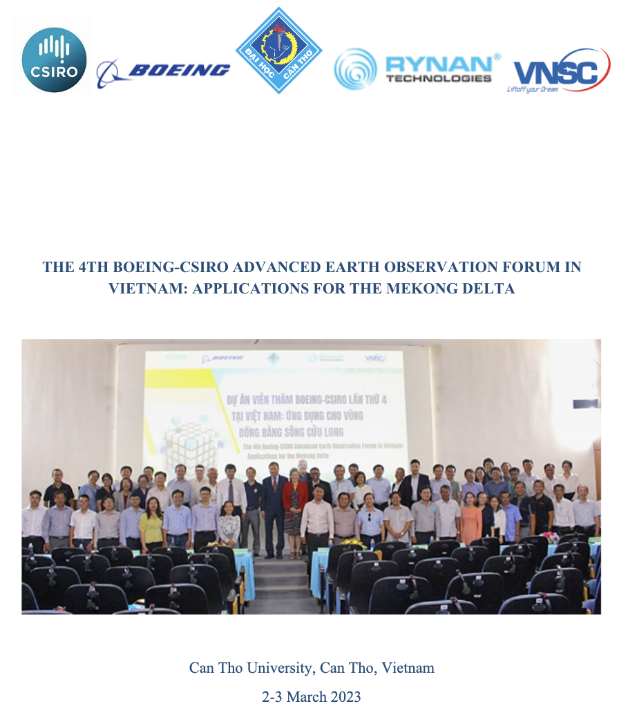
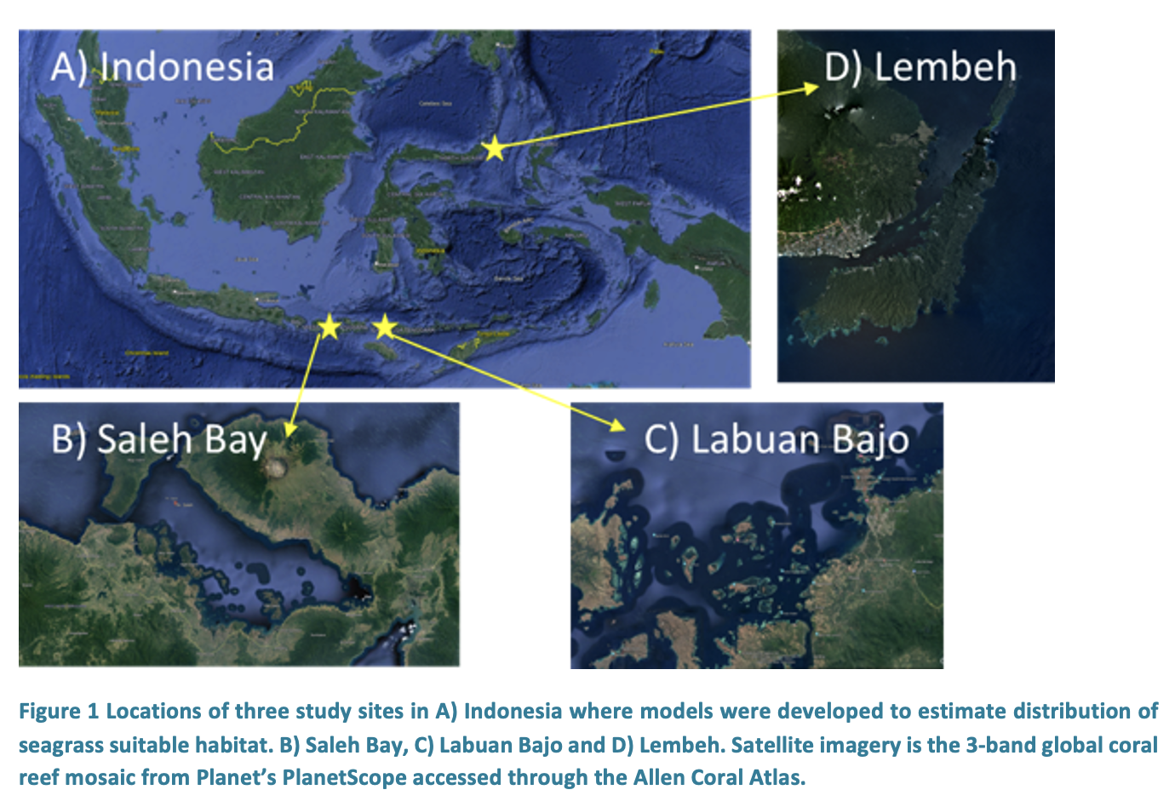
Training, capacity building with SE Asia partners
https://explorer.asia.easi-eo.solutions/ - Data catalogue
https://hub.asia.easi-eo.solutions/ - JupyterLab
https://ows.asia.easi-eo.solutions/ - Web services
Email: easi-help@csiro.au
CSIRO EASI Asia platform
Collaboration, co-development of applications
Cloud-hosted data and analytics
Training and engagement
Public-good and pay-for-use sustainability
Vietnam EO collaboration
Research, Govt, Industry network development
Innovation collaboration platform, multi-organisation
Province and national environmental applications
Indonesia and Fiji
Blue Carbon mapping and assessment
Sarawak, Malaysia
Coastal water quality trends and drivers
Notes:
Training and capacity building is a strong interest for CSIRO
We often partner with Geoscience Australia and Universities for projects across SE Asia
We operate a cloud-enabled platform for EO data and analytics, which we use for
Collaboration and development of science applications of shared interest
Training and engagement on the use and access to EO data
Public-good web services and pay-for-use access
The common platform we use enables the training materials and applications
To be co-developed and shared with partners
And shared with related interests in our CEOS, Chile and CSIRO.

Slide 5
EASI: a change in how we work
CSIRO’s EASI platform for Earth Observation (EO) data:
EO data science platforms
EASI
CSIRO's scalable cloud-computing and ODC implementation
Access to CSIRO science and partnership expertise
Amazon Web Services, Terraform, Kubernetes
Examples of Open Data Cube implementations
Examples of EO data science platform technologies
Notes:
This graphic just shows that EASI platforms are similar to Geoscience Australia’s Digital Earth Aust and Africa platforms
This is by design so that we collaborate and develop together, and our shared history in the Open Data Cube
For CSIRO, our primary objectives are
Efficient and scalable cloud-computing
And easier science and expertise partnerships

Slide 6
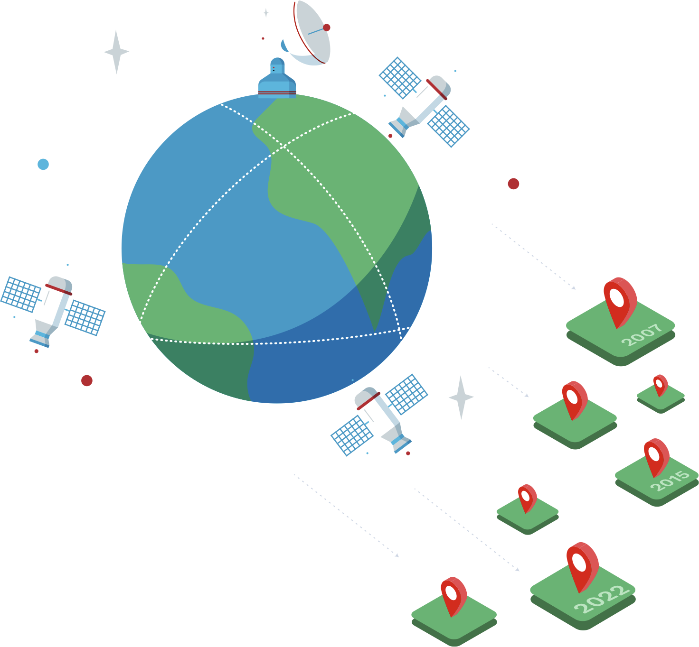
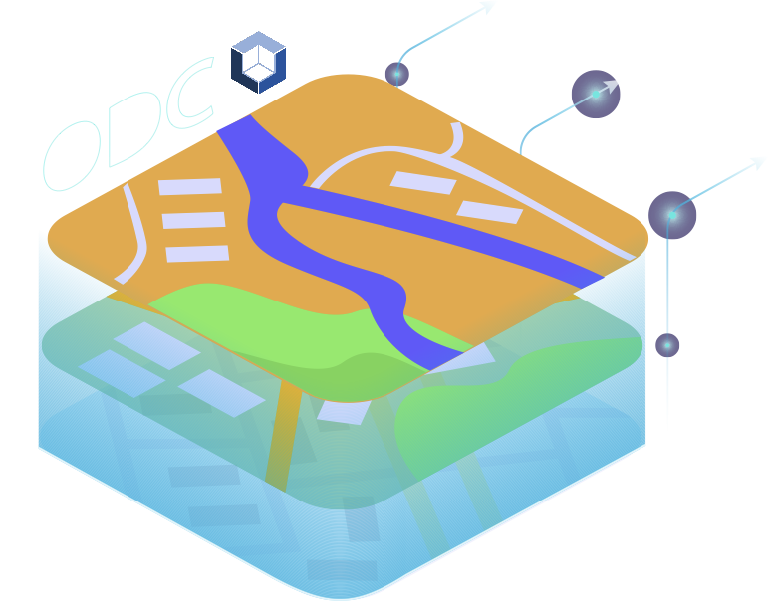
CSIRO EASI
Accelerating Innovation – Enhancing Engagement
5
Cloud Analytics
4
Open Data Cube
6
Analysis Ready Data
7
CSIRO Scientists & Customer Success Team
1
Data Supply
3
Custom Build
2
Individual Products
8
Enterprise Customers
9
Subscription Ecosystem
Notes:
For us, EASI is an end-to-end path
From data supply
Through customisation of data and products
Provision of efficient data and analytics capabilities
And external engagement
So we’re in a good position to provide use-cases and practical examples with CEOS partners at all parts of this path

Slide 7
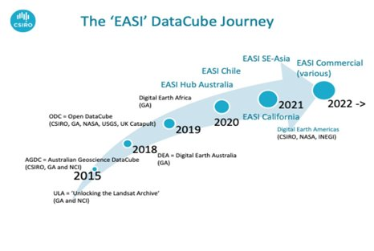
CSIRO's EASI Activities
Science projects​ | International​
Blue Carbon​ | Asia-Pacific,​ South America​
Offshore water quality​ | SE Asia​, Australia
Inland water quality​ | Australia,​ SE Asia​
Bushfire risk​ | Australia​
Murray-Darling Rivers Basin | Australia​
Mineral exploration tools​ | Australia​
Bathymetry​ | Asia-Pacific
Land-Urban-Water interface​ | Vietnam​
Synthetic Aperture Radar (SAR) applications | Global
Lidar, Hyperspectral R&D​ | Australia,​ North America,​ SE Asia​
Deployments | Users
4 x CSIRO managed 3 x Domain specific 1 x EASI Enterprise 1 x EASI subscriber | 250+ CSIRO 80+ external 5 x CSIRO business units Asia and North, South America global contacts
CSIRO EASI | CSIRO projects and partners
CEOS Analytics Lab | CEOS contribution, underpinning platform
Chile Datacube | Chile and S.America
EASI Asia | Partnerships, CapDev across SE Asia
Aquawatch ADIAS | International water quality/extent projects
SME subscribers | Whatever they want ☺
Enterprise customers | Whatever they want ☺
Notes:
Here is a description of the breadth of activities within our EASI program
We connect with CSIRO science groups to support their science and external partnerships
We operate a number of instances of the platform for different domains and user groups, including public-good and commercial
The CEOS Analytics Lab is underpinned by the EASI platform
And we are very grateful to David Borges and Jonathan Hodge for leading this activity
I expect David will talk more about CAL during this week, which I look forward to

Slide 8
Technology contributions: >> CEOS interoperability
Search
STAC
API
Process
Download
Unpack
Convert
COG
Store
Resample
Data preparation pipelines
Cloud-enabled data are best
On-demand access
Managed by custodian
Other scenarios mean that we:
Copy, convert and store
Example: SAR processing pipeline
Open data cube 2.0
Support for multi-dimensional indexing
Hyperspectral and (possibly) Lidar
Improved usability and user experiences
Data preparation workflows
Cross-platform training and applications
Cloud-enabled
STAC, COG
Cloud-available
AWS, PC, GEE
Spatial data layers
Geoserver
Web-accessible
Copy, process, convert, store
WMS
Copy, unpack, convert, store
Direct index
Online archives
Read pixels
Notes:
Here I describe two areas of technical contributions, which can contribute to CEOS interoperability use cases and activities
Our data preparation pipelines are always evolving and improving as upstream data search and supply options, and our requirements change
Cloud-enabled data is best for use as it provides direct search and read of pixels
Other cloud-available or online data sources are okay but often require us to store a copy of the data in a cloud-enabled format
Our forthcoming technical contributions include
Making our data preparation pipelines openly available for transparency and re-use
Contributing to Open data cube 2.0 in particular to help develop a more generic multi-dimensional indexing capability
The intent is to directly support hyperspectral data, and possibly extensible to Lidar point clouds.

Slide 9
Thank you
Matt Paget
Sr. Research Scientist
E Matt.Paget@csiro.au
Dr. Amy Parker
Director, Centre for Earth Observation
E Amy.Parker@csiro.au
Dr. Robert Woodcock
Sr. Principal Research Consultant
E Robert.Woodcock@csiro.au
Dr. Alex Held
Mission Lead, AquaWatch Australia
E Alex.Held@csiro.au

