Slide 1

DLR/USGS Collaboration
Collaboration Area #3 Status
Ground System, Cloud, and HPC Architectures (GSCHA)
Ryan Longhenry
USGS EROS Center
U.S. Department of the Interior
U.S. Geological Survey

Slide 2


Collaboration Objectives
Establishing a dialogue concerning ongoing joint land imaging Earth Observation (EO) collaborative program activities between Germany (DLR) and the United States (NASA/USGS) on sustainable land monitoring for cost reduction, better complementarity, and increased efficiency in support of global change science and policy making in Germany, the United States, and at a worldwide level.
DLR and the USGS wish to collaboratively work toward key efforts to harmonize and exploit Landsat, Copernicus, hyperspectral, and other related data sets to enable ubiquitous science and application utilization.

Slide 3
GSCHA Initiatives for Pilot Project
GSCHA-01: Explore Copernicus/Landsat data distribution and access through the DLR Cloud capability.
GSCHA-02: Explore a robust interoperable infrastructure architecture, which:
  minimizes data archive copies
  leverages standards compliance and interoperable authoritative data access
  improves flexibility and performance by maximizing cloud processing and high-performance computing
GSCHA-03: Exchange experiences with migrating science research, analysis, and development to cloud environments.

Slide 4
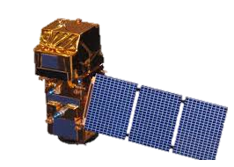
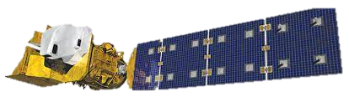
Prototype Objectives
Display interoperability between two
different data holdings using two
different architectures
Remove variability on the client side
by modeling consistent API calls hosted
by the vendor
Implement standardized processing
(NDVI) as part of the API offering
to show value to operational
workflows

Slide 5
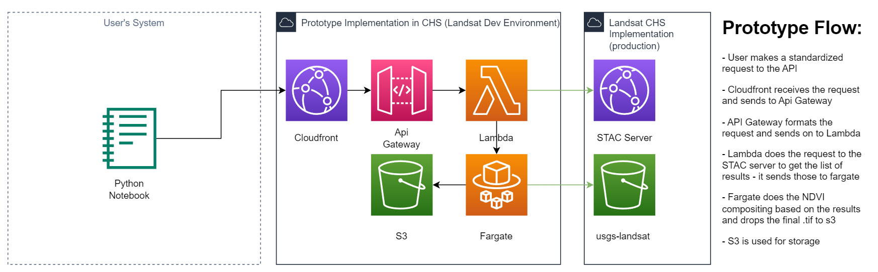
USGS Prototype Service

Slide 6
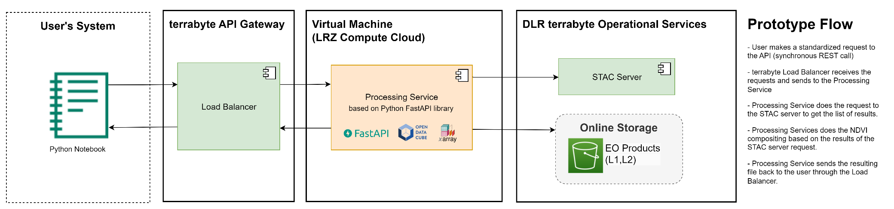
DLR Prototype Service

Slide 7
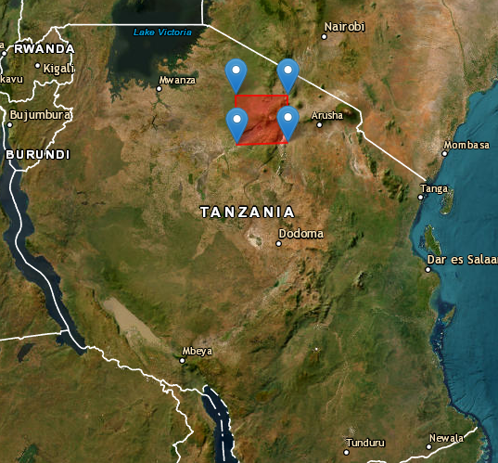
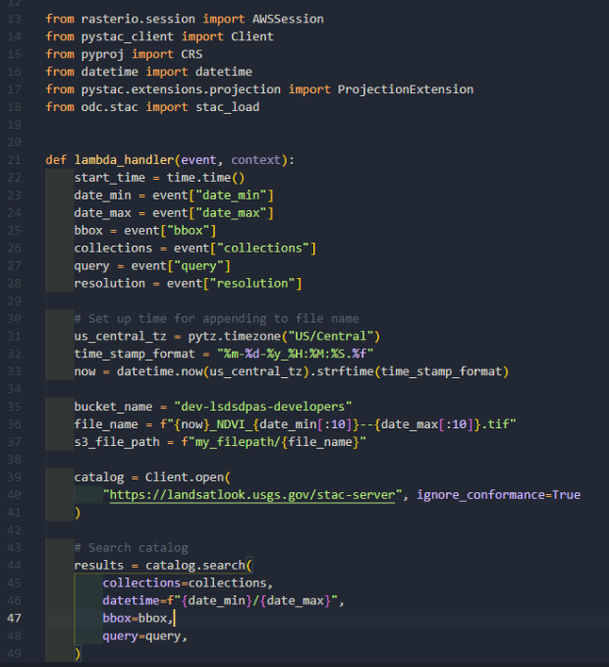
Service Flows Explained
Similarities
Data discovery using STAC API
Data processing using Open Data Cube and xarray/Dask
Differences
Cloud (AWS software stack) vs. on-premise (individual software stack)
Data accessibility: S3 object storage vs. locally available network storage
Provision of output data: S3 vs. HTTP download

Slide 8
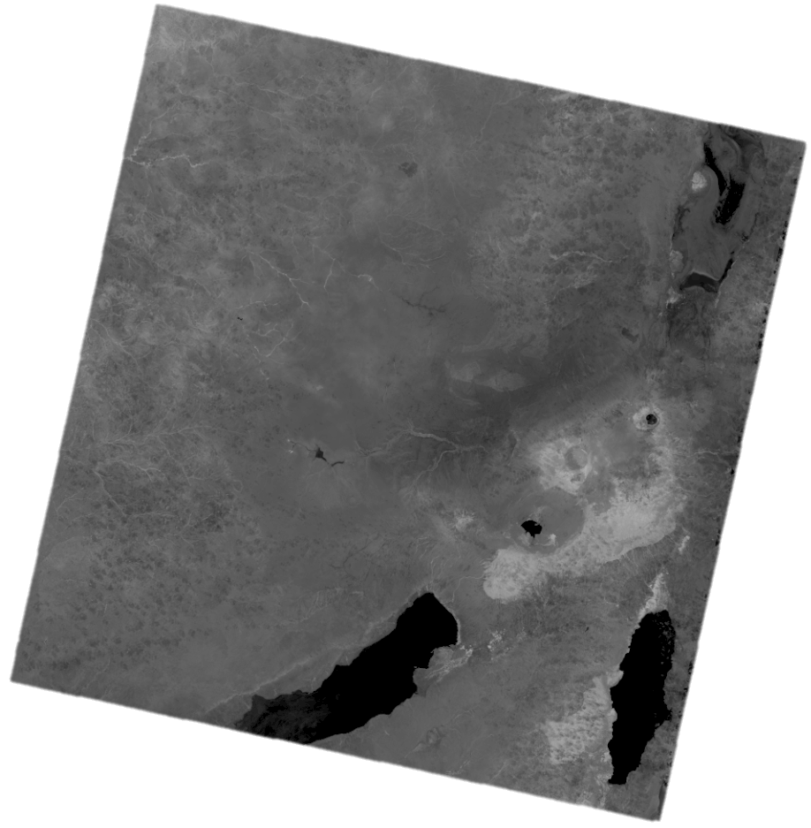
Pilot Conclusion
Pilot successfully shows that data supported by differing architectures can successfully be represented to the end-user in a transparent fashion through the use of middleware APIs
An area for future opportunity would be to focus efforts on standardizing services
offerings at a common tier in
order to allow for efficient data
movement and processing
capabilities
  Covered in GSCHA-04

Slide 9
Operational Modifications
Current pilot utilizes processing capabilities executed on the data provider end. Financially, this may not be sustainable due to variability in cost and demand
Suggest modifying the pilot to move the processing requirement over to the user’s environment while still maintaining consistent, interoperable data calls that are transparent to the end user
  API still runs near the data and allows for direct “read” vs “download”, but the cost for the infrastructure remains on the client side

Slide 10
Future Opportunities
GSCHA-04: DLR and USGS to jointly develop a recommended suite of API and cloud data services to CEOS WGISS
GSCHA-05: DLR and USGS to jointly explore unified access between DLR, USGS, and ESA archives and the Copernicus Data Space Ecosystem (CDSE).
GSCHA-06: DLR and USGS to jointly explore hi gh-performance "data share /transport" mechanisms (e.g., Globus) between each other's corresponding platforms.

Slide 11
Potential Operational Changes
Current flow utilizes the USGS/DLR environments for data processing
Suggested future modifications would be to move the processing over to the client side in order to more closely manage processing demand

