Slide 1
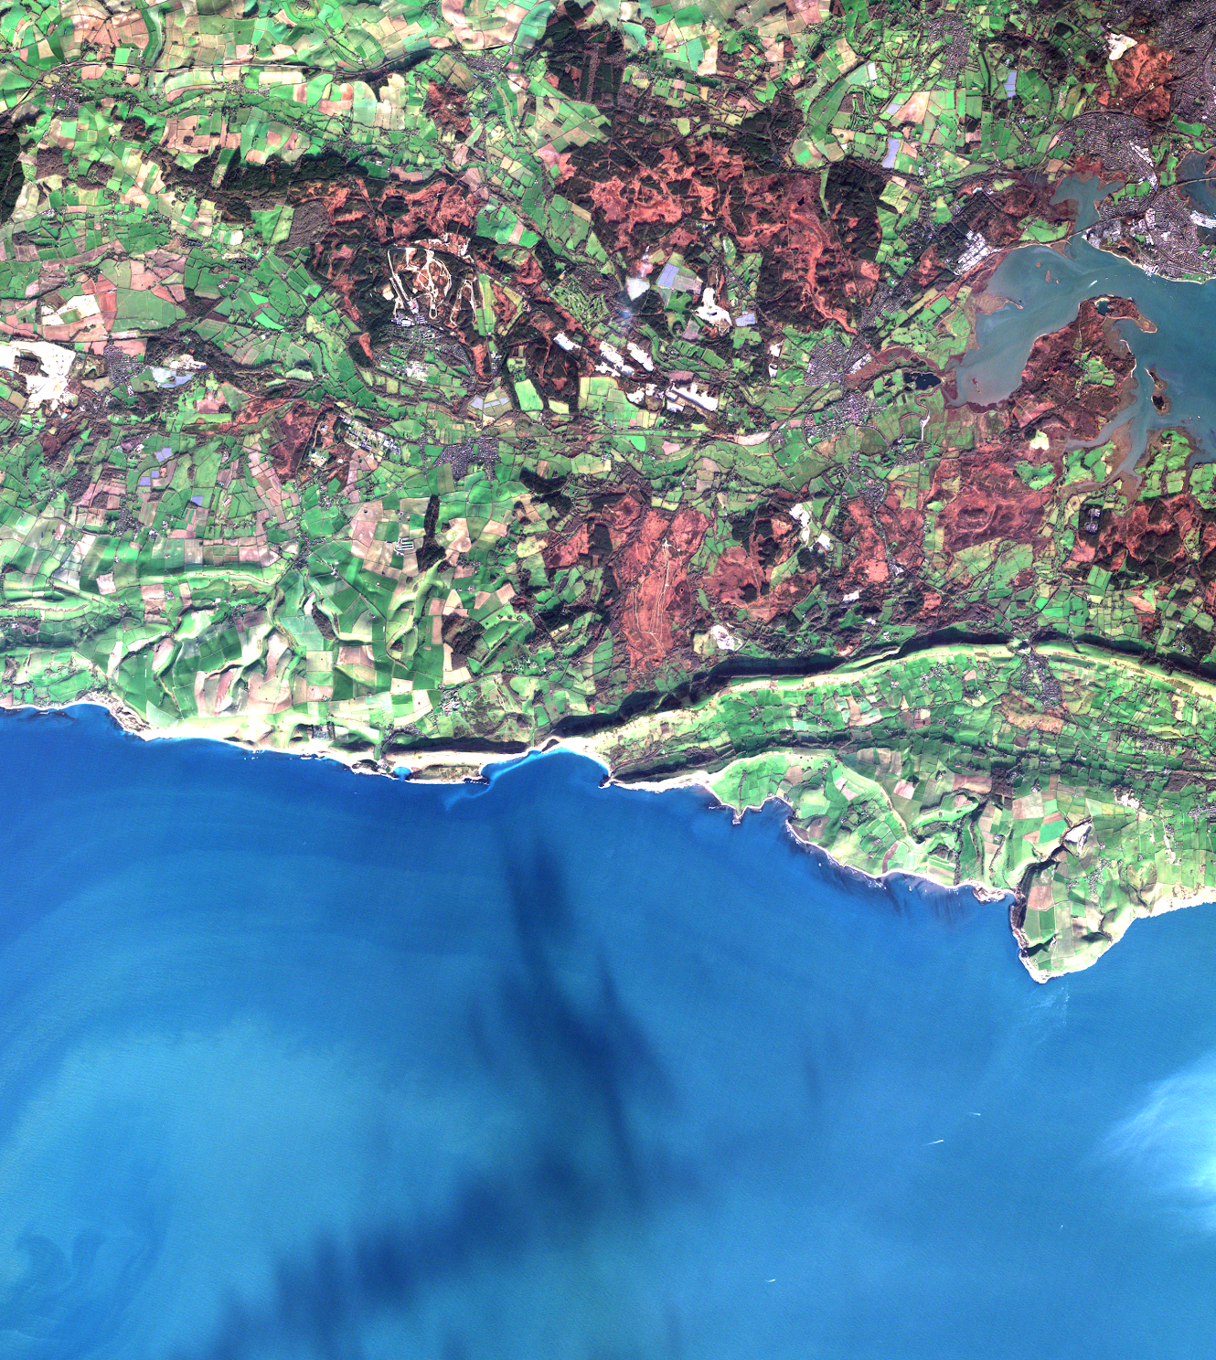
AVHRR level 0 data at CEDA
Ed Williamson
edward.williamson@stfc.ac.uk
Notes:
Datasets in catalogue: https://catalogue.ceda.ac.uk/?q=&sort_by=relevance&results_per_page=20
Number of files: https://elasticsearch.ceda.ac.uk/ceda-fbi/_count

Slide 2
Overview
Who CEDA are and what we do
Who provided us with the Level 0 data
Level 0 datasets we hold of interest

Slide 3
CEDA
23PB of Earth Observation and Atmospheric science data.
Hosted on JASMIN data intensive supercomputer.
Processing facilities next to the data (batch compute, notebooks, GPU cluster).
Long-term archive part of the NERC EDS.
Managed data: catalogued, backed up to tape to ensure data will be searchable and available for the future.
Data can be accessed in a number of different ways including http, ftp downloads and directly via JASMIN.

Slide 4
NEODAAS Dundee Satellite Receiving Station
Ground station and data archive based in Dundee, Scotland.
Running for 40 years.
Number of operational antennae.
Providing lots of different NRT datasets.
Funding from NERC stopped in 2019.
Closed in March 2019.

Slide 5
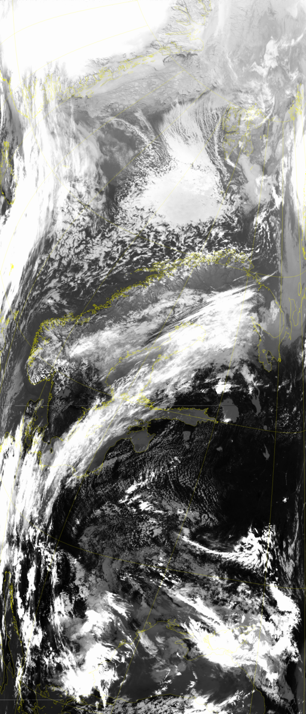
AVHRR archived at CEDA
Level 0 AVHRR data
November 1978 to December 2018.
In total 8.7TB
117,768 products all in HRPT .dat files
Corresponding txt file with metadata for each product
Open access to registered CEDA users.
Mainly covering Europe but some other data as well.
Checked integrity against data from Dundee.

Slide 6
CZCS data archived at CEDA
Level 0 CZCS data.
August 1979 to June 1986
88GB
2211 products all in HRPT .dat files
Corresponding txt metadata file.
Nimbus 7 (image credit: NASA)

Slide 7
SeaWiFS data archived at CEDA
Level 0 SeaWiFS data
September 1997 to December 2010
940GB
9891 products all in HRPT .dat files
Corresponding txt files with metadata.
SeaWiFS (image credit: NASA)

Slide 8
Any questions?
edward.williamson@stfc.ac.uk

