Slide 1
GHRSST R2HA2 WORKING GROUP: AVHRR HRPT RESCUE

Slide 2
Outline
The Rescue & Reprocessing of Historical AVHRR Archives (R2HA2) Working Group
AVHRR HRPT archives to be saved.
L1P – a consistent format for recovered AVHRR HRPT data.

Slide 3

SELECTED SHORTS

Slide 4
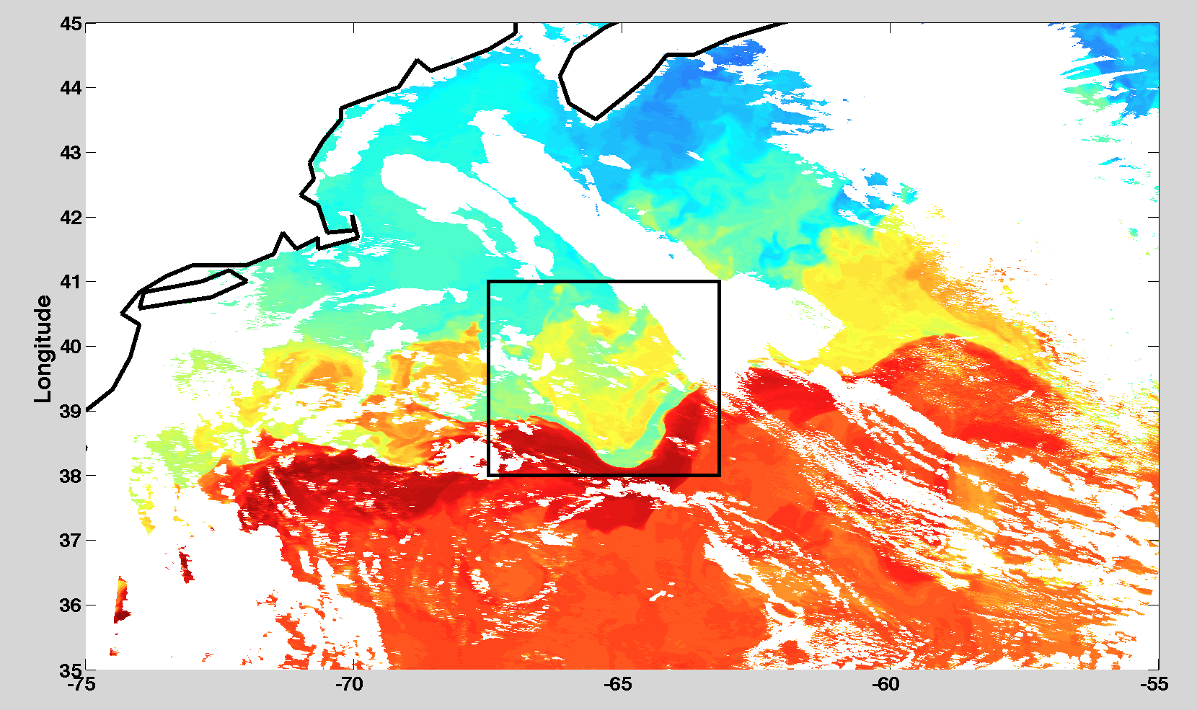
SELECTED SHORTS

Slide 5
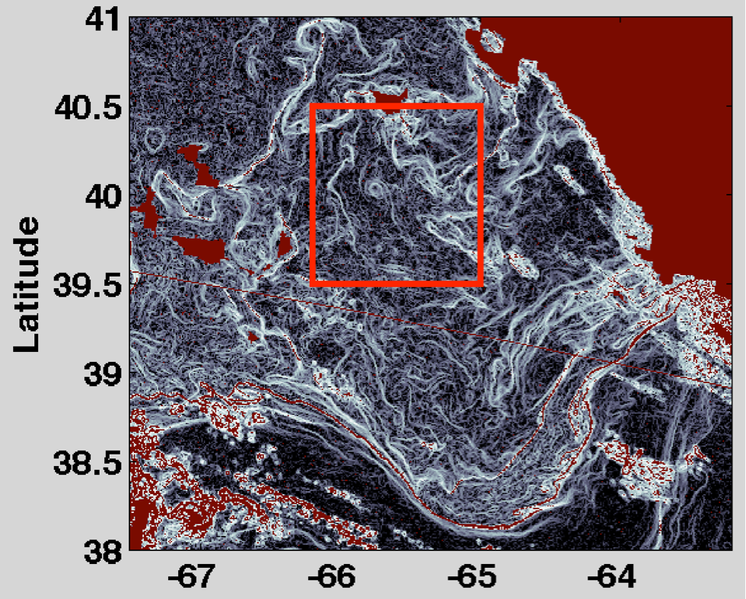
SELECTED SHORTS

Slide 6
SELECTED SHORTS

Slide 7
SELECTED SHORTS

Slide 8
SELECTED SHORTS

Slide 9
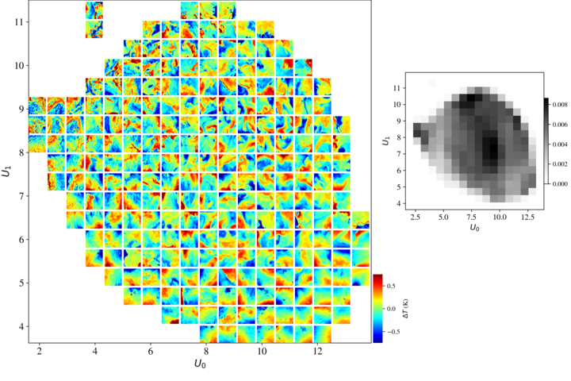
SELECTED SHORTS

Slide 10

THE MAIN ATTRACTION

Slide 11
Rescue & Reprocessing of Historical AVHRR Archives (R2HA2) Working Group
The R2HA2 was a GHRSST working group formed in 2011.
It remained active until about 2014.
Although, I’ve continued to pursue data rescue efforts.

Slide 12
Rescue & Reprocessing of Historical AVHRR Archives (R2HA2) Working Group
OBJECTIVES
  Identify historical archives (pre-2000) of AVHRR HRPT and LAC data
    Copy data from historical archives to a central place.
    Identify a central assembly center(s) CAC,
    Define if/how contributions are to be stitched together - to be done at the CAC
  Identify where the reprocessing is to be performed
    Determine how to do the navigation
    Define the SST algorithm to be used to reprocess.
  Define a format (L1P) in which the data are to be stored,
    Determine how to handle the navigation information.

Slide 13
AVHRR HRPT ARCHIVES:
RECEIVING STATIONS

Slide 14
AVHRR HRPT ARCHIVES
WESTERN NORTH PACIFIC: – U. TOKYO
Receiving station: University of Tokyo, Japan
Obtained from: Prof. Takagi, University of Tokyo, Japan
Current location of data: U. Rhode Island, USA - Unique
Format: ?, close to NOAA standard
Archive Content ~17,000 granules :
  N07 11/11/1983-01/11/1985 — 597 files — 28.37 GB
  N09 01/14/1985-11/08/1988 — 3,310 files — 143.04 GB
  N11 11/09/1988-09/22/1994
  N11 04/09/2000-04/10/2000 — 5,584 files — 224.46 GB
  N14 01/28/1995-5/31/2000 — 7,325 files — 342.26 GB

Slide 15
AVHRR HRPT ARCHIVES
EASTERN NORTH PACIFIC: – SEASPACE
Receiving station: California, USA
Obtained from: Prof. Strub, Oregon State University, USA
Current location of data: U. Rhode Island, USA – Unique (?)
Format: SEASPACE
Archive Content ~7,000 granules :
  N09 09/22/1994-03/23/1995 — 321 files — 8 GB
  N11 02/04/1992-09/14/1993 — 1,844 files — 50.96 GB
  N14 03/23/1995-11/11/2001 — 4,615 files — 139.28 GB
  N15 01/26/2000-12/31/2001 — 756 files — 25.64 GB

Slide 16
AVHRR HRPT ARCHIVES
EASTERN NORTH PACIFIC: – CLASS
Receiving station: Monterey, California, USA
Obtained from: CLASS, USA
Current location of data: U. Rhode Island, USA
Format: CLASS
Archive Content ~42,000 granules :
  N15 01/17/1999-07/24/2000 — 1,900 files — 66.35 GB
  04/03/2002-10/09/2002 — 621 files — 25.53 GB
  04/06/2007-04/08/2007 — 16 files — 0.61 GB
  02/11/2011-06/30/2015 — 3,913 files — 106.33 GB
  N16 04/09/2001-10/05/2005 — 5,526 files — 260.76 GB
  02/11/2011-06/06/2014 — 3,700 files — 178.08 GB
  N17 10/16/2002-04/10/2013 — 11,220 files — 450.59 GB
  N18 10/06/2005-06/30/2015 — 10,705 files — 522.82 GB
  N19 02/11/2011-06/30/2015 — 4,931 files — 239.37 GB

Slide 17
AVHRR HRPT ARCHIVES
WESTERN NORTH ATLANTIC: – UMIAMI
Receiving station: Wallops Island, VA, USA
Obtained from: UMiami, USA
Current location of data: U. Rhode Island, USA - Unique
Format: SCRIPPS
Archive Content ~22,000 granules :
  N07 07/09/1981-12/31/1984 — 3,188 files — 148.98 GB
  N09 01/01/1985-11/27/1988
  N09 09/03/1994-04/28/1995 — 3,827 files — 184.09 GB
  N11 11/01/1988-09/12/1994 — 7,057 files — 330.00 GB
  N14 01/18/1995-12/31/2000 — 7,331 files — 318.45 GB
  N15 06/12/1998-11/05/1998 — 419 files — 19.26 GB
  N16 01/01/2001-10/06/2001 — 345 files — 18.71 GB

Slide 18
AVHRR HRPT ARCHIVES
WESTERN NORTH ATLANTIC: – CLASS
Receiving station: Monterey, California, USA
Obtained from: CLASS, USA
Current location of data: U. Rhode Island, USA
Format: CLASS
Archive Content ~121,000 granules:
  N07 07/09/1981-11/24/1984 — 618 files — 27.45 GB
  N09 04/08/1985-11/07/1988 — 4,795 files — 206.62 GB
  N10 10/21/1986-09/16/1991 — 6,554 files — 264.07 GB
  N11 09/24/1988-03/10/1995 — 9,116 files — 359.04 GB
  N12 05/14/1991-10/10/2006 — 14,220 files — 637.49 GB
  N14 12/30/1994-10/10/2006 — 13,520 files — 604.21 GB
  N15 10/26/1998-06/30/2015 — 21,446 files — 997.14 GB
  N16 09/21/2000-06/04/2014 — 15,737 files — 677.85 GB
  …

Slide 19
AVHRR HRPT ARCHIVES
WESTERN NORTH ATLANTIC: SPATIAL COVERAGE

Slide 20
AVHRR HRPT ARCHIVES
CENTRAL NORTH PACIFIC: SEASPACE
Receiving station: U. Hawaii, Hawaii, USA
Not yet obtained: Prof. Flament, U. Hawaii, USA
Current location of data: U. Hawaii, USA
Format: SEASPACE
Archive Content ~10,000 granules, 1990-1999:
  N07 02/071998-27/12/1999
  N09 14/11/1994-28/2/1995
  N11 28/11/1991-14/11/1994
  N12 19/10/1991-27/12/1999
  N14 05/01/1995-27/12/1999

Slide 21
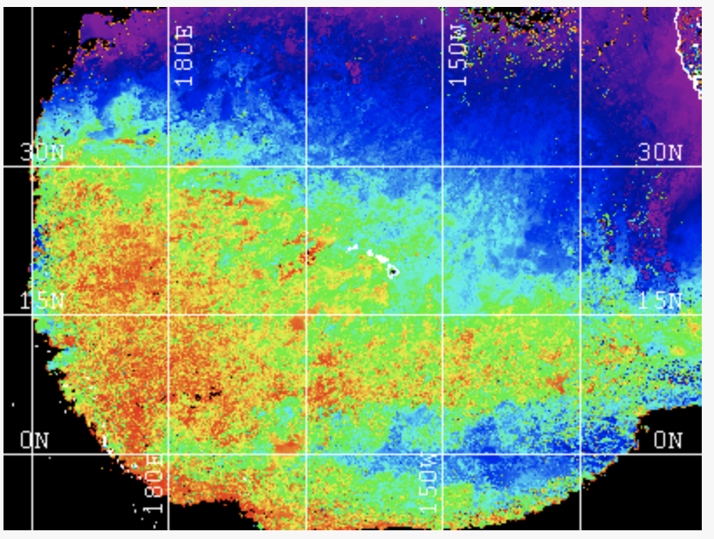
AVHRR HRPT ARCHIVES
CENTRAL NORTH PACIFIC : SPATIAL COVERAGE

Slide 22
AVHRR HRPT ARCHIVES:
RECEIVING STATIONS

Slide 23
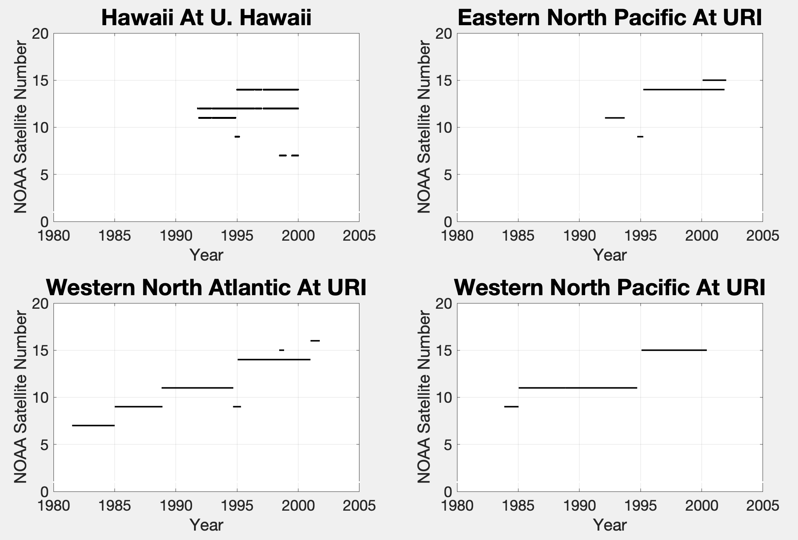
AVHRR HRPT ARCHIVES
CENTRAL NORTH PACIFIC TEMPORAL OVERAGE

Slide 24
AVHRR HRPT ARCHIVES
EASTERN SOUTH ATLANTIC: PERU
Receiving station: U. Hawaii, Hawaii, USA (5ºN-30ºS, 68º-90ºW)
Obtained from: Luis Escudero Herrera, Instituto del Mar del Perú
Current location of data: U. Rhode Island, USA
Format: ? NOAA
Archive Content ~5,500 granules, 1998-2007:
  1998 02/09/1998-12/31/1998 — 270 files — 8.86 GB
  1999 01/01/1999-12/31/1999 — 1,157 files — 32.03 GB
  2000 01/05/2000-12/31/2000 — 955 files — 28.26 GB
  2003 10/02/2003-12/31/2003 — 226 files — 16.36 GB
  2004 01/01/2004-12/15/2004 — 865 files — 61.62 GB
  2005 01/19/2005-12/31/2005 — 1,300 files — 87 GB
  2006 01/01/2006-02/20/2006 — 300 files — 22.95 GB
  2007 01/01/2007-07/17/2007 — 713 files — 46.76 GB

Slide 25
AVHRR HRPT ARCHIVES
AGULHAS RETROFLECTION: SOUTH AFRICA
Receiving station: South Africa
Not yet obtained: Cristo Whittle
Current location of data: U. Rhode Island, USA
Format: ? NOAA
Archive Content ~7,130 granules, 392.41 GB

Slide 26
GHRSST LEVEL 1P FORMAT
R2HA2 began work on an L1P format for acquired granules.
L1P fields fall in three classes:
  Basic telemetry fields. All of will be captured
  Fields added by the data provider; e.g.,
    Calibration information.
    Latitude, longitude fields.
  Fields added to the L1a or L1b data stream; e.g.,
    Year - this information is not in the telemetry stream.
    Spacecraft ID - IDs recycled. We will add a unique GHRSST spacecraft ID.
    Navy high precision ephemerides.
    Clock corrections.

Slide 27


