Slide 1
WGISS-56 ESRIN Archive Evolution

Slide 2
Executive summary
The ESA EO Space Data Preservation System provides archiving, preservation and retrieval of ESA and Third-Party Missions EO data records and associated information.
The main challenge of the archive is the sheer volume of data, the copious number of files, the diversity of formats and the yearly increase of data produced.
The archive is constantly enhanced to facilitate the archival process by using technological innovation and practices. To save energy, thus making the archive and its hardware environmentally friendly, green computing technologies are favorable.
This presentation describes the functionalities and the architecture of the archive, the data archived, the different challenges driving its evolution and the planned future upgrades that will ease archiving operations.
A snapshot of the workshop held in ESA/ESRIN in March is also included presenting similar challenges faced daily by different Archives and agencies involved in similar operations.

Slide 3
ESA EO Archives
Dedicated Sentinels LTA using different technology:
Cloud
Disk
Tape
Optical medium
ESA EO Archive, two archives, two copies of the data each:
Master Archive (DAMPS – External Service)
Space Data Preservation Archive (ESA/ESRIN, Cold Back-up)
Dissemination to users through Cloud based dissemination services
ESA EO Missions
Third-party Missions
Reprocessing
Campaigns
Sentinels (Copernicus programme)
ESA EO Archives
France (DAMPS)
Luxemburg (DAMPS)
ITALY (CBA, ESA Premises)
Copernicus Programme LTA
France
Poland
Italy
Germany

Slide 4
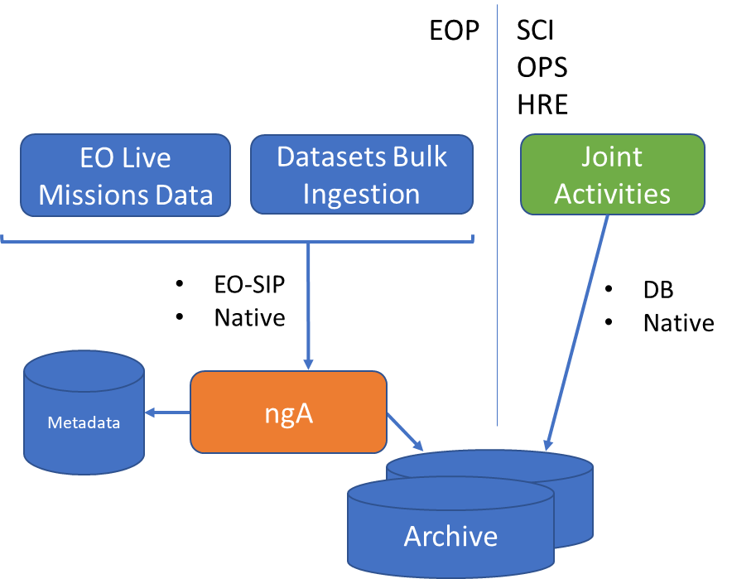
Space Data Preservation Archive
The Space Data Preservation Archive is a data archive deployed at ESA/ESRIN premises to allow seamless archiving and extraction of data. The archive is the front-end of the following long term archiving services:
Second copy of the Master Archive
Long Term Archive of ESA EO Datasets not part of the “Master” suite (e.g. Unconsolidated data, flagged data)
Unique RAW data
Direct Connection to Missions Ground Segment
Direct ingestion of ESA and Third-Party Live Missions
Disaster Recovery of data from other ESA directorates (ESA-SCI, ESA-HRE, ESA-OPS) using a specific Front-end Circulator
The archive is operative 24/7 and receives automatically Live data acquired by ESA and Third Party Live EO Missions

Slide 5
Archive Infrastructure
Main Library capable of storing 36 PB of uncompressed near-line data
Incoming data written on fast SSD physical storage
Data eventually written on Magnetic Tapes
Files seen by clients on a virtual file-system
Data duplicated over a disaster recovery Robotic Library

Slide 6
What do we archive
A vast variety of data:
Native format
Auxiliary data
Documentation
Binary files
However, the favorite format is the EO-SIP, a ZIP archive that includes some additional data:
When received it’s not just copied but metadata is extracted
Different workflow applies
Data is ingested automatically
Half of the archive is EO-SIP, more data will be produced in EO-SIP in the future
We mostly archive, we rarely extract data, data is written once, read rarely (worr ?).

Slide 7
Archive requirements
Seamless archiving of ESA EO Live Missions (24/7)
Quick bulk ingestion of reprocessing campaigns
Data can be near-line or off-line
Data is only bulk extracted
No access to users
Power efficient solution to be favorite
Data duplication
Archive capable of handling increase of data produced (5PB increase confirmed in 2024)

Slide 8
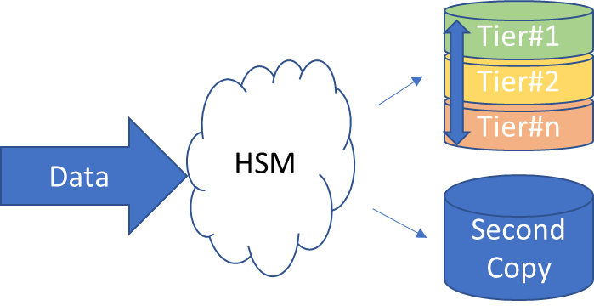
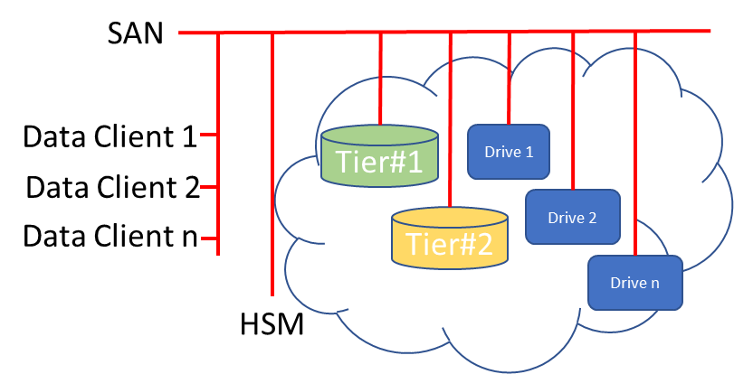
Hierarchical storage management
The archive front-end is a Hierarchical storage management (Oracle HSM) system with data moved into storage tiers depending on user defined rules. In our case, final tier is always tapes of the two Robotic Libraries. With the data always ending onto tapes, the archive has no actual size limitation.
The tiers are seen by data clients as a single logical archive location and can be accessed using classical network protocols (NFS, Samba) or using a specific ORACLE client where metadata is mounted over network but any Read and Write operations are routed through 16gbp/s fibre optic.
To do so, the client needs to be in the same Storage Area Network of the HSM and the Robotic Library drives.
Clients therefore can list and read the data no matter what tier it is, in the background, the HSM moves the data across the tiers accordingly.
Notes:
May be skipped

Slide 9
Archive figures
Mission | Uncons. | Cons. | Native | EO-SIP | LIVE
ERS-1/2 | X | X | X | X
Envisat | X | X | X | X
Cryosat-2 | X | X | X | X | X
SMOS | X | X | X |  | X
SWARM | X |  | X |  | X
AEOLUS |  |  |  | X | X
Goce | X | X | X | X
Oceansat | X |  | X | X | X
Adeos | X |  | X
ALOS | X | X | X | X | X
GOSAT | X |  | X |  | X
Ikonos-2 | X |  | X | X
IRS-P3 | X | X | X | X
JERS-1 | X | X | X | X
Kompsat-1 | X |  | X
Landsat-1,8 | X | X | X | X | X
MOS-1,1b | X | X | X
Nimbus | X |  | X
NOAA-7,19 | X | X | X | X
ODIN | X |  | X |  | X
PROBA-1 | X |  | X |  | X
QuickSCAT | X |  | X
Rapideye | X |  | X
Scisat | X |  | X |  | X
Seasat | X | X | X | X
SeaStar | X |  | X
SPOT1-2 | X | X | X | X
TerraSAR | X |  | X
WorldView-1,3 | X |  | X | X
Windsat | X |  | X
EO Data Volume (Oct 2023) 18 Petabyte | Number of Files (Oct 2023) 1,230,000,000
Average EO data ingested/day: 13 TB
Peak EO data read/day: 20 TB
Future ESA EO mission will increase daily data received considerably.

Slide 10
Main challenges observed
Lots of I/O affects performances due to the iNodes being constantly updated
Performances are still scarce for small files even with iNodes on separate partition/RAID – long term solution required
Media failures recovery takes time and uses resources (drives, storage)
Lots of false media failures alarms (caused by Network or robots)
Current Archive manager forces us being vendor (and OS) locked
Support tickets requires lots of data collection even for obvious failures
Support tickets often result in requests to update firmware
Firmware updates are complicated and time consuming

Slide 11
Main challenges observed (2)
Archive manager migration complicated, time consuming
Longevity of technology has side-effects (maintenance costs, obsolescence of HW)
Tape prices are not predictable. T10K tapes prices doubled when ORACLE declared the end of life of the tape family. LTO-8 tape shortage in mid 2019 due to patent infringement battle meant LTO-8 tapes where unavailable for a long period of time
With the end of some tape families and HSM archive managers, it is feared that the main vendors are moving away from tape archive solutions
We are ready for lots of data, less ready for billions of files
Extracting data from tapes is slow and complicated

Slide 12
Scarce performances for small files
Due to lots of I/O necessary to update iNodes, performances when archiving small files are scarce. The archive has been updated to cope with such limitation and the iNodes have a dedicated partition on two SSD disks in RAID1.
Performances are still scarce and were recently challenged by the bulk ingestion of ESAC Scientific Archive where we were not expecting such a copious amount of files.
The Archive has ~17 PB of data for a total of 220 Millions of files. Only the first three NAS received contained ~200 TB but over 1 Billion of files.
Consequences of such high number of files have been assessed:
Degraded file listing/queries
iNodes are reaching 500 GB of size
Increased time to dump/backup the iNodes
Huge time required to copy the data from NAS into Archive:
300,000 files per day per NAS devices
Maximum of 2 NAS copied in parallel so far
4 NAS in parallel may impact archiving operations requiring more than one drive dedicated to the activity
~4 years to complete the activity and copy the data into the current archive with 2 NAS in parallel

Slide 13
Small file dataset workaround
Solutions have been identified to cope with the iNodes and query issues:
Increase of metadata allocation volume
Creation of a dedicated virtual file-system for the data (queries of EO data and SCI data separated)
Possible solutions to cope with huge time to copy the data are being addressed (long term solution)
Different Archive technology
Dedicated Disk Based archive
Workaround to cope with huge time to copy the data are being addressed:
NAS devices will not be recycled
HDD of NAS devices will be cloned (dd command), the whole NAS will therefore be cloned into an identical one with faster time than the current copy into archive
EO
SCI
Notes:
May be skipped

Slide 14
Media failures
The Main Robotic Library has 8 drives:
5x STK T10000D drives
5x LTO-8 drives
1 LTO drive is dedicated to Live data archival
1 LTO drive is dedicated to bulk ingestion of reprocessing campaigns
1 LTO drive is used according to extraction and/or additional live or bulk ingestion workload
When a tape is declared faulty, data archived onto the tape needs to be read and copied onto a new tape. This requires time, is not achievable automatically, uses two drives (one reading, one archiving).
Often, tapes are declared faulty due to external factors and not strictly doe to tape failures, this is not obvious and often not known.

Slide 15
Avoid vendor locked solutions
The current HSM used in the archive, requires some software pre-requisites:
Archive manager running on Solaris on SUN Storagetek server
Automated Cartridge System Library Software running on SUN Storagetek server
QFS module used by data clients running on Redhat based linux version 6.8 (dated 2017)
NFS is used as a workaround meaning that the common 10G Network is used instead of the dedicated 16GBp/s fibre optic
Alternative Archive managers are either not compatible with iNodes (tape needs to be read from tapes) or have got “complicated” pricing schemes
Is ingesting iNodes comparable to ingesting data ? This is a key factor when choosing the HSM that will replace ORACLE HSM

Slide 16
Longevity vs obsolescence
The Oracle StorageTek SL8500 is an enterprise-class robotic tape library released in 2017. To this date the HW is still being sold by ORACLE and its end-of-file has not been reached nor declared.
Even if the Library has been updated over the last decade, most of the HW is dated and requires regular support.
Requesting support became somehow complicated over the years, sometime time consuming even for apparent obvious failures:
Drive firmware updated no longer under support responsibility
Specific Vendor Monitoring tools are often required to gather logs
“Did you turn it off and on again” approach with firmware upgrade required before even assessing the issue
Logs/dumps are often complicated to gather
It often takes more than 4 days to have a field engineer dispatched for faulty part replacement
Firmware updates and replacement drives with recent firmware means that all other drive needs to be updated to keep drives coherent

Slide 17
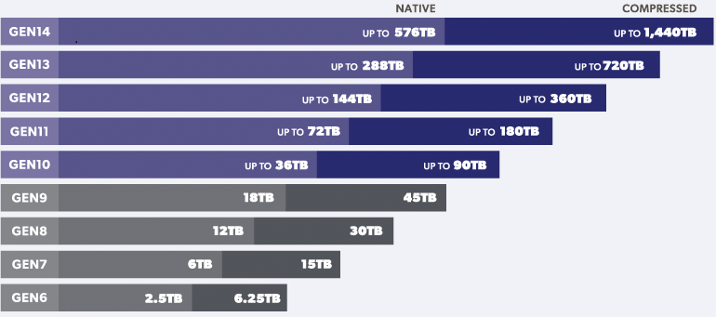
Advantages of Archive
Easy to expand
Power efficient
Tapes became cheap
Tapes evolution are on par with disk evolution
Malicious encryption and/or deletion of data is just not possible

Slide 18
Archive Upgrade
To keep up with the always growing amount and variety of data produced, the archive is constantly enhanced to facilitate the archival process.
Over the course of the last 15 years, several HW upgrade have been performed to the core of the Archive, the Robotic Library.
Future upgrades shall consider technological innovation and practices and. to save energy, thus making the archive and its hardware environmentally friendly, green computing technologies shall be favorite.
The industry has been engaged to help us drawing a roadmap and reach several goal including:
Better ingestion and extraction performances
Wider the audience using the archive
Decrease the power consumption of the whole environment
Use of innovative technology and archiving trends
2014
Archive Kick-off
Migrated technology from T10KB to T10KD
Increased number of drives
Implemented 10GB Network
Upgraded fiber channels environment from 8gbp/s to 16gbp/s
Upgraded 1rst tier from mechanical HDD to SSD Disks
Optimized 1st tier – dedicated LUN for iNodes
Implemented Disaster Recovery
Introduction of 2nd tier
Migration to LTO-8 (increased number of drive to 12)
Increased number of LTO-8 to 5
2015
2016
2017
2018
2019
2020
2021
2022
2023

Slide 19
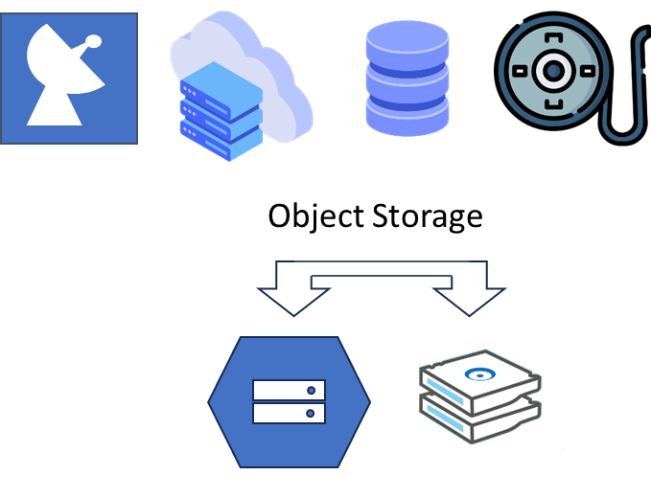
System re-design (Work in Progress)
We want to keep being power efficient
We want to be resilient to cyber attacks
We want to grow our archives without having degradation of performances
Affordable solution
A first system re-design will use Object Storage manager on-prem with a copy of the data onto tapes (same HW ?)

Slide 20
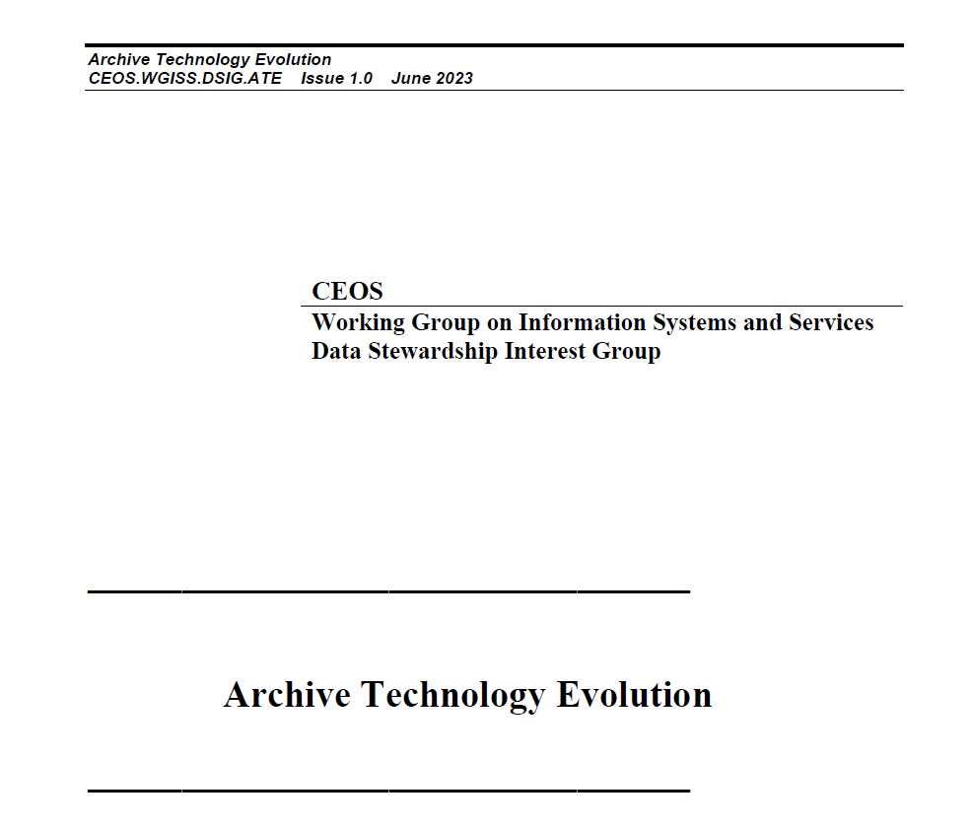
Conclusion
After analyzing the market, the current situation of the Archive and the reference guidelines the best solution for updating the Archive is a hybrid cloud model, which integrates the current tape storage infrastructure with a flexible model that facilitates access and improves its online capabilities.
The current Tape Library work-life has been considered sufficient to cover the needs of the coming years and therefore, the recommendation is to continue using it for some years now. The archive manager shall be replaced by any of the identified alternatives or by an integration into cloud services or by a hybrid solution.
One understated advantage of continuing to use tape-based archives is the always increasing security concerns. Malicious encryption or deletion of the data is not possible or highly complicated. Moreover, to reduce energy consumption and carbon emissions using tape storage instead of hard disk is an effective solution.
The result of this study have been used as input of the Archive Technologies Evolution White Paper
(https://ceos.org/document_management/Working_Groups/WGISS/Interest_Groups/Data_Stewardship/White_Papers/Archive%20Technology%20Evolution%20White%20Paper.pdf)
Upcoming Technology for the Long-Term Digital Preservation Workshop in ESA – November 2023.
The result of the workshop will be presented at WGISS#57 meeting.

