Slide 1
ISO16363 AND CORETRUSTSEAL STANDARDS
SELF-ASSESSMENT at ESA

Slide 2
Executive Summary
The presentation is focused on the ISO16363 and CoreTrustSeal standards;
An Initial Self-Assessment (ISA) has been performed for the ESA Space Data Preservation Archive at ESRIN (Frascati) versus both standards as preliminary step towards potential future certification;
A final internal report was produced with:
  Details on the components measured;
  Results of the measurements to verify the compliance of the ESA Archive;
  Steps to be performed to reach the final compliance to these standards.

Slide 3

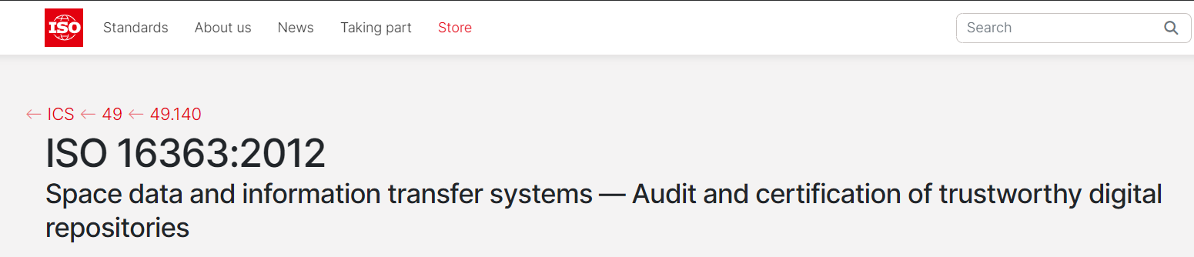
Scope

Slide 4
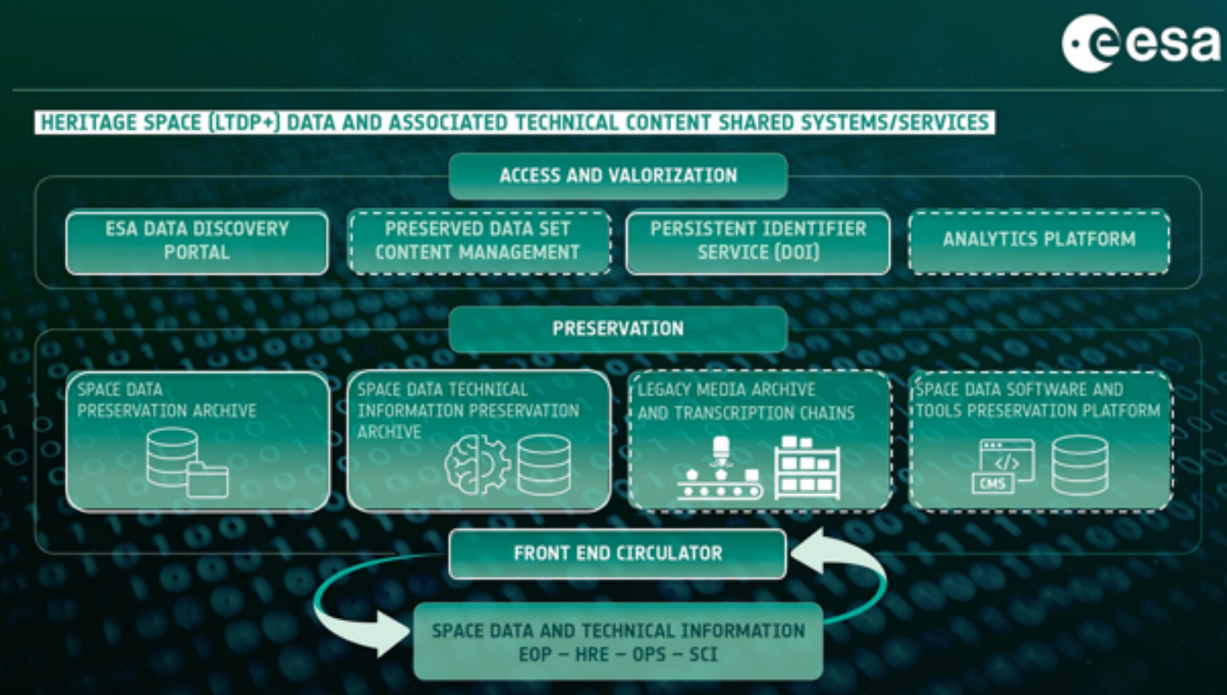
Context
CoreTrustSeal / ISO16363

Slide 5
CoreTrustSeal
CoreTrustSeal is the certification organisation launched by the World Data System of the International Science Council (WDS) and the Data Seal of Approval (DSA). CoreTrustSeal offers to any interested data repository a core level certification based on the DSA–WDS Core Trustworthy Data Repositories Requirements catalogue and procedures.
This requirements catalogue is the result of the joint effort between DSA and WDS under the umbrella of the Research Data Alliance to merge their data repositories certifications. The requirements reflect the core characteristics of trustworthy data repositories.
CoreTrustSeal is an international, community based, non-governmental, and non-profit organisation committed in promoting sustainable and trustworthy data infrastructures and in offering certification tools and services.
The CoreTrustSeal certification can be considered as the first step in a global framework for repository certification which includes the extended level certification (Nestor-Seal DIN 31644) and the formal level certification (ISO 16363).
List of CoreTrustSeal Requirements

Slide 6
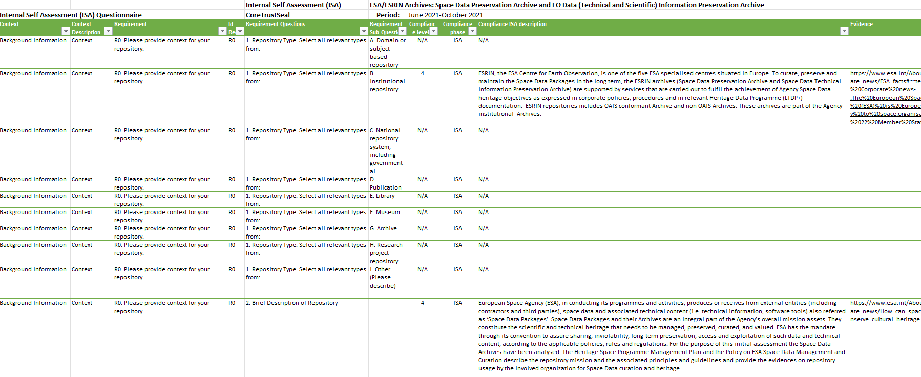
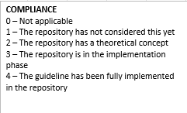
CoreTrustSeal - ISA

Slide 7
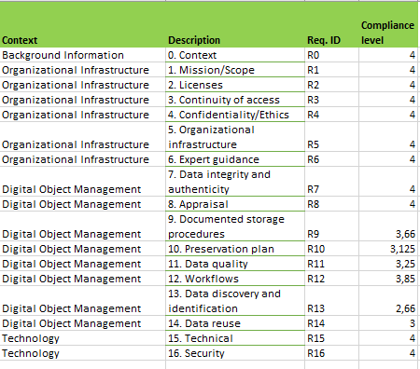
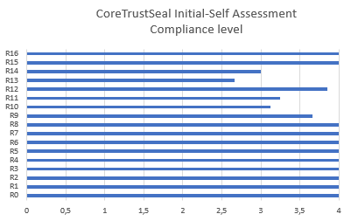
CoreTrustSeal – ISA Outcomes

Slide 8
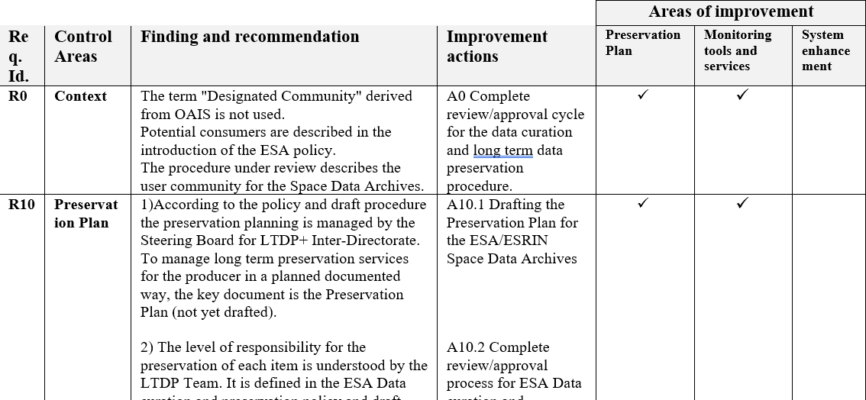
CoreTrustSeal – ISA Final Report

Slide 9
CoreTrustSeal – Improvement Actions
Complete review/approval cycle for the data curation and long term data preservation procedure;
Drafting the Preservation Plan for the ESA/ESRIN Space Data Archives;
Address migration for obsolescence in the Preservation Plan;
Citations management.

Slide 10
ISO16363
ISO 16363:2012 defines a recommended practice for assessing the trustworthiness of digital repositories and organisations. It is applicable to the entire range of digital repositories.
List of ISO 16363 Control Areas

Slide 11
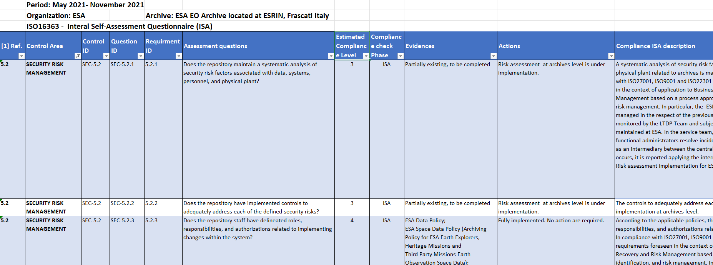
ISO16363 - ISA

Slide 12
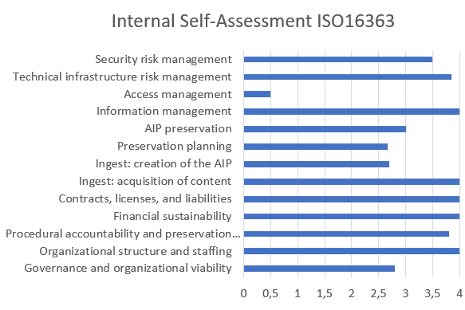
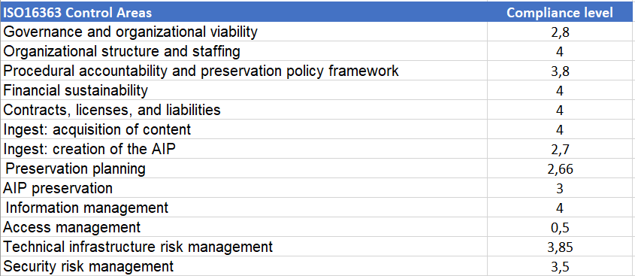
ISO16363 – ISA Outcomes
It is not a real issue because the Space Data Preservation Archive is not opened to the external users

Slide 13
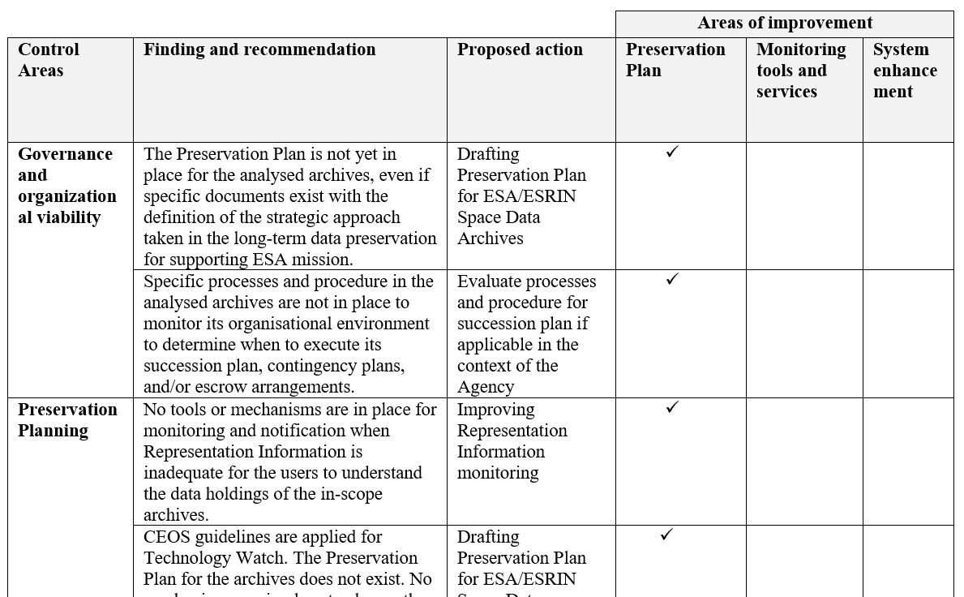
ISO16363 – ISA Final Report

Slide 14
ISO16363 – Improvement Actions
Drafting Preservation Plan for ESA/ESRIN Space Data Preservation Archives and the procedure for the Preservation Plan change management;
Improving AIP definition and system functional capabilities;
Documenting SIP discarding;
Access traceability integration.

Slide 15
Conclusion
ESA performed the Initial Self-Assessment for CoreTrustSeal and ISO16363;
In order of and complexity CoreTrustSeat should be reached first and then ISO16363;
ESA Space Data Preservation Archive is close to be fully compliant with both standards and only few tasks need to be implemented to reach full compliance;
Next steps: resources and tasks assessment and definition to reach full compliance;
Formal certification process (TBC).

Slide 16


