Slide 1
Discover and Explore Heritage Data

Slide 2
Agenda
Introduction
VtWeb framework and HEDAVI
Heritage data
Third party missions
Copernicus data
HEDAVI Explorer
Presentation
POF-ML
HEDAVI Discover
Synthesis mode
Stories

Slide 3
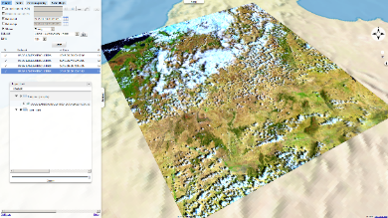
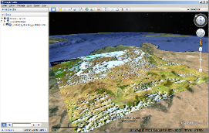
VtWeb platform and HEDAVI
meteo., climate
VisioTerra
collections
Landsat, ASTER…
www.visioterra.fr/?VtWeb
global / free data
data retrieval / data mining
satellites / meteo / Geol. / hydro./ alti./ LULC / populations…
Near Real-Time access
automated processing
collaborative infrastructure(s)
2D webmapping / 3D virtual globe
on user’s area of interest
archives to analyse changes
value-added geoservices, recurring monitoring, alarms…
Copernicus services
NASA
MODIS
NOAA oceano.
maps
Sentinels,
Envisat, ERS…
• • •
GeoTIFF, WMTS
→ G.I.S.
KML KMZ
3

Slide 4
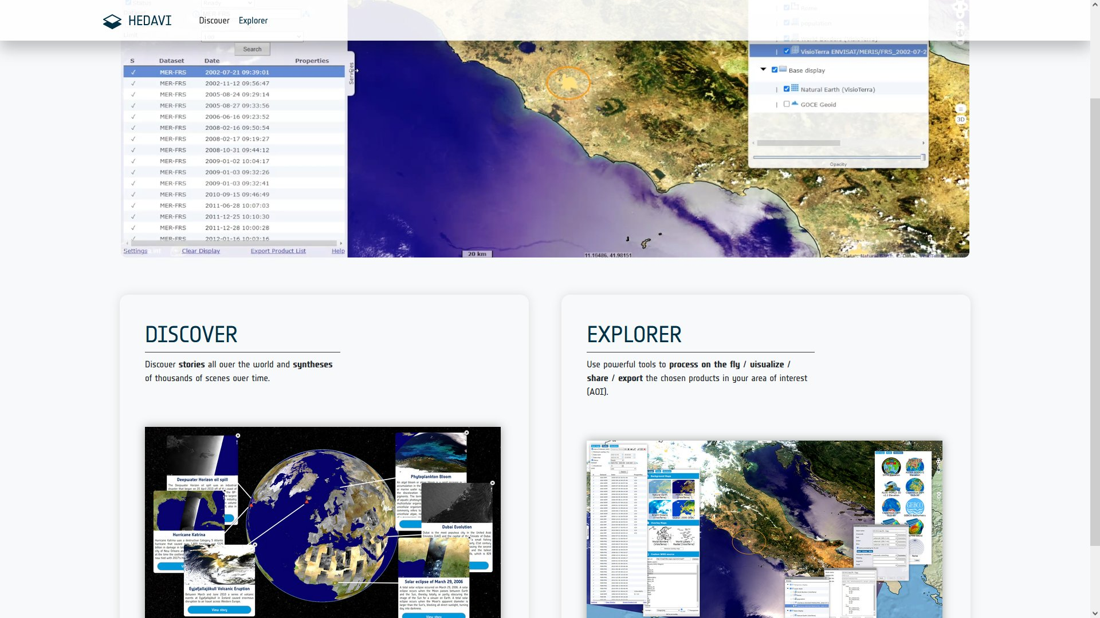
VtWeb platform and HEDAVI
hedavi.esa.int
Based on the VtWeb framework
Explorer and Discover
ESA Heritage data
ESA Third party missions data
Copernicus data

Slide 5
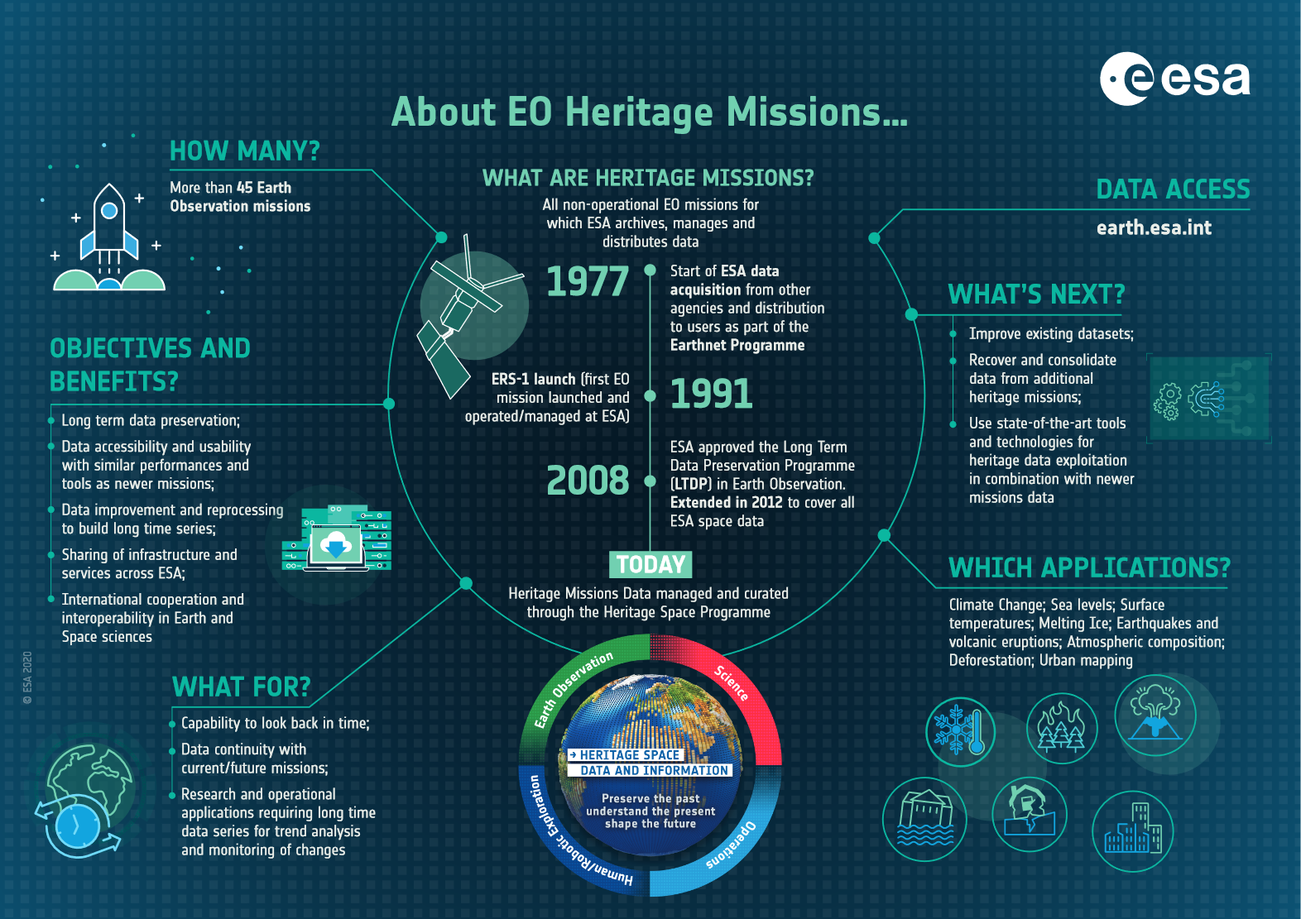
Heritage data
ERS (1991 > 2011)
SAR
IMM 349 803 products
IMP 2 371 719 products
ENVISAT (2003 > 2012)
ASAR
APM 23 889 products
APP 125 809 products
IMM 115 868 products
IMP 874 662 products
WSM 199 277 products
MERIS
FRS 88 322 products
RR 49 476 products

Slide 6
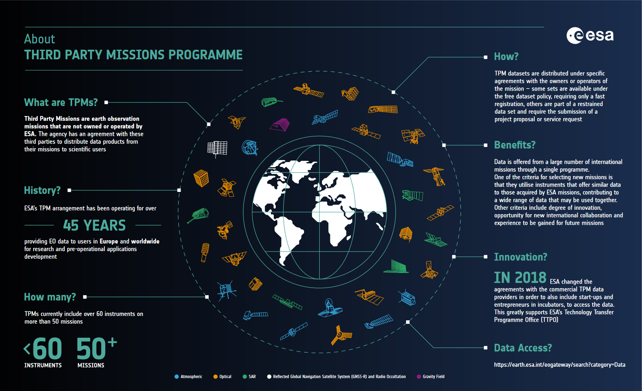
Third party missions
ALOS (2008 > 2011)
AVNIR-2/L1C 401 015 products
PALSAR
FBD 226 484 products
FBS 305 885 products
PLR 93 533 products
WB1 76 665 products
LANDSAT-5 (1984 > 2011)
TM 776 423 products
LANDSAT-7 (1999 > 2003)
ETM 89 521 products

Slide 7
Copernicus data
Sentinel-1A/B (2014 > now)
CSAR EW / IW / SM
Sentinel-3A/B (2016 > now)
OLCI FR / RR
SLSTR RBT
COP-DEM
GLO-30
GLO-90

Slide 8
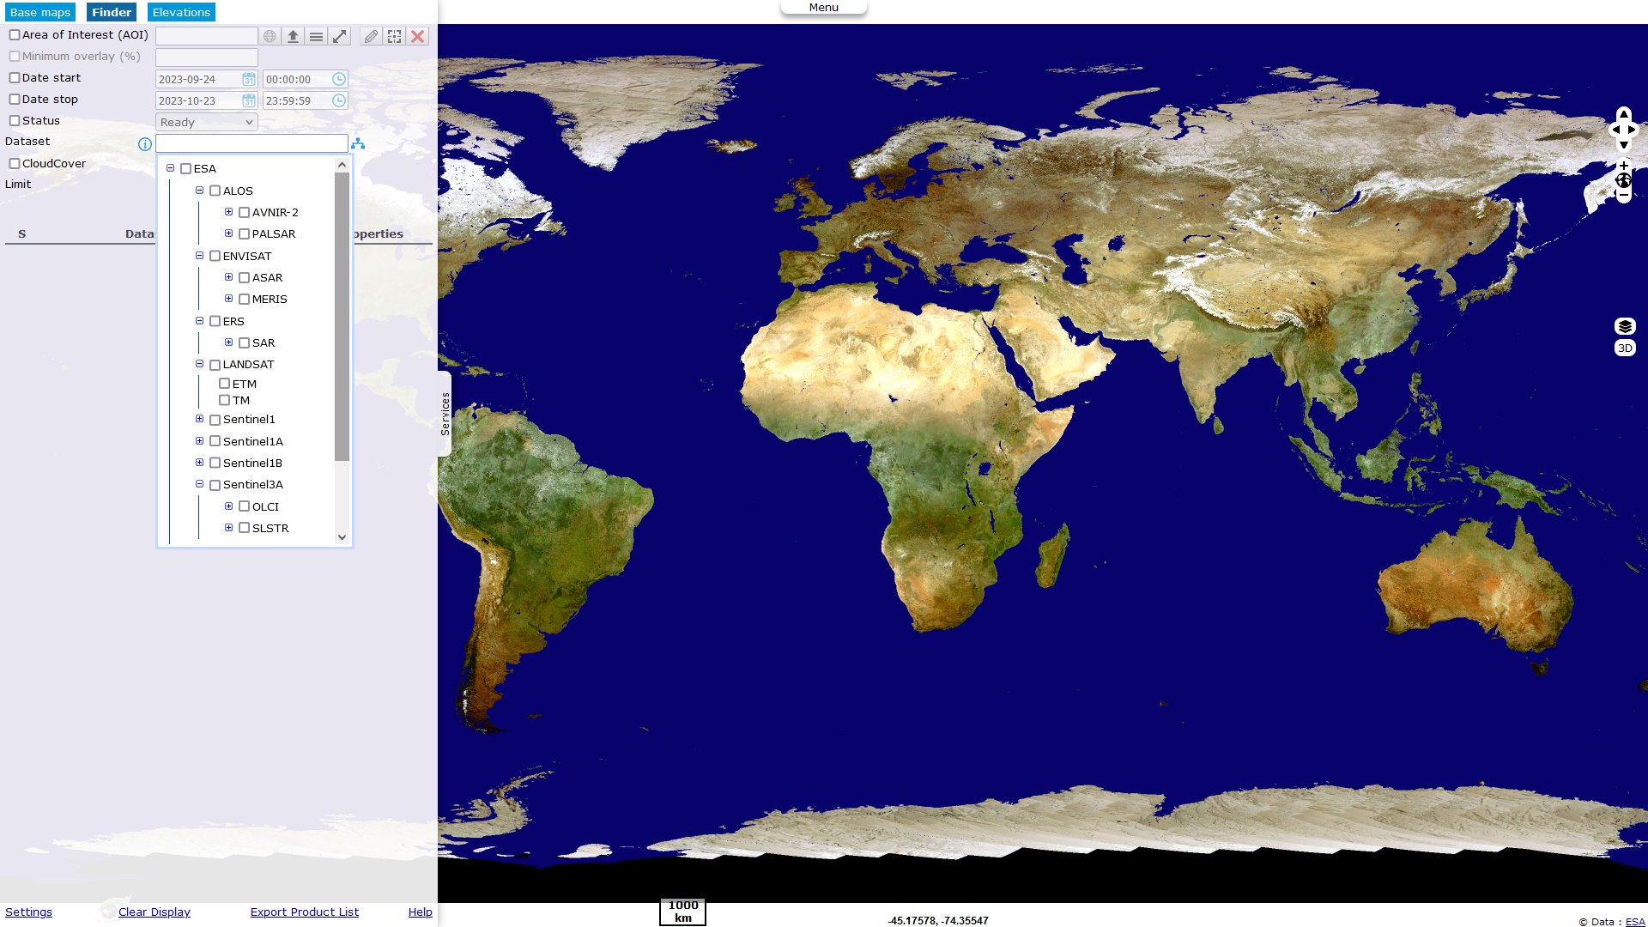
HEDAVI - Explorer
hedavi.esa.int/explorer/
Catalogue
2D/3D display area
Base maps
Elevations
Export GeoTIFF,PNG,JPG
Export KML,KMZ
Export WMTS,WCS
Processing On-the-Fly

Slide 9
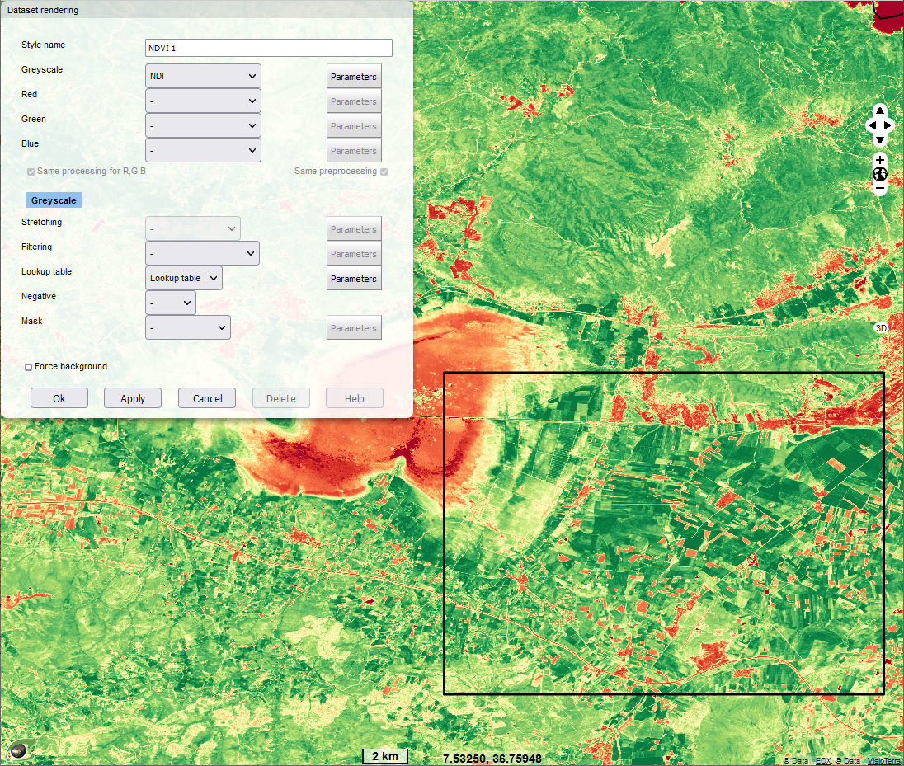
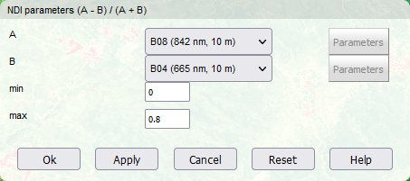
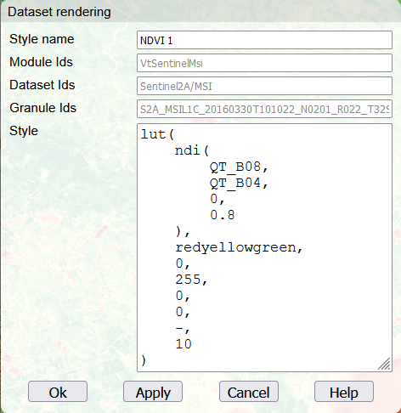
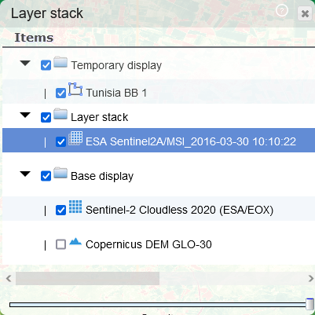
HEDAVI - Explorer
Hyperlook: rich URL describing a layer stack and the POF-ML script of each layer https://visioterra.org/VtWeb/hyperlook/13ed0cd072bb41d38ce69829fbd4d287
POF-ML: Processing-On-the-Fly Macro-Language
PU: Processing Unit
Interactive mode
POF-ML edition mode
WCS ODC
computation PU
Rendering PU
WMTS

Slide 10
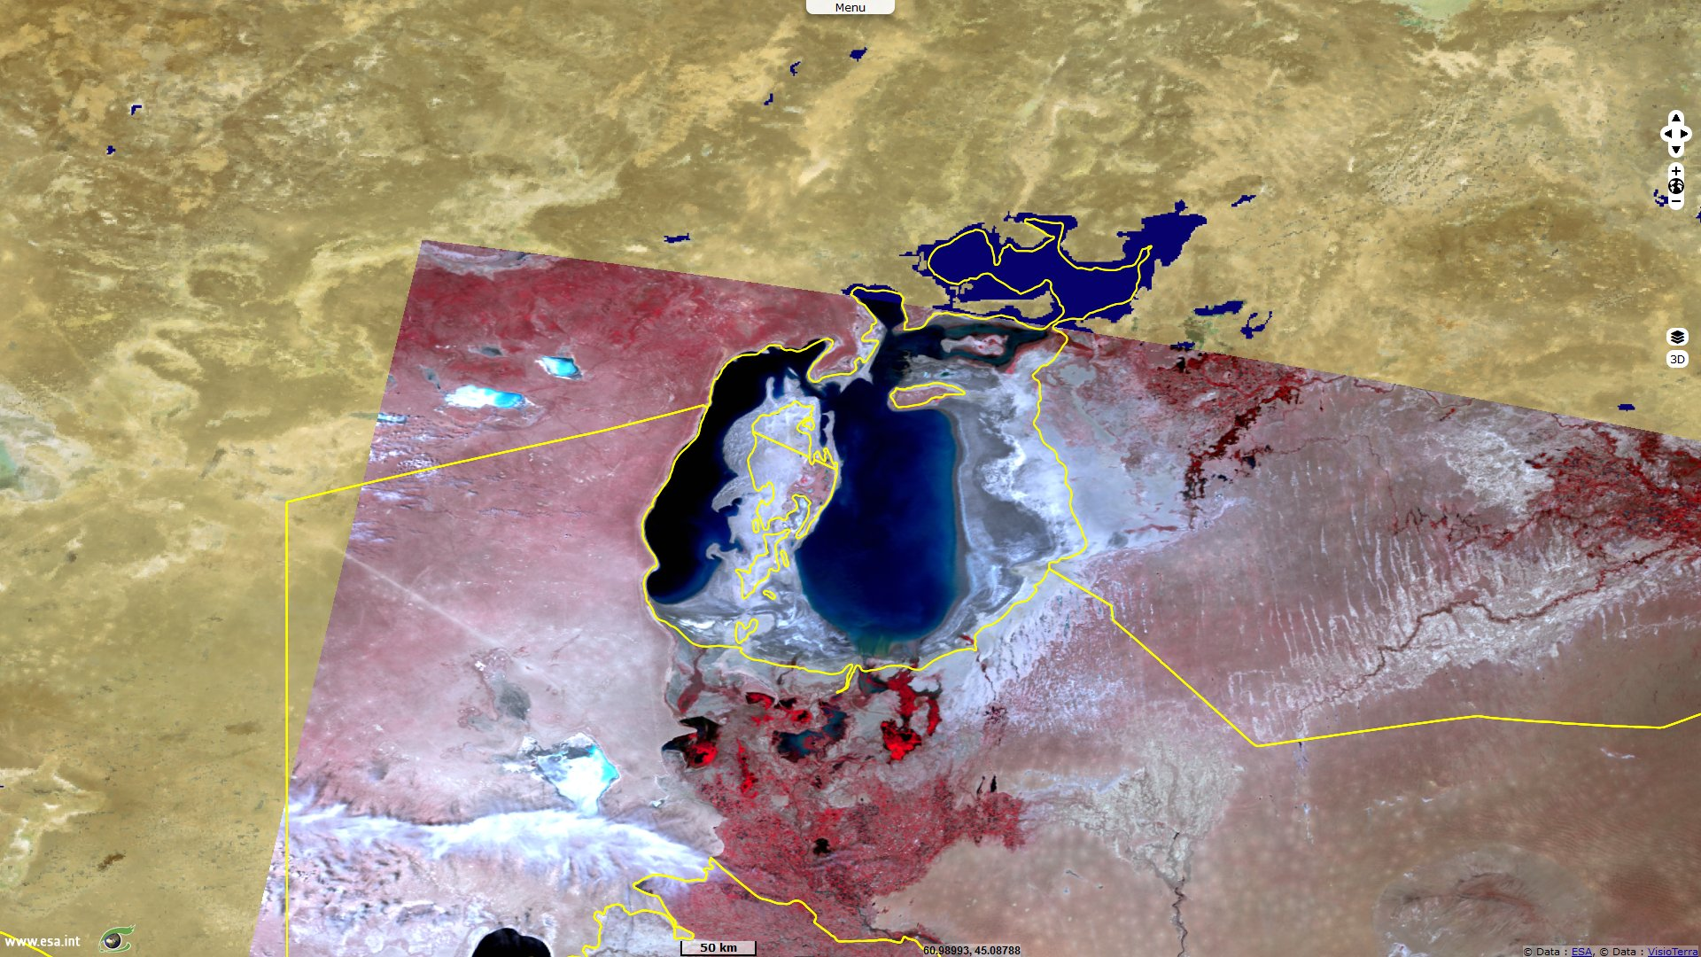
HEDAVI - Explorer
ENVISAT/MERIS/FRS - 2003/06/17 - Composite M13,M07,M05 (865nm, 665nm, 560nm)
http://hedavi.esa.int/explorer/hyperlook/b12a31d690304547b5ababd40c77df9c

Slide 11
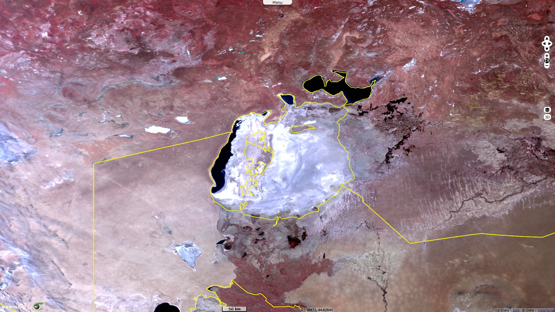
HEDAVI - Explorer
Sentinel-3A/SLSTR/RBT - 2023/05/01 - Composite S3N,S2N,S1N (865nm, 659nm, 555nm)
http://hedavi.esa.int/explorer/hyperlook/0d33cba13e7a4bd283da79a87eaf10c3

Slide 12
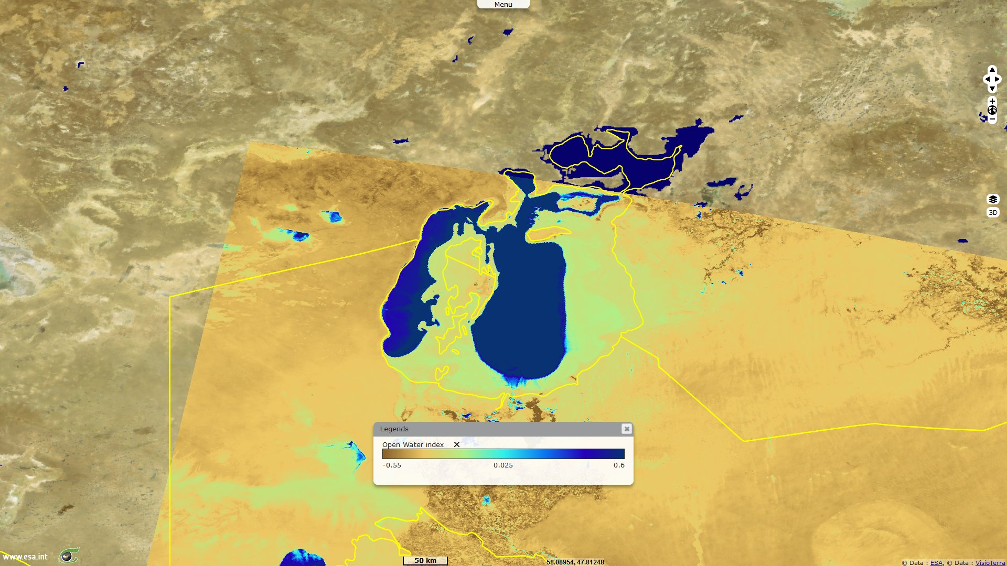
HEDAVI - Explorer
ENVISAT/MERIS/FRS - 2003/06/17 - Open Water Index ((M05 - M13) / (M05 + M13))
http://hedavi.esa.int/explorer/hyperlook/89234530ed9c4cf68d6643051ad7ab94

Slide 13
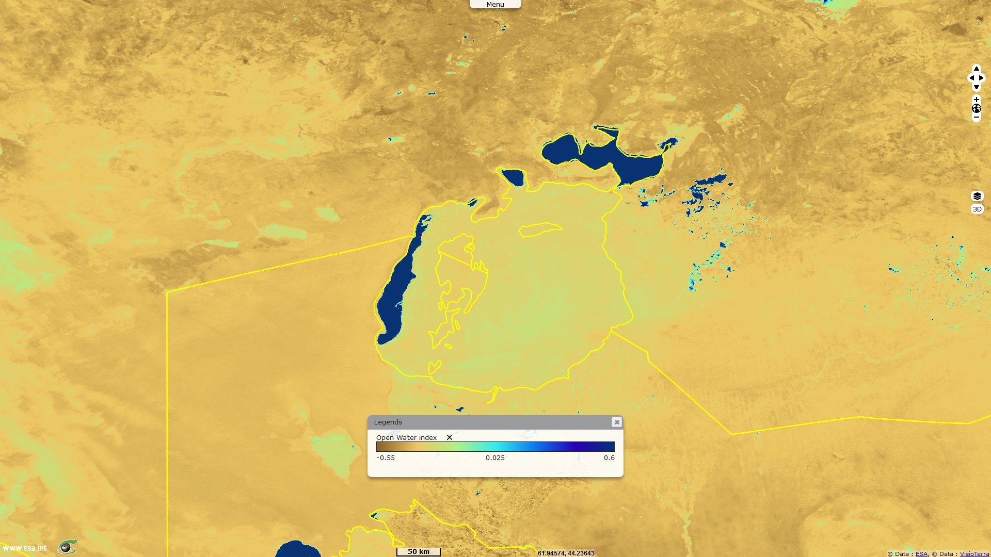
HEDAVI - Explorer
Sentinel-3A/SLSTR/RBT - 2023/05/01 - Open Water Index ((S1N - S3N) / (S1N + S3N))
http://hedavi.esa.int/explorer/hyperlook/bb023d20b8fb4d81bd7618e932cf30cd

Slide 14
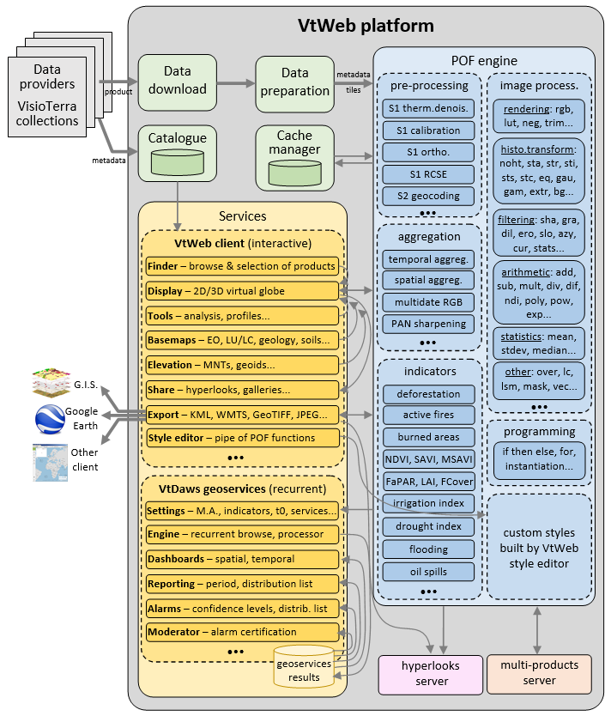
Processing units of POF-ML v1.0
Pre-processing
Orthorectifications
Geocoding
Calibrations…
Aggregations
Temporal
Spatial…
Image processing
Global radiometry transforms
Filtering
Arithmetic
Rendering…
Indicators
Pixel based
Combined…
14

Slide 15
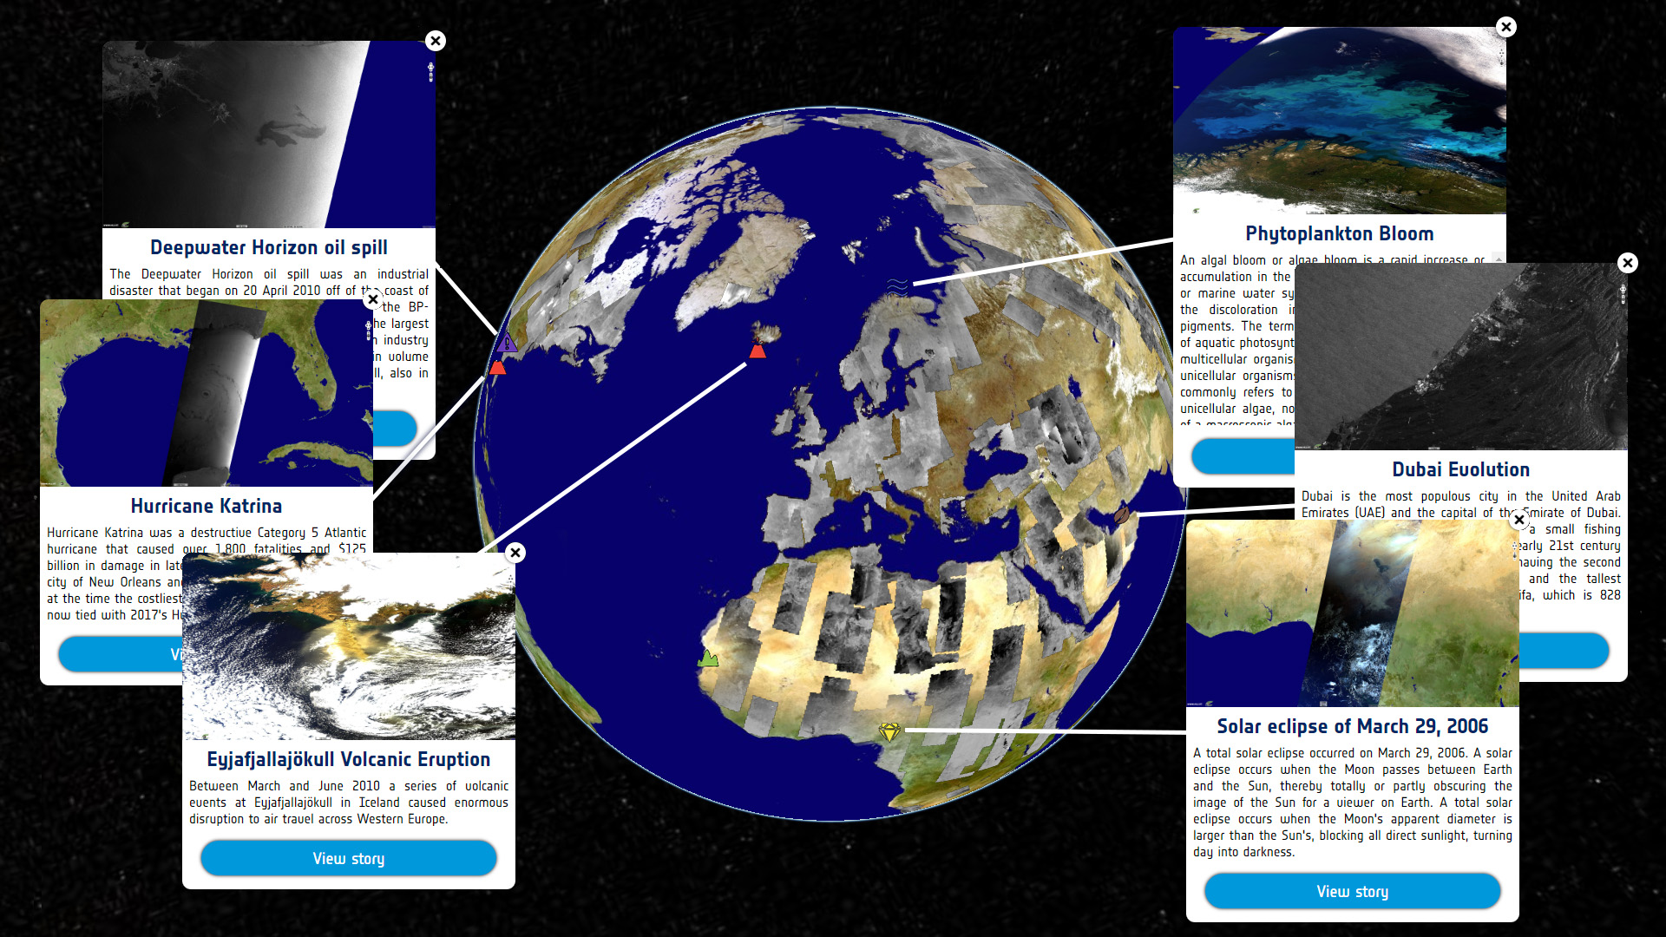
HEDAVI - Discover
hedavi.esa.int/discover/
User friendly interface
2D/3D display area
Synthesis mode
Stories mode

Slide 16
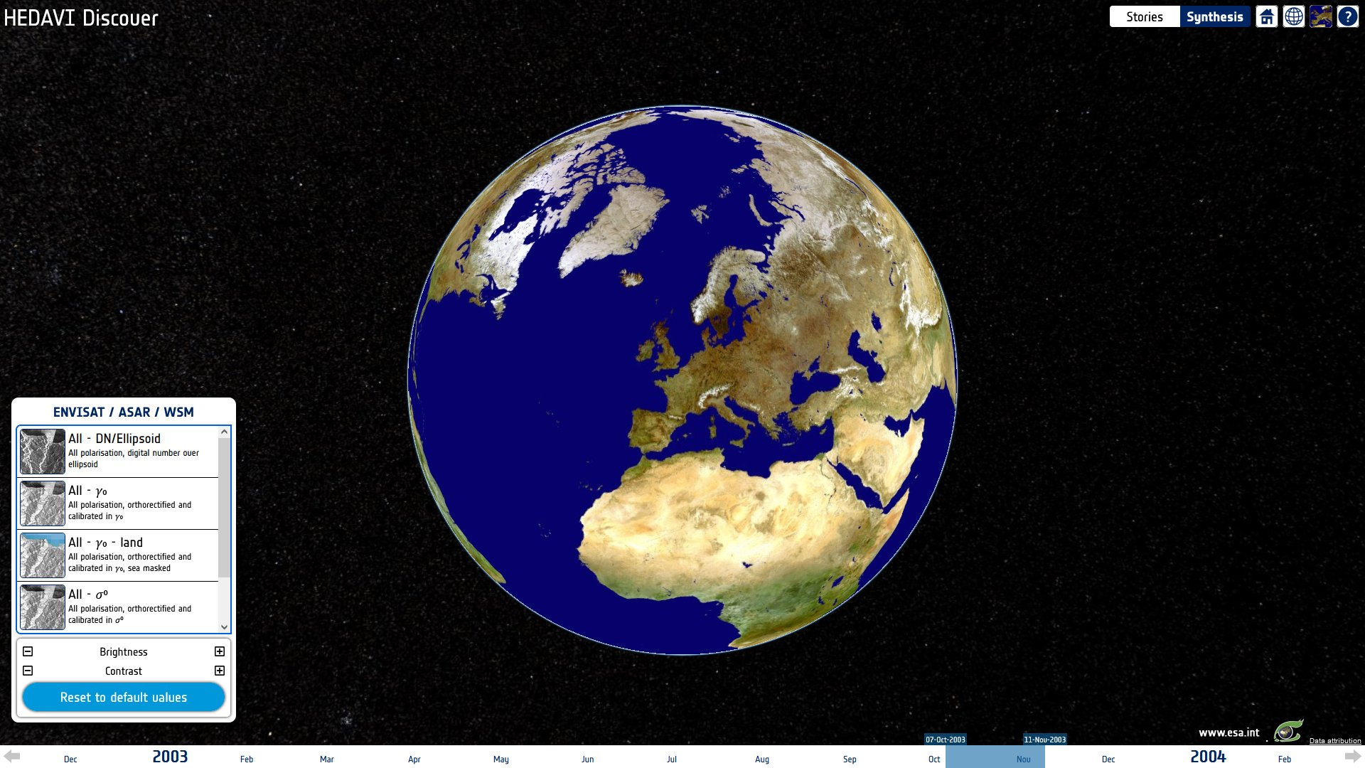
HEDAVI - Synthesis

Slide 17
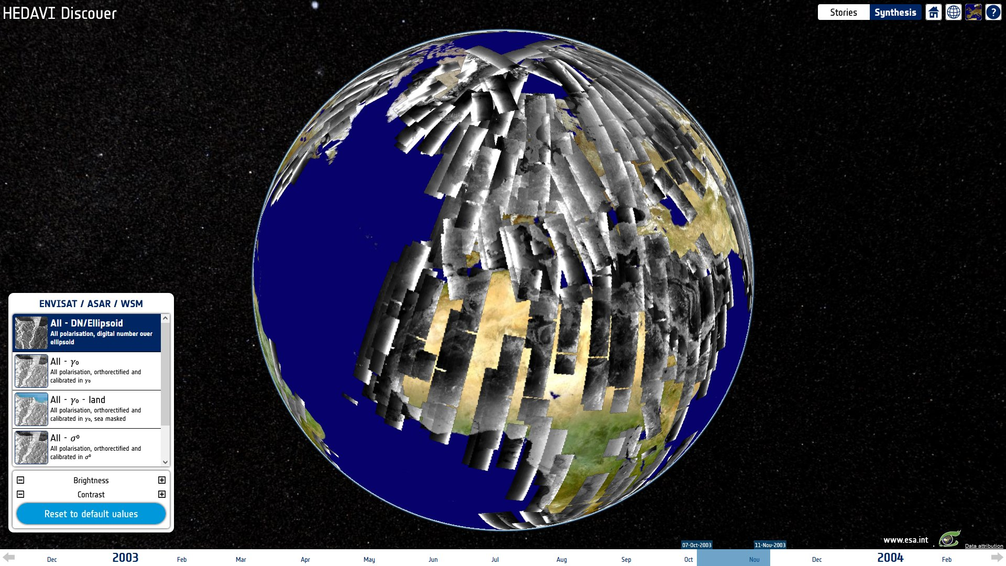
HEDAVI - Synthesis
Display up to 35 days
~2800 products at once
Zoom up to native res.

Slide 18
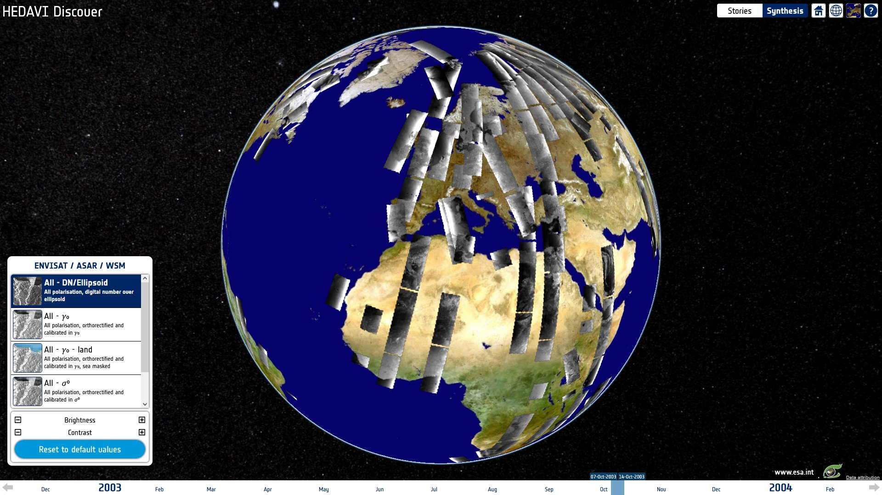
HEDAVI - Synthesis
~34TB of ENVISAT/ASAR/WSM products (native format .N1)
~10TB of sub-res. raster
~20GB of database with metadata, low res. raster and spatial index

Slide 19
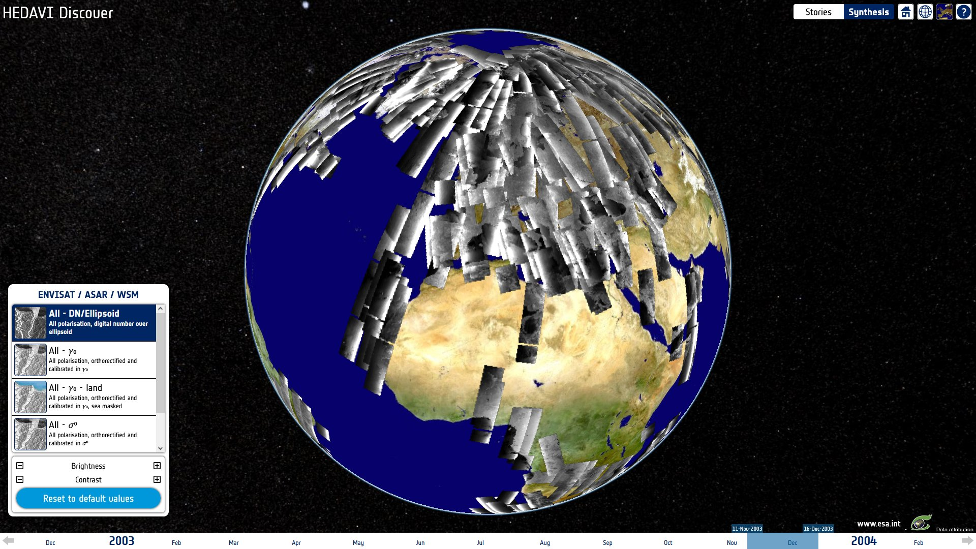
HEDAVI - Synthesis

Slide 20
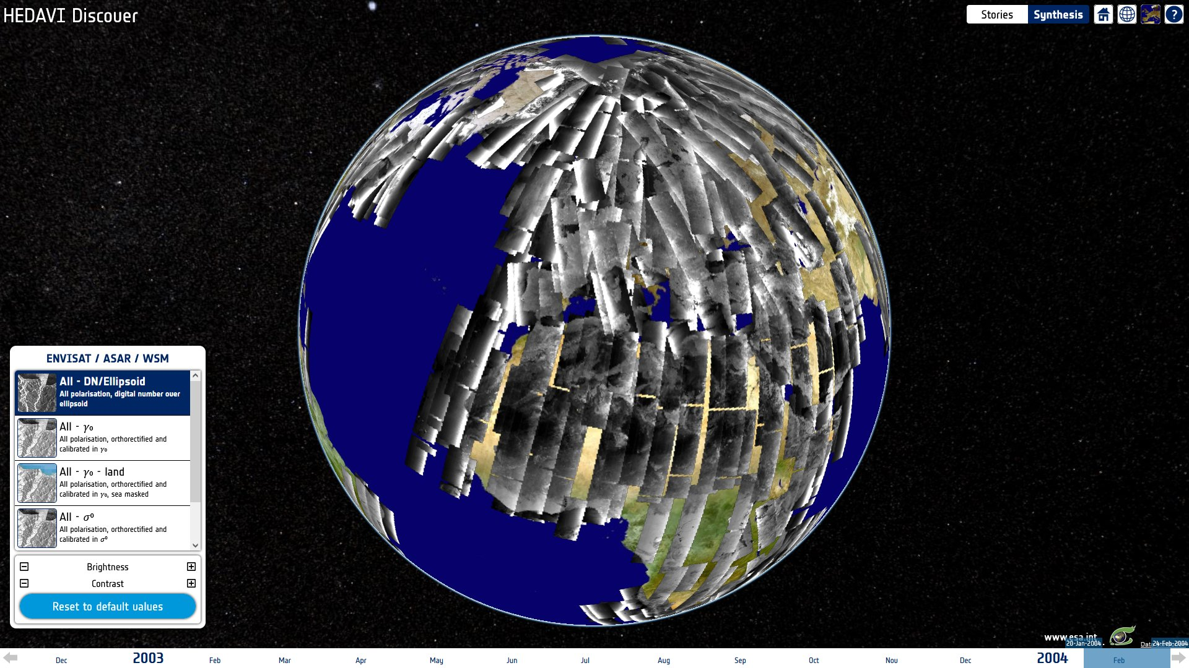
HEDAVI - Synthesis

Slide 21
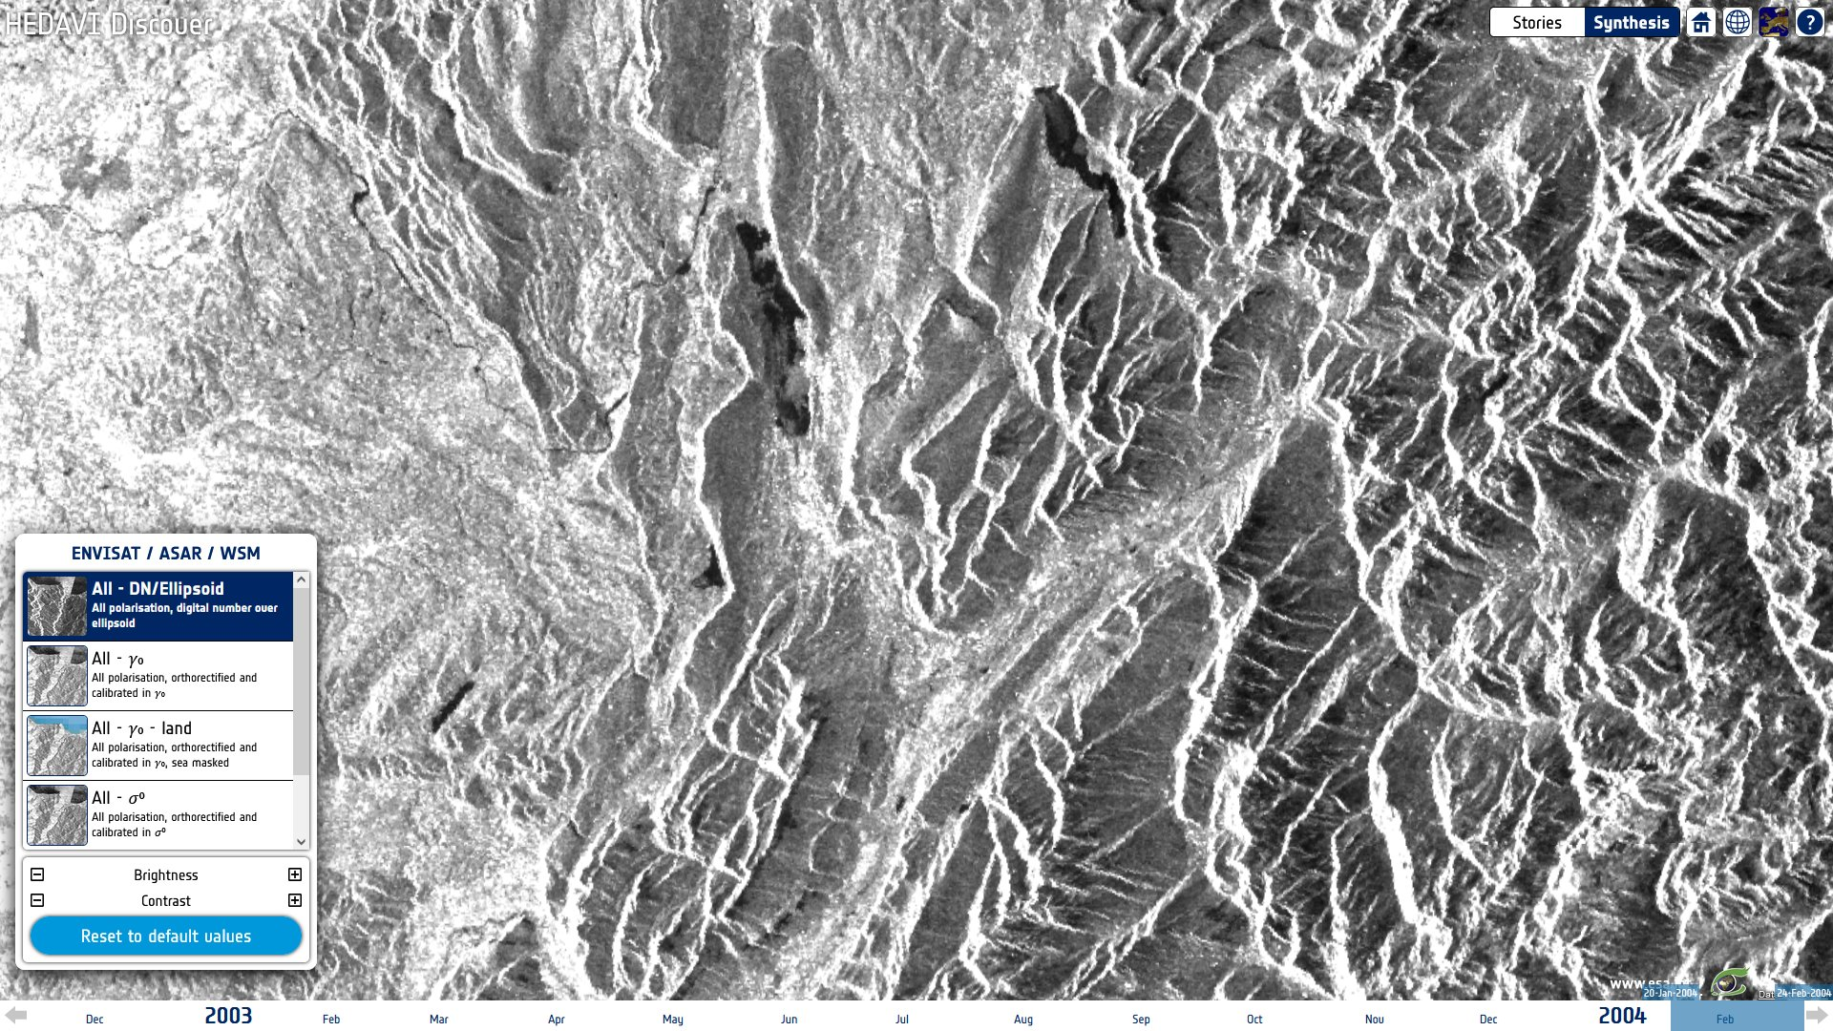
HEDAVI - Synthesis
str(
syn(
dataset=WSM,
dStart=20091103,
dStop=20091208,
ortho=false
),
250,2500
)

Slide 22
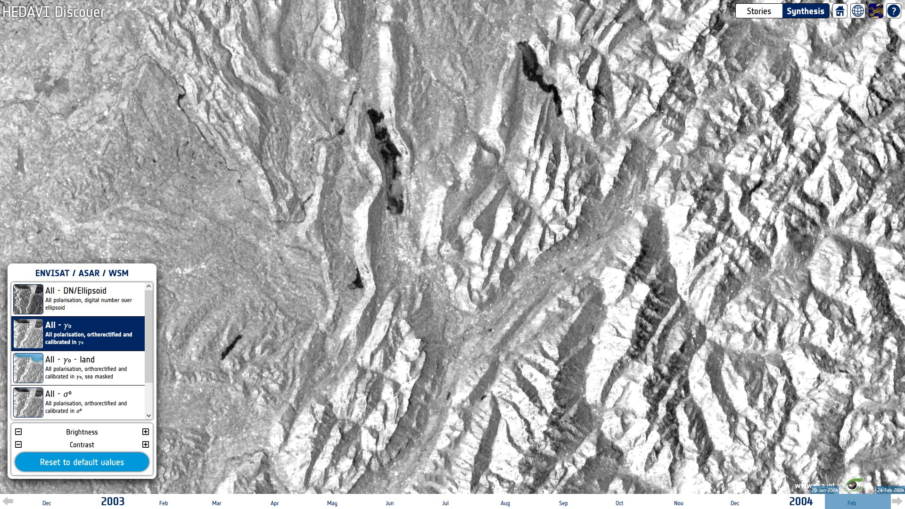
HEDAVI - Synthesis
str(
syn(
dataset=WSM,
dStart=20091103,
dStop=20091208,
ortho=true,
cal=g0,
),
-20,0
)

Slide 23
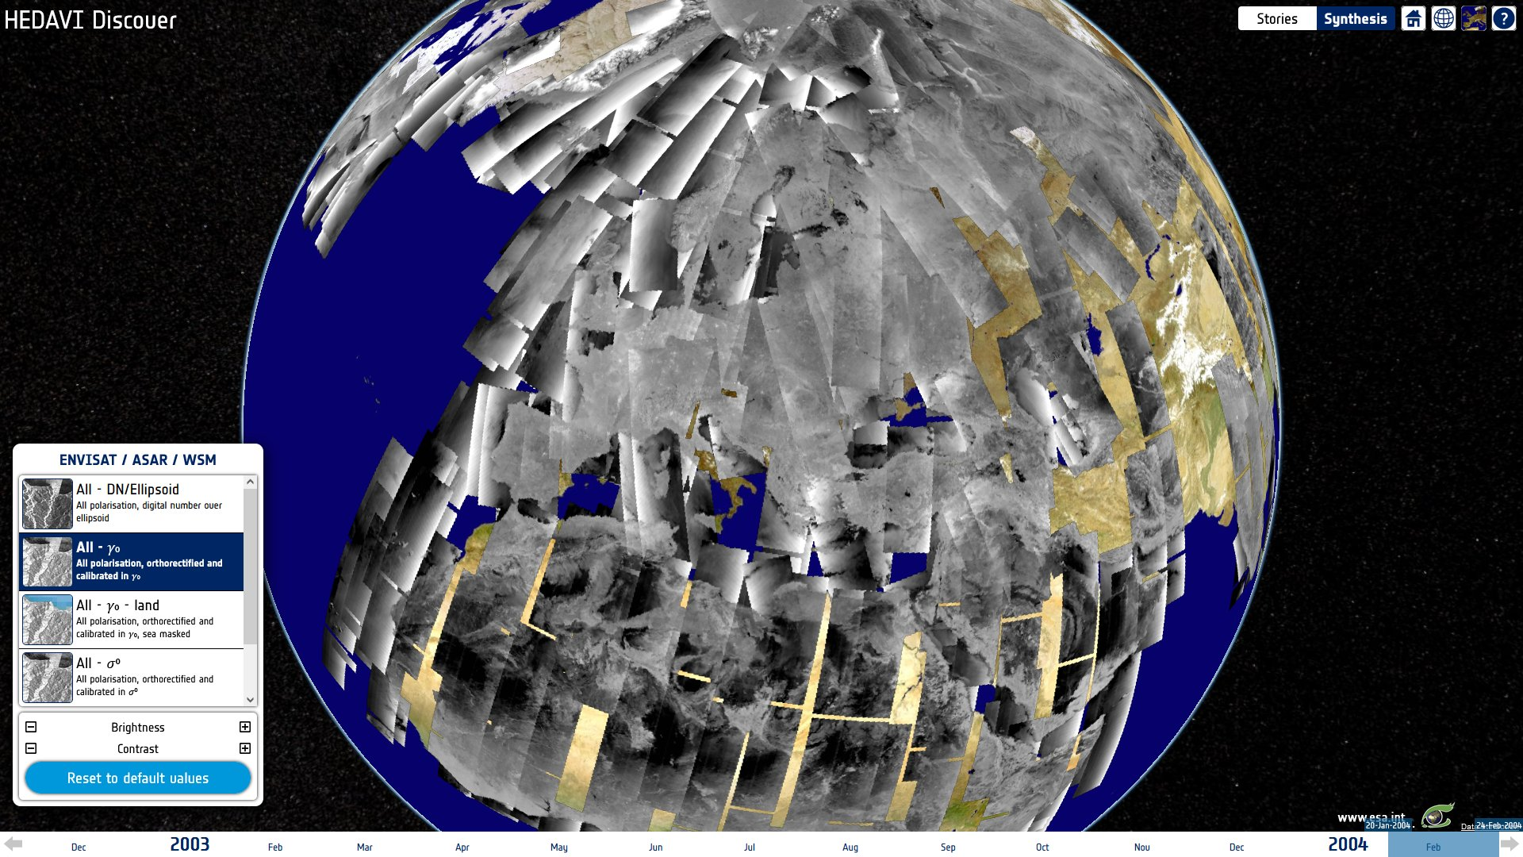
HEDAVI - Synthesis
str(
syn(
dataset=WSM,
dStart=20091103,
dStop=20091208,
ortho=true,
cal=g0,
),
-20,0
)

Slide 24
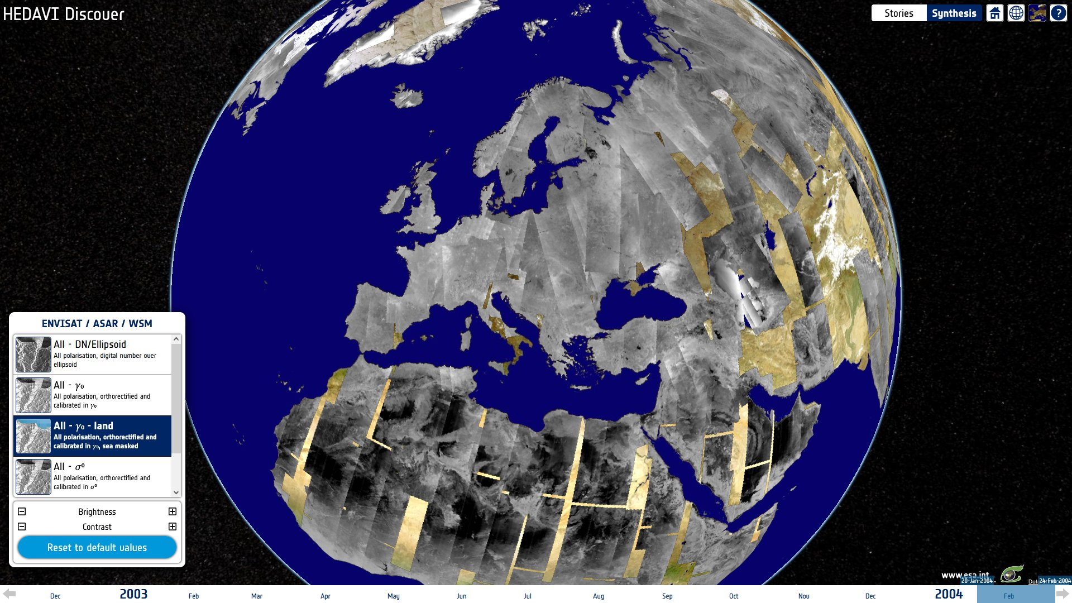
HEDAVI - Synthesis
str(
lsm(
syn(
dataset=WSM,
dStart=20091103,
dStop=20091208,
ortho=true,
cal=g0,
),
clsm30,sea
),
-20,0
)

Slide 25
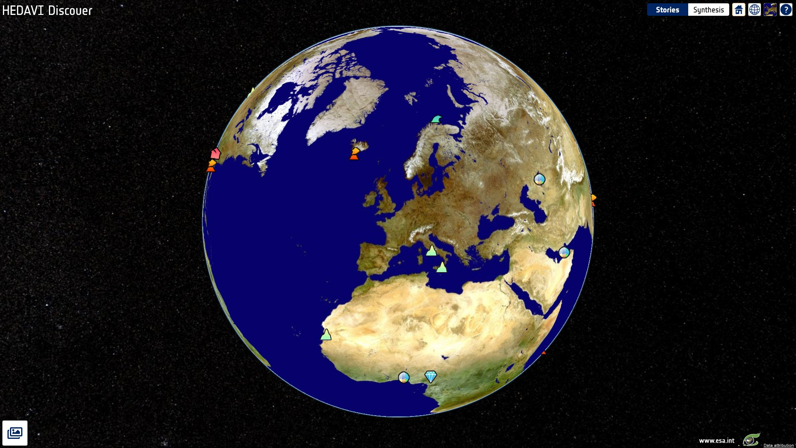
HEDAVI - Stories

Slide 26
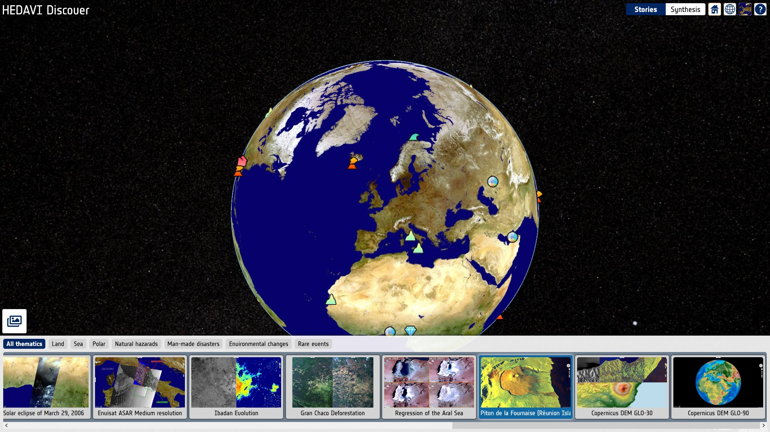
HEDAVI - Stories

Slide 27
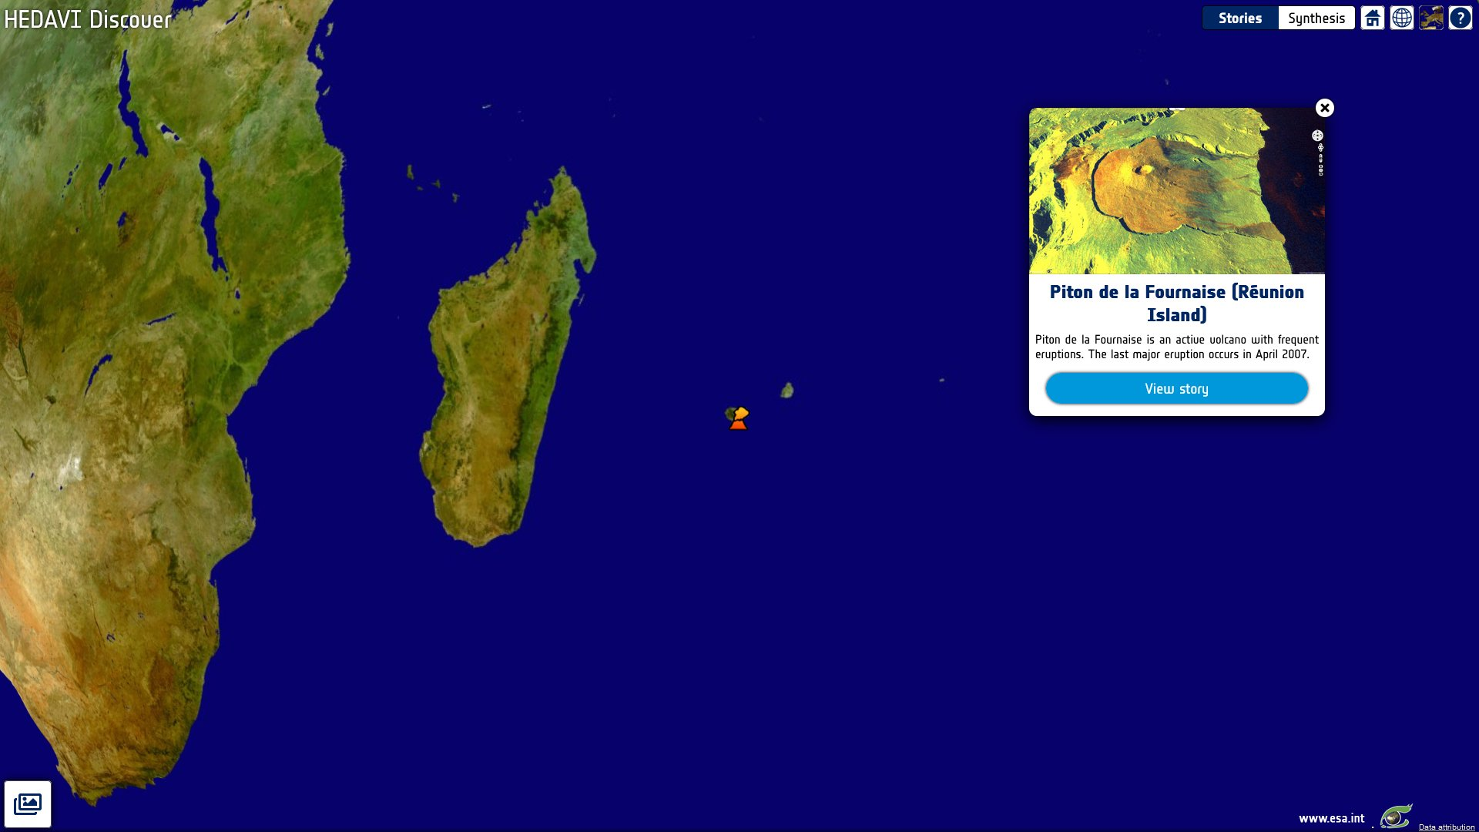
HEDAVI - Stories

Slide 28
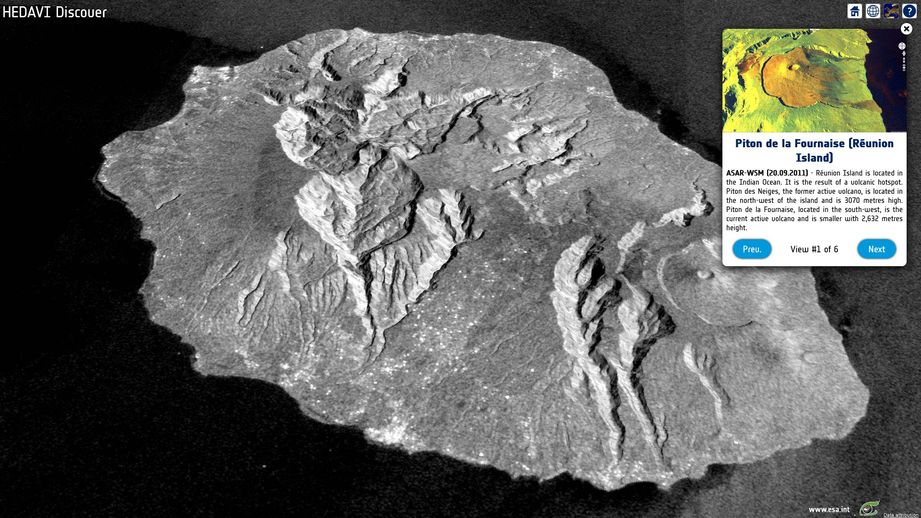
HEDAVI - Stories

Slide 29
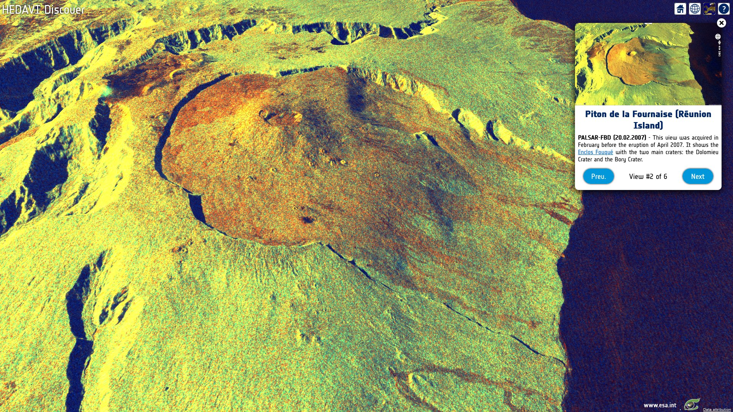
HEDAVI - Stories

Slide 30
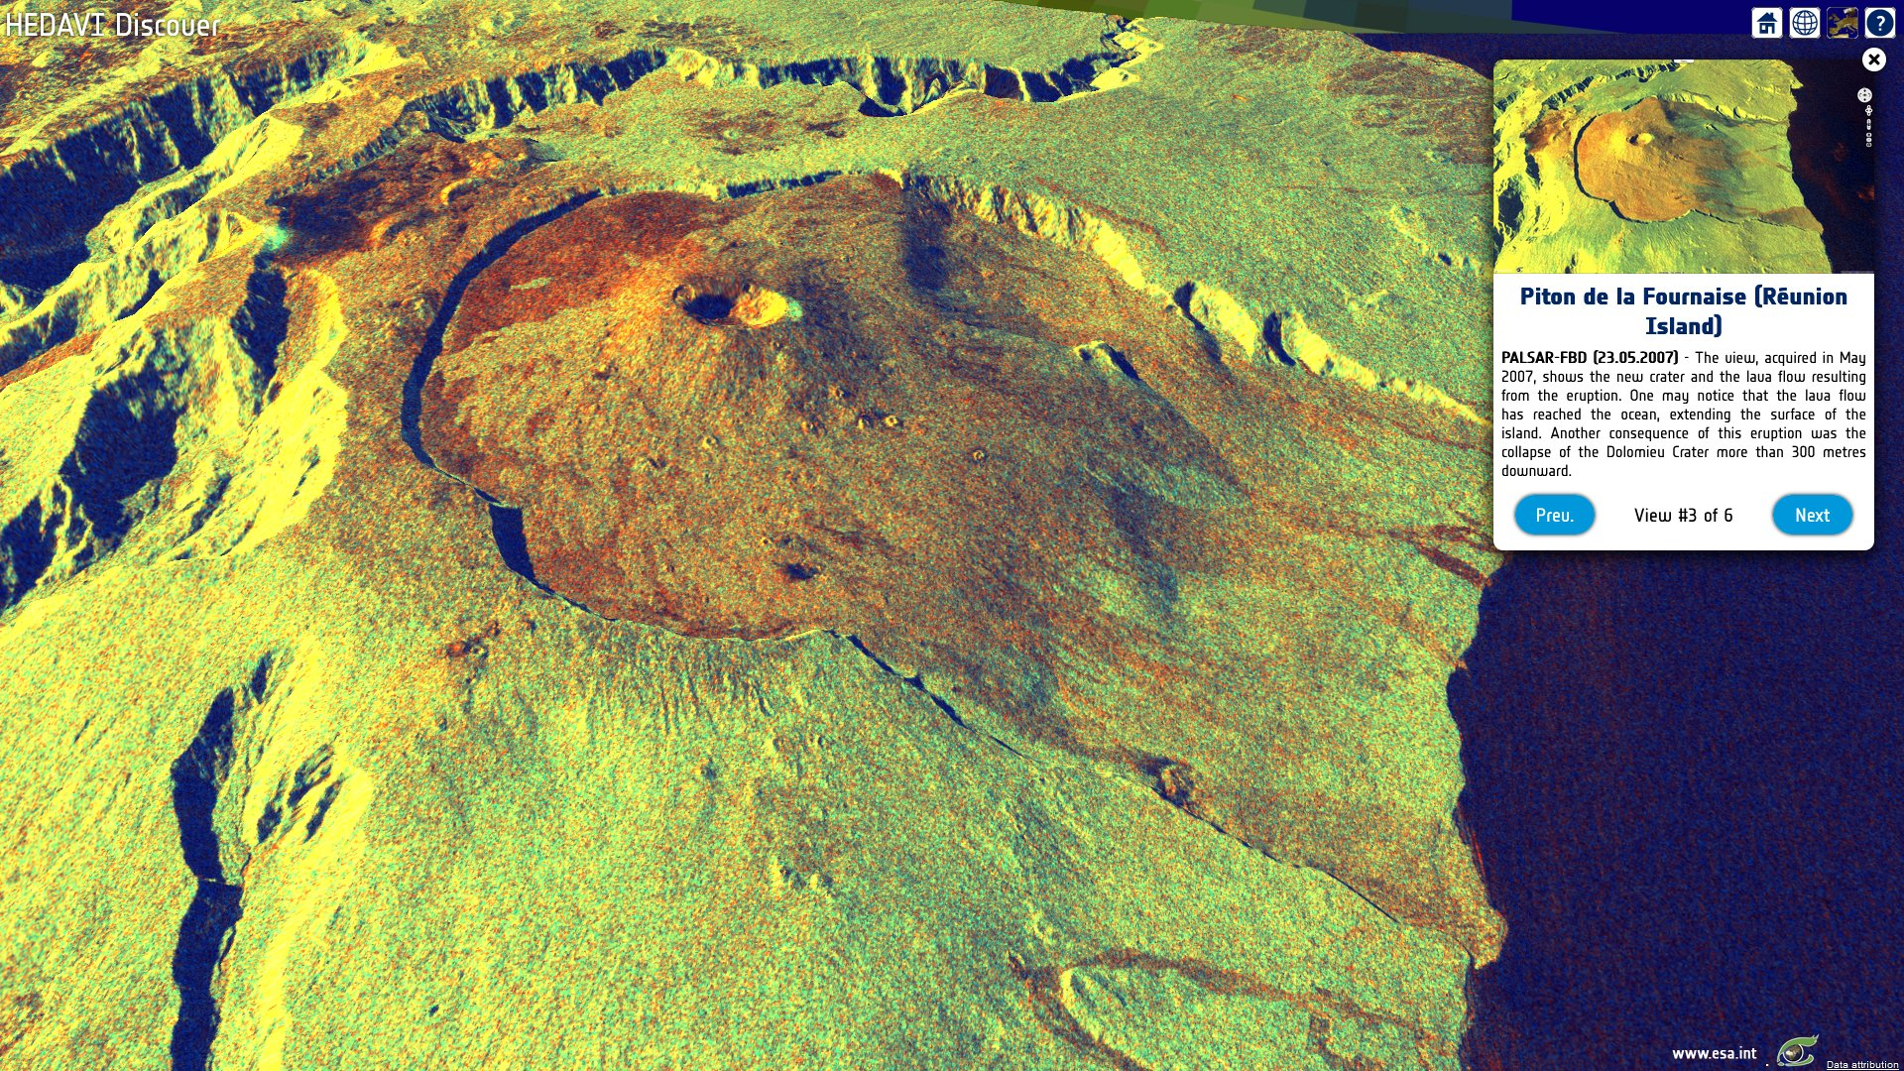
HEDAVI - Stories

Slide 31
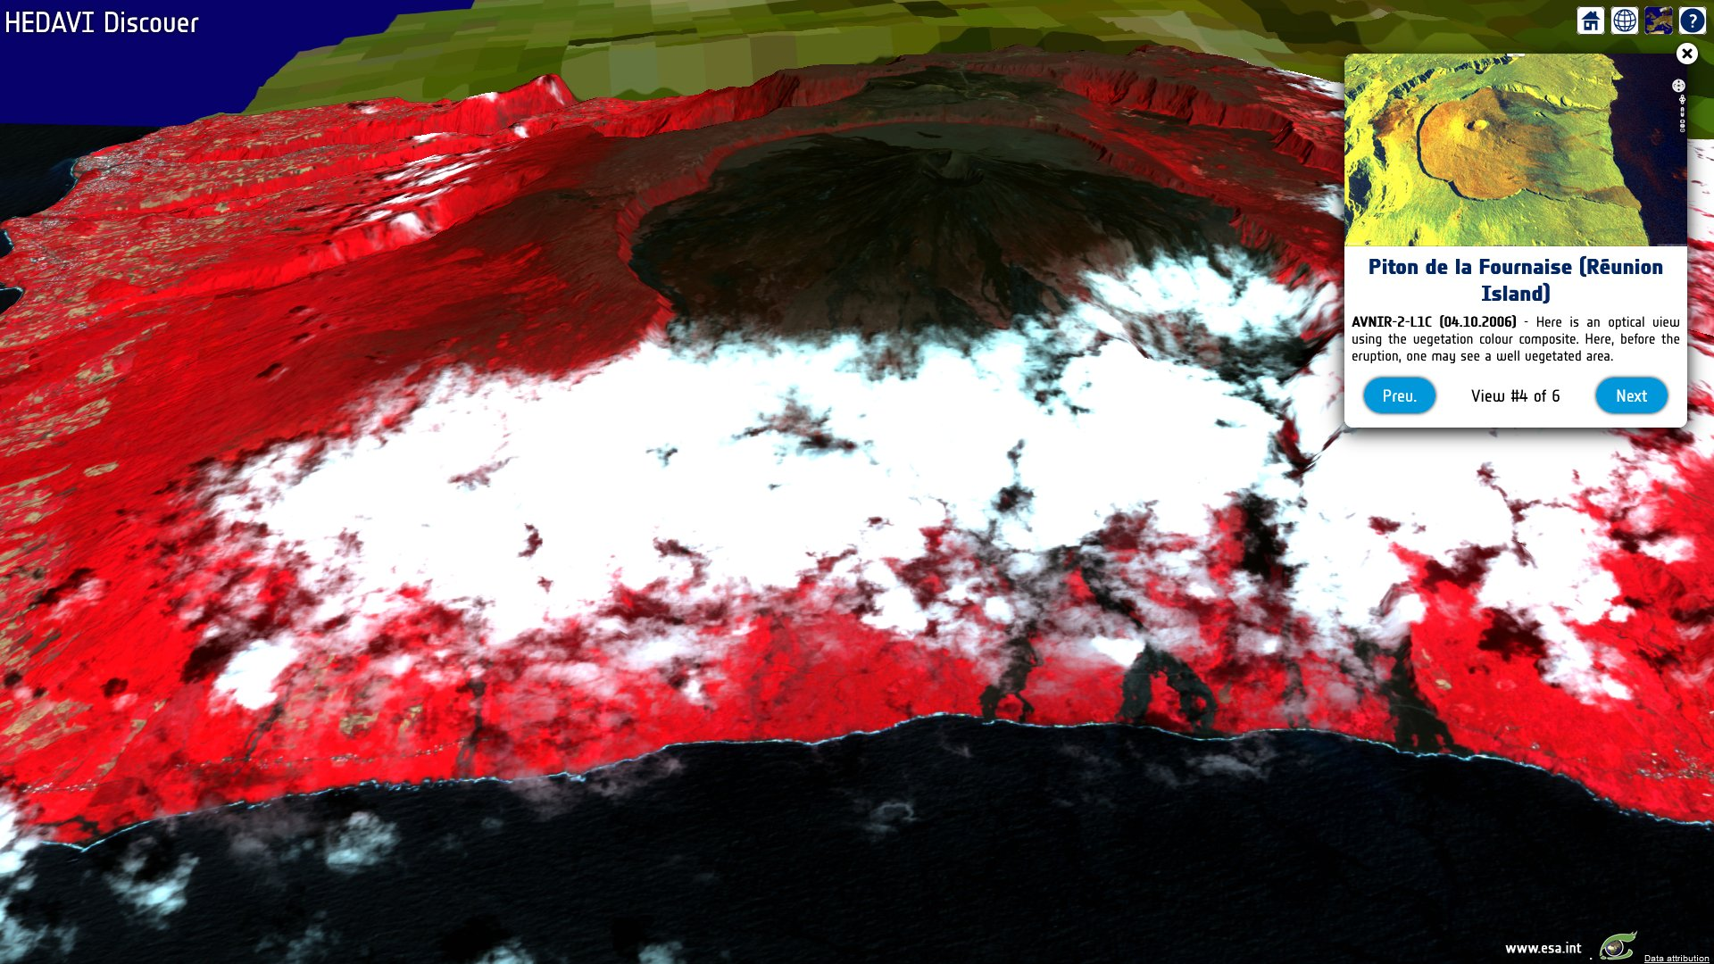
HEDAVI - Stories

Slide 32
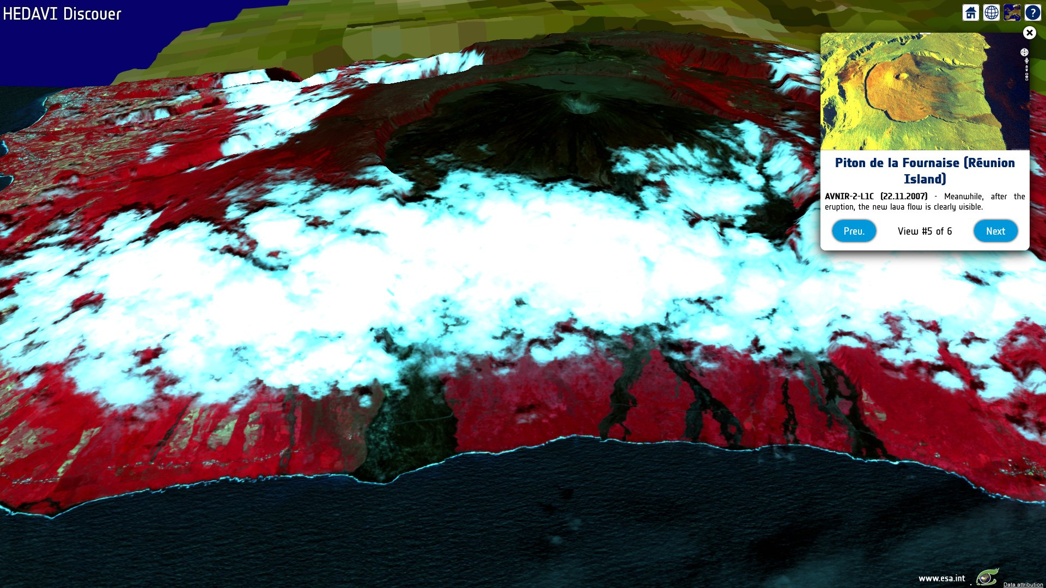
HEDAVI - Stories

Slide 33
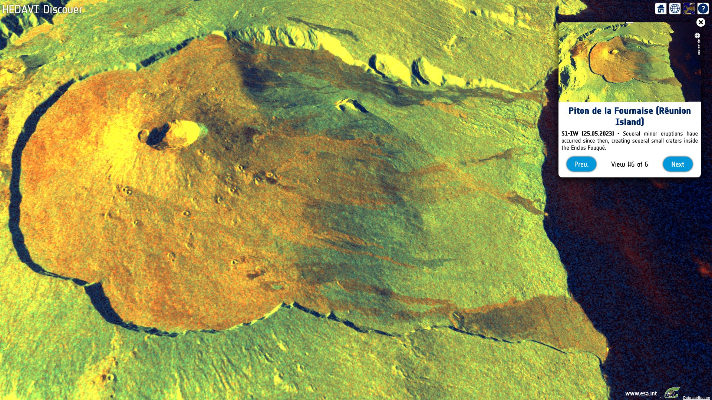
HEDAVI - Stories

Slide 34
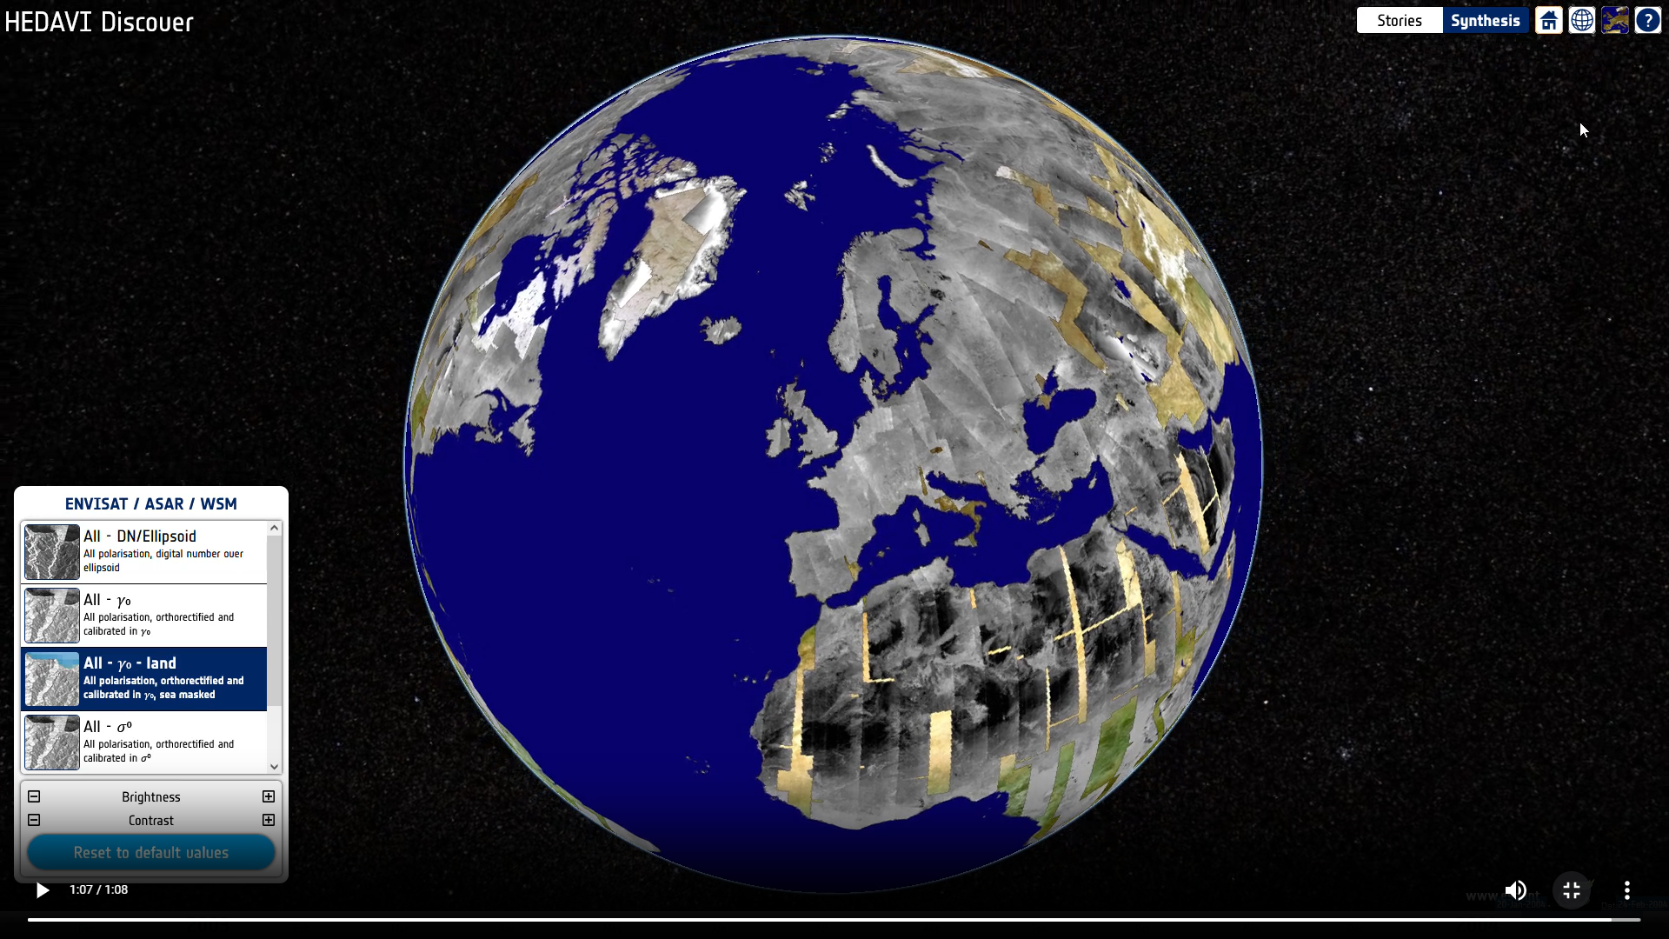
HEDAVI - Synthesis demo
HEDAVI_Discover_Synthesis.mp4

Slide 35
Questions?
Grégory MAZABRAUD Project Manager Engineer gregory.mazabraud@visioterra.fr

