Slide 1
Data Access evolution
towards Collaborative Environment
Roberto Alacevich, Mattia Stipa, Damiano Guerrucci
CEOS WGISS-56
25/10/2023

Slide 2
Overview
Discovery – how and what
Access Policy – authentication and authorisation
Services offering
Evolution
What next

Slide 3
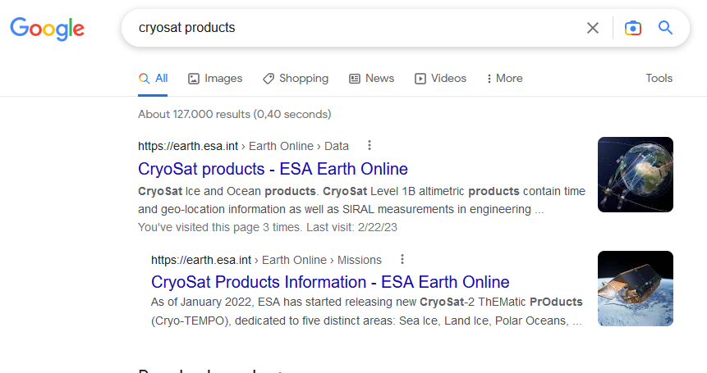
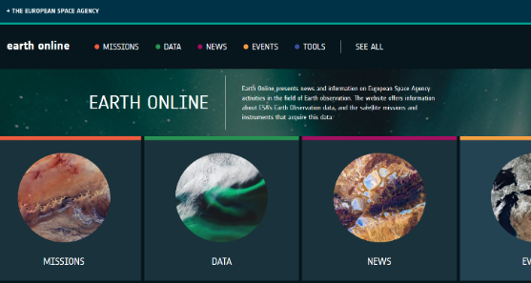
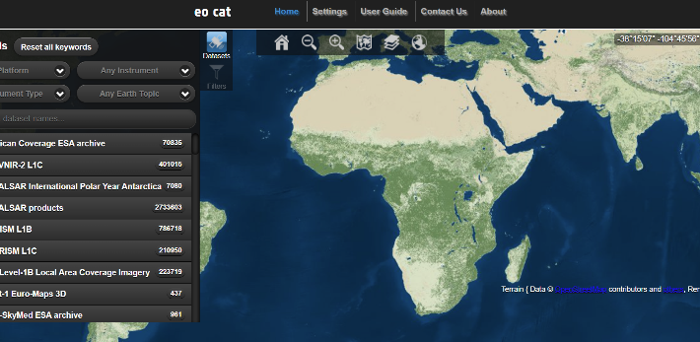
Data Access (3 steps)
Search Engines SEOptimized Ranking highly | Website Clear and concise information Defined user experience | Data Discovery and Download Navigating to most direct download/request point Open data quickly downloadable

Slide 4
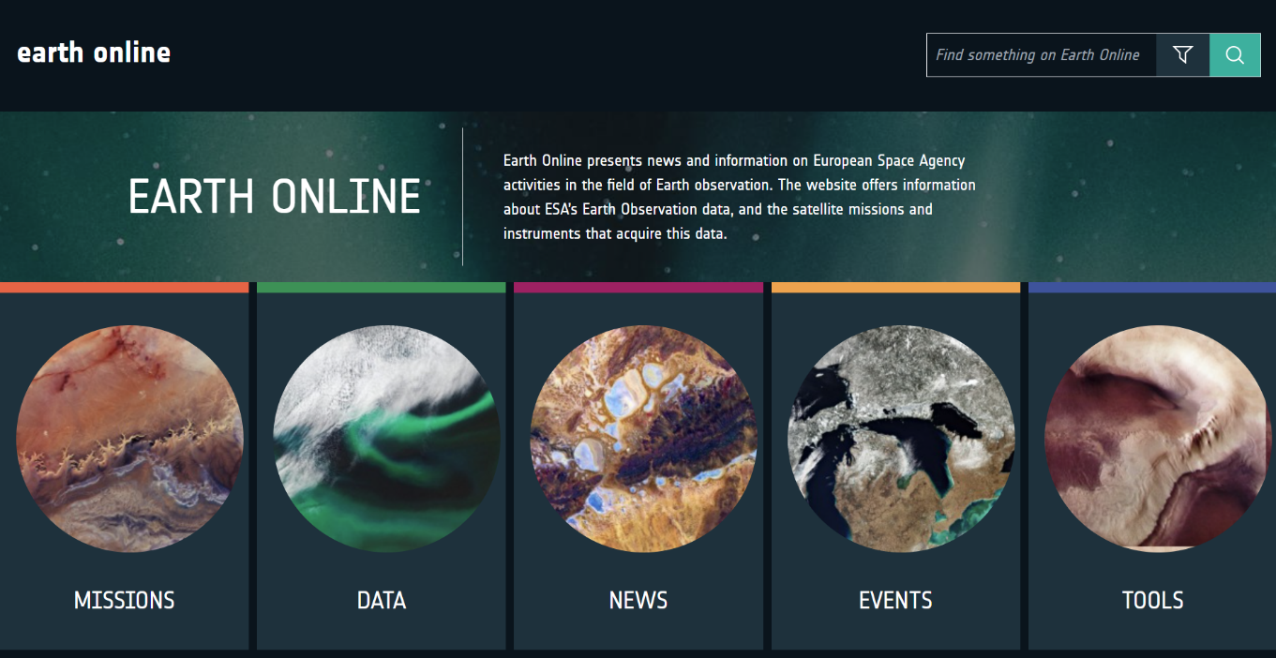
Earth Online (earth.esa.int)
Mission information
Technical reports
Data information
Data access and tools
Success stories
Spotlight on EO Community
News
Events
Activities

Slide 5
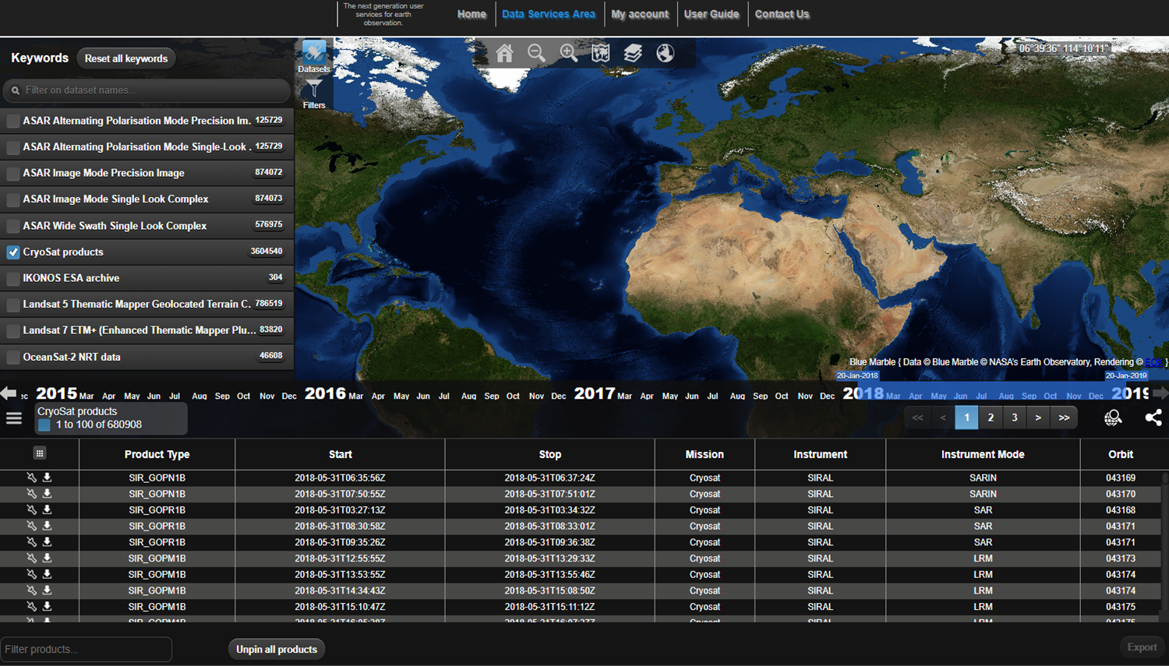
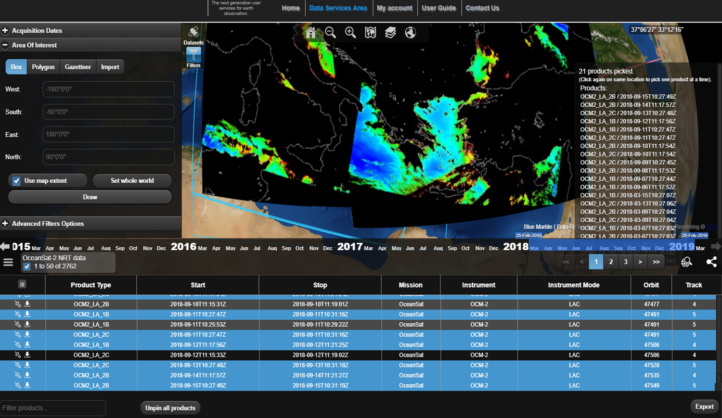
Data Catalogues
Centralized catalogue for discovering all ESA Earth Observation Data
User friendly access to search and retrieval
Allowing user to download desired data

Slide 6
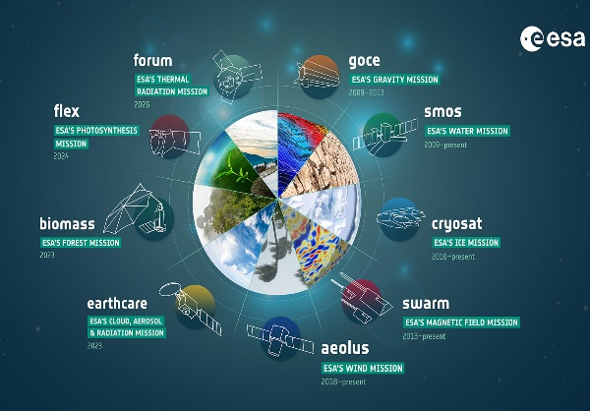
Missions portfolio
7,145
78
~ 59,000
~ 360,000
Web Pages & Documents
Missions
Reports
Recorded visitors per year
7 Earth Explorer Missions
56 Third Party Missions
30 Heritage Missions

Slide 7
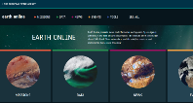
Current ESA EO Ground Segment Architecture
EO WEB SERVICES
EO DATA ONLINE PROVISION
EO DATA ARCHIVE
DATA DOWNLOAD
REPROCESSING
SERVICES MANAGEMENT
MISSION SPECIFIC TOOLS
PIXEL-BASED
DATA ACCESS
MISSIONS DATA SYSTEMATIC PROCESSING
AUXILIARY DATA
ACQUISITION

Slide 8
DRIVERS for the EO GROUND SEGMENT EVOLUTION
IMPROVE
IMPROVE USER EXPERIENCE IN EO DATA ACCESS
Across-mission Data Access
State-of-the art technology
Systems federation
RAISE
RAISE THE OFFER FOR USERS: FROM DATA TO WORKSPACE
R&D-tailored tools and services
Scalable and Secure environment
Effective User Management and User Support
POWER
POWER COLLABORATIVE R&D
Configurable shared environments
Focus on knowledge-sharing and community support
EFFECTIVELY ADDRESS INCREASING COMPLEXITY and OPERATIONAL CHALLENGES
Across-mission technical baseline
Building on existing industrial capabilities and consolidated practices
Focus on core value added activities
ADDRESS
FOSTER
Optimised user journey
Exploiting service-level synergies
Access to wider user community
FOSTER INTEGRATION WITH THE EO ECOSYSTEM

Slide 9
Demonstrators - Major guidelines
Basic Initiative Principles
Direct involvement of industrial expertise
Proof of concept applied to real use cases
Reduced formalism for fast outcome
Anticipation of scientific community needs
Address unconsolidated requirements
De-risk uncertain solutions
Expected Deliverables
Technical notes reporting the result of the activity
Requirements for future procurements
Guiding the short time evolution of currently used elements (e.g. catalog)
Transfer to operation of validated findings (quick wins)
Awareness and industrial fostering
Q1 2023
Time Period
Q1 2024

Slide 10
Demonstrators – Status Overview
Element 1
Element 3
Data transfer
Element 4
Element 5
User Management (incl. policy)
Role based access
PDGS to/from archive, catalog and dissemination
Data Access Authorisation
Access to resources
Operator interface
Element 2
Data Access from archive
User authorisation (partial)
Download
Ordering
Catalogue Interfaces (STAC)
Data conversion (COG, ZARR)
Metadata encoding (Geo-JSON)
Resource Viewer
Improved User Experience
Data & Service Discovery
User login
Status
Status
Status
Status
Status
Implementation
Installation
Integration & Testing
Demonstration
Technical Note
Completion Date: 31/10/2023
Implementation
Installation
Integration & Testing
Demonstration
Technical Note
Completion Date: 30/11/2023
Implementation
Installation
Integration & Testing
Demonstration
Technical Note
Completion Date: 30/11/2023
Implementation
Installation
Integration & Testing
Demonstration
Technical Note
Completion Date: 15/12/2023
User management policy
Use cases definition
Technical Note
Completion Date: Q1 2024
Completed On-going Not yet started

Slide 11
Items Deliveries and Associated Improvements
FedEO evolutions deliveries
#1 Security upgrades, #2 Technological Upgrades, #4 STAC and OGC,
#4 Services Catalogue #4 Federation
1
Metadata Editor (MDE)
2
#1 Security upgrades, #2 Technological Upgrades,
#3 Metadata update automation, #3 Metadata validation
Metrics Client Application (MCA)
3
#1 Security upgrades, #2 Technological Upgrades,
#5 Users queries monitoring and reporting
View Server Application
Object Storage, migration config
4
#1 Security upgrades, #2 Technological Upgrades,
#3 Performances improvements

Slide 12
ASCEND Services
Generic Collaborative Environment
Data
Validated Algorithms & Processors
APIs for Data Access, Visualisation and Processing
WEB SERVICES
Users Management
ESA EO
Ground Segment Back End
Security
Services
Scalable Resources
External
Collaborative Environment
Local Algo & Processors
Local Services
FEDERATION
Local Data
Notes:
Access the collaborative environment from a Web Portal integrated with EarthOnline Web Services for a one-stop-shop solution
Easily access a variety of EO data (based on federated data access principles) in a format which is suitable for cloud processing
Easily access a database of available algorithms/processors for further manipulation and re-use
Use (and release as necessary) scalable computing and storage resources
Work in a processing environment mirroring the features of the EO Ground Segment operational environment and offering large scale orchestrators for automatic processing as well as tools/libraries for assisted processing
Publish newly generated algorithms/processors and expose them to the user community in a fully configurable way
Activate collaborative environment functionalities (including access to specialists forum and helpdesk) in a fully configurable way
Enjoy a safe processing environment where users are managed, protected and supported as needed
So as to minimize delta development and integration efforts when deploying “new” processors in the operational environment
Through adequate security services

Slide 13
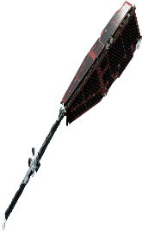
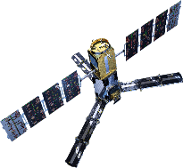
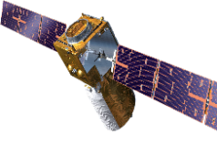
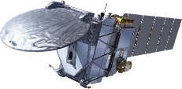
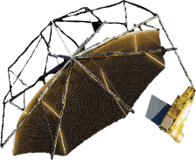
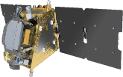
GS EVOLUTION HIGH LEVEL ROADMAP
2023
2024
2025
2026
Existing GS Services
Data Management DEMONSTRATORS
GENERIC PROCESSING ORCHESTRATOR
PRECURSOR
SERVICES
ASCEND
NEW GS SERVICES

