Slide 1
STAC Activities (Open Discussion)

Slide 2
Objectives
Align understanding of source for information and involved bodies
Define WGISS support role and scope

Slide 3
STAC: existing channels
STAC Sprint (September 28, Philadelphia)
Github repository
STAC Catalogs
OGC community standard (WIP)
WGISS STAC Best Practises Github repository
Cloud Native Geospatial Foundation
Questions and Conclusion

Slide 4
STAC Sprint #8 – towards STAC 1.1
Specification
Discussed stac-spec issues for STAC 1.1 (planned to be released in the next months)
eo:bands and raster:bands will be merged into bands in STAC Core
API extensions got stable: Fields, Sort, Query
Filter & Transaction is waiting on OGC for completion
Ecosystem
Mostly improvements for PySTAC (e.g. extensions)
Outreach
Couple of new tutorials (e.g. R) and preparation for workshops and a new FAQ
STAC and GeoParquet
Specification defines how to convert STAC Items into GeoParquet (and vice-versa)
See the blog post for details

Slide 5
GitHub repositories
Best Practises
Extension – how to
New extensions
STAC Browser

Slide 6
STAC Catalogs
List of catalogs

Slide 7
Make STAC OGC standard
A STAC steering committee has been formed (5 members including Matt Hanson on a best effort basis)
Drafted a submission to get the STAC API and Extension submitted as an OGC community standard (Comments were due by October 12, 2023)
The justification documents are
SpatioTemporal Asset Catalog (STAC) STAC [23-051] [.HTML]
STAC API STAC API [23-052] [.HTML]
The community (i.e. the STAC PSC) is still in charge of steering the specification, no OGC SWG will be formed.

Slide 8
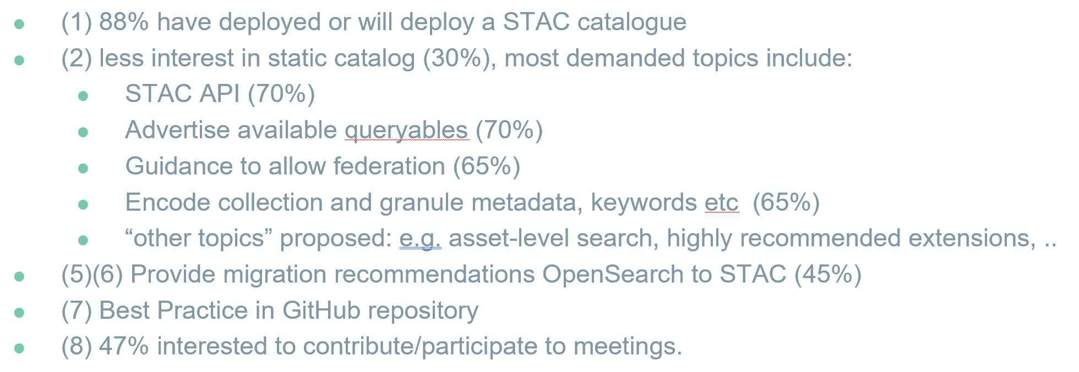
CEOS WGISS Best Practises
Survey run in April 2023
ceos-wgiss / stac-best-practices
Proposed extension
Federated STAC extension
Collection extension (what is the state of the existing one?)
Don't think there should be anything in the CEOS-ARD extension outside of things that are truly unique, e.g. PFS version, details of compliance, etc.
OGC - Common Band Names of Optical and Radar Sensors” di Pedro Gonçalves (Terradue)
Q1: which ones, how to include the CEOS-ARD extension proposal, how to engage with STAC community
Q2: What are the different extensions, who are they used by, how do they correlate, how do they connect, how are they implemented by users, etc
Q3 Shall include an implementation guide? (CEOS-ARD question)

Slide 9
Cloud-Native Geospatial Foundation
The Cloud-Native Geospatial Foundation is a forthcoming initiative to increase adoption of highly efficient approaches to working with geospatial data in public cloud environments.
Our overarching goals with the Cloud-Native Geospatial Foundation are to make geospatial data easier to work with, more interoperable, and accessible to more people worldwide. Learn more at https://cloudnativegeo.org.
has a potentially useful utility called 'Source', which might be part of the solution to authoritative data and replica archives.

Slide 10
Open Questions (?)
Shall WGISS Data Access:
take stock of the status of existing extensions
See list currently considered at https://github.com/ceos-wgiss/stac-best-practices/blob/main/introduction.md#141-applicable-documents
consider mechanisms for CEOS endorsement of extensions
Take the intermediate role for other CEOS groups (i.e. not only CEOS-ARD)
getting involved in standards definition
CEOS-ARD PFS implementation guide for STAC

