Slide 1
The MASSIVE GPU Cluster for Earth Observation (MAGEO) and AI training notebooks
Dan Clewley, David Moffat, Pete Walker, Angus Laurenson, James Harding, Steve Groom
Notes:
1

Slide 2
Overview
Background to our JupyterHub instance
NEODAAS AI service
Training material
Future plans

Slide 3
Background
Awarded capital funding 2019 to purchase The MAssive GPU Cluster for Earth Observation (MAGEO) for artificial intelligence as part of the NERC Earth Observation Data Acquisition and Analysis Service
Commissioned add on work to build JupyterHub instance (MAGEOHub)

Slide 4
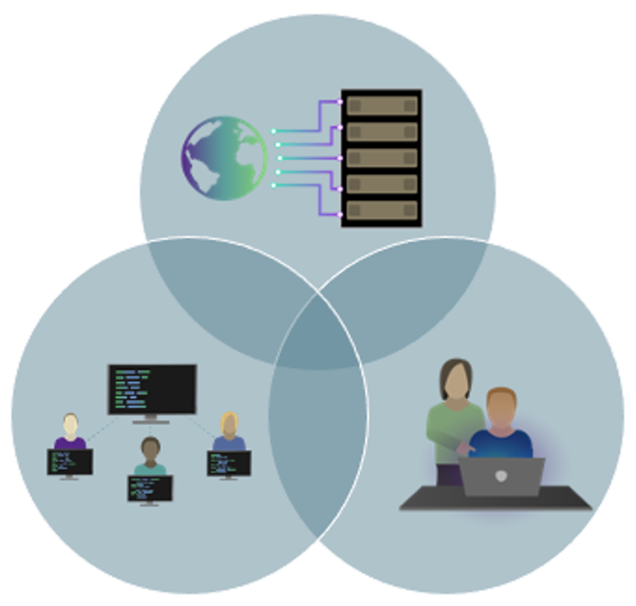
The NEODAAS AI Service
NEODAAS is a NERC facility, overseen by NCEO, which provides facilities for environmental AI research.
Knowledge and Expertise on AI
Hardware Facilities
Training and Support
Earth Observation data processing and analysis

Slide 5
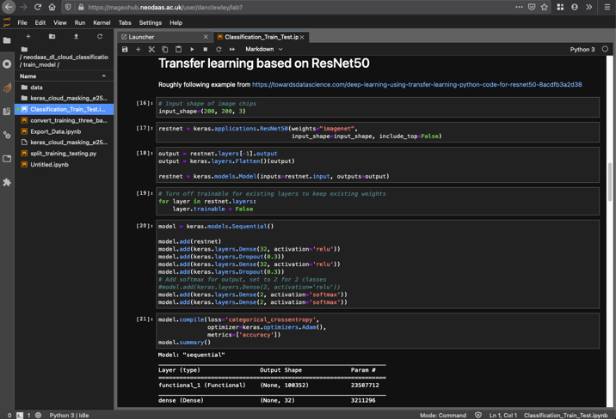
Aims of MAGEOHub
Provide users with easy access to a GPU and libraries for training material and model development.
Scale methods to run on larger cluster as needed
Convert to command line script
Singularity
Slurm

Slide 6
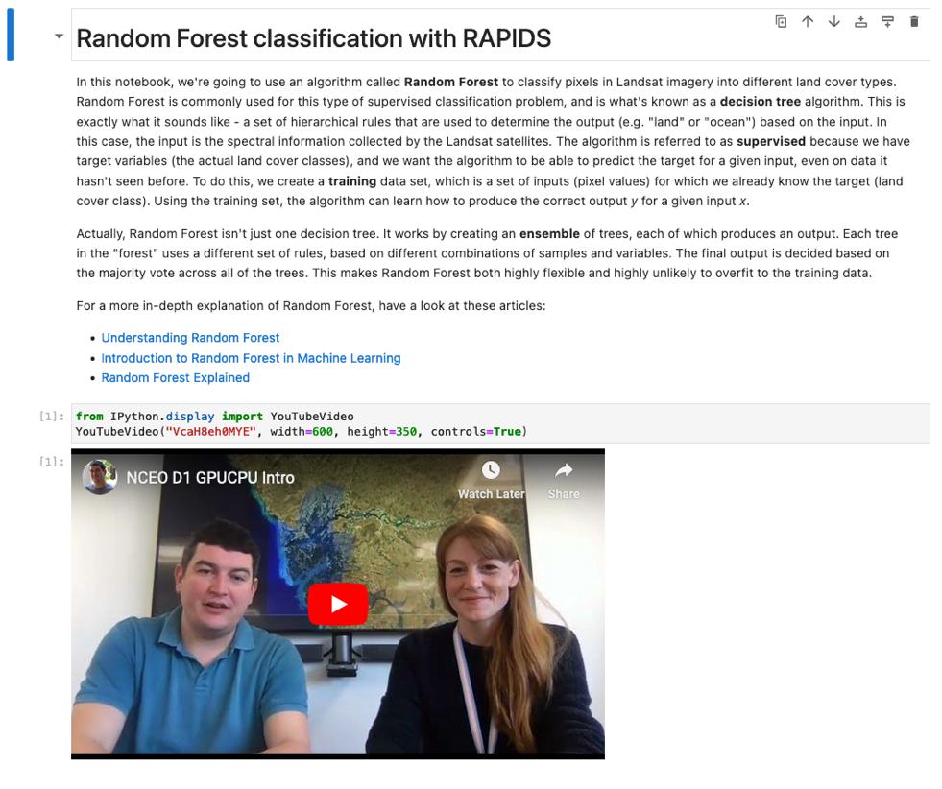
Training Notebooks – Random Forests with RAPIDS
Random forest for image classification (pixel based)
Use GPU for larger training dataset

Slide 7
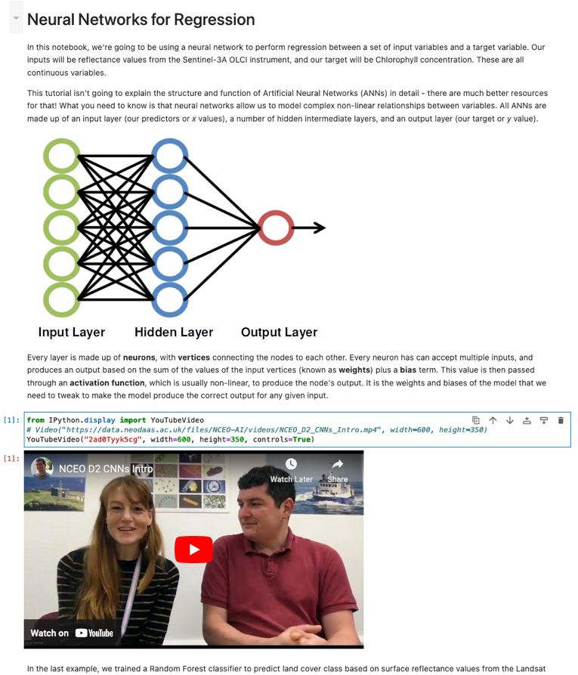
Training Notebooks – Neural Networks for Regression
Use satellite data to predict a variable (chlorophyll)
Introduction to theory

Slide 8
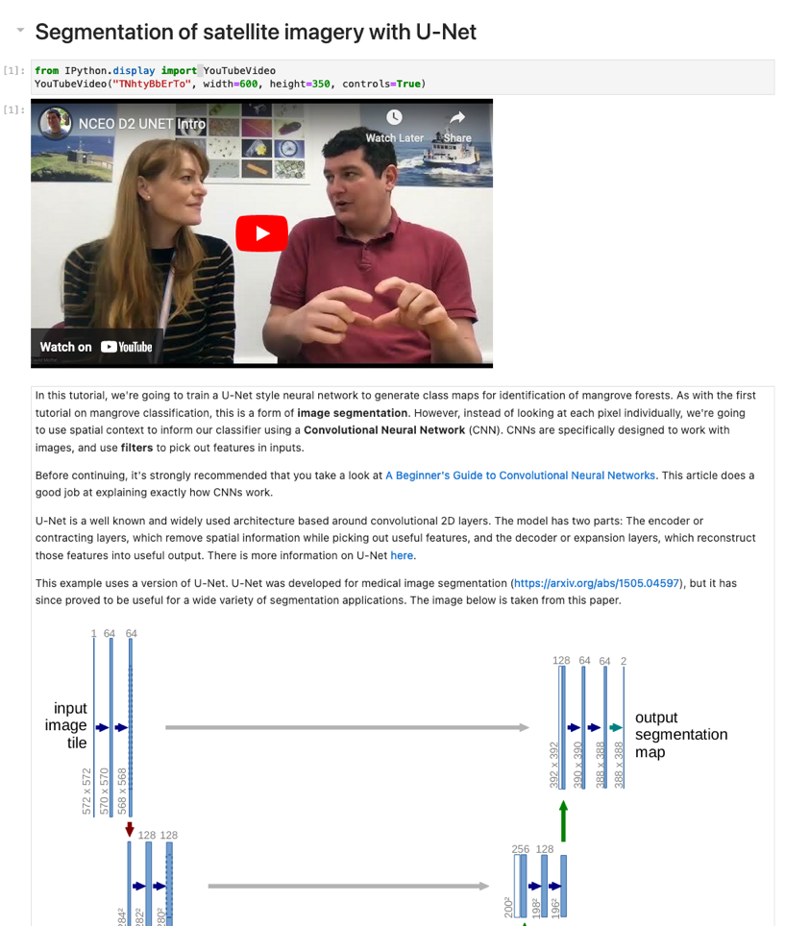
Training Notebooks – Segmentation of satellite imagery with U-Net
Uses mangrove classification as an example
Allows comparison with pixel-based classification shown in notebook 1

Slide 9
Future Plans
Keep developing notebooks to showcase new AI methods / libraries
Focus on real world examples where possible
Code that can easily be adapted to different applications

Slide 10
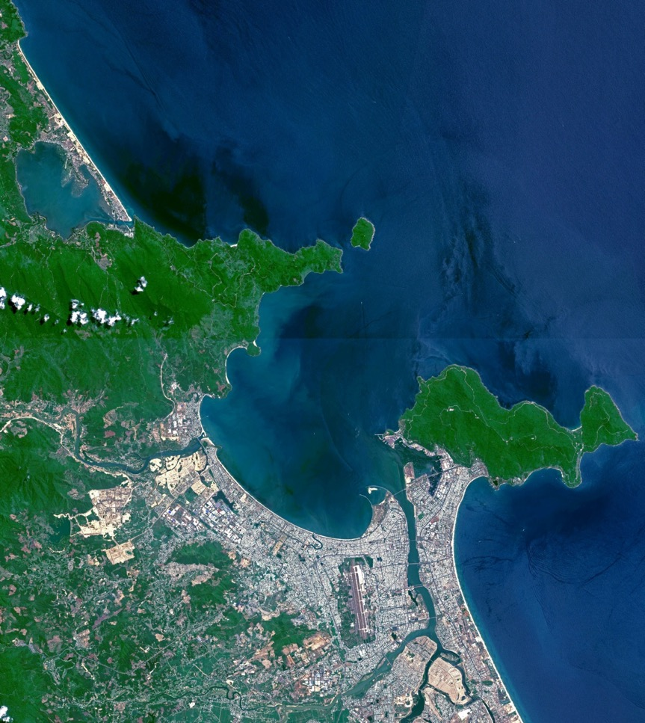
Contact Details
Website: https://www.neodaas.ac.uk
Email: helpdesk@neodaas.ac.uk
X (Twitter): @NEODAAS

