Slide 1
NASA DEVELOP - Current Situation & Training Needs

Slide 2
Executive Summary
DEVELOP Program Description
  Not a training program per se – an experiential-learning approach to workforce DEVELOP with training as support to ~50 project teams per year
Current Training Approach
  Employs a Software Carpentry live coding format
  Looks to Software Carpentry for basic curriculum
  Struggles with intermediate content that connects learners to Earth observations
Training Needs/Future Aspirations
  Need centralized notebooks/tutorials with clear open-source licensing
  Need to move away from downloaded data
DEVELOP Interests
Moving away from the data download model
Need community-developed notebooks in a centralized repository
Relying on Software Carpentry governance framework for consistency of curriculum, support processes, instructor training
Require clarity in licensing

Slide 3
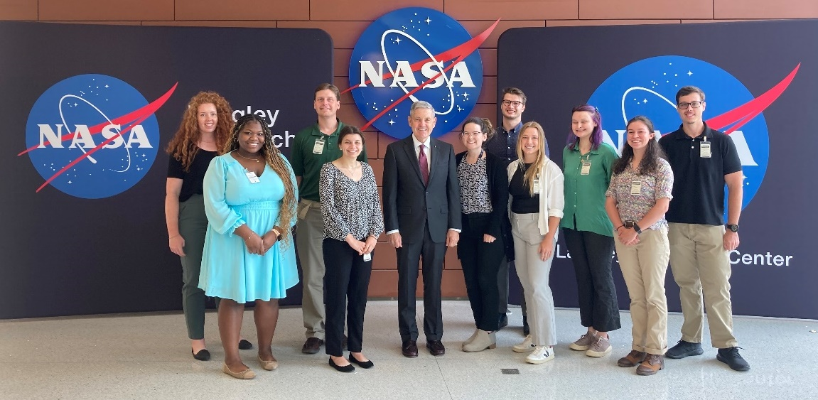
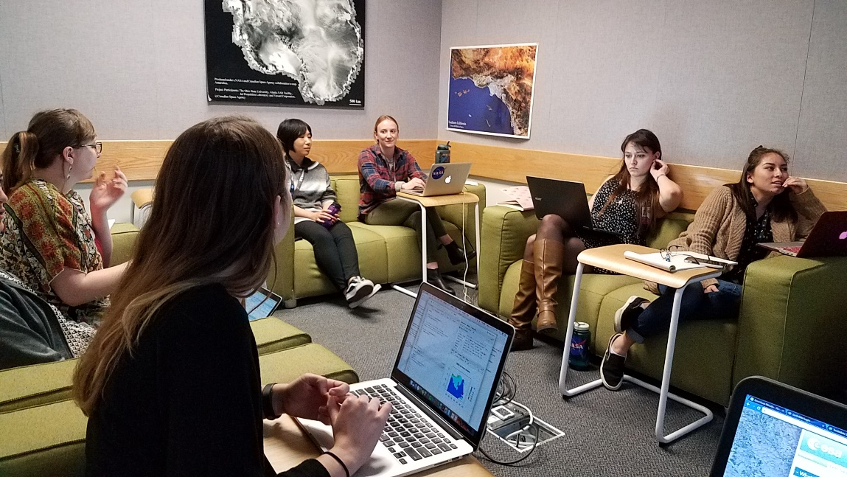
What is DEVELOP?
Geospatial workforce development
Demonstrates EO capabilities for informing action
Conducts Earth science application feasibility studies in 10-week terms
Dual capacity building – engages:
  Individuals: recent grads, early & transitioning career professionals, and students (18+)
  Institutions: local & state govt, non- & for-profits, federal govt, international, academia, etc.

Slide 4
Why DEVELOP?
Mission: Integrating NASA Earth observations with society to foster future innovation and cultivate the professionals of tomorrow by addressing diverse environmental issues today.
Vision: Shaping the future by integrating Earth observations into global decision making.
Expanding awareness & appreciation of, and appetite for, NASA EO data
Improving technical, geospatial & communication skills of participants
Increasing motivation, competence, and agency of individuals to use EO
Enhancing institutional capacity to use EO through proof-of-concept studies
Long term
Supports integration of EO in environmental decision making

Slide 5




DEVELOP Project Characteristics
Center on environmental decision-makers’ priorities & decision-making process
Assess the feasibility of NASA Earth science information to inform action in just 10 weeks
Conducted by a team of participants & managed by a DEVELOP Lead
Advised by NASA and partner science advisors
Create a consistent set of deliverables
Hand-off tailored end-products at end to partner
Focuses on at least one of 10 thematic application areas →
DISASTERS
WILDFIRES
AGRICULTURE
ENERGY
ECOLOGICAL FORECASTING
WATER RESOURCES
URBAN DEVELOPMENT
CLIMATE
HEALTH & AIR QUALITY
TRANSPORTATION & INFRASTRUCTURE

Slide 6




Dual Capacity Building
Mechanism to build skills and competency for using Earth observations to inform decisions:
Rapid Feasibility Projects 2023
71
Participants
Feasibility Projects Conducted
Partners
285
151
Capacity-Building
Opportunities Provided
Unique Partner
Organizations Engaged

Slide 7
DEVELOP Coding Training Needs
DEVELOP training is primarily internal; it is focused on building capacity in the 200+ DEVELOP participants per year, with coding-based trainings occurring three times per year (Spring, Summer, and Fall terms)
DEVELOP training must support learners with diverse competencies (beginner to advanced) and project needs (~50 unique projects per year)
Training must be sufficient to inspire need self-learning, but must be succinct so as not to impact tight 10-week project execution

Slide 8
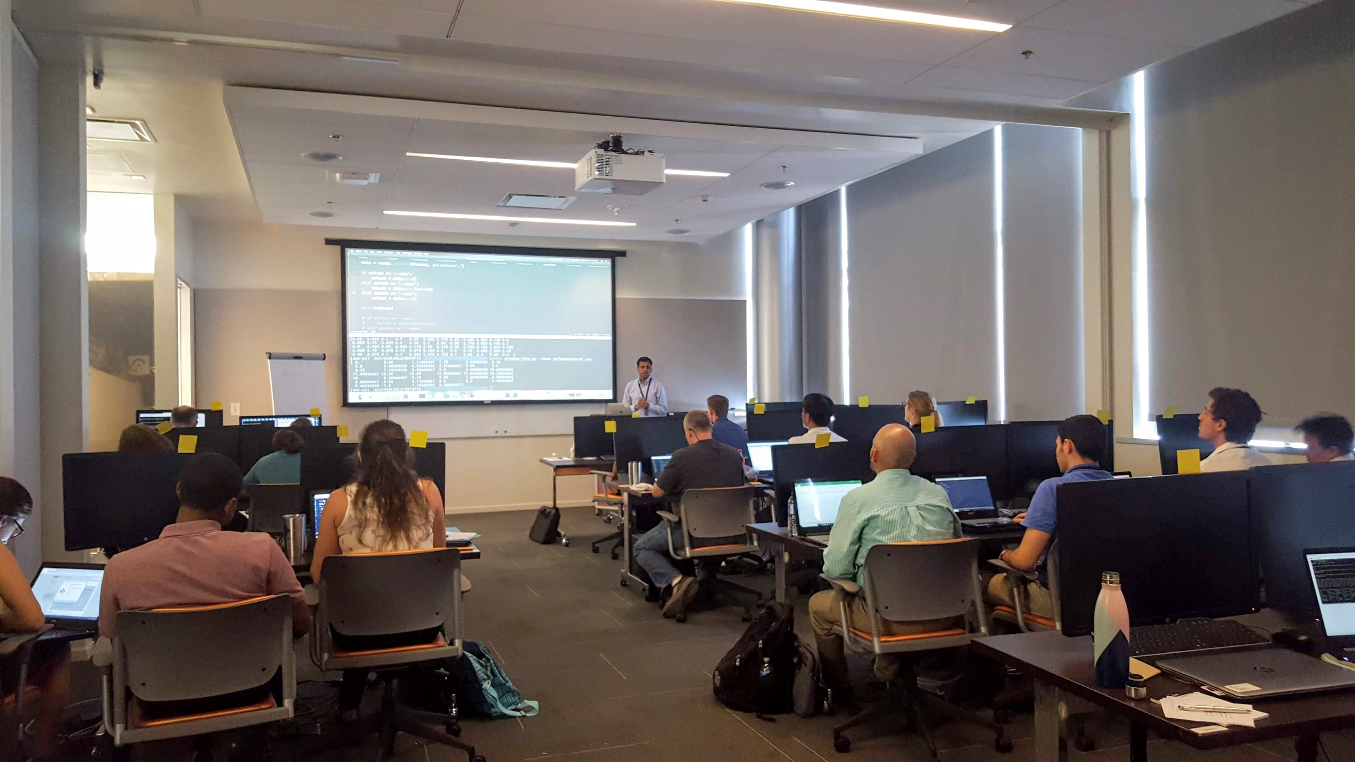


DEVELOP Software Carpentry Beginning
Objective: Offer DEVELOP participants opportunities to build skills in data science and coding
2018 – Membership formalized with Carpentries
In-person workshops held at NASA centers
    6 instructors trained
    2019 – In-person workshops held at NASA centers
    6 instructors trained
Image: DEVELOP Software Carpentry workshop pre-COVID

Slide 9
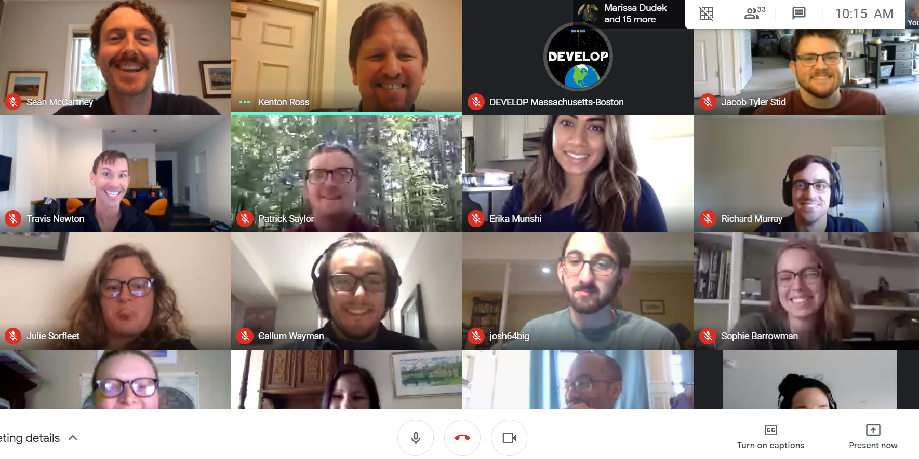
DEVELOP Software Carpentry Approach
2020–2022 – Virtual workshops open to all DEVELOP participants
    Collaboration with Geospatial Centroid (CSU)
    6 instructors trained
    2023 – Hybrid workshops open to all DEVELOP participants
    Collaboration with Geospatial Centroid (CSU)
    5 instructors to-be currently going through training
Image: DEVELOP Software Carpentry workshop (2020)

Slide 10
DEVELOP Software Carpentry Details
Curriculum:
  The Unix Shell
  Version Control with Git
  Programming with Python
  Programming with R
  Introduction to Geospatial Raster and Vector Data with Python (Alpha stage)
Workshops:
  Hybrid: In-person with Microsoft Teams
  Virtual machines available to DEVELOP participants
  75 – 100+ workshop participants (depending on DEVELOP term)
  ~10 helpers assisting with each workshop
Instructors:
  30 trained instructors (~10 active )
  5 instructors to-be currently going through check-out steps

Slide 11
Discussion
Would NASA DEVELOP like to see software carpentry styled notebooks linked to platforms?
  Absolutely; DEVELOP wants to move its learners/participants away from download model, and generally toward open science
Would DEVELOP like to see community-developed notebooks in a centralized repository?
  Yes. An example in the direction DEVELOP needs is NASA Openscapes (https://nasa-openscapes.github.io/)
Governance issues?
  DEVELOP relies on Software Carpentry for governance of basic curriculum, workshop support processes, and instructor training
  Other notebooks/curriculum need similar governance framework with, at a minimum, clear and consistent licensing

