Slide 1
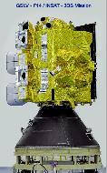
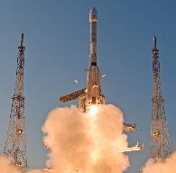
ISRO Agency Report
Indian Meteorological Satellite INSAT-3DS Successfully Launched on 17th Feb 2024 by GSLV-F14 Flight
Nitant Dube, ISRO
Agenda Item 3.4
WGISS-57
4-7 March 2023
Sydney, Australia

Slide 2
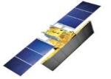
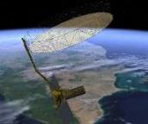
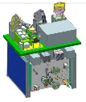
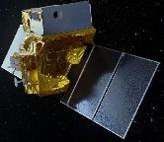
Upcoming EO missions
Next Generation Resourcesat-3
High resolution Stereo Resourcesat-3S
RISAT-1 Series
(constellation)
HRSAT 1,2,3
Wide Swath imaging with improved spatial resolution
Concurrent Stereo & MX imaging
All-weather;
Day& Night Imaging
Daily re-visit of Area of Interest
L & S Band SAR (NISAR)
High res. TIR & VSNIR (TRISHNA)
Oceansat-3A
G20 Satellite
All-weather;
Day & Night Imaging
Ocean Color & Wind vector – Continuity + SST
Environment & climate change
Thermal Imaging
29-Feb-24

Slide 3
ISRO Geo-portals
Geospatial Analysis
Vegetation Monitoring
Solar & Wind Energy Calculator,
Water Spread
Polar Science
AI based Urban Sprawl & More …
Meteorological & Oceanographic Data Archival, Analysis and Dissemination
Store for Indian Meteorological and Oceanographic Satellite Data
Near Real time Visualization and Analysis
194 Products and 23 application
Geospatial Data & Services
Visualize Satellite Imagery & Maps
Create
Download
Host & Analyse
30 State Portals
Supports 24+ Ministries & More…
https://bhuvan.nrsc.gov.in
https://vedas.sac.gov.in
https://mosdac.gov.in

Slide 4
ISRO Geo-Portals
Bhoonidhi : Data repository of remote sensing satellites of the Indian Space Research Organisation, facilitates the dissemination of satellite data products to online users on web.
47 Satellites
https://bhoonidhi.nrsc.gov.in
33 Years of Satellite data
API services

Slide 5
Geo-Spatial Data Policy
In line with Indian Space Policy 2023 following are highlights of EO data dissemination Guidelines
Data of 5m spatial resolution & coarser: The IRS satellite data & products, both current/future data and archived data since 1988, having a spatial resolution of 5 m & coarser, acquired by ISRO through its ground stations in India and abroad, will be made accessible on 'free and open' basis to all.
The above data sets are available for free download from Bhoonidhi

Slide 6
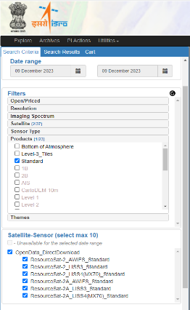
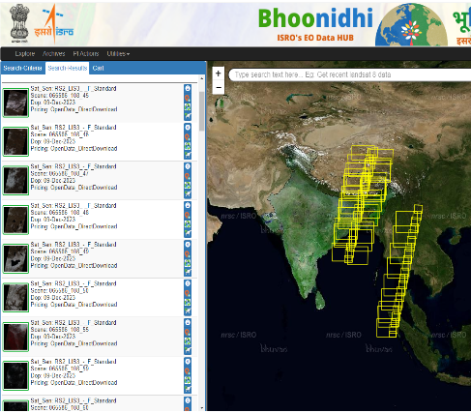
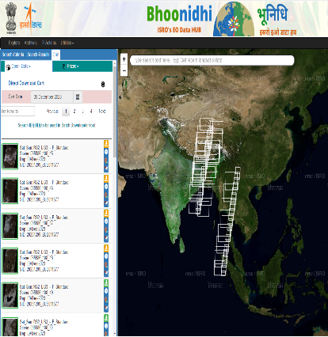
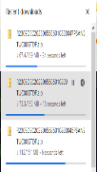
ISRO EO Data Hub - Bhoonidhi
Bhoonidhi is data repository of remote sensing satellites including India and Foreign remote sensing sensors, facilitates the dissemination of satellite data products to online users on web.
New Open data Policy : Indian Space Policy 2023 is implemented at Bhoonidhi for EO data dissemination.
Data of 5m spatial resolution & coarser made accessible as free data to all and derived thematic IRS data made available free to all
Data finer than 5m spatial resolution made available free for all Indian government agencies.
Data finer than 5m spatial resolution dissminated on ‘commercial’ basis by NSIL for Non Government Entities (NGEs) through Bhoonidhi
Ease of Browsing & ordering: new filter based search, new CART interface, color coded map display
User can search the desired data by using filters like Open/Priced, Resolution, Imaging Spectrum, Satellite, Sensor Type, Products, Themes etc.
RS2 - LiSS3/ AWiFS
R2A - LiSS3/AWiFS

Slide 7
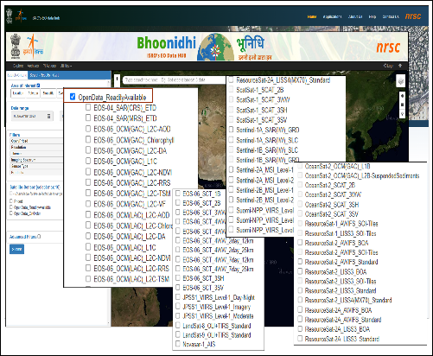
ISRO EO Data Hub - Bhoonidhi
New Product Additions in the repository
EOS-06 SCAT L4WW products (2-day, 7-day, 15-day rolling mean)
Resourcesat-2 AWiFS 10deg x 10deg Tiles (5-day, 15-day composites) @100m . Availability is from today backdated till October and generation is in process for all the data
Resourcesat 1&2 AWiFS 1deg x 1deg Tiles (Dec 2009 – Nov 2019), Liss3 15min x 15min tiles (Oct 2009 –May 2019)
https://bhoonidhi.nrsc.gov.in

Slide 8
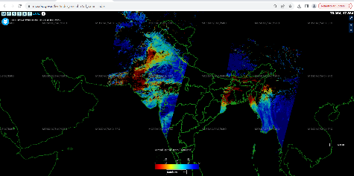
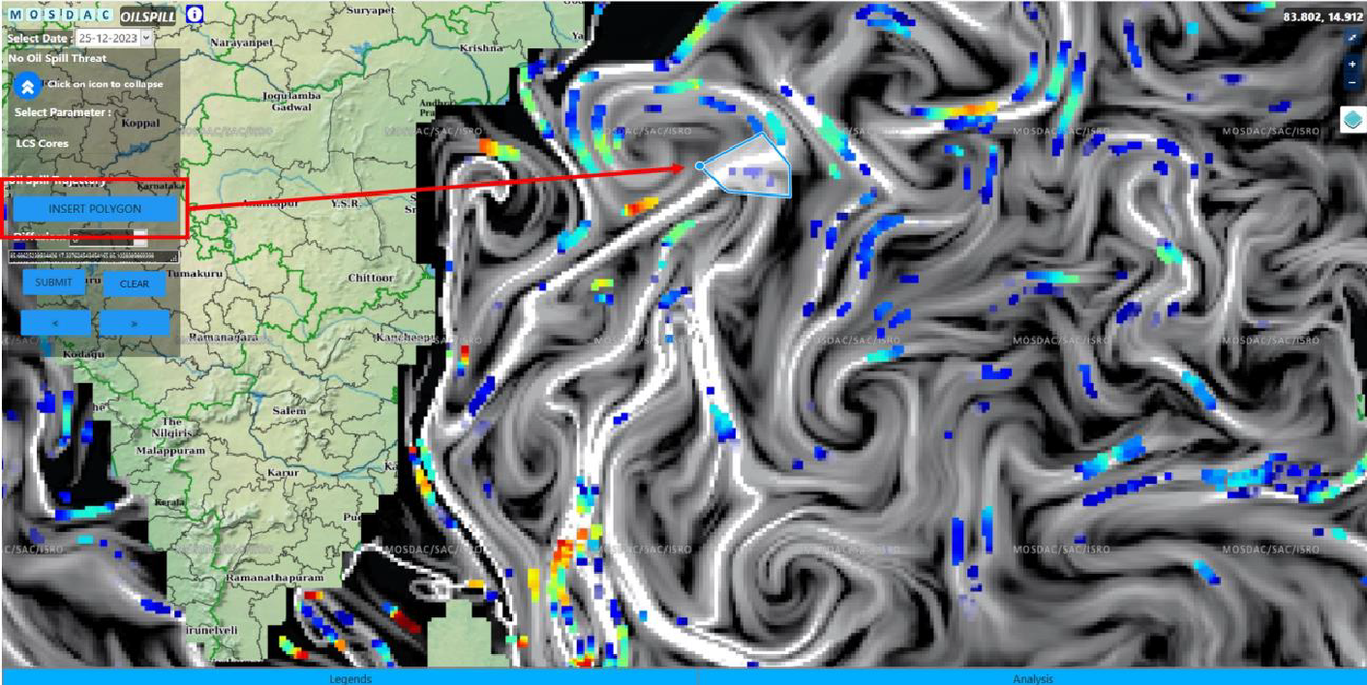
Meteorological and Oceanographic Satellite Data Archival Centre
EOS-06 (Oceansat-3) OCM Aerosol Optical Depth over Land released
Integration of Oil Spill trajectory forecast tool in Oil spill web application
INSAT-3DS Products will be available on MOSDAC after completion of In-Orbit Testing (IoT)

Slide 9
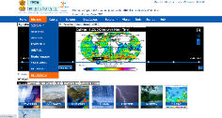
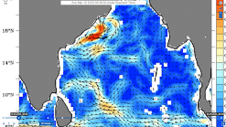
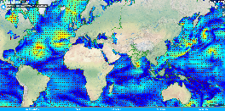
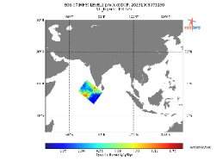
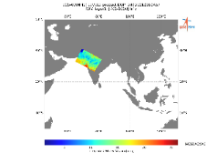
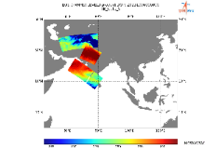
New Release of EOS-06 & EOS-07 Science Products
EOS-06 Mission Pages
EOS-06 Global Ocean Surface Current
Integration of EOS-06 Products into LIVE
EOS-07 Specific Humidity
EOS-07 Integrated Water Vapour
EOS-07 Brightness Temperature

Slide 10
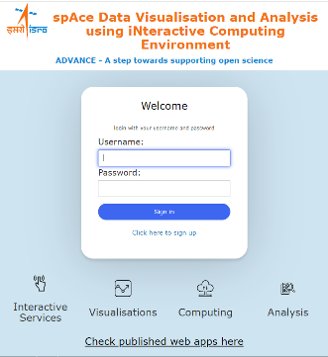
SPACE Data Visualisation and Analysis using iNteractive Computing Environment (ADVANCE)
ADVANCE: A Tool to promote Open Science
Interactive Services
Jupyterhub based services
Allows users to remotely login and process their data
Uses Kubernetes clusters to support scalability
Publish Jupyter notebooks as web-apps using Mercury
Interactive Computing
Access data and process it interactively using Notebooks without requirement of downloading data
Visualization
Interactive Visualization of data directly on web using widgets (ipywidgets, ipyleaflet, bqplot, pythreejs, ipyvolume, nglview)
Analysis
Use python for carrying out processing and analysis of Space and Planetary data and download only the processed data/information

Slide 11
Thanks
nitant@sac.isro.gov.in

