Slide 1
CEOS Analysis Ready Data (CEOS-ARD)
Matt Steventon
CEOS-ARD Oversight Group & LSI-VC Secretariat
WGISS-57
5 March 2024

Slide 2
Motivations

Slide 3
Motivations
Easing the use of satellite EO data to reach new non-expert users and increase data uptake and use
Provision of analysis-ready geophysical measurements
Reduce pre-processing burden for users
Facilitate analysis in the cloud
Reduce egress and processing
Provide a first step for interoperability
Open and transparent
Common starting point; consistency
Promote clear documentation of processing steps
Capitalise on space agency expertise and experience
Best available science and high quality processes

Slide 4
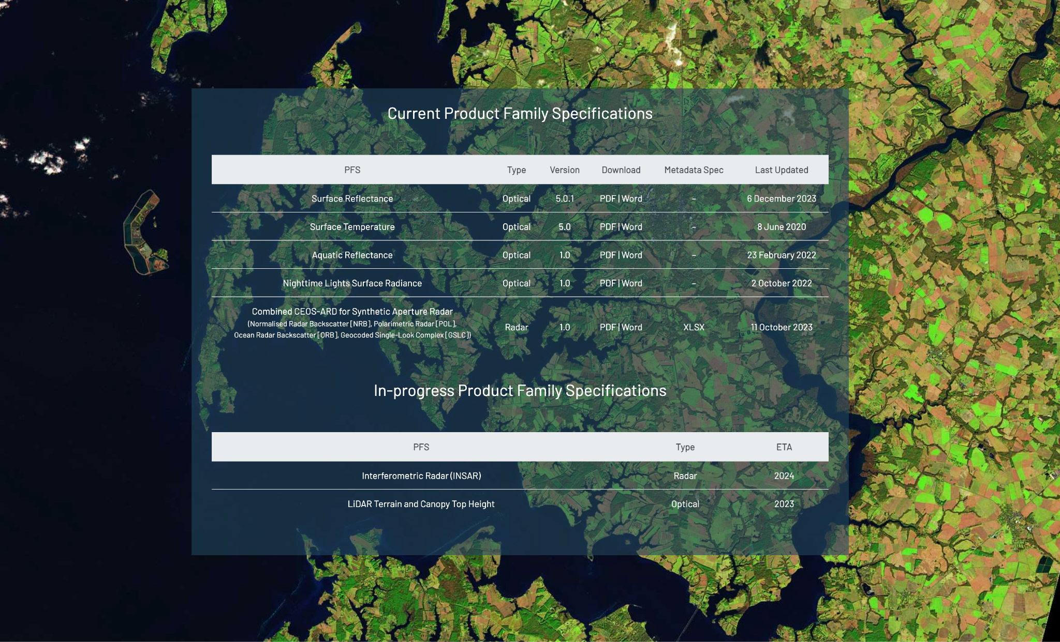
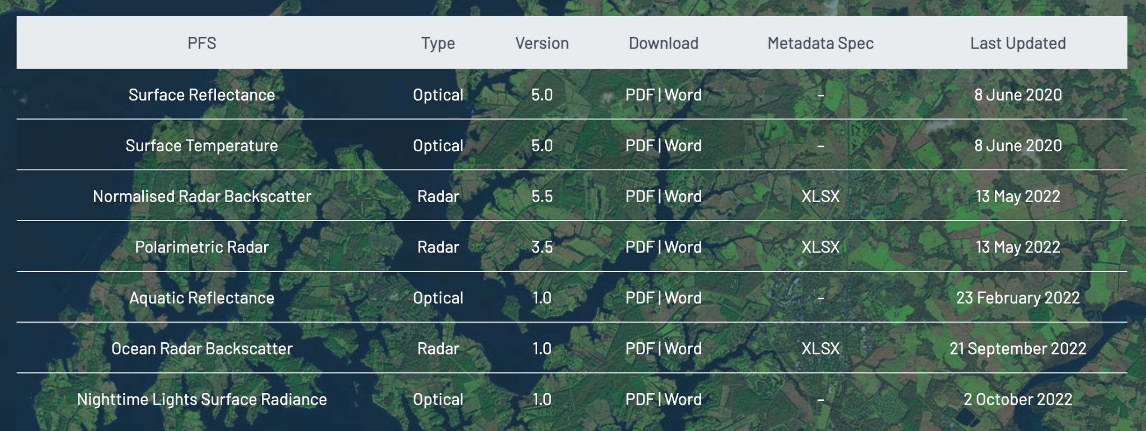
Current + In-development CEOS-ARD Specifications
Land
Inland and Coastal Waters
Oceans
Optical
Surface Reflectance
Surface Temperature
Nighttime Lights Surface Radiance
LiDAR Terrain and Canopy Top Height
Radar
Normalised Radar Backscatter
Polarimetric Radar
Geocoded Single-Look Complex (GSLC)
Interferometric Radar (INSAR)
Aquatic Reflectance
Ocean Radar Backscatter
Precipitation?
Sea Surface Temperature?
Ocean Reflectance?
Atmospheric Composition ?
http://ceos.org/ard/index.html#specs

Slide 5
CARD4SAR – One PFS to Rule Them All
Single PFS for all CEOS-ARD SAR products:
NRB, POL, ORB, GSLC
Benefits:
Ensure consistent parameter names and specifications across all SAR PFSs
Simplify PFS revisions and change tracking
Simplifying interface with ongoing external standarisation frameworks (OGC/ISO, STAC)
Elegance:
CARD4SAR PFS facilitates the generation of one, several or all of the CARD SAR products – a true combined SAR ARD product
Reduces duplication of per-pixel metadata
CEOS-ARD for SAR

Slide 6
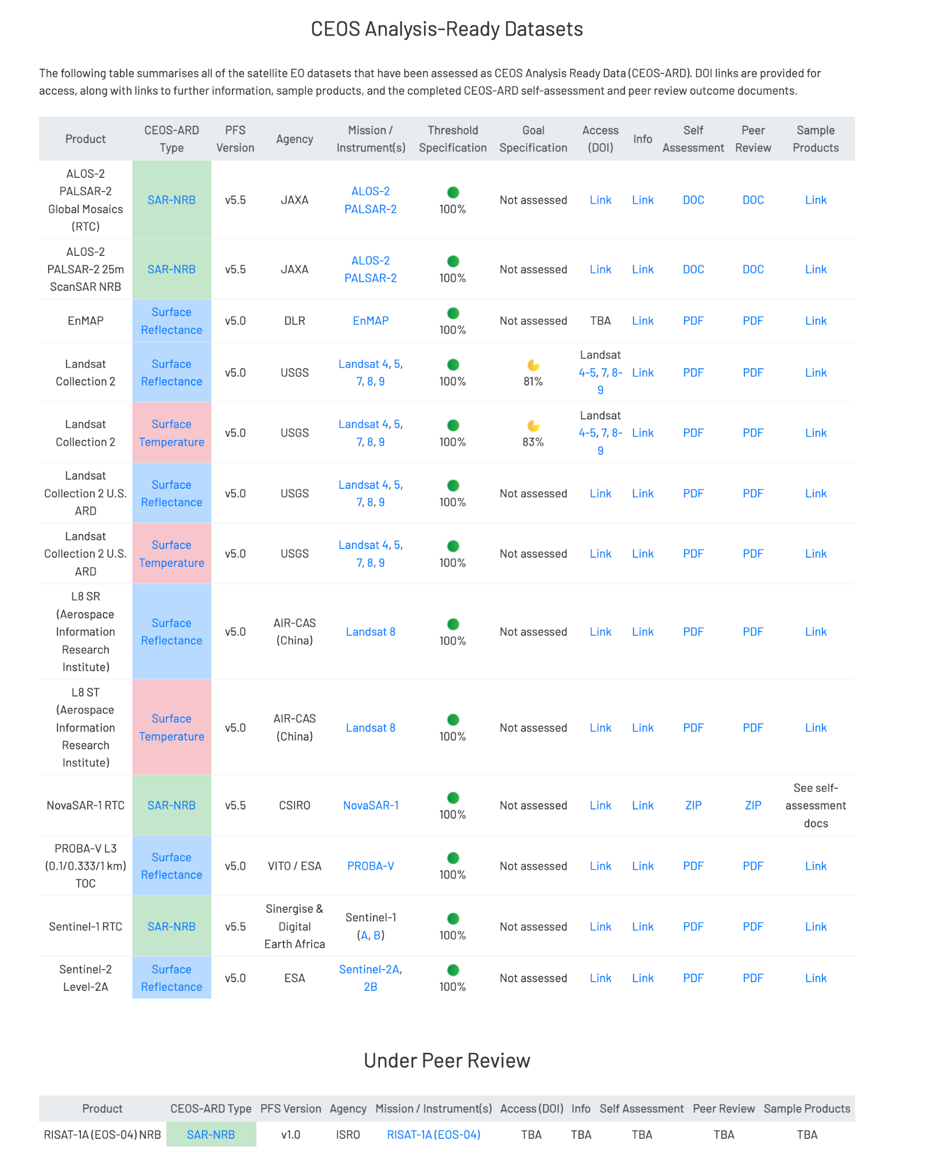

Slide 7
Under Development
KOMPSAT-3/3A Surface Reflectance
KOMPSAT-5 Normalised Radar Backscatter
SPOT 1-7 Surface Reflectance
RISAT-1A (EOS-04) NRB SAR
Resourcesat-2/2A
NovaSAR
SAOCOM
Gaofen-1/6 Surface Reflectance
AVHRR LST Surface Temperature
DESIS L2A Surface Reflectance
EnMAP Aquatic Reflectance
Sentinel-1
OPERA project

Slide 8
Status of ESA CEOS-ARD Products
Mission | Product | PFS | Status | Availability Date
Sentinel-2 | L2A | SR | ✅ | January 2022
PROBA-V | Collection 2 | SR | ✅ | March 2023
Sentinel-2 | L2H | SR | Under Development | 2023 (pilot product), TBD (operational product)
Sentinel-2 | L2F | SR | Under Development | 2023 (pilot product), TBD (operational product)
Sentinel-2 | L2A | AR | Under Development | TBD
Sentinel-1 | NRB / ORB | NRB / ORB | Under Development | TBD
Sentinel-3 | SYN | SR | Under Development | TBD
ERS SAR | TBC | NRB | Under Development | TBD
ERS ATSR | TBC | LST | Under Development | 2024
Envisat ASAR | TBC | NRB | Under Development | TBD
Envisat MERIS | TBC | SR | Under Development | 2024
CHIME | L2A | SR | Under Development | 2029
CHIME | L2H/L2F | SR | Under Development | 2029 (pilot product), TBD (operational product)
LSTM | L2A | ST, SR | Under Development | 2029
LSTM | L2H/L2F | ST, SR | Under Development | TBD
ROSE-L | TBD | NRB…TBC | Under Development | TBD

Slide 9
CEOS-ARD Strategy 2024 and WGISS Support

Slide 10
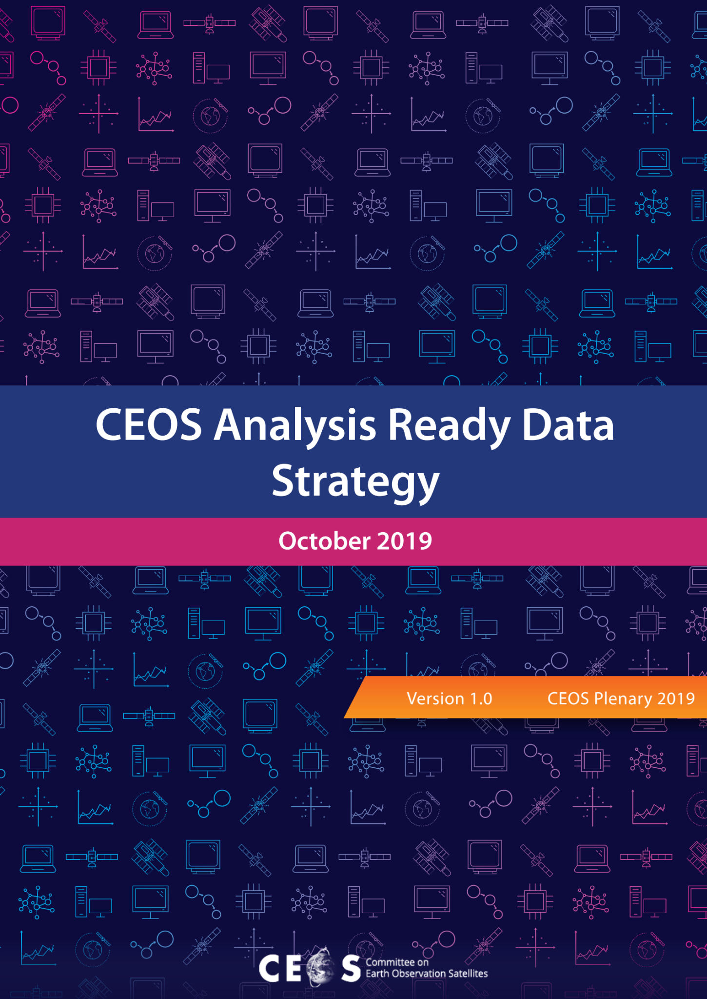
CEOS-ARD Strategy 2024
Update to past editions from 2019 and 2021
Reflect on the progress to date, take stock of future directions and needs, and confirm our strategy for the next few years
To achieve our stated objectives, a broad portfolio of CEOS-ARD that is easily discovered, accessed and utilised is the ultimate goal.
Some aspects of the strategy directly related to WGISS:
Maximising the discoverability and accessibility of CEOS-ARD by getting CEOS-ARD in the cloud, easily identifiable, discoverable, accessible, and in close proximity to users and their tools, and ensuring maximum ‘machine-to-machine’ functionality.
Advancing interoperability of CEOS-ARD by leveraging the CEOS Interoperability Framework and its principles.

Slide 11
CEOS-ARD Strategy 2024
The Strategy activities are categorised into five broad themes:
CEOS-ARD Availability, Product Diversity, and Representation
Framework and Specification Advancement
Discovery, Access, Utilisation, and Interoperability
Community Engagement
Research, Test Cases, and Pilot Activities
WGISS support key!

Slide 12
2: CEOS-ARD Framework and Specification Advancement
CEOS-ARD Strategy 2024
2.1: Evolution of the CEOS-ARD Framework
2.1.1: Issues with CEOS-ARD replica datasets, confirming authenticity, and inherited CEOS-ARD compliance
Mechanism for mirrored datasets; inherit CEOS-ARD compliance; testing authenticity and compliance of copies; identifying original source of CEOS-ARD compliance
2.1.2: CEOS-ARD product Levels
A Revised Processing Level Scheme For Earth Observation Data (Strobl, 2023) (http://doi.org/10.2760/46796).
2.1.3: Terminology
Consistent terminology across PFS and Framework, leverage conventions of WGCV and WGISS
2.1.5: Product Family Specification and CEOS-ARD Product Version Control
Process to manage PFS updates and impact on previously completed assessments
How are changes to Specificationss best communicated to data providers?
2.2 Metadata specifications for optical specifications
Expansion of the CEOS-ARD metadata specification concept
Mapping / alignment of the PFS parameters to existing metadata specifications.

Slide 13
3: Discovery, Access, Utilisation, and Interoperability
CEOS-ARD Strategy 2024
3.1: Embrace the CEOS Interoperability Framework
Broadly, look to the WGISS Interoperability Framework for guidance on improving CEOS-ARD interoperability.
LSI-VC looking to identify gaps over the coming year.
3.2: Adoption of cloud native technologies and facilitate machine-to-machine access and utilisation
Updates to CEOS-ARD to promote machine-to-machine processes; mechanisms for ‘pushing’ updates about CEOS-ARD datasets; continued evolution of the CEOS-ARD STAC Extension, etc.
3.4 CEOS-ARD discoverability and branding
Increase the visibility and accessibility of CEOS-ARD datasets; leverage agency platforms; work with WGISS, the CEOS MIM Database team, and others across CEOS Agencies (e.g., ESA TPM, NASA DAAC, GES DISC, CDSE, etc.) to better promote the availability of CEOS-ARD in a consistent manner, with clear consistent branding, supporting documentation, etc.
3.5: CEOS-ARD on the cloud
Like 3.4 but with a focus on the commercial cloud ecosystem; engage with key cloud providers to ensure CEOS-ARD is promoted on their platforms where applicable and appropriately tagged using the CEOS-ARD logo and branding, etc.
3.6 Technical Advisory Notes
More specific implementation guidance while retaining flexibility in the non-prescriptive baseline provided by the PFS. e.g., on STAC, COGs, HDF5/netCDF, Zarr. Recommending guidelines for publishing source code whenever possible, suggesting succinct algorithm taxonomy/categorization to make it easier to advertise what algorithms were applied and in which order, etc.

Slide 14
CEOS-ARD Strategy 2024
All this is to say:
There is a lot of overlap with what we want to achieve with CEOS-ARD and what WGISS does
We need WGISS help – particularly on Discovery, Access, Utilisation, and Interoperability aspects of CEOS-ARD
Also need help understanding and fitting effectively with the CEOS Interoperability Framework
Need clear delineation of responsibilities and lines of comms
WGISS input on the CEOS-ARD Strategy is welcome (DRAFT)
How do we best work these aspects collaboratively?

Slide 15
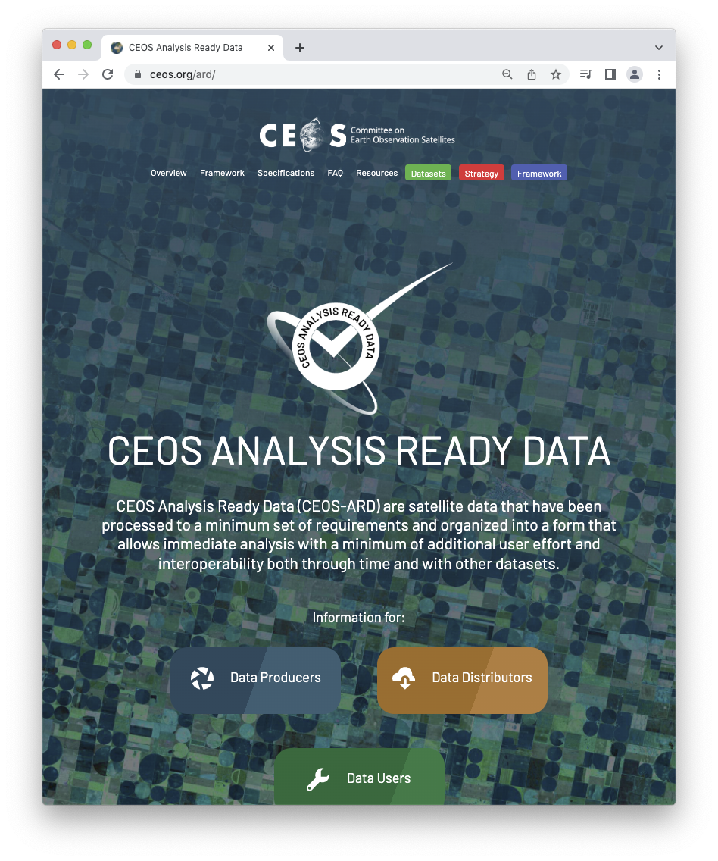
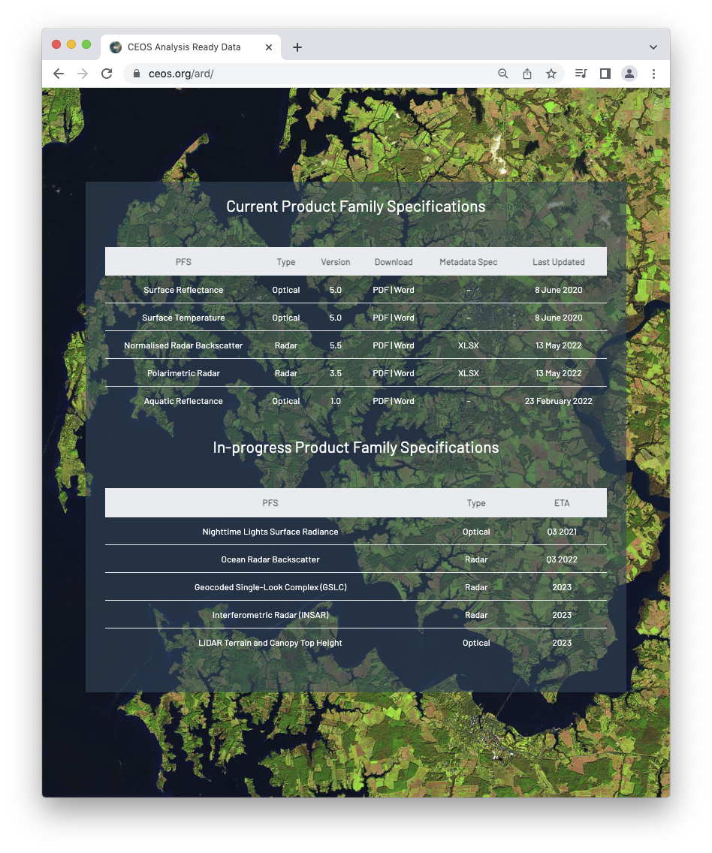
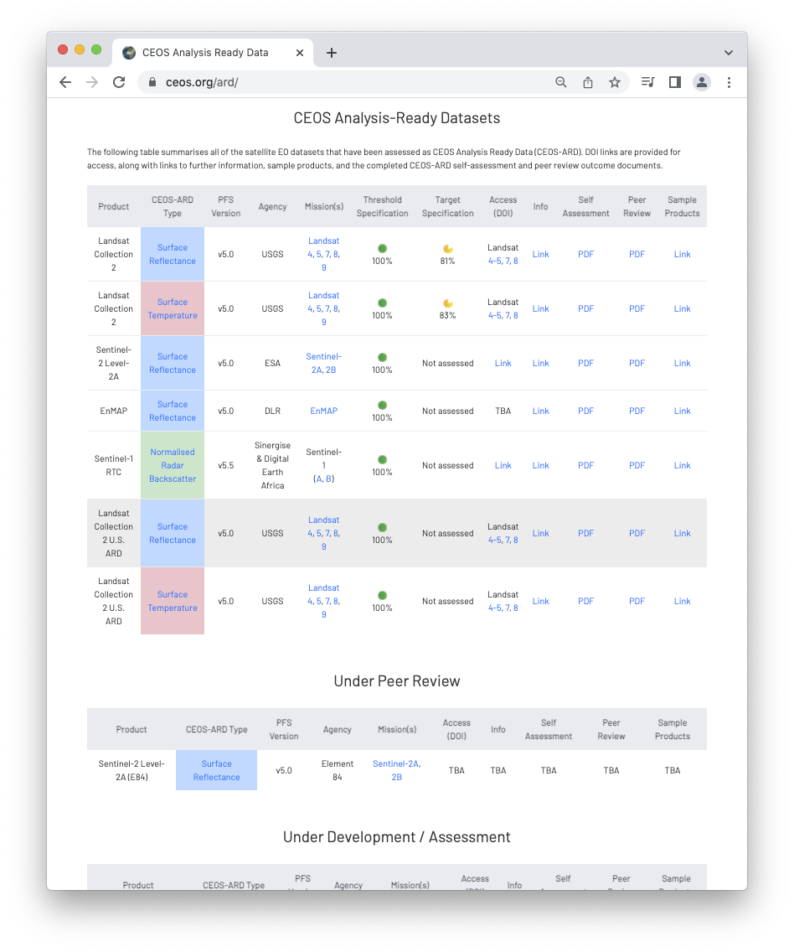
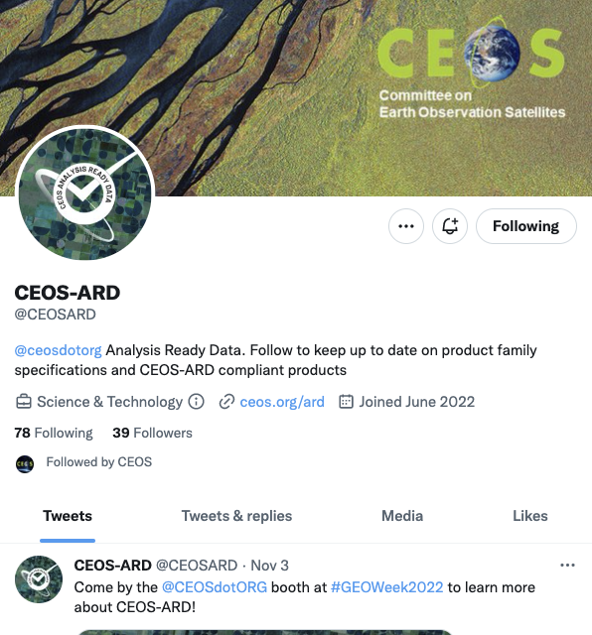
More information
ceos.org/ard
CEOS-ARD Newsletter Sign-up
Past issues: https://ceos.org/ceos-ard-newsletter/
https://twitter.com/CEOSARD
Contacts:
Ferran.Gascon@esa.int
matthew@symbioscomms.com
ard-contact@lists.ceos.org

Slide 16
Thank you!

Slide 17
CEOS-ARD Oversight Group Members
Ferran Gascon (Lead) SIT Chair Team
Matthew Steventon Secretariat
Andreia Siqueira LSI-VC
Steve Labahn LSI-VC
Peter Strobl LSI-VC
Maycira Costa OCR-VC
Mark Higgins OST-VC
Ed Armstrong SST-VC
Chris Kidd P-VC
Barry Lefer AC-VC
Medhavy Thankappan WGCV
Philippe Goryl WGCV
Makoto Natsuisaka WGISS
Jorge Del Rio Vera WGCapD
Mailing list: ard-oversight-group@lists.ceos.org

