Slide 1
Work Plan for Technology Exploration Interest Group (TEIG)
Yousuke Ikehata, JAXA
Agenda ID: 2024.3. 5_13:30
WGISS-57
5th March 2024

Slide 2
Technology Exploration IG
CEOS 2023-2025 Work Plan
Microsoft Word - CEOS Work Plan 2023-2025_v1.1
Section 3.9
The WGISS Technology Exploration Interest Group will survey cutting edge technologies related to the Earth observations. Survey results will be summarised and issued as guidelines and best practices.The “Jupyter Notebook Best Practices” is to be issued in 2023 by collaborating with WGCapD, UN, GEO, etc. Use cases of Artificial Intelligence / Machine Learning (AI/ML) focusing on EO research and applications will be investigated and summarised in a white paper in 2024.
Slide 2

Slide 3
Deliverable
Number | Deliverable | Projected Completion
DATA-22-01 | Jupyter Notebook Best Practice | 2023 Q4 -> 2024 Q2
DATA-23-01 | AI/ML White Paper | 2024 Q4

Slide 4
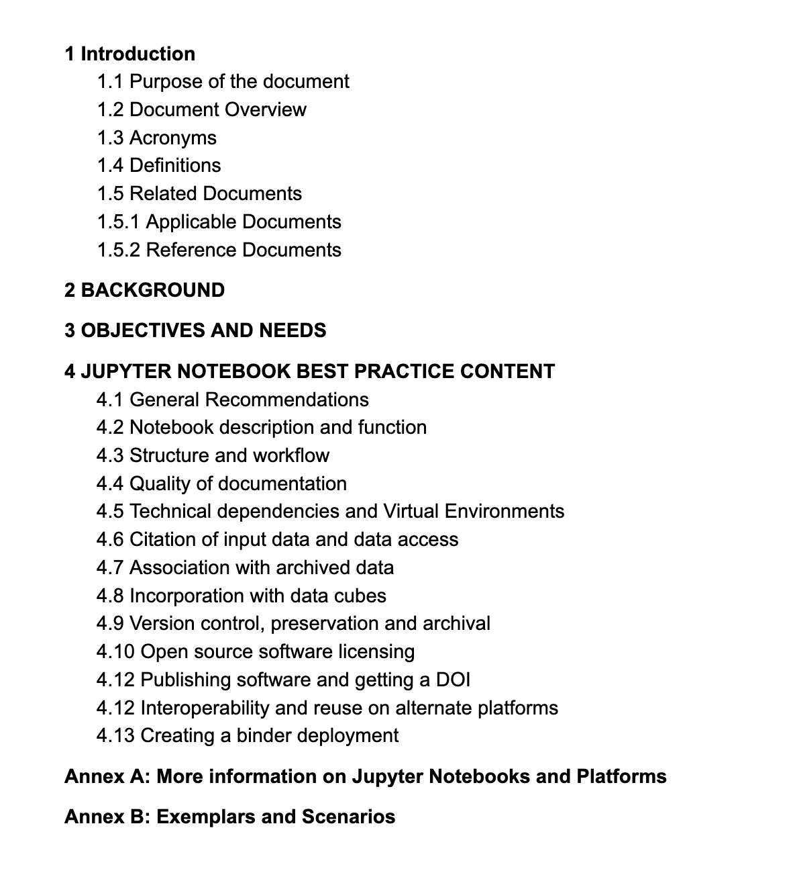
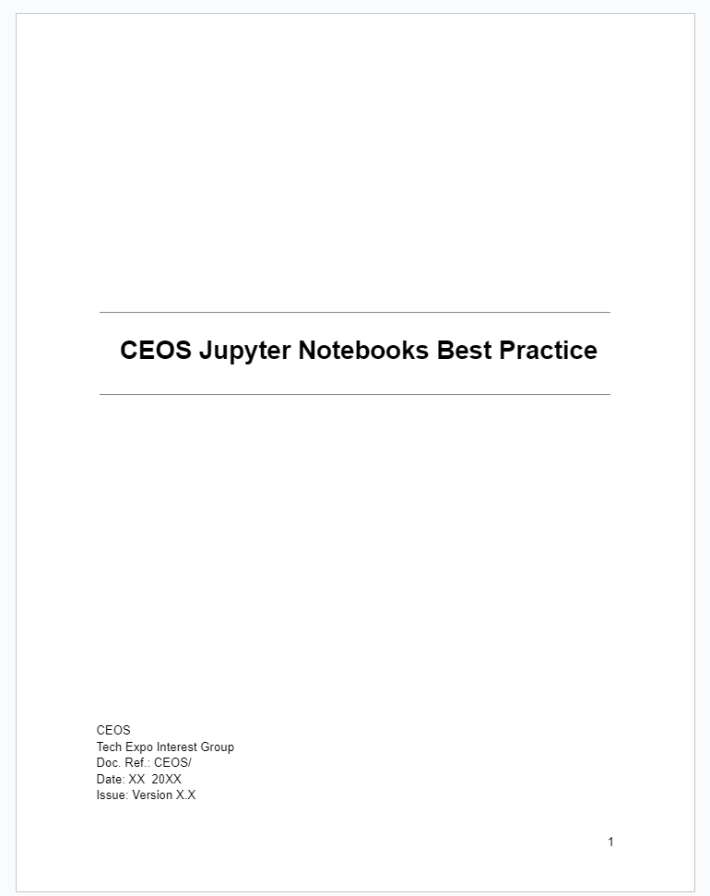
Best Practice Document Draft

Slide 5
Target Communities
Who will benefit from a Best Practice
Data Producers
Authors of Jupyter Notebooks
Providers of EO data training
Users of EO data
EO data archivers
Providers of Data Analysis Infrastructure

Slide 6
Objectives and Needs
Issues to be addressed:
Clear understanding the purpose of a notebook and deciding if it is a reusable asset. Successfully conveying how and why a notebook should be used by its intended community.
Encourage the development of good workflow and structure within notebooks along with quality documentation. Support their reuse and adaptation by new users
Support discovery of relevant notebooks in terms of dataset, domain, application/function and skill level
Delaying technical obsolescence and ensuring longevity of relevant notebooks
Maintaining the quality of archive by timely removal of redundant notebooks
Supporting interoperability of notebooks on different platforms
Lowering barrier for EO data exploitation and raising technical skill level
Slide 6

Slide 7
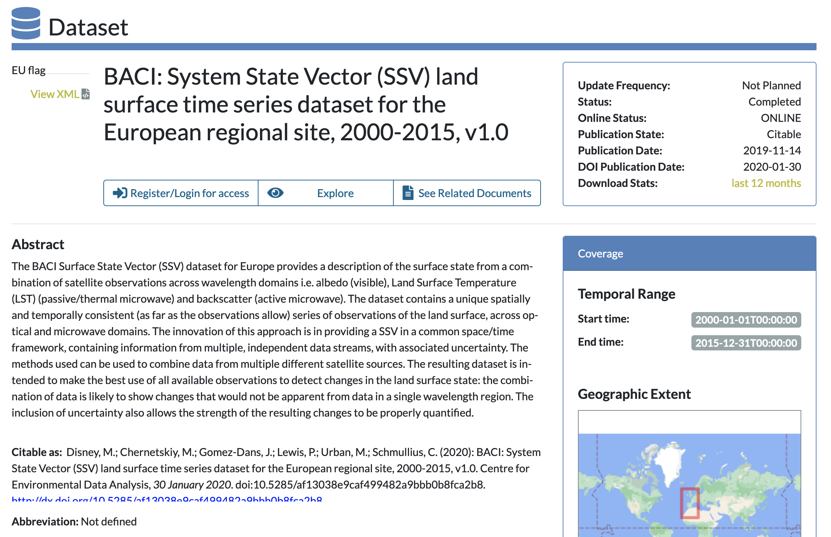
Structure, workflow and documentation
Encourage the development of good workflow and structure within notebooks along with quality documentation. Supporting their reuse and adaptation by new users
Good software engineering principles
Use of Functions
Use of Modules
Size of Notebook
Capturing Output
Linkages to external training materials
Information on formats and data structure
Support for novice users
Information on more complex processes and warnings

Slide 8
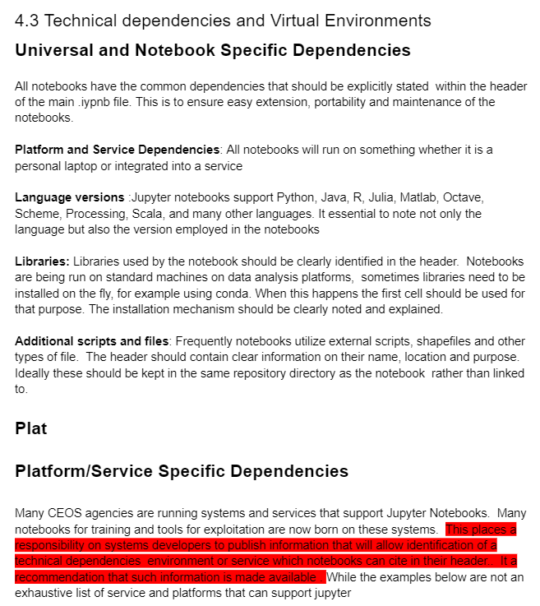
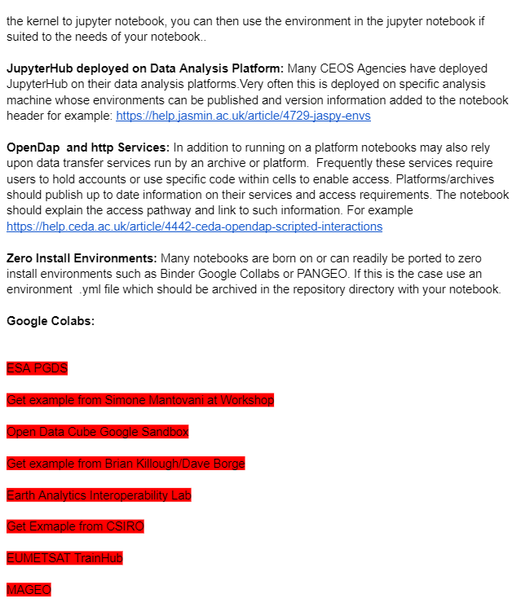
Actions
We need to fix some comments till deadline(2024 Q2).

Slide 9
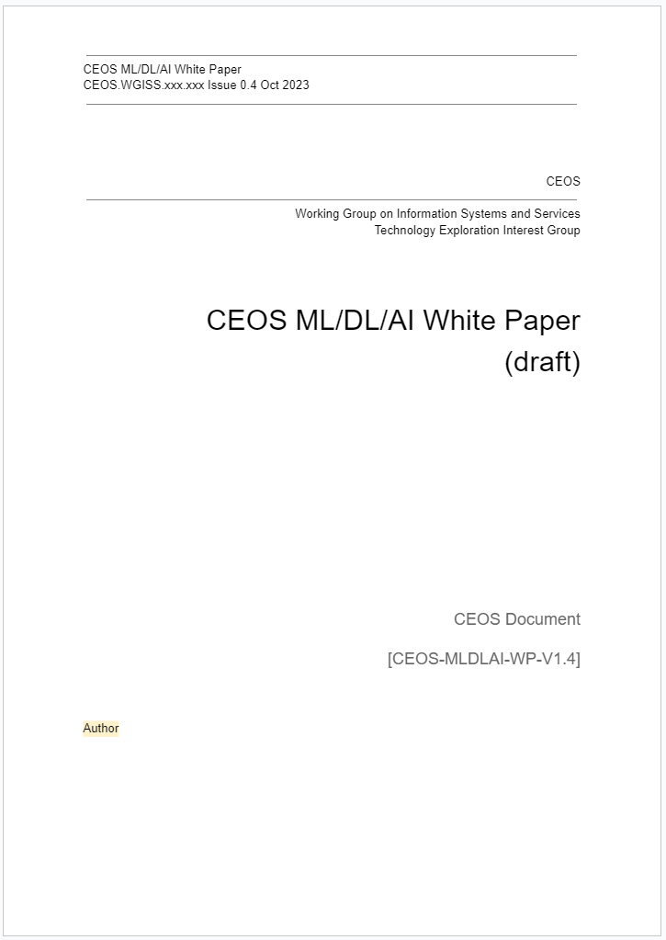
White Paper Draft
Purpose of this document
Expected readers
Project members
Background
Standards
Initiatives and Programs
Usagemethods of machine learning
Use cases at agency joined WGISS
Data and platform
Conclusion

Slide 10
Purpose of this document
This document introduces activities for analysis of Earth observation data using computational and data science methods, such as machine learning (ML) and artificial intelligence (AI) that various CEOS agencies have conducted to date.
Activities include initiatives/programs and individual use cases.
In addition, this document provides information for researchers who wish to conduct similar analysis.

Slide 11
Expected readers
Expected readers of this document are as follows.
Machine learning and AI researchers who use Earth observation data
Remote sensing researchers
Computational science / data science researchers
Data providers of Earth observation data
CEOS agencies
Data providers expecting usage of Earth observation data and composite data (Human flow data, administrative data)

Slide 12
Schedule updated
Share/Check Outline
In-house work
Allocate author to excels part.
Report in monthly meeting
Reorganize
Show draft
Publish
In-house work
Discussion
fulfill each section
Refinement
WGISS-54
WGISS-56
WGISS-57
WGISS-58
12 month
6 month
6 month

Slide 13
Federations
To make different organizations and platform to better cooperate with in mind a good energy efficiency.(exchange data by no duplication, no download)
We need to define and clarify the difference between “interoperability” and “federation”.

Slide 14
Deliverables(1/4)
ID | Action | Actionee | Status
WGISS-54-14 | Technology Exploration Interest Group to develop in-depth presentations at WGISS-55 on federation, including a call for proposals for federation. Due WGISS-55 | Technology Exploration Interest Group | Open

Slide 15
Deliverables(2/4)
ID | Action | Actionee | Status
WGISS-56-02 | Technology Exploration to explore the use of the AI/ML White Paper as a training topic in cooperation with WGCapD. | Technology Exploration | Open
WGISS-56-03 | ISRO team to provide a note on the use of AI/ML tools and techniques from the ISRO perspective for the AI/ML White Paper. | Technology Exploration | Close
WGISS-56-04 | NASA team to provide a note on use of AI/ML tools and techniques from the NASA perspective for the AI/ML White Paper. | Technology Exploration | Close
WGISS-56-05 | Richard Moreno to provide a point of contact with EC to provide use cases for AI/ML for Copernicus to enrich the AI/ML White Paper with EC contributions. | Technology Exploration | Open

Slide 16
Deliverables(3/4)
ID | Action | Actionee | Status
WGISS-56-06 | Tyler Christensen to facilitate discussion with working groups in ESIP for cooperation between NOAA, NASA, USGS on the topic of AI/ML-ready data. | Technology Exploration | Open
WGISS-56-07 | Technology Exploration to consider including an inventory of well-known and easy to use training datasets (AI/ML-ready) in the white paper. | Technology Exploration | Open

Slide 17
Deliverables(4/4)
ID | Action | Actionee | Status
WGISS-56-27 | Richard Moreno to provide Esther Conway with good working examples of the scientific community using tools for accessing data within the Pangeo Ecosystem to be able to feed arrays to access technical catalog. | Richard Moreno | Open
WGISS-56-28 | David Borges to add their dependency stack to the Jupyter Notebooks BP and follow up with Esther Conway. | David Borges | Open
WGISS-56-29 | Kent Ross to send Esther Conway a cautionary note about licensing (MIT, CPL). | Kent Ross | Open

