Slide 1
CEOS Jupyter Notebook inclusion in service catalog – EUMETSAT use case
Yves Coene (Spacebel for ESA), Mattia Stipa (ESA)
CEOS WGISS #57, Sydney (Australia)
Session 7: Data Discovery and Access, 06/03/2024

Slide 2
Outline
Discovery scenarios for Tools and Services
FedEO Jupyter Notebook discovery – EUMETSAT use case
Related CEOS Best Practices
Notebook metadata harvesting
Access via STAC / STAC API
Conclusion

Slide 3
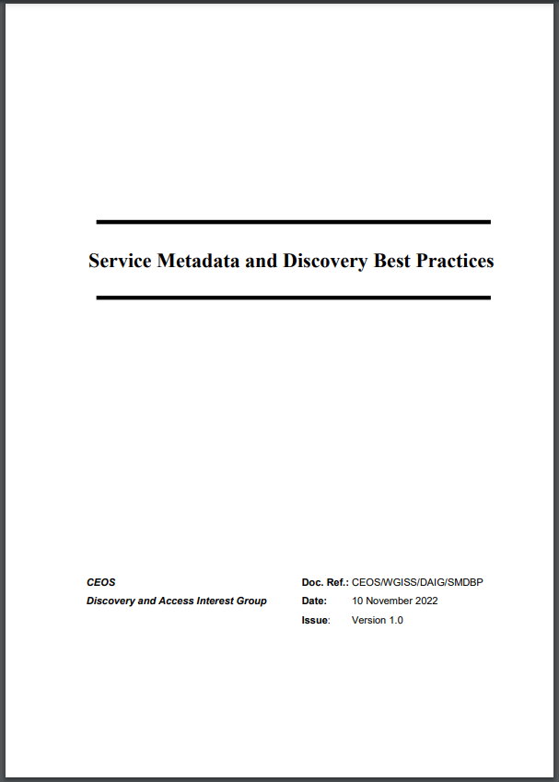
Introduction – Best Practices (1/2)
“CEOS Best Practices for Service Metadata and Discovery”
Version 1.0 approved and published in November ’22.
Extends Best Practices for collection and granule discovery (CEOS OpenSearch Best Practices) to “services” (incl. tools, applications, service endpoints) with intention to “share”.
Defines core set of metadata properties without imposing single metadata format.
First step towards sharing tools and applications metadata via regional registries and CEOS IDN.

Slide 4
Introduction – Best Practices (2/2)
“CEOS Best Practices for Service Metadata and Discovery” discovery scenarios apply also to Jupyter Notebooks:
Scenario 2: Downloadable tools
Source code, binaries, Jupyter Notebooks, Docker images, …
Download from repository (GitHub, GitLab, Zenodo, ..)
Scenario 3: Web GUI tools
Software as a Service (SaaS)
E.g. Jupyter Notebook on Google Colaboratory, Binder
Scenario 5: Coupled Services
Associate tools and services (e.g. Notebook) to EO collections

Slide 5
Notebooks - EUMETSAT Use Case
DRAFT “CEOS Jupyter Notebooks Best Practice” (Esther Conway).
Metadata at notebook level ?
Workshop held at WGISS-56 (Paris, October 2023).
“Training at EUMETSAT with Jupyter Notebooks”
GitLab/GitHub repositories
Metadata included at notebook level

Slide 6
Notebooks - EUMETSAT Use Case
EUMETSAT Notebooks for training publicly available through Gitlab and GitHub repositories

Slide 7
FedEO – Service Discovery (Search)
Resource Discovery:
Collections, Granules
Services and applications (incl. Notebooks)
Multiple discovery interfaces:
OpenSearch
OGC API Features (incl. Part 3 Filtering, CQL2, OpenAPI)
STAC API (incl. Filtering and Collection Search)
OGC API Records
Large number of response and metadata formats.
ISO19139(-2), OGC 10-157r4, OGC 17-003r2, OGC 17-084r1, OGC19-020r1
GeoDCAT-AP and schema.org (JSON-LD, RDF, Turtle)
STAC, UMM JSON, ISO19115-3
Resource coupling available in multiple formats (ISO, OGC, STAC, GeoDCAT-AP, schema.org)

Slide 8
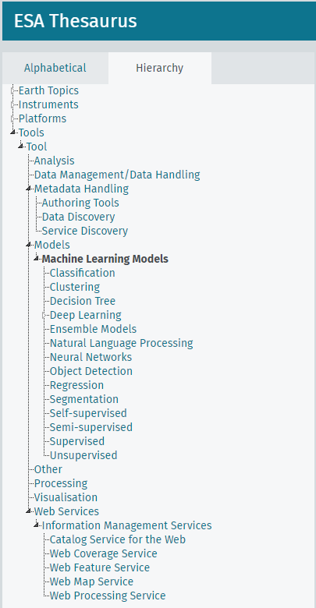
FedEO – Service Discovery (Browse)
Browsable static STAC catalogs organize “collections” according to:
ESA SKOS thesauri: Platform, Instrument, Earth Topic
Organisation
Browsable static STAC catalogs organize “services/tools” according to:
ESA SKOS thesauri: Platform, Earth Topic, tool/service category (TBC)
Organisation
Assumes:
Resource metadata annotated with controlled SKOS keywords/concepts
ESA SKOS thesaurus extended with tool/service categories including correspondence with GCMD.
https://emc.spacebel.be/skosmos/thesaurus/en/page/?uri=https://earth.esa.int/concepts/concept_scheme/tools
DRAFT

Slide 9
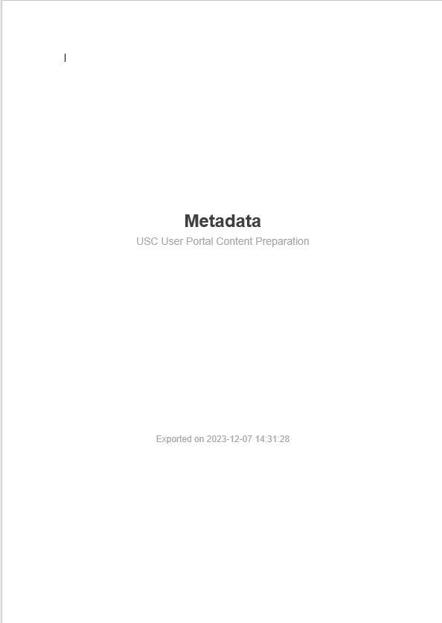
Notebook Discovery – Metadata Harvesting (1/3)
Assumption: metadata embedded in Notebook files as per current EUMETSAT Practice (WGISS-56 Presentation).
Get Notebook metadata from GitHub, GitLab
GitHub API (minimal number of requests to stay below threshold)
May include execution links for or
Sufficient elements to compose OGC 19-020r1 GeoJSON
Enrich metadata with text content:
Associated DOI, presence of “keywords”
Compares “tags” with ESA SKOS thesauri for semantic annotations
ESA SKOS Thesaurus (platforms) extended with additional platforms (EUMETSAT List) and name-mapping needed.

Slide 10
Notebook Discovery – Metadata Harvesting (2/3)
Harvester
Creates (periodically) OGC 19-020r1 metadata records from Github/GitLab API responses
Inserts/updates records in the FedEO catalogue
https://gitlab.esa.int/ ai4eo/esa-philab/
https://github.com/ wekeo
sync
sync
sync
CEOS FedEO
https://gitlab.eumetsat.int/ eumetlab/
https://github.com/ eovoc/eo-books

Slide 11
Notebook Discovery – Metadata Harvesting (3/3)
https://data.datacite.org
Get associated DOI citations
https://gitlab.esa.int/ ai4eo/esa-philab/
https://github.com/ wekeo
sync
sync
sync
CEOS FedEO
https://gitlab.eumetsat.int/ eumetlab/
https://github.com/ eovoc/eo-books
Get concept by label
https://thesauri.eo.esa.int

Slide 12
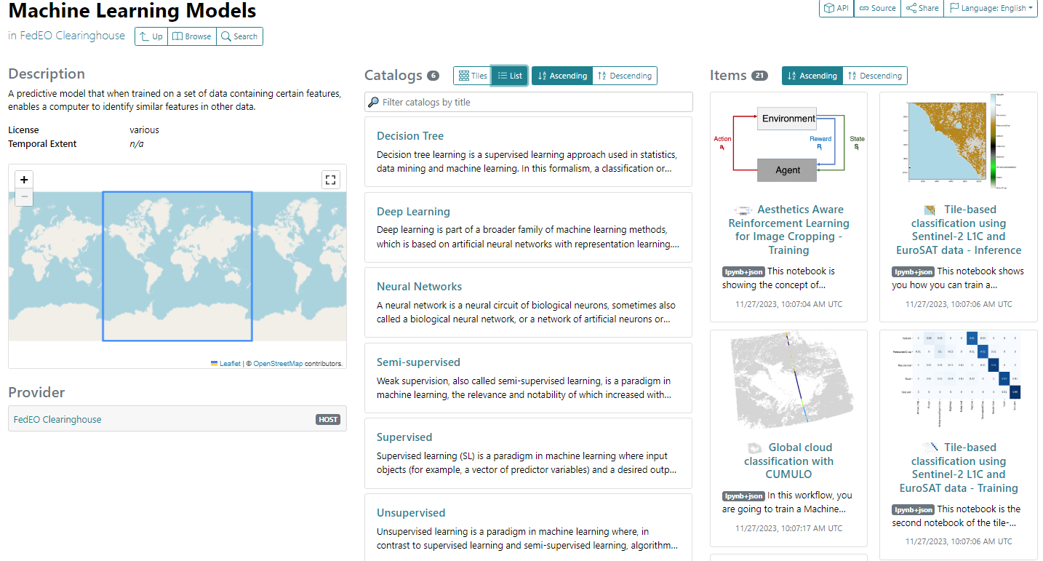
Notebook Discovery – STAC (Browse by tool type)
Assumes Tool and Service metadata annotated with controlled keywords (SKOS).
Access Notebook metadata in several ways:
Static STAC Catalogs: by tool type, by platform, by organization, …
STAC API, OpenSearch
DRAFT
Notes:
https://radiantearth.github.io/stac-browser/#/external/emc.spacebel.be/concepts/tools/5881fd91-58e6-58cb-a4f3-014ae246c67b

Slide 13
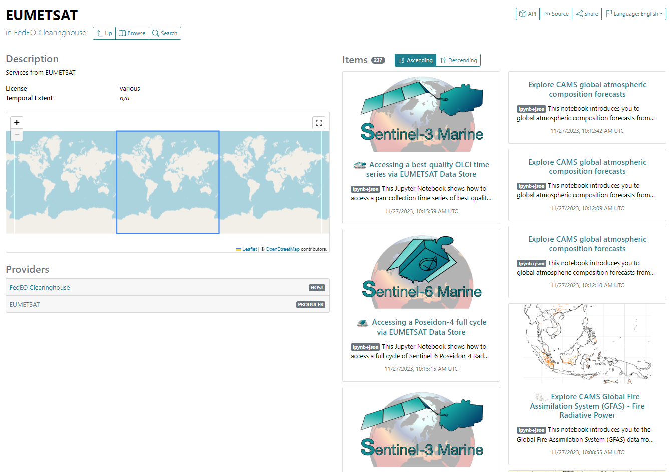
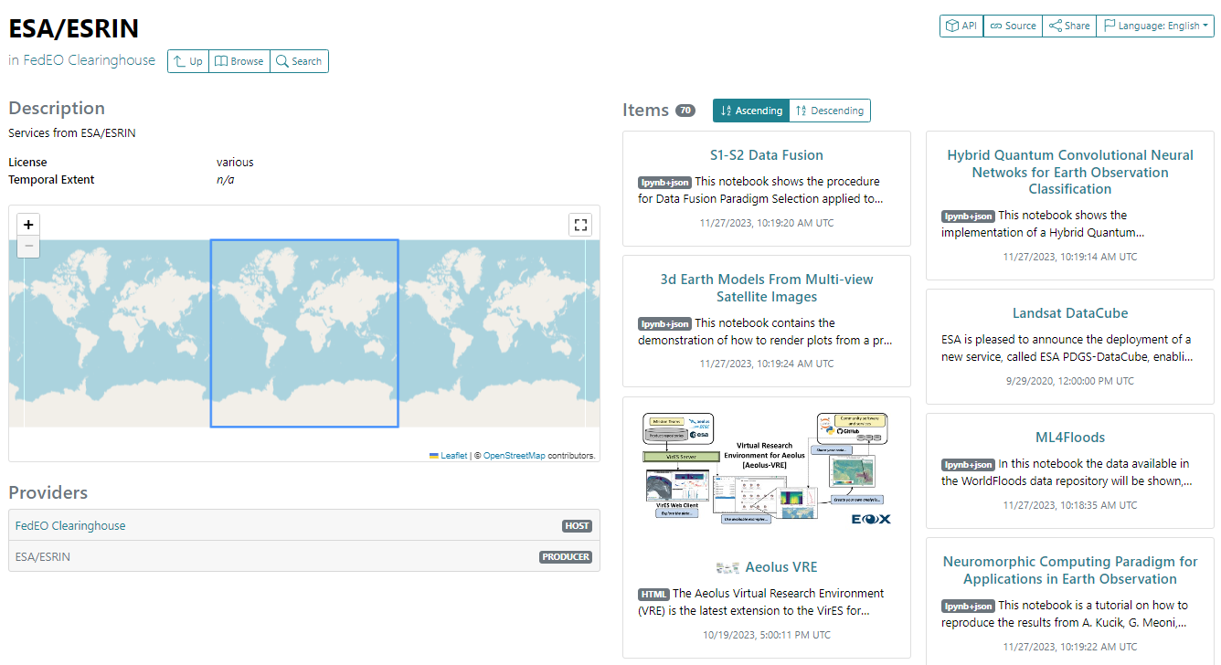
Notebook Discovery – STAC (Browse by organisation)
Static STAC catalogs browsed by STACBrowser
Notes:
https://radiantearth.github.io/stac-browser/#/external/geo.spacebel.be/services/eo:organisationName/EUMETSAT
https://radiantearth.github.io/stac-browser/#/external/geo.spacebel.be/services/eo:organisationName/ESA@ESRIN

Slide 14
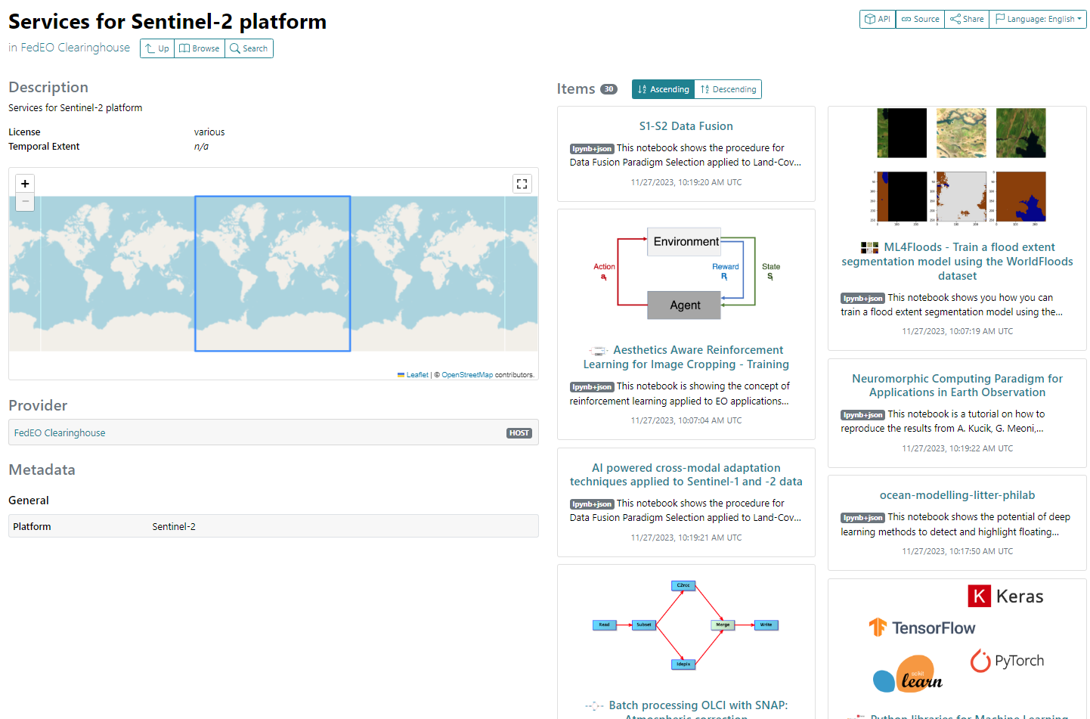
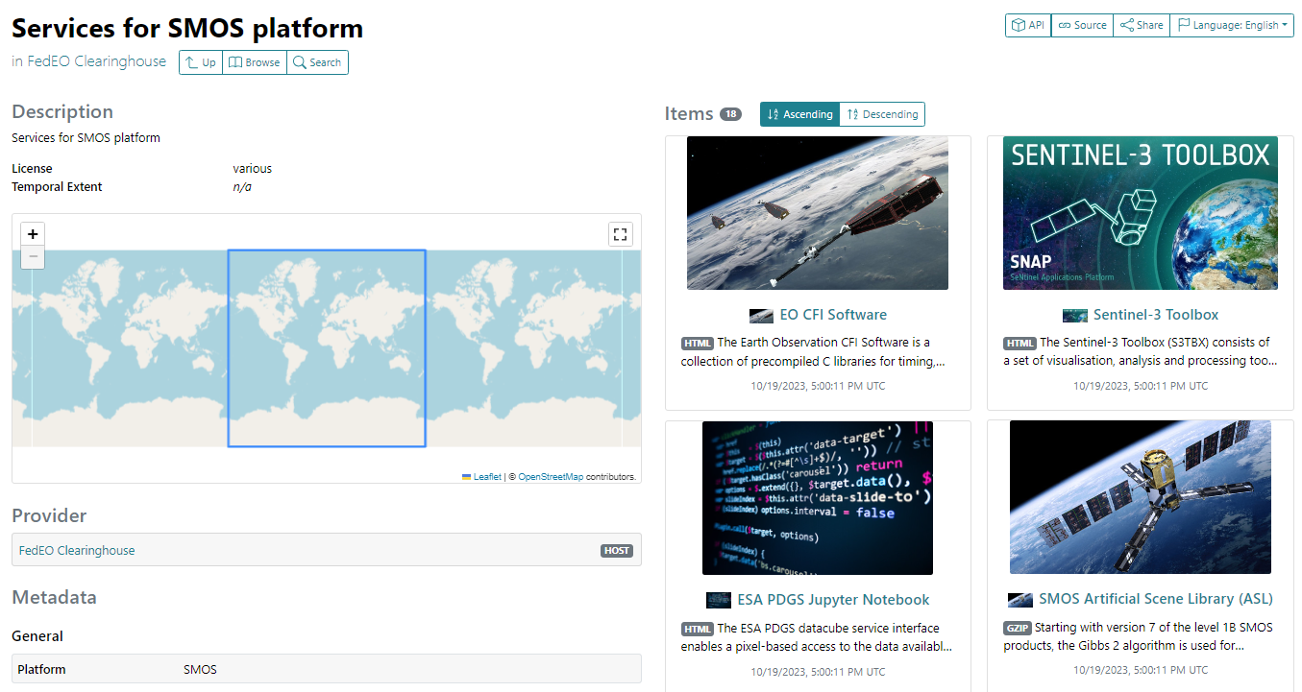
Notebook Discovery – STAC (Browse by platform)
Static STAC catalogs browsed by STACBrowser
Notes:
https://radiantearth.github.io/stac-browser/#/external/geo.spacebel.be/services/eo:platform/SMOS
https://radiantearth.github.io/stac-browser/#/external/geo.spacebel.be/services/eo:platform/Sentinel-2

Slide 15
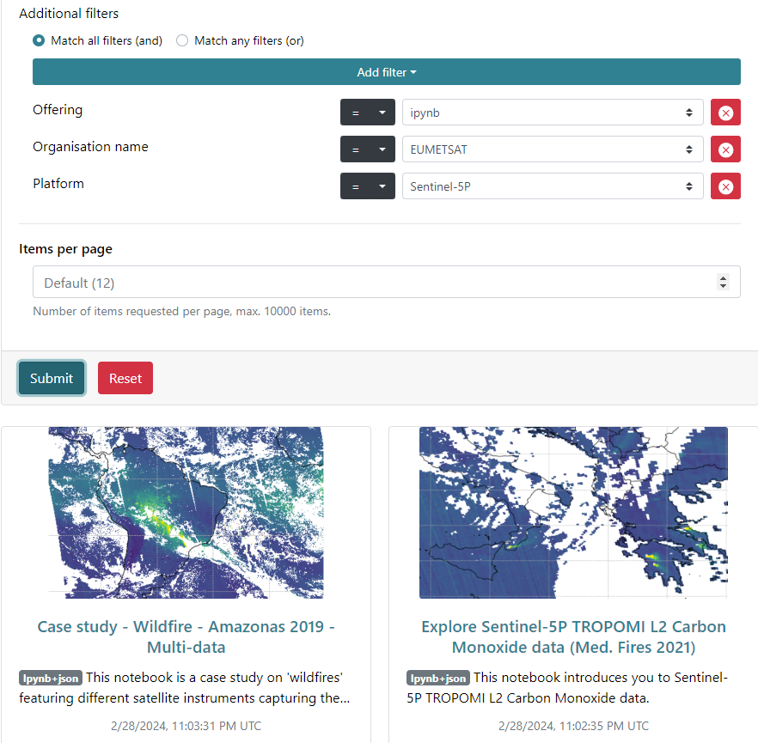
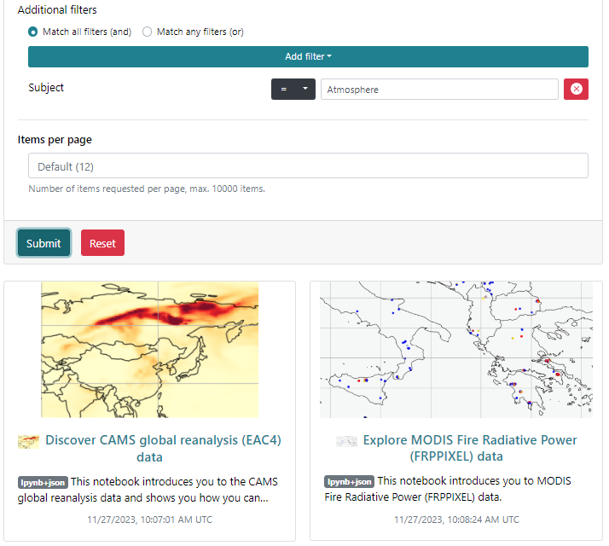
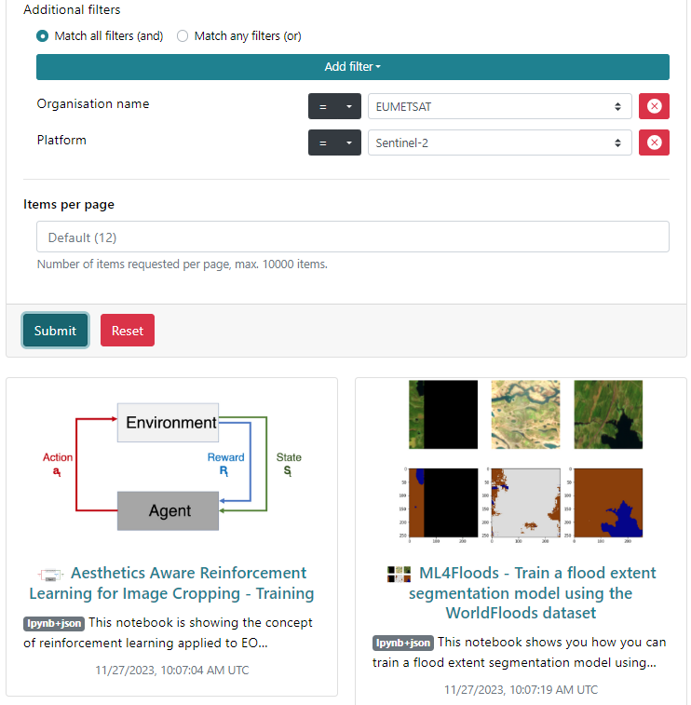
Notebook Discovery – STAC API (Search)
STAC API Search requests (filter, CQL2) to find tools and notebooks about a subject or platform or …
Free text search
Controlled keyword (concept) search

Slide 16
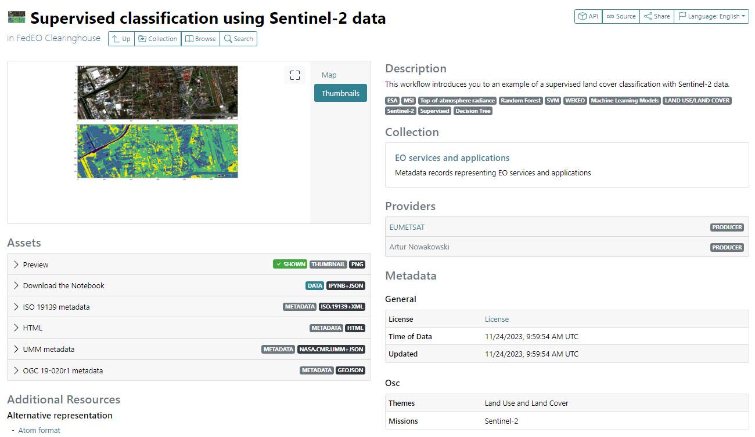
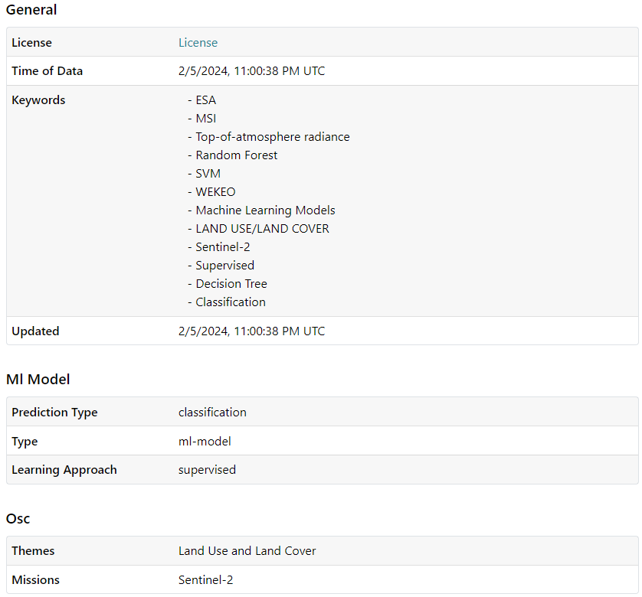
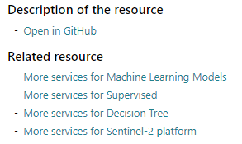
Incl. Controlled Keywords
UMM Metadata allowing import into CEOS IDN
License information (from GitLab/GitHub)
Open or Download the Notebook
More services for …
Machine Learning Model STAC Extension
Open Science STAC Extension
Notes:
https://emc.spacebel.be/browser/external/emc.spacebel.be/services/concepts/tools/adee097f-efde-54d3-aac5-946de260c230/eum_3d2_supervised_classi

Slide 17
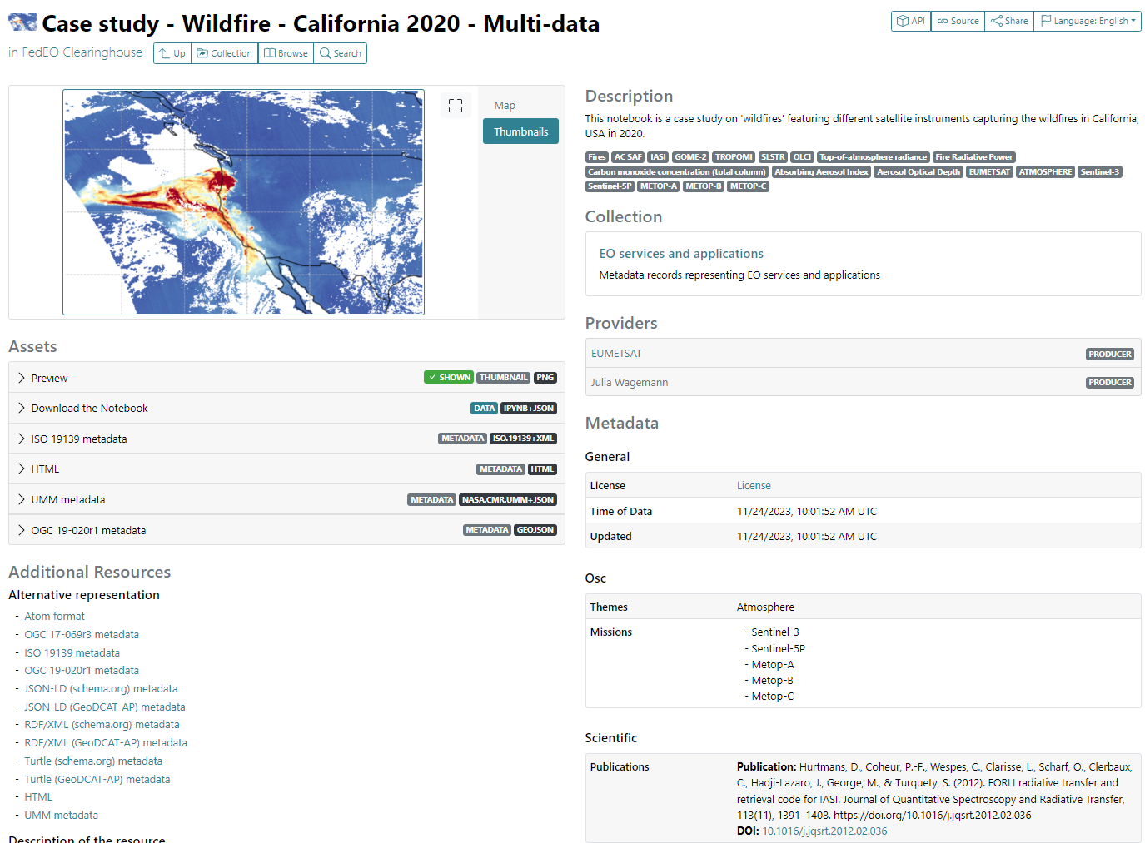
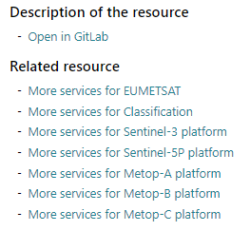
Notebook Discovery – STAC Metadata
Download Notebook
Scientific STAC Extension: citation (for DOI) retrieved via DataCite API
Notes:
https://radiantearth.github.io/stac-browser/#/external/geo.spacebel.be/collections/services/items/eum_313_fire_california_2?httpAccept=application%2Fgeo%2Bjson%3Bprofile%3Dhttps%3A%2F%2Fstacspec.org&.language=en

Slide 18
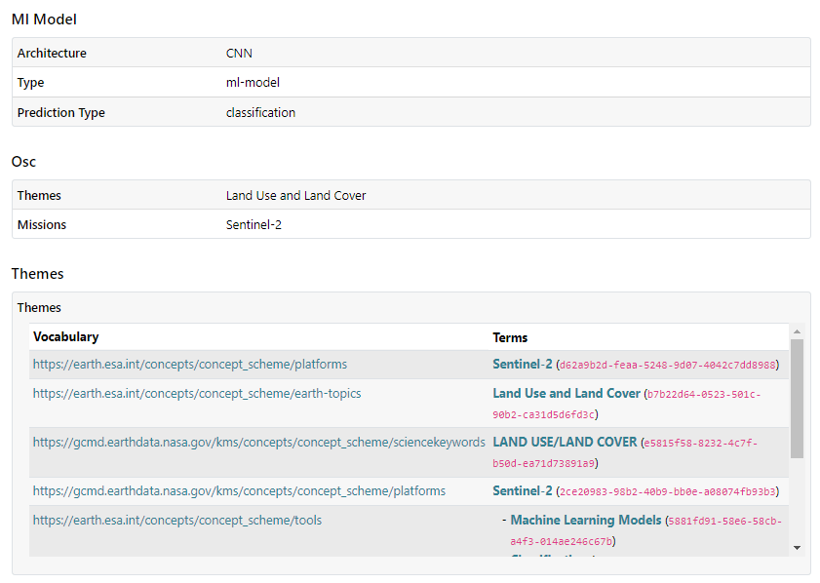
Notebook Discovery – STAC Metadata
Notebook metadata (STAC)
Controlled keywords
Themes STAC Extension to include controlled keywords
(recognized by STACBROWSER)
Notes:
https://radiantearth.github.io/stac-browser/#/external/emc.spacebel.be/services/concepts/tools/5881fd91-58e6-58cb-a4f3-014ae246c67b/eum_3b_tile-based_classif

Slide 19
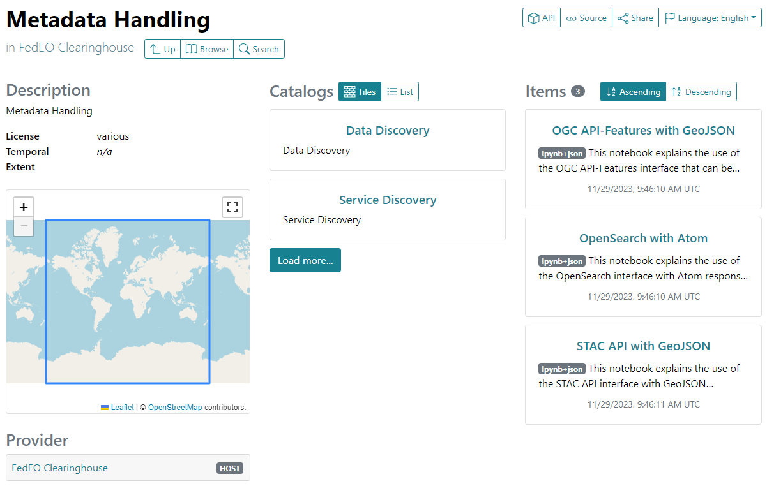
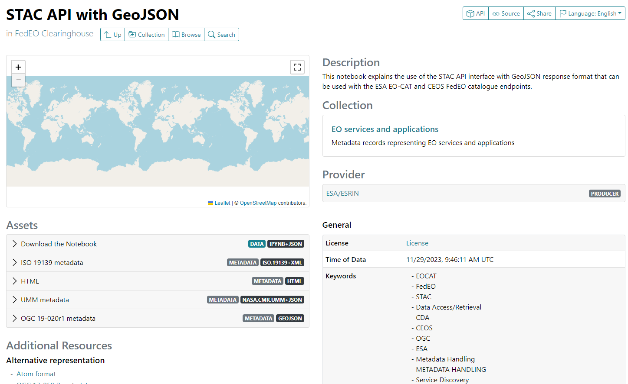
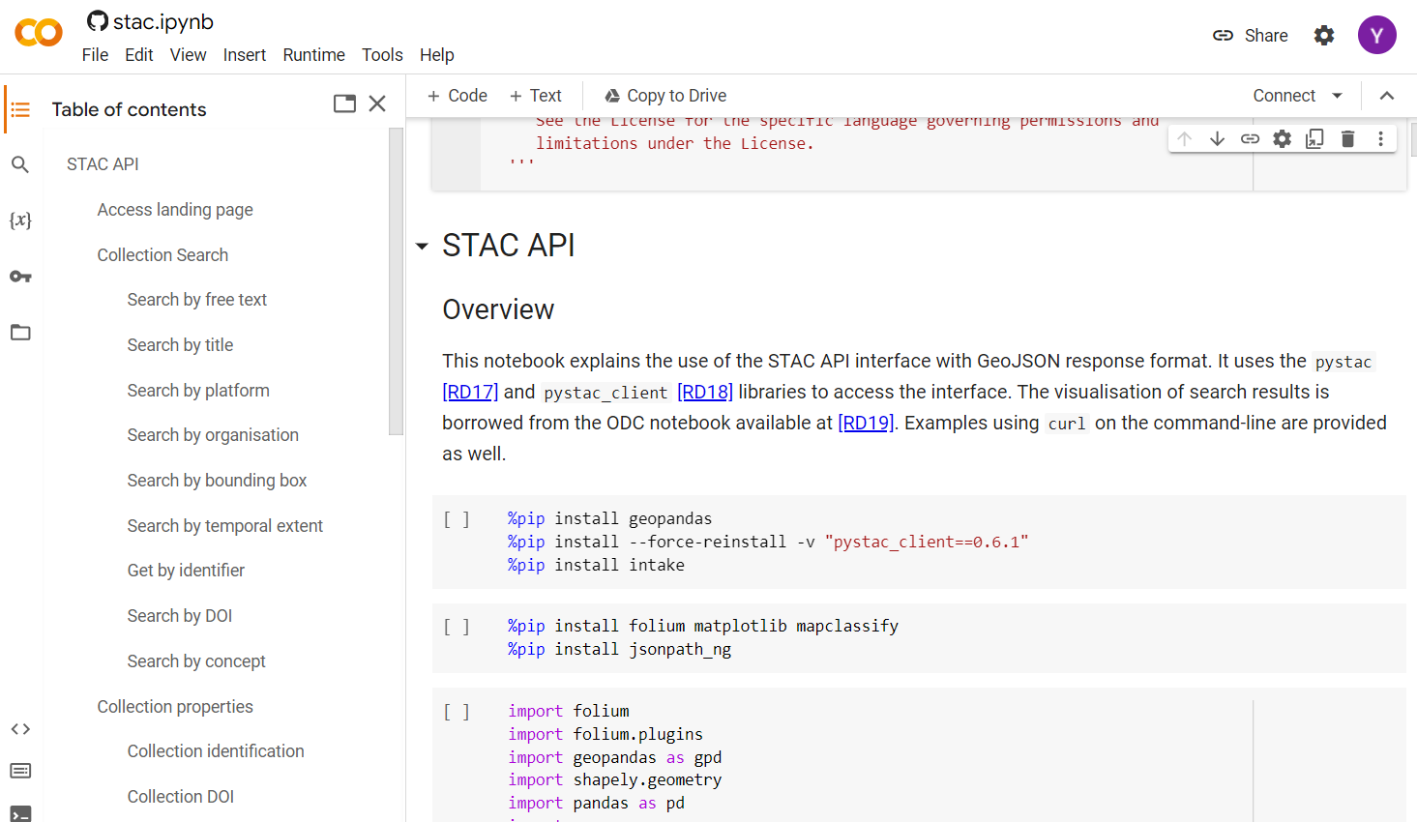
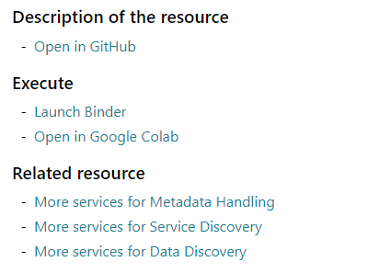
Notebook Discovery – STAC
1
Notebook metadata (STAC).
3
2
Links to Binder or Colab from harvested notebook metadata

Slide 20
Conclusion
Periodic Jupyter Notebook metadata harvesting from GitLab/GitHub can be automated using GitLab/GitHub API
Requires embedded metadata to be present
EUMETSAT and ESA use cases implemented as examples
Both organisations use different controlled vocabularies for platforms, instruments and science keywords (mappings/extensions needed). “instrument/sensor” tags currently ignored.
Propose that forthcoming “CEOS Jupyter Notebook Best Practice”
Recommends embedded Notebook metadata.
Recommends controlled keywords (vocabularies) to be used: platforms, instruments, science, … (e.g. GCMD)
Jupyter Notebook metadata can be encoded/discovered in service catalogue using e.g. OpenSearch, STAC API and STAC metadata encoding.
Jupyter Notebook metadata can be shared/exchanged with IDN/CMR via UMM-JSON encoding.

